Slide 1
About OMICS Group
OMICS Group is an amalgamation of Open Access Publications and worldwide international science conferences and events. Established in the year 2007 with the sole aim of making the information on Sciences and technology ‘Open Access’, OMICS Group publishes 500 online open access scholarly journals in all aspects of Science, Engineering, Management and Technology journals. OMICS Group has been instrumental in taking the knowledge on Science & technology to the doorsteps of ordinary men and women. Research Scholars, Students, Libraries, Educational Institutions, Research centers and the industry are main stakeholders that benefitted greatly from this knowledge dissemination. OMICS Group also organizes 500 International conferences annually across the globe, where knowledge transfer takes place through debates, round table discussions, poster presentations, workshops, symposia and exhibitions.

Slide 2
OMICS International Conferences
OMICS International is a pioneer and leading science event organizer, which publishes around 500 open access journals and conducts over 500 Medical, Clinical, Engineering, Life Sciences, Pharma scientific conferences all over the globe annually with the support of more than 1000 scientific associations and 30,000 editorial board members and 3.5 million followers to its credit.
OMICS Group has organized 500 conferences, workshops and national symposiums across the major cities including San Francisco, Las Vegas, San Antonio, Omaha, Orlando, Raleigh, Santa Clara, Chicago, Philadelphia, Baltimore, United Kingdom, Valencia, Dubai, Beijing, Hyderabad, Bengaluru and Mumbai.

Slide 3
Importance & Growing demand of Edible Cosmetics/Nutricosmetics in Cosmetology treatment
Anandmayi Priyadarshini
Origo Cosmeceuticals Pvt. Ltd., India

Slide 4
Nutricosmetics /Edible Cosmetics
Evolves from the Nutraceutical and Cosmeceutical markets,
The founder of nutricosmetics was the Swedish biochemist Ake Dahlgren, who launched the first such product (Imedeen brand) in the late 1980s.
In the past 10 years advancing manufacturing technologies and growing clinical data have created a favorable body of evidence to support the efficacy of nutricosmetics

Slide 5
Nutricosmetics /Edible Cosmetics
Are nutritional Skin supplements which support the function and the structure of the skin.
Have targeted nutrients and antioxidant - have a preventative or treatment effect on the skin, hair or nails
provide faster and more effective results, which is perfectly fitting in today’s culture where most people have adopted “the faster, the better” lifestyle.

Slide 6
Why Nutricosmetics demands growing??
Increased desire to “age well and look well,”
Healthier lifestyle and increasing beauty concerns
Ageing population
Inclination towards less invasive beauty treatments
More educated to use different form of products (Beauty from within products)
Increased desire to use products to support antiageing
Emergence of the spa culture
Rising medical health care costs

Slide 7
Why Nutricosmetics demands growing??
Seeking convenient solution to support beauty from within
Demand for natural Ingredients because of less side effects.
Seeking holistic regimen for managing beauty as well as ageing.
Rise in demand for specific functional products as well as ingredients.
Well-documented scientific evidence of major ingredients

Slide 9
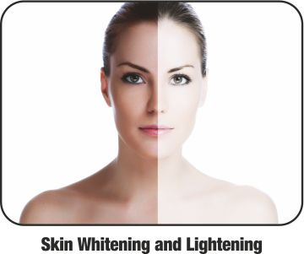
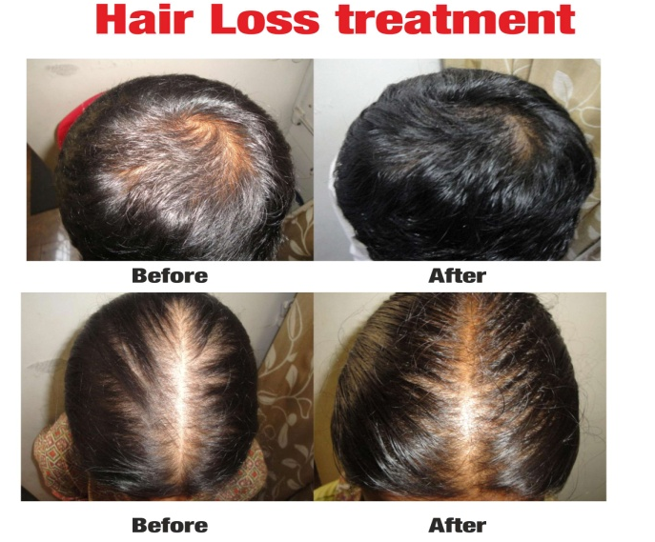
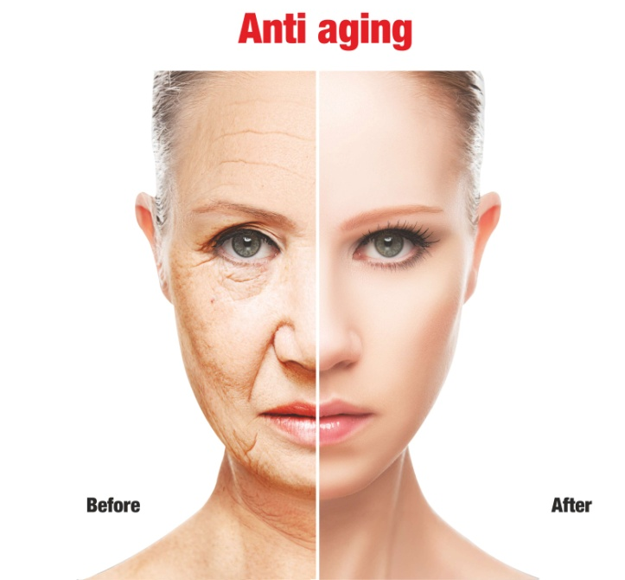
Nutricosmetics - Usage
Nutricosmetics
Weight Loss
Body care

Slide 10
Nutricosmetics – Products
Glutathione
Vitamins
Antioxidants
Oral Photo-Protective Nutrients
Carotinoids
Omega 3 Fatty acid
Flavonoids
Coenzyme Q10
Collagen
Polyphenol
biotin,
Amino acid complexes

Slide 11
Nutricosmetics – Forms
Tinctures,
Beverages,
Powdered stick packs,
Gummy bears or functional foods,
Capsule or
Soft gel
Tablet

Slide 12
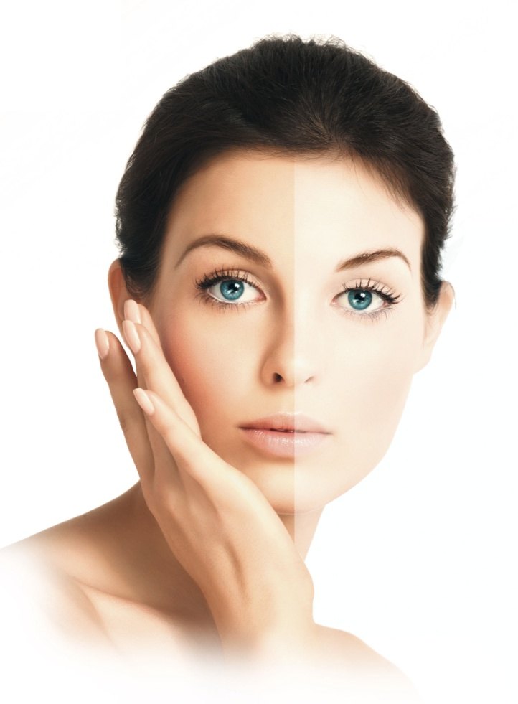
Nutricosmetics for Skin Lightening
Glutathione & Vitamin C,
Anti-oxidant
Anti ageing action
Skin Lightening Property

Slide 13
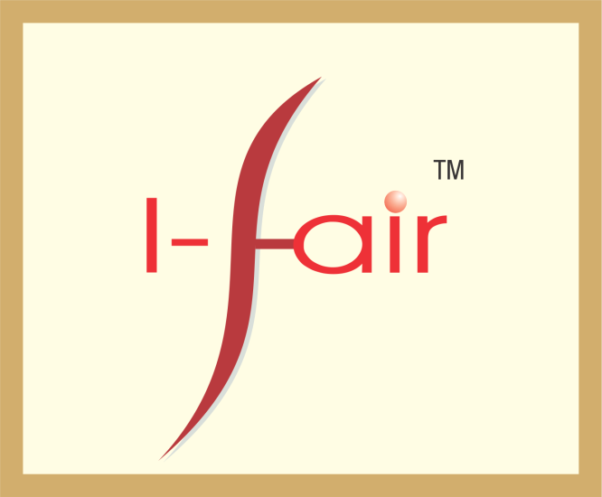
Glutathione supplement
For Skin whitening &
Age Defying

Slide 14
CME Tablet

Slide 16
For Antiageing along with Amino acid Drs are preferring capsule of Antioxidants which contains many natural extracts like Lycopene (Tomato extract), Green tea extract, Pycnogenol, Silica, Marine extract, lemon extract, Hydrolysed collagen, grape seed extract etc. which acts as supplements for skin as well as hair. One such product available in market is Rejinov capsule which contains Natural antioxidants along with amino acid and Hydrolysed collagen. Other than antiageing many nutrients also acts as sunscreen agent from inside.

Slide 17
Nutricosmetics for Hair
Hair loss treatment - for complete internal as well as external care
consist of
Multi vitamin ,
Minerals,
saw Palmetto,
PABA,
Enzymes like collagenase, etc
Amino acid etc. along with topical lotion/serum/oil and shampoo so that conditions should be taken care of.

Slide 18
Nutricosmetics for Hair
Premature graying of hair many Drs are using Biotin supplement along with calcium Panthothenate, PABA and Zinc. Also some Drs are using Nogray Capsule which is a mixture of allopathy ingredients like calcium Panthothenate, PABA and Zinc along with natural herbal extract like – Eclipta alba, Amla extract, Curry Leaf extract, Neem extract as a supplement along with topical serum or lotion or oil.
Capsule

Slide 19
Nutricosmetics for weight reduction
Antioxidant,
Glycerin,
Vegetable Cellulose,
Vitamin B12,
Follic acid,
Citrus acid,
Ambla extract,
caffeine and
many fat burner supplements.

Slide 20
Nutricosmetics – Market Trends
According to Eurormonitor, year-on-year growth did not fall below 5% over 2006-2011, but for further global growth nutricosmetic manufacturers need to target markets with an aging population and where the annual disposable income (ADI) is rising.
Global Nutricosmetics market in 2017 is predicted to be $ 4.5 billion.( Global Industry Analysts)
70% of the sales came from Japan and China which clearly indicates the consumption of the nutricosmetics in these two countries.(Asian markets)
In the US, such products are categorized as dietary supplements and the FDA provides no clear legal definitions.US market is still in infancy

Slide 21
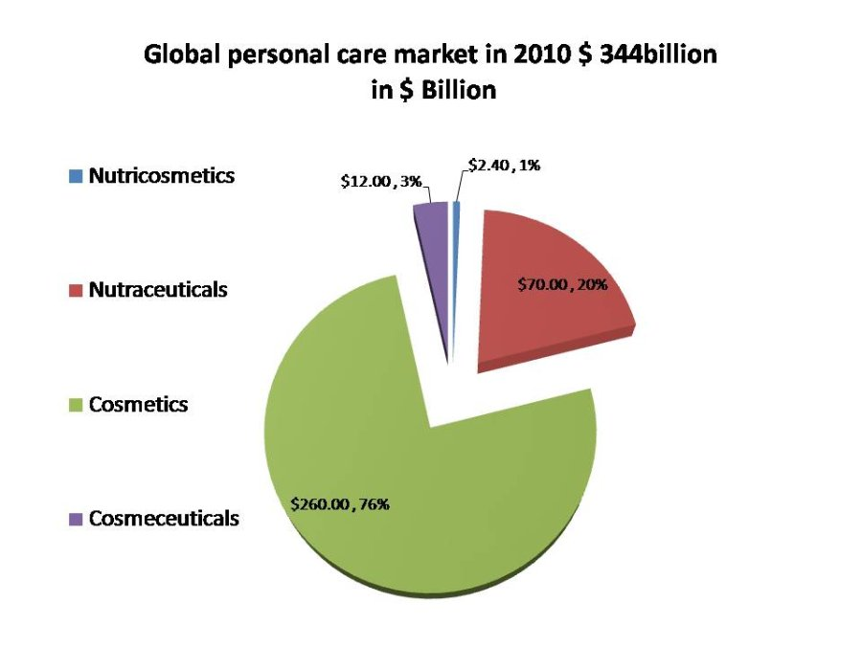
Nutricosmetics – Market Trends
In Europe, nutricosmetics falls under both medicinal and food law, and ambiguity persists about which law is applicable.
Currently, the regulatory system (FOSHU legislation) in Japan is most favorable for introduction of nutricosmetics products.
Markets on growth are North America which virtually is an untapped market
Since the eastern markets retain the majority of market share, many experts still believe North America to be a virtually “untapped market.”

Slide 22
Nutricosmetics – Market Trends
Consumer insights (Datamonitor survey results)
A poll of seven Asia Pacific countries – China, Japan, South Korea, India, Singapore, Indonesia and Australia – found that about three in five consumers agree that food or drinks can provide the same or better health benefits as non-prescription medications.
In China, 54 per cent of consumers indicated they regularly buy foods and drinks products with added health benefits.
Consumers perceive natural products to be superior to non-natural products in many ways
Asia is driving innovation in beauty foods and drinks, with five of the top 10 markets for new product development coming from the region.
Japan leads the way with 19 per cent of new beauty foods and drinks launched since 2012, followed by the US and South Korea with 14 per cent each, and China with 10 per cent( Datamonitor’s product launch analysis)

Slide 23
Nutricosmetics – Perceptual Barrier
Does these products work?? This factor triggers in late acceptance of such product category
I am ingesting something in my body. Will this not have side effects??.Consumers are trained from the birth to apply the topical products on skin( Soaps,shampoo,lotions) and for them it is now a paradigm shift
Are these products natural??
Where is the effect?? While topical have the immediate effect which can be felt but with orally consumed nutricosmetics the time to show the effect will be a lot longer
Are these quality products??
Familiarity of consumers with the topical applications

Slide 24
Nutricosmetics – Awareness Barrier
Low degree of awareness about nutricosmetics is posing a regular challenge
Education level about such products which stimulate the biologic process having a positive impact on external appearance is still not gained momentum
The recent development in the global nutricosmetics market includes Coca-Cola teaming up with French pharmaceutical giant Sanofi to produce nutricosmetics by leveraging their domain expertise in beverage and pharmaceutical industry.
The launched a new brand Oenobiol Beautific in 2013 which is expected to boost the global market for Nutricosmetics.

Slide 25
Nutricosmetics – Opportunity to tap
There is still a great opportunity to tap when looked at the hugely unpenetrated and high potential market for male health and grooming products.
At present nutricosmetics are primarily targeted at women aged 40 or above ,the group who are particularly concerned about health and wellness .
But the trend is shifting with the concept gaining popularity among the younger women in age group 25-35 due to their cosmetic applications and ease of administration ( saves time)

Slide 26
Nutricosmetics – Opportunity to tap
The other significant driver for this market is the rising proportion of people aged 60 years and above.
The number of geriatric people in the world is estimated to be more than double in the next forty years that will provide a large consumer base for the companies in this market.
The nutrocosmetics market is highly dynamic and the manufacturers in the market are required to resonate with the consumer requirements to stay in the market.

Slide 27
Nutricosmetics – Key Market Challenge
Lack of consumer awareness
Skepticism on product claim
Lack of regulatory guidance on formulation
Promoting consumer benefits that are not immediate
Building awareness about importance of nutricosmetics in addition to topical applications which will lead to category acceptance
Clear differentiation in the product offering
Building credibility amongst consumers. This could be developed gradually with the recommendation from dermatologists and cosmetologists
Targeting by understanding the psychographics of the target group
Price point –The marketers need to price the products in such a way which breaks the entry point barrier and ensure a long term trial by the consumers
Country specific targeting .Not every country globally will accept the idea in the same manner. This needs to be taken care while devising a global strategy
Breaking the country specific acceptance barriers for the category emergence
Positioning of such supplements .The products could be positioned specific to certain indications in skin care, hair health, body health which are well backed up by scientific evidences
Building a great deal of education how the consumption of various nutrients can stimulate the biologic process which impacts the external appearance
Innovation in marketing techniques- Delivery system, active ingredients, etc

Slide 28
Nutricosmetics – Companies
Some of the companies operating in the global nutricosmetics market include,
Ferrosan A/S,
Sederma Inc.,
Lucas Meyer Cosmetics,
Provital Group,
Vitabiotics Ltd.,
Origo Cosmeceuticals Pvt. Ltd,
Windmill Organics Ltd.,
Isocell North America, Inc.,
Unipharm, Inc.,
Laboratoire Oenobiol S.A.S., and
Laboratoire Biocyte.

Slide 29
Source
http://www.directfrommind.in/marketing/nutricosmetics-marketing/
http://www.nutraceuticalsworld.com/issues/Beauty-IO-2013/view_features/a-fresh-look-at-nutricosmetics-where-are-we-now/#sthash.xoSvM7zX.dpuf
http://www.slideshare.net/FrostandSullivan/the-nutricosmetics-market-a-global-health-wellness-megatrend
www.origopharma.com
www.cosmonova.in
www.cassevabeauty.com

Slide 30
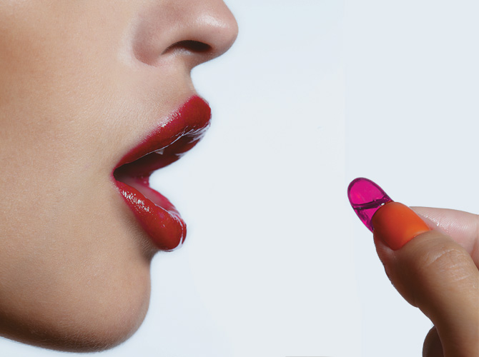
For More Details Please contact –
anandmayi@origopharma.com,
+ 91-8880499977
Thank You

Slide 31
Let us meet again..
We welcome you all to our future conferences of OMICS International
5th International Conference and Expo on
Cosmetology, Trichology & Aesthetic Practices
On
April 25-27, 2016 at Dubai, UAE
http://cosmetology-trichology.conferenceseries.com/

