Slide 1


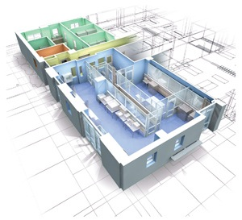
Functionalized Polymeric Electrospun Nanoscaffolds for Bone regeneration and Tissue Healing
Anand Gadre, Ph.D., MBA
Director
Nanofabrication and Stem Cell Instrumentation Facility
University of California, Merced
5200 N Lake Road, California 95343
Ph: 209-228-2345
Email: agadre@ucmerced.edu
Scif.ucmerced.edu

Slide 2
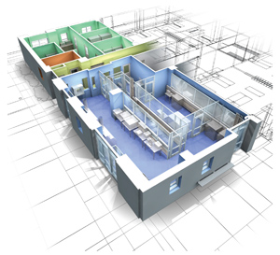
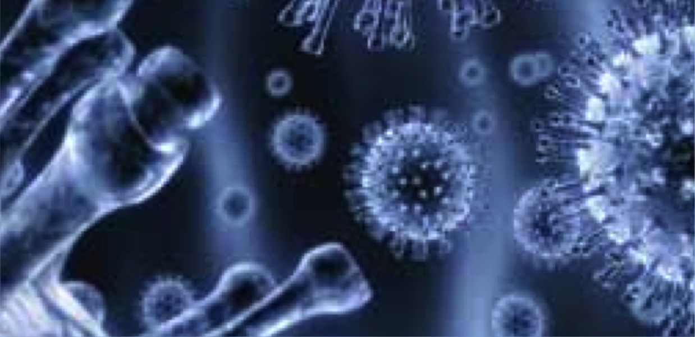

Nanofabrication and Stem Cell Instrumentation Foundry
The Stem Cell Instrumentation Foundry (SCIF) provides stem cell researchers at UC Merced and throughout California access to advanced instruments, techniques and collaborators for single cell analysis. The SCIF is housed in a 4260 asf facility which includes Class 1000 and 100 clean rooms for micro/nano fabrication, facilities for human and mouse stem cell culture, quantitative cell imaging, and workstations.

Slide 3
Objective
Generation and functionalization of Poly-Lactic-co- Glycolic Acid (PLGA) nanofiber scaffolds in the range of ~700 nm using the electrospinning technique.
Design synthetic biodegradable scaffolds comprising electrospun nanofibers that will not only be osteoconductive but also contain porosity for bone cell ingrowth enhanced with Adipose derived human Mesenchymal Stem Cells (AdhMSCs)
Sufficient amount of bioactive ingredient such as Demineralized Bone Matrix (DBM) as well as growth factors that would serve as a more conducive framework for cell adhesion, proliferation, and differentiation.

Slide 4
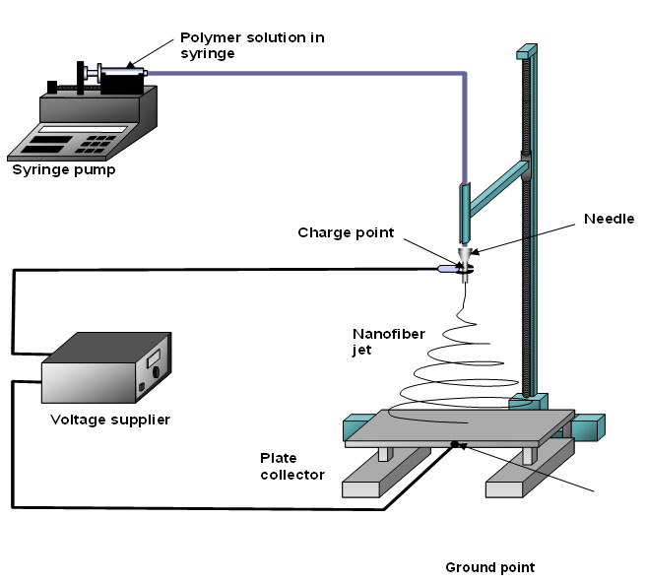
Electrospinning Nanofibers: Process
Fluid is pumped through a syringe with an automatic syringe pump
The syringe needle is positively charged using a voltage supply (Several kV potential used)
The resulting electric field causes fibers to be pulled from the droplet at the end of the syringe tip and onto a grounded metal collector

Slide 5

The Electrospinning Process
Electrospinning Nanofibers
Why?
Fibers can be made much thinner through electrospinning than other methods.
How?
A solution of liquid polymer fluid is put through a capilary device to produce a droplet.
Next a voltage is applied to the droplet, which reduces the surface tension, resulting in a very thin fiber being drawn out.
The voltage applied is very high. Typical values range from 8 to 25 kilo-volts. The diamiter of the fiber is inversly proportional to the applied voltage.
The fiber is then drawn towards a collection plate by gravitational and electrostatic forces.
The fibers become randomly arranged on the collection plate forming a mesh network.

Slide 6
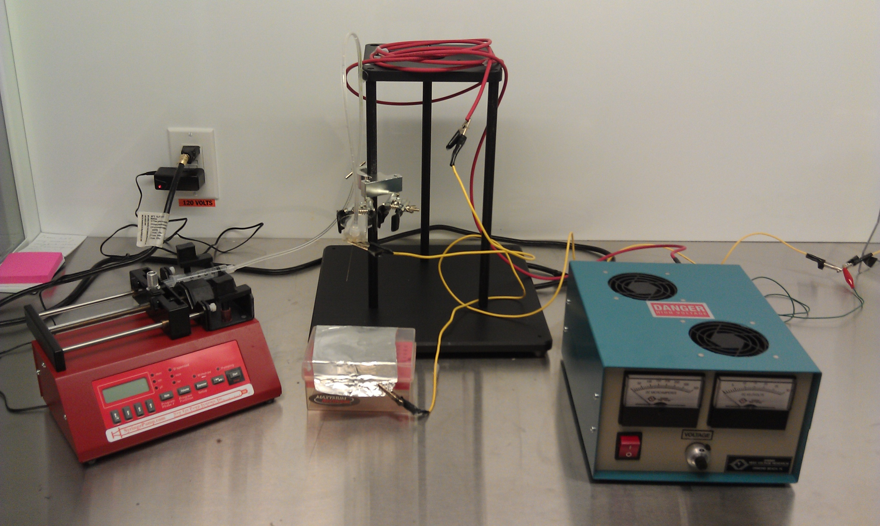
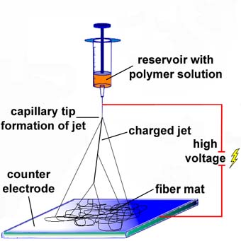
Electrospinning
Controllable Parameters:
Deposition height
  Too high, no fiber deposition; too low, chance of arching
Polymer Concentration
  Too high, viscosity will not allow fiber formation; too low, globules of polymer will form
Voltage Applied
  Too high, chance of arching, too low, not enough pull to form fibers
Flow Rate
  Too high, globules form; too low, inconsistent fiber deposition
Needle Diameter:
  diameter of nanofibers increase with gauge
Fiber Alignment
Figure 1:Experimental Electrospinning Apparatus
Standardized Parameters for Nanofiber Fabrication with PLGA polymer:
Deposition height: 7cm from needle tip to receiving plate
Polymer Concentration: 10% PLGA in HFIP
Voltage Applied: 15kV
Deposition Patterning: Random Deposition (No patterning)
Flow Rate: 30 µL/Min
Needle Diameter: 20 gauge
Figure 2:Electrospinner Mechanics

Slide 7
Methods
Electrospinning:
15kV Power supply
5%/10% PLGA Polymer in HFIP (Hexafluoro Isopropanol)
Scanning Electron Microscopy:
Gold particle coating
Quanta 200, FEI
Mineralization Assay:
-Bone Differentiation was measured using Alizarin Red A dye to stain calcium mineralization
Confocal Microscopy:
488, 561, 405 nm lasers
Nikon Eclipse TI

Slide 8
Methods
Cell Culture:
5% CO₂, Incubation at 37° Celsius for two weeks
Biocompatibility Evaluation:
Live/Dead® cell viability assay measures the amount of live and dead cells
Immunohistochemistry Staining:
DAPI, Osteocalcin and Collagen X stains were used as markers to identify differentiated ADhMSCs
Confocal and Fluorescent Microscopy:
488, 561, 405 nm lasers, Nikon Eclipse TI and EZ-C1
Nikon TE-2000 microscope and Nikon Elements®

Slide 9
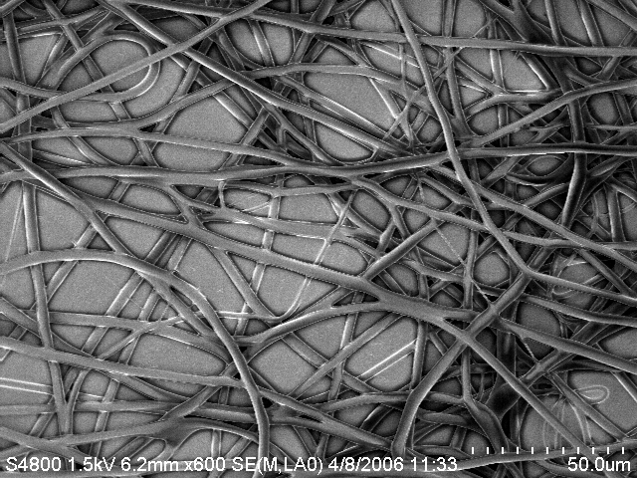
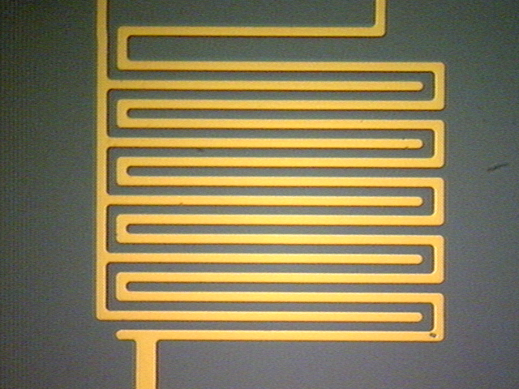
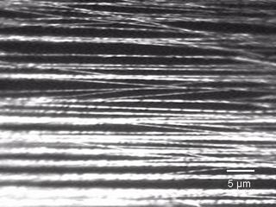
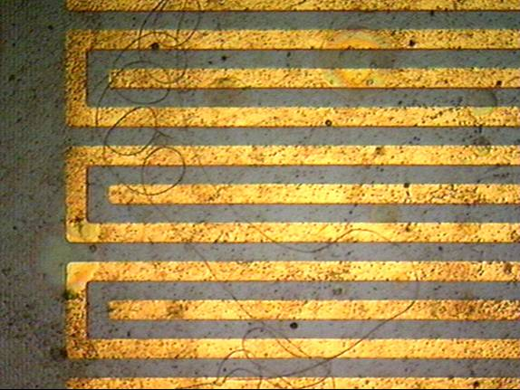
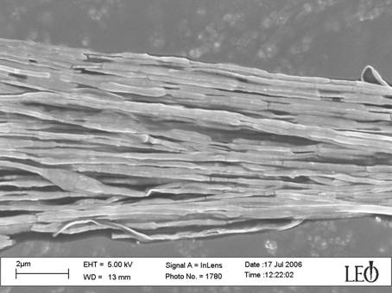
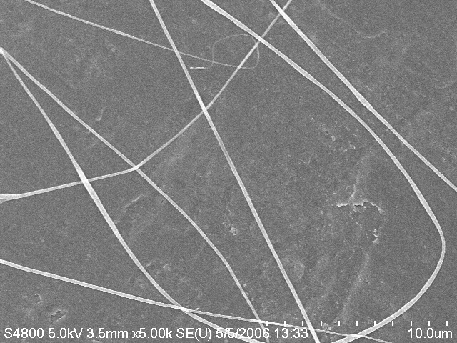
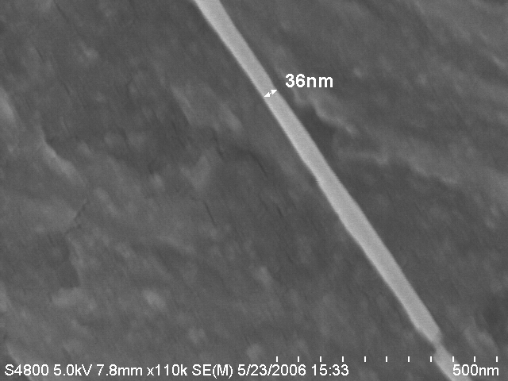
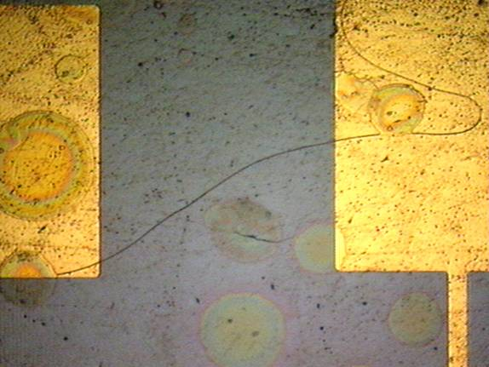
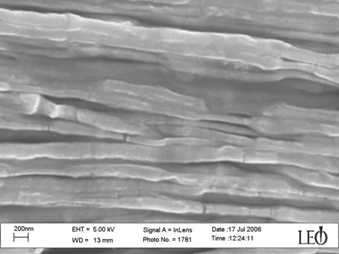

Slide 10
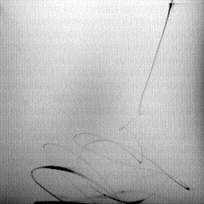
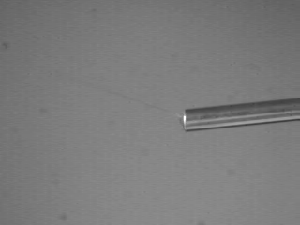
Electrospinning of Polymeric Fibers
Standard Electrospinning Process
Electrospinning of Core-Shell Fibers

Slide 11
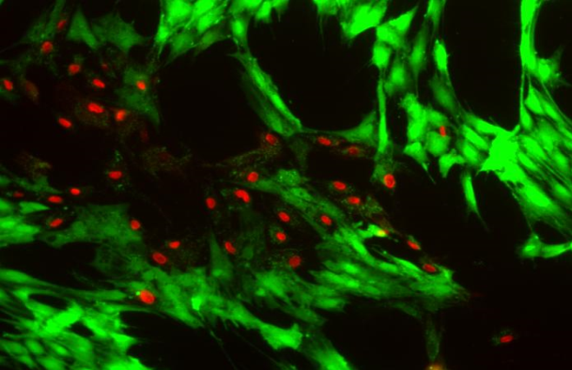
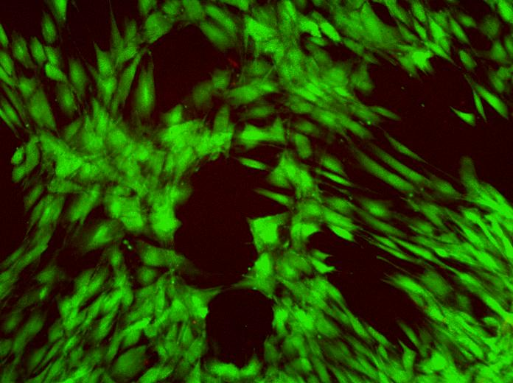
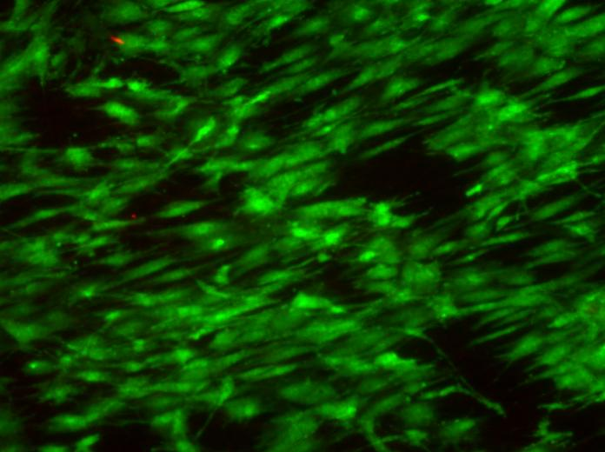
Biocompatibility Evaluation
Cell viability assay of non-PLGA sample demonstrates normal proliferation of adipose-derived stem cells.
PLGA film demonstrates increased differentiation of adipose-derived stem cells when grown on PLGA 5% film.
PLGA 10% fiber sample demonstrates increased uniformly directed bone cell differentiation and proliferation of adipose-derived stem cells when grown on PLGA 10% nanofibers.

Slide 12
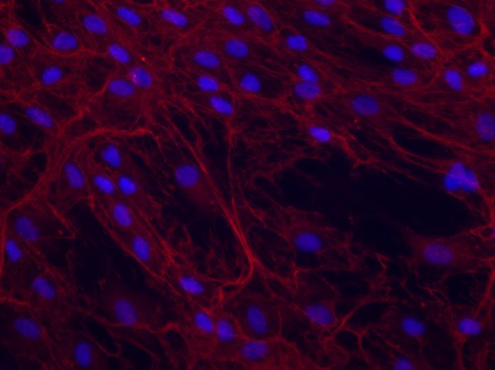
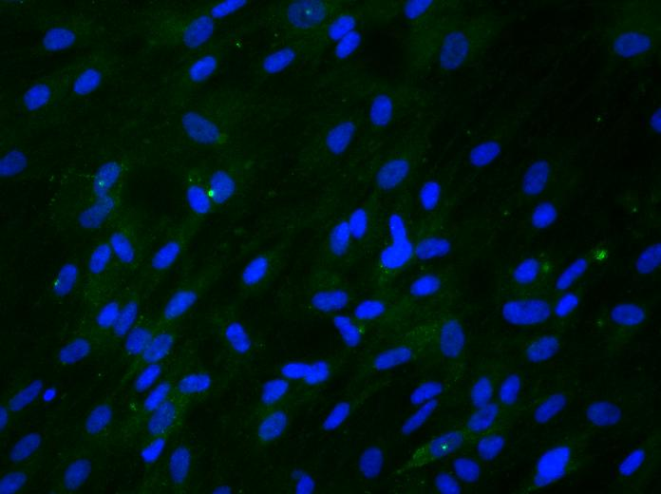
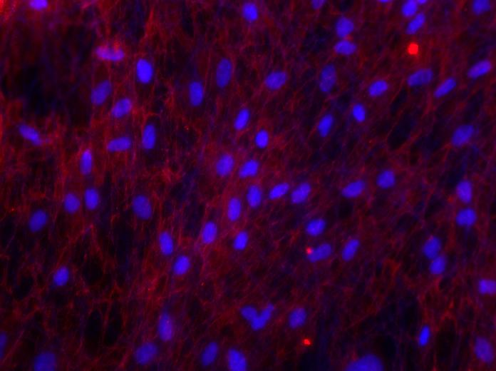
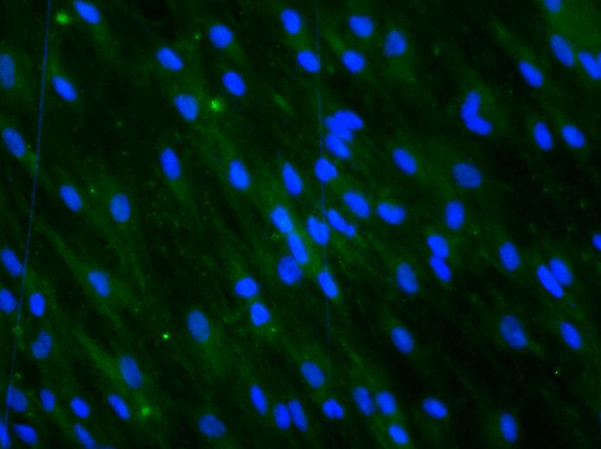
Fluorescent Images
C
A
Anti-Collagen X antibodies bind collagen excreted in the extracellular matrix of connective tissue cells
Osteocalcin R stain binds osteocalcin, a noncollagen protein that is excreted in the extracellular matrix.
5% Film
5% Film
B
D
Fluorescent images of electrospun PLGA fibers seeded with mesenchymal stem cells
A&B: Samples subjected to Anti-Collagen X antibodies
C&D: Samples subjected to Osteo-R stain.
10% Fibers
10% Fibers

Slide 13
Confocal Images
C
A
Confocal images of electrospun PLGA fibers seeded with mesenchymal stem cells
A&B: Samples subjected to Cal-X stain.
C&D: Samples subjected to DAPI staining.
5% Film
5% Film
Collagen X stain binds collagen excreted in the extracellular matrix of connective tissue cells
4,6-diamidino-2-phenylindole(DAPI) stain binds osteocalcin, a noncollagen protein that is excreted in the extracellular matrix.
B
D
10% Fibers
10% Fibers

Slide 14
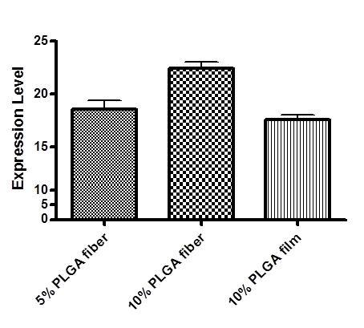
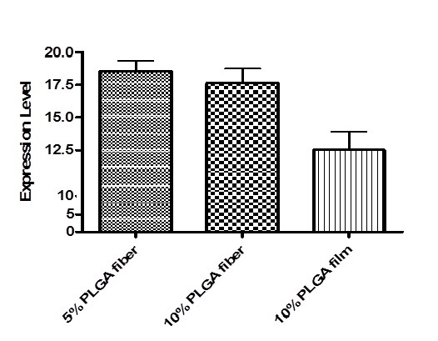
Immunohistochemistry Staining
ADhMSCs grown on 10% PLGA fiber expressed highest level of Collagen X corresponding to proliferation. However ADhMSCs stained for Osteocalcin expression showed no significant difference between in differentiation on 5% and 10% PLGA nanofibers.

Slide 15
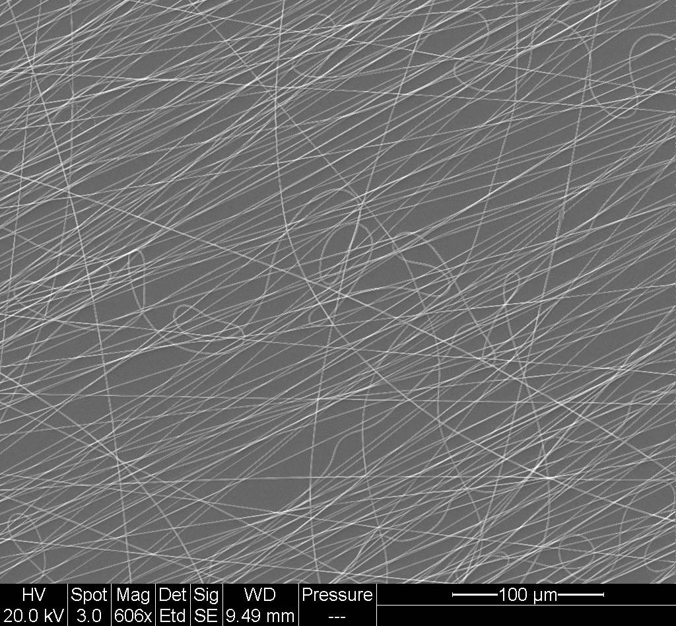
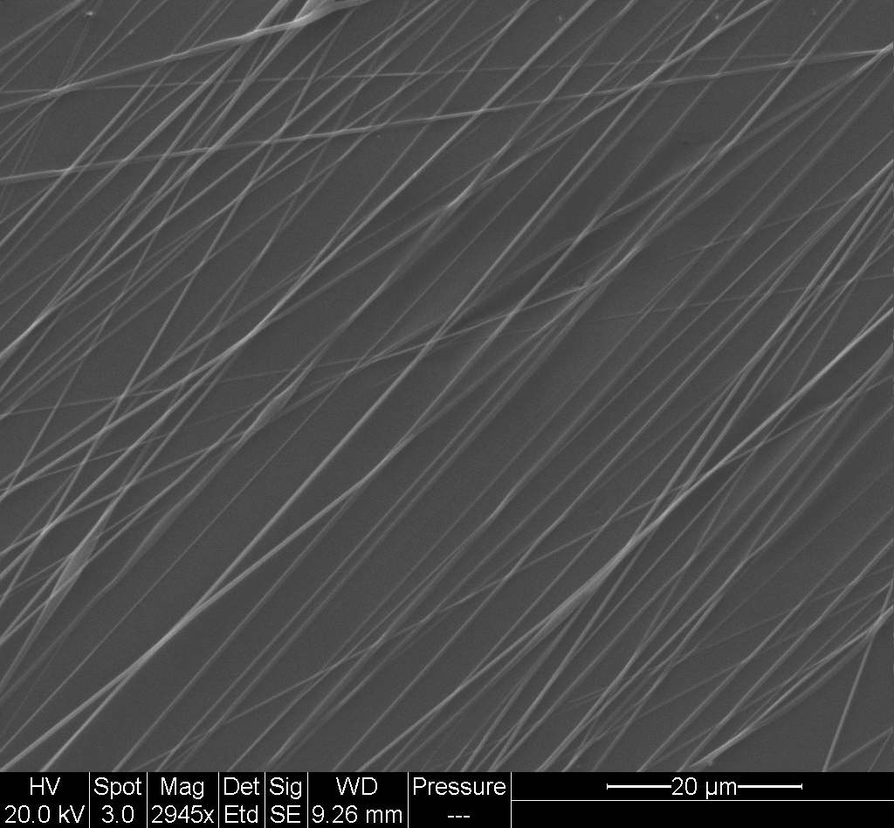
Nanofibers
SEM image of a Random 10% PLGA nanofiber deposition. Electrospun 10% PLGA nanofiber diameter was 679nm ± 60 nm. Scale bar = 100 μm
SEM image of a Aligned 10% PLGA nanofiber deposition. Electrospun 10% PLGA, nanofiber diameter was 679nm ± 60 nm.
Scale bar = 20 μm
Confocal image of 10% PLGA nanofibers

Slide 16
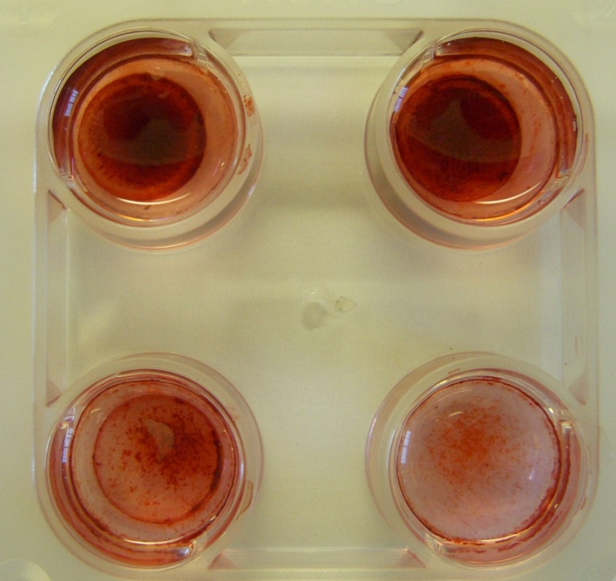
Mineralization Assay
PLGA 10% film showed less calcium mineralization (lighter color) and therefore less bone differentiation
PLGA 10% nanofibers showed greater mineralization (darker color) and therefore greater bone differentiation
PLGA 10% Fibers with a random deposition showed similar calcium expression to that of PLGA 10% Aligned fibers
PLGA 10% Fibers
PLGA 10%-Align
10% PLGA-film
Petri dish

Slide 17
Discussion
Results from Live/Dead cell assay show no difference in cell vitality on PLGA nanofiber scaffolds compared to the 5% film control
Fluorescent microscopy was useful in determining general cell type while confocal microscopy provided a more defined image of cell type and nanofiber structure.
Results from confocal microscopy and immunohistochemistry staining show scaffolds containing 10% PLGA induced more ADhMSC differentiation and proliferation than 5% PLGA fibers and film.

Slide 18
Nanofiber Applications
Cosmetic skin masks
Skin cleansing
skin healing
Skin therapy
Filter media
liquid filtration
gas filtration
molecule filtration
Military protective clothing
minimum impedance to air
efficiency in trapping aerosol particles
anti-bio-chemical gases
Polymer Nanofibers
Nanosensors
thermal sensors
piezoelectric sensor
biochemical sensor
fluorescence optical chemical sensor
Application in life science
drug delivery carrier
hemostatic devices
wound dressing
Tissue engineering scaffolding
porous membrane for skin
tubular shape for blood vessels and nerve regeneration
three dimensional scaffolds for bone and cartilage regeneration
Other electronic applications
micro/nanoelectronic devices
electronic dissipation
electromagnetic interference shielding
photovoltaic devices
LCD devices
ultra-lightweigt spacecraft materials
high efficient and functional catalysts

Slide 19
Nanofiber Applications
Drug delivery system:
- Encapsulation of the drug inside the electrospun fiber
- Improve therapeutic efficacy due to the high surface area and safety
of drugs (Dissolution rate of a particulate drug increases with
increasing surface area of both the drug and the corresponding
carrier if needed.)
Wound dressing:
Novel polymeric composite materials that have antimicrobial properties and variable surface properties that can reduce attachment and adhesion to the wound.
- Wound dressings having antibacterial properties would be highly desirable for wounded personnel

Slide 20
THANK YOU

Slide 21
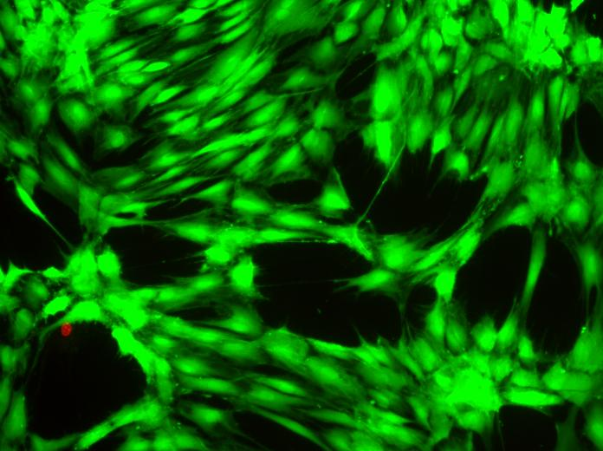
Biocompatibility
Figure 6: Cell viability assay of non-PLGA sample demonstrates normal proliferation of adipose-derived stem cells.
Figure 7: PLGA film demonstrates increased differentiation of adipose-derived stem cells when grown on PLGA 5% film.
Figure 8: PLGA 10% fiber sample demonstrates increased uniformly directed bone cell differentiation and proliferation of adipose-derived stem cells when grown on PLGA 10% nanofibers.

Slide 22
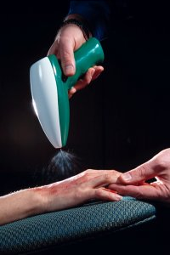
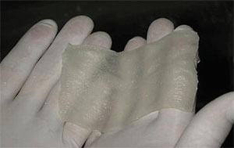
Nanofiber Application
Percentage release of tetracycline HCl from films and nanospun mats vs. time
Drug delivery
Tissue engineering
Wound dressing

Slide 23
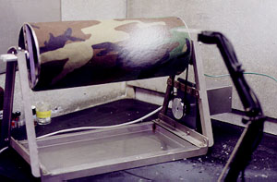

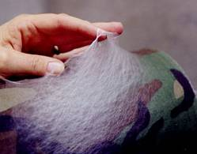
Nanofiber Application
Protective Clothing

Slide 24
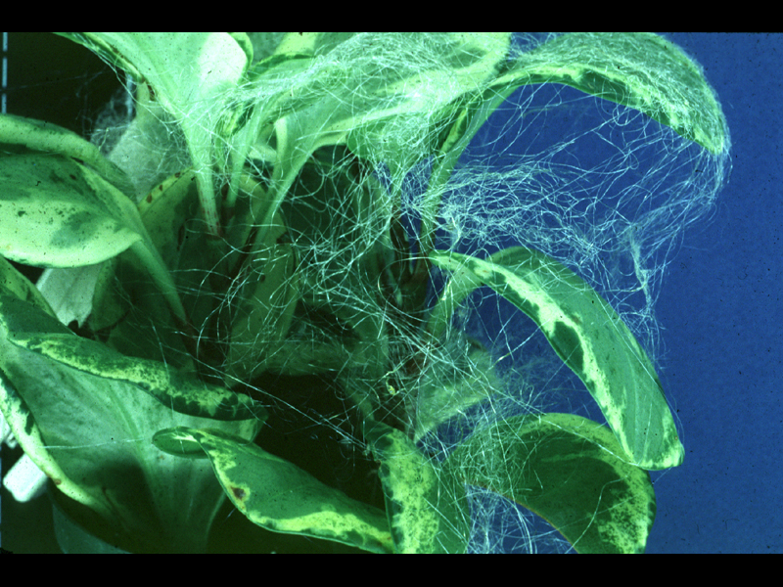
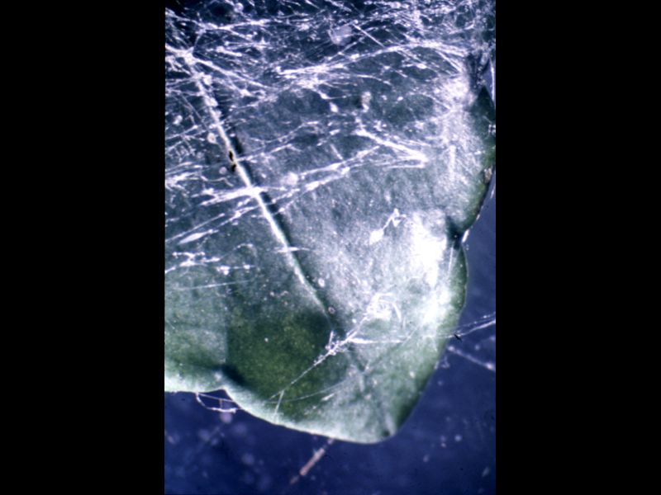
Nanofiber Application
Leaf with nanofibers
containing pesticide
Nanofibers as a physical
barrier to insects

Slide 25
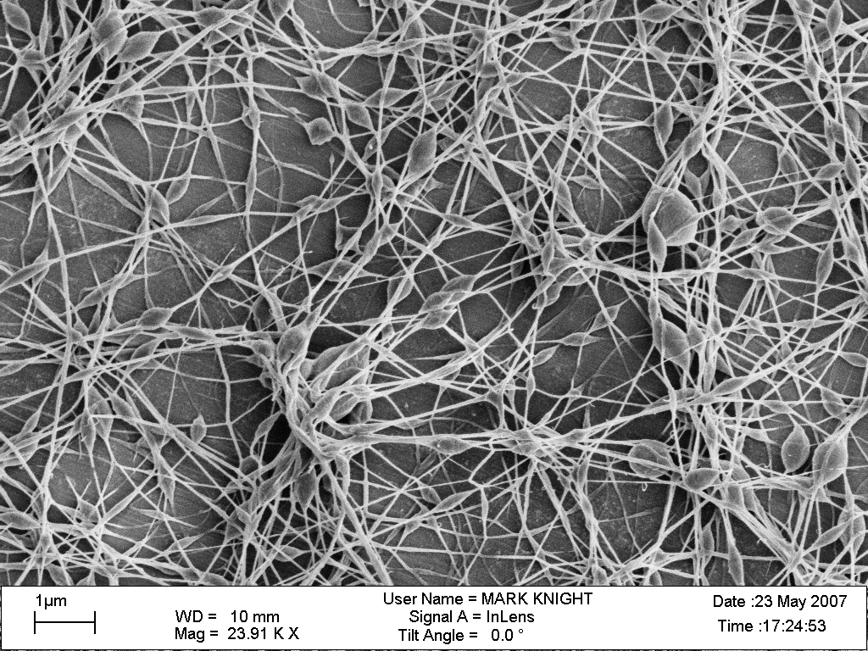
Novel polymeric composite materials that have antimicrobial properties and variable surface properties that can reduce attachment and adhesion to the wound.
Wound dressings having antibacterial properties would be highly desirable for wounded personnel both in the field and in a clinical setting
A conceptual image of a nanofibrous wound dressing is shown. The electrospun polymer fibers would be attached to the dressing material to make direct contact with the wound.

Slide 26
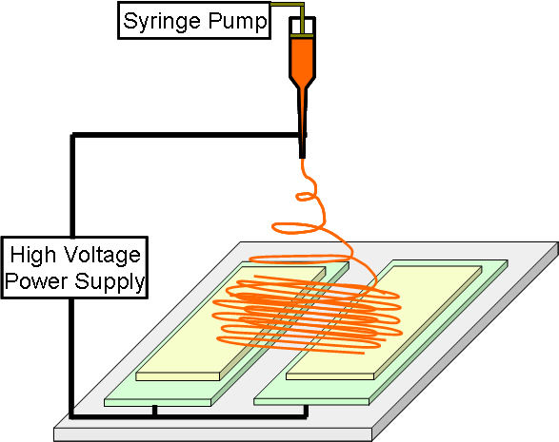
Fiber Alignment
Syringe Pump
High Voltage
Power Supply

Slide 27
Discussion
Variations within the parameters of the electrospinning apparatus allow for the fabrication of nanofiber depositions
Nanofibers fabricated with 10% PLGA polymer provided increased bone cell differentiation.
Increased levels of overall proliferation.

Slide 28
Project Summary
Nanofabrication and Stem Cell Instrumentation Foundry
Objective
Experimental
Results
Conclusions
Next Steps

