Slide 1


The role of glycated hemoglobin in the screening and diagnosis of renal posttransplantation diabetes
Federal University of Rio Grande do Sul
Graduate Program in Endocrinology
Brazil
Ana Laura Pimentel
PhD Candidate: Medical Sciences (Endocrinology)
M.S. Medical Sciences : Endocrinology

Slide 2
POSTTRANSPLANTATION DIABETES MELLITUS (PTDM)
Abnormal glucose metabolism that occurs after solid
organ transplantation
1964: PTDM was first documented.¹
- Incidence in renal transplantation: 2-50%²

Slide 3
RISK FACTORS:
IMMUNOSUPRESSIVE MEDICATION
Type of immunosupressive
74% of the variability in the PTDM incidence
Diabetes Care 2002; 25(3):583-592

Slide 4
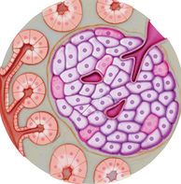
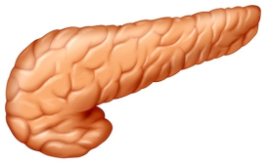

CALCINEURIN INHIBITORS
(Tacrolimus and Cyclosporine)
↓ insulin gen expression
INSULIN SECRETION
↑ islet cell apoptosis
HYPERGLYCEMIA
MUSCLES
ADIPOSE TISSUE
LIVER
↓ Glucose uptake
↓ Glycogen synthesis
↑ Visceral and central adiposity
↑ Lipolysis
↑ Gluconeogenesis
↑Triglycerides
GLUCOCORTICOIDS

Slide 5
PTDM CLINICAL OUTCOMES
survival and
graft function
PTDM
development
patient survival
CVD risk
Figura 1: Consequences of PTDM development.
Note: Adapted from Transplantation,2003;75(10), SS3–SS24.

Slide 6
PTDM CLINICAL OUTCOMES
survival and
graft function
PTDM
development
patient survival
CVD risk
Figura 1: Consequences of PTDM development.
Note: Adapted from Transplantation,2003;75(10), SS3–SS24.

Slide 7
PTDM CLINICAL OUTCOMES
survival and
graft function
PTDM
development
patient survival
CVD risk
Figura 1: Consequences of PTDM development.
Note: Adapted from Transplantation,2003;75(10), SS3–SS24.

Slide 8
PTDM CLINICAL OUTCOMES
survival and
graft function
PTDM
development
patient survival
CVD risk
Figura 1: Consequences of PTDM development.
Note: Adapted from Transplantation,2003;75(10), SS3–SS24.

Slide 9
PTDM DIAGNOSIS

Slide 10
Table 1: PTDM defined by different studies
SOURCE | DESIGN | N | PTDM DEFINITION | PTDM INCIDENCE
Revanur (2001) | RETROSPECTIVE COHORT | 939 | 2 random-G ≥ 200 mg/dL and A1C >8% or use of hypoglycemic | 5.1%
Cosio (2002) | RETROSPECTIVE COHORT | 1811 | Use of hypoglycemic | 16.2%
Kasiske (2003) | RETROSPECTIVE COHORT | 11659 | Medical records | 24%
Gourishankar (2004) | RETROSPECTIVE COHORT | 386 | 2 random-G ≥ 200 mg/dL and/or 2 FG≥126 md/dL | 9.8%
Gonzáles-Posada (2006) | RETROSPECTIVE COHORT | 3365 | 2 random-G >140 or Use of hypoglycemic | 7.5%
Note: Source: Nephrology, 2008; 13: 737-744.

Slide 11
Table 1: PTDM defined by different studies
SOURCE | DESIGN | N | PTDM DEFINITION | PTDM INCIDENCE
Revanur (2001) | RETROSPECTIVE COHORT | 939 | 2 random-G ≥ 200 mg/dL and A1C >8% or use of hypoglycemic | 5.1%
Cosio (2002) | RETROSPECTIVE COHORT | 1811 | Use of hypoglycemic | 16.2%
Kasiske (2003) | RETROSPECTIVE COHORT | 11659 | Medical records | 24%
Gourishankar (2004) | RETROSPECTIVE COHORT | 386 | 2 random-G ≥ 200 mg/dL and/or 2 FG≥126 md/dL | 9.8%
Gonzáles-Posada (2006) | RETROSPECTIVE COHORT | 3365 | 2 random-G >140 or Use of hypoglycemic | 7.5%
Note: Source: Nephrology, 2008; 13: 737-744.

Slide 12
Table 2: Diagnostic criteria for diabetes and increased risk of diabetes according to ADA 2015.
Diagnostic criteria for diabetes mellitus:
A1C ≥6.5% OR
FPG ≥126 mg/dL OR
2-h PG ≥ 200 mg/dL during an OGTT OR
Random plasma glucose ≥200 mg/dL in a patient with classic symptoms of hyperglycemia or hyperglycemic crisis
Categories of increased risk for diabetes mellitus:
FPG 100 mg/dL to 125 mg/dL (IFG) OR
2-h PG in the 75-g OGTT 140 mg/dL to 199 mg/dL (IGT) OR
A1C 5.7–6.4%
FIRST CHOICE TEST: fasting glucose

Slide 13
Table 3: Interfering factors in A1C results
Reduction in A1C levels | Increase in a1C levels
Hemolytic anemias | Presence of carbamylated hemoglobin
Hemoglobinopathies | Nutritional deficiency iron
Nutritional deficiency (folic acid, B6 vitamin, B12 vitamin) | Presence of acetylated hemoglobin
Hyperthyroidism | Conditions that promote an increase in red blood cells
Severe burns
Blood transfusion
Erythropoietin deficiency secondary to renal impairment
J Intern Med 2012; 271(3):227-236.
J Clin Pathol 2004;57(4):346-9.

Slide 14
Aim:
To evaluate the use of A1C test to diagnose PTDM and assess its overall accuracy in renal transplant recipients at four months after transplantation.

Slide 15
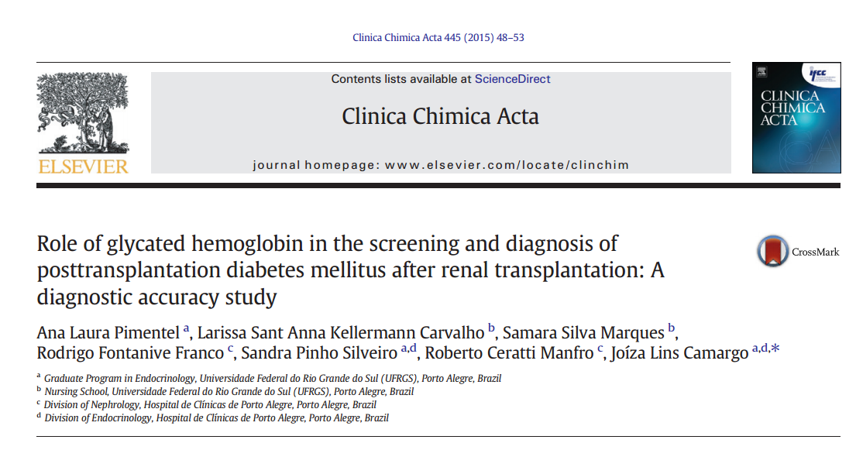

Slide 16
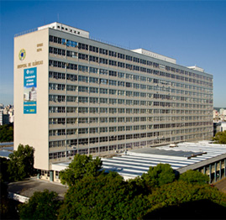

MATERIALS AND METHODS
Diagnostic accuracy study (STARD Initiative)
Adult patients without DM that underwent kidney transplantation at Hospital de Clínicas de Porto Alegre between March 2012 and April 2014.
Clinica Chimica Acta 445 (2015) 48-53

Slide 17
MATERIALS AND METHODS
All patients were invited to participate and to undergo an OGTT following WHO recommendations;
PTDM diagnosis is defined by American Diabetes Association (ADA) as FPG ≥ 126 mg/dl and/or 2h-PG ≥ 200 mg/dl.
Clinica Chimica Acta 445 (2015) 48-53

Slide 18
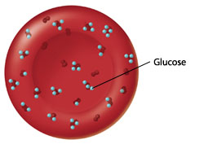
MATERIALS AND METHODS
A1C: HPLC method (Bio-Rad Variant™ II Turbo analyzer), as standardized by the National Glycohemoglobin Standardization Program (NGSP) and aligned with the International Federation of Clinical Chemistry (IFCC)
Bio-Rad Variant™ II Turbo analyzer
Clinica Chimica Acta 445 (2015) 48-53

Slide 19
METHODOLOGY
Statistical analysis
ROC curve: to analyze the performance of A1C test (FPG and/or 2h-PG after an OGTT as reference diagnostic criteria).
Fagan nomogram: to estimate the post-test probability of PTDM, considering the pre-test probability of 20%, estimated from the literature (clinical applicability)
Clinica Chimica Acta 445 (2015) 48-53

Slide 20
RESULTS
1 by FPG alone
122 patients were included
32 patients (26.2%) had PTDM
21 by 2h-PG alone
10 by both FPG and 2h-PG
A1C ≥6.5% diagnosed 16 patients with PTDM.
Among them, 14 were also diagnosed by OGTT.
Clinica Chimica Acta 445 (2015) 48-53

Slide 21
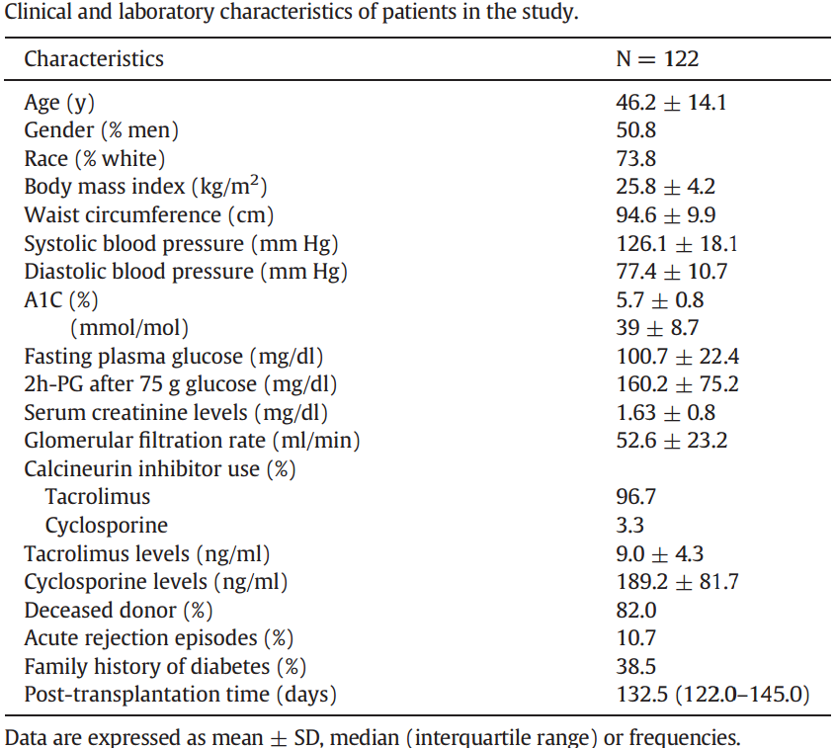

Slide 22

Comparisons between patients with and without PTDM:
Variable | Without PTDM | With PTDM | P- value
Age (years) | 42.8 ± 13.3 | 55.9 ± 11.8 | < 0.001
A1C (%) | 5.4 ± 0.5 | 6.5 ± 0.9 | < 0.001
FPG (mg/dL) | 92.5 ± 8.7 | 123.6 ± 31.8 | < 0.001
2h-PG (mg/dL) | 124.9 ± 38.9 | 260.5 ± 59.7 | < 0.001

Slide 23
RESULTS
Considering A1C of 6.5%:
SENSITIVITY: 43.7%
SPECIFICITY: 97.8%
2x2 table for A1C ≥6.5% sensitivity and specificity
ORAL GLUCOSE TOLERANCE TEST
With PTDM Without PTDM
+
A1C
-
14 | 2
18 | 88

Slide 24
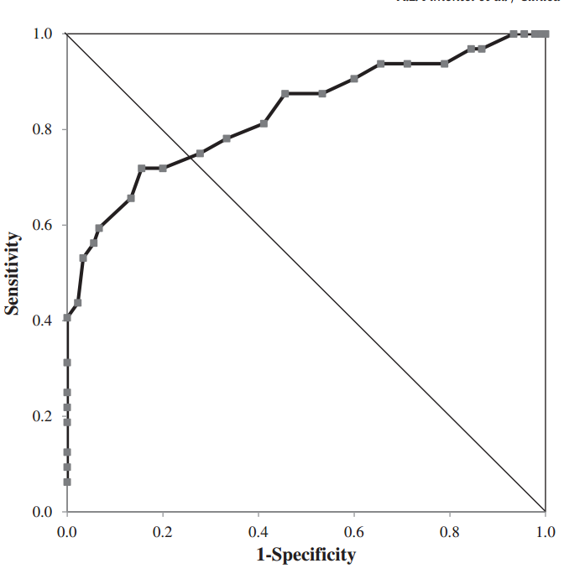
RESULTS
Figure 1:
ROC curve for A1C for the diagnosis of PTDM.
AUC: 0.832 95% CI 0.740–0.924, p <0.001
Clinica Chimica Acta 445 (2015) 48-53

Slide 25
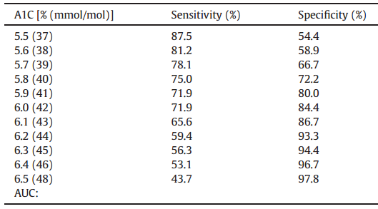
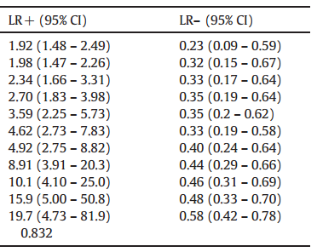
RESULTS
Sensitivities, specificities and likelihood ratios at different A1C cut-off levels.
Clinica Chimica Acta 445 (2015) 48-53

Slide 26
LIKELIHOOD RATIO:
A1C 5.8% (LR- = 0.35)
Patients without PTDM are about 3 times more likely to have an A1C value of 5.8% than patients with the disease.
LR - = 1 – sensitivity
specificity

Slide 27
RESULTS
Sensitivities, specificities and likelihood ratios at different A1C cut-off levels.
Clinica Chimica Acta 445 (2015) 48-53

Slide 28
LIKELIHOOD RATIO:
A1C 6.2% (LR+ = 8.91)
A patient with PTDM is about 9 times more likely to have an A1C value of 6.2% than a person who has not PTDM.
LR+ = sensitivity
1 – specificity

Slide 29
RESULTS
Sensitivities, specificities and likelihood ratios at different A1C cut-off levels.
Clinica Chimica Acta 445 (2015) 48-53

Slide 30
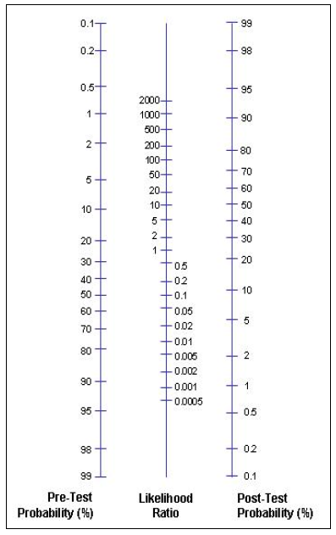
RESULTS
Clinica Chimica Acta 445 (2015) 48-53
A1C ≥6.5% (LR + :19.7)
A1C ≥6.2% (LR + : 8.91)
A1C ≤5.8% (LR- : 0.35)
Post test probability for A1C ≥ 6.5%: 83%
Post test probability for A1C ≥ 6.2%: 69%
Post test probability for A1C ≤ 5.8%: 8%
Figure 3: Fagan's nomogram for A1C test, which showed post-test probabilities for PTDM with A1C ≤ 5.8%, A1C ≥ 6.2% and A1C ≥ 6.5%.

Slide 31
DISCUSSION
A1C 6.5%:
☹
Low sensitivity Rule out PTDM
High specificity Rule in PTDM
☺
This point failed to diagnose half of positive cases by OGTT in our series (16 out of 32).

Slide 32




Previous studies evaluating A1C ≥6.5% to diagnose PTDM found conflicting results;
Discrepant sensitivities were observed at A1C cut-off point of 6.5%.
First Author (Year) | PTDM incidence (%) | Number of patients | Results
Shazia (2013) | 14.3 | 71 | Sensitivity= 83.3% Specificity= 94.4%
Eide (2014) | 10.3 | 1612 | Sensitivity= 38.0% Specificity= 86.3%
Yates (2013) | 20.0 | 50 | Sensitivity= 43% Specificity= 95.4%
Clayton (2015) | 29.0 | 119 | Sensitivity= 20.0% Specificity= 94.0%
Pimentel (2015) | 26.2 | 122 | Sensitivity= 43.7% Specificity= 97.8%
A1C of 6.5% in the initial months after transplantation

Slide 33
DISCUSSION
A1C cut-off point of 5.8% presented the best balance between sensitivity and specificity and also a reasonable negative likelihood ratio (LR− = 0.35).
A1C cut-off point of 6.2% presented high specificity.
Clinica Chimica Acta 445 (2015) 48-53

Slide 34
Proposed diagnostic algorithm for PTDM
A1C ≤5.8% + A1C ≥6.2%
Without PTDM:
81
With PTDM:
25
A1C between 5.9 and 6.1%:
16 patients
OGTT
85%
Clinica Chimica Acta 445 (2015) 48-53

Slide 35
CONCLUSIONS
The use of a single A1C cut-off is not enough for the screening and diagnosis of PTDM.
High specificity
Ideal to be used to diagnose PTDM
(confirmation of the disease)
A1C ≥6.5%
Low sensitivity
A lower cut-off point should be used for
PTDM screening

Slide 36

Financial Support:
Federal University of Rio Grande do Sul
Graduate Program in Medical Sciences: Endocrinology

Slide 37
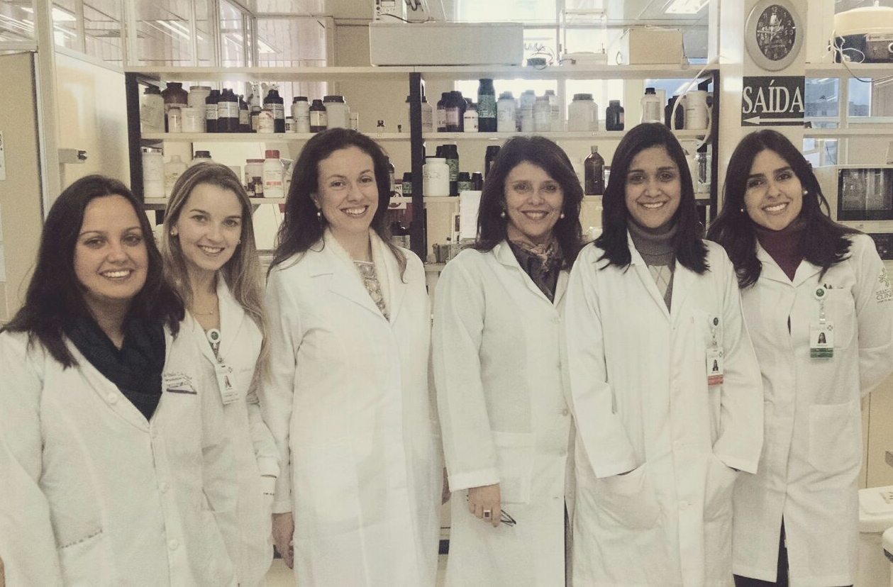

WORKING GROUP ON DIAGNOSTIC METHODS FOR
DIABETES AND ENDOCRINOLOGY
Coordinator:
Dr Joíza Lins Camargo
PhD Candidates:
Ana Laura Pimentel
Paula Renz
Master’s students:
Ana Paula Aguiar
Priscila Freitas
Undergraduate intern:
Lethicia Ehlert
THANK YOU
Ana Laura Pimentel
ana_laurinha@hotmail.com

