Slide 1
Computer-Based Measures of Attentional Function in Ageing and Dementia
Amy Jenkins
Swansea University
643775@swansea.ac.uk

Slide 2
Research Team Research Development Group (RDG)
Andrea Tales - Principal Investigator
Amy Jenkins - PhD Researcher
Stephen Lindsay - Computer Scientist
Parisa Eslambolchilar - Computer Scientist
Monika Hare - OPAN Researcher
Ian Thornton - Computer Programmer
Outline of Presentation...
Introduction to research area of Alzheimer's and Subjective Cognitive Decline (SCD)
Study aim, objective, method
Results
Conclusions & next steps

Slide 3
Alzheimer’s Disease
Main cause of dementia...approximately 70%
AD affects approx. 5% >65 years, 20% >80 years
Approx. 800,000 affected in UK
Approx. 35.6m affected worldwide
Future Challenge...
Ageing population
Social and economic challenge

Slide 4
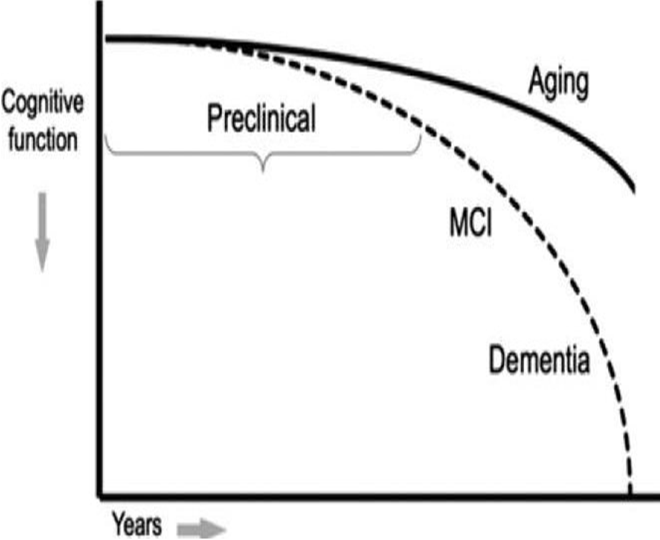

Slide 5
Research Evidence
Reisberg et al (2010):
SCI 4.5x more likely to develop MCI
MCI 12% progressed to AD compared to people without MCI (1-2% progressed)
Kryscio et al (in Press):
Subjective Memory Complaints (SMCs) - increased risk for progression to MCI/dementia (BRAiNS study)
Brain donation autopsy reports: SMCs relating to higher levels of neuritic amyloid plaques
Implications for the design of dementia prevention studies
Jessen et al (2014):
Subjective Cognitive Decline (SCD)- progressive nature of cognitive decline in AD
Characterization of at-risk states and detection of early disease are crucial for targeted dementia prevention
Target for intervention where only mild neuronal damage...preserve functioning at a high level
Problem...cannot detect SCD on standardized tests
SCD is unspecific...also related to e.g.normal ageing, substance use, medication, psychiatric illness etc...
BUT...doesn't take away that people still experience it
SCD-I (Initiative) introduced to facilitate the development of a common SCD research concept

Slide 6
Attention in Ageing
Aim...
To inform the development of more sensitive & specific tests of attention
Translate people's real-life experiences of attention into the development of more ecologically valid and clinically useful objective tests of attention
Ultimately to work towards developing a monitoring tool to help identify AD risk factors earlier
Method...
Cross-sectional study
x3 focus groups >65 years and x2 focus groups 18-30 years
Thematic analysis; two coders
Questions asked about: their understanding of attention; the importance of attention; changes in attention; iPad test feedback

Slide 7
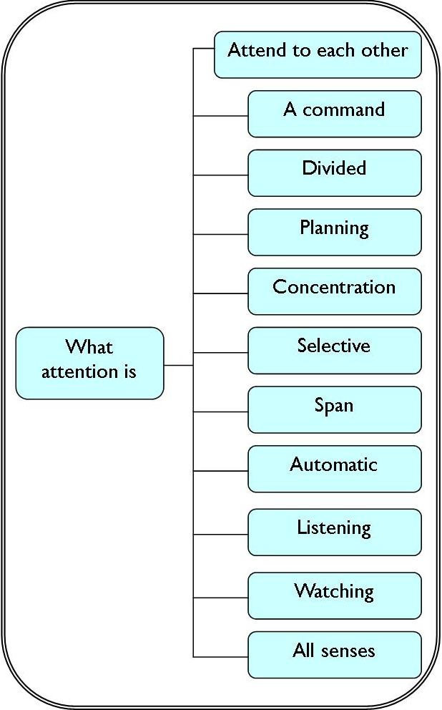
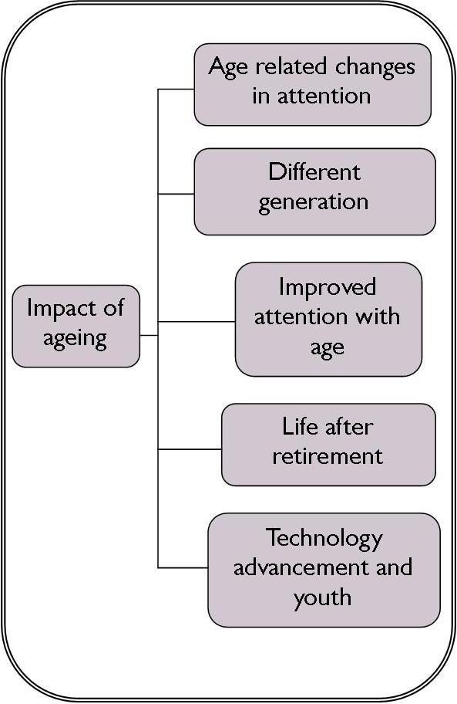
Themes Identified: Attention
Contact me
or see poster
for more details

Slide 8
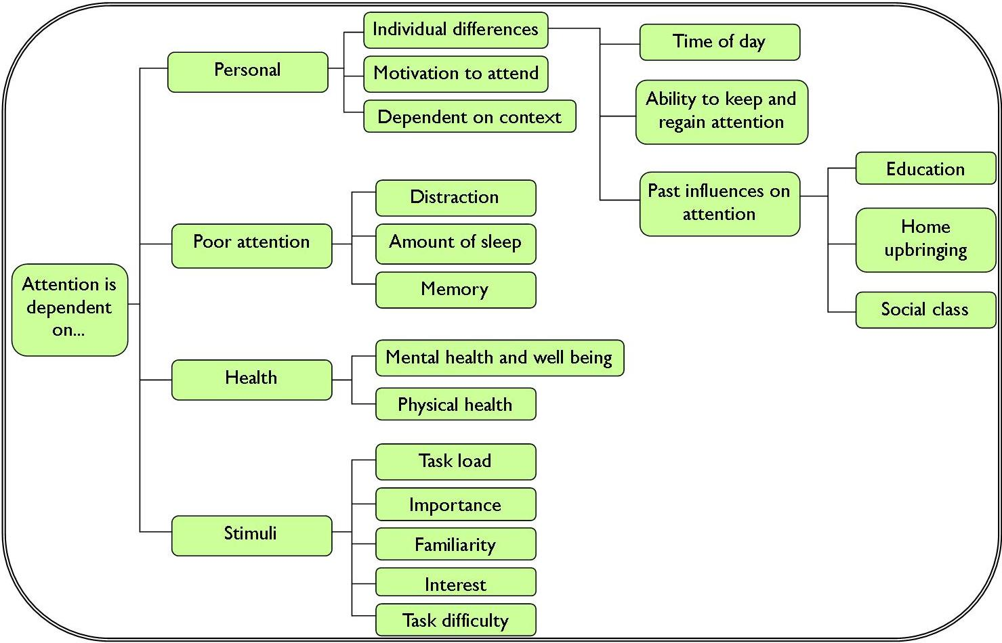
Contact me
or
see poster
for more details

Slide 9
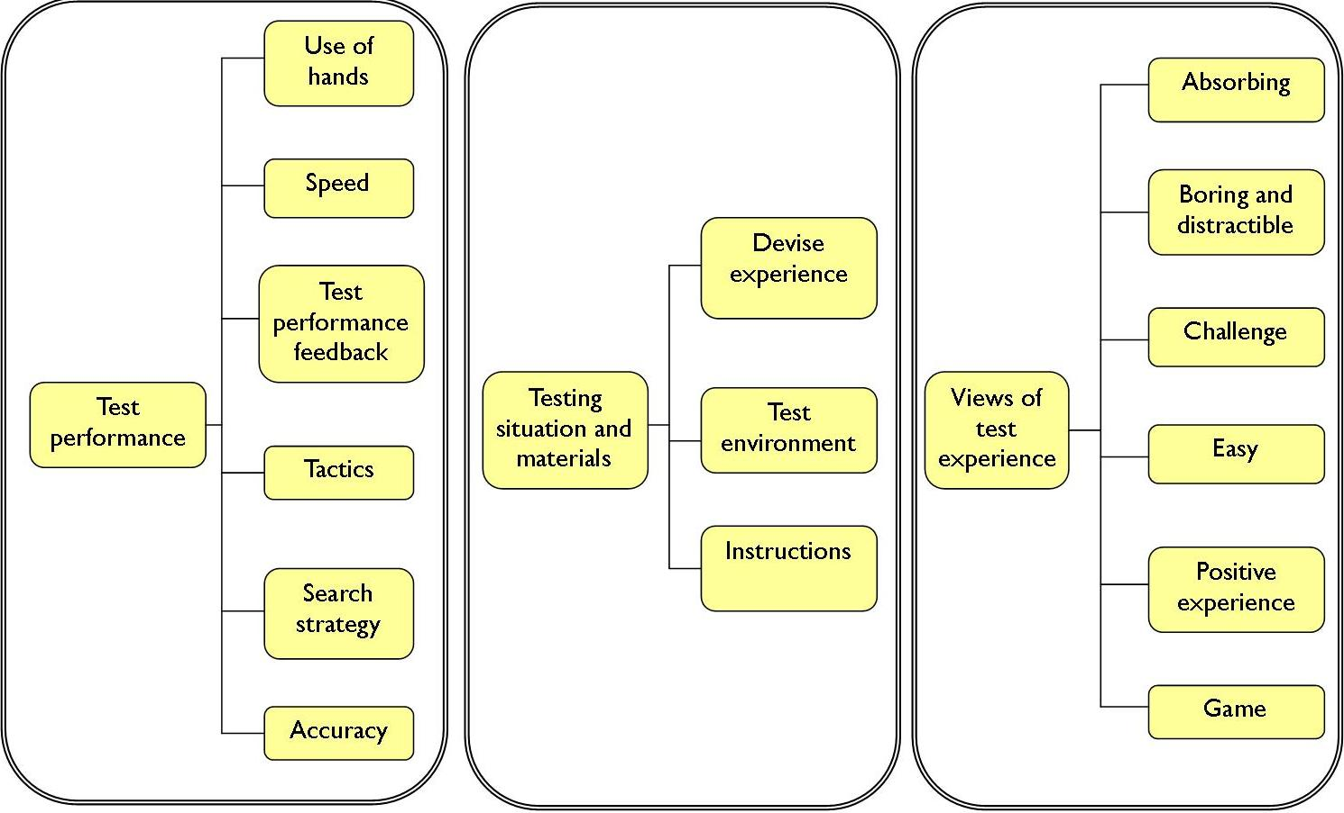
"I made two mistakes the same as you, as soon as I slowed down a bit I was more accurate. And these would slip down all the time [glasses], but it was ok once I pushed them back up“
“The only problem I had with the touch screen is my nails. I have this problem at home, and that’s why I use a pen because I find you have to develop a certain technique of touching”
iPad Test
“Like the shine on the ball, the little white bit I found quite distracting, that was annoying me and distracting me away from the number”
"She didn't say too much about it, it was sort of self-explanatory because you are just following the numbers 1-8 and I wondered what the end thing was going to be"

Slide 10
Conclusions & Next Steps What can we take from this research?
People find it difficult to verbalise what 'attention' is
Highlighted that people will have different preconceived ideas about what the study is on and what they are signing up to (question ability to give informed consent)
Many factors that need to be taken into account when using an iPad with older adults e.g. use of hands, spectacles, experience...
Focus on methodological practice - set test instructions to improve ecological validity of test results

Slide 11
Contact
Amy Jenkins
College of Human and Health Sciences
Department of Psychology
Room 809,
Vivian Building
Swansea University
Singleton Park
Swansea
SA2 8PP
Tel: 01792 604219
E-mail: 643775@swansea.ac.uk
Professor Andrea Tales
College of Human and Health Sciences
Department of Psychology
Swansea University
Vivian Tower
Singleton Park
Swansea
SA2 8PP
Tel: 01792 602567
E-mail: a.tales@swansea.ac.uk

