Slide 1
Real time analysis of gene expression in living yeast cells: Novel approach for accurate cell damage detection
Amparo Pascual-Ahuir Giner
Instituto de Biología Molecular y Celular de Plantas (IBMCP)
Universidad Politécnica de Valencia

Slide 2
Saccharomyces cerevisiae as a Model Organism
STRESS RESPONSE
BIOMEDICAL RESEARCH
TOXICOLOGY
DRUG DISCOVERY
BASIC RESEARCH

Slide 3
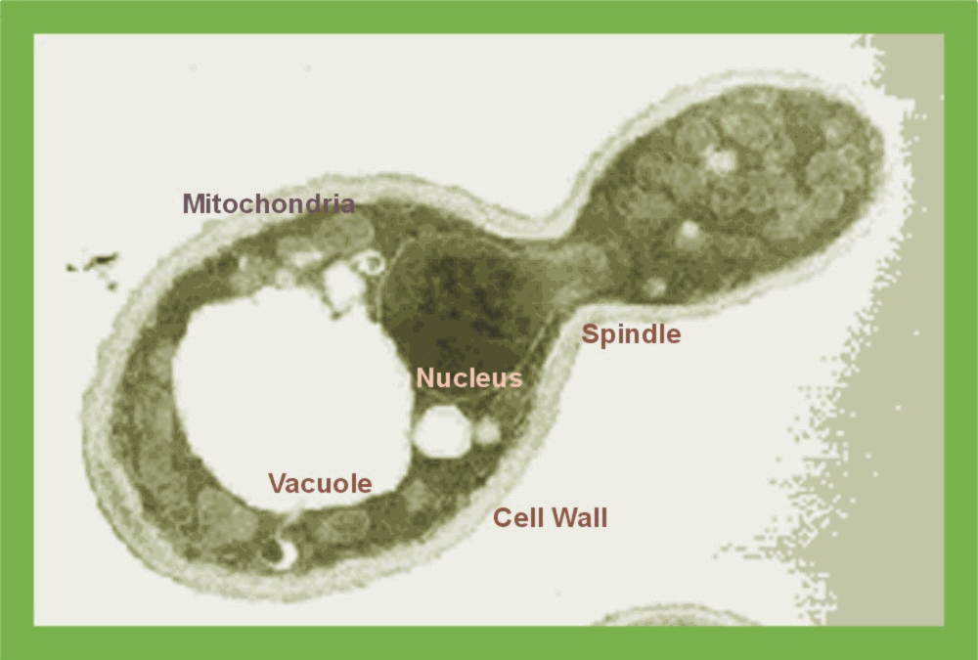
Yeast: A model for understanding cellular stress responses
Hyperosmotic Stress
Water efflux
Cell shrinking
Ionic imbalance (Na⁺)
Oxidative damage
Defense Mechanisms
Activation of ion transport
Synthesis/accumulation of osmolytes (glycerol)
Regulated cell cycle arrest
Activation of transcriptional program
Modulation of mitochondrial activity

Slide 4
The transcriptional program upon osmostress in yeast
Hyperosmotic
Stress
Function
mRNA
mRNA
Function
RNA metabolism
(Processing,
tRNA synthesis,
Splicing)
Translation
Ribosomal Proteins
Others
Glycerol, trehalose,
glycogen metabolism
Sugar uptake
+ metabolism
Redox metabolism
Mitochondrial
functions
Antioxidants
Chaperones
Signal transduction
Cell surface proteins
Others
Osmolyte production
Energy supply
Transient growth
arrest
Protection from
oxidative damage
Protection from
protein denaturation
Coordination of
stress response
Transcriptional Profiling:
Activated genes: 300-1400 (23%)
Repressed genes: up to 1300

Slide 5
Mechanisms of transcriptional control upon osmostress
A
Transcription off
Transcription on
Osmostress
Tup1
Cyc8
SAGA
HOG
Tup1
Cyc8
SWI
SNF
Sko1
TF
TF
Hog1
RNA
Pol II
Sch9
B
Transcription off
Transcription on
Osmostress
Hot1
Msn2,4
SAGA
HOG
Mediator
Rpd3
TF
TF
RNA
Pol II
Hog1
C
Transcription on
Transcription off
Osmostress
Ifh1
TOR/PKA
Crf1
Rap1
Fhl1
RNA
Pol II
Rap1
Fhl1

Slide 6
How is gene expression fine tuned during environmental changes?
Modes of dynamically modulate transcription at different stress doses
1
1
C
A
A
STRESS DOSE
1
1
3
mRNA level
B
B
B
1
3
2
1
A
C
C
min osmostress
-How is promoter activity gradually regulated over a range of stress doses?
-What are the molecular mechanisms which confer dose dependent promoter activity?
-How does cell physiology change the dose sensitive gene expression?
We need: A continuous, real time transcription assay in the living cell adaptable to multiple stress doses

Slide 7
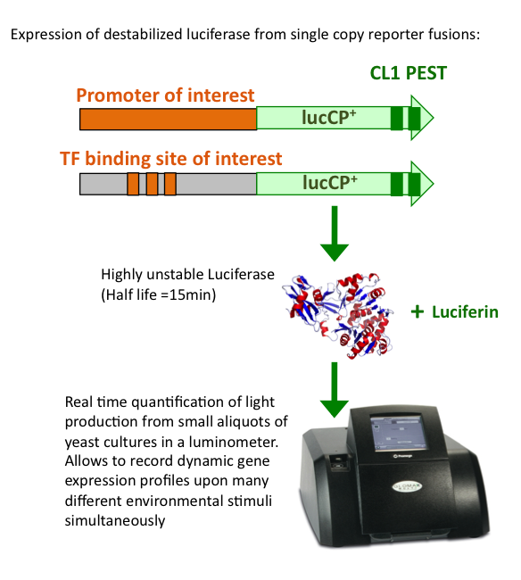
The use of a real time luciferase assay to monitor promoter dynamics in the living yeast cell
Destabilized firefly luciferase (<15min half life in S. cerevisiae)
Measurements in small culture aliquots in multiwell setup allow parallel analyses upon many environmental conditions - DOSE-RESPONSE for a given promoter
We can obtain a quantitative value the EC50.
[%]
time [min]
GRE2 induction by 0.3M NaCl
Rienzo et al., Yeast 2012

Slide 8
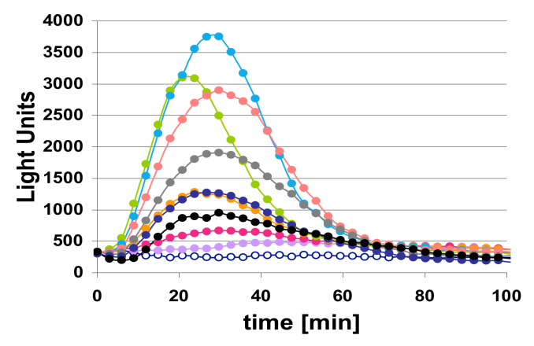
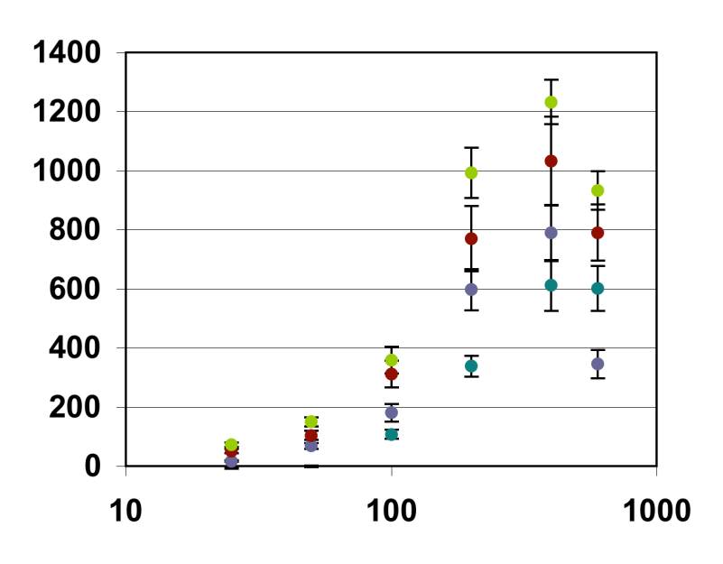
Quantitative Analysis of Natural Promoters upon Oxidative Stress
GRE2
CTT1
H₂O₂
0
25 μM
lucCP⁺
50 μM
GRE2
100 μM
CTT1
lucCP⁺
200 μM
SOD2
CCP1
400 μM
SOD2
lucCP⁺
600 μM
lucCP⁺
800 μM
CCP1
1 mM
2 mM
Dose-Response behavior of the GRE2, CTT1, SOD2 and CCP1 promoters
SOD2 and CTT1 activities are especially sensitive to hydrogen peroxide stress
SOD2 EC₅₀=125μM+/-17μM
CTT1 EC₅₀=130μM+/-19μM
A_{max}
GRE2 EC₅₀=150μM+/-21μM
CCP1 EC₅₀=176μM+/-25μM
H₂O₂ [μM]
Dolz-Edo et al., Mol Cell Biol 2013

Slide 9
Quantitative Analysis of cis elements upon Oxidative Stress
Synthetic Reporter Genes: 3x[TF binding site]-lucCP+
3xCRE
3xSTRE
3xAP1
lucCP⁺
lucCP⁺
lucCP⁺
Osmostress HOG Sko1
Stress Msn2,4
Yap1 Oxidative Stress
CRE
STRE
AP-1
H₂O₂
Dolz-Edo et al., Mol Cell Biol 2013

Slide 10
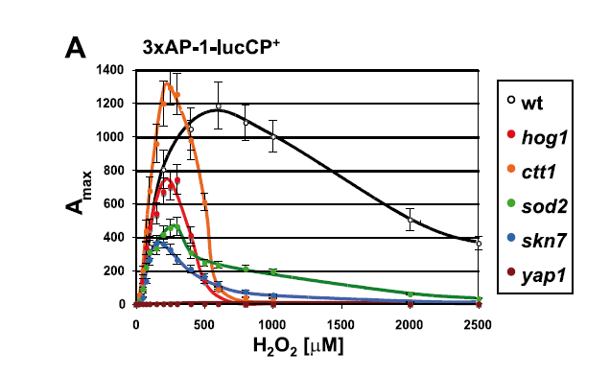
Dose Response for each element under all stress conditions
(NaCl, H₂O₂, Menadione)
Fold Induction
Fold Induction
Fold Induction
AP-1
CRE
STRE
H₂O₂ [μM]
Menadione [μM]
NaCl [M]
Cell physiology modulates the dose response of stress-activated gene
expression
Dolz-Edo et al., Mol Cell Biol 2013

Slide 11
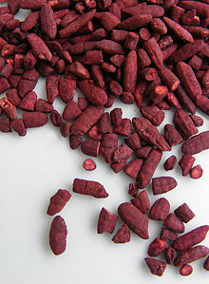
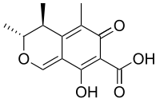
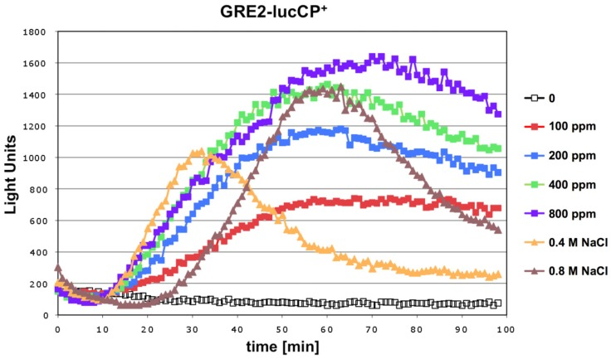
Application of quantitative yeast model to study mycotoxins
Toxicological study of citrinin.
Citrinin triggers an immediate response to oxidative stress characterized by a strong and dose-dependent induction of natural genes.
GRE2
lucCP⁺
3xCRE
3xAP1
3xSTRE
lucCP⁺
lucCP⁺
lucCP⁺
At present we are using the “dose-response assays” to study the transcriptional behavior of other stress response promoters (Oxidative , DNA Damage, Mitochondrial dysfunction, cell cycle)
Pascual-Ahuir et al., Nutrients 2014

Slide 12
Current projects:
-Generate artificial promoters, with optimized sensitivity and specificity to one particular mycotoxin .
Mycotoxin
DETECT
DEGRADE
CURE
-Identify the molecular target of toxicity of citrinin. Expand the dose-response assays to study the toxicological effect of Ochratoxin A.
-Identify new enzymes for biodegradation .

Slide 13
Amparo Pascual-Ahuir Giner (UPV)
Markus Proft (CSIC)
Alessandro Rienzo
Alba Timón Gomez
Sara Manzanares Estreder
Elena Vanacloig Pedros
Daniel Poveda Huertes
Carolina Bets Plasencia
Sandra Saiz Balbastre
Sonia Squeo

