Slide 1



Role of micro-RNAs in Atrial Fibrillation
Amir Shaikh, MD; David D McManus, MD,ScM
Assistant Professor,
Department of Medicine
University of Massachusetts Medical School, Worcester, MA, USA

Slide 2
Disclosures
David D McManus, MD, ScM has received research funding from:
  US Department of Defense
  National Heart Lung and Blood Institute
  Worcester Polytechnic Institute (New Technology Development Grant)
  St. Jude Medical
  Philips Healthcare
  Sanofi Aventis
  Biotronik
  Otsuka Pharmaceuticals
  Astra Zeneca

Slide 3
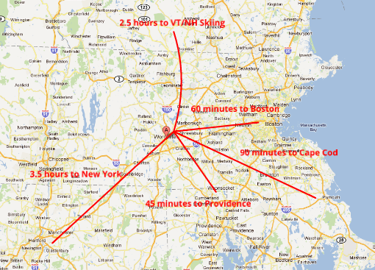

University of Massachusetts Medical School

Slide 4

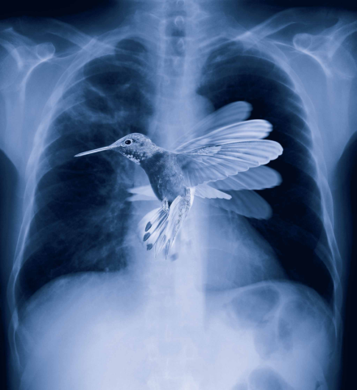
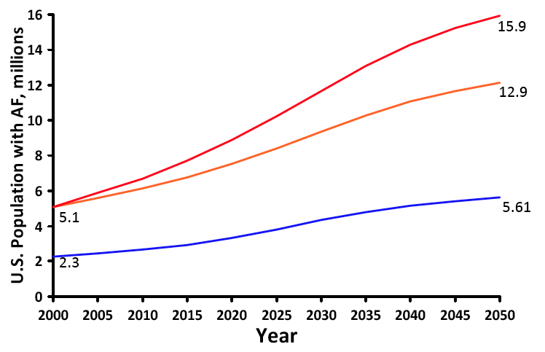
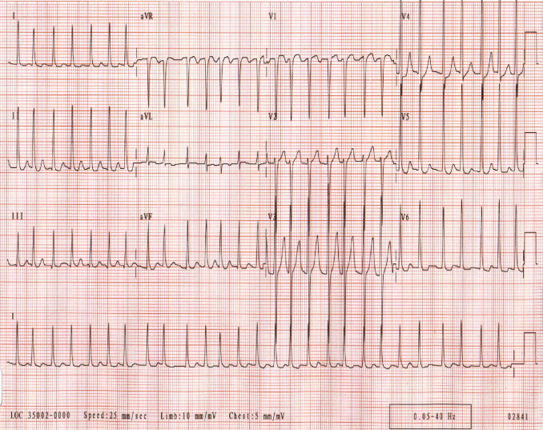


Atrial Fibrillation: A Complex Disease with Far-Reaching Impact
Miyasaka Circulation 2006;11:119; Go JAMA 2001;285:2370
American Heart Association
Notes:
It is fitting that any lecture about AF begin with an ECG. This has been the manner in which AF has been diagnosed since the advent of the ECG by Einthoven in 1903
Current clinical classification systems for AF involve descriptions such as paroxysmal, persistent, or permanent
These terms offer little knowledge of the underlying mechanisms promoting AF
The total costs of AF care in the United States are estimated to be $6.65 billion per year -

Slide 5
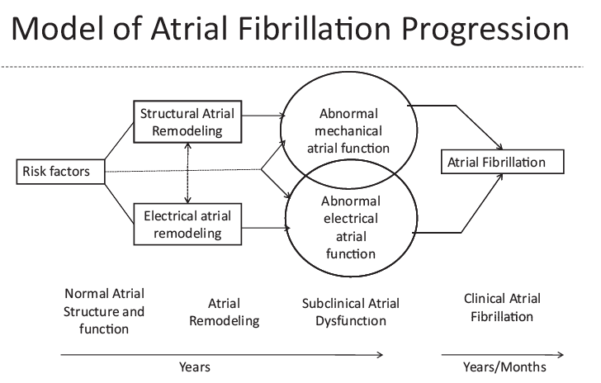
A useful phenotype to explore genetic and transcriptomic underpinnings of AF?
DD McManus, A Shaikh, F Abdhiskek, RS Vasan. Crit Path Cardiol. 2011

Slide 6
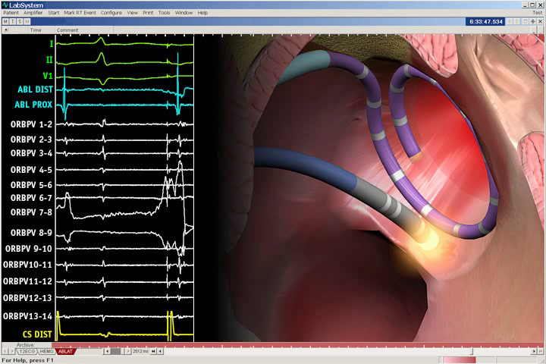
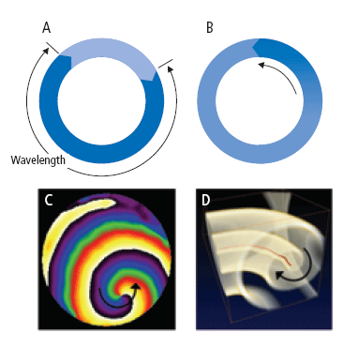
Focal Triggers Initiate AF and Reentry Perpetuates It
AF requires both a trigger and a vulnerable substrate
Interplay between intrinsic susceptibility and exposures largely unknown
Ding Sheng He, MD, PhD
Notes:
Jais/Haissaguerre 1998
Jose Jalife has shown via beautiful animal studies that

Slide 7
Paroxysmal
Persistent
Permanent
Although all are susceptible to AF, why do many individuals develop it early in life with minimal (if any) exposures?
Why do some progress to more persistent forms of the arrhythmia?
Substrate for AF
Initiation substrate
Triggers of AF
AF disease progression

Slide 8
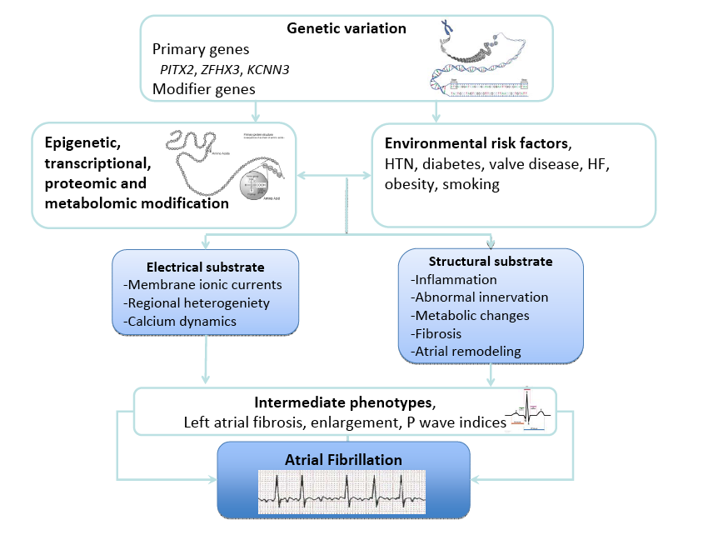
Magnani…McManus…Benjamin. Atrial fibrillation: current knowledge and future directions in epidemiology and genomics. Circulation 2011.

Slide 9
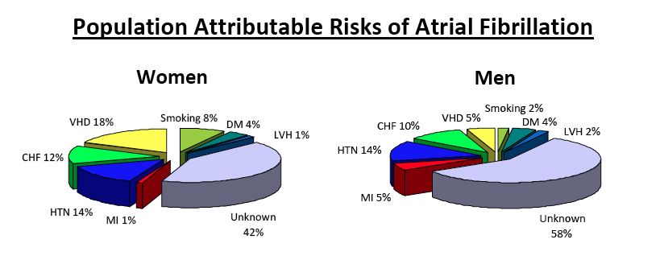
Benjamin JAMA 1994;271:840; Lake Austr NZ J Med 1989;19:321;
Psaty Circulation 1997;96:2455; Sawin NEJM 1994;331:1249;
Tsang JACC 40:36, 2002

Slide 10
Magnani…McManus…Benjamin. Atrial fibrillation: current knowledge and future directions in epidemiology and genomics. Circulation 2011.

Slide 11
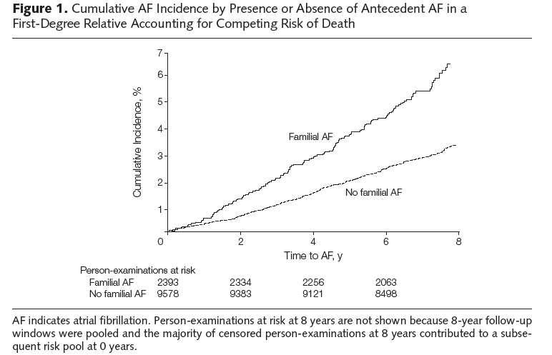
Genetics of AF
Family History of AF Associated with Increased AF Risk
AF ≥ 1 parent OR 1.9; (P=0.02)
<75yo, w/o h/o heart disease OR 3.2; (P< 0.001)
Association with Family History
Candidate Gene Studies
GWAS findings
Lubitz, JAMA 2010.
Fox…Benjamin JAMA 2004;291:2851

Slide 12
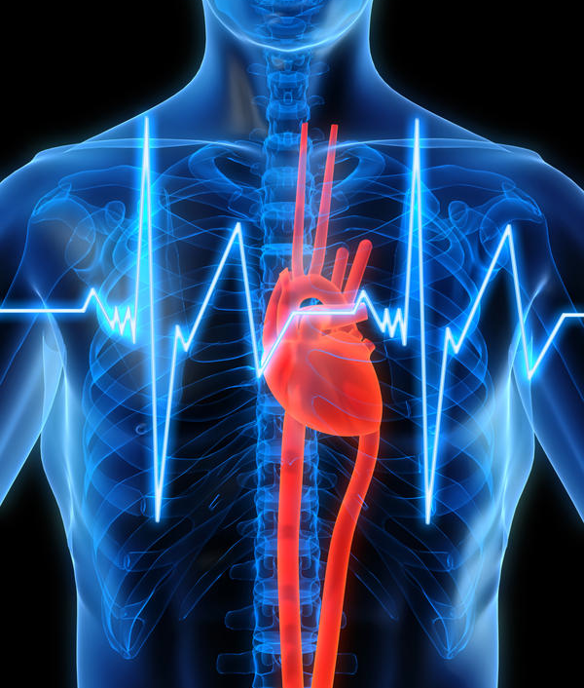
Genetics, Genomics and AF

Slide 13
Candidate Genes Associated with AF
Gene | Variant | Cases | Controls | OR | P value | Replicated?
Candidate Gene Studies
Connexin 40 | -44A, +71G | 173 | 232 | 1.5 | < 0.006 |  | No
Angiotensinogen | M235T | 250 | 250 | 2.5 | <0.001 |  | No
Angiotensinogen | G-6A | 250 | 250 | 3.3 | 0.005 |  | No
Angiotensinogen | G-217A | 250 | 250 | 2.0 | 0.002 |  | No
Mink | 38G | 108 | 108 | 1.8 | 0.024 |  | No
GNB3 | C825T | 291 | 292 | 0.46 | 0.02 |  | No
KCNE5 | 97T | 158 | 96 | 0.52 | 0.007 |  | No
Interleukin 6 | -174 G/C | 26 | 84 | 3.25 | 0.006 |  | No
CETP | Taq1B | 97 | 97 | 0.35 | 0.05 |  | No
KCNE4 | E145D | 142 | 238 | 1.66 | 0.044 |  | No
ACE | D/D | 51 | 289 | 1.5 | 0.16 |  | No
ENOS | 894T/T | 51 | 289 | 3.2 | 0.001 |  | No
SCN5A | H558R | 157 | 314 | 1.6 | 0.002 |  | No
HERG/KCNH2 | K897T | 1207 | 2475 | 1.25 | 0.0003 |  | Yes
Ellinor Med Clin N Am 2008;92:41
Notes:
This slide shows the 14 genes associated with AF in candidate gene studies and the 2 single nucleotide polymorphisms associated with HF
In only one case, HERG or KCNH2, have the findings been replicated in multiple cohorts
This shows

Slide 14
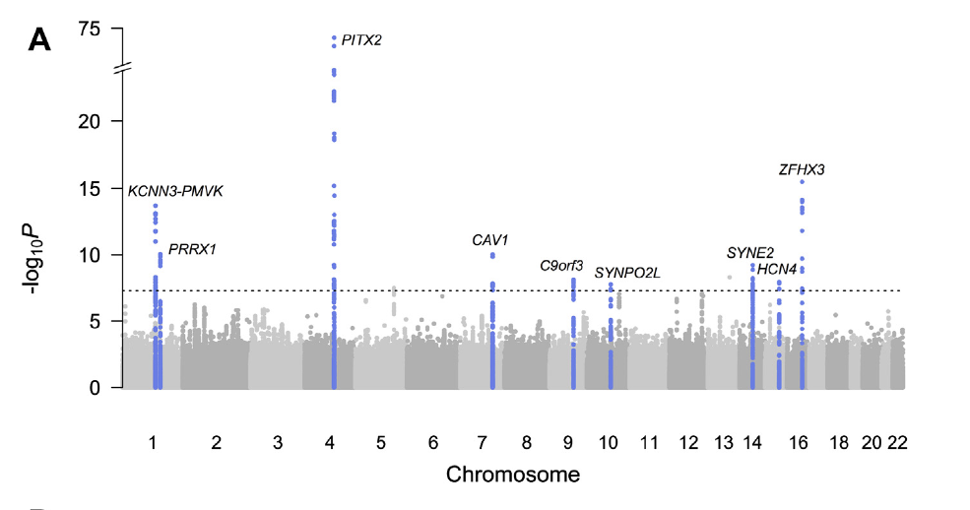
Associations between Genetic Variants and AF
~35% individuals European descent have ≥1 variant
Risk AF OR 1.72, 1.39 /copy
Gudbjartsson Nature 2007;448:353
Lubitz…McManus…Ellinor. JACC 2014
Notes:
Associations between genetic variants and atrial fibrillation are displayed (A) across the genome in marginal association analyses as previously reported
The chromosome 4q25 AF locus is architecturally complex and harbors at least 4 AF susceptibility signals in
individuals of European ancestry. Similar

Slide 15
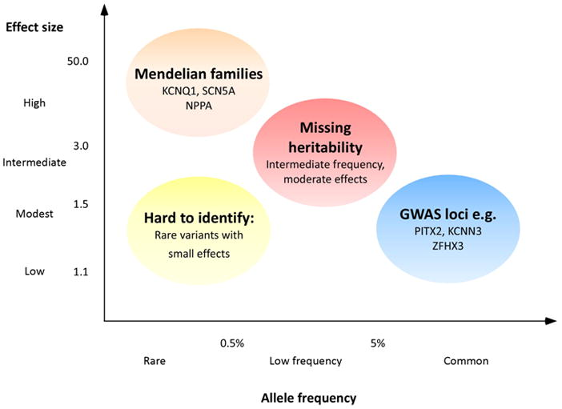
identified genetic associations of AF and future areas of genomic study
Magnani…McManus…Benjamin. Atrial fibrillation: current knowledge and future directions in epidemiology and genomics. Circulation 2011.

Slide 16
Magnani…McManus…Benjamin. Atrial fibrillation: current knowledge and future directions in epidemiology and genomics. Circulation 2011.

Slide 17

Heritability Gap in AF – Moving beyond GWAS
Known unknowns in AF:
40% AF risk unexplained by clinical CV risk factors
2-fold higher risk of AF in patients with family history of AF
90+% of AF heritability unexplained by known SNPs and candidate gene studies
AF triggers contribute to altered atrial gene expression
Could variable gene expression in stress states explain heritability gap?

Slide 18
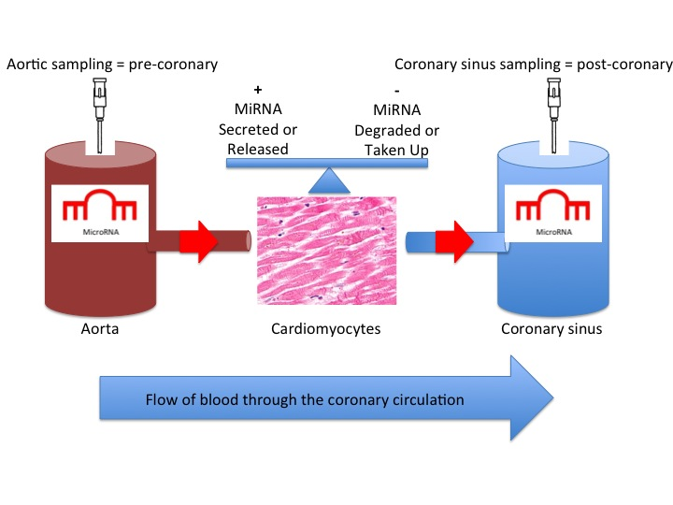
MicroRNA in CVD
MicroRNAs (miRNAs) are endogenous, non-coding RNAs
miRNAs are regulators of gene expression
miRNAs are released by the heart in the setting of an acute MI, heart failure
miRNAs are present in the circulation and provide insights into in vivo gene expression.
McManus, Ambros. Circulation 2011
Notes:
MicroRNAs (miRNAs) are recently discovered small RNAs that play an important role in the negative regulation of gene expression by suppressing protein translation. MicroRNAs are comprised of approximately 22 nucleotides and derived from larger hairpin-forming precursors. MicroRNAs are initially transcribed as long primary miRNAs (pri-miRNAs) and these pri-miRNAs are processed by the RNase III enzyme Drosha to generate stem-loop precursor miRNAs (pre-miRNAs) approximately 70 nucleotides in length. These precursors are exported into the cytoplasm by Exportin-5 and, subsequently, the cytoplasmic enzyme Dicer cleaves the pre-miRNA to release the mature miRNA. Binding of miRNA to a messenger RNA (mRNA) with Ago proteins inhibits protein translation.

Slide 19
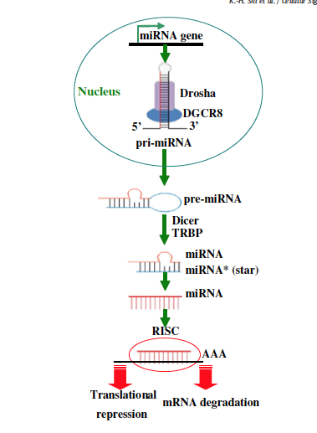
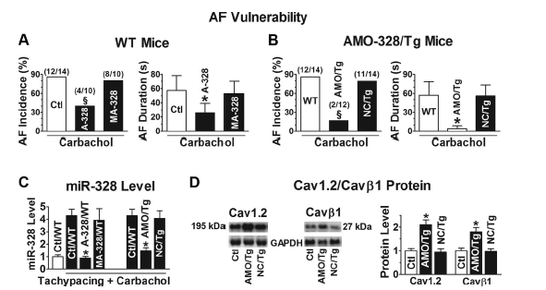

Animal Models suggests Tissue Levels of Mirnas are associated with AF Susceptibility

Slide 20
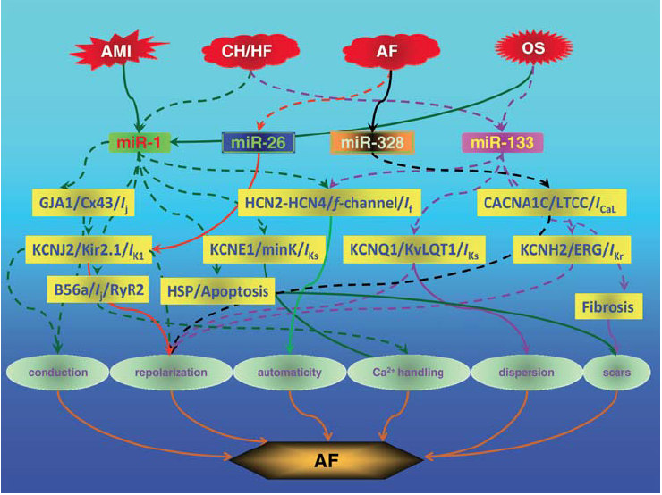
Wang Card Res 2010
Notes:
Figure 4 Schematic summary of regulation of various genes pertinent to AF by miRNAs based on published studies. This diagram shows how some
pathological conditions alter expression of miR-1, miR-133, miR-26, and miR-328 and how these miRNAs regulate their target genes to affect the properties
of atrial cells leading to AF. AMI, acute myocardial infarction; CH/HF, cardiac hypertrophy/heart failure; AF, atrial fibrillation; OS, oxidative stress.
Solid line-arrows indicate positive regulation and dashed line-arrows negative regulation.

Slide 21
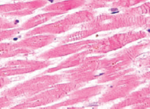
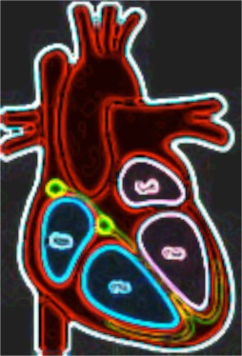
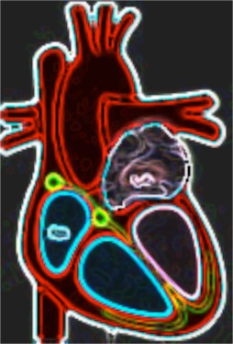


Altered atrial miRNA profile
Atrial Injury
(e.g., from heart failure)
Altered Cardiac Gene Regulation (e.g., TGF-β)
Normal Atria
Diseased Atria
+ miRNAs secreted or released (e.g., exosomes)
- miRNAs degraded or taken up (e.g., platelets)
Cardiac Remodeling Promotes AF
miRNAs detectable in plasma
Notes:
Conceptual model

Slide 22
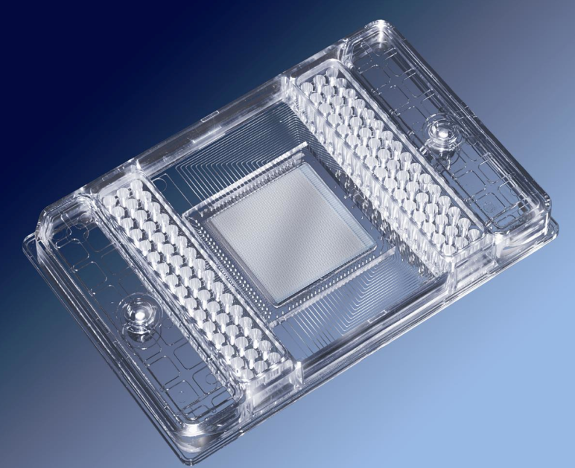
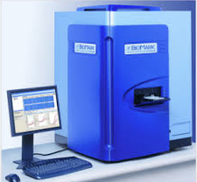
High Throughput Technology exists to assess miRNA expression
High-throughput miRNA expression profiling systems allow rapid profiling of miRNAs from numerous samples
Use real-time PCR, or microarray
Primers correspond to over 1,000 miRNAs
Accurate, specific and sensitive
Courtesy, Jane Freedman, MD Kahraman Tanriverdi, PhD

Slide 23
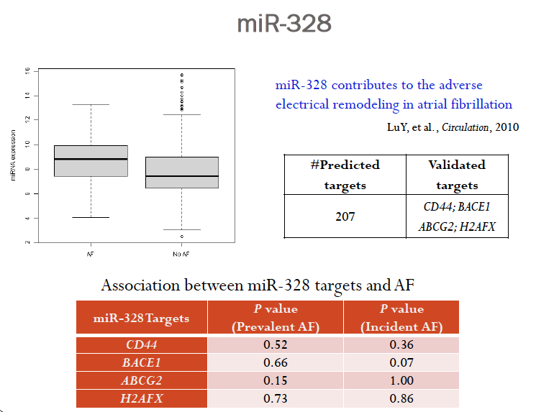
miR-328 is up-regulated in the atria of human subjects with AF
miR-328 regulates L-type Ca2+ channel density, shortens the atrial effective refractory period
miR-328 enhances AF vulnerability in animal models
McManus et al. Heart Rhythm 2014

Slide 24
Baseline Exam:
Plasma
Post-Ablation: Plasma
1-mo
Post-ablation AF (n=47)
Prevalent AF (n=122)
Atrial Tissue
No AF
(n=99)
Cardiac surgery (n=31)
McManus et al. submitted Circulation. 2014

Slide 25
21 Plasma mirnas associated with AF
 | N |  | Average Expression (delta CT) |  |  | Multivariable Adjusted***
miRNA | Total | AF Cases | Prevalent AF (n=112) | No AF (n=99) | Fold Change | Odds Ratio | 95% CI | P-value*
miR-150-5p | 206 | 107 | -3.26 | -0.96 | 2.30 | 0.51 | 0.41-0.63 | 1.5x10⁻¹⁰
miR-100-5p | 205 | 109 | -1.61 | 1.45 | 3.07 | 0.42 | 0.33-0.54 | 3.2x10⁻¹²
miR-122-5p | 209 | 110 | -4.81 | -2.09 | 2.72 | 0.56 | 0.47-0.67 | 4.3x10⁻¹⁰
miR-125a-5p | 202 | 106 | -2.53 | 0.85 | 3.38 | 0.47 | 0.38-0.58 | 4.09x10⁻¹²
miR-146a-5p | 202 | 106 | -2.19 | 0.54 | 2.73 | 0.38 | 0.29-0.51 | 7.8x10⁻¹²
miR-148b-3p | 198 | 105 | -1.27 | 0.83 | 2.10 | 0.47 | 0.37-0.59 | 3.9x10⁻¹⁰
miR-21-5p | 209 | 110 | -5.82 | -3.76 | 2.06 | 0.51 | 0.41-0.63 | 9.2x10⁻¹⁰
miR-221-3p | 208 | 109 | -3.30 | -1.20 | 2.09 | 0.50 | 0.40-0.61 | 2.6x10⁻¹⁰
miR-223-3p | 209 | 110 | -5.88 | -3.62 | 2.27 | 0.49 | 0.39-0.60 | 5.9x10⁻¹¹
21 miRNAs, including several known to regulate genes associated with cardiovascular disease, were associated with prevalent AF
AF=atrial fibrillation; OR = odds ratio; miR = miRNA; CI = Confidence Interval; Bonferroni p value cutoff = 0.05/86 miRNAs = 0.0006
Fold-change is the difference in miRNA expression between individuals with AF compared to no AF
Multivariable adjusted models included age, sex, current smoking, diabetes, prevalent heart failure, and MI
Notes:
Legend. AF=atrial fibrillation; OR = odds ratio; miR = miRNA; CI = Confidence Interval;
*Bonferroni p value cutoff = 0.05/86 miRNAs = 0.0006
**Fold-difference is the difference in miRNA expression between individuals with AF compared to no AF
***Multivariable adjusted models included age, sex, current smoking, diabetes, prevalent heart failure, and myocardial infarction
**** The OR reported represents the ratio of odds resulting from a 1-cycle threshold increase.

Slide 26
33 Plasma Mirs change pre- to post-ablation
 | N |  | Average Expression (delta CT) |  |  | Multivariable Adjusted***
miRNA | Baseline | Post-Ablation | Baseline | Post-Ablation | Fold Change | Odds Ratio | 95% CI | P-value*
miR-150-5p | 47 | 45 | -3.75 | -0.69 | 3.06 | 2.71 | 1.85 - 3.98 | 3.6x10⁻⁷
miR-21-5p | 47 | 47 | -6.09 | -2.65 | 3.44 | 3.07 | 1.98 - 4.76 | 5.3x10⁻⁷
miR-122-5p | 47 | 45 | -5.41 | -1.73 | 3.68 | 2.31 | 1.65 - 3.22 | 8.2x10⁻⁷
miR-223-3p | 47 | 46 | -6.32 | -2.64 | 3.68 | 3.12 | 1.98 - 4.93 | 1x10⁻⁶
let-7b-5p | 47 | 47 | -6.23 | -2.67 | 3.56 | 3.43 | 2.08 - 5.66 | 1.5x10⁻⁶
miR-30c-5p | 47 | 38 | -1.08 | 1.63 | 2.71 | 3.54 | 2.11 - 5.92 | 1.5x10⁻⁶
miR-342-3p | 47 | 47 | -2.07 | 0.54 | 2.61 | 4.53 | 2.41 - 8.51 | 2.7x10⁻⁶
let-7c-5p | 47 | 47 | -4.66 | -0.95 | 3.71 | 3.92 | 2.21 - 6.97 | 3.1x10⁻⁶
miR-148b-3p | 46 | 35 | -1.49 | 1.18 | 2.67 | 2.94 | 1.85 - 4.67 | 4.9x10⁻⁶
miR-146a-5p | 47 | 36 | -2.24 | 0.91 | 3.15 | 3.2 | 1.93 - 5.33 | 7.2x10⁻⁶
miR-125b-5p | 47 | 38 | -2.92 | 1.48 | 4.40 | 3.68 | 2.05 - 6.61 | 1.3x10⁻⁵
miR-126-3p | 47 | 44 | -5.58 | -1.39 | 4.19 | 3.81 | 2.08 - 6.96 | 1.4x10⁻⁵
miR-100-5p | 47 | 33 | -2.07 | 1.29 | 3.36 | 3.95 | 2.09 - 7.47 | 2.2x10⁻⁵
miR-125a-5p | 47 | 36 | -3.22 | 1.48 | 4.71 | 4.86 | 2.12 - 11.16 | 1.9x10⁻⁴
33 miRNAs changed from pre- to post-ablation
14 miRNAs were also associated with AF
AF=atrial fibrillation; OR = odds ratio; miR = miRNA; CI = Confidence Interval; Bonferroni p value cutoff = 0.05/86 miRNAs = 0.0006
Fold-change is the difference in miRNA expression between individuals with AF compared to no AF
Multivariable adjusted models included age, sex
Notes:
14 overlapping highlighted

Slide 27
AF vs. No AF in Atrial Tissue

Slide 28
AF vs. No AF in Atrial Tissue

Slide 29
Post-Operative AF

Slide 30
Considerable Overlap in Highly Variant Mirs and those associated with AF
Pre vs. Post-Ablation
AF vs. No AF
miR-10b-5p
miR-24-3p
miR-29a-3p
miR-99b-5p
miR-221-3p
miR-375
miR-411-5p
miR-21-5p
miR-30c-5p
miR-100-5p
miR-122-5p
miR-125a-5p
miR-125b-5p
miR-126-3p
miR-146a-5p
miR-148b-3p
miR-150-5p
miR-223-3p
miR-342-3p
let-7b-5p
let-7c-5p
miR-7-5p miR-221-3p
miR-10b-5p miR-320a
miR-19a-3p miR-451a
miR-20a-5p miR-144-3p
miR-24-3p miR-146b-5p
miR-25-3p miR-29b-3p
miR-26a-5p
miR-29a-3p
miR-30a-5p
miR-92a-3p
miR-106b-5p
let-7f-5p
let-7g-5p

Slide 31
Gene Targets associated with Significant MIRNAs
miRNA | FUNCTION (TARGET GENES) | ASSOCIATED PHENOTYPE
miR-1 | Cell cycle regulation; (Ion Channels and gap junction genes, GJA1, KNJ2) | Cardiac arrhythmia, cardiac development, downregulation in AF
miR-21 | Upregulation of the protein sprouty (ERK-MAPK), PDCD4 | Anti-apoptotic factor, cardiac stress response
miR-29 | Inhibition of collagen and extracellular matrix proteins (ELN, FBN1, COL1A1), Pro-apoptosis (Mcl-2) | Regulates deposition of intracellular collagen
miR-92a | Inhibition of neorevascularization (integrin subunit α5 and eNOS) | Reduction in cellular apoptosis and improved cardiac function
miR-122 | fatty acid beta-oxidation | Contributes to endothelial dysfunction
miR-150 | (c-Myb), H2O2-induced cardiac cell death | Atherosclerosis, cardiac hypertrophy, heart failure, myocardial infarction, and myocardial ischemia/reperfusion injury
miR-320 | Pro-apoptosis (HSP20 levels); Increases expression of insulin-like growth factor-1 | Down-regulated after ischemia reperfusion injury; down-regulated in AF
miR-92a | Inhibition of neorevascularization (integrin subunit α5 and eNOS) | Reduction in cellular apoptosis and improved cardiac function
McManus et al. submitted Circulation. 2014

Slide 32
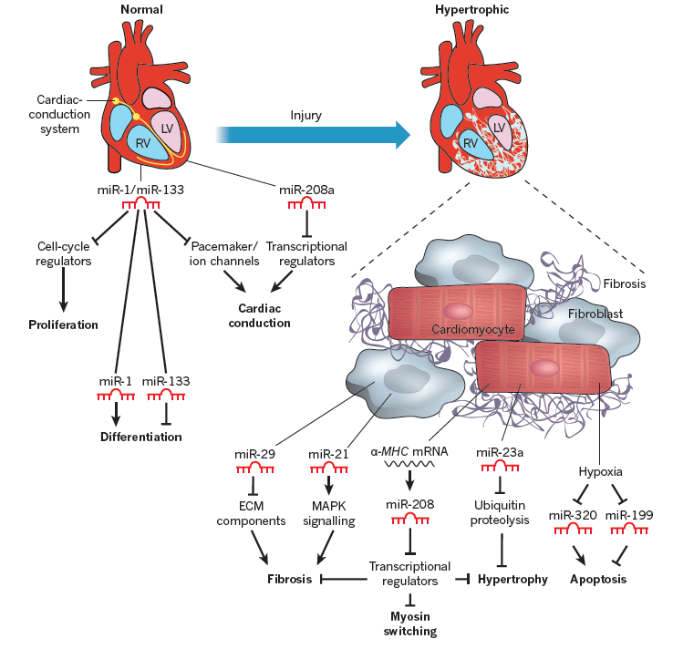
Olson, Nature 2010

Slide 33
MiRhythm Findings
We observed associations between AF and plasma miRNAs linked to gene regulatory pathways responsible for cardiac remodeling
Overlap was observed between plasma miRNAs associated with AF and those changing after ablation
Studies are needed to explore gene regulatory pathways implicated in susceptibility to AF and to examine the role of miRNAs as circulating biomarkers of diagnostic or prognostic importance in AF
McManus et al. submitted Circulation. 2014
Notes:
Males-suggests perceived symptom severity may differ between men and women; Suggests AF-specific QOL may differ between men and women
Persistent AF-Perhaps reflects degree of adaptation to, or acceptance of their AF diagnosis
Few clinical predictors of disease-specific QOL in symptomatic AF pts opting for ablation; NO clinical/demogr predictors for medical treatments
Studies to establish what other factors (as listed) may influence AF-related QOL PSYCHOSOCIAL CHARACTERISTICS, COGNITIVE FUNCTION

Slide 34
Future Directions
Exploring functional significance of miRNA dysregulation in animal models of AF
Complete echocardiographic phenotyping of LA structure in FHS and look at genomic and transcriptomic profiles of LA-EF, LAVI
Leverage AF Registry and Biobank

Slide 35






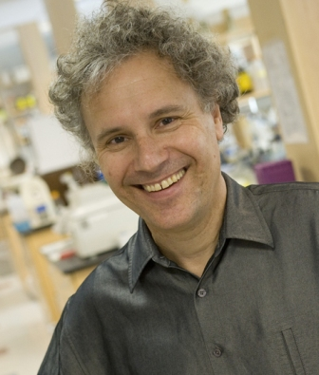




A special thank you to the 650+ AF patients who have entrusted their care to us and participated in the Umass AF Registry, AF Biobank, and InRhythm!
UMMS
-Nada Esa, MD
-Raghava Velagaleti, MD
-John Keaney MD
-Robert Goldberg PhD
-Victor Ambros, PhD
-Jane Freedman, MD
-Kahraman Tanriverdi, PhD
-Rosalind Lee, BS
-Jeanine Ward, MD PhD
-Iryna Nieto, MD
-Divakar Mandapati, MD
-Stanley Tam, MD MBA
-Okike N. Okike, MD
-Timothy Fitzgibbons, MD
-Donna Suter, RN
-Amir Shaikh, MD
-Menhel Kinno, MD
-EP Colleagues
BU/FHS
-Vasan Ramachandran MD
-Emelia Benjamin MD, ScM
-Jared Magnani, MD, MPH
-Shuxia Fan
-Susan Cheng, MD MS
-Honghuan Lin, MD
MGH
-Patrick Ellinor MD, PhD
-Steven Lubitz, MD

Slide 36

Thank you for your attention!

