Slide 1
Post-transcriptional Modification of RNA: Effect on Biology and Virulence of Salmonella
Amin A. Fadl
University of Wisconsin-Madison

Slide 2
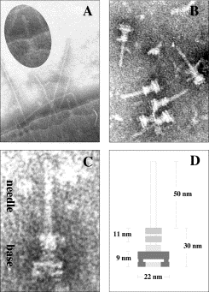
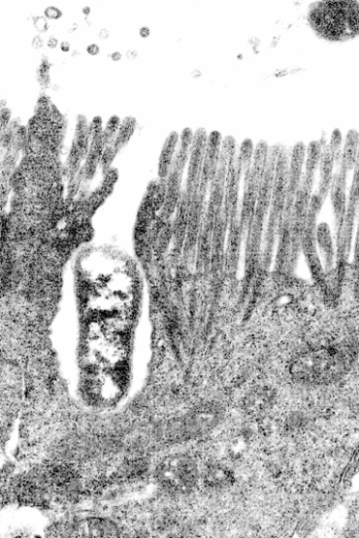
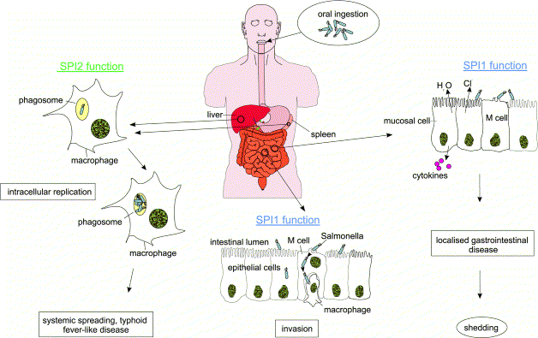
Salmonella Pathogenesis
Hensel et al, 2001

Slide 3
tRNA Modification Enzymes
tRNAs are key molecules of translational machinery that ensure decoding of successive codons in mRNA inside the ribosome.
Post-transcriptional tRNA modification is found in all organisms and is required for tRNA functions, control gene expression
Glucose-inhibited division gene (GidA, MnmG), methylaminomethyl (MnmE), Ribosomal Small Subunit Methyltransferase (RsmG, GidB)

Slide 4
GidA (MnmG)
Thought to be involved in cell division and chromosome replication (filamentous) in Escherichia coli
Recent studies suggested a role in gene regulation and tRNA modification
GidA complexes with MnmE to catalyzed tRNA modification (addition of cmnm group onto the C5 carbon of uridine at position 34 (U34) of tRNAs)

Slide 5
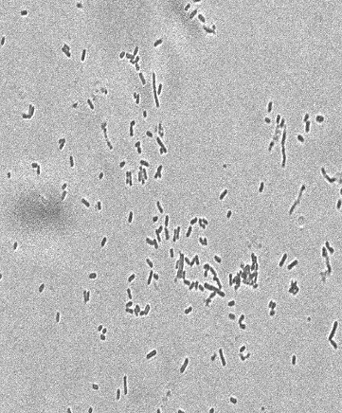
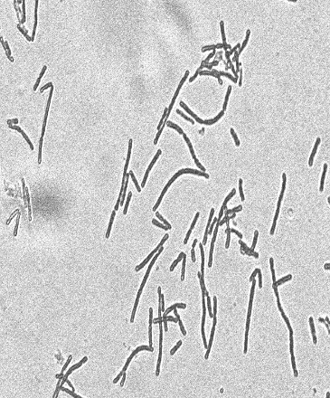
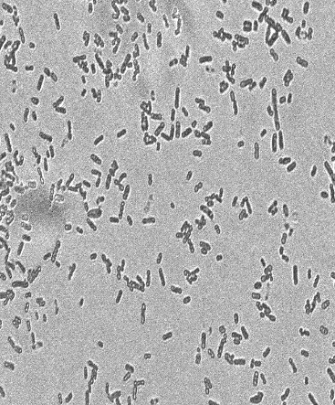
In vitro Virulence Potentials
WT GidA GidA-compl
Filamentous morphology
Defective in invasion of intestinal cells
Inhibit cytotoxicity in murine macrophages
Decreased replication in macrophages
Shippy et al, 2011

Slide 6
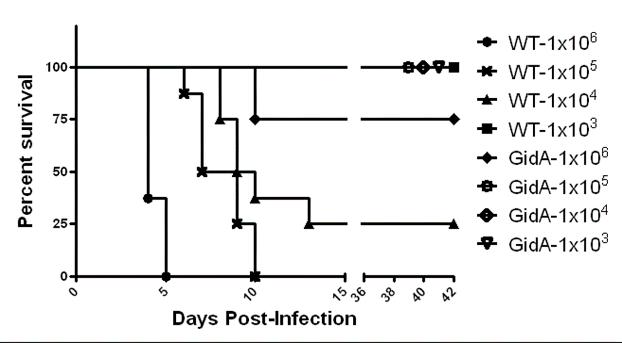
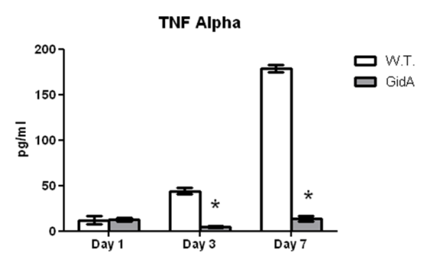
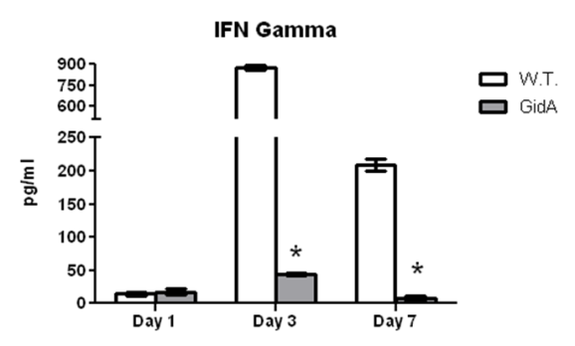
In vivo Virulence of GidA mutant
Increased LD₅₀
Decreased systemic replication
Marked reduction in induction of cytokines
Shippy et al, 2011

Slide 7
Transcriptome Profiling: 154 genes down-regulated and 124 up-regulated. Confirmed by real-time RT-PCR
Gene Name | Gene # | Microarray FC | RT-PCR FC
spaP | STM2890 | -9.61 | -10.85
prgJ | STM2872 | -4.36 | -9.85
fepE | STM0589 | 4.53 | 4.54
hscC | STM0659 | 3.78 | 2.63
yhjC | STM3607 | 4.22 | 2.46
ssaN | STM1415 | 2.96 | 4.59
yebK | STM1887 | 2.86 | 2.36
invF | STM2899 | -11.79 | -9.83
invE | STM2897 | -12.20 | -7.57
motA | STM1923 | -5.05 | -2.09
spaQ | STM2889 | -9.49 | -3.50
invA | STM2896 | -10.21 | -2.16
prgH | STM2874 | -6.86 | -3.82
fliD | STM1960 | -4.79 | -4.26
fliC | STM1959 | -5.64 | -14.89
cheW | STM1920 | -8.71 | -4.86
mukB | STM0994 | 2.10 | 3.46
mreB | STM3374 | -2.54 | -2.27
parA | PSLT052 | 7.07 | 18.64
parB | PSLT053 | 5.45 | 5.08
Semi-quantitative Western blots
WT
GidA
100 ± 3.2
50 ± 1.2
MotB
100 ± 3.2
56 ± 3.1
PrgH
100 ± 5.7
9 ± 1.5
FliC
Assay proteins involved in invasion and motility
Quantitate using densitometry
Shippy et al, 2011

Slide 8
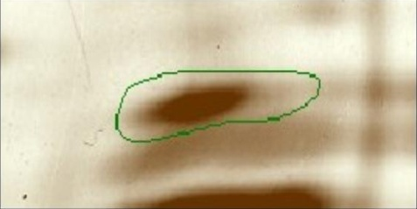
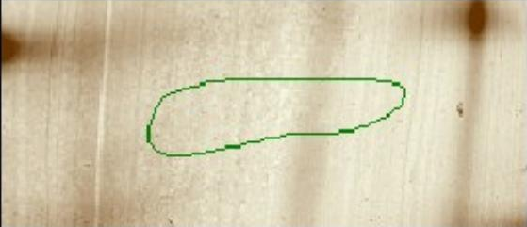
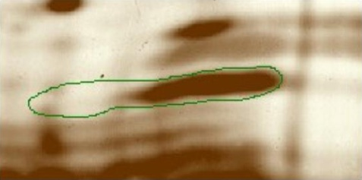
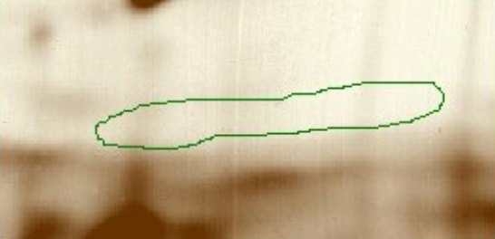
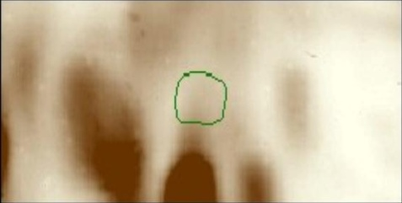
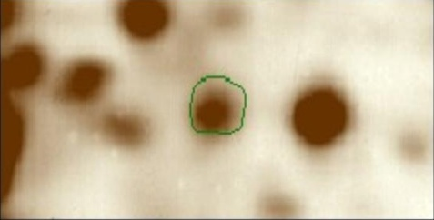
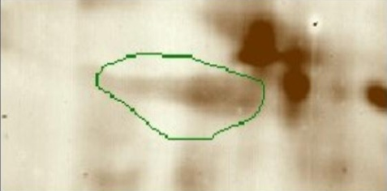
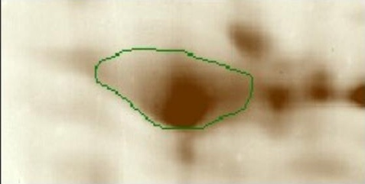
Proteomic Analysis
WT GidA
170 proteins altered
117 proteins down-regulated
53 proteins up-regulated
Identified by MALDI-MS including MalE (maltose-binding protein), YghA (an oxidoreductase help Salmonella survive inside macrophages), Tpx (a thiol peroxidase, help Salmonella survive within macrophages), tpx (H₂O₂ survival)
Shippy et al, 2011

Slide 9
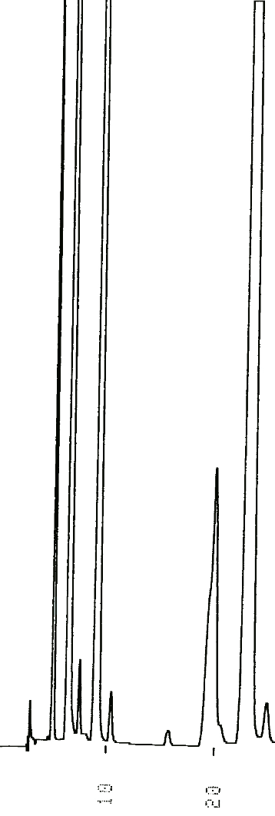
HPLC analysis of enzymatic digests of tRNA isolated from WT and various mutants. Arrow indicates peak corresponding to 5-methylaminomethyl (cmnm5) in the WT and missing in mutants.
cmnm5
WT GidA MnmE Gida/MnmE
Shippy et al, 2013

Slide 10
Immunization study
Mice immunized with gidA mutant was protected against Salmonella WT lethal dose
Th1/Th2 immune response

Slide 11
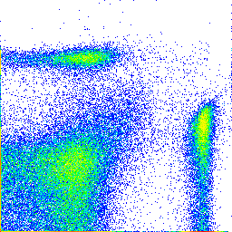
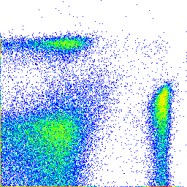
T cell Populations
Day 42
CD4⁺ levels of immunized mice on day 42 (28.1%) compared to levels in control (23.5%)
No difference in CD8⁺ levels
No difference in CD44⁺ and CD62L⁺ in both CD4⁺ and CD8⁺
5
9.76
10
23.5
10
4
CD8
10
3
Control
10
2
0
0
10
2
10
3
10
4
10
5
CD4
10
5
11
28.1
10
4
CD8
10
3
GidA
10
2
0
0
10
2
10
3
10
4
10
5
CD4

Slide 12
Lymphocytes Proliferation & Cytokines

Slide 13
Passive Immunization
Serum
Splenocytes

Slide 14
Summary 1
Deletion of gidA severely affected the morphology and the virulence of Salmonella
Increase in Th1 and Th2 with marked level of Th2 in the sera of immunized mice
Lymphocytes from immunized mice showed a strong response to Salmonella antigen
Passive immunization with lymphocytes and sera provided protection against lethal dose challenge

Slide 15
Regulation of gidAB Operon
Increased filamentous morphology of gidA mutant in growth media supplemented with glucose
gidA thought to be modulated by the AsnC
Bioinformatic analysis indicated two promoters

Slide 16
Transcriptional analysis of gidAB
Real-time RT-PCR to detect gidA and gidB expression under different environmental conditions
gidA and asnC promoter activity under different conditions using lacZ fusion assay
Effect of asnC deletion on GidA expression

Slide 17
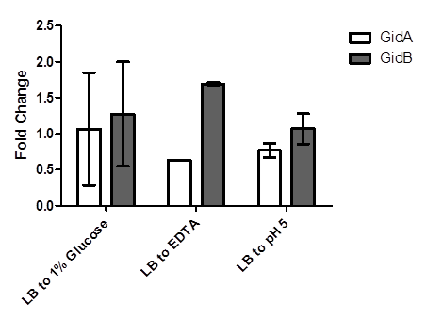
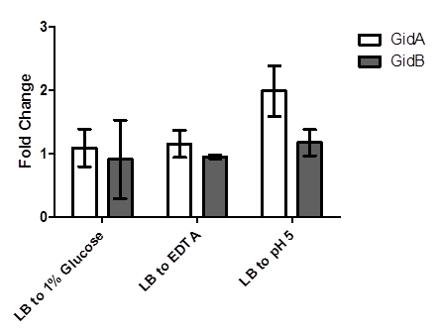
No significant difference in gidA and gidB expression at transcriptional level using real-time RT-PCR

Slide 18
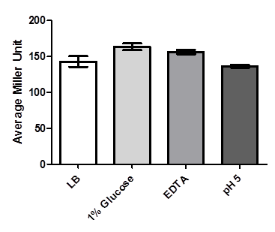
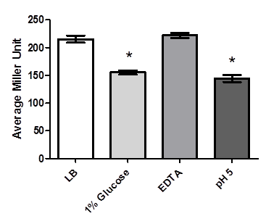
The lacZ assay indicated no significant gidA promoter activity (left), while asnC promoter (right) showed a significant decrease in activity in media supplemented with 1% glucose and under acidic pH 5.

Slide 19
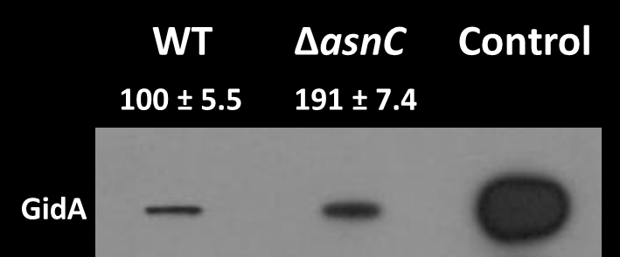
GidA Expression in Salmonella Grown Under Different Conditions
WT Salmonella
100 ± 1.0
LB
179 ± 3.8
LB + 1% glucose
138 ± 5.4
LB + 100 µM EDTA
Deletion of Salmonella asnC increased GidA Expression
201 ± 15.7
LB pH 5

Slide 20
Virulence Assays under Growth Conditions
Motility
Cytotoxicity

Slide 21
Summary 2
Transcriptional analysis, using real-time RT-PCR, indicated no significant difference in gidA expression under various conditions.
No gidA promoter activity, asnC promoter showed decreased activity under glucose and acidic pH.
Significance increase in GidA protein expression under different conditions and when asnC deleted.
Suggested that GidA expression is modulated by environmental condition and by the AsnC mostly at post-transcriptional level

Slide 22
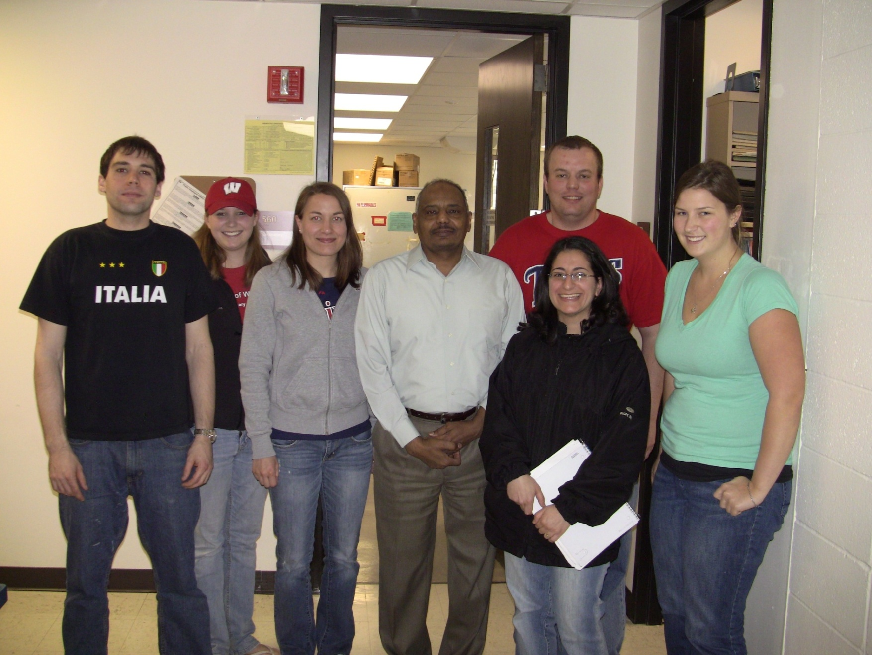
Acknowledgements
Dan
Katie
?
Jackie
Nick
Megan
Dareen

Slide 23
Acknowledgements (Collaborators)
Ralph Albrecht, Ph.D., Animal Sciences
Mark Cook, Ph.D., Animal Sciences
Philip Bochsler, DVM, Ph.D., WVDL
Ogi Okwumabua, Ph.D., WVDL
Richard Gourse, Ph.D., Bacteriology
Charles Lauhon, Ph.D., School of Pharmacy
Ashok Chopra, Ph.D., Microbiology & Immunology, UTMB

Slide 24
Thank you. Question…comment?

Slide 25
Post-transcriptional Modification of RNA: Effect on Biology and Virulence of Salmonella
Amin A. Fadl
University of Wisconsin-Madison

Slide 26
Background & Significance
Rate per 100,000 population
Campylobactor species
2010
Targets
Salmonella species
Listeria monocytogenes
Escherichia coli O157:H7
HUS*
Source: Foodborne Disease Active Surveillance Network (FoodNet)
Notes:
RIMA KHABBAZ (NCID): EXPERT ON FOODNET DATA (FoodNet covers 14% of U.S. population).
The bacterial pathogens targeted by HP2010 with the highest relative incidence during 1997-2003 were Campylobacter and Salmonella. Pathogens with lower incidence were E. coli O157:H7 and Listeria monocytogenes. Bacterial infections have been estimated to cause 30% of all foodborne disease. [Remainder is 3% by pathogens and 67% by viruses.]
Postdiarrheal hemolytic uremic syndrome (HUS) data have recently been obtained; the objective measure was developmental. HUS is a life-threatening syndrome caused by E. coli that is fairly distinctive among children, and surveillance efforts rely on recognition by physicians. Incidence rates will be tracked for children under 5.
Targets are set at 50% improvement.
Foodborne illnesses from viruses don’t usually result in a doctor visit; they are less severe. If they do result in a doctor visit, the doctor usually treats the symptoms and doesn’t report them to a lab. If they are reported to a lab, they are identified by a group other than the FoodNet group.
The data shown here are un-modeled (crude) data from FoodNet (AN ACTIVE DATA COLLECTION SYSTEM); we cannot base statements on trends using the crude data. The most recent MMWR discusses trends based on modeled data (accounting for increased number of FoodNet sites from 5 to 9 and variation in the incidence among sites). Modeling the FoodNet data started about 2 years ago and is still being tweaked.
April 30, 2004 MMWR article shows estimated incidence of E. coli O157 and Campylobacter have significant declines; Listeria not changing significantly. Salmonella is declining using modeled data, but not using our crude rates.

Slide 27
Background & Significance
 | Cases | %
Overall foodborne illness | 76,000,000
Bacterial foodborne illness | 4,200,000 | 5.5
Foodborne salmonellosis | 1,400,000 | 1.7
salmonellosis from SE | 194,408 | 0.25
Egg association: 40 to 80% | 77,000- 155,000 | < 0.20
Out of 1.4 million cases of salmonellosis, 95% (1.3 million) associated with food; 20% (234,000) from SE (about 75% associated with eggs).
* Cost $23 billion (Salmonella $2.65 billion)
CDC, 2002
Notes:
In 1998, there were 1.4 million cases of salmonellosis in the U.S.
Ninety five percent, 1.3 million, are thought to be associated with food
Eighteen percent, or 234,000, are from SE
Health officials believe that about 75% are associated with eggs

Slide 28
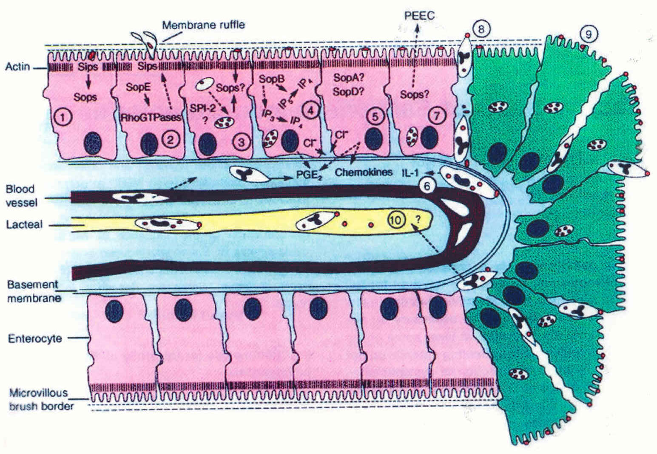
Pathogenic mechanisms associated with Salmonella infections
(Wallis and Galyov, 2000)

Slide 29
Altered genes/proteins expression of factors associated in cell division in the gidA mutant compared to the WT
WT
GidA
100
100
±
±
5.7
5.7
63
63
±
±
2.1
2.1
MreB
Gene Name | Gene # | Microarray FC | RT-PCR FC
mreB | STM3374 | -2.54 | -2.27
recX | STM2828 | -2.34 | -5.28
mukB | STM0994 | 2.10 | 3.46
parB | PSLT053 | 5.45 | 5.08
parA | PSLT052 | 7.07 | 18.64
xerC | STM3949 | 2.08 | 9.56
yhbC | STM3288 | -2.35 | -2.43
- | STM1015 | 3.91 | 7.62
- | STM2626 | 3.79 | 3.00
100
100
±
±
0.6
0.6
66
66
±
±
1.5
1.5
RecX
100
100
±
±
8.6
8.6
115
115
±
±
1.4
1.4
MukB
100
100
±
±
1.2
1.2
135
135
±
±
1.7
1.7
ParB
100
100
±
±
1.4
1.4
461
461
±
±
2.1
2.1
ParA
Shippy et al, 2011

Slide 30
gidAB Operon
gidA-P
asnC-P
gidB
gidA
oriC
mioC
asnC
Contains gidA and gidB genes

Slide 31
Regulation of gidAB operon
gidB
gidA
mioC
asnC
gidA thought to be modulated by the AsnC

Slide 32
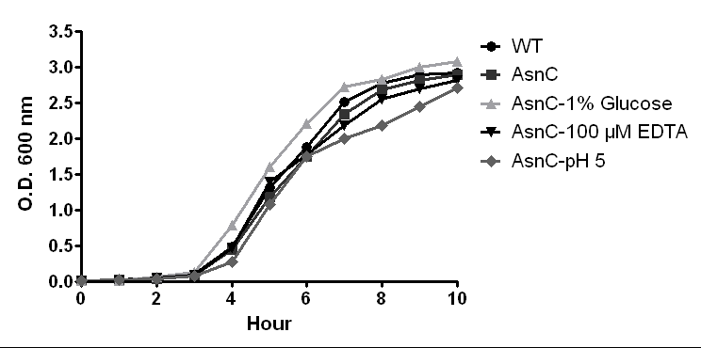
AsnC growth curve

Slide 33
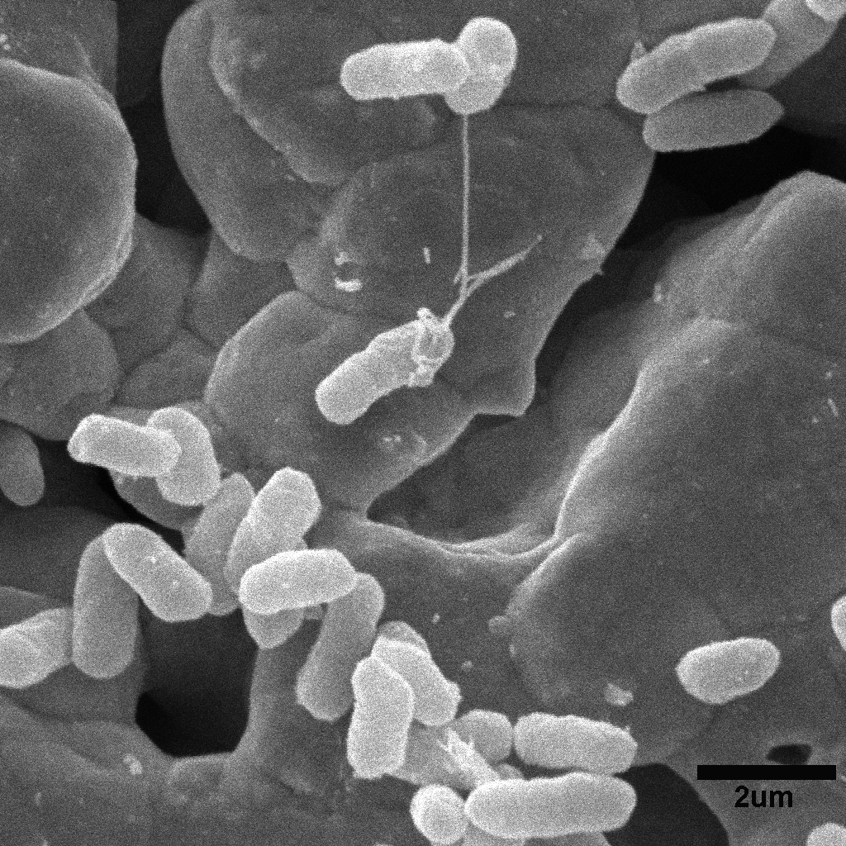
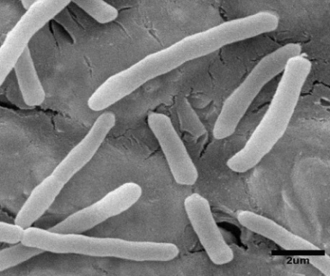
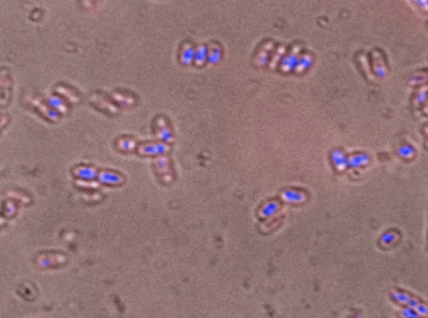
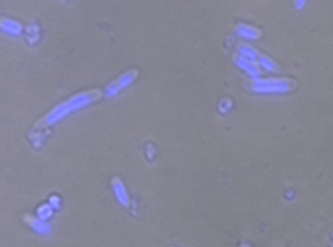
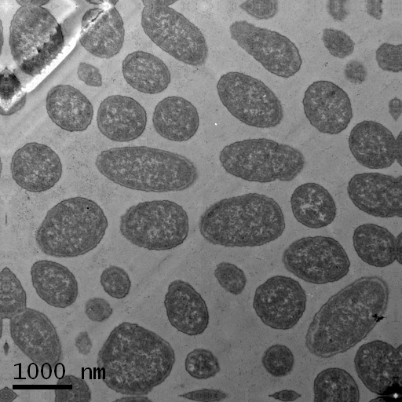
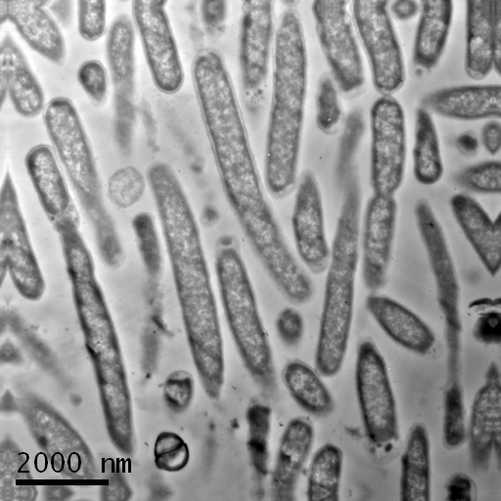
Mechanism of Filamentous Morphology
WT GidA
The majority of the gidA mutant cells appear to be one filament, with few signs of constriction.
A
The gidA mutant displaying a filamentous morphology with a defect in chromosome segregation.
B
defect in chromosome segregation causing a filamentous morphology in the gidA mutant compared to the normal rod-shaped WT.
C
Shippy et al, 2012

Slide 34
Summary
The gidA mutant displayed the following phenotypes:
-filamentous morphology
-impaired motility, invasion of T84 intestinal epithelial cells, cytotoxicity, limited replication in macrophages
Transcriptome and proteome analyses showed significant alterations in genes/proteins encoding for factors involved in Salmonella pathogenesis, indicating regulatory role
The gidA mutant was attenuated in mice and animals immunized with gidA mutant protected from lethal dose of WT Salmonella

Slide 35
Th1/Th2 immune response

Slide 36
Deletion of Salmonella asnC increased GidA Expression
WT
∆asnC
Control
100 ± 5.5
191 ± 7.4
GidA
WT-14028 versus asnC mutant for GidA expression levels

Slide 37
Background & Significance
Model organism to study bacterial genetics and virulence.
Major cause of food-borne diseases (poultry, meat, dairy products), use as an indicator of how safe a country’s food supplies are
Multiple antibiotic-resistance strains: use in animal feed
FDA report: half of livestock and poultry feed meals and 16% of complete feeds contaminated with Salmonella

Slide 38
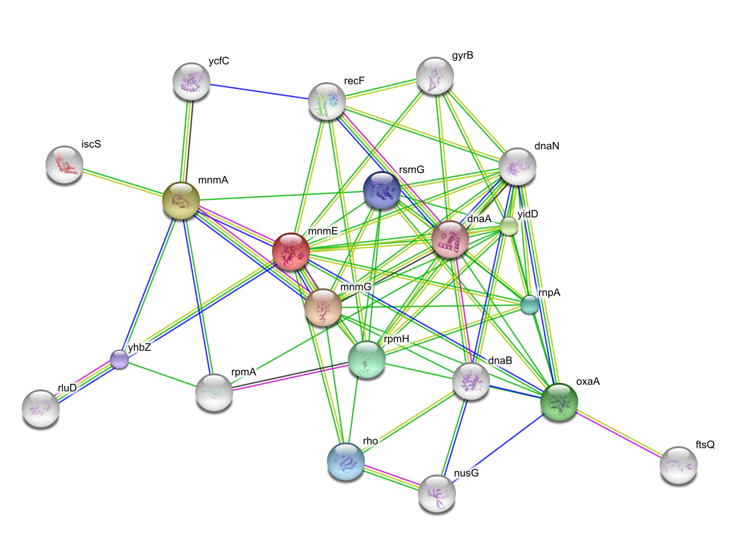
Predicted regulatory & functional association for GidA
(STRING 8.3 software, Jensen et al, 2009)

Slide 39
Effects on Biology & Virulence
Morphological changes in Aeromonas and E. coli (filamentous), Proteus mirabilis & Myxococcus (colonial).
Identified to modulate potent virulence factors: Aeromonas cytotoxic enterotoxin (Act), quorum sensing (RhlR expression ) in Pseudomonas, inhibition of SpeB protease expression in S. pygenes, Shigella flexneri altered transcription regulator VirF

