Slide 1
About OMICS Group
OMICS Group International is an amalgamation of Open Access publications and worldwide international science conferences and events. Established in the year 2007 with the sole aim of making the information on Sciences and technology ‘Open Access’, OMICS Group publishes 400 online open access scholarly journals in all aspects of Science, Engineering, Management and Technology journals. OMICS Group has been instrumental in taking the knowledge on Science & technology to the doorsteps of ordinary men and women. Research Scholars, Students, Libraries, Educational Institutions, Research centers and the industry are main stakeholders that benefitted greatly from this knowledge dissemination. OMICS Group also organizes 300 International conferences annually across the globe, where knowledge transfer takes place through debates, round table discussions, poster presentations, workshops, symposia and exhibitions.

Slide 2
About OMICS Group Conferences
OMICS Group International is a pioneer and leading science event organizer, which publishes around 400 open access journals and conducts over 300 Medical, Clinical, Engineering, Life Sciences, Phrama scientific conferences all over the globe annually with the support of more than 1000 scientific associations and 30,000 editorial board members and 3.5 million followers to its credit.
OMICS Group has organized 500 conferences, workshops and national symposiums across the major cities including San Francisco, Las Vegas, San Antonio, Omaha, Orlando, Raleigh, Santa Clara, Chicago, Philadelphia, Baltimore, United Kingdom, Valencia, Dubai, Beijing, Hyderabad, Bengaluru and Mumbai.

Slide 3
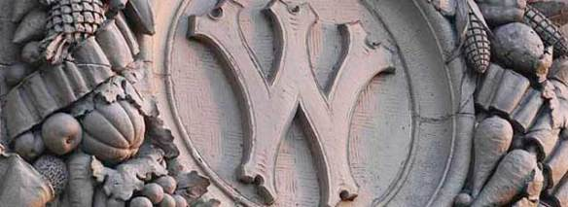
Biological and Pathogenic Regulatory Role of Salmonella gidAB Operon
Amin Fadl
University of Wisconsin-Madison

Slide 4
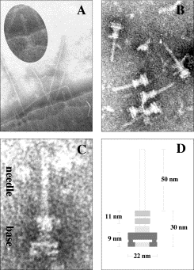
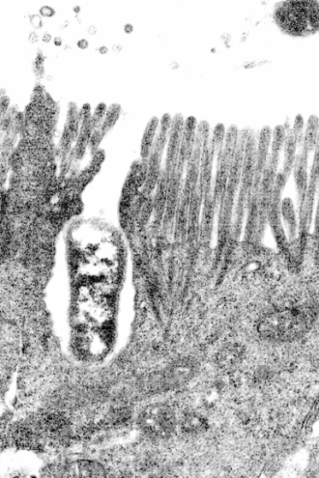
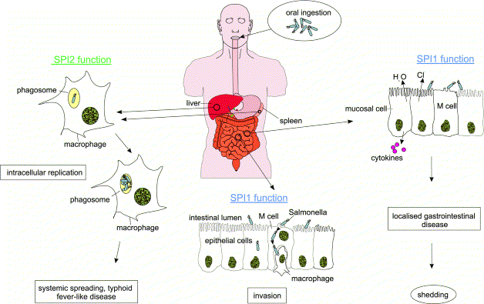
Pathogenesis
Hensel et al, 2001

Slide 5
Salmonella gidAB operon
Glucose-inhibited division gene (GidA, MnmG), methylaminomethyl (MnmE), Ribosomal Small Subunit Methyltransferase (RsmG, GidB)
tRNAs are key molecules of translational machinery that ensure decoding of successive codons in mRNA inside the ribosome
Post-transcriptional tRNA modification is found in all organisms and is required for tRNA functions, control gene expression

Slide 6
GidAB Mutant
The gidA mutant attenuated in vitro and in animals
Immunization with the gidA mutant protected mice from a lethal dose of WT Salmonella by Th1/Th2 mechanism
GidA modulates several pathogenic factors
GidA complex with MnmE to modify tRNA and regulate virulence
GidB catalyses the methylation of 16S rRNA in bacteria, a binding sites for aminoglycosides

Slide 7
Salmonella & Stress Response
Required for response to adverse conditions and survival
Closely associated with virulence gene expression
Overcome external environment, food matrices and host environment such as ability to survive inside macrophages
Regulated by genes/proteins network

Slide 8
Objectives
Investigate the role of gidAB operon in stress response, overall effect on Salmonella virulence and mechanism of regulation

Slide 9
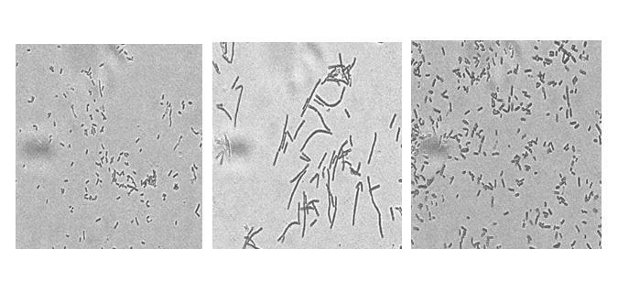
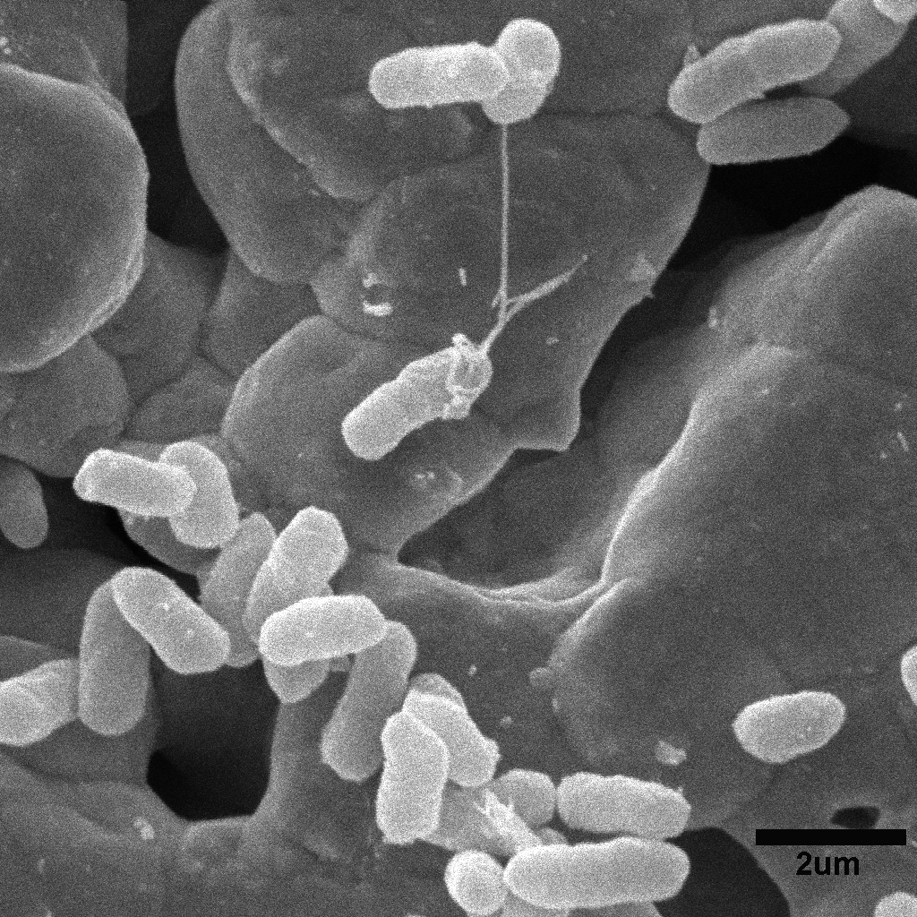
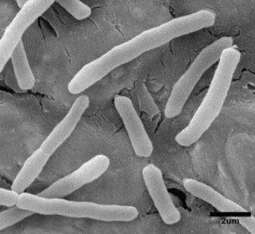
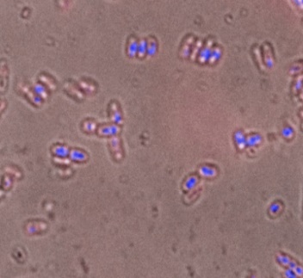
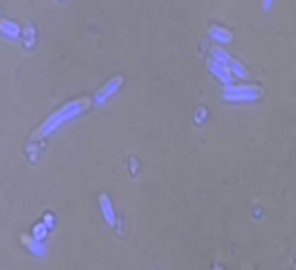
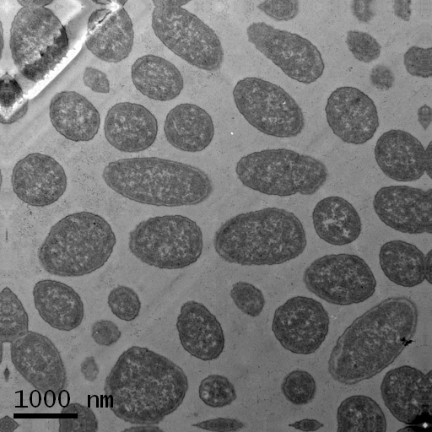
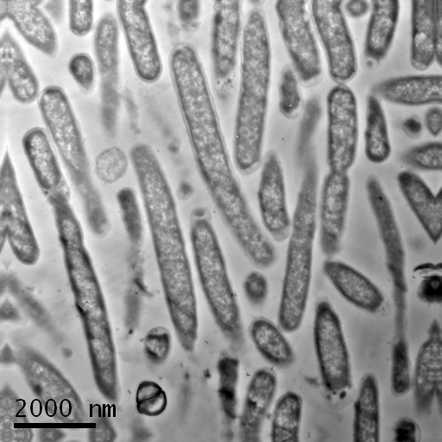
GidA mutant: filamentous morphology specially under stress conditions
filaments with few signs of constriction.
A
The gidA mutant: defect in chromosome segregation.
B
defect in chromosome segregation
C

Slide 10
GidA mutant: defective in intracellular & systemic replication
Cultured macrophages
Mice

Slide 11
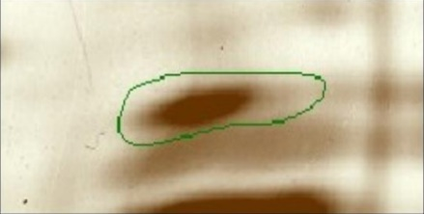
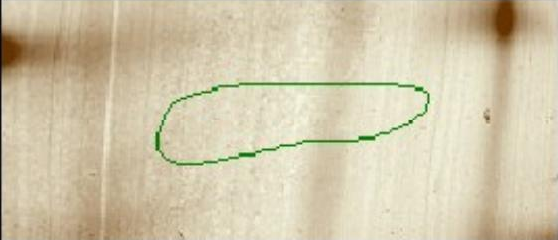
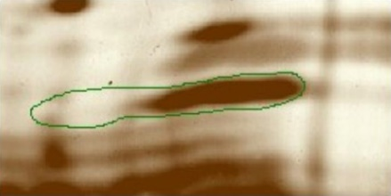
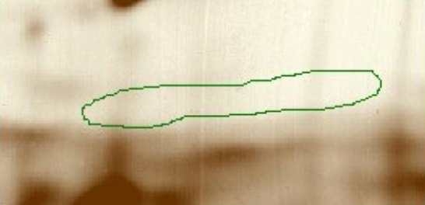
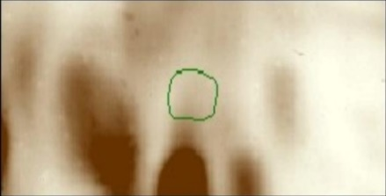
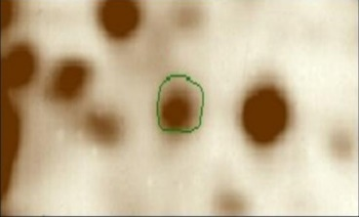
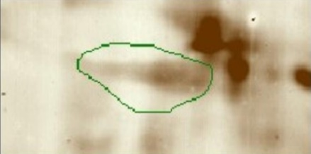
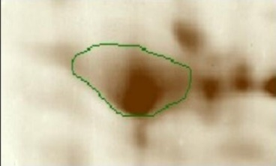
Transcriptome and proteome analyses of gidA mutant
WT GidA
Gene Name | Gene # | Microarray FC | RT-PCR FC
spaP | STM2890 | -9.61 | -10.85
prgJ | STM2872 | -4.36 | -9.85
fepE | STM0589 | 4.53 | 4.54
hscC | STM0659 | 3.78 | 2.63
yhjC | STM3607 | 4.22 | 2.46
ssaN | STM1415 | 2.96 | 4.59
yebK | STM1887 | 2.86 | 2.36
invF | STM2899 | -11.79 | -9.83
invE | STM2897 | -12.20 | -7.57
motA | STM1923 | -5.05 | -2.09
spaQ | STM2889 | -9.49 | -3.50
invA | STM2896 | -10.21 | -2.16
prgH | STM2874 | -6.86 | -3.82
fliD | STM1960 | -4.79 | -4.26
fliC | STM1959 | -5.64 | -14.89
cheW | STM1920 | -8.71 | -4.86
mukB | STM0994 | 2.10 | 3.46
mreB | STM3374 | -2.54 | -2.27
parA | PSLT052 | 7.07 | 18.64
parB | PSLT053 | 5.45 | 5.08
Identified stress related proteins including YghA (an oxidoreductase help Salmonella survive inside macrophages), Tpx (a thiol peroxidase, help Salmonella survive within macrophages), tpx (H₂O₂ survival)
Down-regulation in stress related genes including heat-shock proteins (e.g. hscC)

Slide 12
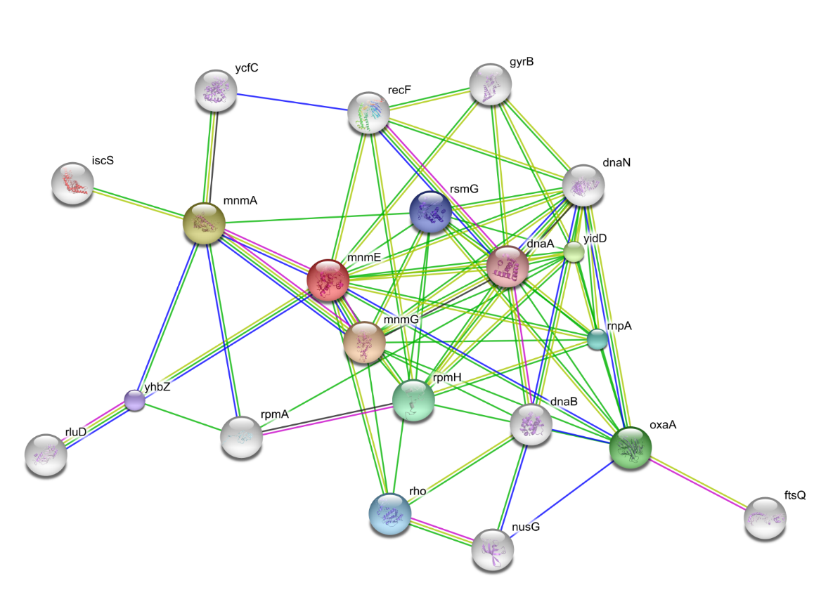
Predicted functional association for GidA mutant with other proteins using STRING 8.3 software (Jensen et al, 2009)
GidA interacts with proteins involved in stress response and replication (e.g. DnaA, DnaN, YhbZ, GyrB) and RNA modification enzymes (MnmE, MnmA, and RsmG).

Slide 13
Deletion of gidB altered colony and cellular morphology under stress conditions
WT ∆gidB gidB compl.
WT ∆gidB gidB compl.
-Nal
-Nal
+Nal
+Nal

Slide 14
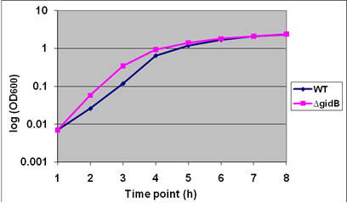
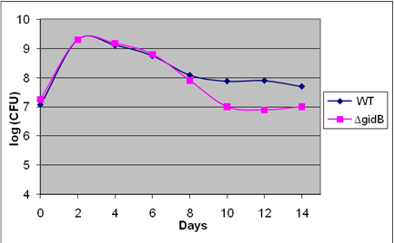
Deletion of gidB decreased survival and motility under stress
WT ∆gidB gidB complement
+Nal

Slide 15
GidB Mutant Phenotype Microarray: stress, antibiotic susceptibility
∆gidB was resistant to many antimicrobial agents such as amoxicillin, cloxacillin, and polymyxin B
Differential phenotypes for gidB mutant: utilization of carbon, nitrogen, phosphorus, or sulfar sources, compared to WT Salmonella

Slide 16
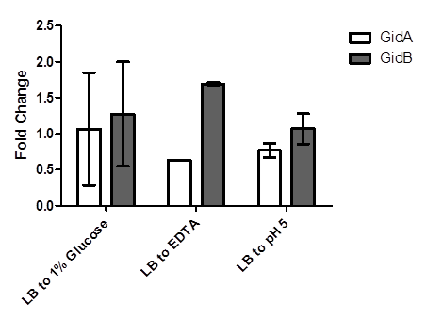
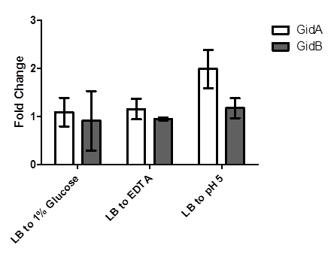
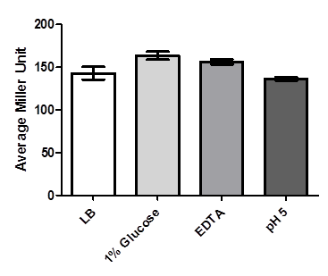
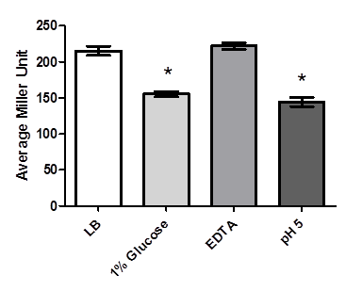
How gidAB operon is regulated?
Increased filamentation under high glucose
Bioinformatic indicated AsnC as potential regulator and showed two promoters

Slide 17
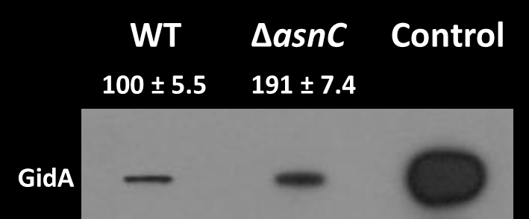
How gidAB operon is regulated?
WT Salmonella
100 ± 1.0
LB
179 ± 3.8
LB + 1% glucose
138 ± 5.4
LB + 100 µM EDTA
201 ± 15.7
LB pH 5
Cytotoxicity
Motility
AsnC mutant

Slide 18
Summary
Deletion of gidA rendered Salmonella defective in survival and replication inside macrophages and animal host. Phenotype associated with down-regulation in genes/proteins required for survival and stress response.
GidB mutant showed filamentation, smaller size colonies, and reduced motility in the presence under stress conditions, compared to the WT
Competitive growth assay: deletion of gidB significantly affected overall fitness of Salmonella under limited nutrient conditions.
GidA expression is regulated by environmental conditions and the AsnC at post-transcriptional level
GidAB operon play important role for survival under stressful conditions

Slide 19
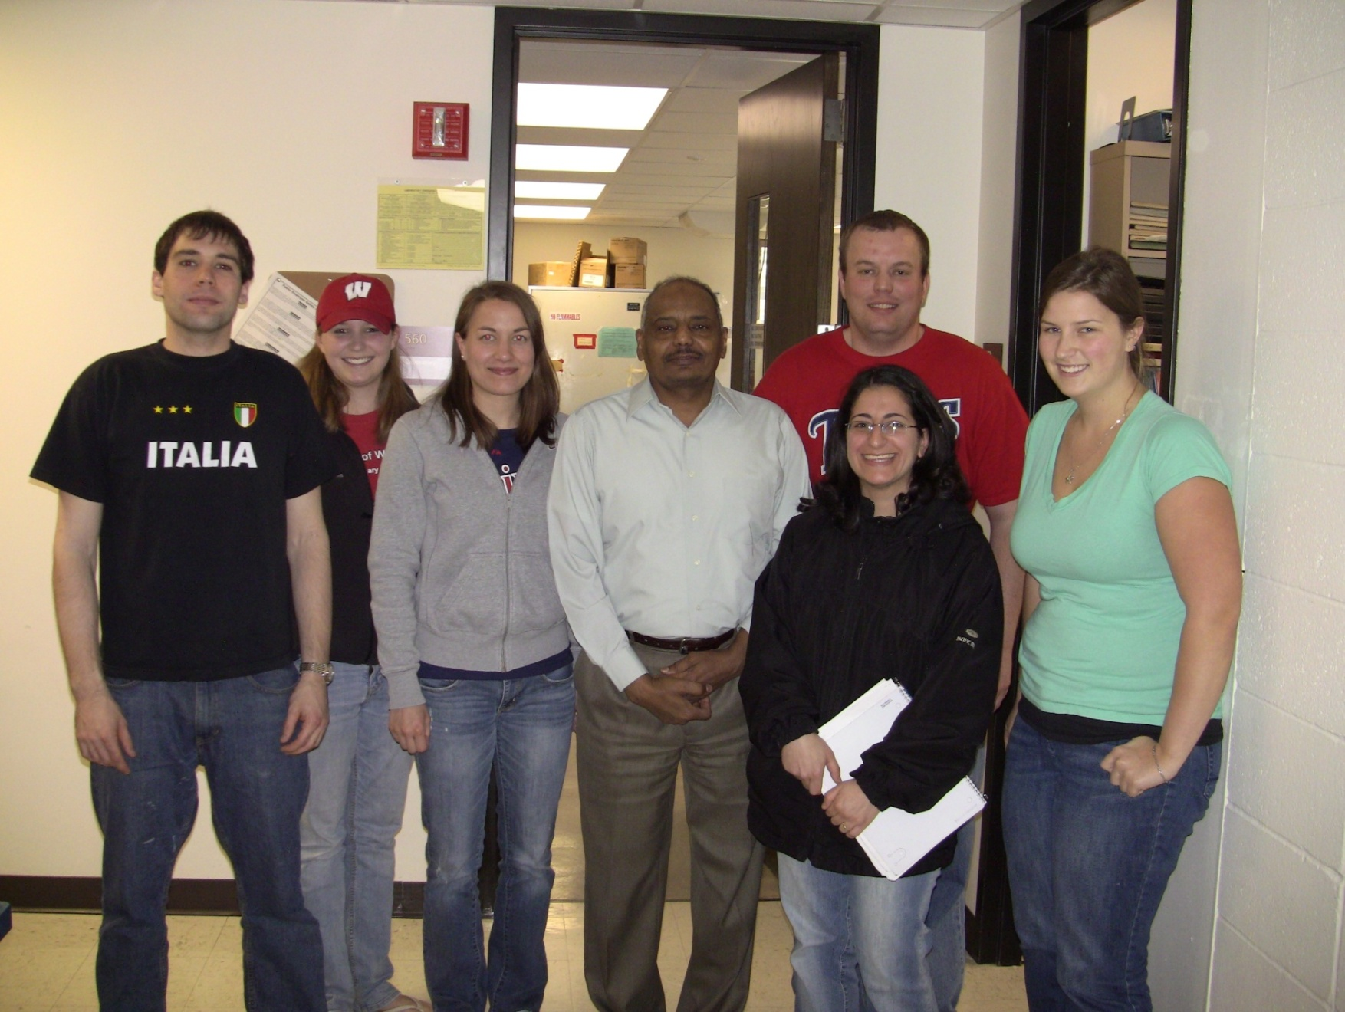
Acknowledgements
Alexis
Dan
Katie
?
Jackie
Nick
Megan
Dareen

Slide 20
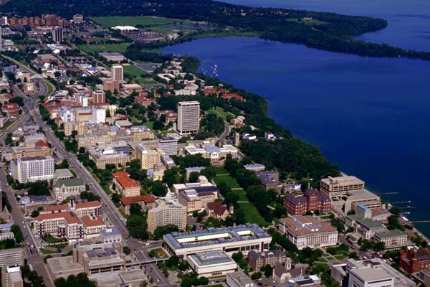
Thank you. Question…comment?

Slide 21
Why Salmonella
 | Cases | %
Overall foodborne illness | 76,000,000
Bacterial foodborne illness | 4,200,000 | 5.5
Foodborne salmonellosis | 1,400,000 | 1.7
salmonellosis from SE | 194,408 | 0.25
Egg association: 40 to 80% | 77,000- 155,000 | < 0.20
Out of 1.4 million cases of salmonellosis, 95% (1.3 million) associated with food; 20% (234,000) from SE (about 75% associated with eggs).
* Cost $23 billion (Salmonella $2.65 billion)
CDC, 2002
Notes:
In 1998, there were 1.4 million cases of salmonellosis in the U.S.
Ninety five percent, 1.3 million, are thought to be associated with food
Eighteen percent, or 234,000, are from SE
Health officials believe that about 75% are associated with eggs

Slide 22
Significance
Rate per 100,000 population
Campylobactor species
2010
Targets
Salmonella species
Listeria monocytogenes
Escherichia coli O157:H7
HUS*
Source: Foodborne Disease Active Surveillance Network (FoodNet)
Notes:
RIMA KHABBAZ (NCID): EXPERT ON FOODNET DATA (FoodNet covers 14% of U.S. population).
The bacterial pathogens targeted by HP2010 with the highest relative incidence during 1997-2003 were Campylobacter and Salmonella. Pathogens with lower incidence were E. coli O157:H7 and Listeria monocytogenes. Bacterial infections have been estimated to cause 30% of all foodborne disease. [Remainder is 3% by pathogens and 67% by viruses.]
Postdiarrheal hemolytic uremic syndrome (HUS) data have recently been obtained; the objective measure was developmental. HUS is a life-threatening syndrome caused by E. coli that is fairly distinctive among children, and surveillance efforts rely on recognition by physicians. Incidence rates will be tracked for children under 5.
Targets are set at 50% improvement.
Foodborne illnesses from viruses don’t usually result in a doctor visit; they are less severe. If they do result in a doctor visit, the doctor usually treats the symptoms and doesn’t report them to a lab. If they are reported to a lab, they are identified by a group other than the FoodNet group.
The data shown here are un-modeled (crude) data from FoodNet (AN ACTIVE DATA COLLECTION SYSTEM); we cannot base statements on trends using the crude data. The most recent MMWR discusses trends based on modeled data (accounting for increased number of FoodNet sites from 5 to 9 and variation in the incidence among sites). Modeling the FoodNet data started about 2 years ago and is still being tweaked.
April 30, 2004 MMWR article shows estimated incidence of E. coli O157 and Campylobacter have significant declines; Listeria not changing significantly. Salmonella is declining using modeled data, but not using our crude rates.

Slide 23
Significance
Major cause of food-borne diseases (poultry, meat, dairy products), use as an indicator of how safe a country’s food supplies are
Multiple antibiotic-resistance strains: use in animal feed
Model organism to study bacterial genetics and virulence

Slide 24
gidAB operon
gidB
gidA
mioC
asnC
GidB (RsmG) is an enzyme that catalyses the methylation of 16S rRNA in bacteria, a binding sites for aminoglycosides e.g. Streptomycin

Slide 25
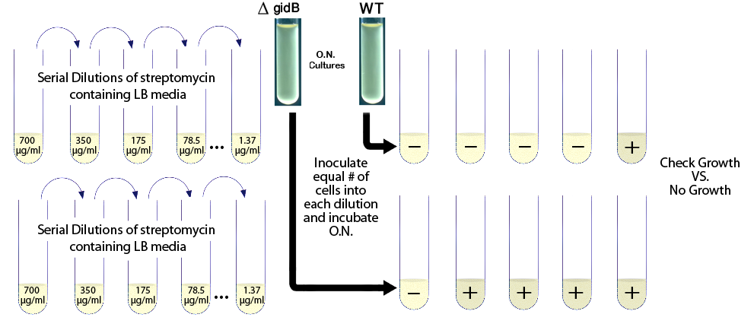
Deletion of gidB affects susceptibility of Salmonella to aminoglycosides
C526
 | WT | ∆gidB
Antibiotic | MIC (Sensitivity) | MIC (Sensitivity)
Florfenicol | 4 (I) | 2 (S)
Neomycin | <=4 (S) | >32 (R)
Spectinomycin | 64 (R) | 32 (I)
Streptomycin | 16 (R) | 128 (R)

Slide 26
Current and Future Work
Role of gidAB & mechanism in systemic infection and survival in food matrices and animal hosts
Examine effect of GidB on ribosomal function and effects on antibiotic resistance in Salmonella
Role of GidB in stress response & metabolic pathways as suggested by the PM

Slide 27
Let Us Meet Again
We welcome you all to our future conferences of OMICS Group International
Please Visit: www.omicsgroup.com
www.conferenceseries.com

