Slide 1
The Forgotten Disease
Dr. Amera Elzubeir- University Hospital Birmingham.

Slide 2
The case-1900hrs
Master AD
18 year old male
1st week at university
PC: Generally unwell
HPC: Tonsillitis 5/7 ago
D&V
Fever & Rigors
Pleuritic chest pain, cough & sputum
PMHx/DHx- Nil

Slide 3
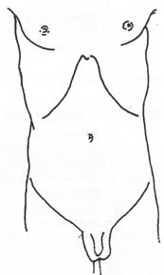
On Examination
A- Patent
B- Peripherally cyanosed
RR- 30
Sats-75% RA
Auscultation- reduced A/E & crepitations
Rt Base
C- HR-110
BP- 95/42
CRT <2sec, warm
HS-I-II-O
Good urine output
D-GCS 15
E-Calves SNT, No Rash, 40.2°
Soft
++central tenderness
BS-Present
No masses

Slide 4
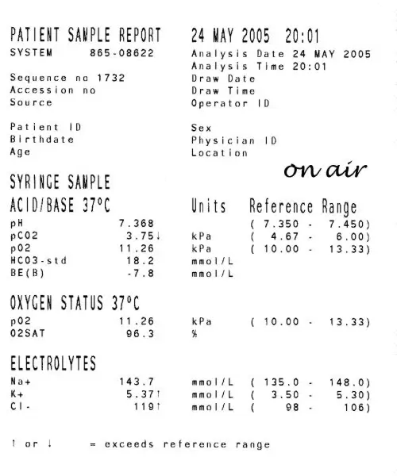
Investigations
ABG on 35%- pH-7.47
p02-11.66
pCO2- 3.65
HCO3- 22.5
Lactate-2.01
ECG- Sinus tachycardia

Slide 5
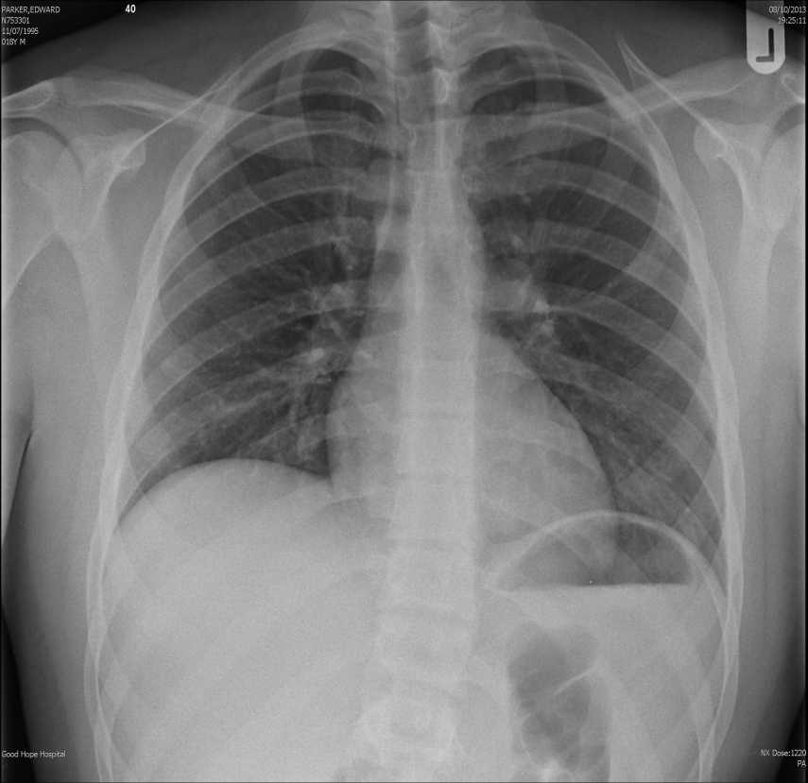
Investigations

Slide 6
Blood Results-2000hr
Na 129
K 4.1
Urea 14.7
Creatinine 133
GFR 64
Albumin 28
ALT 38
ALP 184
Bilirubin 13
Corrected Ca 2.3
CRP 302
WCC 21.81
Neutrophils 18.70
Monocytes 1.67
Lymphocyte 1.25

Slide 7
Current problems
1. Probable CAP
2. Type 1 Respiratory Failure
3. AKI

Slide 8
Investigations pending-2200hrs
HIV
Atypical serology
Urinary leigonella and pneumococcal
Viral studies
Throat swab
Blood cultures
Sputum MC&S
Amylase

Slide 9
Treatment
IV benzylpenicillin and clarithromycin
IV Fluids
Analgesia
Antipyretics

Slide 10
43hrs post admission
Patient improving
Preliminary blood cultures- gram variable cocci and gram positive rods
Tx- IV Tazocin and oral clarithromycin

Slide 11
67 hrs post admission
Patient improved further
Further micro input-Anaerobes ? Pharyngeal source
Tx- IV tazocin & oral clarithromycin under micro advice

Slide 12
72hrs post admission
Reg on call ASTP RE: spiking temperature
Appearance of maculopapular rash
? EBV

Slide 13
Investigations day 6
EBV POSITIVE
HIV NEGATIVE

Slide 14
Day 6 ward round
Patient much improved
Apyrexial for 48hrs
No rash
Pain free
Throat still ++ hyperaemic
PLAN- Repeat CXR

Slide 15
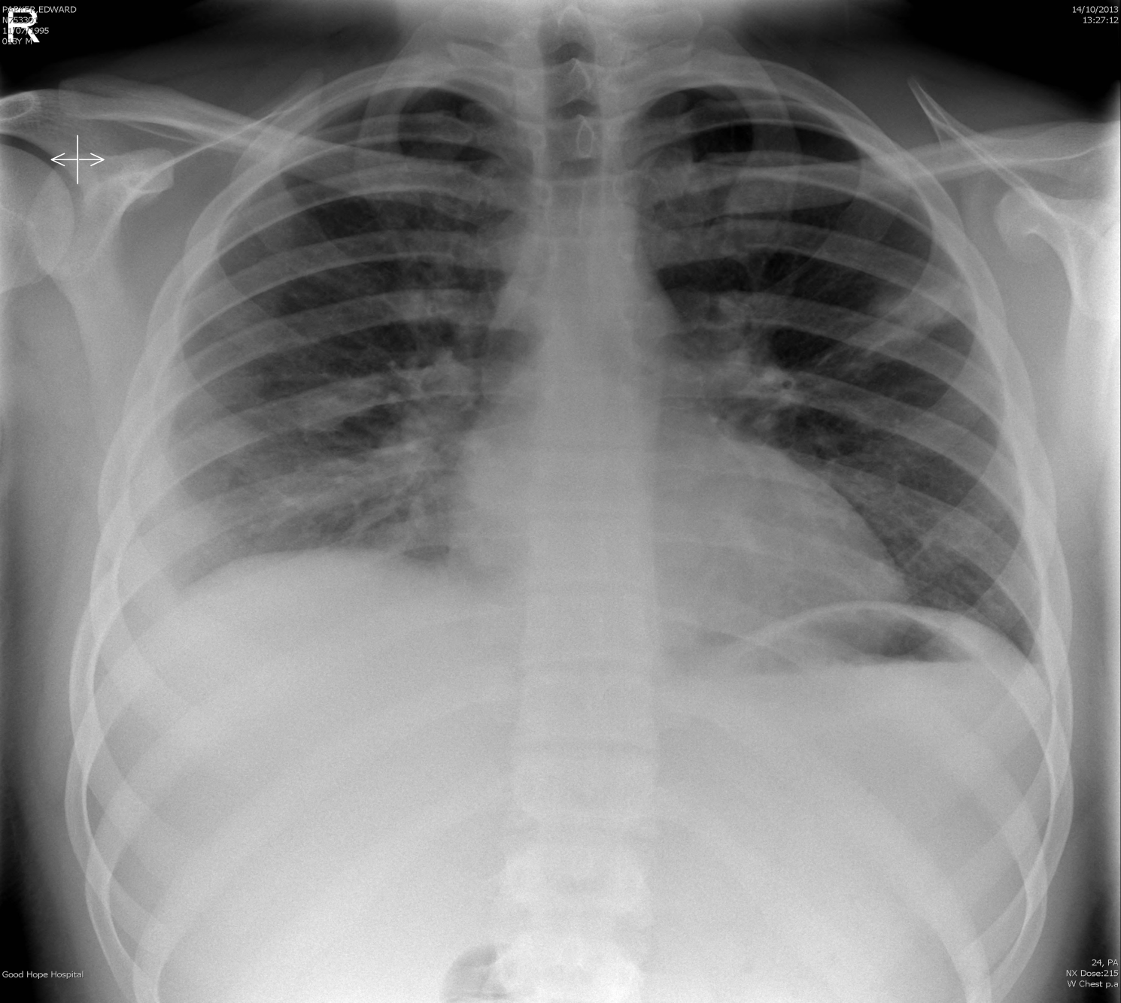
Repeat CXR

Slide 16
Another phone call from Micro
Blood cultures grown:
1. FUSOBACTERIUM NECHROPHORUM

Slide 17
Fusobacterium Necrophrum
Anaerobic gram negative bacilli
First described as a pathogen in animals
First described in 1900 by Courmont & Cade- post anginal septicemia
Andre Lemierre, 1936- published 20 case reports of a syndrome.
“syndrome is so characteristic that a mistake is almost impossible”.

Slide 18
Lemierres Syndrome
Aka Post anginal septicemia or necrobacillosis.
Rare
Mortality rate- 8 to 30%
M>F
A syndrome characterised by:
Oropharyngeal infection
Anaerobic septicemia
Clinical/radiological evidence of internal jugular vein thrombosis

Slide 19
Fusobacterium Necrophurm
Normal inhabitant of-oral cavity, genital tract, GI tract.
Most virulent
Common in pre-antibiotic era & usually fatal.
Substantial decrease-1940.
Resurgence since late 1990.

Slide 20
Unusual ability to affect previously healthy young adults humans
F.
NECROPHORUM
LPS Endotoxin
Platelet aggregation
TONSILS
Lateral pharyngeal space
Posterior compartment
Aetiology
Septic emboli
Metastatic
infections
IJV THROMBO-PHLEBITIS

Slide 21
Pathogenesis
Reason why F. Necrophum becomes invasive is unknown
? EBV as risk factor
? Enhancement of toxins

Slide 22
Clinical presentation
Nil Oropharyngeal
Hyperaemic pharynx
Tonsillitis
IJV/peritonsilar vein thrombophlebitis
Local signs - Pain
- Swelling
- Induration
- Trismus
Persistent fever
Septic/metastatic emboli
-Lungs
-Bone
-Liver/spleen
-Brain
-Skin

Slide 23
Diagnosis
Causative organism isolated.
Suspicion of IJV thrombophlebitis must be objectively confirmed.
CT Neck + contrast
U/S

Slide 24
Treatment
IV antibiotics as mainstay
Prolonged-due to endovascular nature
Sensitive to: metronidazole, penicillin, clindamycin & chloramphenicol
Some strains produce Beta-lactamase.
Role of anticoagulation is controversial.
Surgical or excision of IJV-rarely needed.

Slide 25
Our patient-Lemierres syndrome
A syndrome characterised by:
Oropharyngeal infection
Anaerobic septicemia
Clinical/radiological evidence of internal jugular vein thrombosis

Slide 26
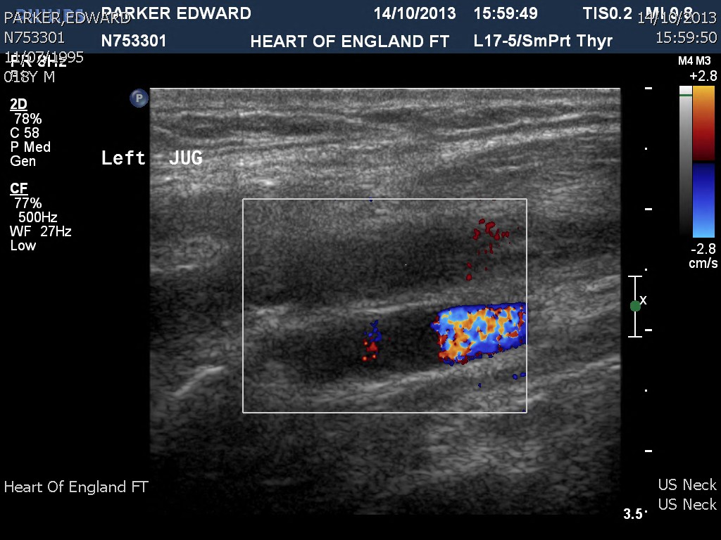
Ultrasound Neck

Slide 27
CT Head & Neck

Slide 29
CT Report
“Thrombus seen in the Lt IJV, and extending towards the Lt tonsil”.
“Inflamed tonsils seen bilaterally, with pockets of gas seen within the tonsils-compatible with tonsillitis.”
“Small abscesses in upper chest which corresponds to septic emboli from the jugular lesion”.

Slide 30
Take home message
High index of suspicion
Blood cultures
Radiological/clinical confirmation of suspected IJV thrombosis
Prolonged treatment with IV antibiotics
Uncertain role of anticoagulation

Slide 32
References
Golpe R, Marin B, Alonso M. Lemierres syndrome (necrobacillosis). Postgrad Med J 1999, 75:141-144.
Lu et al. Lemierre syndrome following oropharygeal infection: A case series. J Am board of fam med 2009; 22:79-83.
Eilbert W, Singla N. Lemierres Syndrome. International journal of Emergency medicine 2013, 6:40-45.
Ridgway et al. Lemierre syndrome: a paediatric case series and review of the literature. Am J Otolaryngology- Head and neck medicine and surgery 2010;38-45.

