Slide 1
Non-Thermal Processing Technologies to Inactivate Foodborne Viruses
Alvin Lee, Ph.D.
Center Director / Associate Professor
Center for Processing Innovation
Institute for Food Safety and Health
Food Processing and Technology
Las Vegas, USA
July 2014

Slide 2
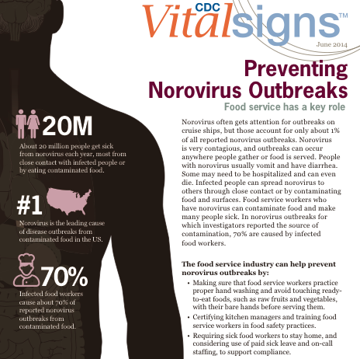
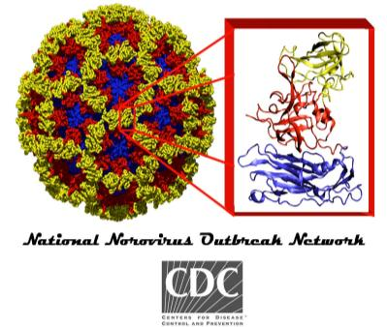
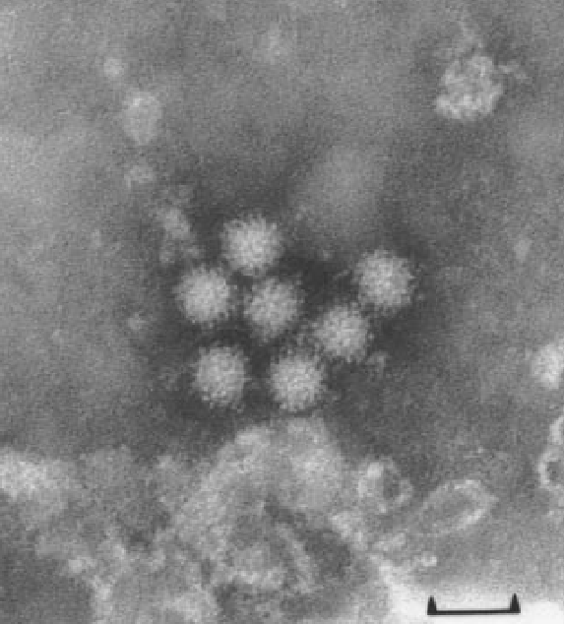
Norovirus
Transmission via human feces and vomit
  30 million virions shed in one vomiting episode
Infectious dose very low – 2-100 virions
Incubation period 24-40 hours
Symptoms: Nausea, vomiting, diarrhea, cramps, occasional headache and low-grade fever
Duration: 1-2 days
Notes:
2

Slide 3
Annual Burden of Norovirus Disease in the United States
800 Deaths
71,000 Hospitalizations
414,000 Emergency Dept Visits
1.7 million Outpatient Visits
21 million Episodes
Hall 2012 CID; Lopman 2011 CID; Gastañaduy 2012 EIS; Hall 2011 EID; Scallan 2011 EID

Slide 4
Foods Implicated* in Norovirus Outbreaks Reported to CDC by Commodity and Point of Contamination, 2001-2008
49% produce
Hall 2011 IAFP

Slide 5

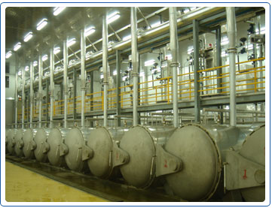
Intervention/Mitigation Strategies
Depuration and Relaying
High Powered Ultrasound
High Pressure Processing
Thermal/Heat – Cooking and Pasteurization
Non-thermal Plasma
Irradiation
Freezing
Drying
Pulsed Light including UV
Shockwaves

Slide 6
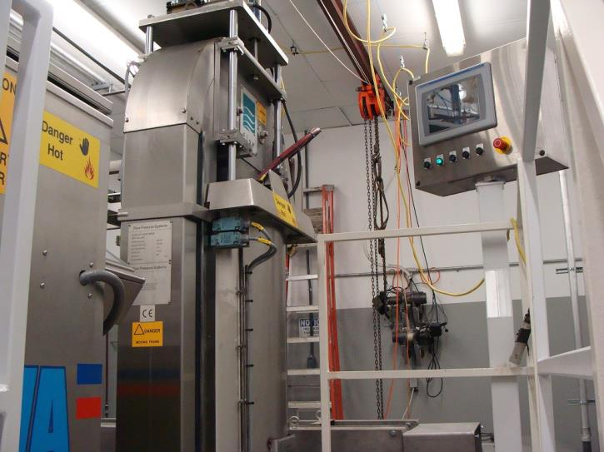
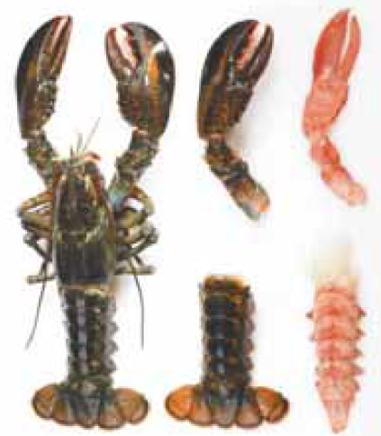
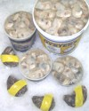
High Pressure
Processing (HPP)
24 L High Pressure Sterilization Unit
Max: 890 MPa @ 131˚C

Slide 7
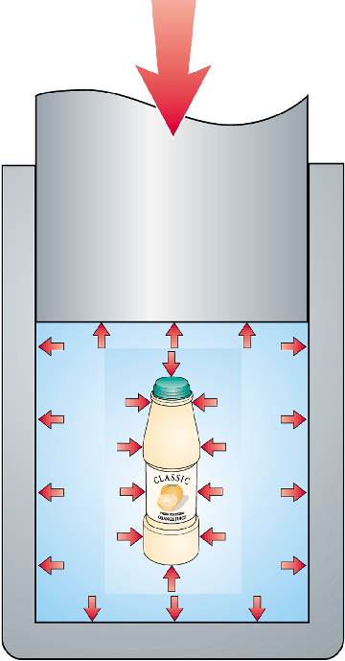
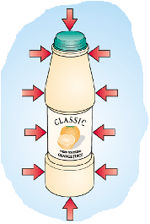
High Pressure Processing for Food Applications
-
-
-
-
200 elephants weighing 3000 kg each standing on a piston with a diameter of a CD, create a pressure of 600 MPa, 6000 bar or 90,000 psi
-
-
-
-
Size CD
-
-

Slide 8

Schematic diagram of a HPP system
Data acquisition computer
Top closure
Pressure chamber
Sample holder containing pre-packaged food
Temperature control jacket
Pressure-transmitting fluid
Bottom closure
High pressure intensifier/pump

Slide 9
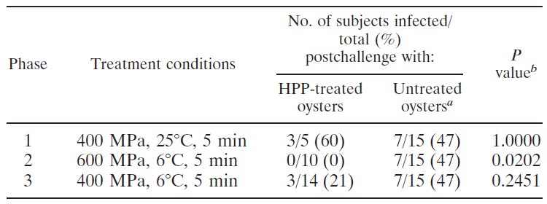
Distribution of study subject infection status among oyster treatment groups in a HPP challenge study
Leon et al., 2011, AEM (77) 5476-5482

Slide 10
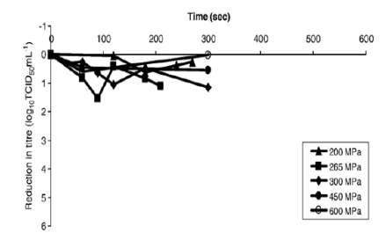
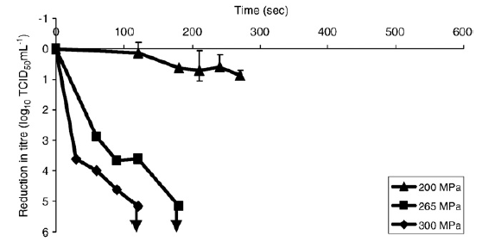
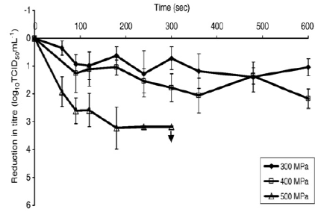
High Pressure Processing and Viruses
Poliovirus
Feline Calicivirus
Hepatitis A
Grove et al., 2008

Slide 11
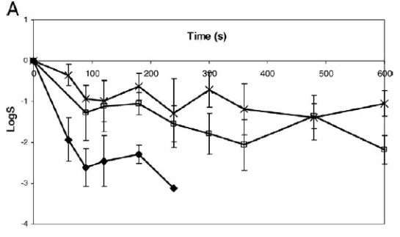
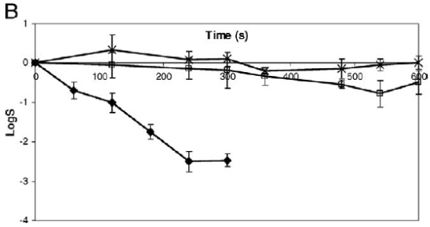
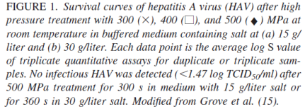
HPP and Hepatitis A in various salt
300, 400 & 500 MPa in 15 & 30 ppt salt
Grove et al., 2009

Slide 12
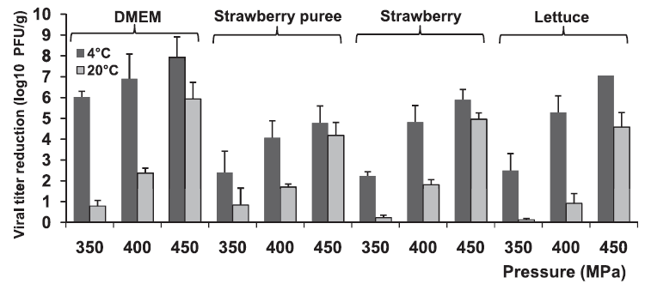
MNV-1 inactivation by HPP in various food matrices
Lou et al., 2011, AEM 77(1862-1871)
More at IAFP 2014, Indianapolis

Slide 13
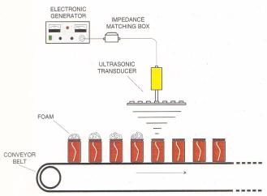
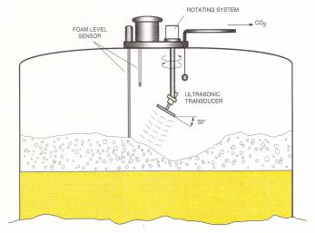
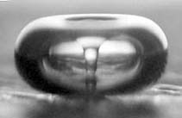
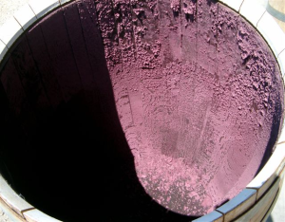
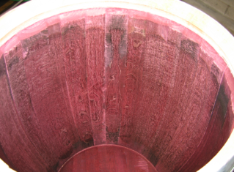
High Power Ultrasound

Slide 14
High-Power Ultrasound
Ultrasonic waves form bubbles via expansion and contraction
- Termed ‘Cavitation’
Temperature 5000 k (4700°C)
Pressure 2000 atm (30,000 PSI)
Frequency ~20 kHz
20 kHz
100 kHz
1 MHz
Acoustic
Low & High Power Ultrasound
High Frequency Ultrasound
Human hearing
Industrial & agricultural cleaning
Medical uses
Notes:
14
Frequency range gap?

Slide 15
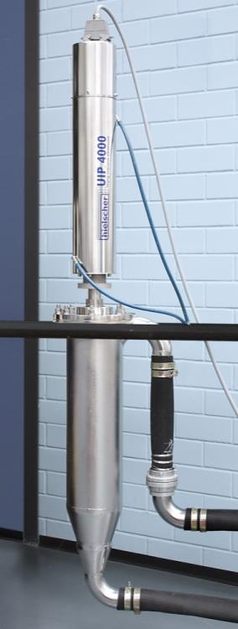
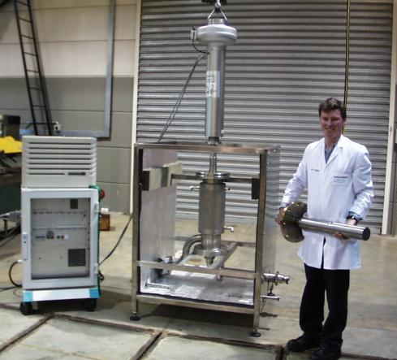
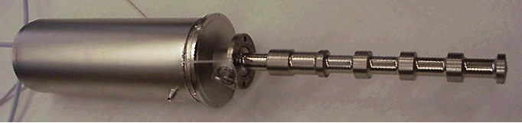
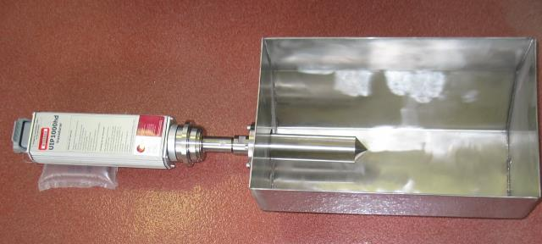
High Power Ultrasonic Transducer and Sonotrode

Slide 16
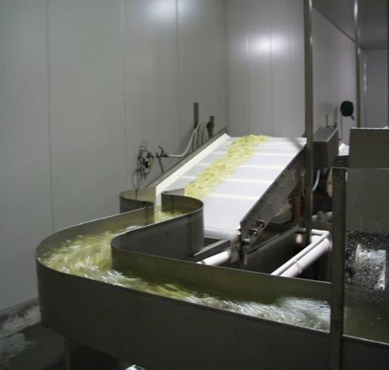
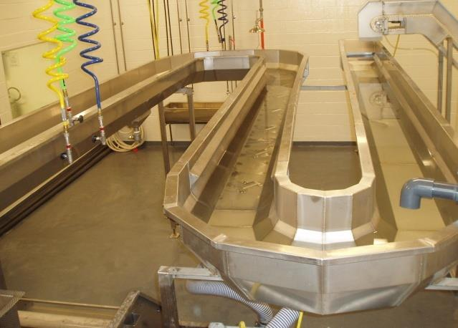
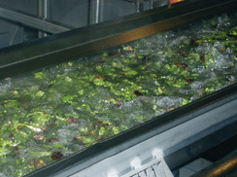
HPU and Produce Washing

Slide 17
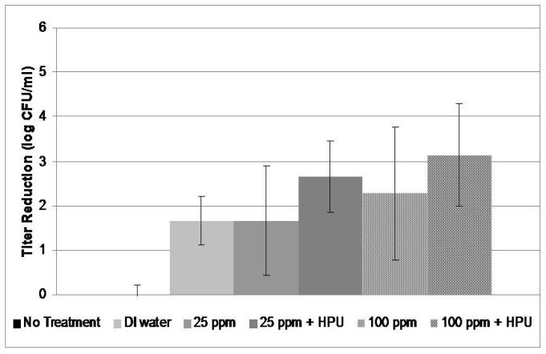
Chlorine with High Power Ultrasound on Murine Norovirus (MNV-1)
Liu, Grove and Lee, 2009

Slide 18
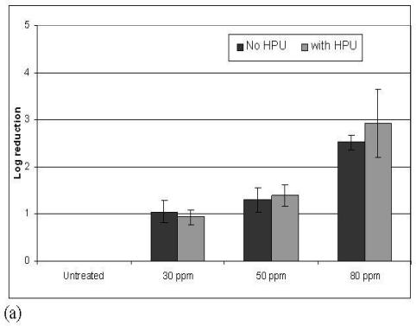
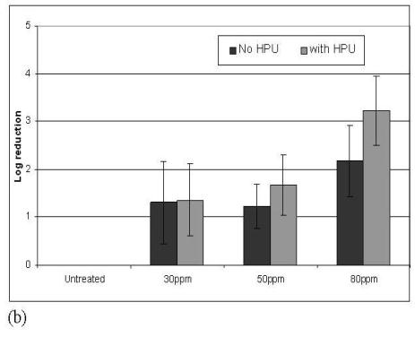
Sanitizers – POAA on MNV-1
Log reduction of MNV-1 washed from the surface of inoculated romaine lettuce leaves after treatment with peroxyacetic acid (POAA) alone or with additional high power ultrasound (HPU) at (a) 4°C or (b) 10°C.
Liu, Grove and Lee, 2009

Slide 19
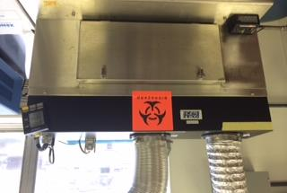
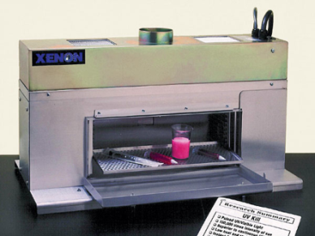
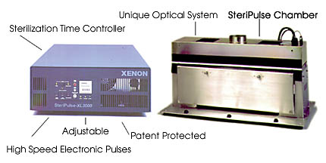
Pulsed Light
Pulsed light is a food processing method that involves the use of intense and short duration pulses of a broad spectrum.
Xenon Steripulse XL-3000TM pulsed light system
1.27J/cm², 3 pulses/second
Notes:
Spectrum C zoom in , talks about infrared camera and temperature increase
3 pulses/s
in 1996, when the Food and Drug Administration approved the use of PL technology for production, processing, and handling of foods.
UV (100–400 nm), visible light (400–700 nm), and infrared (700–1,100 nm).
Electromag- netic energy is accumulated in a capacitor during fractions of a second and then released in the form of light within a short time (nanoseconds to milliseconds), resulting in an amplification of power with a minimum of additional energy consumption (Dunn et al. 1995).

Slide 20
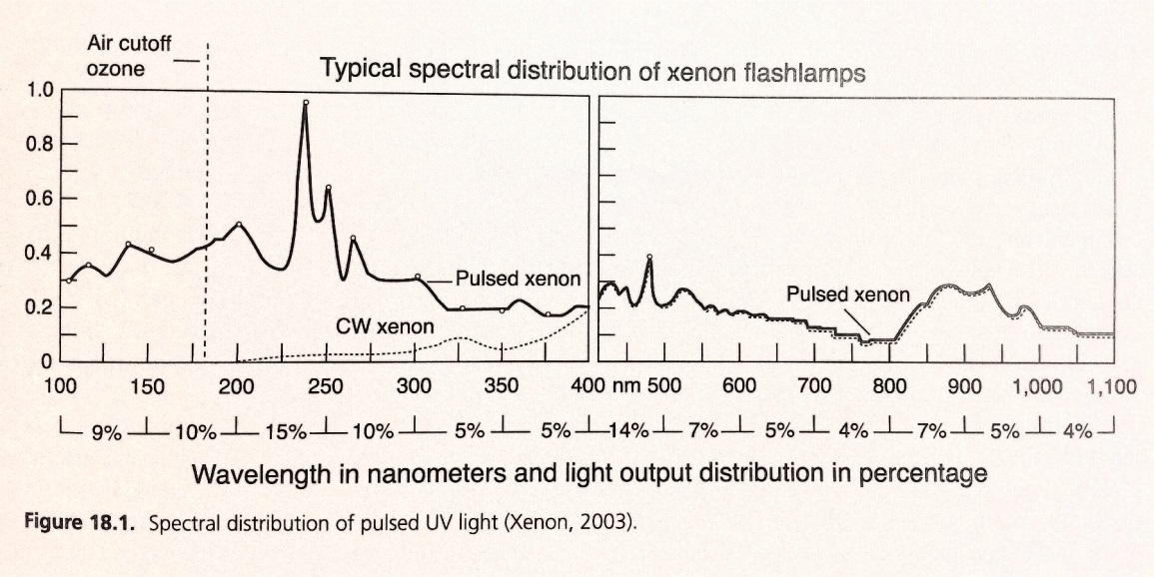
Pulsed Light
Broad spectrum(100-1000nm) includes 54%, 26% and 20% of the energy at UV light, visible, and infrared region, respectively.
Inactivation of pathogenic and spoilage microorganisms on foods and packages (surface)

Slide 21
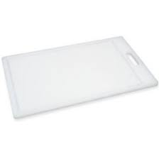
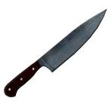
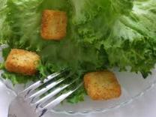
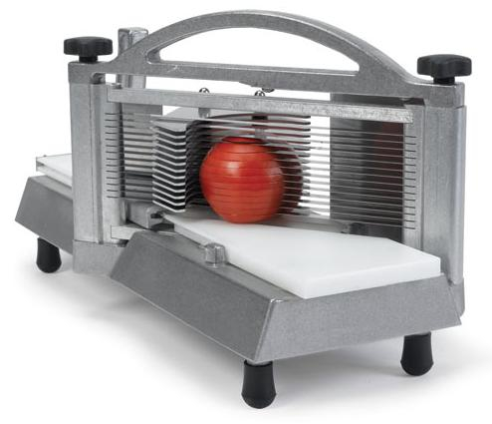
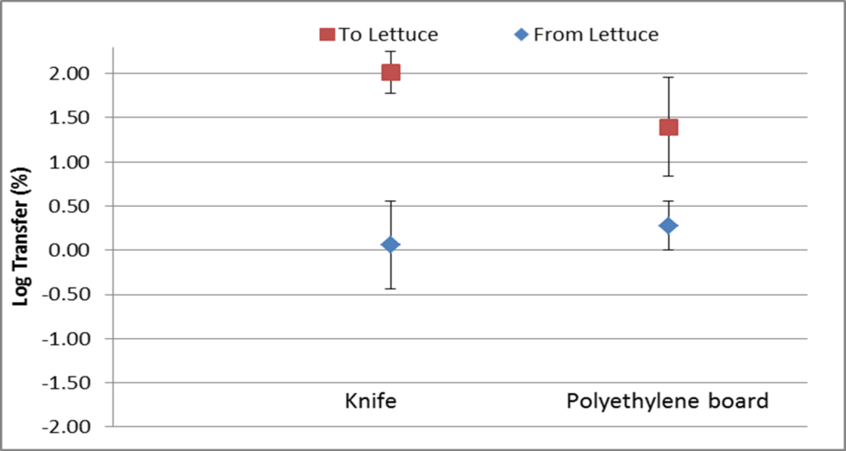
MNV-1 Transfer during Chopping
Knife
Polyethylene Board

Slide 22
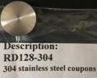
Pulsed Light on Stainless Steel
MNV-1 Inactivation and Temperature on Stainless Steel
at Distance of 10.8 cm
Surface Temperature

Slide 23
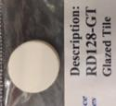
Pulsed Light on Glazed Tile
MNV-1 Inactivation and Temperature on Tile Surface
at Distance of 10.8 cm
Surface Temperature

Slide 24
Pulsed Light on Plastic
MNV-1 Inactivation and Temperature on Polypropylene Surface (10.8cm)
MNV-1 Inactivation and Temperature on Polyethylene Surface (10.8cm)

Slide 25



Acknowledgements
IFSH Food Virology Research Group
Stephen Grove (now with Nestle PTC Solon)
Carol Shieh
Mary Lou Tortorello
Diane Stewart
David Laird
Kathiravan Krishnamurthy
Zijin Zhou (MS candidate)
Sagar Agarwal (MS candidate)
Jin Zeng (MS candidate)
NoroCORE financially supported by
USDA NIFA 2011-68003-30395

Slide 26
Thank you
&
Questions

