Slide 1
Extended Inherent Safety Index: Inclusion of Biological Inherent Safety Index
A. W. L. EE, E. Kuznetsova, J. T. E. Lee, and T. S. Ng
Presented by: Mr. Alvin Ee, NUS Environmental Research Institute
Notes:
Safety consideration is unavoidable in policy making. Regardless of type of process adopted, treatment capacity as well as meeting of local regulations, safety is definitely part of the consideration. Hence, it is important to have a single tool that will be able to assess various type of process to offer a fair comparison, that can be used for process selection, safety assessment and hazard identification.

Slide 2
Agenda
Introduction and motivation
Extended Inherent Safety Index framework development
Case study
Notes:
Point 1: The agenda of the talk will be [Click] the introduction as well as the motivation for the development of EISI
Point 2: [Click] The development of the EISI framework
Point 3: [Click] testing of EISI framework on food waste treatment processes

Slide 3
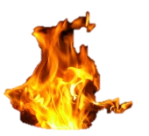
Introduction - Safety
Safety is an important concerns with waste management
Accident in waste treatment do happens
Type of process | Year | No of injury | Causes
Waste water treatment | 2013 | 1 fatality, 1 serious injury | Explosion
Waste water treatment | 2016 | 1 fatality, 1 serious injury | Exposure to toxic gas (H₂S)
Chemical waste treatment | 2016 | 3 serious injury | Fire and explosion due to Chemical reaction
Waste water treatment | 2017 | - | Release of toxic gas
Residential Area
Waste
Option 1
Decentralized treatment (e.g. Anaerobic digestion)
Industrial Area
Option 2
Centralized treatment (e.g. Anaerobic digestion)
Option 3
Centralized treatment (e.g. Incineration)
Notes:
Point 1: [Click] Safety is paramount concerns in industries and of course, there is no exception for waste management.
Point 2: For example in the considering the waste generated by community [Click] The community will
Point 3: [Click] generate waste and policy maker such as National environmental agency of Singapore may want to consider the type of technology as well as deployment strategy for waste treatment such as centralize and decentralize approach.
Point 4: [Click] if anaerobic digestion have been selected for decentralized treatment, this will mean the treatment will take place [Click] within the community itself.
Point 5: Due to the presence of flammable gas [Click] fire may take place and it may spread to near by residential area.
Point 6: As it is a biological process, if hazardous micro-organism is present, there may be risk of biological accident [Click]. Of course many other possible accident may take place.
Point 7: Similar to decentralize approach, [Click] centralized may be situated in industrial area with factories surrounding the treatment plant [Click]
Point 8: Accident such as fire [Click] may occurs. Do note that with bigger inventory, magnitude of accident may be more greater and may cause more damage. Similar accident such as biological release and toxic gas release may also occurs [Click].
Point 9: And accidents do really happen! [Click] This are just some of the accidents that have had occurred [Click]. Accidents may be catastrophic, may cause fatality, injury and definitely cost the company significant financial burden and reputation

Slide 4
Introduction – Accident Risk
Accident risk is a function of Hazards and Probability
$$Risk=Hazards ×Likelihood$$
To reduce overall risk, we can either reduce the number of hazards presence or reduce the likelihood of occurrence
Controlling hazards is the most effective method to reduce the overall risk
To control hazards, we have to identify the hazards at early stage and carry out appropriate action
Potential of harm
Probability of occurrence
Notes:
In order to reduce accident, we have to reduce accident risk associated with the process.
Point 1: As definite by OSHA, [Click] Risk is a function of hazards and Likelihood of occurrence.
Point 2: Hazards [Click] are source of potential harm such as the presence of flammable gas that may cause a fire or explosion while
Point 3: [Click] Likelihood is the probability of occurrence such as trip and fall may occurs once a month, or remote occurrence
Point 4: So in order to reduce overall risk, [Click] one can reduce the hazards or the likelihood.
Point 5: [Click] the best way to control hazards is to remove or eliminate the hazard. With no hazards, there will be not likelihood of occurrence
Point 6: [Click] in order to control the hazards, we have to identify the hazards at early stage and eliminate or control the hazards as there is more freedom for modification

Slide 5
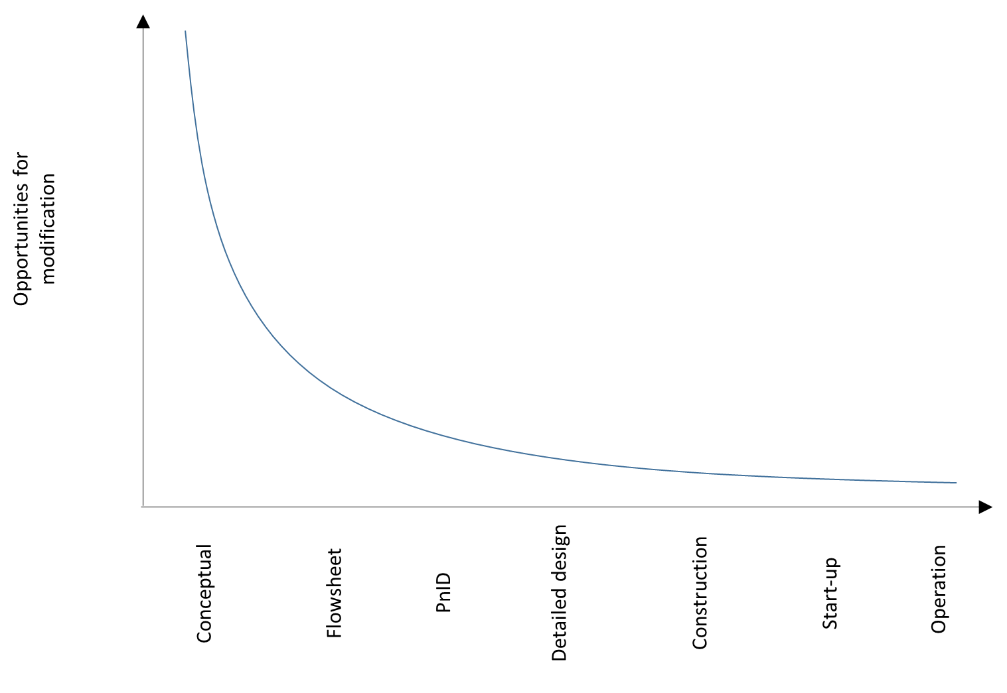
Introduction – Hazard identification
FMEA
What-if
Fault tree
Event tree
Check list
CCA
etc.
FMEA
HAZOP
What-if
Fault tree
Event tree
Check list
DOW FEI
CCA
etc.
=
Cost saving opportunity
?
Information availability
[Adapted from Kletz, 1991; CCPS, 1992; Heikkila, 1999]
Notes:
Point 1: As mentioned, identification of hazards allows more opportunity for modification. [Click] this is the graphical representation of opportunity for modification throughout the life cycle of the plant.
Point 2: With more opportunity for modification, [Click] this will also relate to potential cost saving opportunity. As at early stage where production or treatment plant is not build, modification will just be a re-simulation, or even better, backspace or an eraser away.
Point 3: It is ideal to identify source of hazards at early stage so a safer alternative process can be planned or additional safety system can be planned. However [click] information availability are limited at the early stage. Detailed information such as actual process efficiency, operational hazards such as space planning may not be available at early stage
Point 4: Despite the limited information at conceptual stage, it will be economically sensible to identify hazards [Click] in conceptual stage before additional financial and effort being carried out.
Point 5: In order to identify hazards, tools are required to aid assessor to identify hazards [Click] More safety tools are available at later stage of process as more information are available. Lesser tools are at the earlier stage of the plant life cycle [Click]. So what are the tools available at the earliest stage of the plant life cycle?

Slide 6
Safety assessment tools - Conceptual
What-if analysis
Checklist
Process hazard analysis
Prototype Inherent Safety Index
Inherent Safety Index
Have element of human judgement involved
Index Based
Notes:
Point 1: [Click] This are some of the few tools available to carryout the hazard assessment.
Point 2: [Click] The first 3 safety assessment tools, the “What- If” analysis, checklist and process hazards analysis involved human judgement. A same process may yield different results if people with different level of experience is involved.
Point 3: [Click] Unlike the first 3 safety assessment tool, the next 2 tools are index based where assessor will allocate a score for each parameter assessed based on a standard set of table.
Point 4: If you can guess from the title of the presentation, our work will make use of the framework proposed by [Click] Inherent Safety Index as the basis of the Extended inherent safety index. You might be wondering why not prototype inherent safety index. The reason is that Inherent safety index is an extended and refined version of prototype safety index so it will make more sense to use the later version.

Slide 7
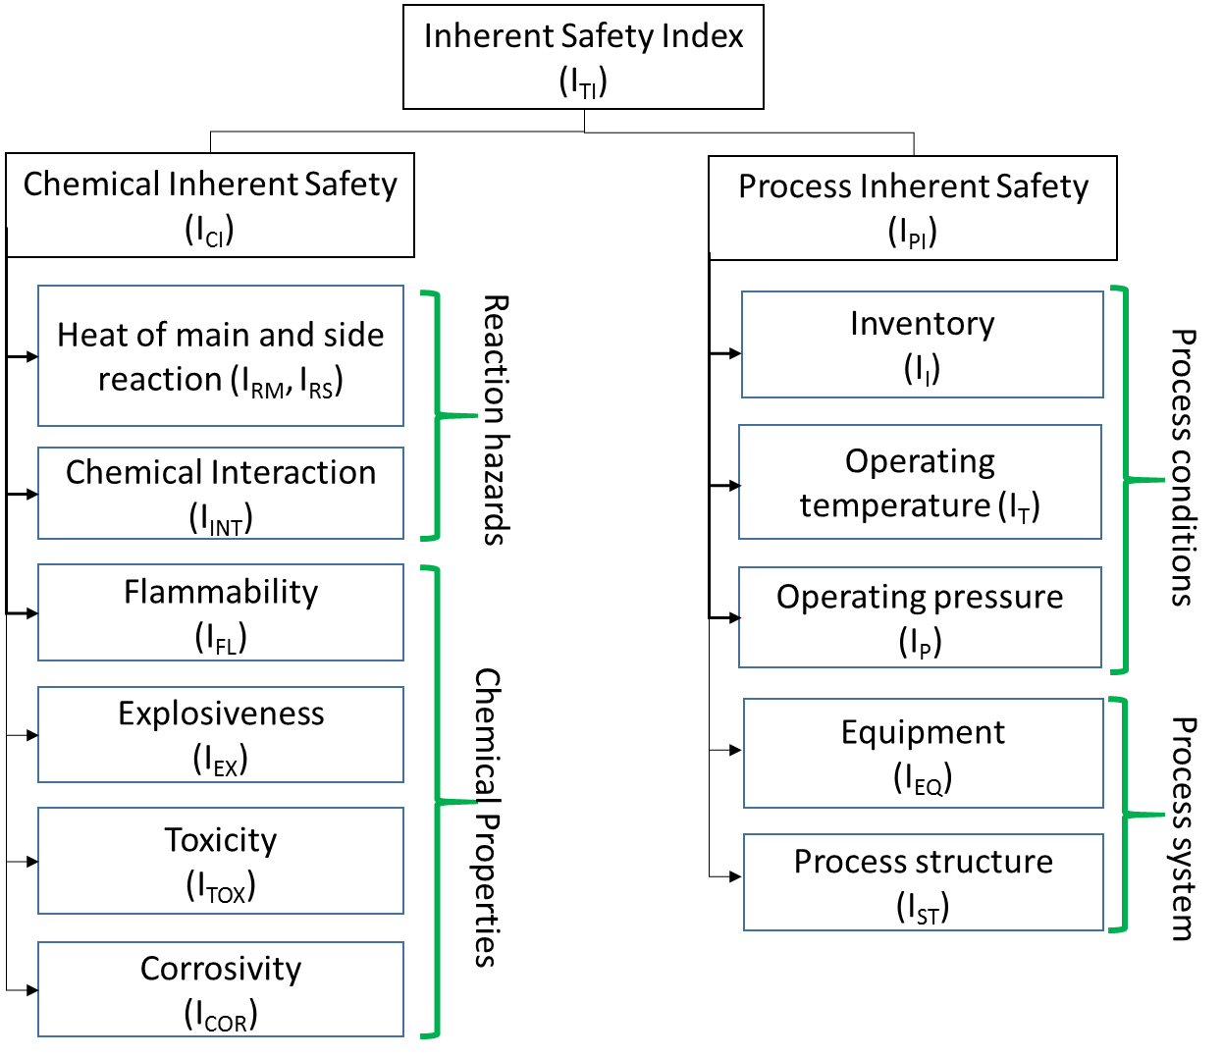
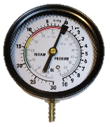
ISI framework
[Heikkila, 1999]
Notes:
Point 1: [Click] This is the overall ISI assessment framework.
Point 2: [Click] The overall inherent safety index made up of both the chemical inherent safety as well as the process inherent safety.
Point 3: [Click] The chemical inherent safety index considers both reaction hazards as well as the chemical properties of material present in the process while
Point 4: [Click] The process inherent safety index considers the process conditions as well as process system.
Despite having limited information available, several hazards are able to be assessed by the ISI.

Slide 8
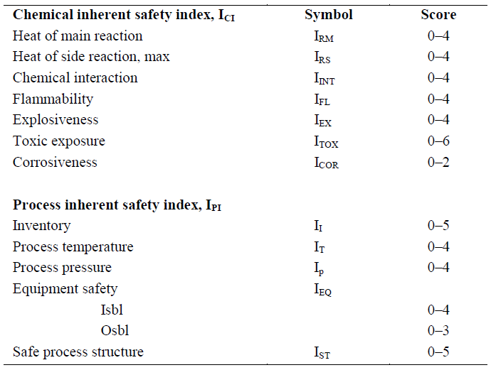
Allocation of score
Each index score are allocated based on the observed/calculated parameter
Weighting can be applied to emphasis various factors based on company policy
$$I_{TI}= I_{CI}+ I_{PI}$$
(1)
$$I_{CI}=I_{RM}+ I_{RS}+ I_{INT}+ I_{FL}+ I_{EX}+ I_{TOX}+ I_{COR}$$
(2)
$$I_{PI}=I_{I}+ I_{T}+ I_{P}+ I_{EQ}+ I_{ST}$$
(3)
[Heikkila, 1999]
Notes:
Point 1: [Click] Each index are allocated based on observed and/or calculated parameters such as heat of reaction, explosiveness etc.
Point 2: This is the overall scoring [Click] of each parameters. Weighting can be carried out based to emphasis factors according to each company policy.
Point 3: [Click] The total ISI can be calculated by adding the total calculated Chemical inherent safety and process inherent safety score.
Point 4: [Click] Chemical Inherent safety and process inherent safety score can be calculated by summing up each sub-indices.

Slide 9
Limitation
Lack of biological hazards
EISI
ISI
Not considered
Type of treatment | Chemical Hazards | Process Hazards | Biological hazards | Comment
Incineration | Present | Present | Not present | No biological activity involved
Aerobic | Present | Present | Present | May release toxic gas e.g. CO
Anaerobic | Present | Present | Present | Presence of flammable, toxic gas etc.
Co-digestion | Present | Present | Present | Presence of flammable, toxic gas etc.
Notes:
Point 1: However, there are limitation to the tool. It considers chemical processes, process conditions [Click] but it did not considers biological hazards.
Point 2: At this current moment, there are various waste treatment methods [Click] and each method poses different set of hazards
Point 3: While chemical and process hazards [Click] can be assessed by ISI, Biological hazards [Click] is not being considered. This calls for an extension to ISI [Click] to include all 3 type of hazards. As we have done our literature review that tools to assess biological hazards does not include chemical and process hazards consideration. Most of the time each assessment were carried out independently

Slide 10
Development of Inherent biohazard scoring (I_{bi})
Biohazards considerations are:
Type of biological agent used
Type of daughter product it may form
Growth rate
Ease of transmission
Biosafety level (BSL)
Decontamination precaution based on the type of biological agent
Multiple factors (including biohazards) were considered to determine the BSL level
Most of the biological agent have been categories to their corresponding BSL level.
(Available at conceptual stage!)
Notes:
Point 1; [Click] Biohazards are the inherent issues with the type of biological agent [Click], Type of offspring [Click], Growth rate [Click] as well as ease of transmission [Click].
Point 2: After several round of reviews, we found that biological agents were classified by its biosafety level [Click] in order to determine the type of laboratory and process premises are suitable to handle the agent. .
Point 3: The BSL rating [Click] actually refers to the decontamination precaution required which considered [Click] multiple factors including biohazards.
Point 4: [Click] Most of the biological agent have been categories to their corresponding BSL and is available at [Click] early stage!

Slide 11
Development of Inherent biohazard scoring (I_{bi})
Biosafety Level | Description | Example of microorganism/agent
BSL-1 | Use of well characterized agent not known to consistently causing diseases in immunocompetent adult | Escherichia coli
BSL-2 | Use of agents that cause human and animal diseases with moderate individual or low community risk | Staphylococcus aureus
BSL-3 | Use of indigenous or exotic agents that may cause serious or potentially lethal diseases via inhalation, having high individual risk and low community risk | Mycobacterium tuberculosis
BSL-4 | Use of dangerous/exotic agents of life threatening nature; serious diseases readily transmitted | Zaire ebolavirus
[US Department of Health and Human Services, 2009]
Notes:
Point 1: [Click] This is the description of BSL

Slide 12
Development of Inherent biohazard scoring (I_{bi})- I_{Bs}
Δ 4
I_{Tox}
Applicable to industries
Δ 3
Δ 2
Δ 1
[Mohammadi, 2013]
Notes:
Point 1 [Click] this is the proposed Biosafety index is shown in the graph. Considering the potential impacts each BS-level may cause, we have added an incremental penalty between each Bs-L level. [Click] use of BS-L 1 biological agent will results in a penalty of 1 , while the use of BS-L 2 agent will have a penalty of 3. [Click] the same goes for the use of BS-L 3 and 4 biological agent.
Point 2: From our literature review, most commercial biological processes such as pharmacy uses BSl-2 agent and rarely uses BSl-3 agent. At this moment, from our best knowledge, there isn’t any production facilities that uses BS-L 4 agent for production. [Click] hence, it will only be practical have a maximum score of 6.
Point 3: If you remember in the earlier slides, the maximum scores for chemical toxicity [Click] is 6. By having similar maximum scores for both Toxicity and Biosafety hazards will means that both chemical toxicity and biological hazardousness is equality important.

Slide 13
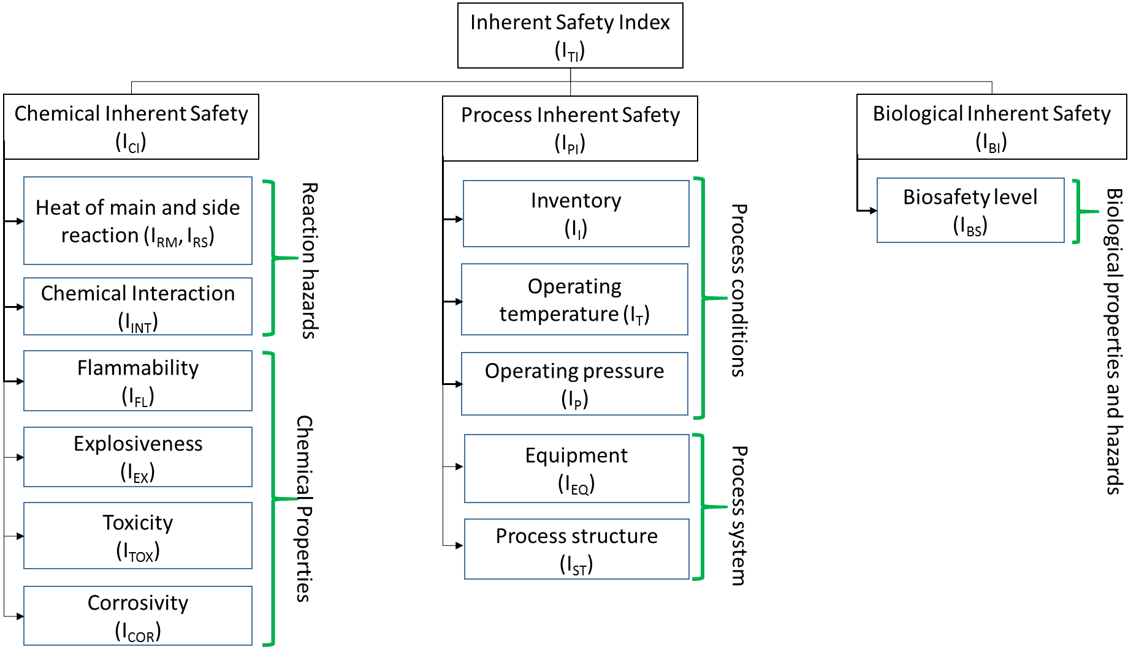
Proposed EISI framework
Notes:
Point 1: [Click] the proposed Extended Inherent Safety Index

Slide 14
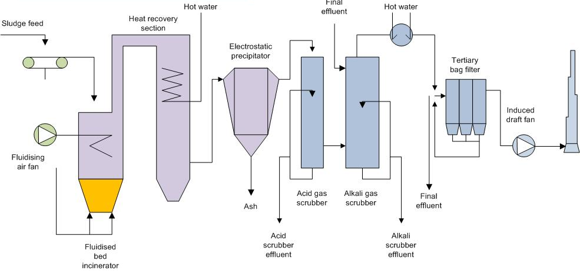
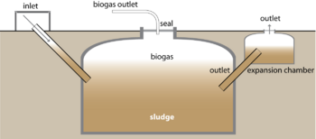
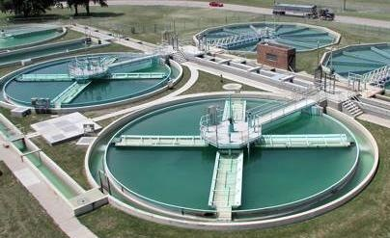
Case study
Test the proposed framework on:
Incineration
Aerobic digestion
Anaerobic digestion
Chemical process
Biological process
Notes:
Point 1: [Click] to test the applicability of the proposed framework, we will assess the Extended Inherent Safety score for various waste treatment processes.
Point 2: [Click] the first technology will be incineration, the technology which Singapore uses to treat majority of the waste. The waste will be transfer to the furnace for combustion which will produce both heat and flue gas. The heat is used to generate electricity while the flue gas have to be treated before releasing to the atmosphere.
Point 3: [Click] unlike incineration, Aerobic digestion is a biological waste treatment that makes use of biological agent to break organic matters into smaller compound such as CO2, SO2 in the presence of oxygen. Material that is not broken down are sludge which can be dewatered and produce compost for agriculture sector
Point 4: [ Click] Last but not least, the last technology we will like to test is anaerobic digestion. Organic material will be broken down by biological agent in the absents of oxygen. The main product will be biogas which can be use as a fuel for energy production.

Slide 15
Parameters comparison- I_{Ci}
 |  | Incineration | Aerobic | Anaerobic
Heat of main reaction | I_{Rm} | 4 | 4 | 4
Heat of side reaction | I_{Rs} | 4 | 0 | 0
Chemical Interaction | I_{Int} | 2 | 2 | 1
Flammability | I_{Fl} | 0 | 0 | 4
Explosiveness | I_{Ex} | 0 | 0 | 1
Toxic Exposure | I_{Tox} | 3 | 3 | 5
Corrosiveness | I_{cor} | 2 | 0 | 1
Chemical Inherent Safety Index (Max score 28) | I_{Ci} | 15 | 9 | 16
Notes:
Point 1: [Click] This is the Inherent chemical safety index calculated for the 3 technology. As you can see from that anaerobic digestion have the highest inherent safety index scores while aerobic have the least.
Point 2: [Click] All 3 technology have high heat of main reaction. This is mainly due to the treatment of carbohydrates. [Click] incineration have the highest heat of side reaction as the side reaction of burning diesel in the incinerator release more heat than the gas treatment process. Anaerobic also have gas treatment process but the amount of heat release is controlled by the excess caustic present in the scrubber.
Point 3: For chemical interaction [Click] Both incineration and aerobic have the highest score of 2 due to the potential undesirable reaction. Production of monoxides and production of methane.
Point 4: For Flammability [Click] and explosiveness [Click] are relatively straight forward as both are due to the presence of Methane.
Point 5: [Click] Anaerobic have a high penalty scores of 5 for toxic exposure due to the presence of H2S which is a nasty chemical.
Point 6: Lastly, [Click] Incineration have a score of 2 due to potential thermal corrosion.

Slide 16
Parameters comparison- I_{Pi}
 |  | Incineration | Aerobic | Anaerobic
Inventory | I_{I} | 1 | 2 | 2
Process temperature | I_{T} | 4 | 0 | 0
Process pressure | I_{P} | 0 | 0 | 0
Equipment safety | I_{Eq} | 4 | 0 | 3
Safe Process structure | I_{st} | 0 | 0 | 0
Process Inherent Safety Index (Max score 22) | I_{Pi} | 9 | 2 | 5
Notes:
Point 1: [Click] This is the Inherent process safety index calculated for the 3 technology. As you can see from that incineration fared the worst this round.
Point 2: The 3 technology were assumed to treat 5ton/day of waste. [Click] due to the difference residence time of reaction, both Aerobic and Anaerobic requires bigger inventory for storage and treatment purposes.
Point 3: Incineration operates in a very high temperature range from 800 degree Celsius to 12000 degree Celsius. [Click] this attributes to the high scores for process temperature.
Point 4: As all 3 technology operates at atmospheric pressure, there is no penalty scores being awarded. Moving on, [Click] Incineration have higher equipment safety scores than the rest due to the use of furnace. Anaerobic technology was given a score of 3 due to the use of compressors for storing of biogas.
Last but not least, all 3 technology were not penalize for safe process structure as it was assumed that treatment plant will be design based on recommended standards.

Slide 17
Parameters comparison- I_{Bi}
 |  | Incineration | Aerobic | Anaerobic
Biosafety level | I_{Bs} | 0 | 1 | 1
Biological Inherent Safety Index (Max score 6) | I_{Ci} | 0 | 1 | 1
Notes:
Point 1: Finally, [Click] here is the biological safety index score.
Point 2: [Click] Both Aerobic and Anaerobic have the highest score amount the 3 technology due to the use to biological agent with BS-L 1 rating.

Slide 18
Parameters comparison- I_{TI}
 |  | Incineration | Aerobic | Anaerobic
Chemical Inherent Safety Index | I_{CI} | 15 | 9 | 16
Process Inherent Safety Index | I_{PI} | 9 | 2 | 5
Biological Inherent safety index | I_{BI} | 0 | 1 | 1
Extended Inherent Safety Index (Max score 56) | I_{Ti} | 24 (42%) | 12 (21%) | 22 (39%)
Notes:
Point 1: [Click] This is the overall EISI scores. The External inherent safety inherent safety index is the sum of the chemical inherent safety index, process inherent safety index and the biological safety index.

Slide 19
Discussion
Aerobic technology fared the best while incineration is the least favorable in term of inherent safety
Incineration is not recommended for decentralize deployment due to high operating temperature
Temperature cannot be reduced due to technological constraint
Anaerobic has high flammability, explosivity and toxicity inherent hazards which likelihood of occurrence can be, however, reduced by additional safety measures
In overall, Aerobic and Anaerobic can be considered as suitable for decentralized deployment
All 3 technologies are suitable for centralize deployment
Notes:
Point 1: [Click] Aerobic have the lowest inherent safety hazards while Incineration have the highest inherent safety hazards\
Point 2: [Click] Incineration is not recommended for decentralize approach as high operating temperature is used. [Click] This hazards cannot be eliminated as high temperature are required to prevent the formation of dioxins
Point 3: [Click] Both Aerobic and Anaerobic are suitable candidate for decentralize approach. You must be thinking that anaerobic [Click] have relatively high EISI score as its have high flammability, explosivity and toxicity inherent hazards.
Point 4: The reason is [Click] once we have identify the hotspots, we can think of way to control the risk by considering safety features to reduce the likelihood of occurrence to reduce the overall risk.
Point 5: [Click] All in all, all 3 technology are suitable for centralize deployment.

Slide 20
Further analysis
Incineration ISI score: 24 out of 50 (48%)
Incineration EISI score: 24 out of 56 (43%)
With the introduction of biological inherent hazards, safety assessment scores are not being diluted.
Notes:
Point 1: You might be wondering if I am having chemical processes, will the introduction of biological hazards dilute the information. Let us do the further analysis using Incineration process, which is a chemical process. [Click] The incineration ISI score will be 24 out of 50 while [Click] Incineration EISI scores 24 out of 56.
Point 2: With the difference of 5% [Click], I will argue that the introduction of biological inherent safety hazards, the overall scores will not be diluted.

Slide 21
Conclusion
Novel way to compare the hazardousness level of chemical and/or biological processes in a fair manner
Use of same parameters for comparison
Do not need to use multiple tools for assessment
EISI is able to carryout a relatively comprehensive assessment despite having limited information at conceptual stage
The tool allow assessor to identify potential hotspot and may allocate additional resources to contain the hazards
Suitable tool for route selection (comparing chemical and bioprocesses)
Notes:
Point 1: In conclusion, EISI have proven to be a [Click] a novel tool to compare both chemical and biological processes, that uses [Click] the same parameter for comparison and the best part, [Click] do not need to use multiple tools for assessment.
Point 2: [Click] like ISI, it is able to carry out relatively comprehensive assessment despite having limited information. [Click] and allowing each user to identify potential hotspots associated with each process, understand the type of additional resources to contain the hazards
Point 3: [Click] a suitable tool for route selection, especially chemical and bioprocesses, e.g. Green vs brown process.

Slide 22
Acknowledgement
This research is funded by the Singapore National Research Foundation and the work is supported under the Campus for Research Excellence and Technological Enterprise (CREATE) programme – Energy and Environmental Sustainability Solutions for Megacities (E2S2).
Notes:
This research will never be possible without the support under the campus for research excellence and technological enterprise or also known as CREATE programme – Energy and Environmental Sustainability solutions (E2S2) funded by Singapore National Research Foundation.

Slide 23
Thank you!

Slide 24
References
CCPS 2008. Guidelines for Hazard Evaluation Procedures, Wiley.
HEIKKILA, A.-M. 1999. Inherent safety in process plant design: an index-based approach. 384., Technica Research Centre of Finland.
KLETZ, T. A. 1991. Plant design for safety: a user-friendly approach, Hemisphere Publishing Corporation.
US Department of Health and Human Services 2009. Section IV—Laboratory Biosafety Level Criteria. Biosafety in microbiological and biomedical laboratories, 5th ed. US Department of Health and Human Services, Washington, DC h ttp://www. cdc. gov/biosafety/publications/bmbl5, 30-59.

