Slide 1
NUTRIEQUALIZATION: Attempting to improve survival in cancer patients through nutritional modifications
Alvaro Ronco, MD
Assoc.Prof. Cancer Epidemiology,
IUCLAEH School of Medicine,
URUGUAY

Slide 2
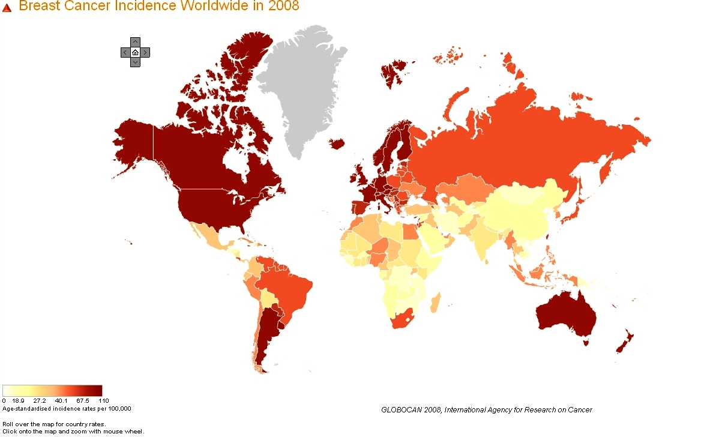
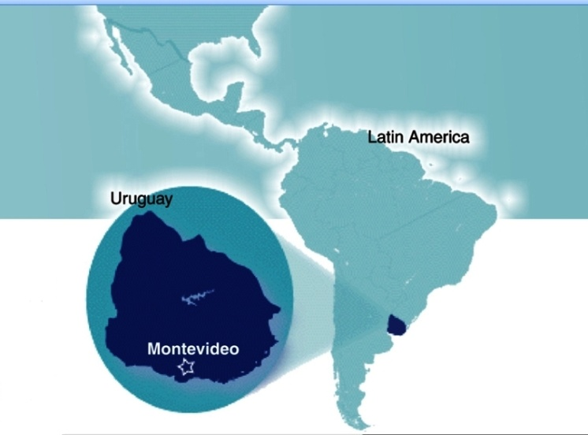

Slide 3
The current evidence suggests longer disease-free survivals and longer global survivals among those patients who change their nutrition (diet and body composition), also their physical activity.
Carmichael A & Bates T, Breast 2004;13:85-92.
Loi S et al, Cancer Epidemiol Biomarkers Prev 2005; 14:1686-91
Whiteman MK et al. Cancer Epidemiol Biomarkers Prev 2005; 14:2009-2014
Abrahamson PE et al. Cancer Epidemiol Biomarkers Prev 2006; 15:1871-7

Slide 4
Hypertriglyceridemia
High intake of soy, sunflower or corn oil
OBESITY
EXPECTED CONSEQUENCES OF A WESTERN DIETARY STYLE
Hypertension
Insulin resistance - Diabetes
High intake of high glycemic load foods
Inadequate Ω-6/Ω-3 PUFAs ratio + high cholesterol intake
Hyperestrogenemia
High intake of well- done red meat
Inadequate 2/16 αOH E₂
Hypercholesterolemia
Low fiber intake
NFkB
Hyperuricemia
Increased bile lithiasis
Low intake of fish or sea foods
RISK OF BREAST, COLON & OTHER CANCERS
Low available Vitamin D

Slide 5
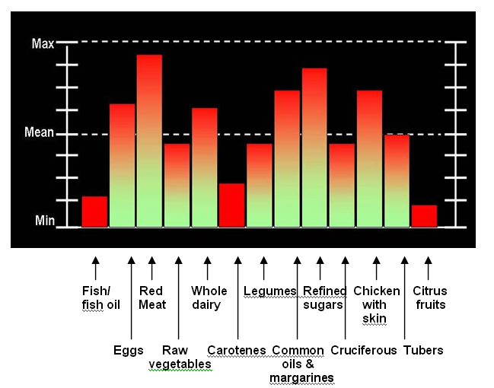

Slide 6
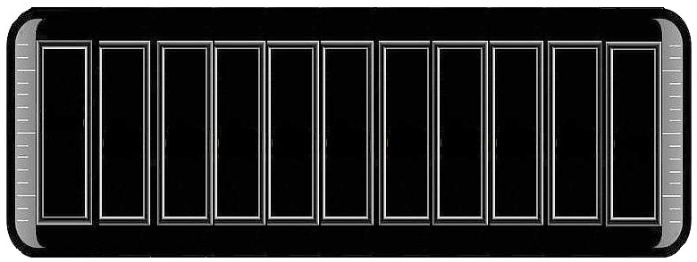
ADEQUATE NUTRITIONAL PATTERN
INADEQUATE NUTRITIONAL PATTERN
PROTECTIVE FOODS
RISK FOODS
PROTECTIVE FOODS

Slide 7
NUTRIEQUALIZATION
TARGET: EACH SELECTED RISK/PROTECTIVE ITEM SHOULD REACH THE LOW-RISK ZONE.
THE LOW-RISK ZONE COULD BE GIVEN BY THE LOWEST INTAKE CATEGORY (Risk factors) OR THE HIGHEST ONE (Protective factors).

Slide 8
SELECTED ITEMS as EXAMPLES
1. BREAST CANCER
Red meat intake (beef, bbq, fried meat ≤1 time/wk)
Fruit intake (orange, orange juice ≥ 8 units/wk)
Oils & fats (only virgin olive oil & no margarine)
Triglycerides/HDL ratio <2
2/16 α-OH estrogens ratio >2
Serum vitamin D level >40 ng/ml
Fasting insulinemia <10 μU/ml

Slide 9
SELECTED ITEMS as EXAMPLES
2. COLORECTAL CANCER
Red meat intake (beef, bbq, fried meat ≤500g/wk)
Fruit intake (≥ 1kg /wk)
Vegetable intake (≥ 1.700 kg /wk)
Fish intake (Fatty fish preferred >2 times/wk)
Oils & fats (only virgin olive oil & no margarine)
Omega-3 supplements ( 3-4 g/day [in 10-15 g of oil])

Slide 10
BETTER
RESULTS EXPECTED
Conventional Therapies
+ Specific NUTRITIONAL STRATEGY
CANCER PATIENT
Conventional Therapies ONLY
OUR PROPOSAL TAKES INTO ACCOUNT POPULATION-SPECIFIC FEATURES
THE OWN NUTRITIONAL PROFILE OF THE STUDIED POPULATION,
COMBINED WITH SELECTED INTERNATIONAL REFERENCE VALUES

Slide 11
The American Cancer Society (Doyle et al, Ca A Cancer J Clin 2006) has described some strategies for cancer patients, in order to reduce weight excess.
The first one of those strategies suggest that patients should ask their oncologist before beginning with any diet or exercise program.
Almost everywhere, medical education lacks of nutrition in their curricula. Hence, the physician is not always prepared to give adequate nutritional counseling.
Patients within the medical office usually do not receive adequate answers to their questions about what to do concerning nutrition.
The cancer patient does not deserve to afford the costs that the underestimation of nutritional issues represent for the physician.
Why? Because the patient might loose an opportunity of improving her/his quality of life and probably the prognosis of her/his cancer.

Slide 12
OXIDATION
INFLAMMATION

Slide 14
ANTIOXIDATION
ANTIINFLAMMATION

Slide 15
Before trying to make an attempt of nutritional changes…
…we must take into account the different
dietary patterns of the studied population.

Slide 16
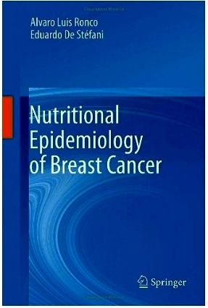
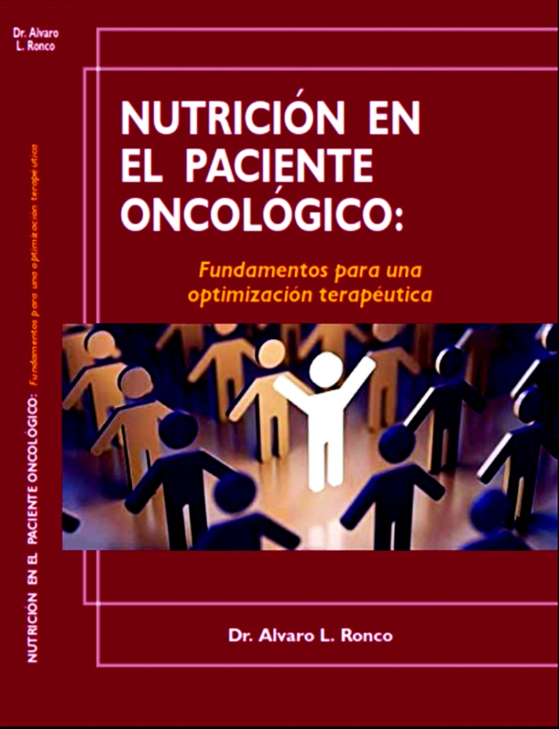
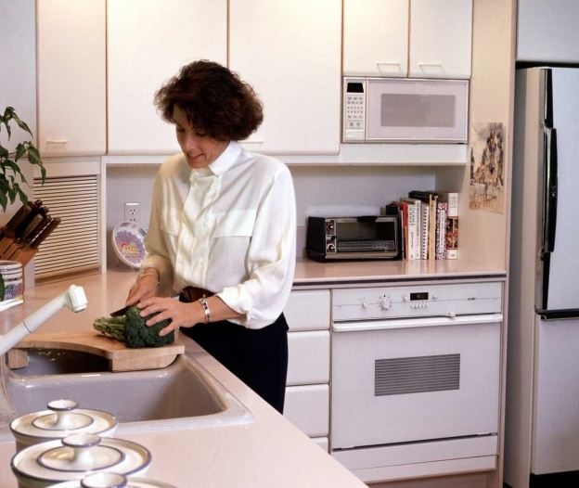
The kitchen is a place from where a patient can optimize the efficacy of oncological therapies, therefore improving the prognosis of her/his cancer.

Slide 19
THANK YOU VERY MUCH FOR YOUR ATTENTION
E-mail: alv.ronco58@gmail.com

