Slide 1
Contemporary Prenatal Diagnosis – The Clinician’s Perspective
Allan J Fisher, MD, FACOG, FACMG
Director, Perinatal Genetics
Elliot Hospital System
Manchester NH

Slide 2
Noninvasive Prenatal Testing (Screening)
Introduced commercially October 2011
High sensitivity and specificity in the high risk population
Two types
Massive Parallel Shotgun Sequencing
Targeted Fetal DNA Sequencing

Slide 3
Criteria
Currently: High risk population
35 and above
Ultrasound findings
Increased risk via other screening
Family history
Prevalence = 1/8 vs. 1/600 (low risk population)
PPV 90% vs. 11%

Slide 4
Which is Best?
Tough question
MPSS (Sequenom, Vernata)
Targeted Fetal DNA Sequencing
Ariosa DANSR/FORTE: hybridize, amplify, sequence
Natera: Massive multiplex isolation with SNP analysis

Slide 5
Sensitivities & Specificities
All have high sensitivities
>99% DS and T18
More variable for T13
Less data for sex chromosomal abnormalities
All have low false positive rates

Slide 6
False Negatives
Gestational age (<10 wks)
Fetal fraction
Maternal Weight
Genetic Variants
Failure to extract adequate material
Individual variation in cfDNA amount
GC rich regions

Slide 7
False Positives
Contamination
Vanishing twin
Placental mosaicism (more in T13,18, 21)
Low level mosaicism (esp. sex chromo)
Maternal mosaicism (loss of X in older women)
Maternal Cancers (only a few cases, no specific pattern)

Slide 8
Failure Rates
Trial | Failure Rate | DS Detection | FP rate
Chiu et al. 2011 | 11/764 (1.4%) | 86/86 | 3/146
Ehrich et al. (2011) | 18/467 (3.8%) | 39/39 | 1/410
Palomaki et al. (2011) | 13/1696 (0.8%) | 209/212 | 3/1471
Bianchi et al. (2012) | 148/532 (3.0%) | 89/89 | 0/404
Norton et al. (2012) | 148/3228 (4.6%) | 81/81 | 1/2888
Zimmerman et al. (2012) | 21/166 (12.6%) | 11/11 | 0/145
ALL | 424/6687 (3.2%) | 424/427 (99.3%) | 8/5319 (0.15%)
Note: Not all study designs the same, different techniques, variety of FP rates,
thresholds to call DS risk have different methodologies

Slide 9
Remember
There is no free lunch
Nothing in biology is 100%
Are we going backwards in PNDx?
Does not detect many things… yet

Slide 10
ACOG,ACMG, ISPD, NSGC: Common Themes
Great sensitivities and specificities for T21 & T18
Not diagnostic
Needs Genetic Counseling (pre- and post)
Should only be used in validated groups
More studies needed for the general population

Slide 11
Shifting Paradigms
Does NIPT replace other screening tests available today?
Better sensitivity but… look what we are missing….
First & second trimester ultrasound benefits
Increased NT, early defects, cardiac esp.
Other anomalies seen in embryological progression (cranial, skeletal, cardiac)
Serum screening benefits
Unexplained increased MSAFP
Low uE3 (SLO, X linked ichthyosis, sulfatase deficiency, congenital adrenal hypOplasia, Zellweger, Antley Bixler, POMC deficiency, other cholesterol metabolism, IUGR, SAB)
Low PAPP-A
Combination of abnormal biochemical markers

Slide 12
Future
Twin and population data
Aneuploidy in all chromosomes
Targeted microdeletion and microduplication syndromes
“Low density” microarray (>10mB)
Single gene defects (CF, β-thal, many others)
Whole genome sequencing (ultimate goal)

Slide 13
Chromosomal Microarray (CMA)
Introduced in the prenatal arena circa 2005
Results and counseling still from postnatal databases
Unknowns (VOUS)
Comparative array hybridization vs. SNP oligo-array

Slide 14
CMA has changed Prenatal Diagnosis
Increased detection of chromosomal variation
Ability to detect absence of heterozygosity (SNP Oligo-array)
Consanguinity
UPD (heterodisomy is harder to detect)
Inherited disorders (AR, AD, X-linked)
Triploidy
Both miss true balanced translocations (0.08-0.09%) and other balanced rearrangements

Slide 15
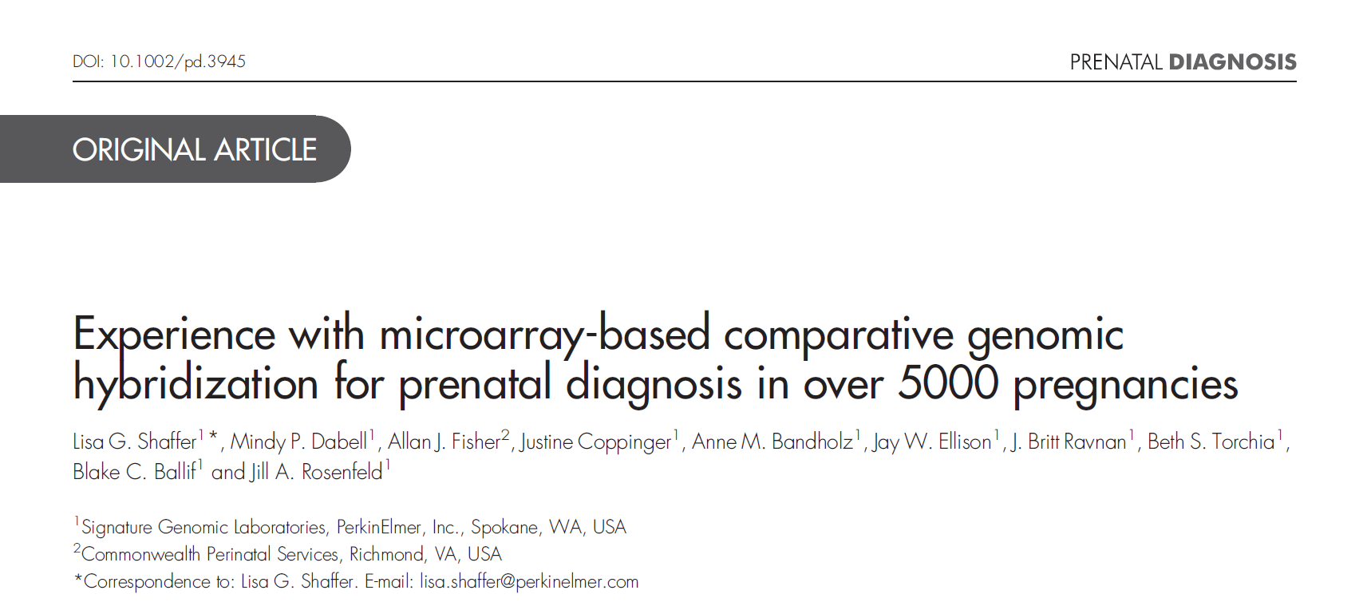
CMA Increases Detection

Slide 16
Increases Detection
Shaffer et al. Prenatal Diagnosis 2012
2004-2011
N = 5003 prenatal cases, various reasons
All known aneuploidy excluded from karyotype
No fetal demises
Detection of an additional 5.3% abnormals (6.5% & 8.2% for abnormal US and demise, respectively)
0.39% de novo copy number variations noted
71% found below the resolution of karyotype (<10Mb). Thus 29% should have been detected via karyotype!

Slide 17
Specific Ultrasound Anomalies
Detection rates of clinically signiﬁcant genomic alterations by microarray analysis for speciﬁc anomalies detected by ultrasound n=2858 cases
Clinically signiﬁcant genomic alterations were identiﬁed in cases with a single ultrasound anomaly (n= 99/1773, 5.6%)
Anomalies in two or more organ systems (n= 77/808, 9.5%), isolated growth abnormalities (n= 2/76,2.6%), and soft markers (n= 2/77, 2.6%).
High detection rates: holoprosencephaly (n= 9/85, 10.6%), posterior fossa defects (n= 21/144, 14.6%), skeletal anomalies (n= 15/140, 10.7%), ventricular septal defect (n= 14/132, 10.6%), hypoplastic left heart (n= 11/68,16.2%), and cleft lip/palate (n= 14/136, 10.3%)
Shaffer et al, Prenatal Diagnosis 2012, 32: 986–995 (free)

Slide 18
“GENERAL” POPULATION?
Issues:
Wapner et al. (NEJM 2012) showed 1.7% (1:60) of patients with abnormal CMA (aCGH) for AMA alone (no ultrasound findings) or abnormal serum screening
Positive Predictive Values decreases significantly
“Unknowns” – more so with Whole Genome/Exome Sequencing

Slide 19
The Unknowns – this is truly not unique to us
Copy number loss and gain
Parentally inherited?
Incompletely penetrant/variable phenotype?
What genes are involved? Significance of these genes? Inherited disorders (AR, AD) involved? Does it agree with the phenotype?
How large? Does this make a difference?
What about future findings at this site? Are we obligated to follow up in the future? Who will take this responsibility?

Slide 20
How Do We Navigate Now?
Talk with the patient : “nothing”, “everything” or “don’t know”
Are patients truly informed?
Find out the patient’s perception of risk and their comfort level
The information (and decision) can be overwhelming for patients
Time constraints for patient education (not everyone is at the same level)
When to educate? Prenatal is ideal.

Slide 21
Paradox vs. Paradigm
Noninvasive vs. Diagnostic (none vs. slight risk)
Less vs. detailed information
Missing clinically significant disorders vs. VOUS
Explaining FP and FN with all tests
Pleotropic phenotypes with all genetic disorders (or findings)
Education for professionals and lay public

Slide 22
Thank you.
Questions?

