Slide 1
MODY 2 diabetes in Siberia: 3 years of follow
Alla Ovsyannikova, PhD,
Federal State Budget Institution "Scientific Research Institute of Therapy and Preventive Medicine", Russia, Novosibirsk

Slide 2
Russia
The population in Russia is 146 519 759 people, in Novosibirsk –
1,584,000

Slide 3
The number of patients with DM in Russia

Slide 4
Prevalence of DM in youth in Russia*
3 %
12 %
85 %
* Kuraeva, T., Zilberman L., Titovich E., Peterková V. Genetics of monogenic forms of diabetes .Diabetes. - 2011. - № 1. - P. 20-27.

Slide 5
The prevalence of nonimmune forms of DM in Russia*
*Peterková V. et al. Molecular genetics and clinical features monogenic forms of diabetes. Herald RAMN.- 2012. - № 1.- pp 81 - 86.

Slide 6
Clinical characteristics of MODY and type 2 diabetes
CHARACTERISTIC | MODY | TYPE 2 DIABETES
Mode of inheritance | Monogenic, autosomal dominant | Polygenic + environment
Age of onset | Childhood, adolescence or young adulthood (<25yr) | Adulthood (40-60yr) occasionally adolescence (obese)
Pedigree | Usually multigenerational | Rarely multigenerational
Penetrance | 80-95% | Variable (~10-40%)
Body habitus | Nonobese | Usually obese
Metabolic syndrome | Absent | Usually present
M. Vaxillaire et al., 2006

Slide 7
Definition of MODY
S. Fajans и R.Tattersall entered abbreviation of MODY in 1965 year
first mutation (gene glucokinase) was diagnosed in 1992
five subtypes of MODY were identified in 2002
NOW: 13 subtypes of MODY

Slide 8
Characteristics of MODY diabetes*
relatives with disorders of carbohydrate metabolism;
manifestation of DM before the age of 25 years;
the absence of ketoacidosis;
good compensation (HbA1c ≤ 7%) diabetes;
long-term (at least 1 year) remission ("honeymoon diabetes") without periods of decompensation;
preservation of the secretory activity of beta cells (the level of C-peptide is in the normal range or slightly reduced);
Absence of markers of autoimmune response against beta cells (antibodies to beta-cells, GAD, insulin);
Absense of obesity;
absence of association with HLA.
*M. Vaxillaire et al., 2006, Ch. Henzen, et al., 2012 ;

Slide 9
Pancreatic β-Cell and the Proteins Implicated in MODY
Glucose
sensing
Insulin
gene
expression
N Engl J Med, Vol. 345, No. 13, September 27, 2001

Slide 10
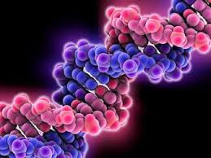
MODY types*
HNF 4a (hepatocyte nuclear factor)
GCK,
HNF-1a,
IPF (insulin promoter factor),
HNF-1b,
NEUROD1
KLF-11,
CEL,
PAX-4,
INS,
BLK ABCC8
KCNJ11
Ch.. Henzen, 2012, B. Johansson,.2011,
Bowman et al ., 2012
New types (2012)

Slide 11
Prevalence of subtypes MODY diabetes
MODY 2-5% of all cases of diabetes, in the UK up to 10%.
MODY 3:
MODY 2: ,

Slide 12
Prevalence of subtypes MODY diabetes in Russia
MODY 2 = MODY 3

Slide 13
Phenotype of MODY 2*
Symptoms;
Can begin to
Good compensation;
Moderate fasting hyperglycemia (not more than 6.5 mmol / l);
OGTT: increase in blood glucose of less than 3.5 mmol / l;
Neuropsychiatric disorders 7.5%;
Absence obesity.
*A. Senatorova et al., 2009

Slide 14
Characteristics of carbohydrate metabolism in MODY 2
14 %
48 %
38 %
2 Russian Congress «Innovative
technologies in endocrinology» (may 2014)

Slide 15
Treatment of MODY 2
86 %
27 %
3 %
70 %
2 Russian Congress «Innovative
technologies in endocrinology» (may 2014)

Slide 16
MODY GCK in Siberia*
The purpose: to identify the clinical features of MODY GCK diabetes which we need to follow of this group of patients.
*The reported study was
supported by RSCF,
research project No. 14-15-00496.

Slide 17
Materials and methods:
diagnose of MODY GCK during the molecular genetic testing of glucokinase gene;
once a year: full clinical examination, blood samples for biochemical research, determination of C-peptide and TSH, antibodies to b- cells, microalbuminuria, abdominal ultrasound, heart and thyroid ultrasound, examination of ophthalmologist.

Slide 18
Results
Patients with MODY GCK:
14 peoples (8 probands +6 relatives)= 6 males (43%) and 8 (57%) female.
The average age of the probands was 12 ± 2,6 years.
Age of onset ranged from 3 months to 32 years.
Median of duration of diabetes was 3 years.
Hereditary: 93% of patients had relatives with disorders of carbohydrate metabolism, 1 patient had mutation “de novo”.

Slide 19
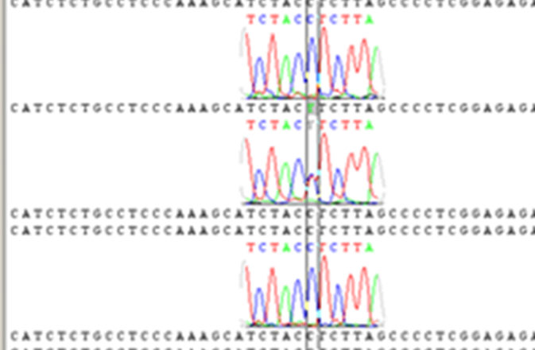
Results
Mutations were in 1 ekzon, 3, 4, 5, 7 of GCK gene.
Mutation 60 C > T

Slide 20
Results
DEBUT:

Slide 21
Results
DEBUT:
%

Slide 22
Results
Diabetes complications:
1 patient (7%) had diabetic nephropathy, chronic kidney disease, Stage 1, category 2 (A2).

Slide 23
Results
3 YEARS OF FOLLOW UP:
Overweight and obesity were not detected in any patient.
The same patient had no progressive diabetic nephropathy.
Biochemical analysis: no changes.

Slide 24
Results
%
ng/ml

Slide 25
Results
%

Slide 26
Conclusions
1. The earliest age of clinical manifestations of disorders of carbohydrate metabolism in MODY 2 diabetes was six months which should be considered in the differential diagnosis with type 1 diabetes because it is also manifest in a younger age group.
2. MODY 2 diabetes had oligosymptomatic onset, soft flow, good compensation of carbohydrate metabolism, no complications, no need for exogenous insulin in most cases.

Slide 27
Clinical case
Patient D. (boy) 2002 year of birth.
2010 year: thirst, itchy skin. Fasting hyperglycemia 6,5 mmol/l (capillary blood), postprandial hyperglycemia 8,9 mmol/l, HbA1c 5,9 %. Antibodies to b cells, GAD negative.
The patient had diabetic nephropathy, chronic kidney disease, Stage 1, category 2 (A2).

Slide 28
Clinical case
Relatives of the patient did not have diagnosis of diabetes.
2012 genetic research of GCK gene. Mutation 146 (146C > G) was detected.
Probands parents were examined. Father had asymptomatic fasting hyperglycemia. He was examined and same mutation was detected.

Slide 29
Pedigree
Hyperglycemia
MODY 2
Hyperglycemia
MODY 2

Slide 30
Clinical case
Probands father had mild hypertension.

Slide 31
Clinical case
Treatment in 2012:
Patient: Insulin (4-6 U Detemir)
Father: diet.
Treatment in 2015:
Patient: glibenclamid ¼ tab 1,75mg
Father: diet.

Slide 32
Alla Ovsyannikova aknikolaeva@bk.ru
Thank you for your attention!

