Slide 1
Organization and analysis of NGS variations.
Alireza Hadj Khodabakhshi
Research Investigator

Slide 2
Why is the NGS data processing a big challenge?
Computation cannot keep up with the Biology.

Slide 3
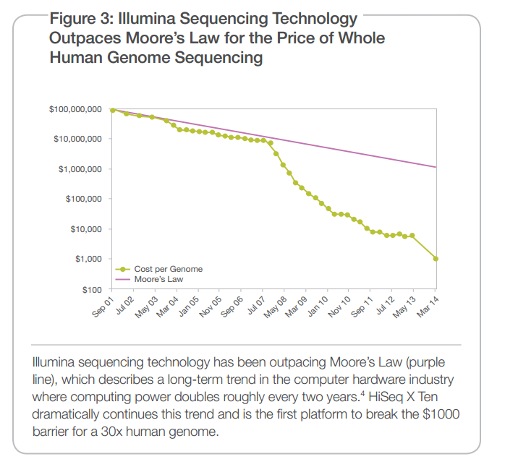
Source: illumina.com

Slide 4
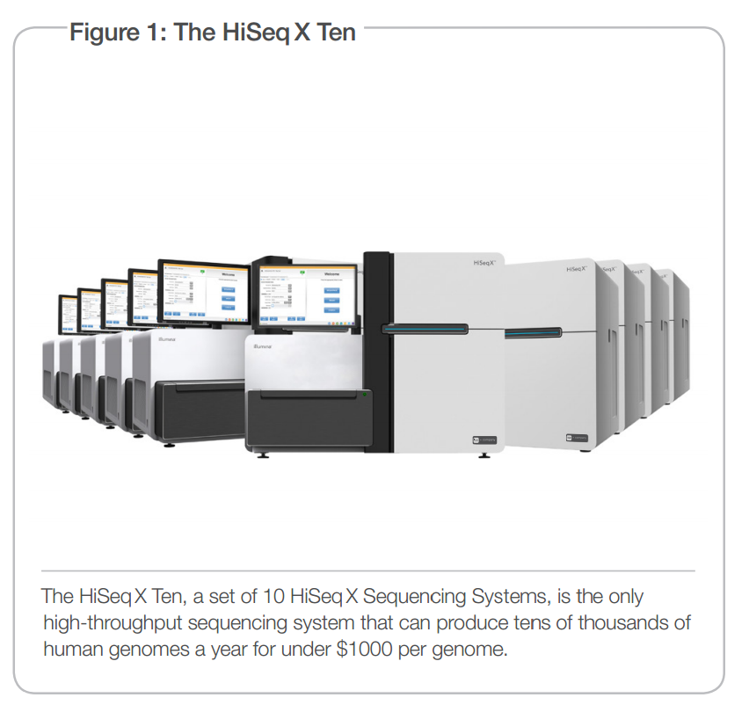
$1000 human gnome
- 50 whole genome per day
- 5 tera bytes (only mapped reads) per day
Source: illumina.com

Slide 5
Source: strand-ngs.com

Slide 6
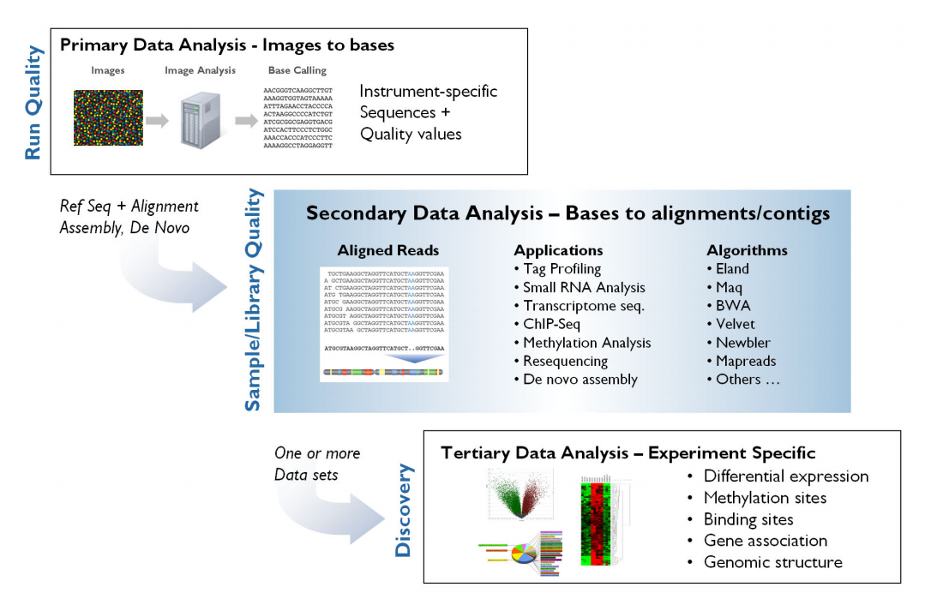
Bioinformatics of NGS data
Performed by the sequencing instrument.
Has been the main focus of Bioinformatics research.
Less tools are available.
GeneSifter: Next Generation Data Management and Analysis for Next Generation Sequencing. http://www.geospiza.com/

Slide 7
Organizing the variation data.
Scalable.
Enable insightful queries in a timely manner.
Support various NGS data (variations, expressions, annotations,…).

Slide 8
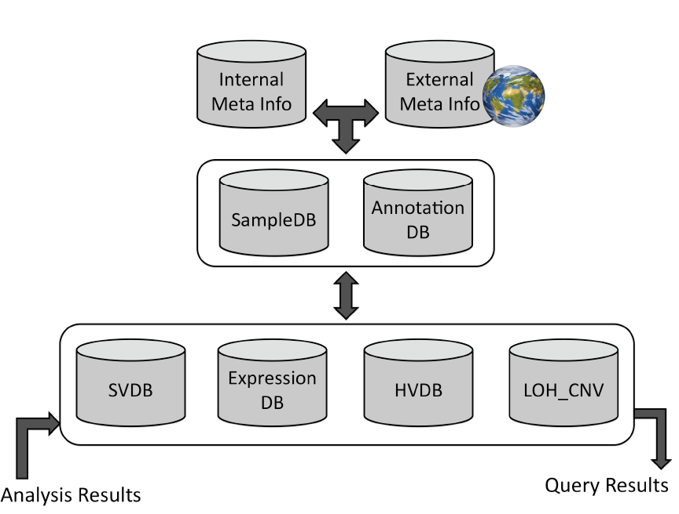
A consortium of databases for genomic discovery.

Slide 9
Sample Database(SampleDB):
clinical and experimental information of the samples (type of disease, pathology, age, sex,…).
Annotation Database(AnnotationDB):
annotations of genomic regions (sources: UCSC, Ensembl,….)
Structural Variation Database(SVDB):
genomic structural variations (translocations, inversions, large indels).
Expression Database (ExpressionDB):
expression levels of genomic regions (RPKM values).
Human Variation Database (HVDB):
small genomic variants (SNP, small indels)
Loss of Heterozygosity & Copy Number Variation (LOH_CNV)

Slide 10
Human Variation Database (HVDB)
Starting point of the consortium.
Stores SNPs and small indels.
Contains more than 4 billion variations across over 6000 samples.
Implemented with PostgreSQL and Java.
Its template and APIs are publically available.

Slide 11
Analyzing the data
Mutated pathways in types of cancer.
Variation hotspots.
Correlation between various variation types (eg. correlation between SNVs and genomic translocations).
Correlation between variations and expressions.

Slide 12
Mutation analysis pipeline:
A high throughput pipeline on top of the genomic database consortium.
Current version identifies statistically significant mutational hotspots.

Slide 13
Validating the variations
Through the analysis of mapped read (raw data) at the variation site.
Calculates the confidence based the ratio of good reads that support the variation.
Uses the mapped read of the matched normal if available.
The process is performed on a computing cluster in a parallel way

Slide 14
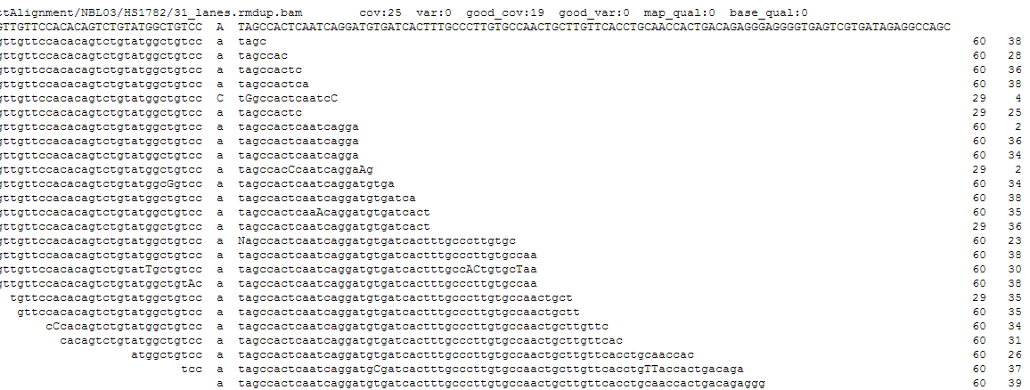
Alignment report.

Slide 15
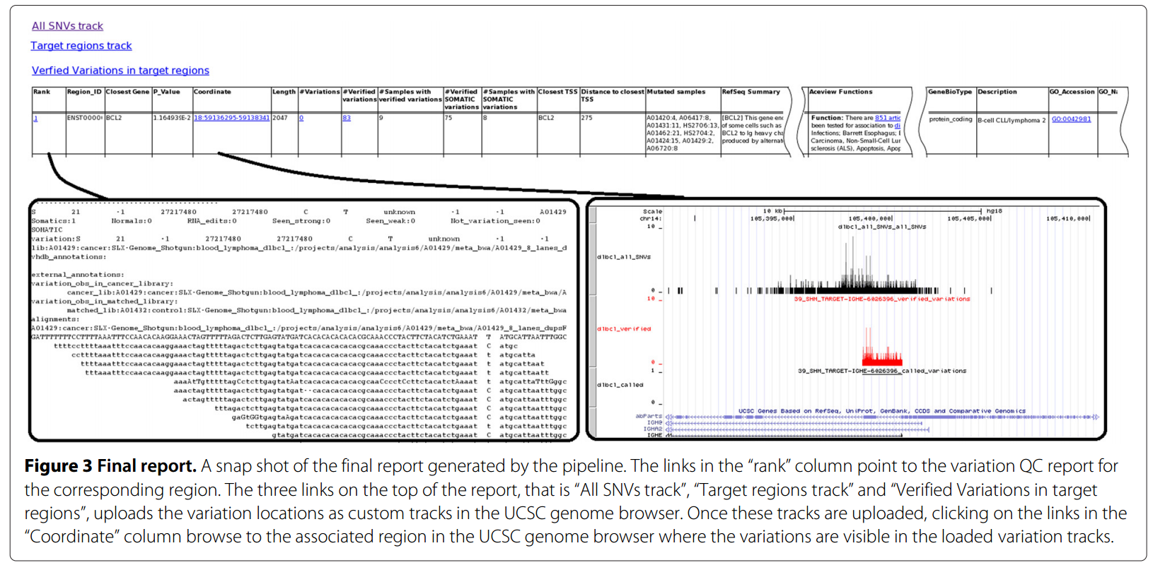

Slide 16
Performance
Data size:
2.5 billion variations
~2000 cancer samples.
~2000 normal samples.
Platform:
Linux Centos
PostgreSQL database.
Java APIs.
Database server: eight core Xeon ® 3.00 GHz, 64 GB memory
Application machine: 4 core, 8 GB memory
The pipeline run completes in about 23 hours.

Slide 17
Analysis of 40 DLBCL genomes.

Slide 18
Goal: Identify mutational hotspots in DLBCL genome.
Cohort: 40 whole genome DLBCL samples and their matched normal samples.
Conclusion: Small regions in the promoter of certain genes harbor an extraordinary amount of somatic mutations.
These regions undergo somatic hypermutation.

Slide 19
Somatic HyperMutation (SHM)
Naturally occurs in B-Cell development to generate diverse antibodies.
It occurs in variable region of immunoglobulin genes.
10⁵-10⁶ fold greater than the normal rate of mutation across the genome.
Mutations are mostly single base substitution (insertion and deletions are less common).

Slide 20
SHM Characteristics
SHM has a tendency toward certain motifs in DNA sequence, most significantly
WRCY (where W denotes A or T; R denotes A or G; and Y denotes C or T) or its reverse complement RGYW

Slide 21
SHM can aberrantly target proto-oncogenes (BCL6, PIM1, MYC, RHOH, PAX5) and tumor suppressors (CD95).
Such mistargeting of SHM (aSHM) contributes to the development of diffuse large B-ell lymphomas.
SHM also has a driving role in chromosomal translocations in B-cell lymphomas.
In the past decade twelve genes had been identified to have aSHM.
In addition to these genes our analysis identifies many more.
Are these novel genes really targeted by aSHM?

Slide 22
Do they show characteristics of SHM?
More Transition than Transversion SNVs.
Tendency toward WRCY/RGYW motif.
More C:G mutations than A:T
A bell shape mutation distribution around TSS.
We studied these characteristics for the genes that had similar or higher mutation rate than those known to be aSHM targets (44 genes).

Slide 23
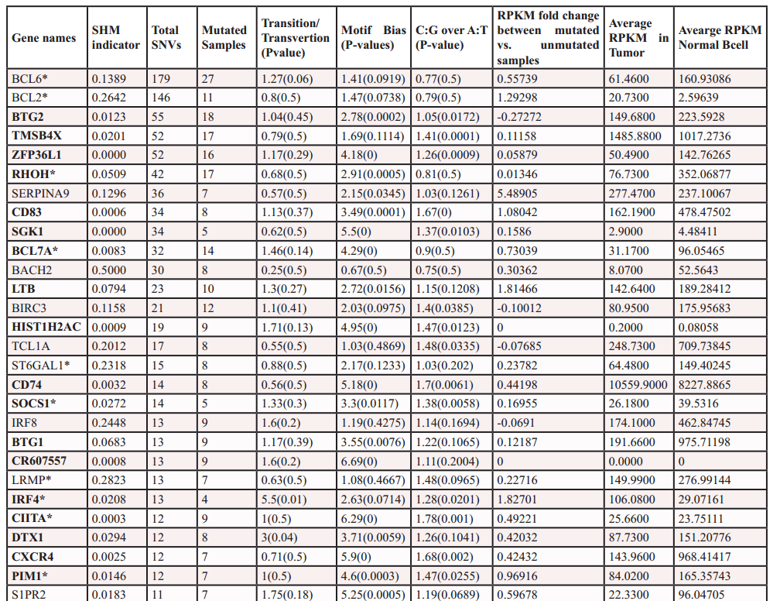
Oncotarget 2012; 3: 1308-1319

Slide 24
All known targets of aSHM (12 genes) are in the list and 75% of them have a significant aSHM indicator (a good control for our analysis).
More than 81 and 90 percent of the SHM-targets showed a bias for SHM criteria “Motif enriched” and “C:G vs A:T mutation bias”.
If these gene are enriched with aSHM mutations, a random mutated gene should have a significantly less aSHM indicator value.

Slide 25
The difference in RPKM values reflects a trend towards higher mRNA abundance of the mutated genes. This coincide with the observation that gene expression promotes SHM.

Slide 26
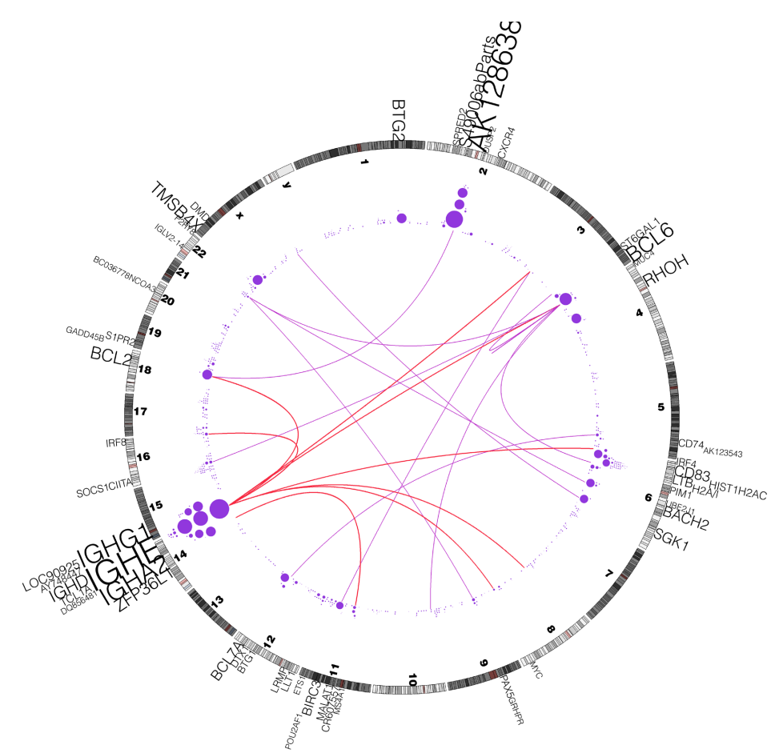
Correlation between mutations and rearrangements

Slide 27
Future works
The processing pipeline is specially in early stages (include more analysis).
Data visualization and GUI to browse results.
Utilizing Big Data technologies to improve performance.
Incorporate other data sources in a systematic way (pathways, PPI networks, …).
Implement mechanisms to share data.

Slide 28
Anthony Fejes
Steven Jones
Inanc Birol
Ryan Morin
Maria Mendez-Lago
Nina Thiessen
An He
Richard Varhol
Tina Wang
Richard Corbett
Misha Bilenky
Gordon Robertson
Andy Chu
Readman Chiu
Karen Mungall

Slide 29
Thanks

