Slide 1


PARRS RISK SCORE
A Renal Risk Score Development By An Artificial Neural Network
Ali Reza Khoshdel, MD-PhD
Associate Professor in Epidemiology
Department of Clinical Epidemiology
School of Medicine, Tehran, Iran

Slide 2
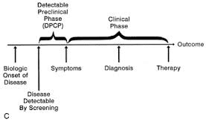
Why Screening and Risk Assessment?
Even Earlier:
RISK ASSESSMENT

Slide 3
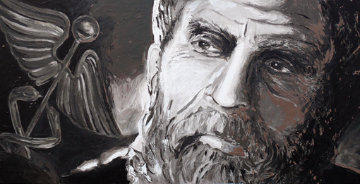
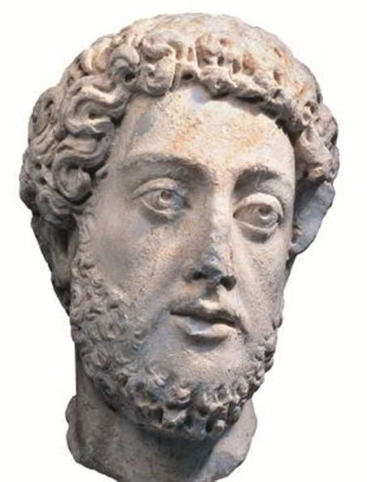
Footsteps in the history of medicine
Increased health risk due to obesity and alcohol has been mentioned in ancient writings of Hippocratus (370 BC).
Galen (The father of experimental medicine, 130-210 AD) introduced the theory of Humorism and had interesting comments on the polycystic kidney disease and about the circulation physiology and risk factors.

Slide 4
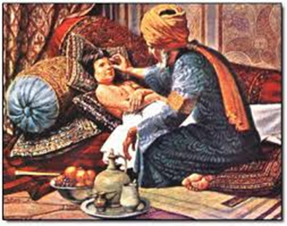
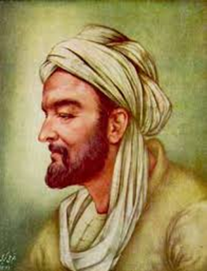
Rhazes (the Galen of Islam, 865-925 AD)described risk factors for renal stone formation and prescribed herbals to avoid recurrence. He noted differential diagnosis for anuria and hematuria by combination of Clinical markers.
Avicenna (The King of Medicine, 980-1037 AD) predicted renal outcomes by uroscopy findings and added patients’ characteristics (age, gender, Obesity, …) into account for the stone risk assessment. He also described about 20 CV risk factors and developed Clinical Sphygmology.

Slide 5

Pre-Modern Approaches
(Bad Drivers)
Regression plot of inverse Serum Creatinine
Mitch WE, Walser M, Buffington GA, Lemann J Jr: A simple
method of estimating progression of chronic renal failure.
Lancet; 18: 1326–1328, 1976
Proteinuria, even within the normal range is a predictor of the development of ESRD
Isseki et al, KI, 1996; 49: 800-805
CKDp
Microalbuminuria: early but not really predictive in some cases

Slide 6
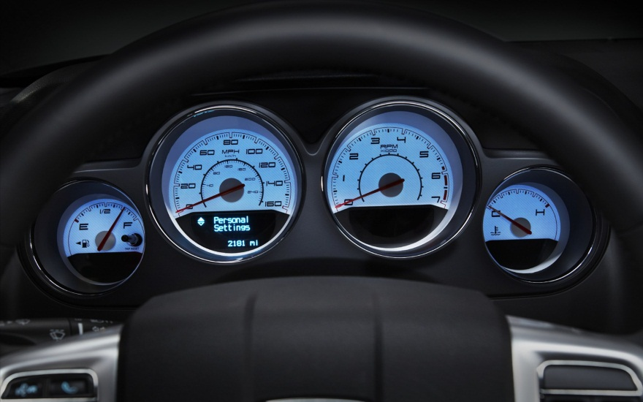
Modern Approach
(Bad Engine)
physician-centric and physician-dominated
Sub-spacialties
Decision Check points (e.g. HTN, DM, HLP,…)
predisposing
initiating
perpetuating
CVD
HLP
DM
CKD

Slide 7

Post-modern Era (Scoring)
patient-centric, on science and technology-dominated. It relies, on evidence, on genomics, bionics, proteomics
personalized, regenerative, on simulation and digital medicine ….
Consider Heterogeneitis

Slide 8
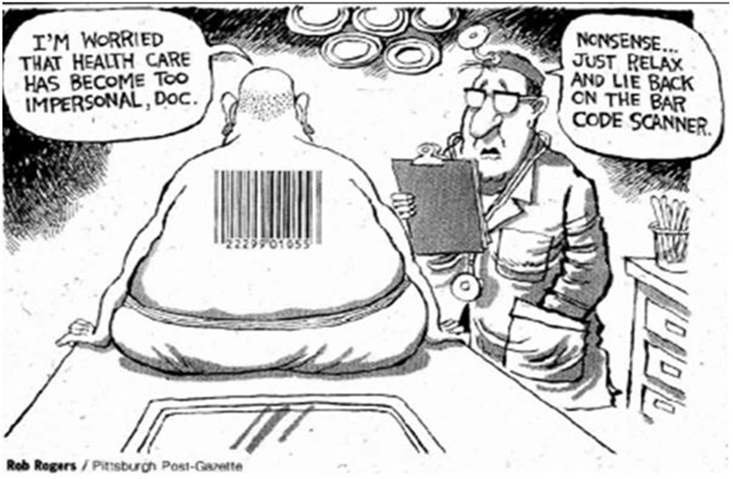

Slide 9
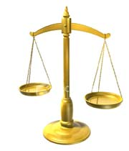
Scoring Systems
Multivariate Regression Analysis
Cox-Proportional Hazard Analysis
Decision-tree Simulations
Bayesian Modeling
There is an urgent need for a simple method of risk assessment for all patients with CKD (Taal- KI, 2008)

Slide 10
NHANES and ARIC studies
Risk factors for CKD (GFR<60 ml/min)
TEST SET:
ROC=0.88
PPV= 0.18
NPV=0.99
VALIDATION SET:
ROC=0.71
Cross-Sectional: 8530
Age
Gender
HTN
Anemia
DM
PVD
CVD history
CHF
Proteinuria
Cohort
14155
TEST SET:
ROC=0.69
PPV= 0.17
Bang et al, Arch Intern Med (2007);167: 374-381
Kshirsagar et al, Arch Intern Med (2008): 168: 2466-2473

Slide 11
Chien et al, Am J Med (2010); 123: 836-846
Age
Gender
BMI
HTN (DBP)
Uric Acid
Anemia
DM (+HbA1C)
Chnese Cohort: 5168
TEST SET:
ROC1=0.77
ROC2= 0.67
HipCox et al, BMC Fam Prac(2010); 11: 49
UK >1.5 million primary Care
(MOD to SEV)-CKD
TEST SET : ROC=0.82
Validation SET: ROC= 0.88
Added:
Ethnicity
SEC, NSAIDs
SLE
7 years Follow-up

Slide 12
PREVEND study
Risk factors for CKD (GFR<60 or 20% decline)
TEST SET:
ROC=0.84
PPV= 0.28
NPV=0.98
Only int. VALIDATION
Only white population
MDRD-eGFR
Age
Gender
Sys-HTN
Albuminuria
CRP
Population-based
6809
6.4 y. follow-up
Halbesma et al, Clin J Am Soc Nephrol (2011); 6: 222

Slide 13
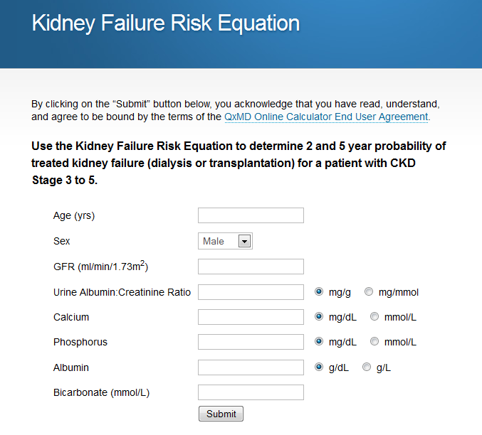
QXMD-risk score
REGISTRY for CKD stage 3-5
4942 pts
Model included:
Age,
sex,
eGFR,
AlbU,
sCa, sP, sHCO3,
s-albumin
C-Statistics=0.92
Not include HTN, DM….
Not exclude RF
Tangri N, Stevens LA, Griffith J, et al. A predictive model for progression of chronic kidney disease to kidney failure. JAMA. 2011;305(15). DOI:10.001/jama.2011.451

Slide 14
Have The Renal Risk Score Dream Come True?!
Astrid Czock et al/ 2013
2402 people screened in Switzerland by a Renal Risk Score including
AGE
SEX
Family History
Personal History
BP
ACR
NOT FOLLOWED-UP, NOT VALIDATED !!!

Slide 15
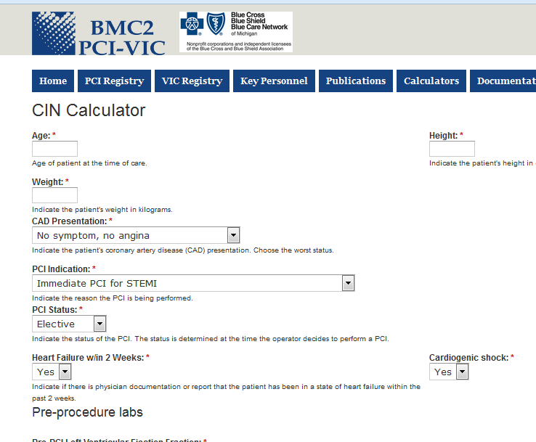
Contrast-induced Nephropathy (CIN) risk estimator
68573 PCI cases, Multicentre in Michigan 2010 to 2012
Model included:
age, sex, race, creat, Hb, Trop, clinical, mediciations
AUC=0.85 for contrat-induced nephropathy and AUC=0.87 for dialysis need
Classified Risk levels
Doubt in CIN diagnosis
No follow-up
Limited Clinical Use
Hitinder, et al, JACC, Vol. 61, No. 22, 2013, 2242-8

Slide 16

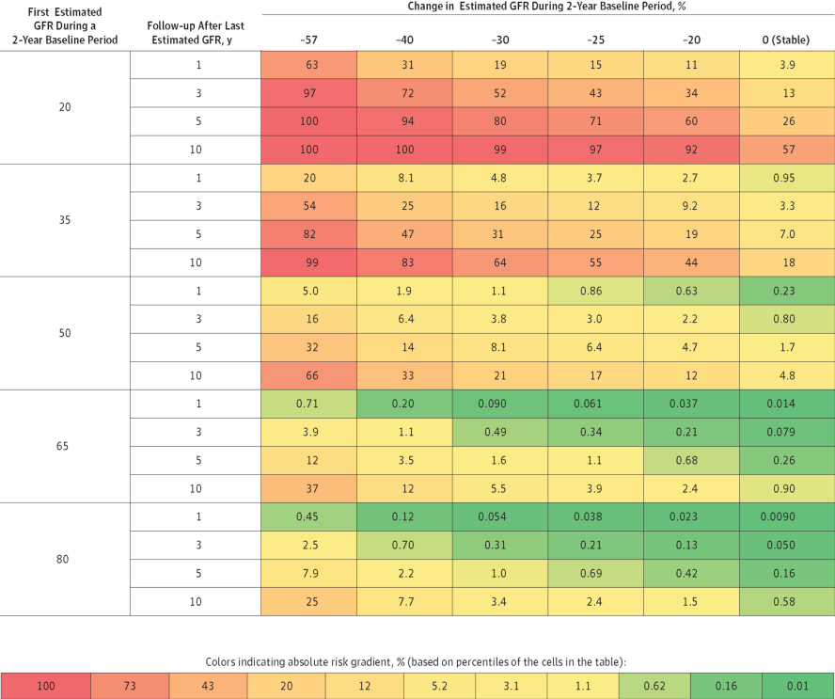
From: Decline in Estimated Glomerular Filtration Rate and Subsequent Risk of End-Stage Renal Disease and Mortality
JAMA. 2014;():. doi:10.1001/jama.2014.6634
Risk of End-Stage Renal Disease by Change in Estimated Glomerular Filtration Rate (GFR) During a 2-Year Baseline Period, First Estimated GFR, and Subsequent Follow-up. Baseline risk is calculated for participants with 0% change in estimated GFR, estimated GFR of 50 mL/min/1.73 m², age of 60 years, male sex, nonblack race, systolic blood pressure of 130 mm Hg, total cholesterol level of 5 mmol/L, and without diabetes or a history of cardiovascular disease.
Copyright © 2014 American Medical Association. All rights reserved.

Slide 17

Clinical Application of “Renal Risk Scores”: Where do we stand?
How popular they are in Clinical Practice?
Could we extrapolate evidences to our patients?
What happens if new markers will be introduced?
How can we deal with changing demographics?
Can we assess the net impact of our medication?
Are they applicable in different population?
Are these really early detectors?
How to mix with CV risk scores

Slide 18

Identifying & understanding the new, advanced approaches in Nephrology for better renal health

Slide 19
ANN characteristics
ANN is an intelligent system
In ANN, computation occurs in parallel across large numbers of simple processing units, rather than in the serial fashion of traditional computer architectures.
parallel distributed processing
learning algorithms and memory
Experiments and adjustments
Patient-specific and individual

Slide 20
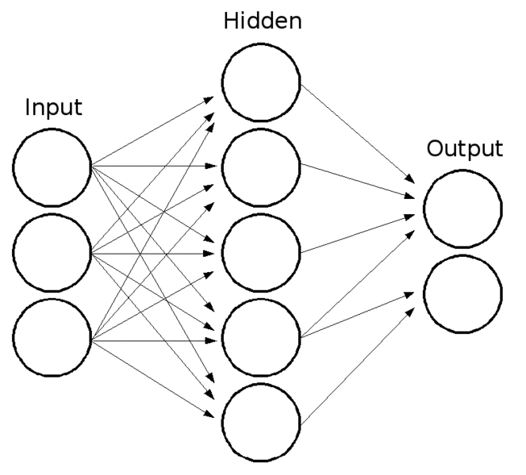
ANN structure
ANN consists of simple interconnected computational nodes, that work like a switch with particular threshold.
Input between -1 and +1
Output between 0 and 1

Slide 21
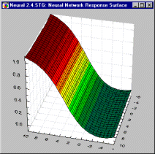
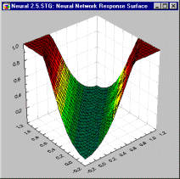
Network Response Surface
The first activation level is a linear function which is passed through a sigmoid curve
One hidden layer
Two hidden layers

Slide 22
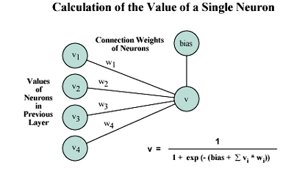
How ANN works?
Each neuron sums weighted signals come from previous layer……..
Then weights become adjusted according to the strength of the results until Good predictivity is reached.

Slide 24
360-degrees Approach
ANN
Demographic
Medical History
Hemodynamic
Blood Markers
medication
Urine markers

Slide 26
Patients Characteristics
For ANN analysis, 50 characters including the pts’ demographics, medical history, medication, urine and blood biomarker tests, hemodynamic and BP profile, and arterial evaluation related to 207 outpatient cases (including 100 DM patients) were included in this study. Average age for the study population was 60± 16 with 55% being male. Twenty six percent had a history of ischemic heart disease, 13% had experienced a previous stroke. They have been followed-up since 2003.

Slide 27
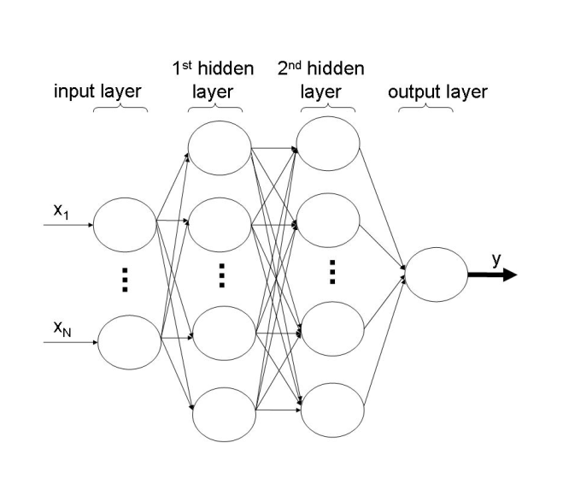
Binary 35 17 8 1
(60)
4-levels 38 19 9 4
(60-80-100)
forward feed, back propagation
Error Function: logistic activation function
Classification: confidence limit (for binary outcome)
Classification: Winner-takes-all method (for four-level outcome)

Slide 28
Training, Validation, Test
Sixty nine, 15 and 16% of the data were randomly selected for the training, validation and test set respectively.
Factors were reduced in refinement phases, with 10 manual backward elimination steps (based on their importance ratio) followed by 10 forward additions of clinically important factors to evaluate their impact on the model performance. Finally 11 factors with the binary outcome and 12 factors for the four-level outcome remained for final analysis.

Slide 29
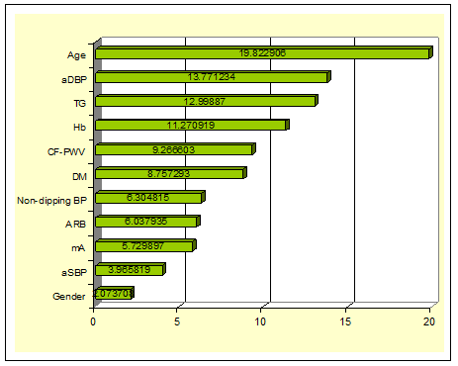
“PARRS-1 “ based on ANN
Outcome:
GFR ≤60 or >60
Accuracy
Total: 94.6%
Training: 99.2%
Validation: 86.2%
Test: 83.3%
The most important predictors for GFR (as a binary variable with 60 ml/min as the cut-off point)

Slide 30
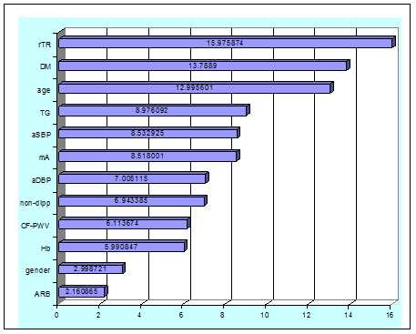
“PARRS-2 “ based on ANN
Outcome:
GFR >100-80-60>
Accuracy
Total: 89.2%
Training: 99.2%
Validation: 71.4%
Test: 62.1%
The most important predictors (max. impact on outcome) for GFR (as a four-level variable with 60, 80 and 100 ml/min as the cut-off points)

Slide 31
Conclusion
Renal Risk Score is an urgent need
A Post-modern Approach for the score is required
ANN is an ideal model for risk assessment
A holistic view is necessary
Individualization is mandatory
Notice Central Arterial Function rather than Peripheral blood pressure
PARRS performs well in Renal Risk Assessment
Let’s go further!

Slide 32
Future Roadmap
Genetic Epidemiology
Clinical Epidemiology
Community Epidemiology
Assess earlier
Add genetic Factors
Consider Microbiom
Take SEC into account
Personalize treatments
Act for Cohort Consortiums
Multidisciplinary research
Multidisciplinary training

Slide 33

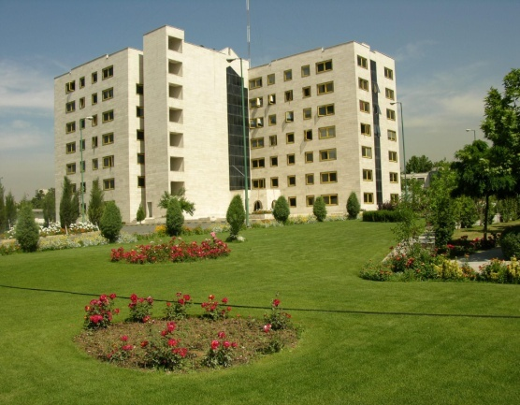

MERC, AJA University, Tehran, Iran
Thanks
سپاسگزارم
CCEB, Nobbys Beach, Newcastle, Australia

