Slide 1

CAN INFORMATICS TRANSFORM PUBLIC HEALTH
IN SAUDI ARABIA
By:
Dr Ali Al Shehri | MD, MPhil, FRCGP, ACHE, MFPH
Associate Dean, Academic and Student Affairs
President, Saudi Association of Public Health (SAPH)
Health Informatics & Technology Conference
Baltimore, USA
October 20-22, 2014

Slide 2
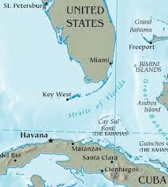
WHY PUBLIC HEALTH?
Increase life expectancy (40s to 70s & 80s)
Decrease/prevent diseases (eradication of
lethal disease)
Enhance cost-effectiveness of
healthcare (Cuba = USA!!)

Slide 3

ESSENTIAL FUNCTIONS OF PUBLIC HEALTH
Monitor health status to identify community health problems.
Diagnose and investigate health problems and health hazards in the community.

Slide 4

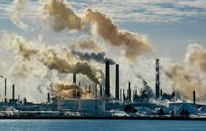
ESSENTIAL FUNCTIONS OF PUBLIC HEALTH
Inform, educate and empower people about health issues.
Mobilize community partnerships to identify and solve health problems.

Slide 5
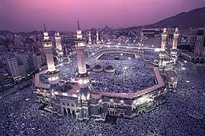
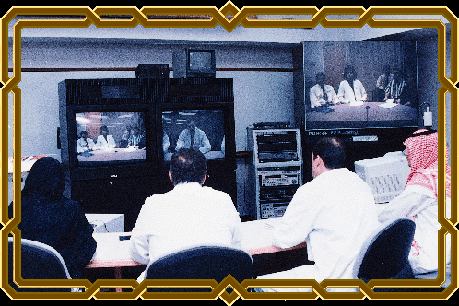

ESSENTIAL FUNCTIONS OF PUBLIC HEALTH
Develop policies and plans that support individual and community health efforts.
Enforce laws and regulations that protect health and ensure safety.
Link people to needed personal health services and ensure the provision of health care when otherwise unavailable.

Slide 6


ESSENTIAL FUNCTIONS OF PUBLIC HEALTH
Assure a competent public health and personal healthcare workforce.
Evaluate effectiveness, accessibility and quality of personal and population-based health services.
Research for new insights and innovative
solutions to health problems.

Slide 7



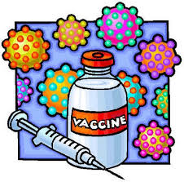
PUBLIC HEALTH ACHIEVEMENTS
U.S. 2001-2010
Vaccine-Preventable Diseases
Prevention and Control of Infectious Diseases
Tobacco Control
Maternal and Infant Health
Motor Vehicle Safety

Slide 8


PUBLIC HEALTH ACHIEVEMENTS
U.S. 2001-2010
Cardiovascular Disease Prevention
Occupational Safety
Cancer Prevention
Childhood Lead Poisoning Prevention
Public Health Preparedness and Response

Slide 9


PUBLIC HEALTH FACES
MAJOR CHALLENGES
IN THE 21ST CENTURY
Emerging diseases, e.g. Ebola
Non communicable diseases
Bioterrorism and chemical poisoning
Globalization and easy travels: Global Outbreak Alert and Response Network.

Slide 10
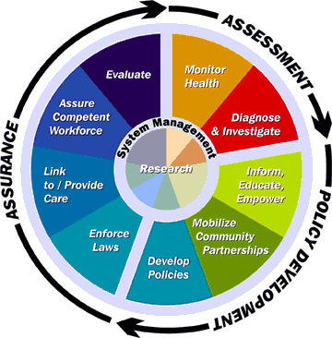
  Public health has to enhance its functions in this information age by utilizing the information and communication technology (ICT)
Information → Decision
The better the information
the better the
decision

Slide 11


PUBLIC HEALTH INFORMATICS
Public Health Informatics provides fast, reliable and valid information to make decisions.
Sound information about public health leads to sound decisions for public health.
Sound information is essential for Health care management, planning and policy.

Slide 12


PUBLIC HEALTH INFORMATICS
Public Health Informatics deals with electronic resources and processes of:
  Collecting
  Keeping
  Retrieving
  Disseminating and utilizing information in public health practice
  Research and learning.

Slide 13


CDCs NATIONAL CENTER FOR PUBLIC HEALTH INFORMATICS (NCPHI)
Provides leadership in the application of information and computer science and technology to public health practice, research and learning.

Slide 14

CDCs NCPHI
Electronic health record support of public
health functions
Use of health care, population and other public health data in supporting public health systems and analyses
Basic capabilities that support public health practice such as statistical and health surveillance
Public Health decision support

Slide 15

PUBLIC HEALTH INFORMATICS
“the systematic application of information and
computer science and technology to public
health practice, research and learning”
ACTIVITIES MAY INCLUDE:
  Collection and storage of vital statistics
  Collection and reporting of communicable diseases
  Disease surveillance
  Display disease statistics and trends
  Immunization
  Hospital statistics

Slide 16
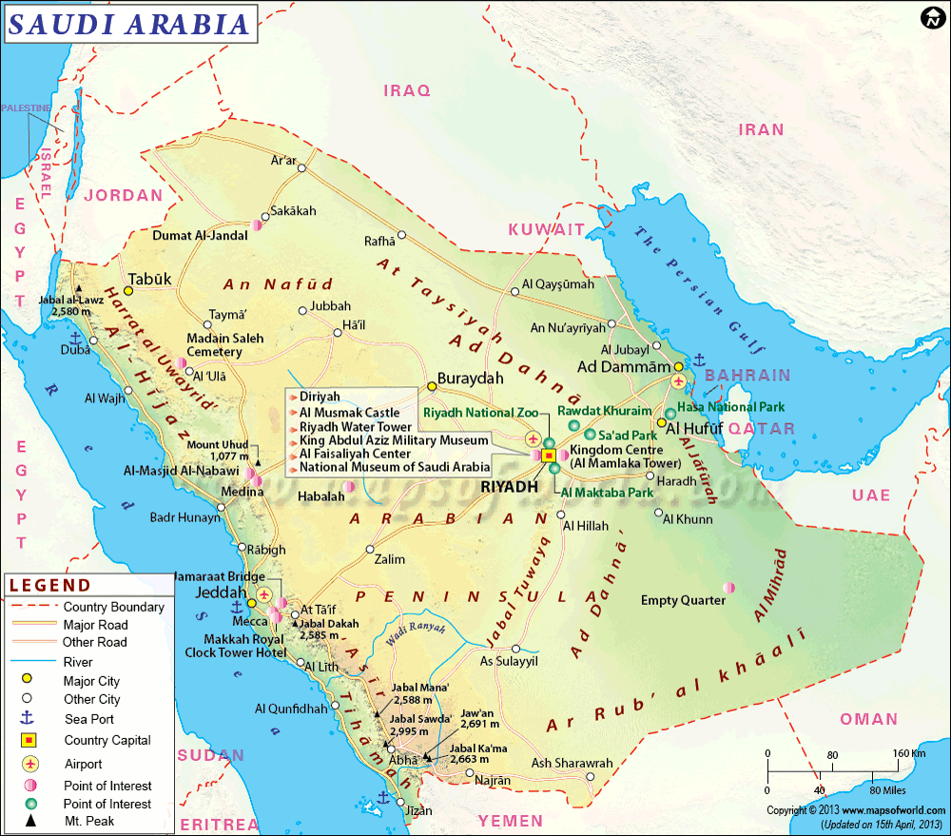
PUBLIC HEALTH
INFORMATICS and KINGDOM OF
SAUDI ARABIA
Large country
2,250 sq m
GDP 2013
746 Billion US$
Population:
1950=3M
2011=27M
2015=30M (Mostly young)
Life Expectancy
73.7
Vaccine coverage
Almost 99%
Eradication of polio and many other communicable diseases
But …

Slide 17
  More chronic diseases (Obesity, DM, IHD)
  Road traffic accident is a major problem
  Environmental and Occupational Safety Issues
  Multiple providers of healthcare: cost-effectiveness?
  Mass Gathering Medicine
  Others

Slide 18


BRIEF HISTORY AND DEVELOPMENT OF HEALTHCARE IN SAUDI ARABIA (MoH)
1
1925 Department of Health
2
Later General Directorate of
Health and Aid
1950 Ministry of Health (MoH) was established
3
1978 KSA signed Alm-Ata Declaration as a member of WHO: Health for All through PHC as preventive, curative and rehabilitative approach
4

Slide 19

BRIEF HISTORY AND DEVELOPMENT OF HEALTHCARE IN SAUDI ARABIA (MoH)
5
1981 Directorate of PHC at MoH
6
2002 Establishment of Council of Health Services
2009 National Evaluation Committee reviewed PHC and made recommendations
7
2010 Deputy minister PH
8
Now more than 2,037 PHCCs and 244 Hospitals under MoH
9

Slide 20
CURRENT SYSTEMS
Services provided through Primary, Secondary and Tertiary care and Accounts for almost 60% of services kingdom-wide.
Other Sectors 40% Governmental and Private
Multiple providers and sectors with multiple levels and tiers of services

Slide 21
Multiple providers with little connection
Ministry of Health
University Hospitals
National Guard Health Affairs
School Health Units
Health Services in the Royal Commission for Jubail and Yanbua
Security Forces Medical Services
Armed Forces Medical Services
ARAMCO Health Services
Red Crescent
Others

Slide 23


Creation of Council of Health Services as a coordinating body for all Healthcare providers.

Slide 24
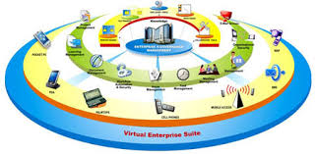

  Development in ITC:
eGovernment: many initiatives and projects to transform:
  G2C: Government-to-citizen
  G2B: Government-to-Business
  G2G: Government-to-Government
  G2E: Government-to-Employee
  IEE: Internal Efficiency and Effectiveness

Slide 25



  Development in ITC:
eLearning and Education
  National eLearning Center
  SEU: Saudi Electronic University
  Many graduate programs in information management and health informatics
  MoHE programs, projects and units
  Thousands of scholarship in HI and public health-related specialties

Slide 26


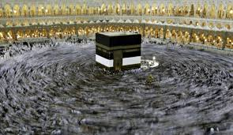
  A number of electronic surveillance systems:
GPHIP has worked with the Kingdom of Saudi Arabia, Ministry of Health (MoH) to strengthen its surveillance for mass gatherings (i.e., Umrah Ramadan, Hajj).
Mobile-based Notifiable Electronics Disease Surveillance System (MNDESS), to create instant daily reports which allowed MoH officials to respond promptly to early signs of possible outbreaks.
Notes:
GPHIP has worked with the Kingdom of Saudi Arabia, Ministry of Health (MoH) to strengthen its surveillance for mass gatherings (i.e., Umrah Ramadan, Hajj).
Mobile-based Notifiable Electronics Disease Surveillance System (MNDESS), state-of-the-art technology that collects and processes infectious disease data using smartphones. As a result, disease data were analyzed and interpreted onsite to create instant daily reports which allowed MoH officials to respond promptly to early signs of possible outbreaks. More than 300 healthcare professionals have been trained to use the system for the Hajj.

Slide 27
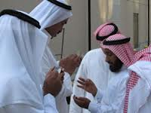

  A number of electronic surveillance systems:
The Saudi Arabia National Guard Health Authority (SANG-HA); CDC/NGHA Integrated Electronic Disease Surveillance System (NG-IEDSS) pulls together data from three major disease reporting systems.
Healthcare Associated Infections (HAI), notifiable diseases, and environmental and occupational disorders.
Notes:
The Saudi Arabia National Guard Health Authority (SANG-HA).
CDC/NGHA Integrated Electronic Disease Surveillance System (NG-IEDSS) pulls together data from three major disease reporting systems.
Healthcare Associated Infections (HAI), notifiable diseases, and environmental and occupational disorders.
Almost all major medical cities, hospitals and health authorities have an electronic health data systems but interoperability and exchange of data are lacking.

Slide 28


  Many initiatives for Health Informatics but ?coordination and ?Integration.

Slide 29
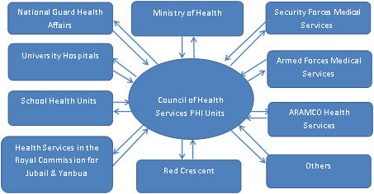
  National Public Health Informatics may play a major role in optimizing current public health functions and transform it on the long run.
Notes:
Proposed structure of Public Health Informatics (PHI) based in Council of Health Services and coordinating & collaborating with all healthcare sectors/providers.

Slide 30



Challenges
Multiple providers
Multiple systems
Trained staff

Slide 31


Where are we now?

Slide 32
CAN INFORMATICS TRANSFORM
PUBLIC HEALTH
IN SAUDI ARABIA
THANK YOU!
Presented By:
Dr Ali Al Shehri | MD, MPhil, FRCGP, ACHE, MFPH
Associate Dean, Academic and Student Affairs
President, Saudi Association of Public Health (SAPH)
Health Informatics & Technology Conference
Baltimore, USA
October 20-22, 2014

