Slide 1
The Ecosystem and Energy Development in Wyoming and the Intermountain West
David Aadland, John Tschirhart & Alfredo Cisneros-Pineda (PhD Student)
UW Department of Economics and Finance
Milton Geiger
UW Extension & School of Energy Resources
Jacob Goheen
UW Departments of Zoology/Physiology and Botany
Berry Biodiversity Center

Slide 2
Overview
Focus on ecological impacts from natural gas development
Calibrate rangeland food web to Atlantic Rim Natural Gas (ARNG) region
Introduce natural gas development and predict impacts on rangeland species

Slide 3
Introduction
Rapid growth of energy development in Wyoming
Unexpected consequences of human activity on Biodiversity
Ecosystem Services: Hunting and Cattle Grazing

Slide 4
Atlantic Rim Natural Gas Development
ARNG region is 109,297 hectares
ARNG will contain 2,000 natural gas wells
ARNG will produce 1.35 Tcf of natural gas (heat 1.93 million homes for one year)
ARNG is home to many rangeland species
Disturbance area (Buffer Zones) of 1,000 meters

Slide 5
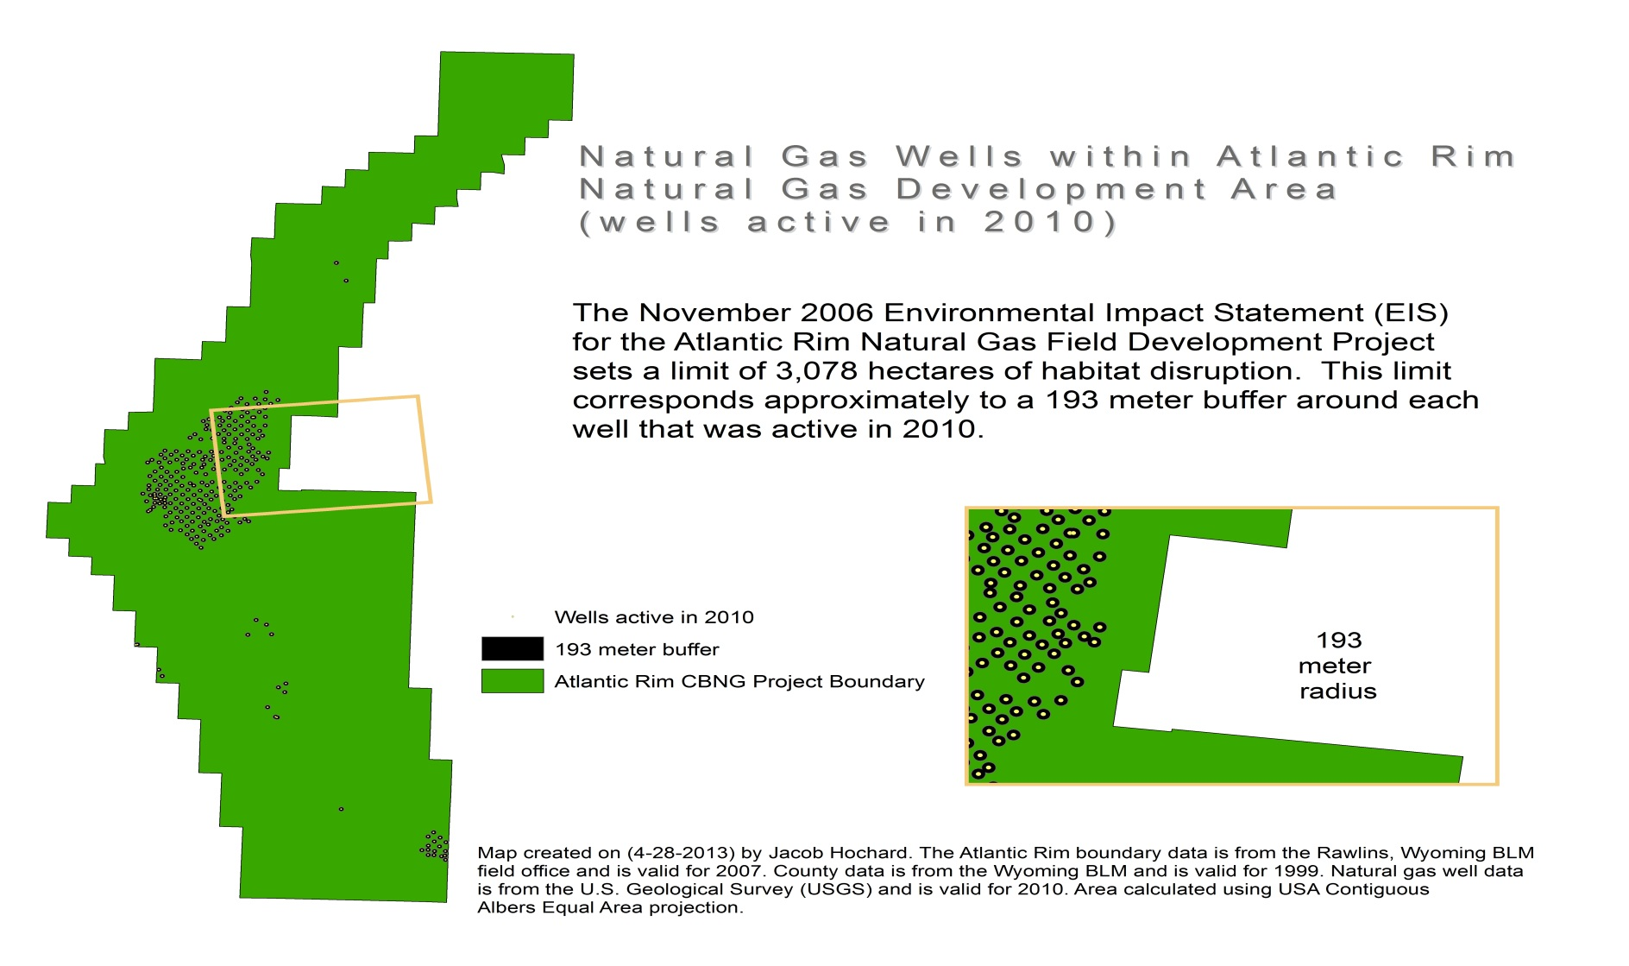
Atlantic Rim Natural Gas Development, WY

Slide 6
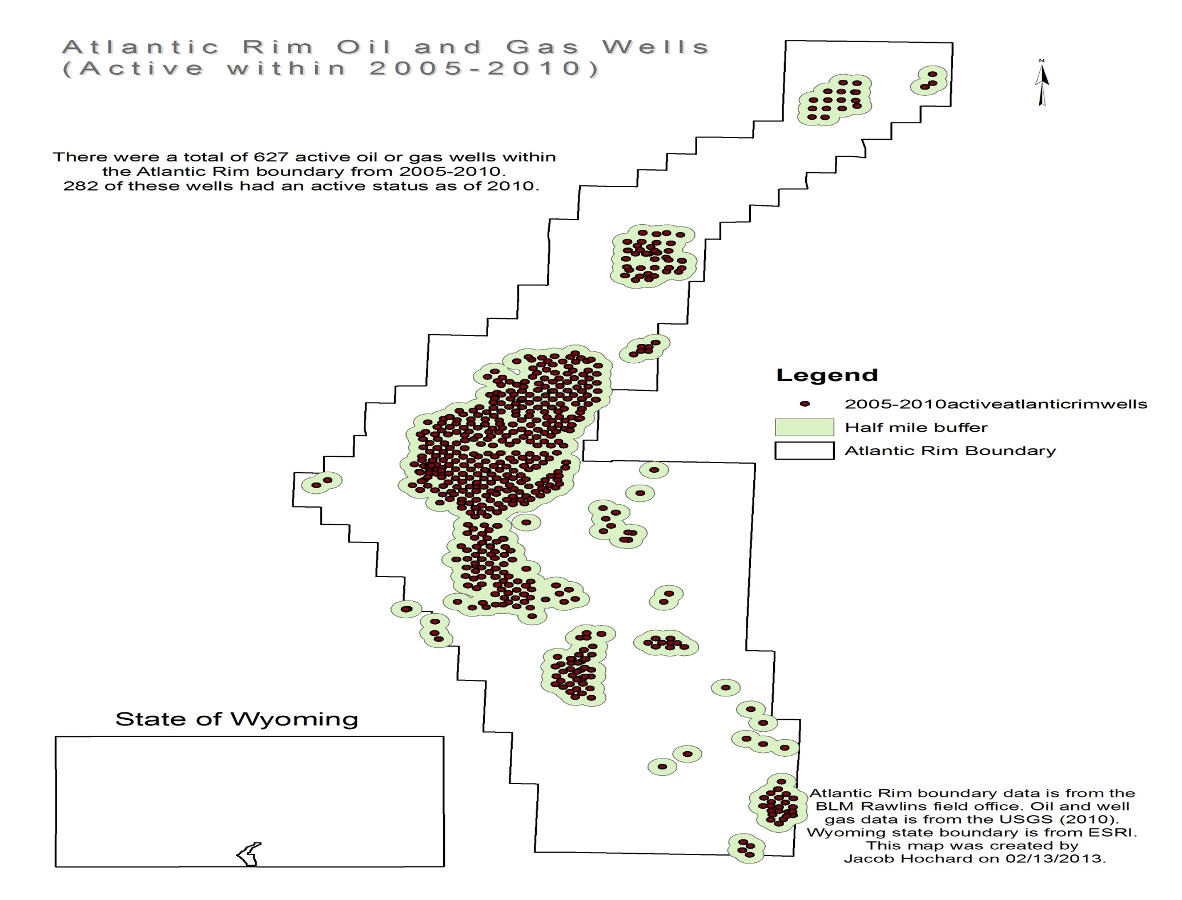

Slide 7
Rangeland Ecosystem and GEEM
Ecosystem contains many species (elk, deer, sage grouse, grasshoppers, prairie dogs, etc.)
General Equilibrium Ecosystem Model (GEEM)
  Tschirhart (Journal of Theoretical Biology, 2000)
GEEM is calibrated to ARNG region

Slide 8
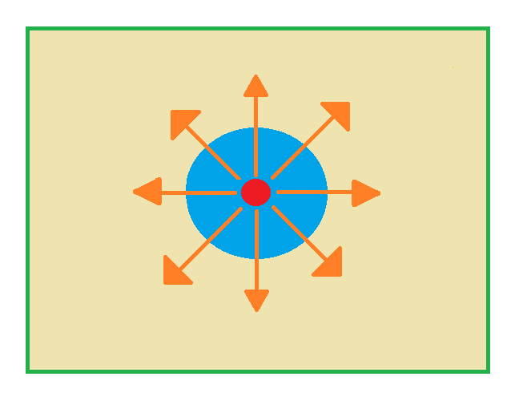
Rangeland Food Web & Natural Gas Development

Slide 9
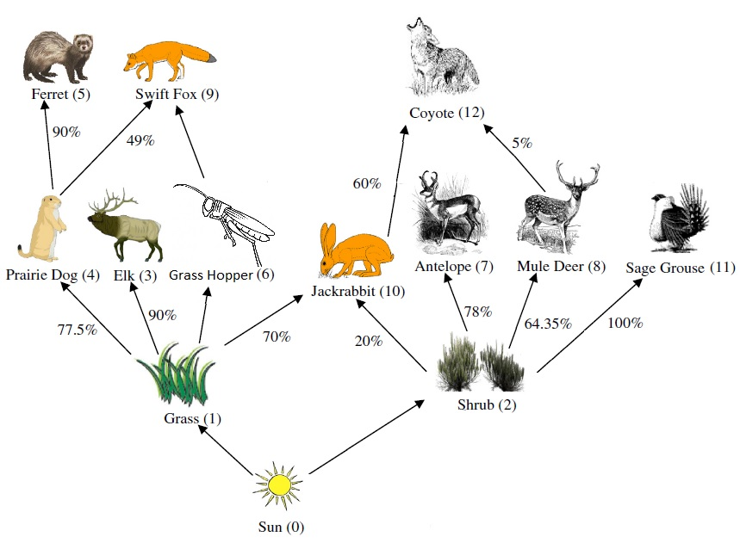
Rangeland Food Web & Natural Gas Development

Slide 10
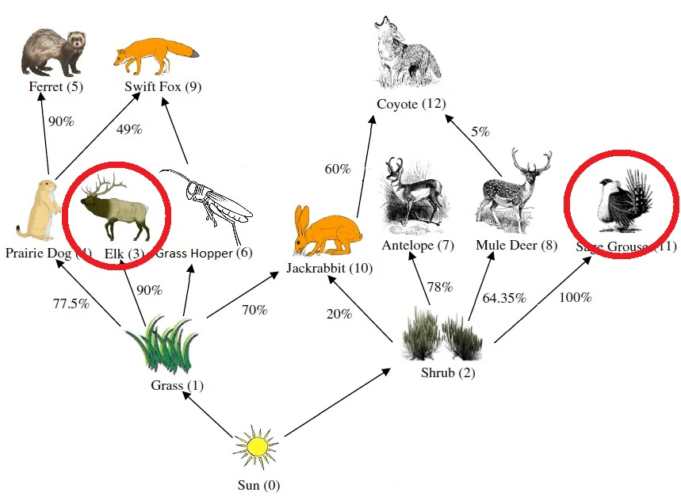
Rangeland Food Web & Natural Gas Development

Slide 11
General Equilibrium Ecosystem Model
Plants & Animals act as if they were rational agents that maximize the net energy of Biomass Consumption (Hunting or Grazing)
Benefits: Energy content in Biomass
Grazing & Hunting Cost: Energy Expenditure Price
Variable Cost: Respiration, Feces, Locomotion & Reproduction
Energy content in Biomass vs Exposing to Predators & Respiration Cost

Slide 12
Net Energy Equation

Slide 13
Optimal Management
We use GEEM and Mathematica v 9.0 to predict:
  Impact on species populations of energy development activities
  Change in benefits for ecosystem services
We consider two scenarios:
  Hunting & Cattle Grazing
  Hunting & Cattle Grazing + Buffer Zones

Slide 14
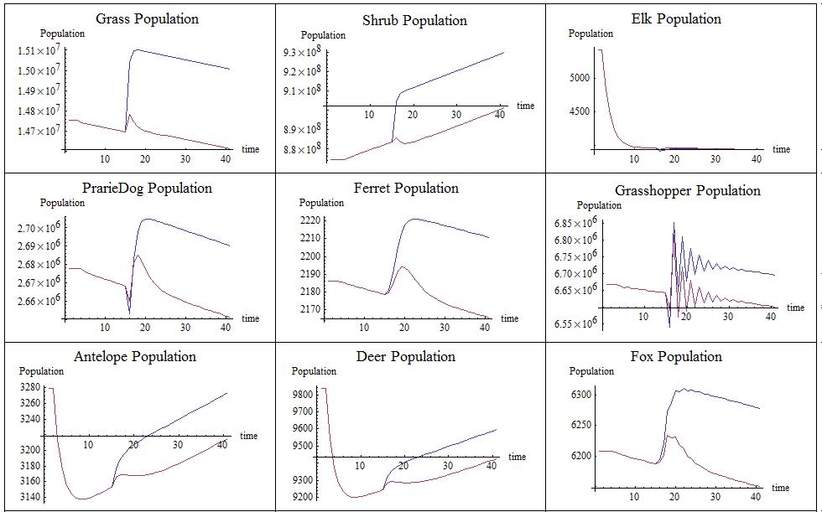
Population simulations using GEEM

Slide 15
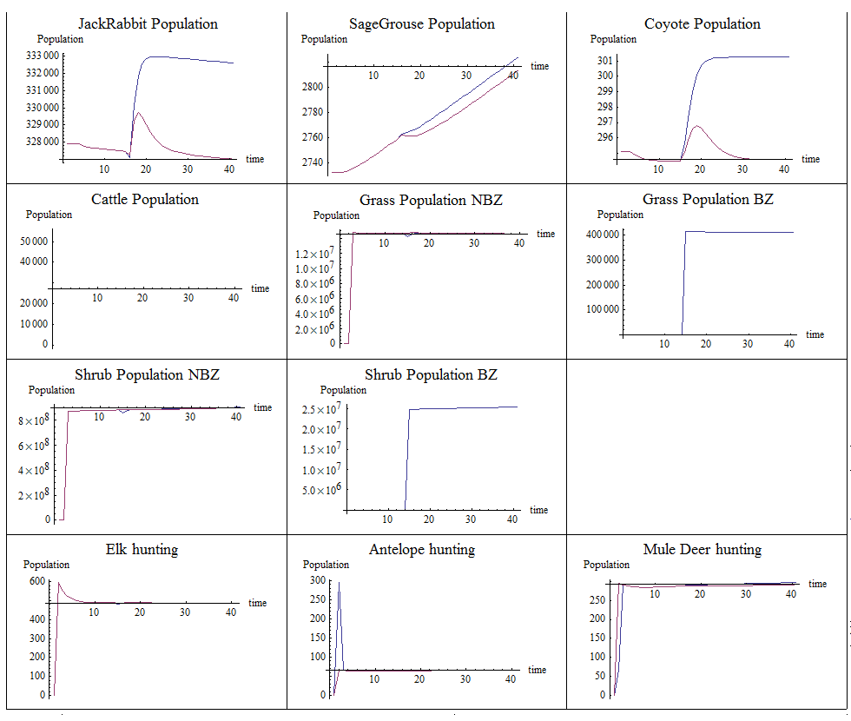
Population simulations using GEEM

Slide 16
Where are we now?
Write manuscript for publication
Add other ecosystem externalities (e.g., land degradation from cattle grazing)
Using GEEM to solve for “natural” steady state
Adding migration corridors & spatial component
Finding optimum extraction levels: hunting & cattle grazing

