Slide 1
The Clinical Manifestations In Children With Tonsillar Lymphoma
Dr. Alexandre Caixeta Guimarães
ENT doctor from Department of Otolaryngology, Head and Neck Surgery, University of Campinas (UNICAMP), Brazil.
e-mail: alecgxl2@hotmail.com

Slide 2
The Clinical Manifestations In Children With Tonsillar Lymphoma

Slide 3
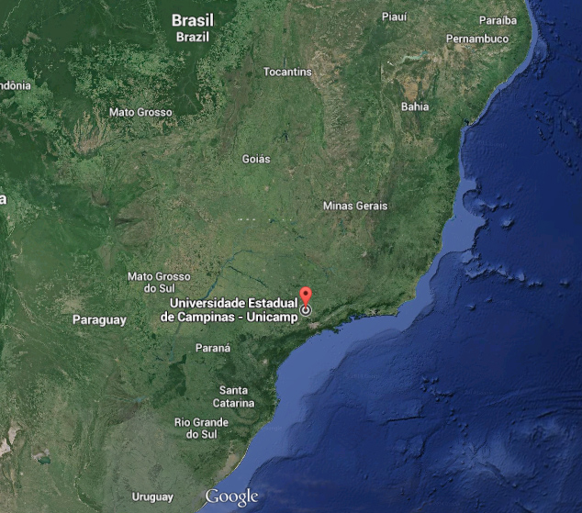
The Clinical Manifestations In Children With Tonsillar Lymphoma

Slide 4
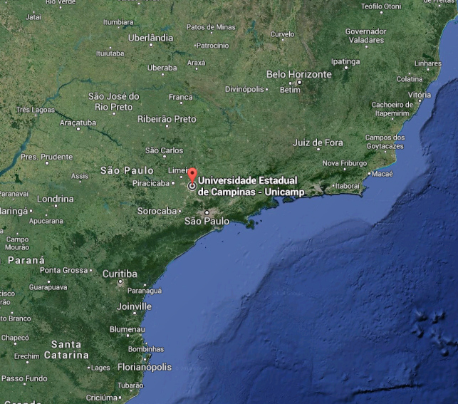
The Clinical Manifestations In Children With Tonsillar Lymphoma

Slide 5
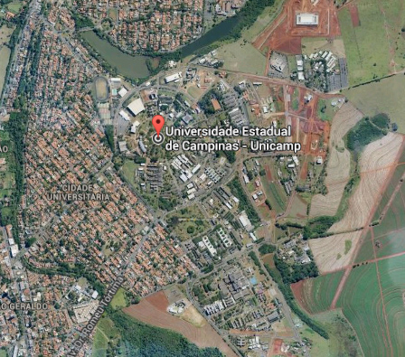
The Clinical Manifestations In Children With Tonsillar Lymphoma

Slide 6
The Clinical Manifestations In Children With Tonsillar Lymphoma

Slide 7
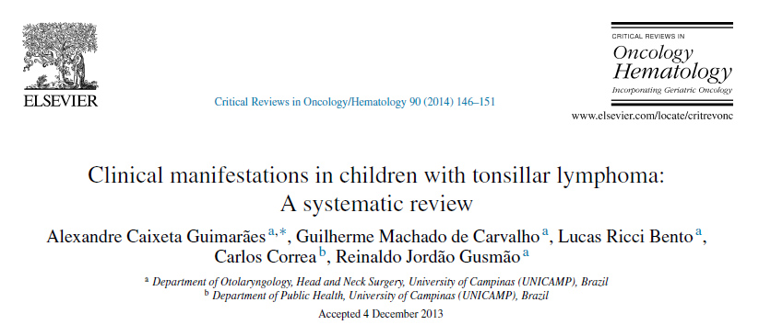
Clinical Manifestations In Children With Tonsillar Lymphoma: A Systematic Review

Slide 8
Introduction
Lymphoma is the third most common childhood malignancy and the most common in the head and neck.
Approximately 15% of head and neck lymphomas in children affect the Waldeyer's ring
Non-Hodgkin lymphoma (NHL) is the most common type
The palatine tonsils (PT) are the most frequent site of involvement for extra-nodal NHL
Early diagnosis and treatment are of great importance in the prognosis of tonsillar lymphoma patients.

Slide 9
Objective
To realize a systematic review of the literature on the clinical manifestations present at diagnosis of tonsillar lymphoma in pediatric patients

Slide 10
MATERIALS AND METHODS:
Articles in English, Spanish or Portuguese in the last 15 years about lymphoma in palatine tonsil in children from PubMed/Medline, LILACS, IBECS, Cochrane, SCIELO, BIREME and Scopus.
The MesH terms and free text words used were "tonsillar lymphoma and children.“
Two authors were responsible for selecting all the articles that had been completely read.

Slide 11
MATERIALS AND METHODS:
Articles and case reports were included covering the pediatric age group, considered up to 18 years old that contained information of the clinical manifestations of tonsillar lymphoma at diagnosis

Slide 12
RESULTS:
87 articles were found, in which 18 (20.6%) met the inclusion criteria.
87 – Papers
Full Text
18 – Papers INCLUDED

Slide 13
RESULTS:
There were 66 cases of PT lymphoma
The age ranged from one to 17 years with a mean of 7.4 years
There was a predominance of male patients, with a male/female ratio of 1.95
Most of the cases (68.3%) were from North America, followed by Europe with 13.7% cases, Australia with 10.5%, South America with 4.5%, and Africa with 3% of the cases.

Slide 14
Prevalence of clinical manifestations
SIGN/ SYMPTOM | Cases | %
Unilateral tonsillar enlargement/ Tonsillar asymmetry | 48 | 72.7%
Color alteration/ Visible lesion in PT | 30 | 45.4%
Cervical lymphadenopathy | 20 | 30.3%
Dysphagia | 19 | 28.7%
Snore/apnea | 16 | 24.2%
Recurrent tonsillitis | 8 | 12.1%
Fever | 7 | 10.6%
Weight loss | 6 | 9%
Vocal alteration/difficulty to speak | 6 | 9%
Local pain (tonsillar) | 5 | 7.5%
Tonsillitis treatment without improvement | 4 | 6.6%
Immunosuppression | 4 | 6.6%
Auricular fullness | 2 | 3%
Prior radiotherapy | 1 | 1.6%
TOTAL (n=66)

Slide 15
RESULTS:
The presence of B symptoms occurred in only 16% of the patients
Burkitt's lymphoma was the most common type (50%), followed by B-cell NHL (30%),and T lymphoblastic (6%)

Slide 16
RESULTS:

Slide 17
Discussion:
This data contrast with the data collected for the adult population with PT Lymphoma, in which the most common manifestations are dysphagia or odynophagia and cervical lymphadenopathy
This was the largest review of PT lymphoma in children and the first systematic review that included case reports and appointed the most common symptoms in this disease.

Slide 18
Discussion:
Children with a high level of suspicion should undergo to surgery of tonsillectomy for diagnosis.
Children who present only some of the manifestations should have a close follow up and be submitted to complementary examinations such as ultrasound when cervical lymphonodes are present. PET/CT may be discussed with the family.
For cases with atypical manifestations we advise only a close clinical follow up and perform complementary examinations or surgery if the level of suspicion increases.

Slide 19
Conclusion:
The most common clinical manifestations found in children with PT lymphoma were unilateral tonsillar enlargement, alteration of appearance of the PT, cervical lymphadenopathy, dysphagia, and snoring
Burkitt's was the most common type of lymphoma, followed by B-cell NHL
A detailed description of the PT lymphoma cases and the use of criteria for the classification of tonsil asymmetry are important for future review.

Slide 20
Key Points:
Considering that early diagnosis and treatment are of great importance in the prognosis of tonsillar lymphoma patients;
The knowlegde of the most frequent clinical manifestations are relevant for early suspicion and diagnosis

Slide 21
Key Points:
Most frequent clinical manifestations:
Unilateral tonsillar enlargment / Tonsillar asymmetry (72%)

Slide 22
Key Points:
Most frequent clinical manifestations:
Alteration of appearance of the PT (45%)

Slide 23
Key Points:
Most frequent clinical manifestations:
Cervical lymphadenopathy (30%)

Slide 24
Key Points:
Most frequent clinical manifestations:
Dysphagia (28%) and Snoring (24%)

Slide 25
Key Points:
Other frequent clinical manifestations:
Recurrent tonsillitis / Weight Loss / Fever

Slide 26
Key Points:
Tonsillar Lymphoma:

Slide 27
Future Directions:
Association between unilateral tonsillar enlargement and lymphoma in children: A systematic review and Meta-Analysis
The main cause of asymmetry of palatine tonsils was lymphoid hyperplasia, followed by lymphoma and nonspecific benign changes
The asymmetry of tonsils was present in 73.2 % of cases of lymphoma
There was association between asymmetric palatine tonsils and lymphoma, with a likelihood ratio of 43.5 for children with asymmetry of palatine tonsils and 8938.4 for children with asymmetry of tonsils and other signs of suspicion for malignancy

Slide 28
Future Directions:
Tonsillar lymphoma in children: An age distribution study
The children's ages ranged from 1 to 17 years with a mean of 7.7 years.

Slide 29
Future Directions:
Tonsillar lymphoma in children: An age distribution study
Most patients (55%) are concentrated in the age group 2-7 years, with a peak between 4 and 5 years.
There was no difference between the pattern of age distribution between males and females.

Slide 30
Thank you for the attention
Clinical Manifestations of children with tonsillar lymphoma
E-mail: alecgxl2@hotmail.com

