Slide 1
About OMICS Group
OMICS Group International is an amalgamation of Open Access publications and worldwide international science conferences and events. Established in the year 2007 with the sole aim of making the information on Sciences and technology ‘Open Access’, OMICS Group publishes 400 online open access scholarly journals in all aspects of Science, Engineering, Management and Technology journals. OMICS Group has been instrumental in taking the knowledge on Science & technology to the doorsteps of ordinary men and women. Research Scholars, Students, Libraries, Educational Institutions, Research centers and the industry are main stakeholders that benefitted greatly from this knowledge dissemination. OMICS Group also organizes 300 International conferences annually across the globe, where knowledge transfer takes place through debates, round table discussions, poster presentations, workshops, symposia and exhibitions.

Slide 2
About OMICS Group Conferences
OMICS Group International is a pioneer and leading science event organizer, which publishes around 400 open access journals and conducts over 300 Medical, Clinical, Engineering, Life Sciences, Phrama scientific conferences all over the globe annually with the support of more than 1000 scientific associations and 30,000 editorial board members and 3.5 million followers to its credit.
OMICS Group has organized 500 conferences, workshops and national symposiums across the major cities including San Francisco, Las Vegas, San Antonio, Omaha, Orlando, Raleigh, Santa Clara, Chicago, Philadelphia, Baltimore, United Kingdom, Valencia, Dubai, Beijing, Hyderabad, Bengaluru and Mumbai.

Slide 4
Facial Plastic Surgery & ENT
COSMEDICALS, CEO
Health, Beauty and Wellness Medical Center.

Slide 5
Facial Plastic Surgery & ENT
COSMEDICALS, CEO
Health, Beauty and Wellness Medical Center.

Slide 6
MINIMAL INVASIVE PROCEDURES IN AESTHETIC FACE

Slide 7
MINIMAL INVASIVE PROCEDURES IN AESTHETIC FACE
Specific problems:
Age related facial changes (treatment of choice)
Acne scars
Skin laxity
Marionette lines and jowl formation
Pigmentary changes - Spots - Rosacea
Benign epidermal pigmented and vascular lesions
Unwanted darkly pigmented facial hair
Hyperkinetik and dynamic facial lines
Prominent nasolabial folds
Flattening of malar fat pads
Skin appearance
Upper lip atrophy
Perioral wrinkles
Smoking
MINIMAL INVASIVE PROCEDURES IN AESTHETIC FACE

Slide 8
Quick Face Design

Slide 9
Quick Face Design
Microdermabrasion - Hidrodermabrasion
Laser-Radiofrecuency
Fractional - Fraxel CO2
Botulinum Toxin
Fillers - Facial sculpturing
Plasma
Radiosurgery
Cosmeceutical Products
Cold Laser Medical Therapy for smoking cesation

Slide 10
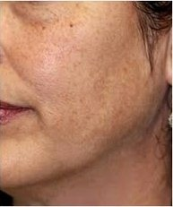
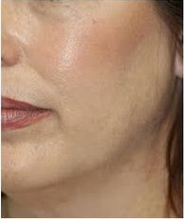
Quick Face Design
Microdermabrasion
PRE
POST
Noninvasive rejuvenation with fine rasps: polish, exfoliate and rejuvenate the skin exceptionally.

Slide 11
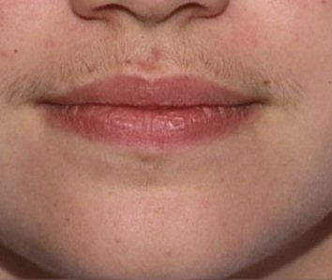
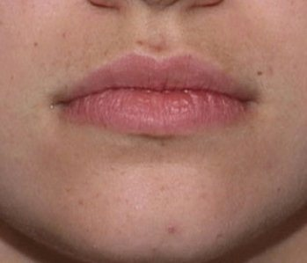
Quick Face Design
Laser
Depilation
PRE
POST
After a few sessions, the patient may enjoy many prolonged hairless months and with more sessions, the effect lasts during years.
Faster and less painfull than elecrolysis.

Slide 12
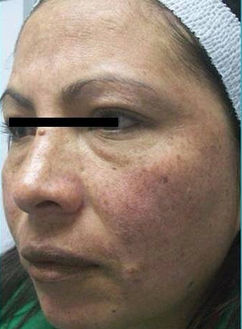
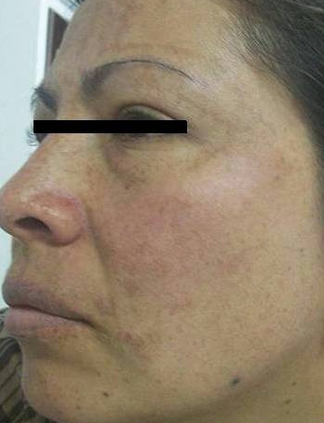
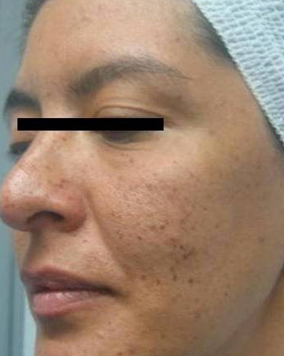
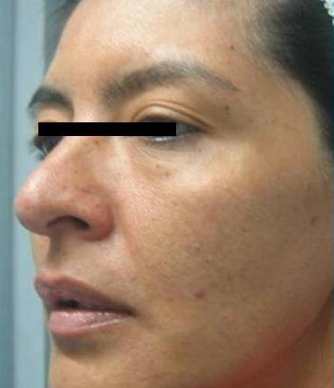
Quick Face Design
Laser
Spots & rosacea
The latest technology in laser systems clear, regularize, tone up, tighten and rejuvenate all skin types, different textures and tones, with no risks, no restrictions, recovery in a few hours, no disability, no scarring and no pain.
PRE
POST

Slide 13
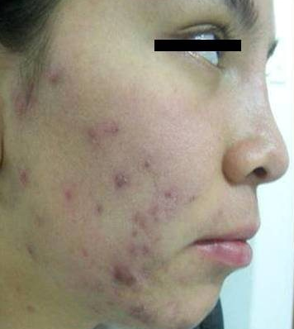
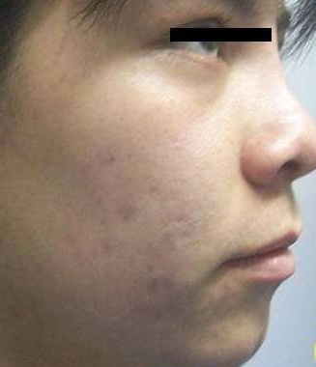
Quick Face Design
Laser
Acne
PRE
POST
Laser technology reduces sebaceous gland activity and destroy the bacteria that causes acne safely and effectively on all skin types.

Slide 14
Quick Face Design
Acne scars
Increase tissue repair
Rejuvenation
Skin tearings
Cheloyds
Skin surface irregularities
Skin laxity
Induces collagen neogenesis
Fractional CO2 Laser

Slide 15
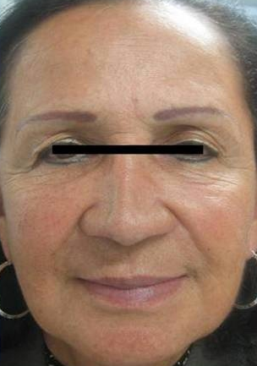
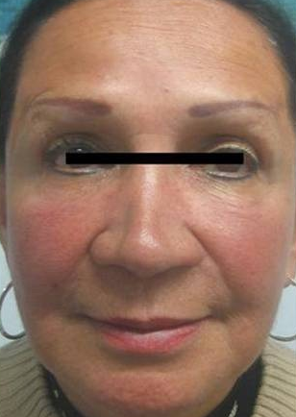
Quick Face Design
Fractional CO2 Laser
Rejuvenation
Laser systems latest technology generate a complete facial rejuvenation, face lift and skin remodeling.
PRE
POST

Slide 16
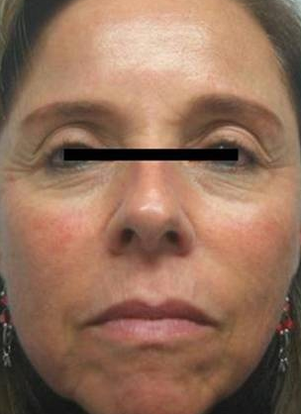
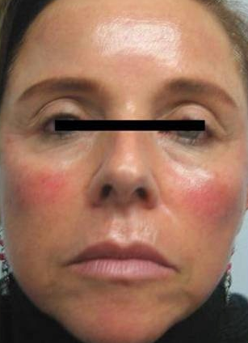
Quick Face Design
Intense pulse light / photo rejuvenation
Rejuvenation
Tighting skin.
PRE
POST

Slide 17
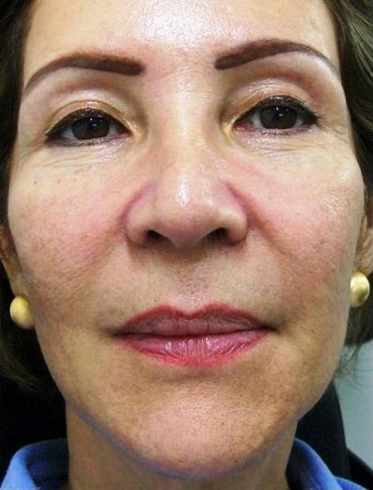
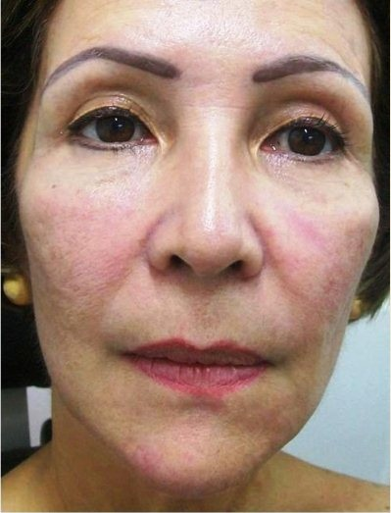
Quick Face Design
Laser
Rejuvenation
PRE
POST

Slide 18
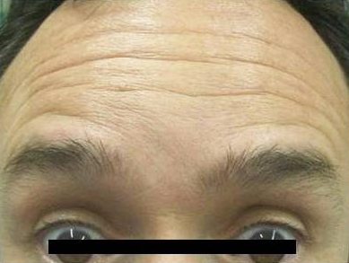
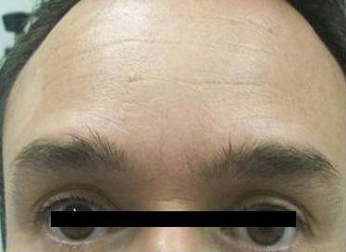
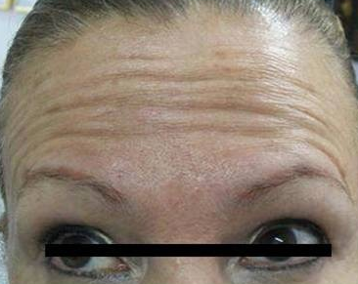
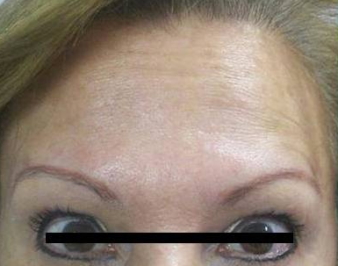
Quick Face Design
Botulinum Toxin
Front
Treatment of lines or marks of expression from the face and neck, providing rejuvenation and a youthful appearance.
Short procedure time.
PRE
POST

Slide 19
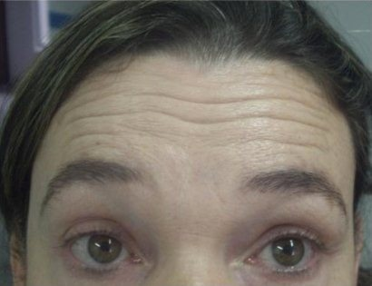
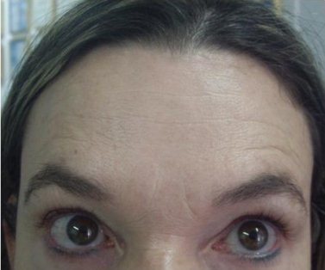
Botulinum Toxin
Quick Face Design
Front
PRE
POST

Slide 20
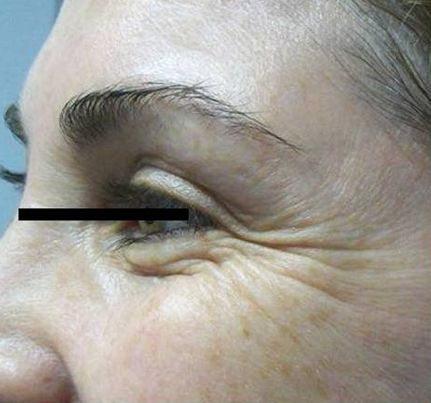
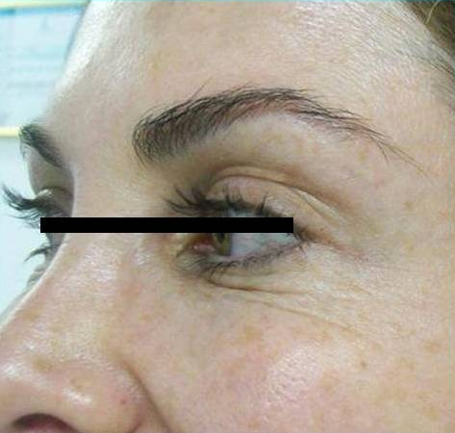
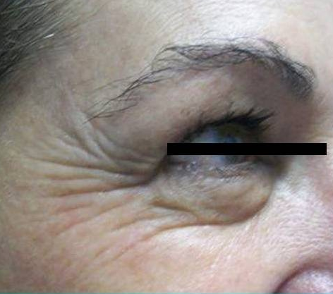
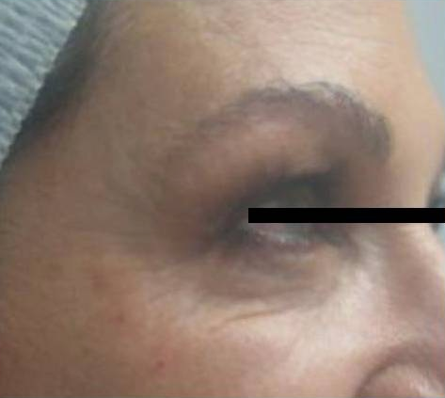
Botulinum Toxin
Quick Face Design
Eyes contour
Attenuates moderate to marked lines from the eyes, face and neck in patients from 18 to 75 years old.
Dramatic results.
PRE
POST

Slide 21
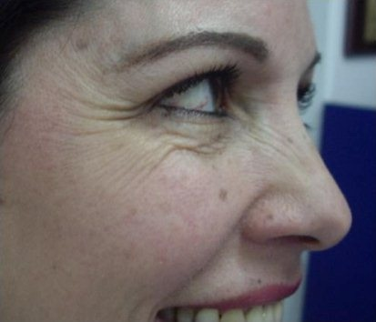
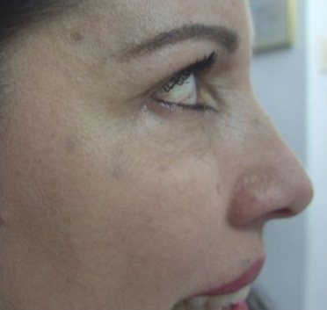
Botulinum Toxin
Quick Face Design
Eyes contour
PRE
POST

Slide 22
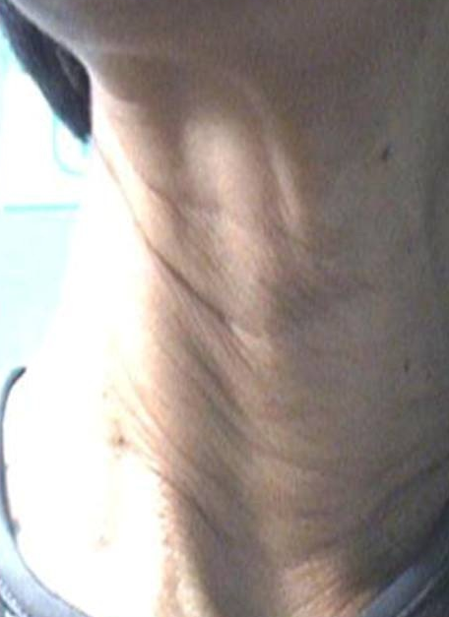
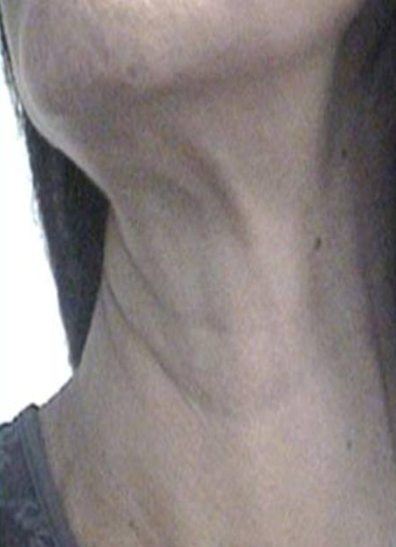
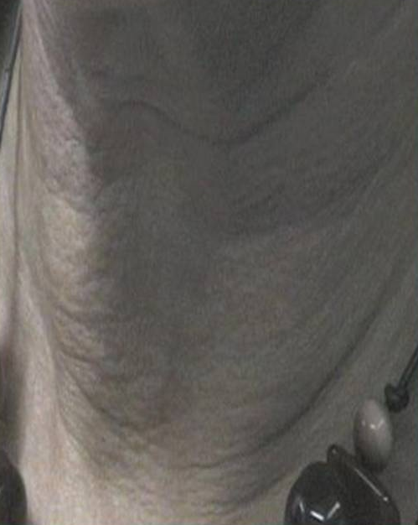
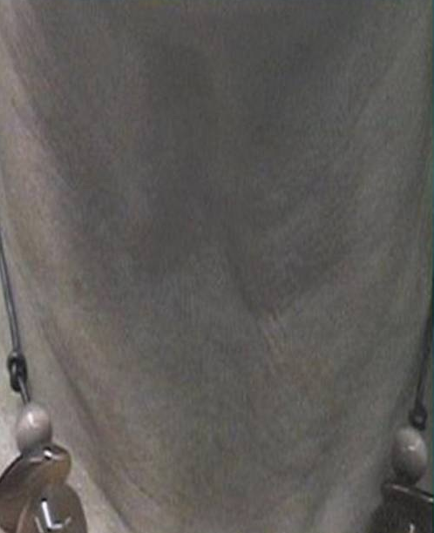
Botulinum Toxin
Quick Face Design
PRE
POST
Neck
Administration of very low doses of Botulinum Toxin by a few tiny injections directly into the muscles that are responsible for the formation of those persistent lines.
Safe and effective.

Slide 23
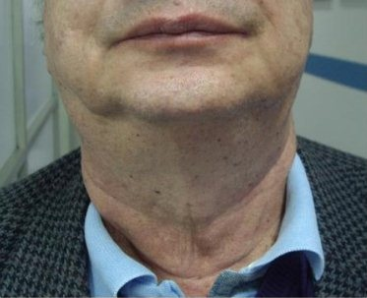
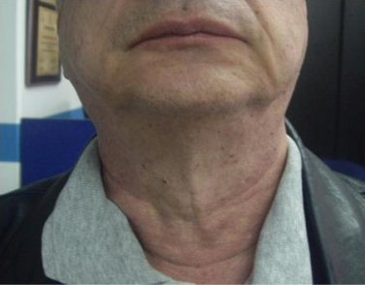
Botulinum Toxin
Quick Face Design
Neck
PRE
POST

Slide 24
Quick Face Design
Remodeling & lip
augmentation
PRE
Lip filler
Indicated in small, sunken, scarcely shaped or slightly fleshy lips.
It is a simple procedure that generates a high degree of satisfaction to the patient.
POST

Slide 25
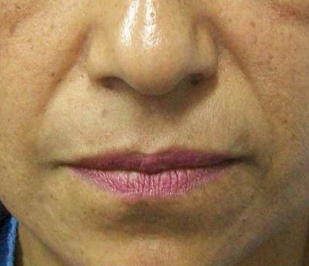
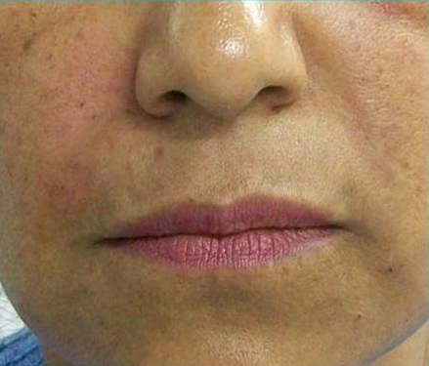
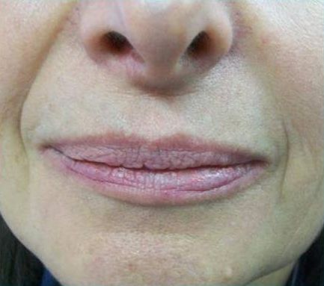
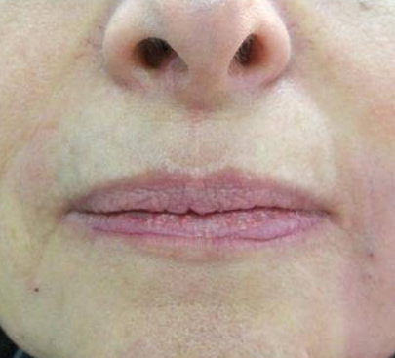
Quick Face Design
Facial fillers
Nasolabial folds
Facial fillers are indicated in furrows, fine lines, deep, depressed scars, asymmetries and folds of aging, to enhance the natural beauty.
PRE
POST

Slide 26
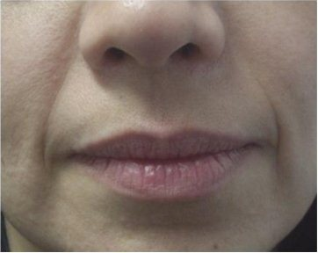
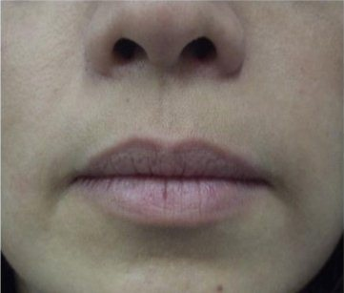
Quick Face Design
Facial fillers
Nasolabial folds
PRE
POST

Slide 27
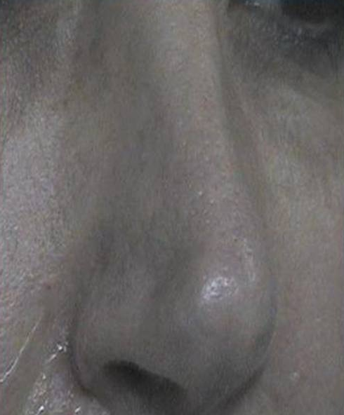
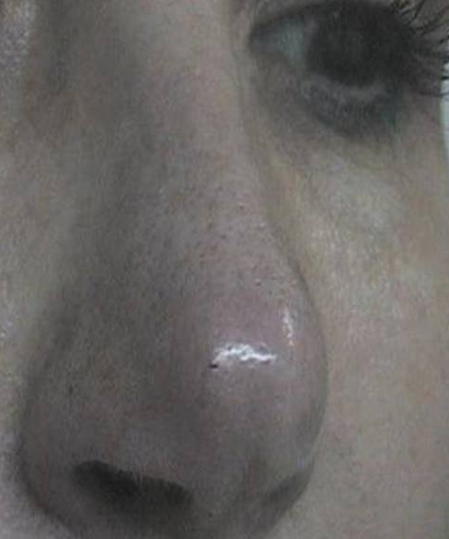
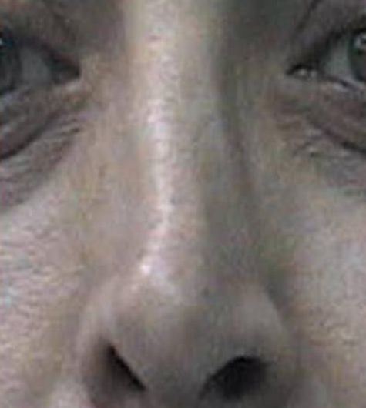
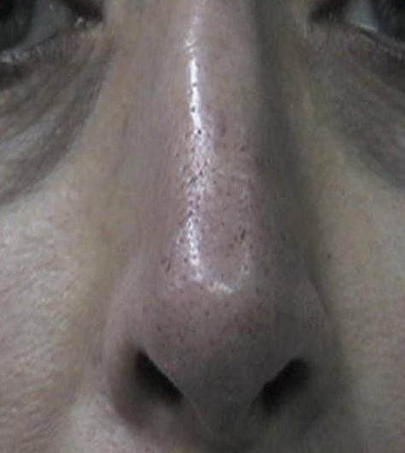
Quick Face Design
Facial sculpturing
Filled asymmetries
Its application is safe, effective. It is indicated for folds, scars, asymmetries, furrows, wrinkles, producing immediate and lasting results.
PRE
POST

Slide 28
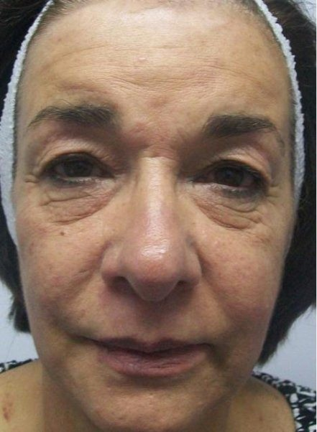
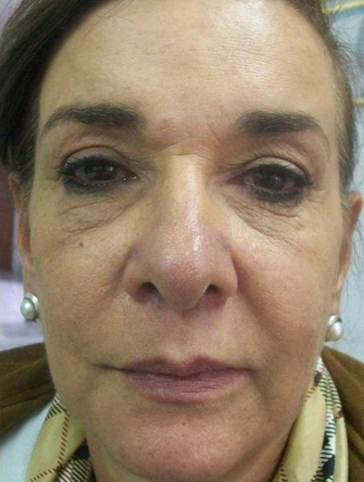
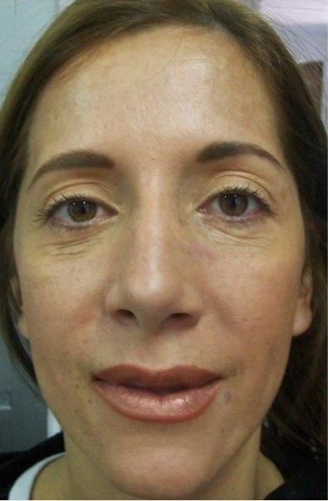
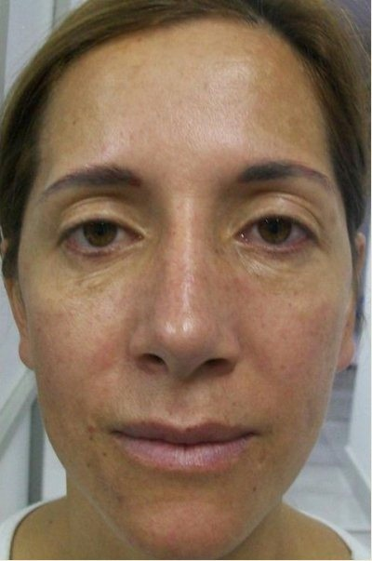
Quick Face Design
Plasma
Plasma
Application of autologous platelet-rich plasma for facial rejuvenation.

Slide 29
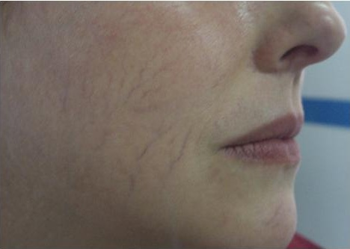
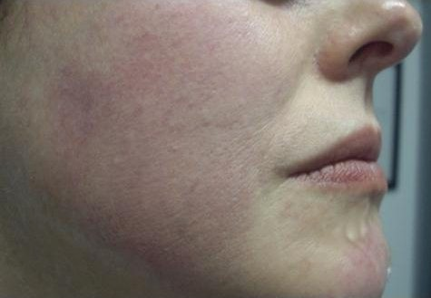
Quick Face Design
Radiosurgery
PRE
Veins
Radiosurgery is used to treat small veins purple and red "spider veins" (telangiectasias) present on the face or other body areas.
POST

Slide 30
Quick Face Design
Radiosurgery
Benign skin lesions
Procedure to treat warts, moles, benign lesions of the skin and scars.
PRE
POST

Slide 31
Quick Face Design

Slide 32
Quick Face Design
PRE
POST
Microdermabrasion
Laser rejuvenation
Botulinum Toxin - face
Fillings for folds and lip profiling
Plasma

Slide 33
Quick Face Design
PRE
POST
Microdermabrasion
Laser fraxel CO2
Botulinum Toxin - face
Fillers for folds
Plasma

Slide 34
Quick Face Design
PRE
POST
Microdermabrasion
Laser
Botulinum Toxin - face
Fillers for NL folds
Plasma

Slide 35
Quick Face Design
Medical products with cosmetic purposes.
Cosmeceuticals

Slide 36
Quick Face Design
Cosmeceuticals
Specialized products for cleansing, exfoliating, rejuvenating and hidrating the skin.
Treatments for acne, sun spots, and to protect the skin from the solar damage.

Slide 37
Quick Face Design
Cosmeceuticals
Formulas to prevent aging signs, that improve skin appearance.

Slide 38
Quick Face Design
Cosmeceuticals
Treatments for acne, sun spots, and to protect the skin from the solar damage.
Prevent pigmentary changes.

Slide 39
Quick Face Design
Cold Laser Therapy
www.freelasertherapy.com
Treatment for smoking cessation.
Cold Laser is applied to accupuncture points.
Prevents smoking related skin aging signs and diminishes risk of basal cell carcinoma related to smoking.

Slide 40
Quick Face Design
MINIMAL INVASIVE PROCEDURES IN AESTHETIC FACE
Results
Relax over active facial muscles
Fill wrinkles
Redefine facial contours
Reduce unwanted hair
Improve epidermal hyperpigmentation and vascularities.
Improves skin appearance
Remove irregularities

Slide 41
Quick Face Design
MINIMAL INVASIVE PROCEDURES IN AESTHETIC FACE
Advantages:
Lunch time procedures
Incorporated into office practice
Painless
Fast recovery time (few hours to days)
Immediate visible results
Minimally invasive
Applies to all skin types, age, men and women
Highly effective

Slide 42
Quick Face Design
MINIMAL INVASIVE PROCEDURES IN AESTHETIC FACE
Benefits:
No risks
No disability
No scarring
Specific medical procedures (taylor made to age and skin)
Preventive medicine
Short procedure time
Minimal discomfort
Low incidence of adverse effects
High satisfaction (patient and physician)

Slide 43
Quick Face Design
MINIMAL INVASIVE PROCEDURES IN AESTHETIC FACE
Conclusions
Delay minor signs of facial aging
Repair aquired disfigurements
Minimal risks
Ideal complement of surgical procedures
Natural look
Highly selective for lesions
Safe for all skin types
Few absolute contraindications
Promote and mantain a youthfull appearance

Slide 44
MINIMAL INVASIVE PROCEDURES IN AESTHETIC FACE
Quick Face Design
Natural look
Aesthetic medical procedures are an integral part of ethical medicine, not a part of fashion.

Slide 45
Quick Face Design
MINIMAL INVASIVE PROCEDURES IN AESTHETIC FACE
Surgery is still an option for patients with signs of advanced facial aging.

Slide 46
Quick Face Design
MINIMAL INVASIVE PROCEDURES IN AESTHETIC FACE
www.dralexandramora.com
facebook.com/cosmedicals
@cosmedicals

Slide 47
Quick Face Design
MINIMAL INVASIVE PROCEDURES IN AESTHETIC FACE
Thank you!

Slide 48
Lets Meet again at Cosmetology-2015
4th International Conference and Expo
On Cosmetology & Trichology
June 22-24, 2015 Philadelphia, USA
Theme: Cosmetology and Trichology: Tracking and Tackling its Consequences
Website: http://cosmetology-trichology.conferenceseries.com/

