Slide 1
Cytoreductive surgery and hyperthermic intraperitoneal chemotherapy in the management of colorectal cancer: case report and literature review
Universidad Autónoma del Estado de México
Alexandra Garcilazo Reyes
MD. Juan Manuel Medina Castro
MD. Isaias Padilla

Slide 2
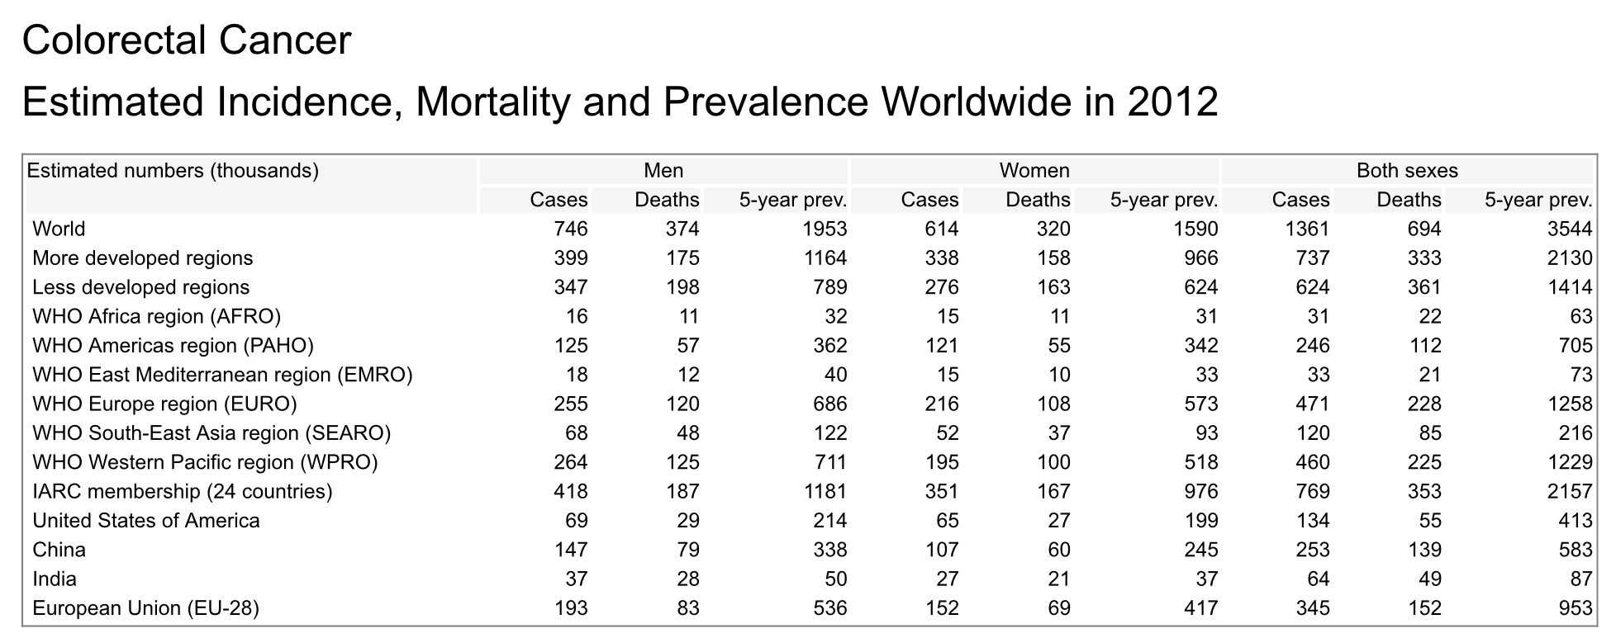
EPIDEMIOLOGY
//globocan.iarc.fr/Default.aspx

Slide 3
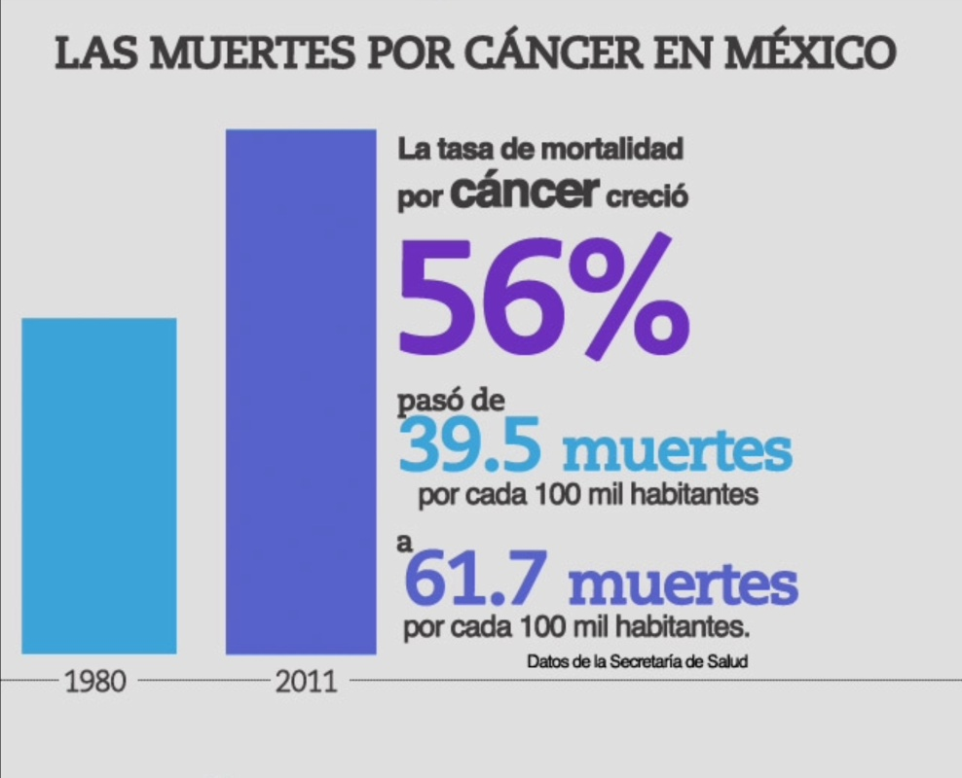
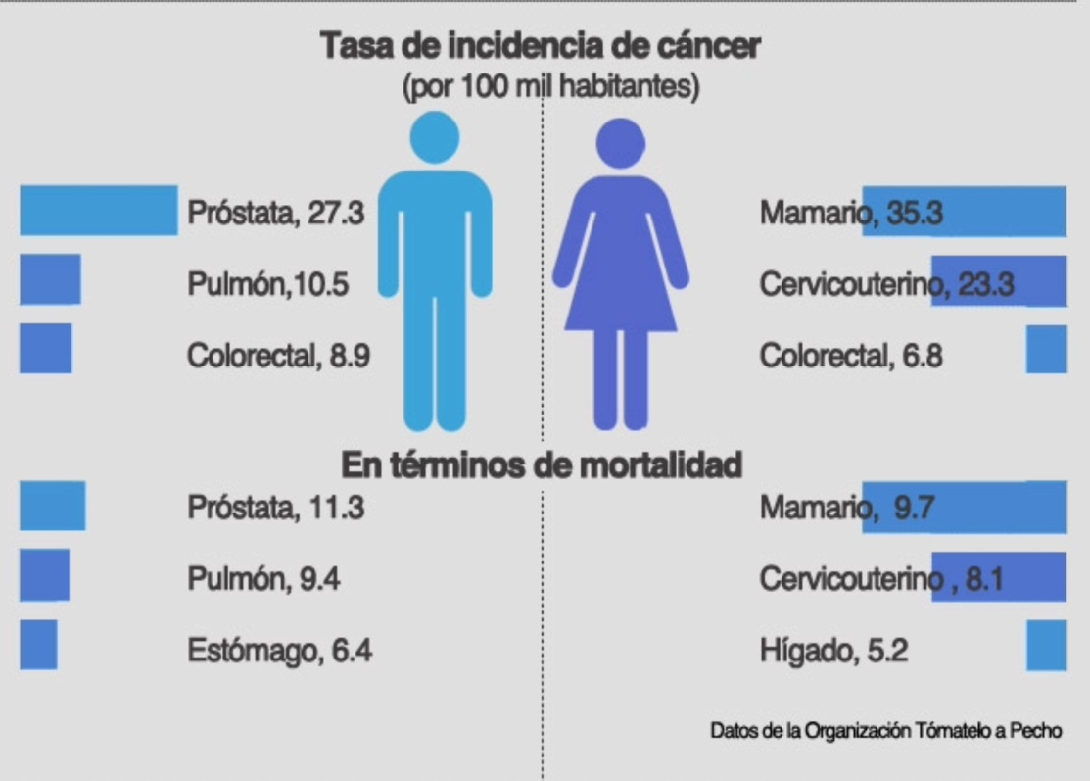
EPIDEMIOLOGY
www.infocancer.org.mx

Slide 4
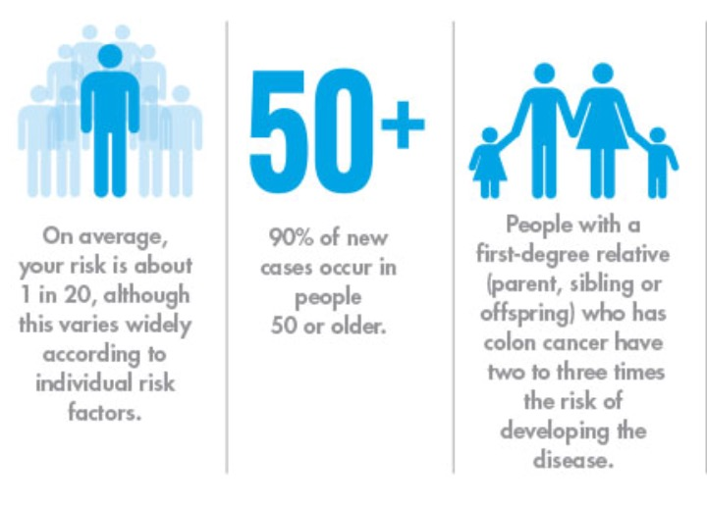
Risk and Protective Factors
CASE REPORT
Female
43 years old
No family history of cancer
Without comorbidities
Regular aerobic exercise
High fat diet
Nonsmoker
Protective Factors
Diet high fruits and vegetables Regular aerobic exercise No family history of colorrectal Ca
ruixinxin.com/signs-of-colon-cancer-in-women-and-early-prevention/

Slide 5
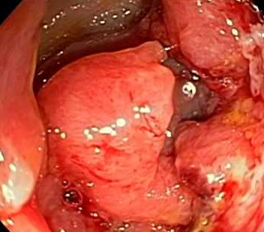
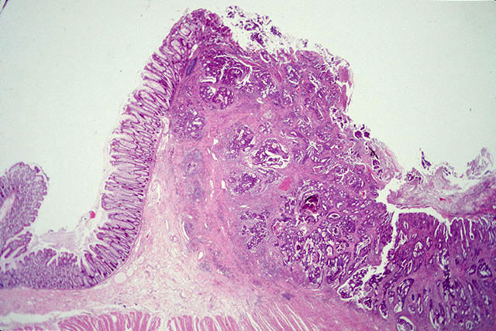
Diagnosis
CASE REPORT
Symptoms: pain
Palpable tumor of 10 x 8 cm in lower abdomen and right lower quadrant
Colonoscopy: right colon tumor occupying 80% of the lumen
Histopathological: poorly differentiated adenocarcinoma
TAC :5.4 cm tumor in the right colon with invading lesser and greater omentum, right parietal peritoneum and regional lymph nodes.

Slide 6
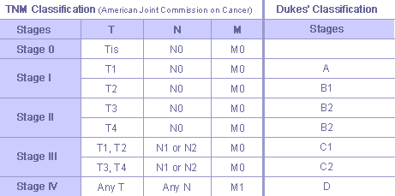
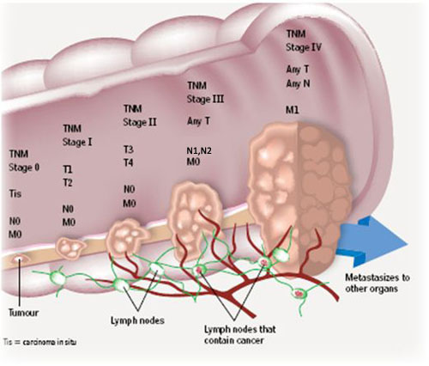
Staging
CASE REPORT
TNM IV
Dukes C2
cancer.gov/about-cancer/diagnosis-staging/staging/staging-fact-sheet

Slide 7
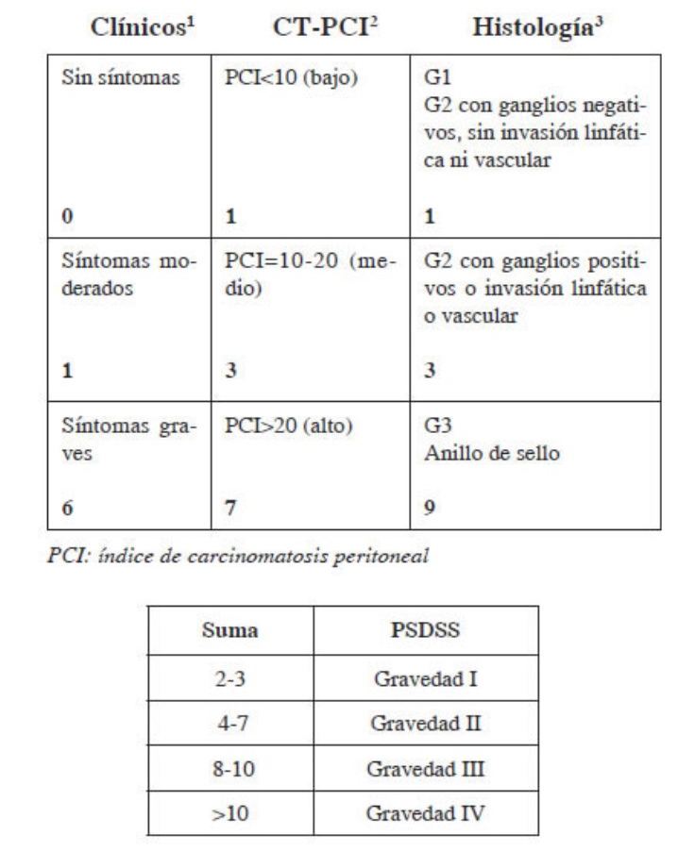
Peritoneal Surface Disease Severity Score

Slide 8
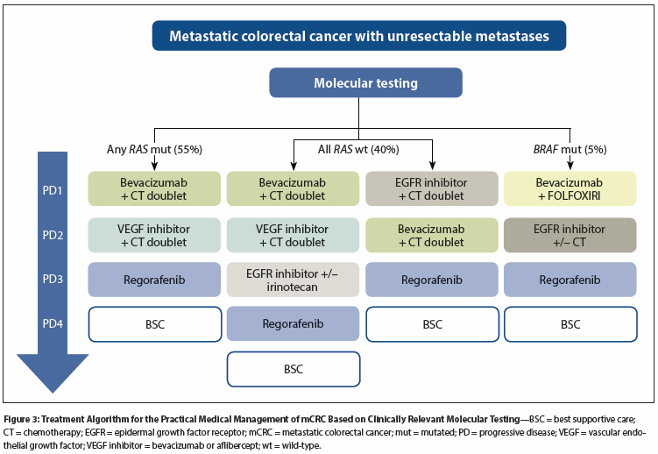
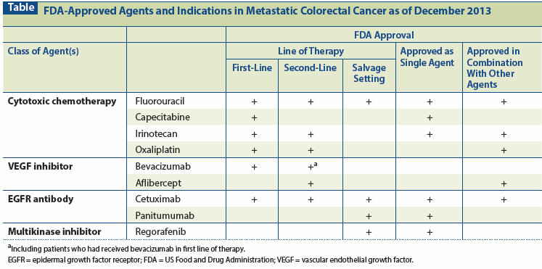
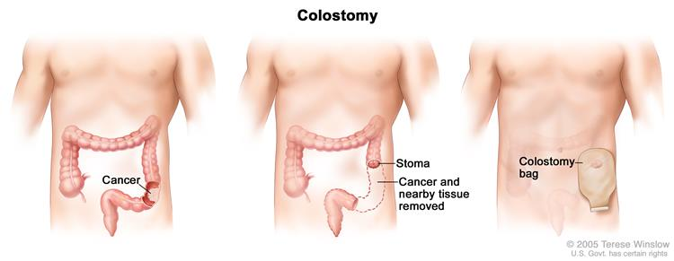
Treatment
cancernetwork.com/oncology-journal/colorectal-cancer

Slide 9
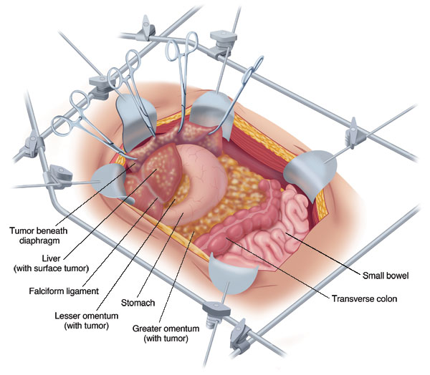
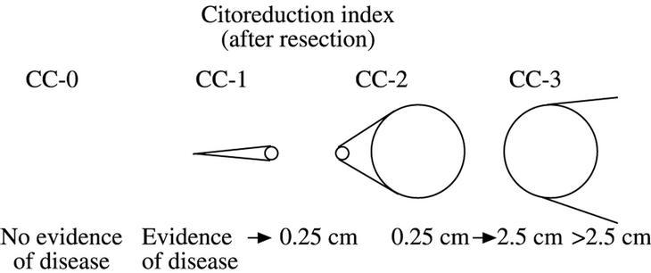
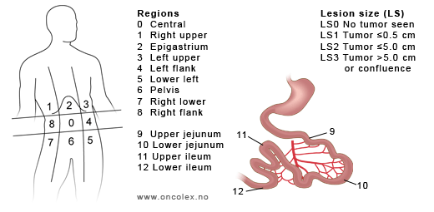
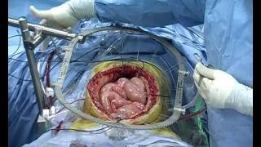
Cytoreductive surgery plus intraperitoneal hyperthermic chemotherapy
CASE REPORT
Peritoneal Carcinomatosis

Slide 10
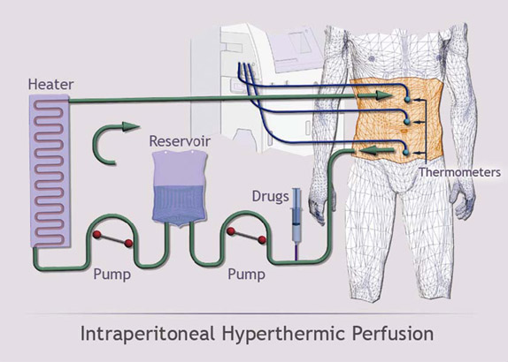
Cytoreductive surgery plus intraperitoneal hyperthermic chemotherapy
CASE REPORT

Slide 11
Complications and Mortality
Morbidity 35-56%
Mortality 3-23%
Thromboembolic events Anastomotic leak
Bowel obstruction
Surgical site infection, Bleeding
Alteration of renal function
CR + HIPEC is an independent prognostic factor survival
Phase III clinical study (Verwall, 2003)
Median survival of 22.2 months reported using CR + HIPEC treatment vs 12.6 months with surgery plus chemotherapy systemic palliative.
CASE REPORT

Slide 12
Analysis
Peritoneal carcinomatosis is a sign of progression of the tumor disease and being associated with poor prognosis and high mortality, survived an average of 5.2 months
Cytoreductive surgery associated with hyperthermic chemotherapy aims intaperitoneal have local control of the disease and increase survival time of 12.6 months for patients.
It is important to standardize the selection criteria (inclusion and exclusion) for this treatment
The complete cytoreduction is considered the most important prognostic factor for treatment success
Monitoring metabolic pathways is essential for prevention of complications after treatment
This treatment does not replace systemic chemotherapy
The completion of this treatment should be performed in a specialized center

Slide 13
Conclusions
Cytoreductive surgery and hyperthermic intraperitoneal chemotherapy is a favorable treatment option for peritoneal carcinomatosis secondary to colon cancer, increased the survival time of patients and improving the quality of life. Currently protocols are performed to determine if the realization of this treatment may prevent the occurrence of peritoneal carcinomatosis.
THANK YOU

