Slide 1
8th European Immunology Conference
June 29-July 01, 2017 Madrid, Spain
Theme: Disseminating the New Trends in Immunology
Released-active antibodies are innovative products for the effective management of severe respiratory viral infections
Alexandra G. Emelyanova
Laboratory of physiologically active substances
Institute of General Pathology and Pathophysiology
(Russian Federation)

Slide 2
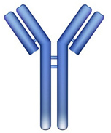
INTRODUCTION
Antibodies-based drugs are broadly studied and used
49
52
Europe¹
USA¹
Application:
Autoimmune diseases; Cardiovascular diseases; Infectious diseases; Cancer; Inflammation²
Limitations³:
Production
Cost
Pharmacokinetics
Route of administration
Safety
Approaches²:
Adjuvants
Modification
Encapsulation
1 – Reichert J.M., updated October 23, 2016 (http://antibodysociety.org); 2 – Chames P. et al. Br J of Pharmacol157: 220-233 (2009); 3 – Zhang M.-Y. et al. BioMed Research International 2015, ID 168935 (2015)

Slide 3
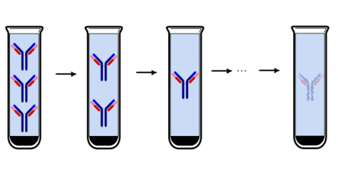
BIOTECHNOLOGICAL PLATFORM
Technology of concentration reduction
Therapeutic Antibodies
Released-active form of antibodies
Specific action
+
Neutralize the target
Specific action
+
Modify the target
Released-activity determined by initial substance derivatives’ emergence
Epstein O.I. Usp Fiziol Nauk 44:54-76 (2013)

Slide 4
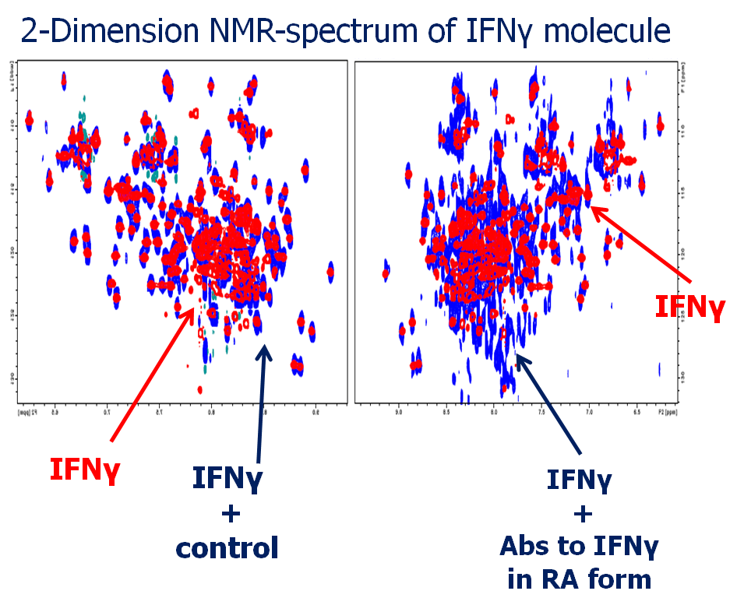
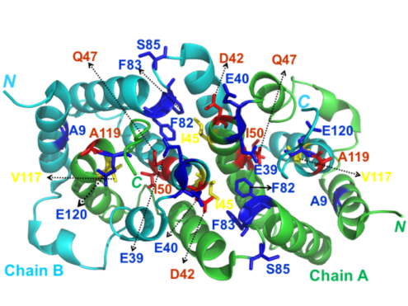
TARGET MODIFICATION
Abs to IFNγ in RA form induces conformation changes of the IFNγ
Model: Nuclear Magnetic Resonance Spectroscopy

Slide 5
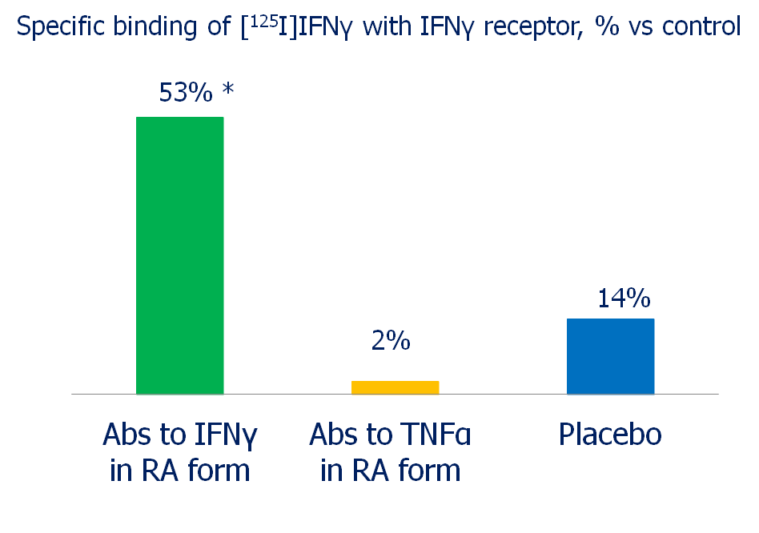
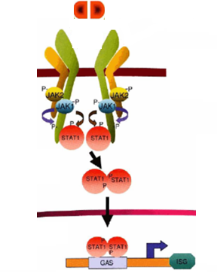
TARGET MODIFICATION
Abs to IFNγ in RA form enhance ligand-receptor interaction
Model: radioligand binding assay
IFNγ
IFNγ receptor
IFNγ regulated genes
Picture was adapted from:
“The Interferons: Characterization and Application”
(Ed. By A. Meager) 2006 WILEY-VCH Verlag GmbH & Co. KGaA, Weinheim
*- p<0.05 vs Abs to TNFɑ in RA form, placebo

Slide 6
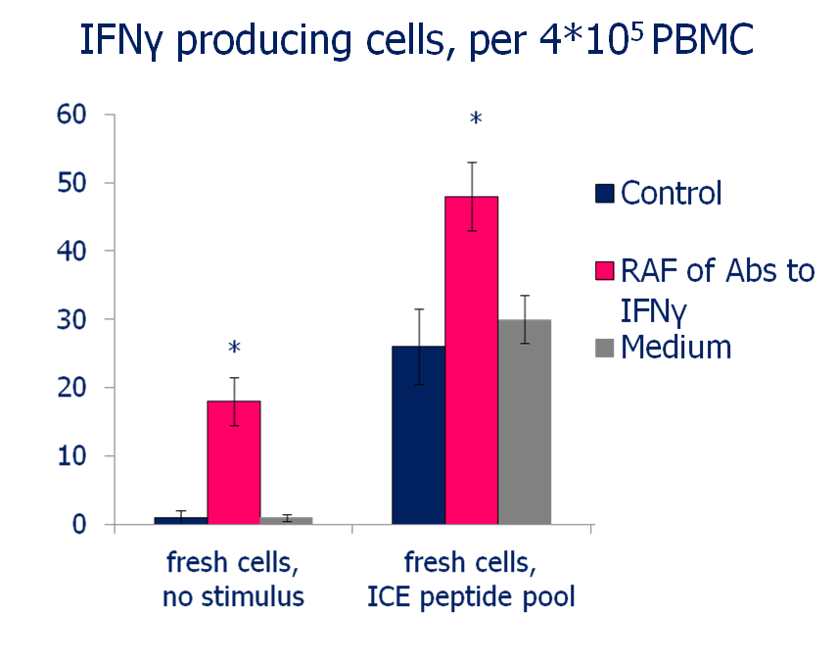
MODIFICATION OF BIOLOGICAL PATHWAYS
Abs to IFNγ in RA form increase the number of IFNγ producing cells
Model: production of IFNγ by PBMC in vitro
IFNγ
IFNγ receptor
IFNγ regulated genes
Picture was adapted from:
“The Interferons: Characterization and Application”
(Ed. By A. Meager) 2006 WILEY-VCH Verlag GmbH & Co. KGaA, Weinheim
* - p<0.05 vs control

Slide 7
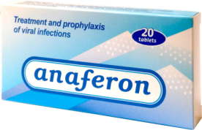
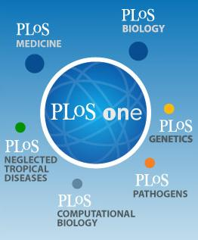
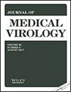
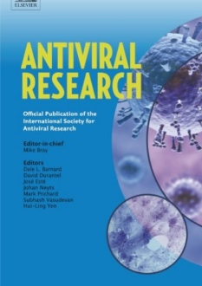
ABS IN RA FORM: FIRST ANTIVIRAL PRODUCT
Anaferon
Abs to IFNγ in RA form
Launched in 2001-2002
Registered in 17 countries
The most prescribed pediatric medicine in Russia (2012)
Brand №1 in Russia 2013 prize in antiviral medicines
Publications in peer-reviewed Russian and international journals

Slide 8
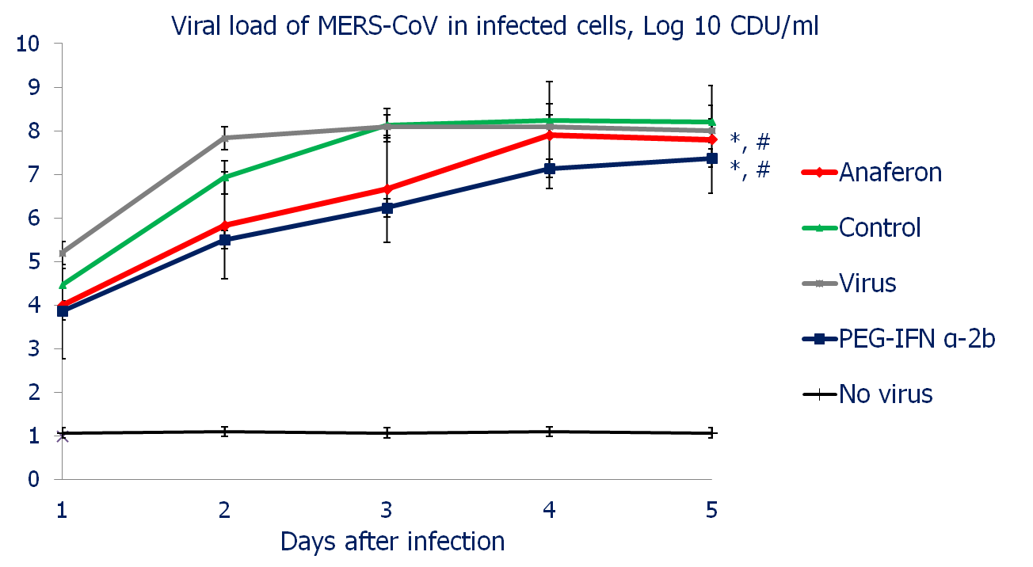
Middle East Respiratory Syndrome Coronavirus
Target: IFNγ
Agent: Abs to IFNγ in RA form
Anaferon is effective in treatment of MERS-CoV infection
*, #- р<0.05 vs PEG-IFN α-2b-treated group, virus control

Slide 9
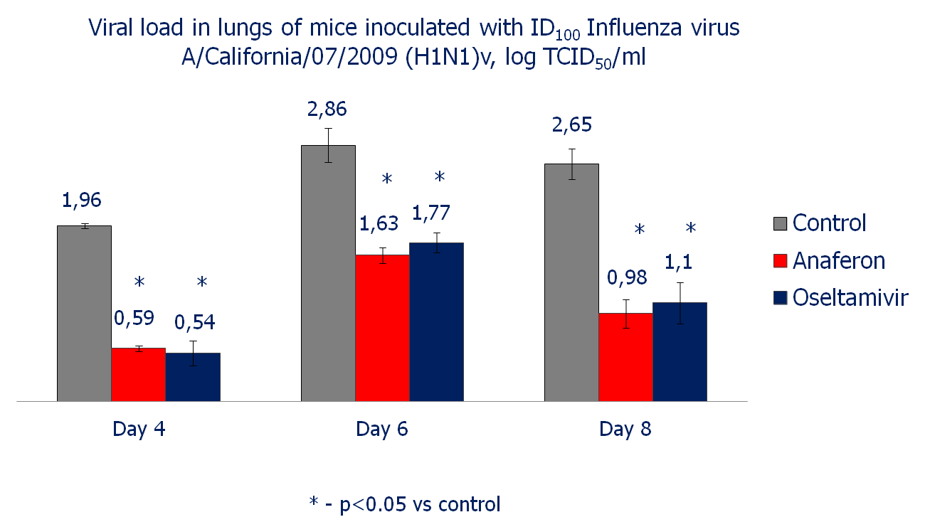
INFLUENZA
Target: IFNγ
Agent: Abs to IFNγ in RA form
Anaferon is effective against pandemic influenza strain H1N1

Slide 10
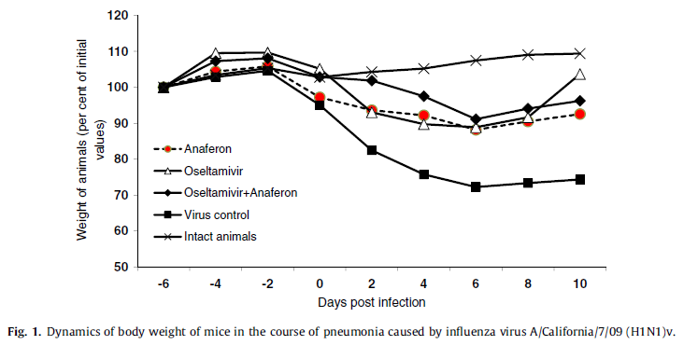
INFLUENZA
Target: IFNγ
Agent: Abs to IFNγ in RA form
Anaferon
is effective against ‘swine flu’ (A/H1N1)
Anaferon
Oseltamivir
Anaferon+Oseltamivir
Virus control
Intact animals
1 LD50
7/20 35%
19/20 95%
10 LD50
2/20 10%
18/20 90%
10/20 50%
Tarasov S.A. et al. Antiviral Res 93:219-224 (2012)

Slide 11
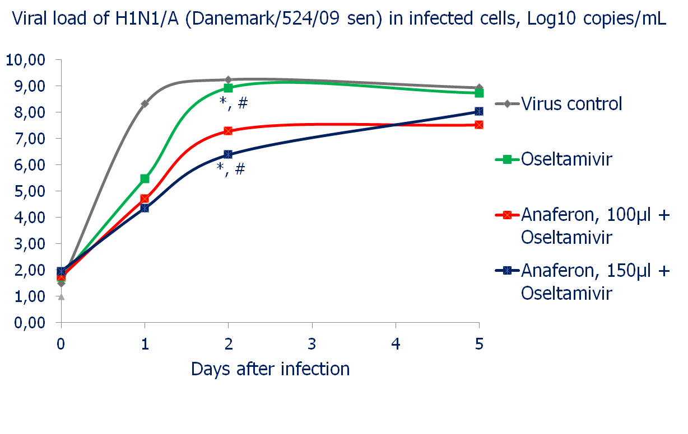
INFLUENZA
Target: IFNγ
Agent: Abs to IFNγ in RA form
Anaferon increases the efficacy of Oseltamivir in treatment of Oseltamivir-sensitive strain of Influenza virus (A/H1N1pdm09)
*, #- р<0.05 vs Oseltamivir-treated group, virus control

Slide 12
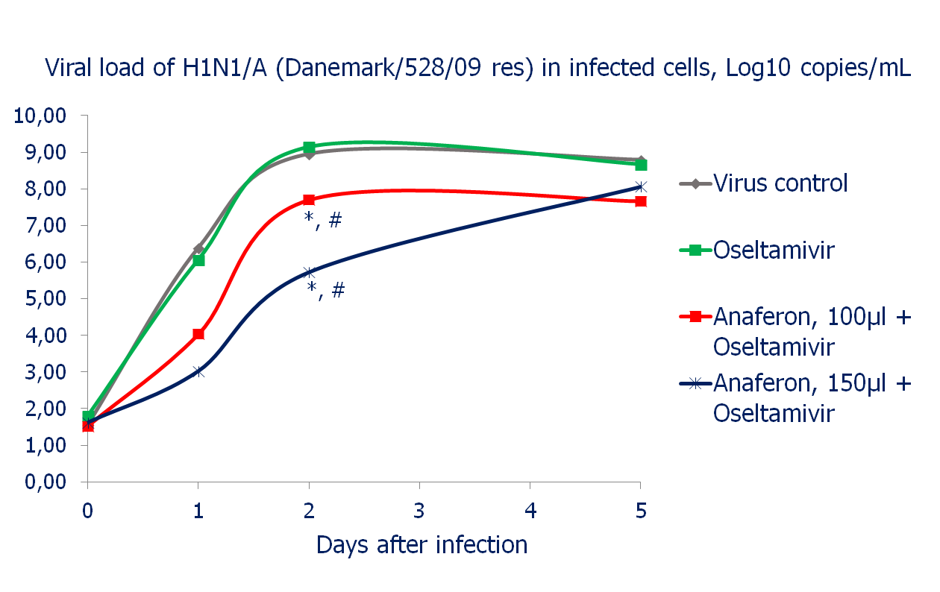
INFLUENZA
Target: IFNγ
Agent: Abs to IFNγ in RA form
Anaferon is effective in treatment of Oseltamivir-resistant strain of Influenza virus (A/H1N1pdm09)
*, #- р<0.05 vs Oseltamivir-treated group, virus control

Slide 13
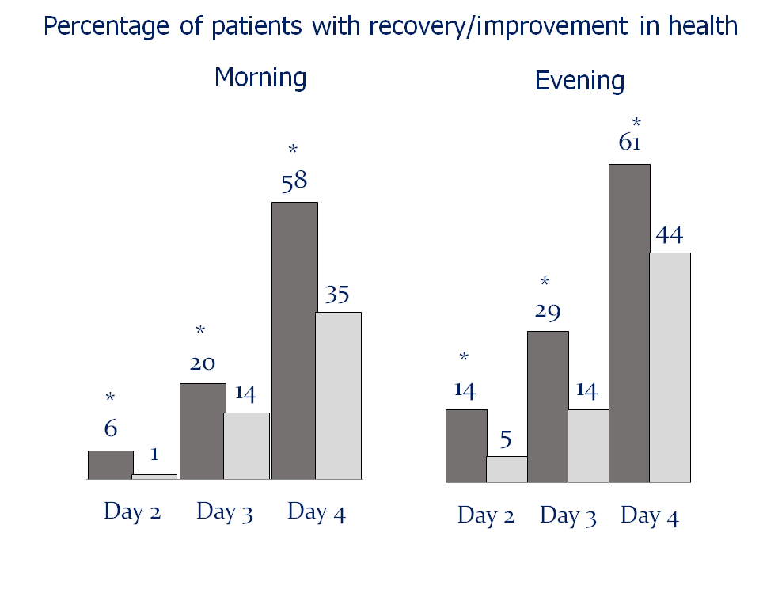
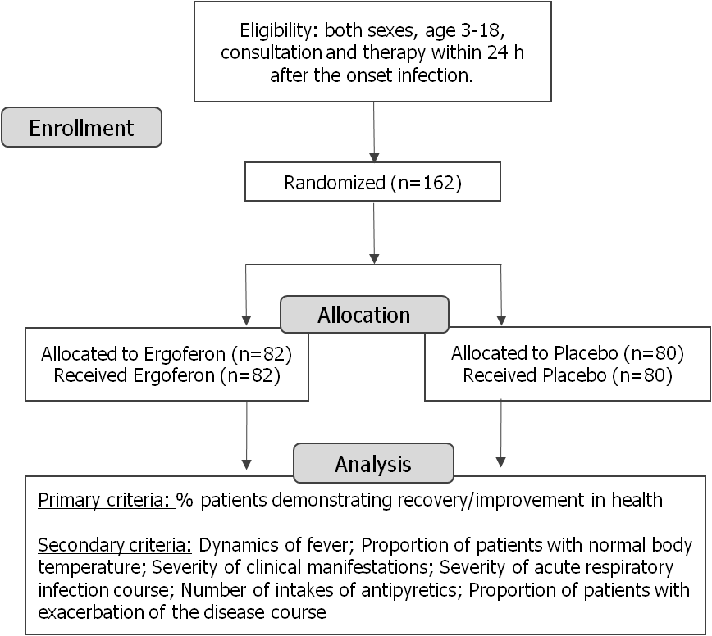
EFFICACY IN CLINICS
Ergoferon proven clinical efficacy by randomized double blind placebo control trials
Ergoferon
Placebo
* - р<0.05 vs placebo
Geppe N.A. et. al. Antibiotics and Chemotherapy, 2014, 59: 5-6

Slide 14
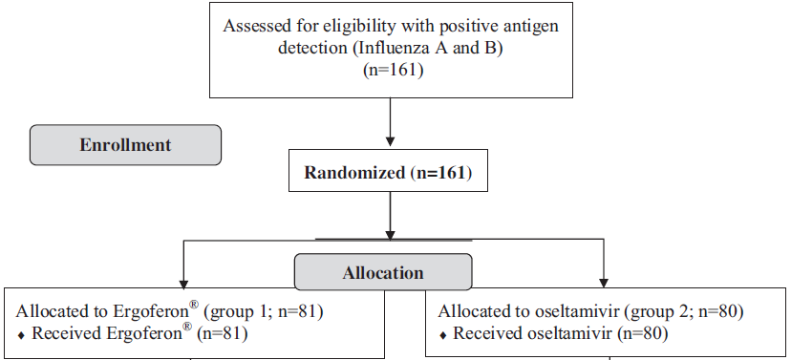
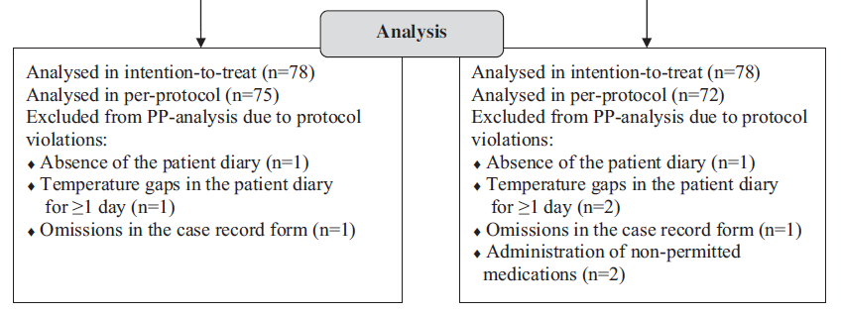
EFFICACY IN CLINICS
Ergoferon proven clinical efficacy comparable to Oseltamivir by multicenter open-label randomized trials
Study design:
Both sexes
age 18-60
12 research centers
Rafalsky V. et. al. International Journal of Infectious disease, 2016, 51: 47-55

Slide 15
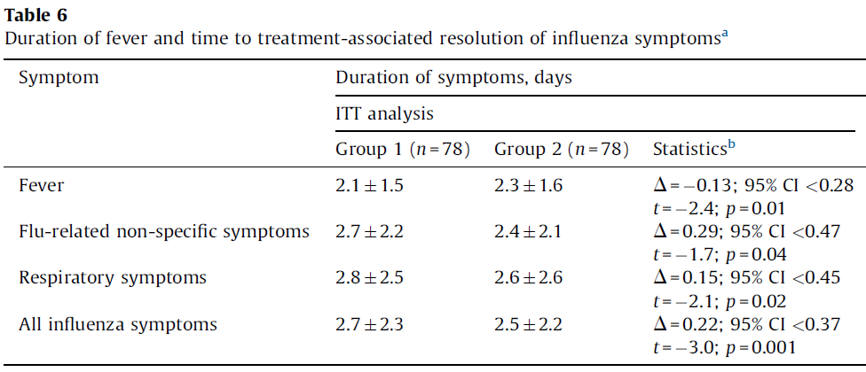
EFFICACY IN CLINICS
Ergoferon proven clinical efficacy comparable to Oseltamivir by multicenter open-label randomized trials
Rafalsky V. et. al. International Journal of Infectious disease, 2016, 51: 47-55

Slide 16
STRONG SAFETY
Single-dose toxicity
General toxicity
Potential mutagenic properties
Allergenic properties
Reproductive toxicity
Effect on postnatal development
Immunotoxicity
Preclinical
studies
No toxic effects have been revealed
No mutagenic properties have been revealed
No toxic effects on lactating females (general condition, BW gain) and postnatal development
Results
No severe adverse events reported
Can be safely used in combination with symptomatic and other drugs, on a long term basis / in patients with immunodeficiencies
Do not cause exhaustion of the immune system
Clinical
safety

Slide 17
TAKE-HOME MESSAGES
Modifying activity of the RA drugs
High safety and absence of adverse effects
High efficacy in severe respiratory infections management
Standard drugs’ efficacy increase in conjoint use
Released-active drugs represent promising opportunity for being included in standard treatment schemes

Slide 18
Thank you for you attention
The Russian Academy of Sciences
Institute of General Pathology and Pathophysiology
Laboratory of physiologically active substances
Alexandra G. Emelyanova
Research Associate
8, Baltiyskaya st., Moscow, Russian Federation
Tel. +7 (916) 556-20-19; E-mail: agemelianova@gmail.com

