Slide 1

About OMICS Group
OMICS Group International is an amalgamation of Open Access publications and worldwide international science conferences and events. Established in the year 2007 with the sole aim of making the information on Sciences and technology ‘Open Access’, OMICS Group publishes 400 online open access scholarly journals in all aspects of Science, Engineering, Management and Technology journals. OMICS Group has been instrumental in taking the knowledge on Science & technology to the doorsteps of ordinary men and women. Research Scholars, Students, Libraries, Educational Institutions, Research centers and the industry are main stakeholders that benefitted greatly from this knowledge dissemination. OMICS Group also organizes 300 International conferences annually across the globe, where knowledge transfer takes place through debates, round table discussions, poster presentations, workshops, symposia and exhibitions.

Slide 2
About OMICS Group Conferences
OMICS Group International is a pioneer and leading science event organizer, which publishes around 400 open access journals and conducts over 300 Medical, Clinical, Engineering, Life Sciences, Pharma scientific conferences all over the globe annually with the support of more than 1000 scientific associations and 30,000 editorial board members and 3.5 million followers to its credit.
OMICS Group has organized 500 conferences, workshops and national symposiums across the major cities including San Francisco, Las Vegas, San Antonio, Omaha, Orlando, Raleigh, Santa Clara, Chicago, Philadelphia, Baltimore, United Kingdom, Valencia, Dubai, Beijing, Hyderabad, Bengaluru and Mumbai.

Slide 3


3rd International Conference and Exhibition on
Mechanical & Aerospace Engineering, San Francisco, USA.
October 05-07, 2015.

Slide 4

Alexandre de Macêdo Wahrhaftig
alixa@ufba.br
Polytechnic School
Federal University of Bahia,
Salvador-Bahia, Brazil

Slide 5


ANALYTICAL SOLUTION FOR WELDED JOINTS OF PERPENDICULAR PLATES SUBJECTED TO TORSIONAL MOMENT

Slide 6


What is the specific objective of this work?
Specifically, the objective of this work is to present an analytical solution based on shearing stress for welded joints of perpendicular plates subjected to torsional moment.

Slide 7

Solution of reference
Technical Mechanic and Resistance of Materials
Melconian, Sarkis; Ed. 18, São Paulo, Brasil, 2008.

Slide 8
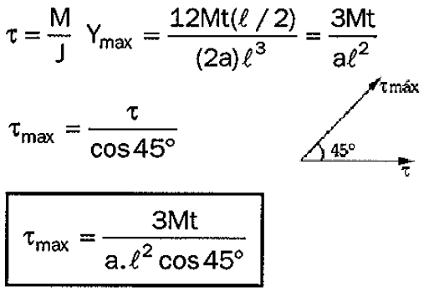
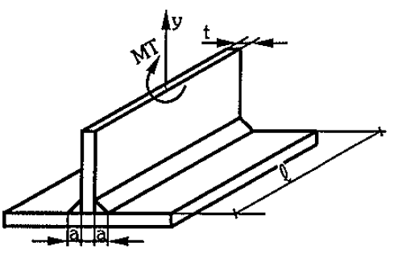
Solution of reference
It is based on normal stress from bending.
M = Bending Moment; t = Thickness of the perpendicular plate;
l = Lenght of weld line; a = Base of the weld line.

Slide 9
The analytical solution of this work is based on shearing stress
Take a welded joint of perpendicular plates requested by torque M
and an infinitesimal element of area dA in weld.

Slide 10
The analytical solution based on shearing stress
The distribution of the shearing stress obeys the law from Resistance of Materials, where “ρ" is the generic distance in relation to the center of joint and “J ” is the polar moment of inertia.
The polar moment of inertia to be determined by

Slide 11
The analytical solution based on shearing stress
The polar moment of inertia is obtained by the equation.
Substituting the polar moment of inertia on that equation, with the integration limits appropriate to the problem, one has

Slide 12
The analytical solution based on shearing stress
Replacing the polar moment of inertia obtained and knowing that the linear distribution of stresses requires that the maximum stress occurs at the end of the weld, we can approximate to ρ_{max} equals to L/2, and write the equation of maximum shear stress

Slide 13
The analytical solution based on shearing stress
The prior expression can be used for the design of the base "a" of the bead weld. To this must be put it in the polynomial form
Where
and
Whose real root is
in which

Slide 14
NUMERICAL SIMULATIONS
Consider two steel plates welded perpendicularly through a weld bead length of L = 500 mm and weld base a = 12 mm. By the specifications of the American Welding Society, the allowable stress indicated is τ_{adm} = 70 MPa. One wants to know the maximum torque that can act at the joint.
“M” is the torsional moment,
“a” is the base of bead weld and
“L” is the length of bead weld.

Slide 15
NUMERICAL SIMULATIONS
Solving the problem by the proposal for Sarkis, one has.
and
and by Wahrhaftig
and

Slide 16

NUMERICAL SIMULATIONS

Slide 17
NUMERICAL SIMULATIONS
It allows performing to study the influence of the thickness of vertical plate over dimensions of the weld.

Slide 18
NUMERICAL SIMULATIONS
It allows to obtain the weld dimensions in function of the torsional moment acting.

Slide 19
NUMERICAL SIMULATIONS
Maximum
Shearing stress distribution on weld line to t = 12 mm.
Minimum
-250mm

Slide 20

CONCLUSIONS
Analytical solution presented in this work (Wahrhaftig) is appropriate for the design and verification of bead weld to joints of perpendicular plates subjected to torsional moment;
It allows evaluating of the horizontal shearing stresses induced in the way that it really occurs;

Slide 21
CONCLUSIONS
Difference of the polar moment of inertia between Sarkis and Wahrhaftig is 1.51%;
Results by Wahrhaftig and Sarkis are consistent in order of magnitude; but
Sarkis, considers the bending theory, while Wahrhaftig the torsion theory.

Slide 22



The author express its gratitude to:
UFBa – Federal University of Bahia, Brazil.
Mech Aero 2015 – San Francisco, USA.
Thank you very much!

