Slide 1



Novel nanotechnology approach to target cancer - Switch from Proto-Oncogene to Tumor Suppressor.
Alexander Kazansky (Sasha)

Slide 2
STAT: Signal Transducer and Activator of Transcription
What are STAT proteins?
Relationship to cancer ?
Family of cytoplasmic transcription factors that participate in normal cellular events
Constitutive activation of STAT5 proteins has been demonstrated in many diverse human cancer cell lines and clinical tumors.
There are at least seven STAT proteins in mammalian cells.

Slide 3
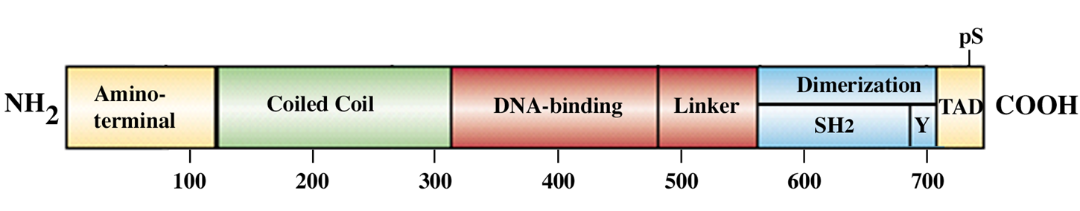
While the full form of STAT5B can promote tumor progression, a naturally occurring truncated isoform acts as a tumor suppressor
Present approaches of therapeutic targeting STAT proteins based on inhibition of functional domains of STAT's, such as DNA-binding, cooperative binding (protein-protein interaction), dimerization and phosphorylation will halt the action of the entire gene, both the proto-oncogenic and tumor suppressor functions of Stat’s.
Notes:
We previously demonstrated that truncated STAT5 is generated by insertion of an alternatively spliced exon and results in the introduction of an early termination codon.

Slide 4
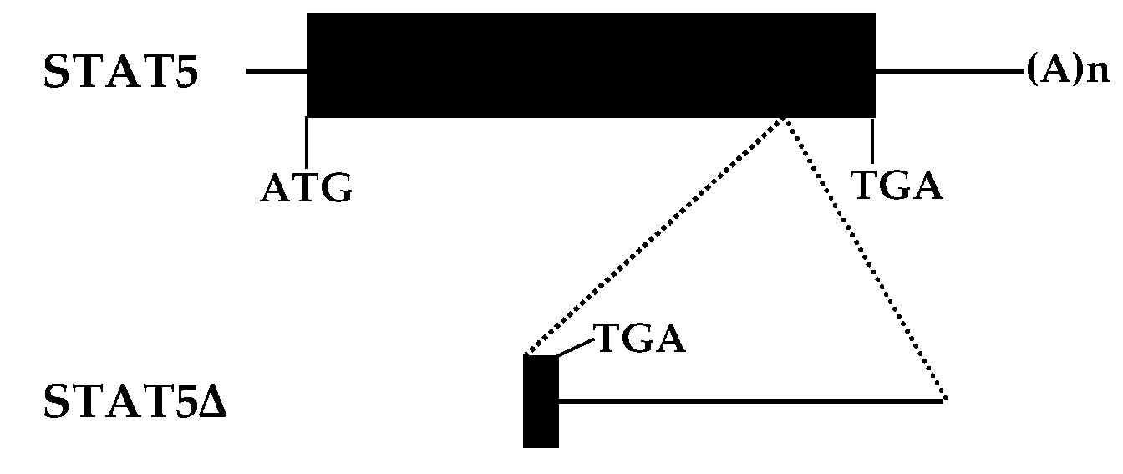
Naturally occuring dominant negative isoform of STAT5
U24175
U25137
The protein coding sequences are shown by the solid black bars.
STAT5∆ appears to be generated by the insertion of an alternatively spliced exon in STAT5 results in the introduction of an early termination codon.
Kazansky at all, Mol Endocrinol. 1995

Slide 5
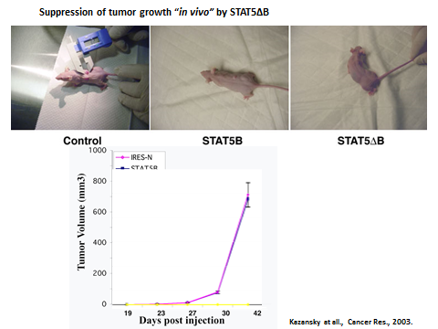
In previous study we demonstrated that STAT5∆B could inhibit the growth of cancer cells and tumors in vitro and in vivo.

Slide 6
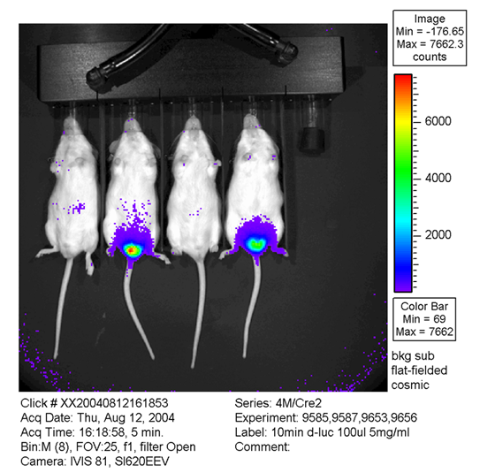
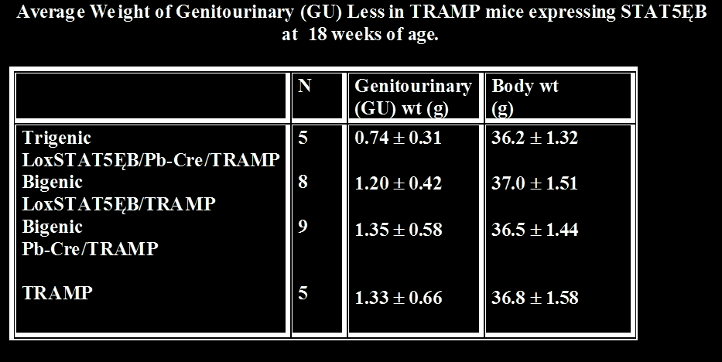
Suppression of tumor progression in the
Transgenic Adenocarcinoma Mouse Prostate model

Slide 7
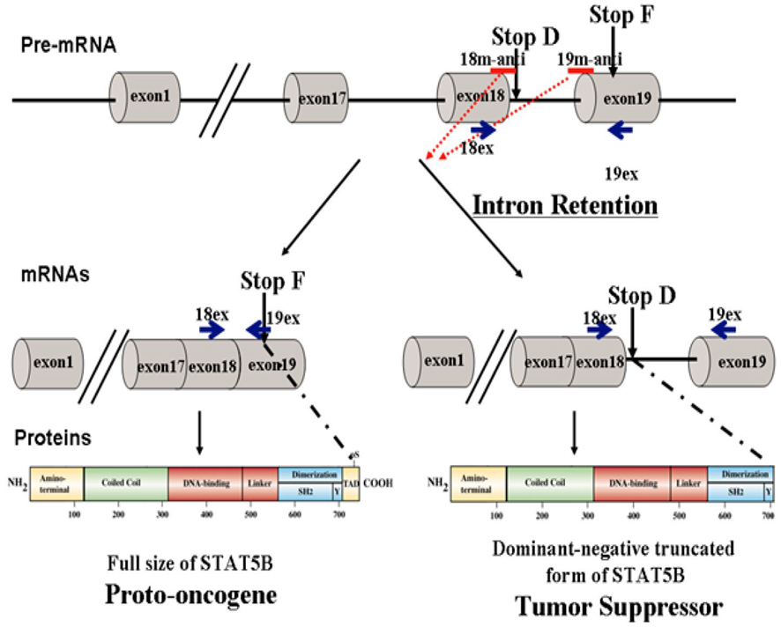
Tuning of alternative splicing--switch from proto-oncogene to tumor suppressor.
Implication of steric-blocking splice-switching oligonucleotides (SSOs) with a complimentary sequence to the targeted exon-intron boundary to enhance alternative intron/exon retention to produce a tumor suppressor protein.

Slide 8
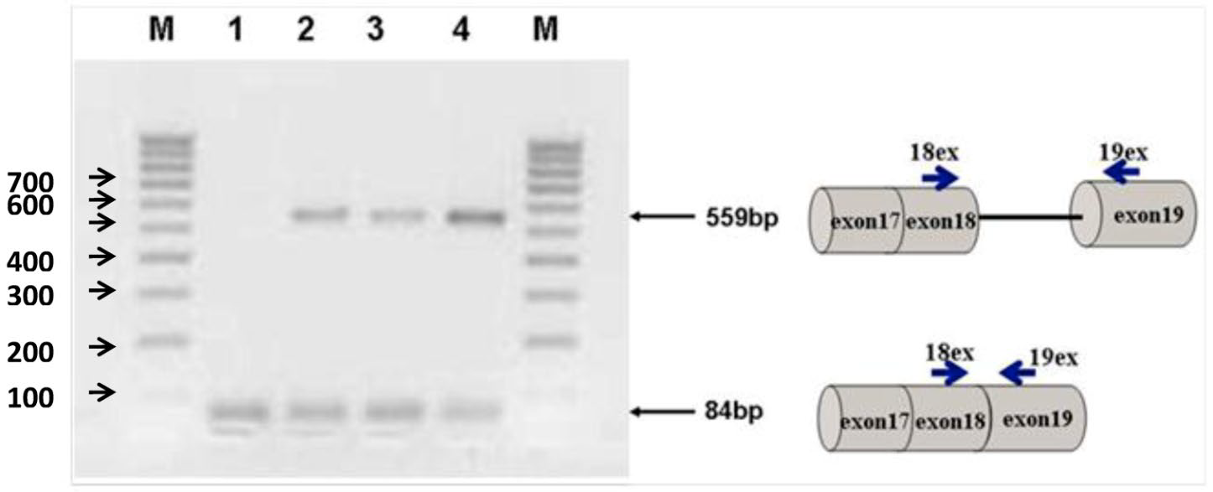
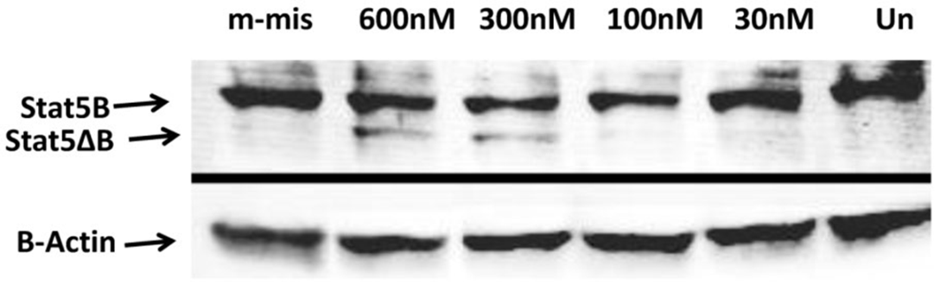
Specific intron retention in Stat5B pre-mRNA by steric-blocking splice-switching oligonucleotides in prostate cancer cells
Western Blot analyses
Semi-quantitative RT-PCR
The functional effect was validated by cell proliferation and clonogenic assays.
Shchelkunova at all, Int J Biol Sci. 2013

Slide 9
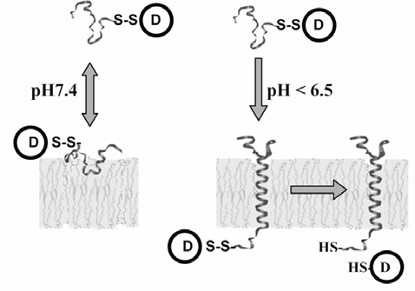
Translocation of cargo molecules across the plasma membranes of living cells.
Water-soluble transmembrane peptide pHLIP (pH Low Insertion Peptide) inserts an alpha-helical domain in membrane in acidic extracellular environments
Solid tumors have an acidic extracellular environment (Warburg effect)
Acts as a nanosyringe targeting the membrane and releasing cargo molecules inside the cells
Reshetnyak Y. at all, Proc Natl Acad Sci U S A, 2006.
Notes:
The method is based on the discovery a water-soluble transmembrane peptide called pHLIP (pH Low Insertion Peptide) that inserts an alpha-helical domain in membrane in acidic extracellular environments [32]. The mechanism of accumulation is based on the Warburg effect, that solid tumors have an acidic extracellular environment.

Slide 10
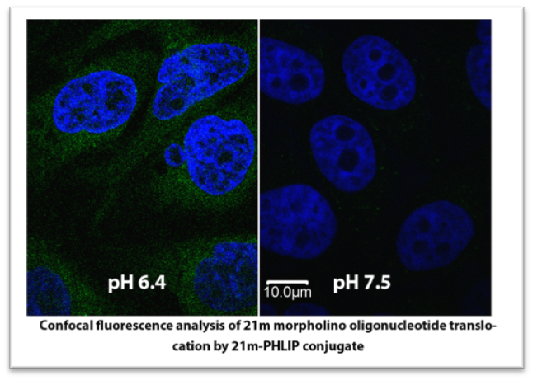
Translocation of splice-switching oligonucleotide (SSO) by pH insertion peptide (pHLIP)

Slide 11
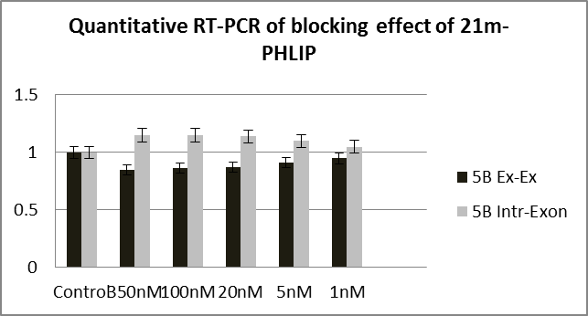
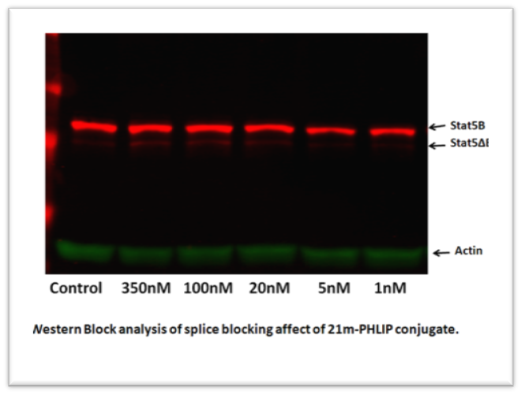
Validation of the targeting procedure

Slide 12
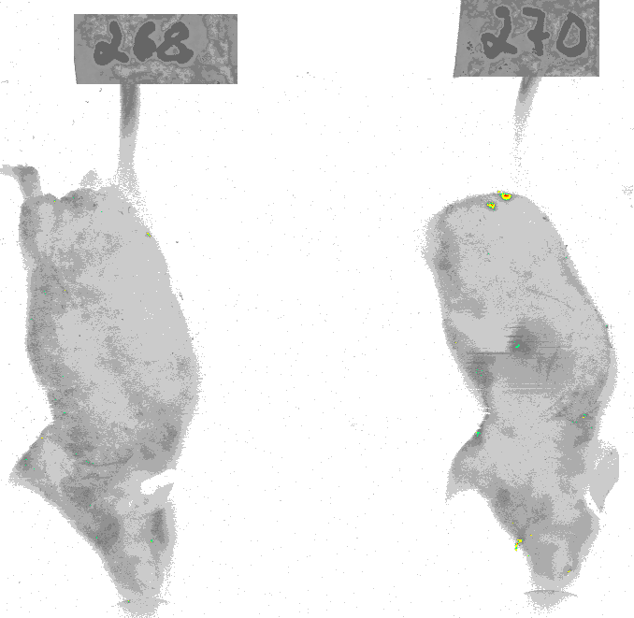
Delivery of the splice-switching oligonucleotide (SSO) by pH insertion peptide (pHLIP) in vivo
Control 11 days (3injections) 22 days (7 injections)
Notes:
Evaluate safety and effectiveness of Morpholino oligonucleotides to reach prostate tumors in animal models

Slide 13
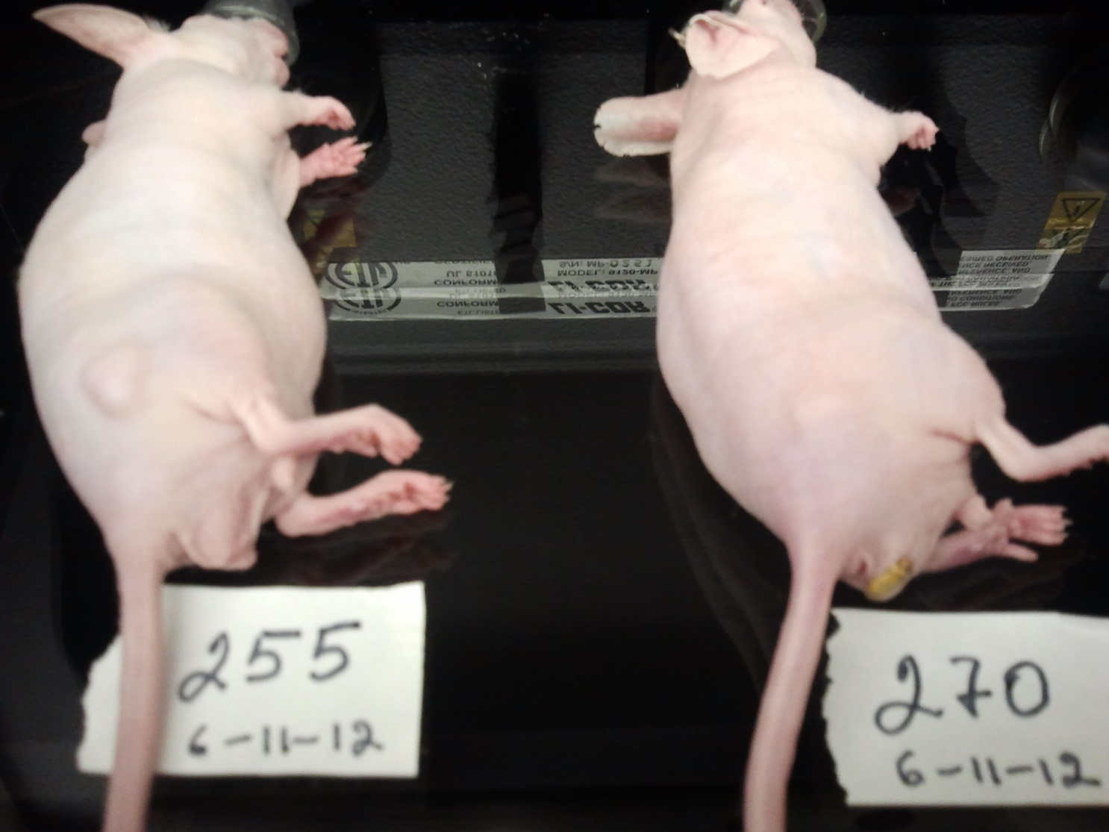

Effect of targeted delivery of the splice-switching oligonucleotide on tumor growth

Slide 14


Dr. Boris Ermolinsky
Dr. Thomas W. J. de Maar
Other students and researchers who contributed to previous research!!

