Slide 1
About OMICS Group
OMICS Group International is an amalgamation of Open Access publications and worldwide international science conferences and events. Established in the year 2007 with the sole aim of making the information on Sciences and technology ‘Open Access’, OMICS Group publishes 400 online open access scholarly journals in all aspects of Science, Engineering, Management and Technology journals. OMICS Group has been instrumental in taking the knowledge on Science & technology to the doorsteps of ordinary men and women. Research Scholars, Students, Libraries, Educational Institutions, Research centers and the industry are main stakeholders that benefitted greatly from this knowledge dissemination. OMICS Group also organizes 300 International conferences annually across the globe, where knowledge transfer takes place through debates, round table discussions, poster presentations, workshops, symposia and exhibitions.

Slide 2
About OMICS Group Conferences
OMICS Group International is a pioneer and leading science event organizer, which publishes around 400 open access journals and conducts over 300 Medical, Clinical, Engineering, Life Sciences, Phrama scientific conferences all over the globe annually with the support of more than 1000 scientific associations and 30,000 editorial board members and 3.5 million followers to its credit.
OMICS Group has organized 500 conferences, workshops and national symposiums across the major cities including San Francisco, Las Vegas, San Antonio, Omaha, Orlando, Raleigh, Santa Clara, Chicago, Philadelphia, Baltimore, United Kingdom, Valencia, Dubai, Beijing, Hyderabad, Bengaluru and Mumbai.

Slide 3

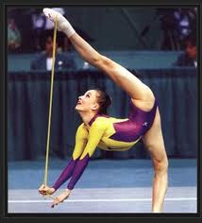


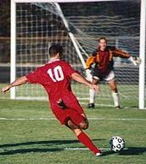
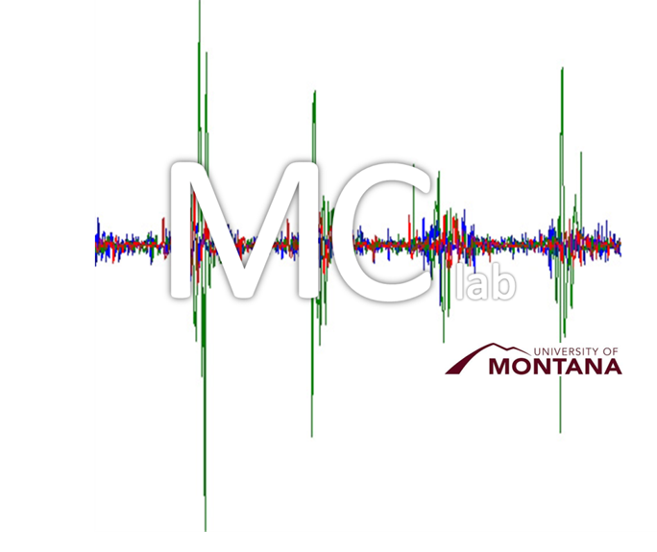
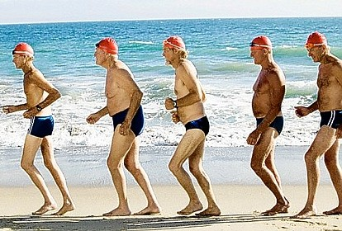


“Multi-muscle control of postural muscles: Manifolds and Frequencies”
Alessander Danna-dos-Santos, PT PhD
Motor Control Laboratory
School of Physical Therapy and Rehabilitation Science

Slide 4

Outline
Topic: Human Posture / Mechanisms of multi-muscle control.
Objectives of Research: Recognition, quantification, and understanding of neurophysiological mechanisms involved on multi-muscle control.
This presentation
    Comprehensive overview
    Operational definition of “Synergy”
    Recognition and quantification of muscle synergies
    Uncontrolled Manifold Hypothesis
    Frequency domain analysis

Slide 5
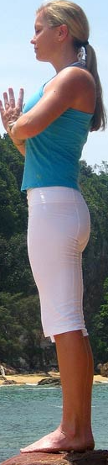


Axial Skeleton
Inherently unstable:
  Large number of joints
  Vertically positioned segments while standing
  High center of gravity
  Relatively small base of support
  Large number of muscles
  Presence of uni- and poli- articular muscles
  Non-linear force production features
  Dynamic interactions of joint torques generated by polyarticular muscles
  Interaction of internal forces across segments
  Response to external perturbations

Slide 6





Large number of effectors
Large repertoire of postures
(system flexibility)
Complex system of control

Slide 7
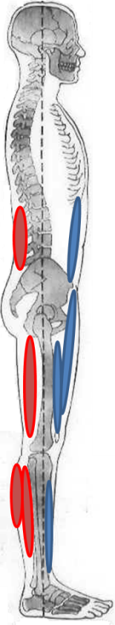

A possible solution
  Creation of functional groups (“Synergies”)
Bernstein 1967, reviewed in Latash ML 2002

Slide 8
The use of the term “synergy”
To study the topic we need an
OPERATIONAL DEFINITION
What is synergy ?
How do we find it ?
How do we quantify it?

Slide 9
The use of the term “synergy”
To study the topic we need an
OPERATIONAL DEFINITION
What is synergy ?
How do we find it ?
How do we quantify it?

Slide 10
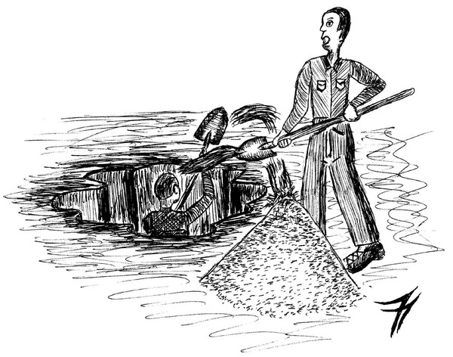
The use of the term “synergy”
Synergy = Working together ????
Gerald J. Furnkranz for The Examiner.com 2012

Slide 11
The use of the term “synergy”
To study the topic we need an
OPERATIONAL DEFINITION
What is synergy ?
How do we find it ?
How do we quantify it?

Slide 12
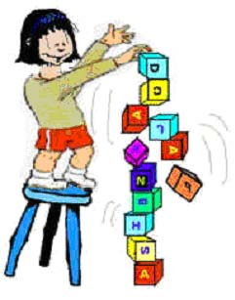
The Uncontrolled Manifold Hypothesis (UCMh)
It offers a computational method to estimate synergies quantitatively using an index of structure of the variance.
The controller computes a subspace (a manifold, UCM) within the space of elemental variables and limits variability orthogonal to the UCM while allowing more variability within the UCM.
(Scholz and Schoner 1999; Latash et al 2002)

Slide 13
Main assumption
Existence of at least 2 levels of control
CNS
k1
k3
k2
Level 2
M1- mode
M2- mode
M3- mode
Level where M-Modes co-vary to stabilize a performance variable
Level 1
m1 m2
m3 m4 m5
m6
Level where M-Modes are formed
ΔCOP

Slide 14

9
M2
8
GOOD VAR
M1
7
6
M2
5
4
3
2
M1
M2
2 8
1
4 6
0
1
2
3
4
5
6
7
8
9
5 5
M1
6 4
$$M1+M2=10 N/m$$
9 1

Slide 15
9
M2
8
M1
7
BAD VAR
6
M2
5
4
3
2
M1
M2
2 3
1
3 4
0
1
2
3
4
5
6
7
8
9
5 5
M1
6 6
$$M1+M2=10 N/m$$
9 1

Slide 16
9
M2
8
M1
7
6
M2
5
4
3
2
M1
M2
x₁ y₁
1
x₂ y₂
0
1
2
3
4
5
6
7
8
9
x₃ y₃
M1
…
…
$$M1+M2=10 N/m$$
x_{n} y_{n}

Slide 17
9
M2
8
M1
7
6
M2
5
4
3
2
GOOD
1
Index =
BAD
0
1
2
3
4
5
6
7
8
9
M1
$$M1+M2=10 N/m$$

Slide 18
SYNERGY
Non-SYNERGY
ANTI-SYNERGY
9
9
9
8
8
8
7
7
7
M2
6
M2
6
M2
6
5
5
5
4
4
4
3
3
3
2
2
2
1
1
1
0
1
2
3
4
5
6
7
8
9
0
1
2
3
4
5
6
7
8
9
0
1
2
3
4
5
6
7
8
9
M1
M1
M1
+1
0
-1
GOOD/dfg
GOOD/dfg
Index (Δvar) =
=
BAD/dfd + GOOD/dfg
Total/(dfg+dfb)

Slide 19

M2
M3
M2
M1
M1
M3
$$M1+M2+M3=10 N/m$$

Slide 20
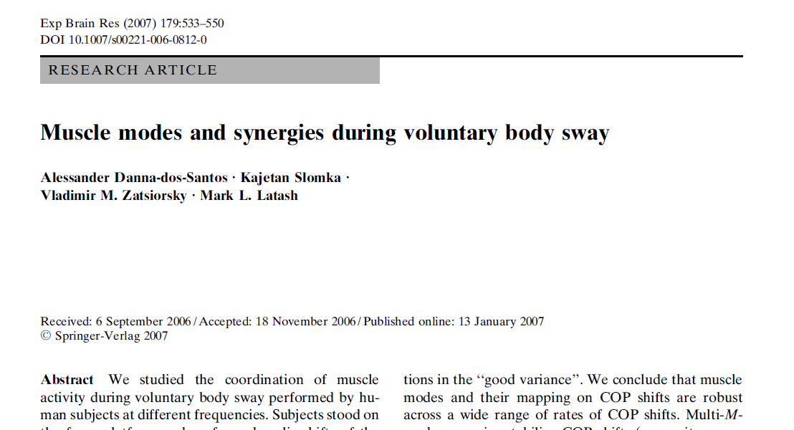

Slide 21
Study #1
Muscles recorded: SOL, GL, GM, BF, ST, ERE, TA, VL, RF, RA
- 5 conditions: Bipedal stance at five frequencies (0.125, 0.25, 0.5, 0.75 and 1 Hz)
Force plate

Slide 22
Steps of Data Processing
1- IEMG matrix (1200x11) is submitted to PCA and Varimax rotation
- Output: loading matrix
- 3-5 first PCs were taken into account for further analysis
- Modes are computed by IEMG matrix x ‘loading matrix’ (eigenvector)
2- Multiple regression is performed to obtain the Jacobian matrix (J) between M-modes and COPap.
- ∆COPap= k1*∆M-mode1 + k2*∆M-mode2 + k3*∆M-mode3 +…+ kn*∆M-mode n
- J = [k1 k2 k3 … kn].
3- UCM analysis is performed
- Vort and Vucm
- ∆V (index of synergy) = (Vucm/dof_ucm) - (Vort/dof_ort)
Total Var/dof_total

Slide 23
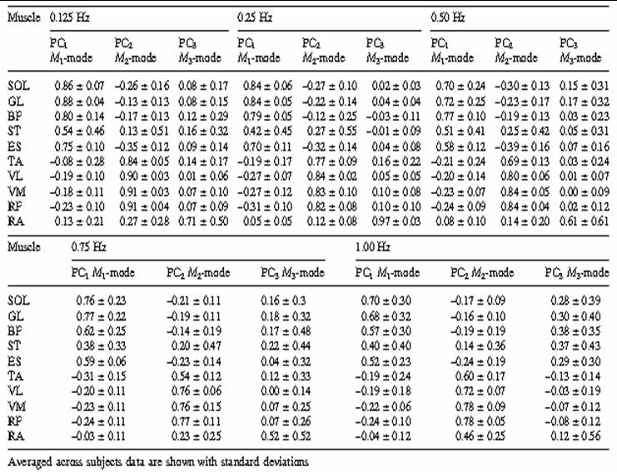
Results – Study #1
Conclusion
- M-mode composition does not depend on sway frequency;

Slide 24
CNS
k1
k3
k2
Level 2
M1- mode
M2- mode
M3- mode
Level 1
SOL GM GL BF ST ERE
TA RF VL
RA
ΔCOP
Force plate

Slide 25
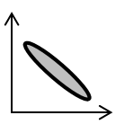
Results – Study #1
ΔV > 0 - a multi-M-mode synergy
V
35
V
UCM
1.6
V
UCM
30
V
ORT
1.4
ORT
1.2
2
)
25
20
1.0
Synergy
ΔV
0.8
15
Variance (cm
0.6
10
0.4
5
0.2
0
0.0
Non-synergy
0.125
0.25
0.50
0.75
1.00
0.125
0.25
0.50
0.75
1.00
Frequency (Hz)
Frequency (Hz)
Frequency (Hz)
Frequency (Hz)
Anti-synergy

Slide 26
CNS
k1
k3
k2
Level 2
M1- mode
M2- mode
M3- mode
Level 1
SOL GM GL BF ST ERE
TA RF VL
RA
ΔCOP
Force plate

Slide 27
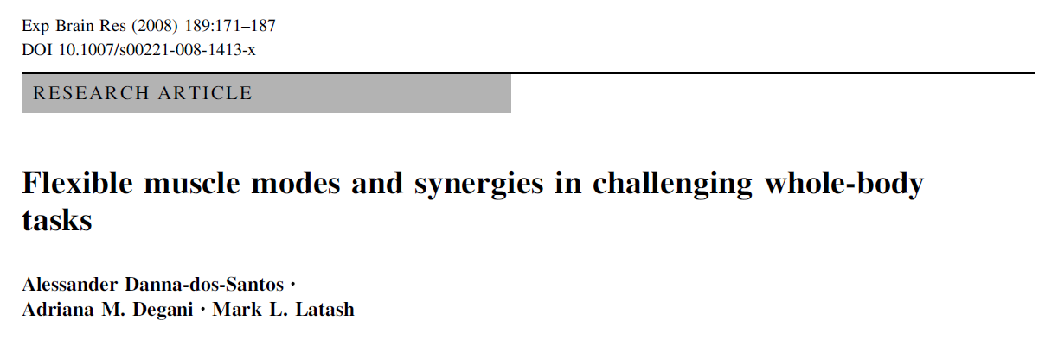

Slide 28
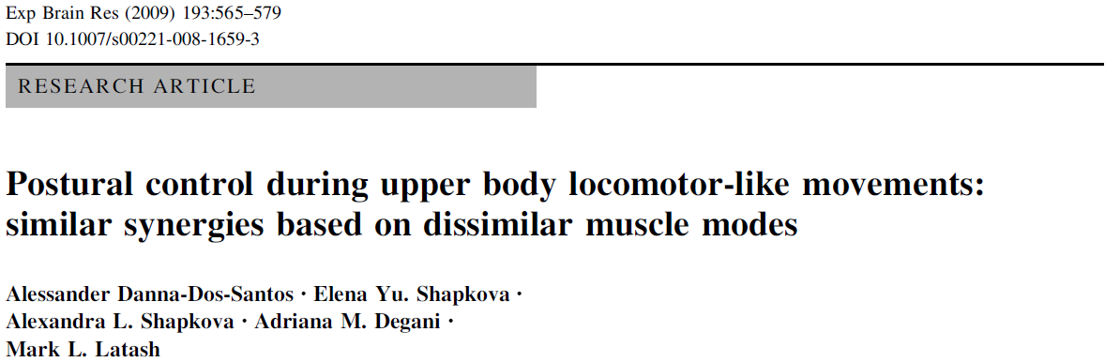

Slide 29
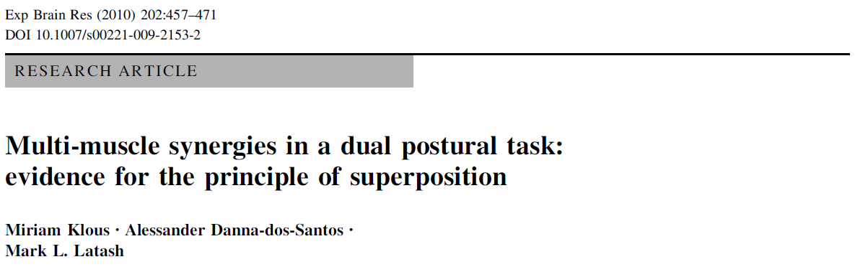

Slide 30
Conclusions
- The UCM hypothesis offers a fruitful framework for analysis of multi-muscle synergies involved in postural tasks.
- There are M-Mode synergies stabilizing the COPap trajectory
- M-mode composition are stable during routine whole-body actions
- M-mode composition changes under challenging conditions

Slide 31
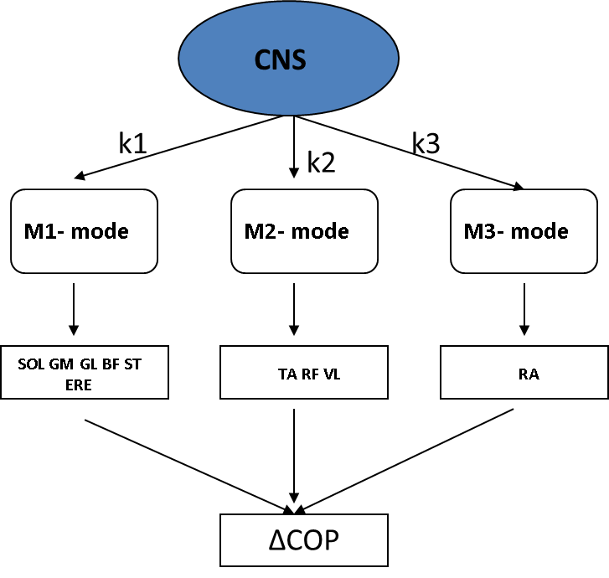
Next Step
- The UCM hypothesis is still a behavioral analysis
- What about the neural mechanisms generating the functional groups ?

Slide 32
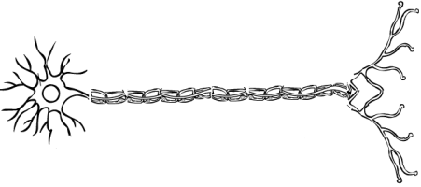
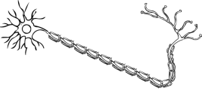
Multi-Muscle Control: Frequencies
Neurophysiological mechanisms responsible for the formation of these groups are still unclear and understanding these mechanisms is still one of the fundamental goals of motor control
Common (correlated) neural inputs may be the mechanism used by the CNS to coordinate the activation of muscles forming a synergistic group
(Farmer 1998; Semmler et al 2004; De Luca and Erim, 2002; Santello
and Fuglevand 2004; Johnston et al 2005; Winges et al 2008)
SOL
BF
Preliminary

Slide 33
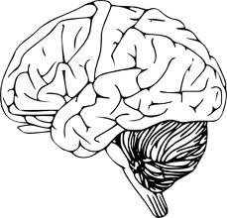
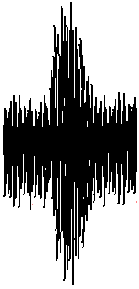
Procedures for quantification of correlated neural inputs
EMG
Coherence is estimated separately for pairs of EMG signals by using the cross-spectrum of two EMG signals (fxy) squared and normalized by the product of the autospectrum of each signal (fxx and fyy) at each frequency (λ)
SOL
=
|R_{xy}(λ)|² = |f_{xy}(λ)|² / (f_{xx}(λ)f_{yy}(λ))
BF
=
f_{xy} : cross-spectrum
f_{xx} , f_{yy} : auto-spectra
0.30
0.25
0.20
Coherence estimation (a.u.)
0.15
0.10
sig(α) = 1-(1-α)^{1/(L-1)}
0.05
0.00
0
10
20
30
40
50
60
70
80
90
100
110
120
130
140
150
160
170
180
190
200
210
220
230
240
250
Frequency (Hz)
Coherence is a measure used to determine the linear relation between two signals in the frequency domain. Similar to the coefficient of determination (r²) in linear statistics, the magnitude of coherence at a given frequency is bounded by 0 and 1, indicating that no linear relationship and a perfect linear relationship, respectively, exists at that frequency.
Rosemberg et al (1989)

Slide 34


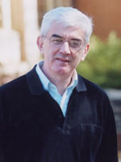

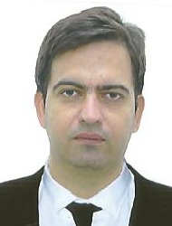

Thank you !!!
Dr. Tjeerd Boonstra, PhD
University of New South Wales
Sydney, Australia
Dr. Charles Leonard, PT PhD
University of Montana
Missoula – MT, USA
Dr. Mark Latash, PhD
Penn State University
University Park –PA, USA
Adriana M Degani, PT MSc
University of Montana
Missoula – MT, USA
Dr. Vinicius S Cardoso, PT, MSc
Universidade Federal Piaui
Parnaiba – PI, Brazil
Dr. Alessander T Magalhaes, PT, PhD
Universidade Federal Piaui
Parnaiba – PI, Brazil
Luis Mochizuki, PhD
Universidade de Sao Paulo,
Sao Paulo– SP, Brasil

Slide 35
Let Us Meet Again
We welcome you all to our future conferences of OMICS Group International
Please Visit:
www.omicsgroup.com
www.conferenceseries.com
www.pharmaceuticalconferences.com

