Slide 1
Strong Quadrupole Light-Molecule Interaction and Surface Enhanced Optical Processes
1
2
V.P. Chelibanov and A.M. Polubotko
1
State University of Information Technologies, Mechanics and Optics
Kronverkskii 49, Saint Petersburg 197101, Russia
2
A.F. Ioffe Physico-Technical Institute, Russian Academy of Sciences,
Politechnicheskaya 26, 194021, Saint Petersburg Russia
Spectroscopy is a powerful tool for investigation of molecules and
can be very useful in physics chemistry, biology and medicine

Slide 2
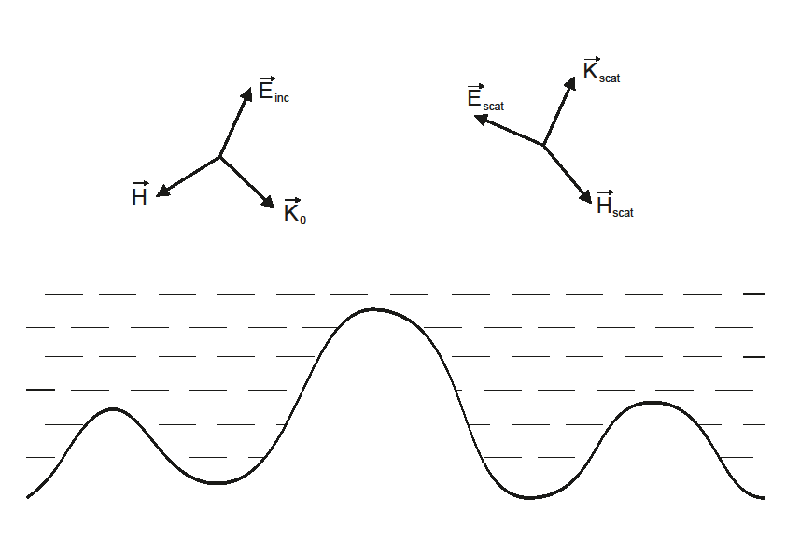
SERS-Surface Enhancement of Raman Scattering
Molecules
Metal-(silver, copper, gold)

Slide 3
Discovery of Surface Enhanced Raman Scattering, SERS, is a great achievement, because it allows to rise the sensitivity of this method
There are another Surface Enhanced optical processes
Surface Enhanced Infrared Absorption (SEIRA)
Surface Enhanced Hyper Raman Scattering (SEHRS)

Slide 4
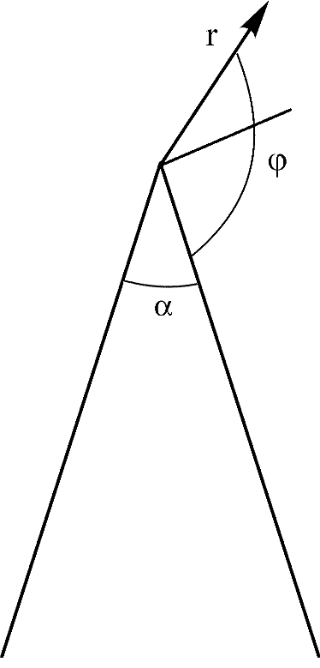
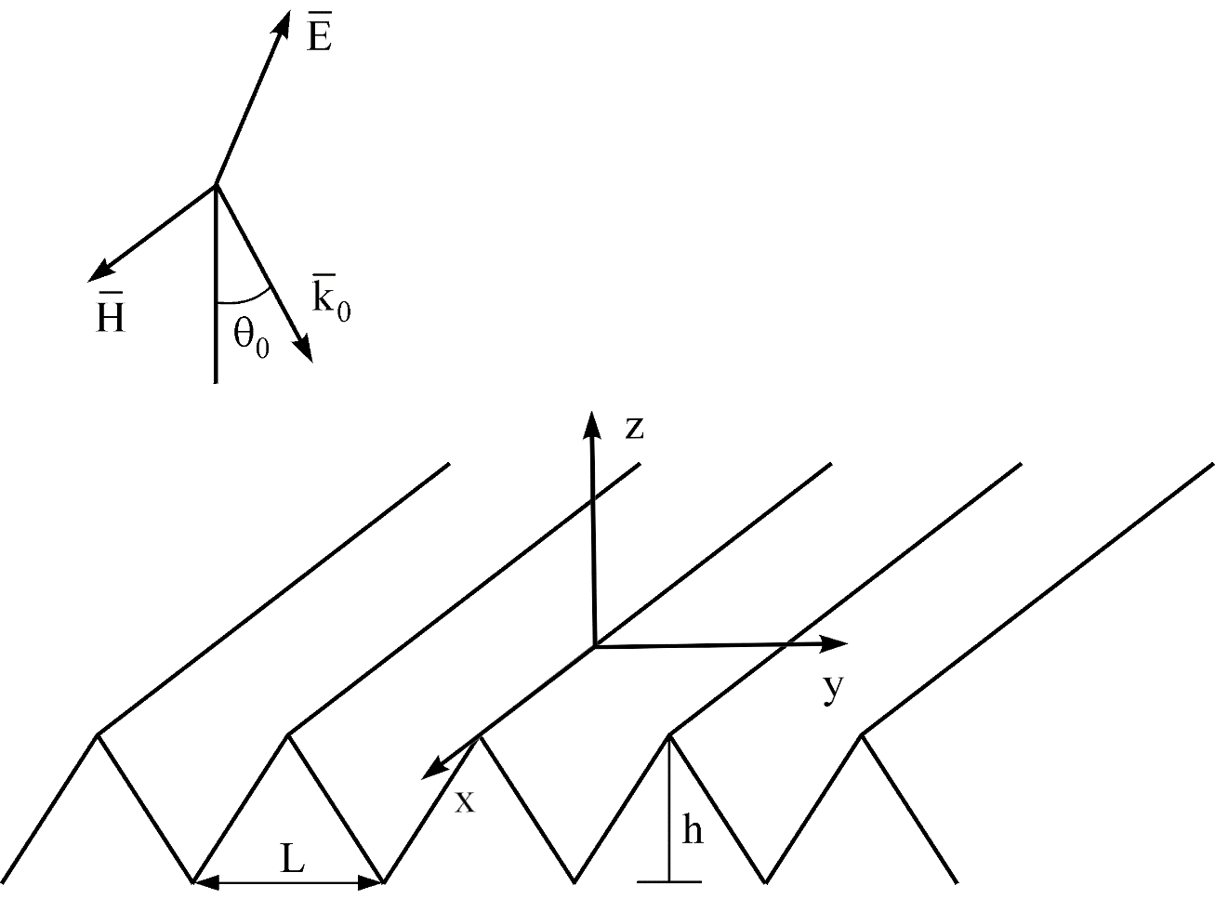
Models of roughness and a rough surface

Slide 5
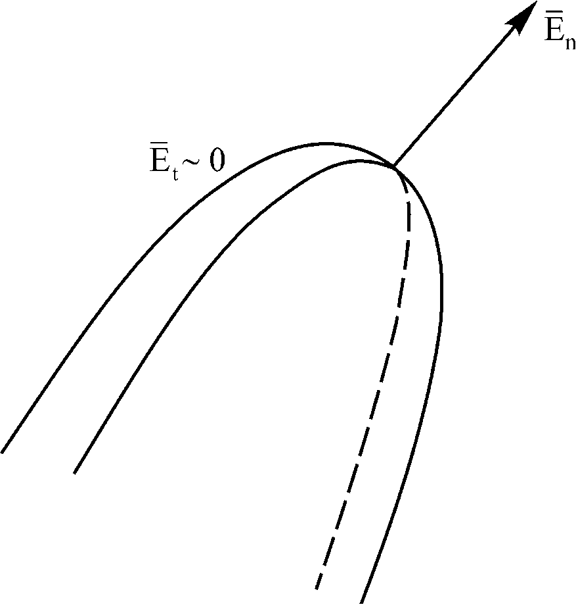
For more real model of the roughness there is the enhancement both
the component of the electric field, which is perpendicular to the
surface and the enhancement of its derivatives
This results in the necessity to take into account
not only the dipole but the quadrupole light-molecule
interaction, because of the increase of the electric field
derivatives.

Slide 6
Thus the light molecule interaction Hamiltonian must be in a form, when the quadrupole interaction is taken into account
The second factor is that the quadrupole interaction with a constant sign
are responsible for the strong additional enhancement, while the moments
are not essential
The moments, are designated as

Slide 7
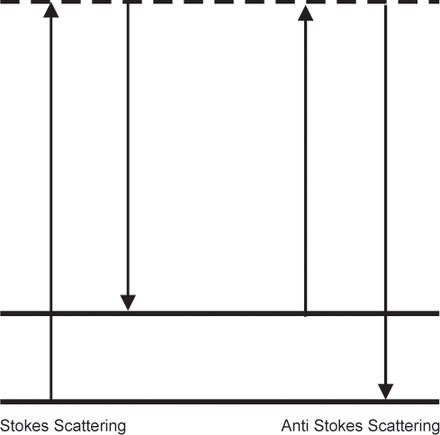
The Raman process with the dipole and quadrupole interactions taken into account is presented on the diagram
In SERS it takes place via various combinations of the
dipole and quadrupole moments, for example

Slide 8
It can be demonstrated that the quadrupole interaction with the moments
can be more than the dipole interaction with the moment
The quadrupole interaction and the increase of the number of moments, responsible for
the scattering results in the change of the SERS, SEHRS and SEIRA spectra of
molecules of symmetrical molecules and appearance of forbidden lines.
The most enhanced scattering arise from the scattering via the moments
and
In SERS
the most enhanced scattering occur via

Slide 9
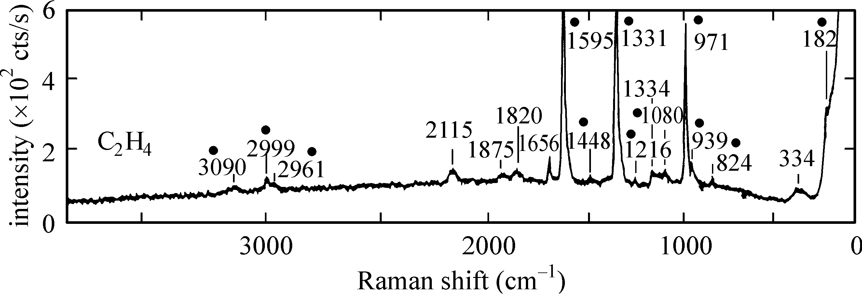
The quadrupole interaction changes main
regularities of thesespectra and results in
appearance of strong forbidden lines
The SERS spectrum of ethylene
allowed
allowed
forbidden

Slide 10
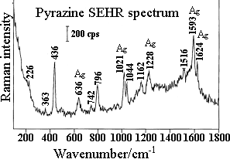
The SEHRS spectrum of pyrazine
with D2h symmetry group
Wu-Hu Li, Xiao-Yuan Li, Nai-Teng Yu // Chem. Phys. Lett. 1999, V.
305, P. 303.

Slide 11
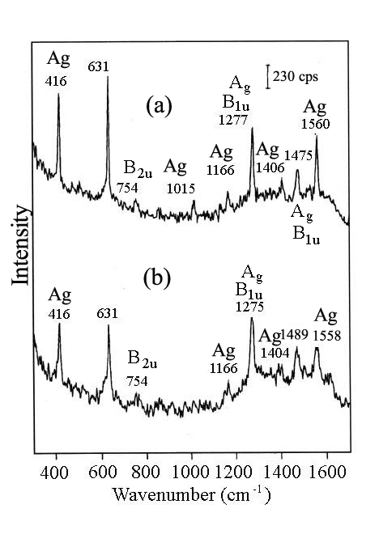
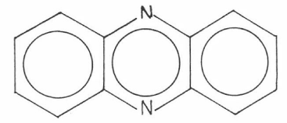
The SEHRS spectrum of phenazine
with D2h symmetry group
Wu-Hu Li, Xiao-Yuan Li, Nai-Teng Yu, Chem. Phys. Lett. 327, 153, (2000)

Slide 12
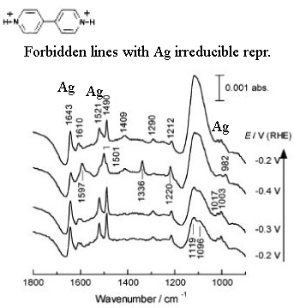
The SEIRA spectrum of with D2h symmetry group
Yu-Xia Diao, Mei-Juan Han, Li-Jun Wan, Kingo Itaya, Taro Uchida, Hiroto Miyake,
Akira Yamakata and Masatoshi Osawa, Langmuir 22, 3640, (2006).

Slide 13
CONCLUSION
Thus the theory, which is based on the conception
of the strong quadrupole light-molecule interaction
successfully explains all features of the spectra of
Surface Enhanced Optical processes. It can be
demonstrated that it explains all accompanying
phenomena.

