Slide 1
Some preliminary RESULTS OBTAINED when INDOOR RADON mitigation methods are applied
Alejandro Martín Sánchez
María José Nuevo
Department of Physics
University of Extremadura
06006 Badajoz, Spain

Slide 2
Some preliminary RESULTS OBTAINED when INDOOR RADON mitigation methods are applied
Outline
- TWO RESEARCH PROJECTS
- PREVIOUS WORKS AND RESULTS (1st proj.)
- METHODOLOGY AND WORKING PLAN
- RESULTS
- SUMMARY AND CONCLUSIONS

Slide 3
RESULTS OBTAINED BY THE APPLICATION OF SOME MITIGATION METHODS IN WORKPLACES WITH HIGH INDOOR RADON concentration
Two research projects:
Radon concentration in working places
2. Remedial or mitigation actions (if needed)

Slide 4
1st reSearch project
HELP PROGRAM FOR CONDUCTING RESEARCH AND DEVELOPMENT ON NUCLEAR SAFETY AND RADIATION PROTECTION
R+D CSN 2008-2011
Title: Measurement of radon concentrations in workplaces with particular exposure.
Duration: Three years
Goals: Monitoring workplaces with expected high concentration of radon in the region of Extremadura (Spain)

Slide 5
1st reSearch project
Measuring Methods
Type of detector | Passive/ Active | Tipical uncertainty * (%) | Tipical sampling period | Economic cost
Nuclear Tracks | Passive | 10 – 25 | 1 – 12 months | Low
Actived charcoal | Passive | 10 – 30 | 2 – 7 days | Low
Electret | Passive | 8 – 15 | 5 days – 1 years | Average
Electronic integrator | Active | ~ 25 | 2 days - years | Average
Continuos Monitor | Active | ~ 10 | 1 hour - years | High
* Typical uncertinty considering a mean of about 200 Bq/m³

Slide 6
1st reSearch project
identificaTiOn of places
“Título VII del Real Decreto 783/2001, de 6 de julio”
(Spanish legislation)
Resorts and spas.
Caves, tunnels and mines (other than uranium).
Facilities storing and dealing with water.
Other underground and surface suspected workplaces.

Slide 7
1st reSearch project
zones

Slide 8
1st reSearch project
sampling
Sites | Places | Measurements
Resorts and spas | 11 | 20
Caves, Tunnels and Mines | 4 | 12
Water treatment | 2 | 2
Other | 111 | 170
TOTAL | 128 | 204
 | Places | Measurements
Warehouses | 20 | 25
Parkings | 7 | 8
Hotels | 5 | 8
Museums | 36 | 46
University | 4 | 39
Unclassified | 39 | 44
TOTAL | 111 | 170

Slide 9
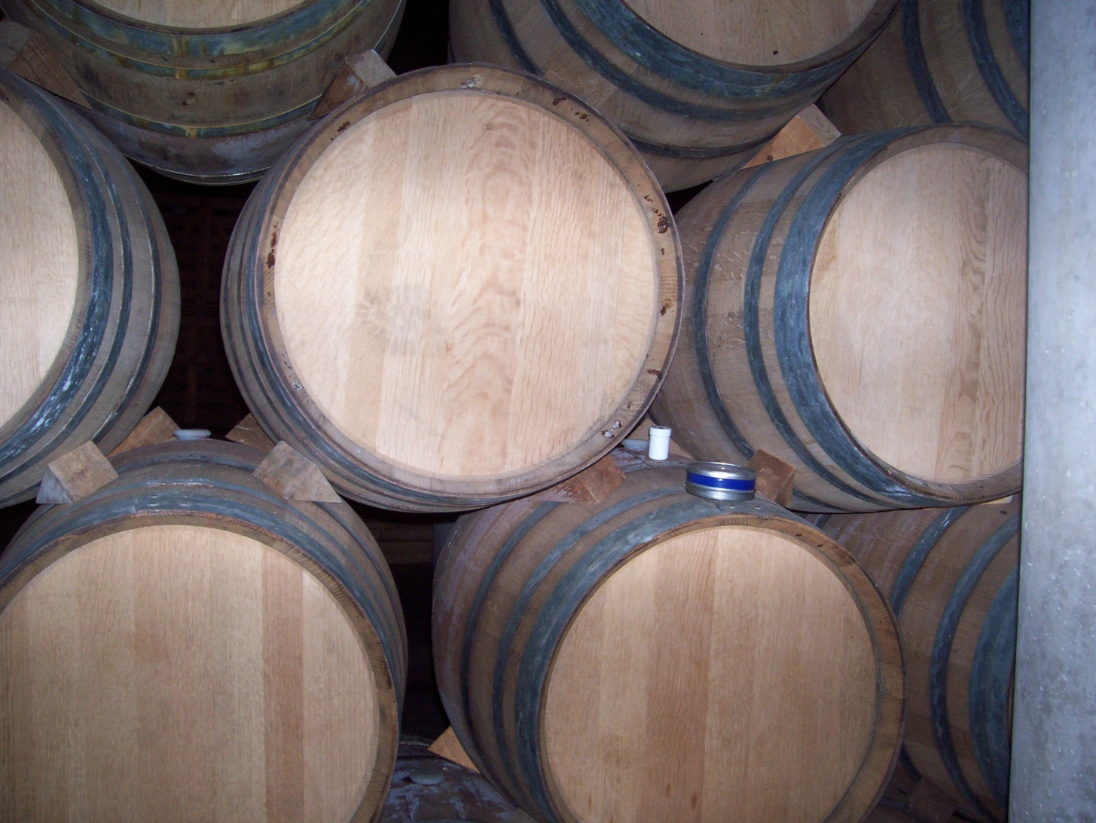
1st reSearch project
sampling
Activated Charcoal Detectors.
48 hours.
Collected 203 of 204: 99,5 %.
Laboratory analysis. “EPA 520/5-005”. Detector NaI(Tl).
Nuclear tracks detectors CR-39.
3 months.
Collected 174 of 194: 89.7 %.
External Laboratory analysis. University of Cantabria.

Slide 10
1st reSearch project
Clasification of working places
“Título VII del Real Decreto 783/2001, de 6 de julio”
(Spanish legislation)
Let C to be the yearly mean of indoor radon concentration. Then:
If C < 200 Bq/m³ → No actions needed
If 200 Bq/m³ < C < 400 Bq/m³ → Single remedial actions recommended
C = 400 Bq/m³ is the level for the protection of workers
If 400 Bq/m³ < C < 1000 Bq/m³ → the place is considered with low-level radon activity for professional exposed workers
For C > 1000 Bq/m³ → Significant exposition levels → Compulsory protection actions

Slide 11
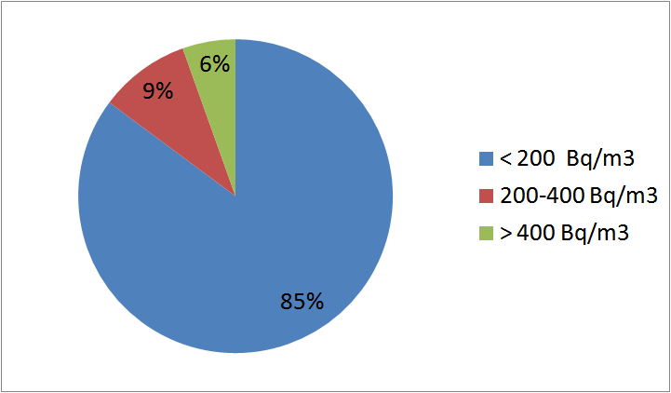
1st reSearch project
results
Measured places | < 200 Bq/m³ | 200-400 Bq/m³ | > 400 Bq/m³
128 | 108 | 12 | 8

Slide 12
1st reSearch project

Slide 13
1st reSearch project
SUMMARY
Participation of companies (27 % rejection).
15 % (19/128) of the sites above 200 Bq/m³.
Some interesting facts.
60% (3/5) above 200 Bq/m³ for resorts.
100% (2/2) of the Caves upper than 400 Bq/m³.
0% (0/8) of the water facilities exceeds 75 Bq/m³.
UNDERGROUND Places:
100% (7/7) of the parking lots below 20 Bq/m³.
92.3% (12/13) of the wareshouses below 100 Bq/m³.
SURFACE Places:
20% (6/30) of the museums are over 200 Bq/m³.
17.6% (6/34) from other places are over 200 Bq/m³.
“Radon in workplaces in Extremadura (Spain)”. A. Martín Sánchez, J. de la Torre Pérez, A.B. Ruano Sánchez, F.L. Naranjo Correa. J. Environ. Radioact. 107, 86-91 (2012).

Slide 14
2nd RESEARCH PROJECT
METHODOLOGY AND WORKING PLAN
- In the new R+D project, 4 SURVEYS
have been performed
Track detectors were exposed for 3 MONTHS (1 year total time)

Slide 15
METHODOLOGY AND WORKING PLAN
The new research project started measuring again in those sites with concentrations greater than 200 Bq/m³
New workplaces and also some dwellings (in zones suspected to have great Rn concentrations) were now included.
Nuclear track detectors (exposed for three months) were used.
New limits have been defined in the spanish legislation

Slide 16
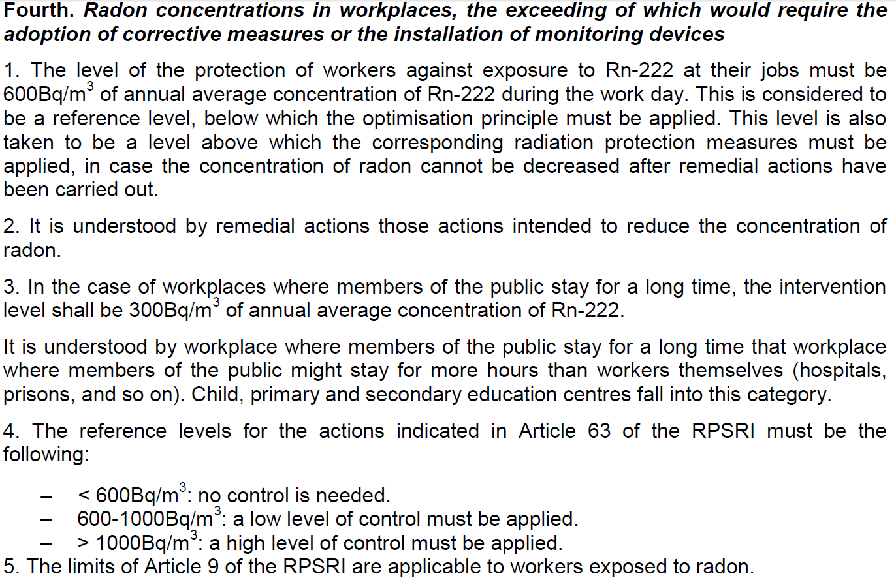
New Legislation
Instruction IS33 of CSN

Slide 17
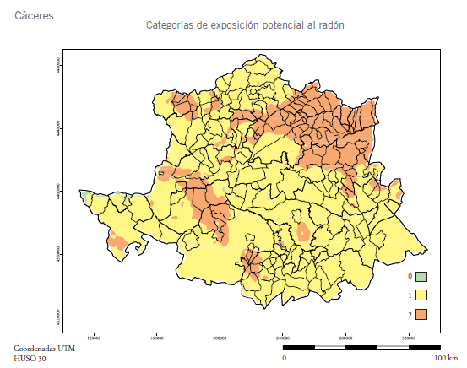
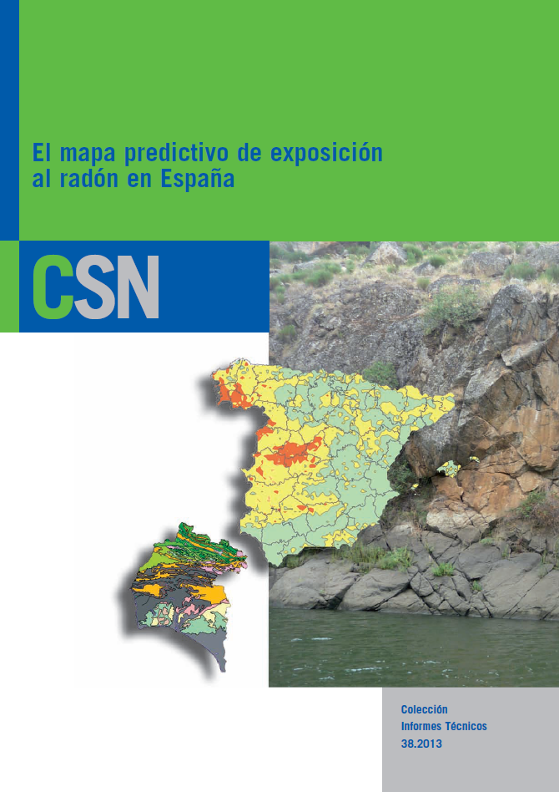
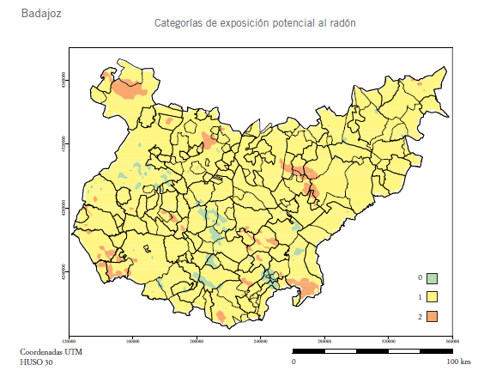
METHODOLOGY AND WORKING PLAN

Slide 18
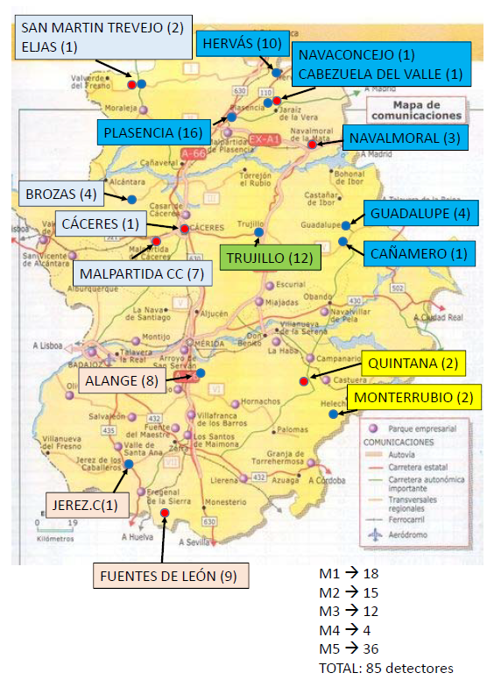
METHODOLOGY AND WORKING PLAN

Slide 19
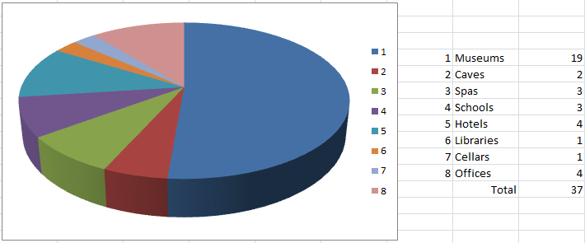
METHODOLOGY AND WORKING PLAN

Slide 20
METHODOLOGY AND WORKING PLAN
PROPOSED ACTIONS
Ventilation (when possible)
Changing the working place
(inside the same building, when possible)
Limiting the time of residence of people
Architectonics actuations

Slide 21
FIRST RESULTS
ANALYZED SITES IN THE 1st PROJECT vs
RESULTS REACHED IN THE FIRST SURVEY
OF THE 2nd PROJECT
 | Architec. Actuations | Ventilation | Changing Workplace | Limiting time | No actions
MUSEUMS | 2 | 5 | 2 |  | 10
CAVES |  |  |  | 1 | 1
SPAS |  | 1 |  |  | 2
SCHOOLS |  | 1 | 2
HOTELS |  | 2 | 1 |  | 1
LIBRARIES |  |  |  |  | 1
CELLARS |  |  | 1
OFFICES |  |  | 1 |  | 3

Slide 22
FIRST RESULTS
ANALYZED SITES IN THE 1st PROJECT vs
RESULTS REACHED IN THE FIRST SURVEY
OF THE 2nd PROJECT
 | Architec. actuations | Ventilation | Changing Workplace | Limiting time | No actions
MUSEUMS | 1↑1↓ | 1↑4↓ | 2↓ |  | 1↑2↓4→3−
CAVES |  |  |  | 1→ | 1↓
SPAS |  | 1↓ |  |  | 1↑1−
SCHOOLS |  | 1↓ | 2↓
HOTELS |  | 2↓ | 1↓ |  | 1↑
LIBRARIES |  |  |  |  | 1↓
CELLARS |  |  | 1↓
OFFICES |  |  | 1↓ |  | 2↑1−

Slide 23
ACTUAL WORKING PLAN
Some places were discarded by:
- Low concentration
- Scarce occupational sites
Remedial actions were proposed and applied in some cases
Studies on places with or without applications of remedial actions continued
Dose on each site are being estimated

Slide 24
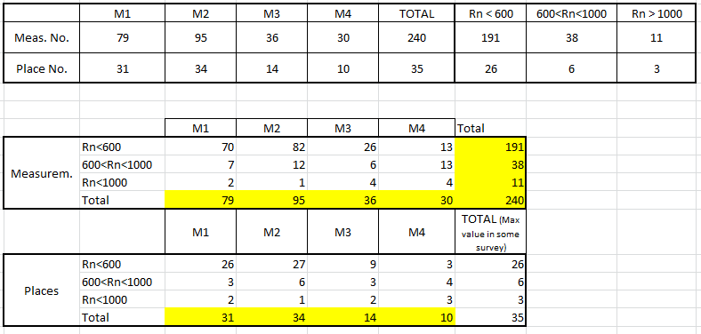
SUMMARY

Slide 25
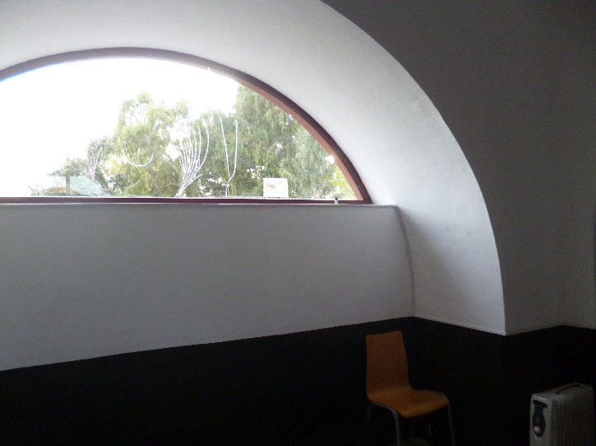
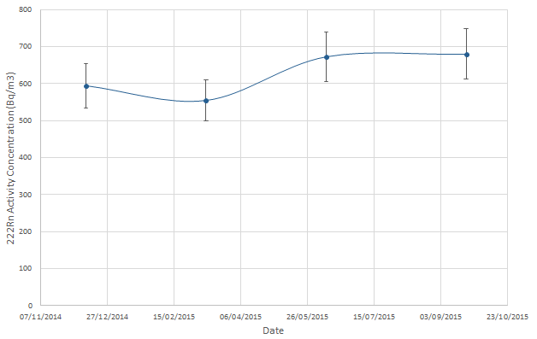
SOME EXAMPLES:
Reception room of a museum
… even with ventilation

Slide 26
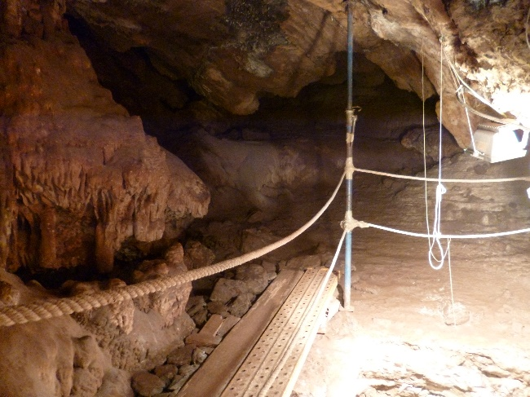
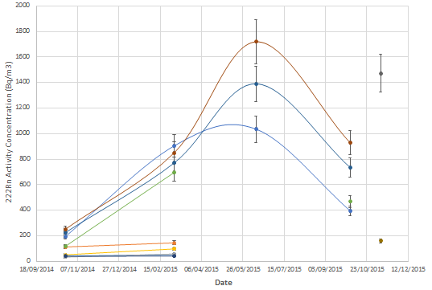
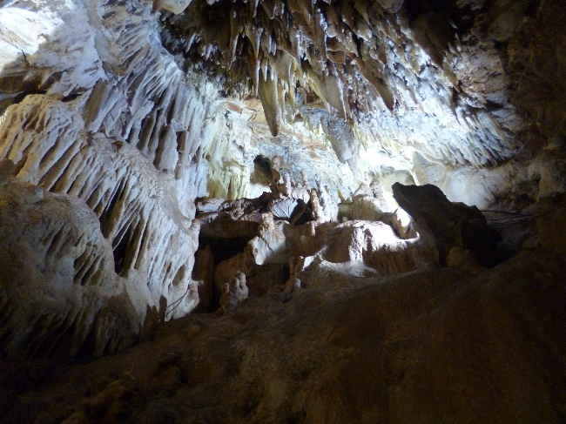
SOME EXAMPLES:
A touristic cave
No possible ventilation in this case

Slide 27
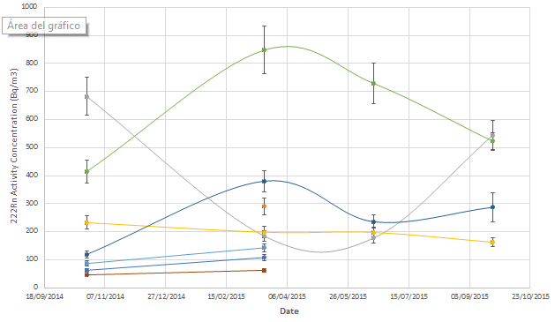
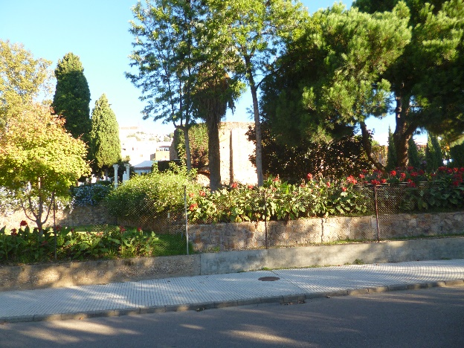
SOME EXAMPLES:
A Roman spa
- Reception room : ventilation in hot seasons (grey line)
- Cold water spa: reverse behaviour (green line)
- Rest of dependences: office, massage rooms, hot water spa, etc., without great problems

Slide 28
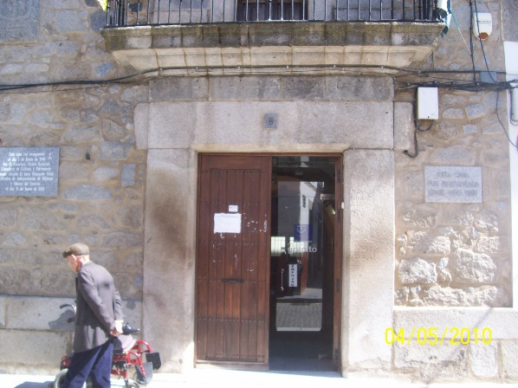
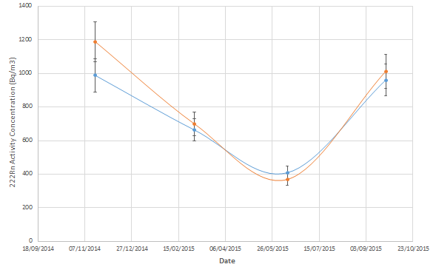
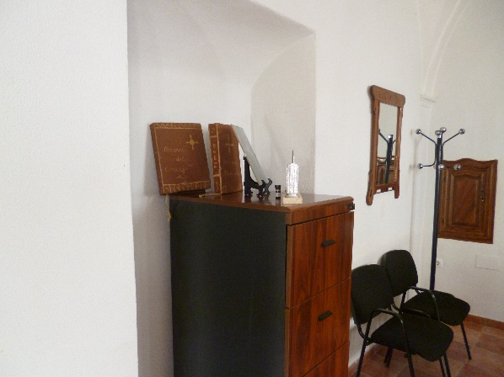
SOME EXAMPLES:
Office room of a museum
Ventilation in hot seasons

Slide 29
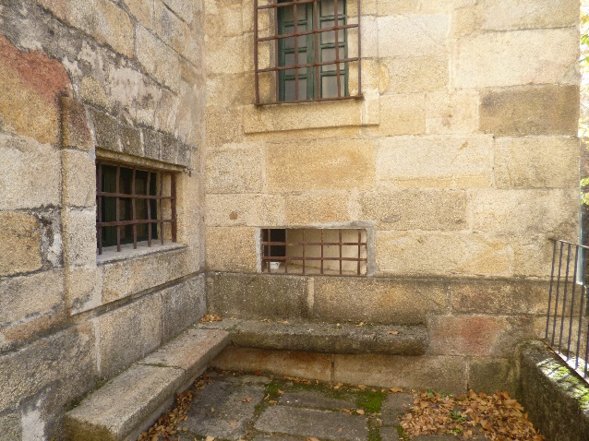
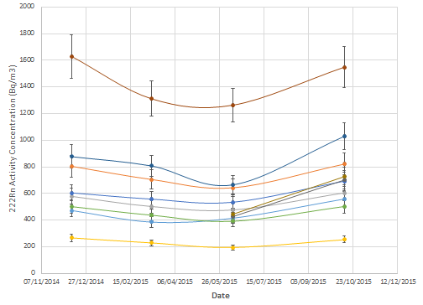
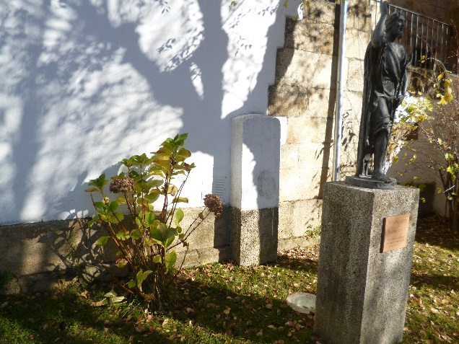
SOME EXAMPLES:
Another museum
Even including architectonic actuations

Slide 30
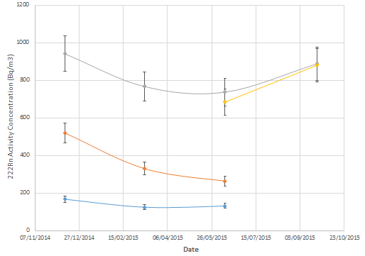
A CASE STUDY: A museum
The reception desk room showed average values of the
radon concentration greater than 600 Bq/m3 (grey line)

Slide 31
A CASE STUDY: A museum
Ancient building (historic hospital)
The reception desk room showed average values of the radon
concentration greater than 600 Bq/m³ (grey line).
Next door room showed similar concentrations (yellow line).
This room has a (now sealed) well
(probably the source of radon).
Both rooms are semi-undergrounded
Both rooms have direct communication
without any separation gate.
The room with the well have a little window (30 x 80 cm²)
in the upper part, which is opened early in the morning for
about 15 min (ventilation).

Slide 32
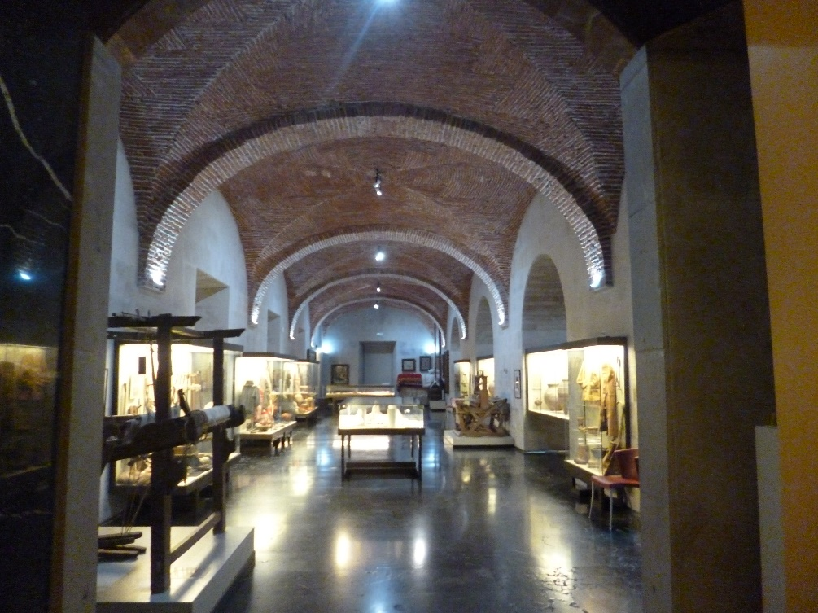
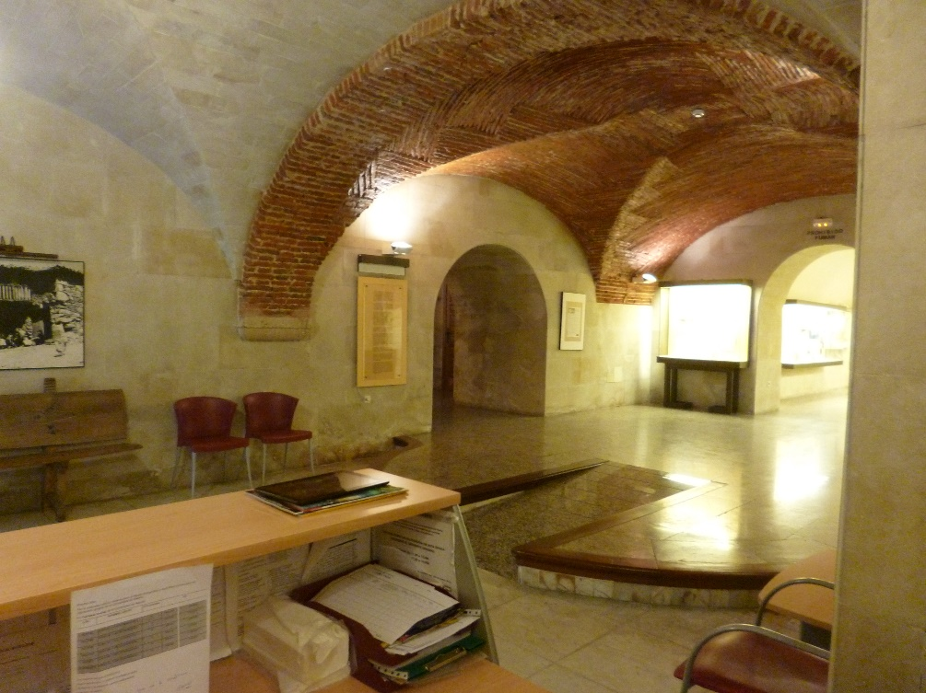
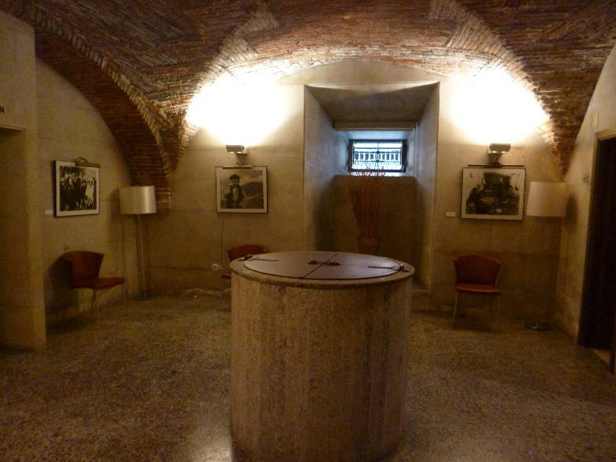
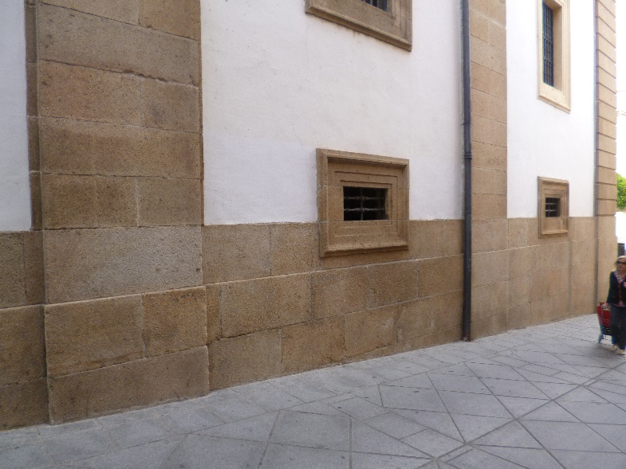
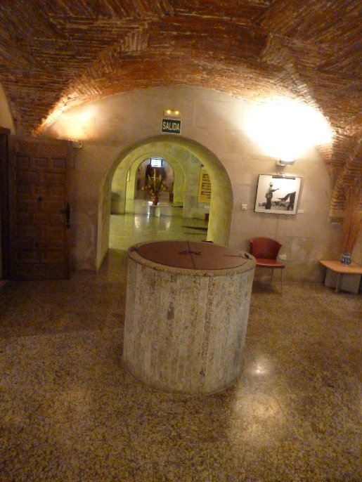

Slide 33
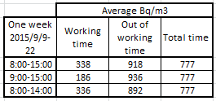
A CASE STUDY: A museum
A continuous monitor AlphaGuard was then used

Slide 34
SUMMARY AND CONCLUSIONS
Great variability in the radon concentrations
Seasonal changes
Specific “one place – one study” is required
Difficult extrapolation to other places
Indicated remedial actions could be not appropriate
One-year study is recommended for each case
Hourly variations must be taken into account
Assesment of dose to the people must be estimated
New remedial actions must be proposed and applied (if possible)

Slide 35
ACKNOWLEDGEMENTS
THANK YOU FOR
YOUR ATTENTION !!!

