Slide 1
About OMICS Group
OMICS Group International is an amalgamation of Open Access publications and worldwide international science conferences and events. Established in the year 2007 with the sole aim of making the information on Sciences and technology ‘Open Access’, OMICS Group publishes 400 online open access scholarly journals in all aspects of Science, Engineering, Management and Technology journals. OMICS Group has been instrumental in taking the knowledge on Science & technology to the doorsteps of ordinary men and women. Research Scholars, Students, Libraries, Educational Institutions, Research centers and the industry are main stakeholders that benefitted greatly from this knowledge dissemination. OMICS Group also organizes 300 International conferences annually across the globe, where knowledge transfer takes place through debates, round table discussions, poster presentations, workshops, symposia and exhibitions.

Slide 2
About OMICS Group Conferences
OMICS Group International is a pioneer and leading science event organizer, which publishes around 400 open access journals and conducts over 300 Medical, Clinical, Engineering, Life Sciences, Phrama scientific conferences all over the globe annually with the support of more than 1000 scientific associations and 30,000 editorial board members and 3.5 million followers to its credit.
OMICS Group has organized 500 conferences, workshops and national symposiums across the major cities including San Francisco, Las Vegas, San Antonio, Omaha, Orlando, Raleigh, Santa Clara, Chicago, Philadelphia, Baltimore, United Kingdom, Valencia, Dubai, Beijing, Hyderabad, Bengaluru and Mumbai.

Slide 3
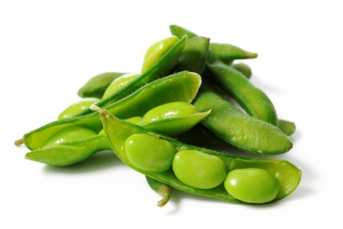
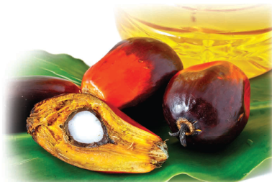
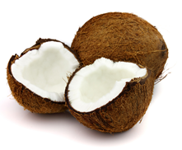
POLYMERS and Composites from Plant Oil-based Resin
Alejandrina Campanella
3rd International Conference and Exhibition on
Materials Science & Engineering
October 06-08, 2014 San Antonio, USA

Slide 4

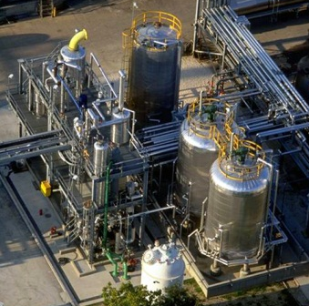
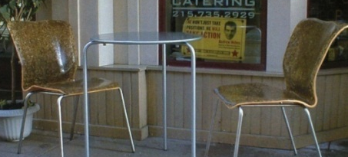
Outline
Market Drivers
Bio-Polymers from Plant Oils
Plant oil overview
Bio-resins:
Monomers: MAESO, MAELO
Diluents: styrene, MFA, …
Bio-Thermoset Polymer
Bio-Composites Applications
BMC
VARTM
Summary

Slide 5
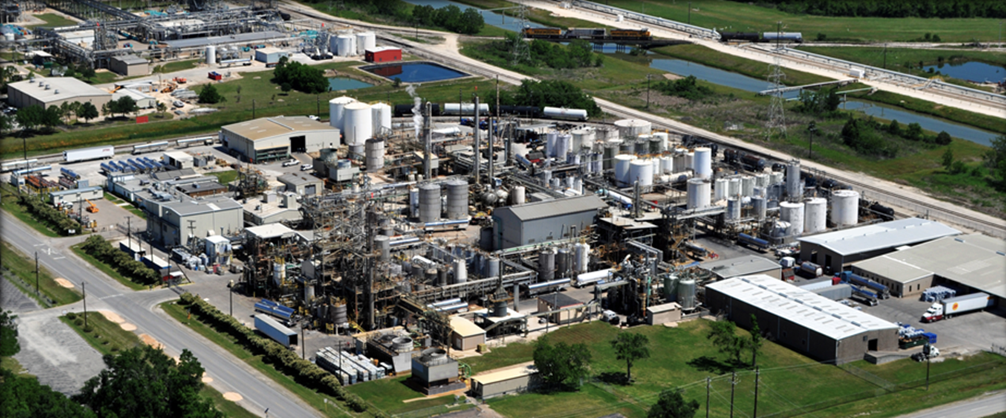
Dixie Chemical
Dixie Chemical is a global supplier of specialty chemicals in four key market segments:
Thermoset Materials
Alkaline Paper Sizing
Fuel and Lube Additives
Life Sciences

Slide 6
Bio-Composites Market Drivers
Reduce dependence on petroleum based products
Increase the use of renewable resources
Reduce emissions and impacts on the environment and health
Improve working conditions and worker safety
Sustainable materials with comparable properties
Ability to differentiate from competitive offerings (Bio-based)
Open new markets throughout the supply chain
Rural community stability and development (USDA BioPreferred)
Improve product life cycle footprint

Slide 7








Bio-Composites Market Drivers
Expand options for end of life recycle/re-use
Help customers adapt to Local, Regional and Federal regulation
Increasing consumer interest in sustainable products
Produce a sustainable product that is certified and/or labeled by:

Slide 8
Bio-POLYMERS from Plant Oils

Slide 9
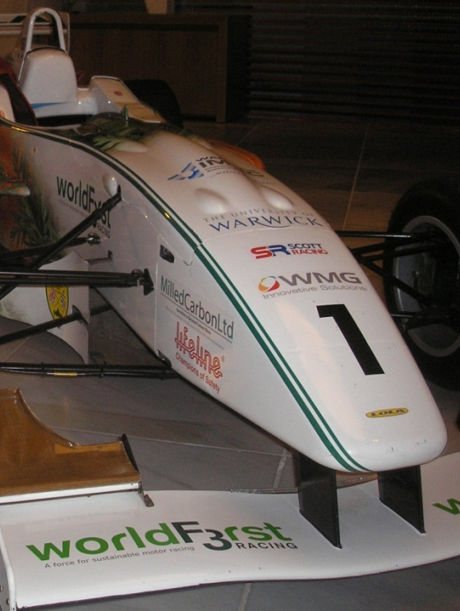
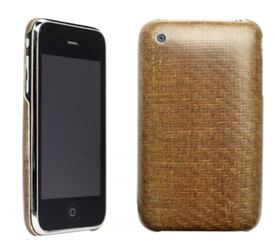
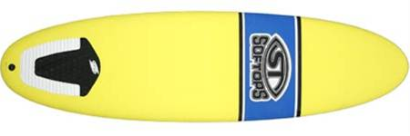
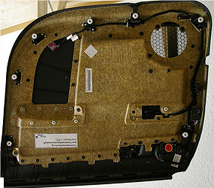


Bio-Based Composite Materials

Slide 10
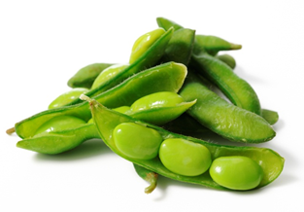
PLANT OIL OVERVIEW
Soybean, Corn, Sunflower, Linseed…
0-3 Double Bonds
12-22 Carbons long

Slide 11
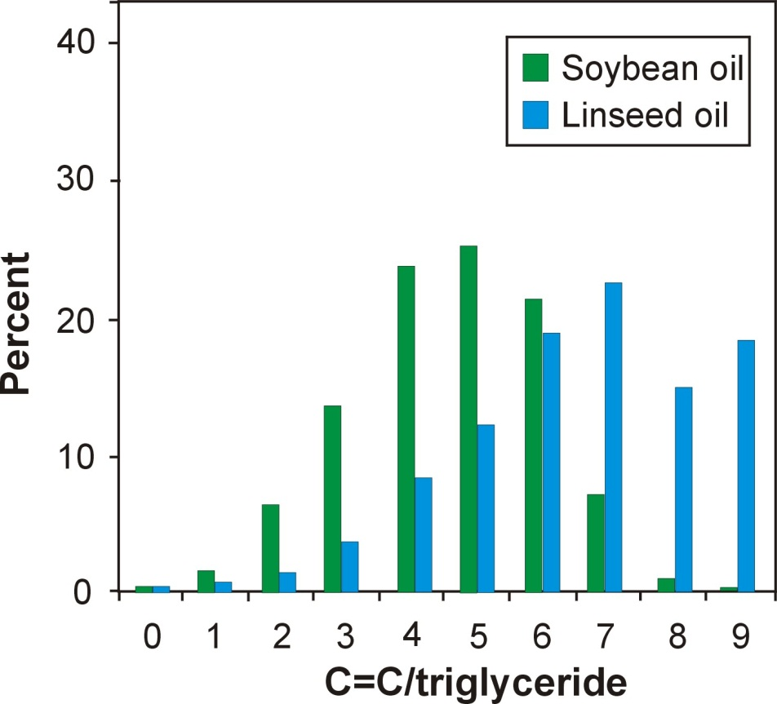
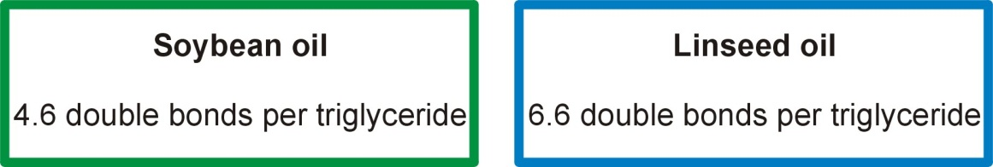
Fatty Acid Distribution
# Carbons | # Double bonds | Soybean oil % Comp. | Linseed oil % Comp.
14 | 0 | 0.1 | 0.0
14 | 1 | 0.0 | 0.0
16 | 0 | 11.0 | 5.5
16 | 1 | 0.1 | 0.0
18 | 0 | 4.0 | 3.5
18 | 1 | 23.4 | 19.1
18 | 2 | 53.2 | 15.3
18 | 3 | 7.8 | 56.6
20 | 0 | 0.3 | 0.0
20 | 1 | 0.0 | 0.0
22 | 0 | 0.1 | 0.0
22 | 1 | 0.0 | 0.0

Slide 12
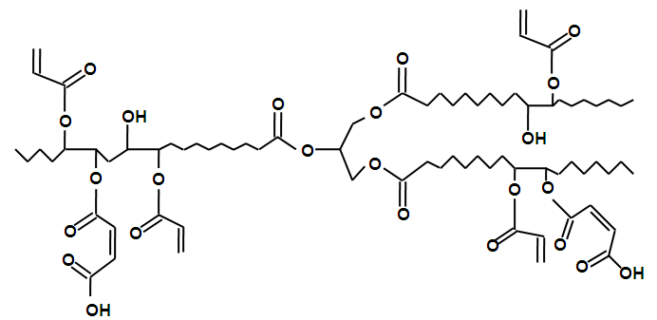
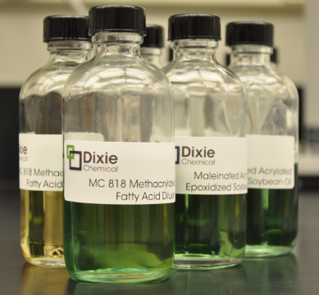
Bio-Resins Definition
+
Reactive
Diluent
MAESO/MAELO
Reactive Diluent: styrene, MFA, vinyl toluene and others

Slide 13
Bio-Thermosetting Polymer
Resin | MAESO | MAELO
T_{g} (ºC) | 108 | 120
Flexural strength (MPa) | 77.1 | 95.6
Flexural modulus (GPa) | 2.7 | 2.8
Tensile strength (MPa) | 39.7 | 58
Tensile modulus (GPa) | 2.2 | 2.8
Iso-UPR | Ortho-UPR
110 | 120
80.0 | 130.0
3.5 | 3.6
55 | 75
3.5 | 3.4
MAESO: Maleinated acrylated epoxidized soybean oil
MAELO: Maleinated acrylated epoxidized linseed oil
UPR: Unsaturated polyester resin

Slide 14
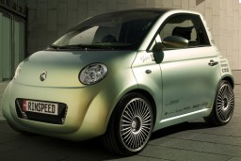
VOC/HAP Emissions
Liquid resins used in molding large scale composites are a significant source of Hazardous Air Pollutants.
HAP emission
HAP emission
HAP emission
HAP emission
Mixing
Molding
Curing and Post-curing
In Service
Composites industry consumes 9% of the styrene, but accounts for 79% of styrene emissions.
Lacovara, 1999

Slide 15
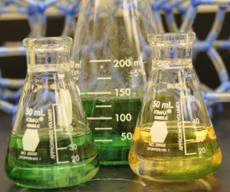
Methacrylated fatty acid
+
catalyst
MFA
La Scala et al., Polymer, 2005

Slide 16
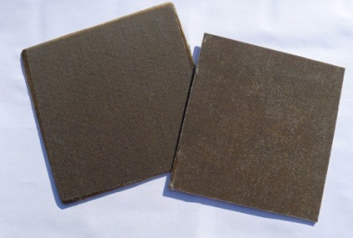
Bio-Thermosetting Polymer
+
+
+
Initiator
MFA
(Styrene Offset)
Bio-Resin
Heat
Use fatty acid monomers to reduce styrene content.
Non-volatile
Maintain low viscosity
Increase bio-based content
Bio-Based
Thermoset Polymer

Slide 17
MAESO with styrene/MFA
Resin | 1 | 2 | 3
Styrene (wt%) | 33 | 20 | 13
MFA (wt%) | 0 | 13 | 20
T_{g} (ºC) | 108 | 85 | 69
E’(MPa) | 1889 | 1385 | 911
Crosslink density (mol/m³) | 3848 | 2165 | 1253
M_{c} (g/mol) | 285 | 500 | 877
BBC | 57 | 65 | 69
BBC = bio-based content
MFA

Slide 18
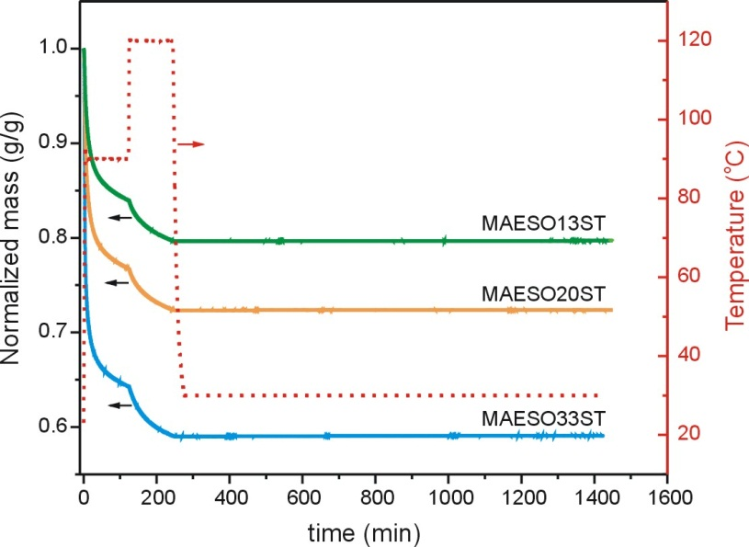
Styrene Emission Study
Mass Loss: Reactive diluents
Decreasing
emissions

Slide 19
MAESO with different diluents
Resin | DB | S | VT | MMA
Diluent (wt%) | 33 | 33 | 33 | 33
T_{g} (ºC) | 122 | 108 | 109 | 67
E’(MPa) | 2120 | 1889 | 1838 | 1690
Crosslink density (mol/m³) | 4620 | 3848 | 3207 | 2575
M_{c} (g/mol) | 127 | 285 | 342 | 427
S: styrene
DB: divinyl benzene
VT: vinyl toluene
MMA: methyl methacrylate

Slide 20
Bio-Composites Applications

Slide 21
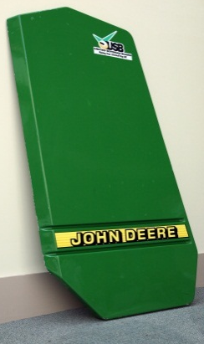
SMC – BMC Applications
+
Filler
+
MgO
+
+
+
Fibers
Initiator
Resin and
Additives
Bio-Resin
Filler
Compression
Molding
Mixing
extruders
Robotic
Handling
Cutting
Extrusion
Conveyor
Glass fiber feeding
(chopped fibers)

Slide 22
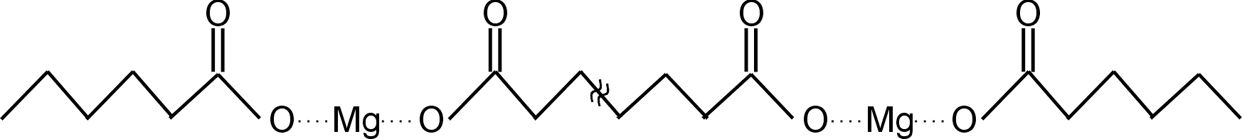
Thickening
η
7-10 days
Time

Slide 23


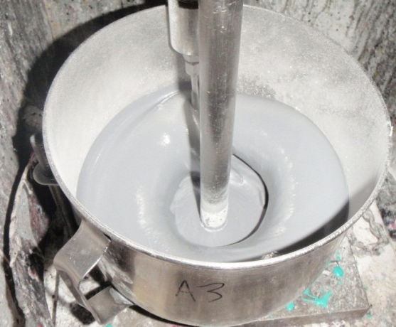
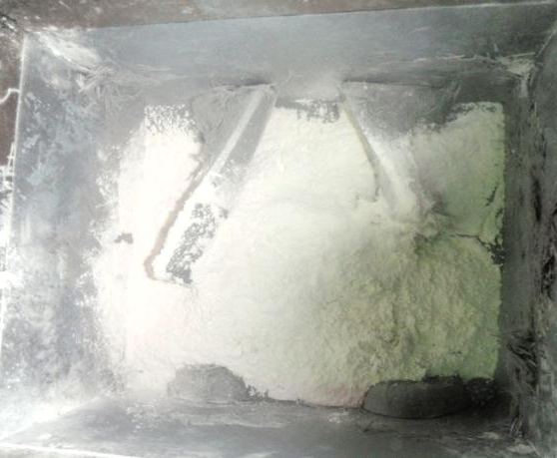
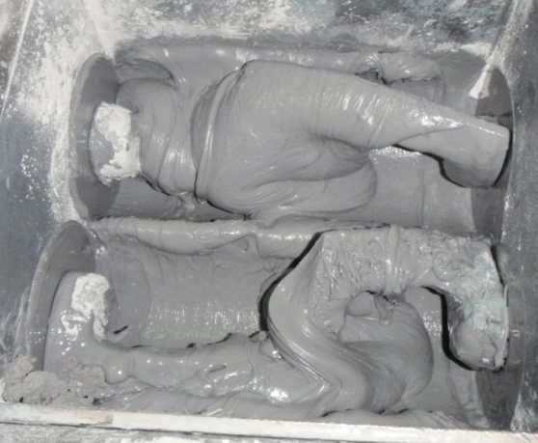
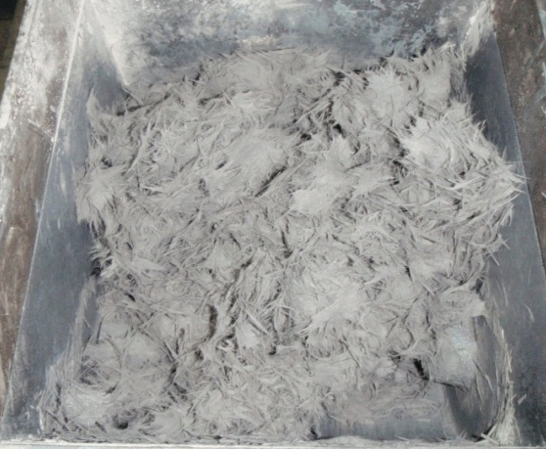
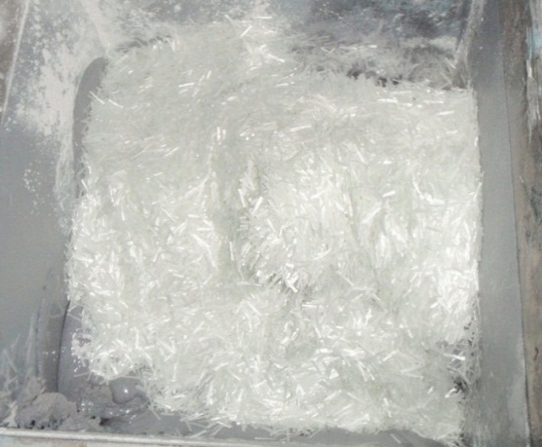
BMC Manufacturing
Resin & Initiator
Filler added
Mixed
Mixed
Fiber glass added

Slide 24
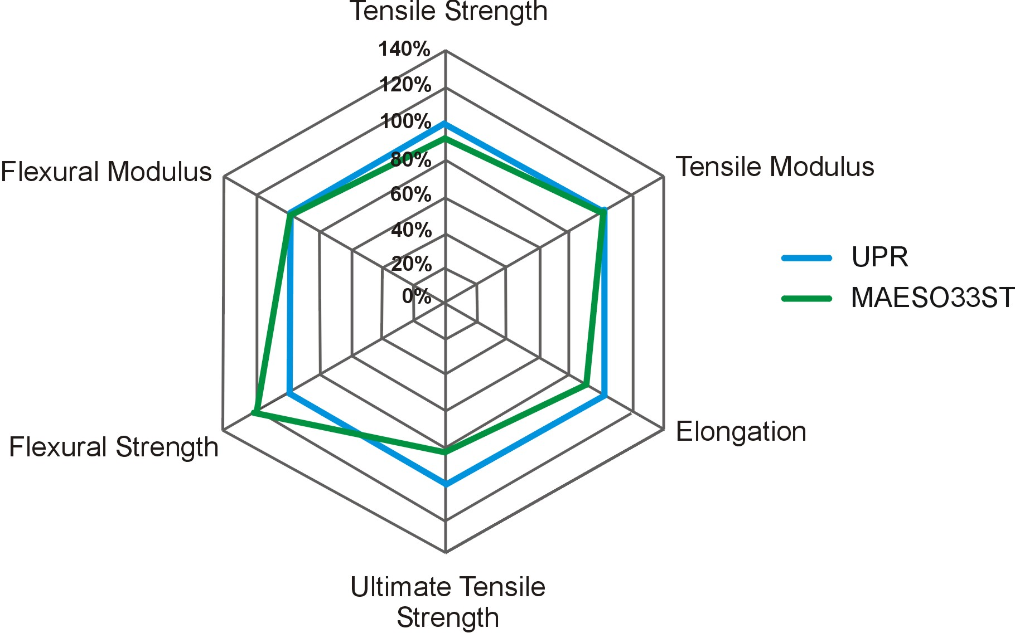
BMC properties

Slide 25
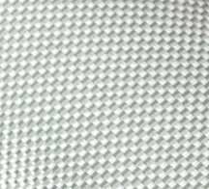
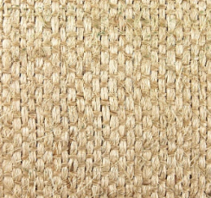
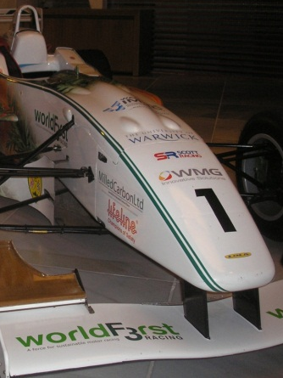
VaRTM/RTM Applications
+
+
+
and/or
Initiator
Synthetic
Fiber
Natural
Fiber
Bio-Resin

Slide 26


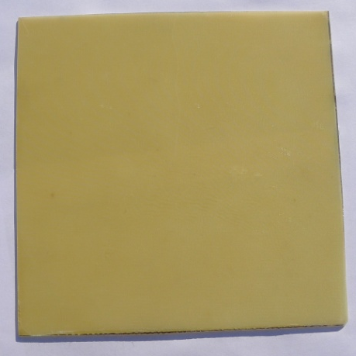
VARTM
Composite made from Bio-Resin and Fiberglass
Resin | MAESO | MAESO
Glass Fiber | - | 44 vol%
T_{g} (ºC) | 96 | 120
E’ (MPa) | 1310 | 20578
Flexural strength (MPa) | 61.8 | 304.1
Flexural modulus (GPa) | 1.6 | 21.1
Tensile strength (MPa) | 39.7 | 291.8
Tensile modulus (GPa) | 2.2 | 11.4
BBC | 57 | 57
MAESO = MAESO33ST

Slide 27
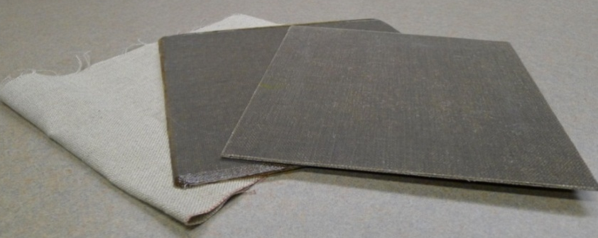
VARTM
Composite made of Bio-Resin and Flax Fiber
Resin | MAESO | MAESO
Glass Fiber | - | 44 vol%
T_{g} (ºC) | 96 | 100
E’ (MPa) | 1310 | 4373
Flexural strength (MPa) | 61.8 | 78.9
Flexural modulus (GPa) | 1.6 | 3.9
Tensile strength (MPa) | 39.7 | 81.9
Tensile modulus (GPa) | 2.2 | 3.3
BBC | 57 | 72
MAESO = MAESO33ST

Slide 28
Summary
Functionalized plant oils can be used with or in place of petroleum based resins.
Selection of oils (such as soybean or linseed oil) and reactive diluent (such as styrene, MFA and others) can be used to customize the physical and mechanical properties.
Methacrylated fatty acids (MFA) can be used to increase the bio-based content, and reduce styrene emissions and related health and environmental risk.
Bio-resins from MAESO/MAELO are suitable for BMC and VARTM.
Bio-composites can be produced with good mechanical properties and high bio-content.

Slide 29



Acknowledgement
Dr. G. Macdonell, M. Gromacki, Dr. C. Shen, A. Grous (Dixie Chemical)
Prof. R. Wool (University of Delaware, Center of Composite Materials and Crey Bioresins)
Dr. M. Zhang (Crey Bioresins)
Mrs. P. Watts. (Premix)
Dr. J. La Scala (ARL)
Prof. G. Palmese (Drexel University)
THANK YOU!!!!!

Slide 30

QUESTIONS?

Slide 31
Maleinated Acrylated
Epoxidized Oils
O
O
O
O
O
O
O
catalyst
O
O
+
O
H
Epoxidized oils (ESO, ELO)
O
O
Acrylic Acid
O
O
O
O
O
O
H
O
O
O
H
O
O
O
O
O
O
O
H
+
catalyst
O
H
O
O
O
O
Acrylated Epoxidized Oils (AESO, AELO)
Maleic Anhydride
O
O
O
O
O
O
H
O
O
O
O
O
O
H
O
O
O
O
O
O
O
O
O
O
O
H
O
H
Maleinated Acrylated Epoxidized Oils (MAESO, MAELO)
Wool and Sun, Bio Based Polymers and Composites, 2005

Slide 32
Bio-Thermosetting Polymer
+
+
Initiator
Bio-Resin
Heat
Bio-Based
Thermoset Polymer

Slide 33
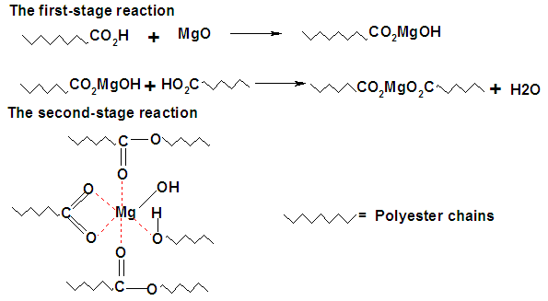
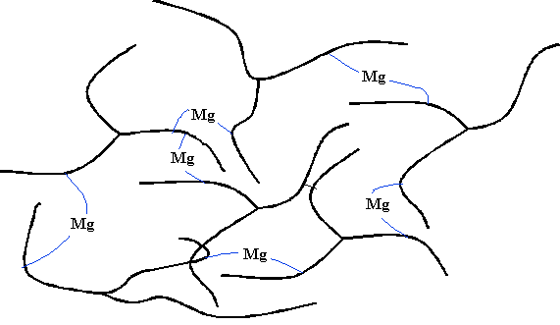
Thickening for SMC Bio-Resins
Lu, PhD thesis, University of Delaware, 2005

Slide 34
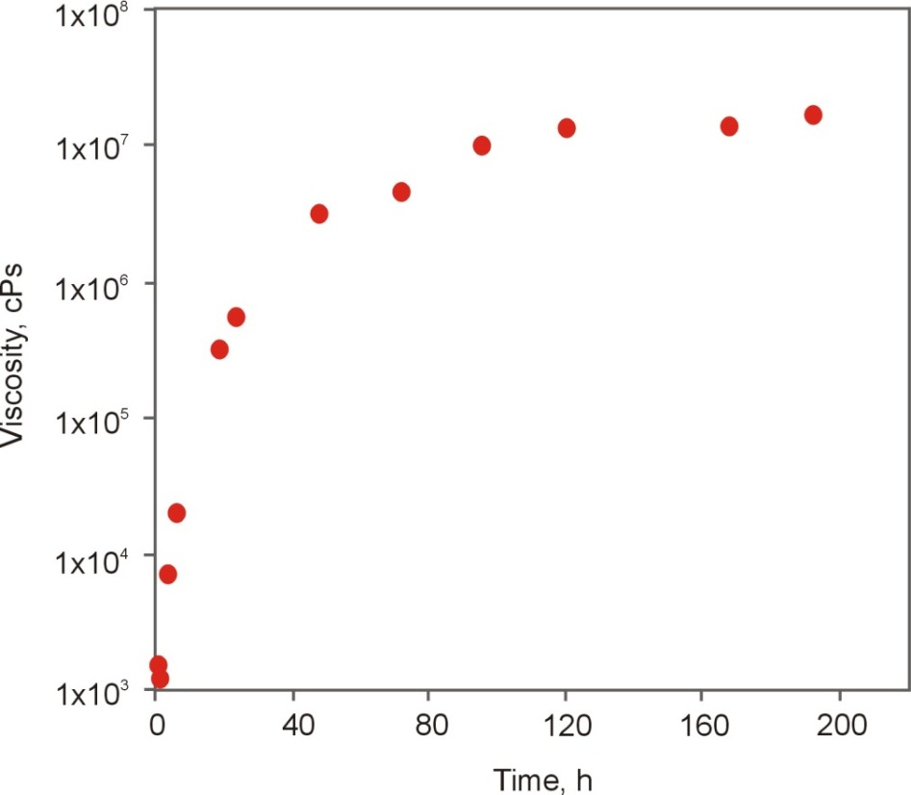
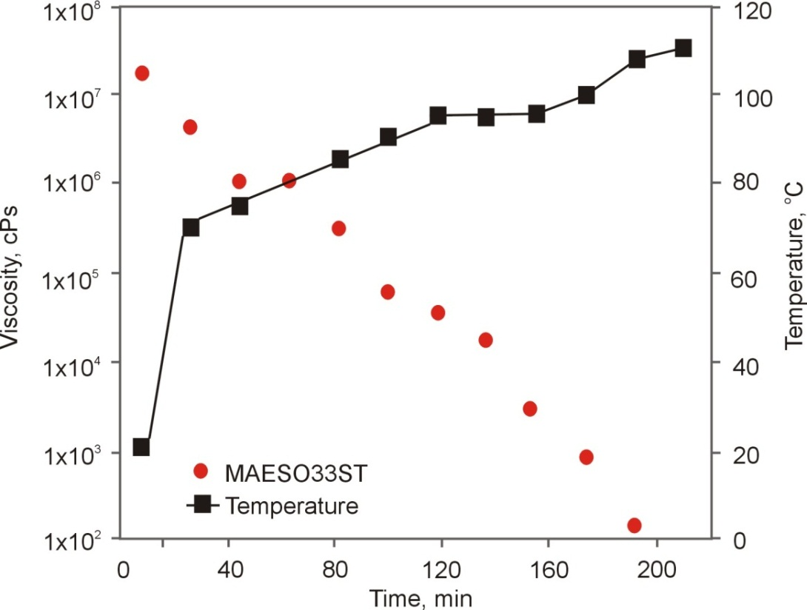
Thickening Behavior
Lu, PhD thesis, University of Delaware, 2005

Slide 35

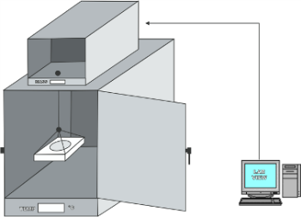
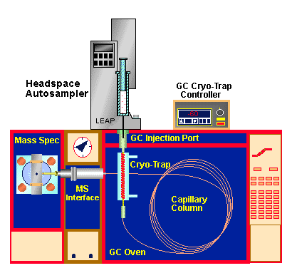


Styrene Emission Study
Mass Loss: Resins
Mass Loss: Reactive diluents
Decreasing
emissions
Decreasing
emissions
45%MFA
25%MFA
Low HAP resin systems reduce emissions by 40-80%¹
Head Space
CGMS
¹ La Scala et al., Clean Techn Environ Policy, 2009

Slide 36
Bio-Based Content
Amount of bio-based carbon
Amount of bio-based carbon + Amount of petroleum based carbon
Bio-Based Content =
x 100
http://www.biopreferred.gov

Slide 37
Bio-Based Content
MAESO33ST (MAESO with 33 wt% styrene) 57% BBC
MAESO20ST (MAESO with 20 wt% styrene and 13 wt% MFA) 65% BBC
MAESO13ST (MAESO with13 wt% styrene and 20 wt% MFA) 69% BBC
MAESO33MFA (MAESO 33 wt% MFA) 77% BBC
MAESO is compatible with VE and UPR resins
Resin made of MAESO (32.5%) and
VE/UPR (32.5%) with 33wt% styrene 28% BBC
Resin made of MAESO (32.5%) and
VE/UPR (32.5%) with 33wt% MFA 48% BBC

Slide 38

Bio-Based Content
Composites prepared with bio-resin and fiber glass
Bio-resin |  |  | BBC
Monomer | Styrene (wt%) | MFA (wt%) | Neat polymer | Composite Example 1 ª | Composite Example 2 ^{b}
MAESO | 33 | 0 | 57% | 57% | 57%
MAESO | 20 | 13 | 65% | 65% | 65%
MAESO | 13 | 20 | 69% | 69% | 69%
MAESO | 0 | 33 | 77% | 77% | 77%
ª 50 wt% fiber glass
^{b} 70 wt% fiber glass
O
O
O
O
OH
O
O
O
O
O
O
OH
+
and/or
+
O
O
O
O
O
O
O
O
Synthetic
fiber
OH
O
O
OH

Slide 39

Bio-Based Content
Composites prepared with bio-resin and of carbon fiber
Bio-resin |  |  | BBC
Monomer | Styrene (wt%) | MFA (wt%) | Neat polymer | Composite Example 1 ª | Composite Example 2 ^{b}
MAESO | 33 | 0 | 57% | 27% | 17%
MAESO | 20 | 13 | 65% | 30% | 19%
MAESO | 13 | 20 | 69% | 32% | 20%
MAESO | 0 | 33 | 77% | 36% | 23%
ª 50 wt% carbon fiber
^{b} 70 wt% carbon fiber
O
O
O
O
OH
O
O
O
+
O
O
O
OH
+
and/or
+
O
O
O
O
O
O
O
O
Carbon
fiber
OH
O
O
OH

Slide 40
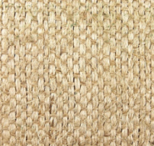
Bio-Based Content
Composites prepared with bio-resin and of natural fibers
Bio-resin |  |  | BBC
Monomer | Styrene (wt%) | MFA (wt%) | Neat polymer | Composite Example 1 ª | Composite Example 2 ^{b}
MAESO | 33 | 0 | 57% | 78% | 87%
MAESO | 20 | 13 | 65% | 82% | 89%
MAESO | 13 | 20 | 69% | 84% | 90%
MAESO | 0 | 33 | 77% | 87% | 93%
ª 50 wt% natural fiber
^{b} 70 wt% natural fiber
O
O
O
O
OH
O
O
O
+
O
O
O
OH
+
and/or
+
O
O
O
O
O
O
O
O
Natural
fiber
OH
O
O
OH

Slide 41
Let Us Meet Again
We welcome you all to our future conferences of OMICS Group International
Please Visit:
http://materialsscience.conferenceseries.com/
Contact us at
materialsscience.conference@omicsgroup.us
materialsscience@omicsgroup.com

