Slide 1
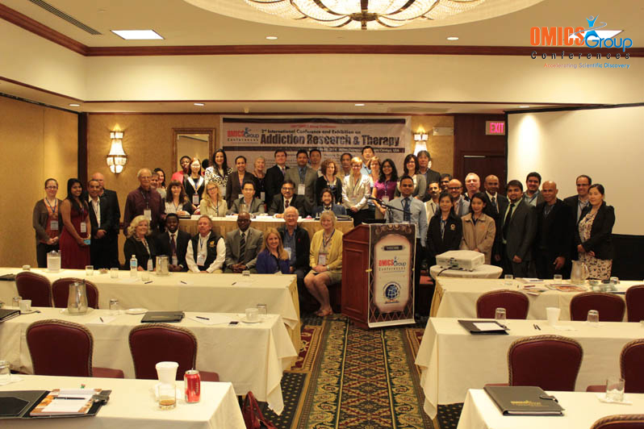
Addiction Therapy-2014 Chicago, USA August 4 - 6, 2014
Akshaya Kambhatla

Slide 2
Chronic alcoholism altering the genetic structure
Dr.Akshaya Kambhatla M.D.

Slide 3
Some Facts about the influence on genes related to hippocampus
639 genes studied in the post mortem hippocampal tissue in 20 alcoholics and 19 controls.
False Discovery Rate less than or equal to 0.20
Glucocorticoid receptor and related gene FK506 Binding protein 5 ( FKBP5 ), UDP Glycosyltransferase 8 ( UGT8 ), urea transporter (SLC14A1), zinc transporter (SLC39A10), Interleukin 1 receptor type 1 (IL1R1), thioredoxin interacting protein (TXNIP), and many metallothioneins.
Inappropriate activation of inflammation through the mediation of NF- KB pathway
Decline in neurogenesis and myelination pathways.

Slide 4
Metallothianeins
Four isoforms of Zinc binding proteins made of cysteine .
Zinc is predominantly found in retina, pineal gland and hippocampus.
Altered levels of Zinc levels in the neurons in several CNS disorders including Alcoholism.
Help in sequestering Zinc in the synaptic vesicles and thereby maintaining the redox potentials at the nerve endings in the hippocampus, pineal gland and retina.

Slide 5
Pro-Opio Melano Cortin Neurons
In chronic alcoholism, there is reduced function in POMC neurons due to gene methylation of several CpG dinucleotides .
Associated with altered histone modifying proteins and DNA methyltransferases in the POMC neurons.
Fetal alcohol exposed male and female rat offspring showed hyper methylation of POMC gene but was transmitted only through male offspring.

Slide 6
C- fos gene activity
Increased expression of c-fos gene in the cerebral cortex in offspring of chronically alcohol exposed rats when treated with alcohol .
Altered content of biogenic amines which in turn lead to behavioral disturbances.
Genetically derived alcoholic motivation.

Slide 7
Effects on Pancreas
Activation of Transcription factor 3, Heat Shock Protein 70, Heat Shock Protein 27 and Methotrypsiogen.
Decreased Pancreatitis Associated Protein, Folate Carrier and Metallothianein.
Animals wre fed Alcohol containing Leiber De Carle and control diet for 8 weeks and Pancreas RNA was analyzed later .
CRITERIA – changes being nore than 3-fold and P<0.05
Likely reason for Pancreas injury after long term alcohol ingestion.

Slide 8
Effects on Lung Alveoli
Altered dynamic balance between GM-CSF and TGF Beta 1 factors both being increased.
Decreased expression of KLF4 and PIF4 genes.
Decreased Zinc in the alveoli
Cellular dysfunction in the ‘ Alcohol lung’ phenotype.
Studies were done on rat alveolar macrophage lineage under ethanol exposure for 4 weeks.

Slide 9
References – Pubmed 2008-2014
http://www.ncbi.nlm.nih.gov/pubmed/19302082
http://www.ncbi.nlm.nih.gov/pubmed/17895971
http://www.ncbi.nlm.nih.gov/pubmed/7931547
http://www.ncbi.nlm.nih.gov/pubmed/23413810
http://www.ncbi.nlm.nih.gov/pubmed/23714385
http://www.ncbi.nlm.nih.gov/pubmed/19302082
http://www.ncbi.nlm.nih.gov/pubmed/11484913
http://www.ncbi.nlm.nih.gov/pubmed/23013362
http://www.ncbi.nlm.nih.gov/pubmed/23413810

Slide 11
Meet the eminent gathering once again at Addiction Therapy-2015 Florida, USA August 3 - 5, 2015
Addiction Therapy – 2015 Website:
addictiontherapy.conferenceseries.com

