Slide 1
About OMICS Group
OMICS Group International is an amalgamation of Open Access publications and worldwide international science conferences and events. Established in the year 2007 with the sole aim of making the information on Sciences and technology ‘Open Access’, OMICS Group publishes 400 online open access scholarly journals in all aspects of Science, Engineering, Management and Technology journals. OMICS Group has been instrumental in taking the knowledge on Science & technology to the doorsteps of ordinary men and women. Research Scholars, Students, Libraries, Educational Institutions, Research centers and the industry are main stakeholders that benefitted greatly from this knowledge dissemination. OMICS Group also organizes 300 International conferences annually across the globe, where knowledge transfer takes place through debates, round table discussions, poster presentations, workshops, symposia and exhibitions.

Slide 2
About OMICS Group Conferences
OMICS Group International is a pioneer and leading science event organizer, which publishes around 400 open access journals and conducts over 300 Medical, Clinical, Engineering, Life Sciences, Phrama scientific conferences all over the globe annually with the support of more than 1000 scientific associations and 30,000 editorial board members and 3.5 million followers to its credit.
OMICS Group has organized 500 conferences, workshops and national symposiums across the major cities including San Francisco, Las Vegas, San Antonio, Omaha, Orlando, Raleigh, Santa Clara, Chicago, Philadelphia, Baltimore, United Kingdom, Valencia, Dubai, Beijing, Hyderabad, Bengaluru and Mumbai.

Slide 3


Slide 4
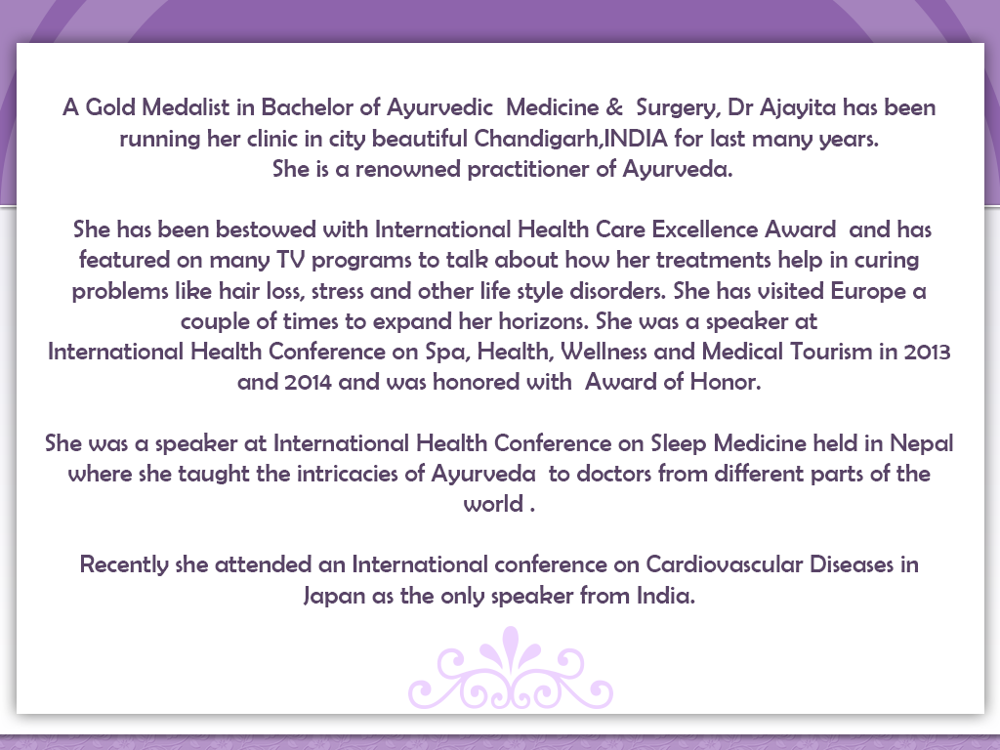

Slide 5


Slide 6


Slide 7


Slide 8


Slide 9


Slide 10


Slide 11


Slide 12


Slide 13


Slide 14


Slide 15


Slide 16


Slide 17
Lets Meet again at Cosmetology-2015
4th International Conference and Expo
On
Cosmetology & Trichology
June 22-24, 2015 Philadelphia, USA
Theme: Cosmetology and Trichology: Tracking and Tackling its Consequences
Website: http://cosmetology-trichology.conferenceseries.com/

