Slide 1


LITHUANIAN UNIVERSITY
OF HEALTH SCIENCES
In-store hygiene evaluation and its relationship with microbiological indices of some foods, sold in different retail market places in Lithuania
assoc. prof. Aistė Kabašinskienė
8th International Conference on Food Safety & Regulatory Measures – Healthier the Food, Merrier the World; 11-12 June 2018 Barcelona, Spain

Slide 2
LITHUANIAN UNIVERSITY
OF HEALTH SCIENCES
01 | INTRODUCTION
GMF, HACCP
Microbiological safety and quality of the products
The hygiene
The control
8th International Conference on Food Safety & Regulatory Measures – Healthier the Food, Merrier the World;
11-12 June 2018 Barcelona, Spain
Notes:
Worldwide interest in food microbiology has never been greater as it is now. Consumers nowadays take more attention not only to the food content, but to the food environment. Retail markets are highly visible to visitors and usualy give aditional information about food storage, preparation and possible contamination sources.
Food hygiene is one of the most critical aspects to complement the overall shopping experience. Poor hygiene in retail markets, especialy in food preparation sections can even lower shopping rates. It was calculated that 66% of shoppers would reduce their shopping time to avoid unacceptable hygiene.
Of cource the main food safety prevention aspects are GMP and HACCP systems, implemented not only in food production, but in food selling areas as well. The hygiene is aditionaly audited and controled by Veterinary services, but the hygiene violations are still evident.
Microbiological analysis is a valuable tool, which interests both control authorities and food operators, because it promotes monitoring of the actual situation in order to assess the emerging risk.

Slide 3
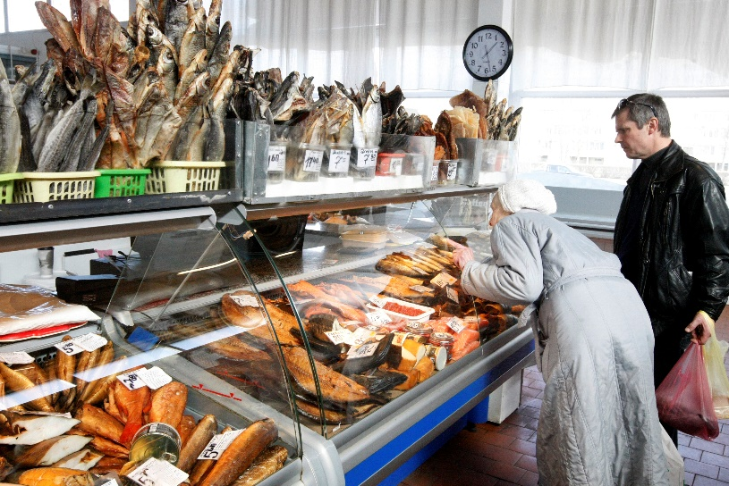
LITHUANIAN UNIVERSITY
OF HEALTH SCIENCES
01 | INTRODUCTION
Poor hygiene in retail market:
leads to insufficient quality and safety of food;
is related with foodborne outbreaks:
  about 92% of all outbreacs occur because of insufficial staff‘ knowledges of food processing and personal hygiene.
Photo: http://www.naujasisturgus.lt
Data of State Food and Veterinary Service official control
8th International Conference on Food Safety & Regulatory Measures – Healthier the Food, Merrier the World;
11-12 June 2018 Barcelona, Spain
Notes:
Poor hygiene in retail market. is one of the most relevant problems closely related with the quality and safety of the sold food.
Insufficient hygiene in retail market sector is also related with the frequent occurrence of outbreaks involving groups of varying numbers of consumers.
About 150 consumers need medical treatment because of foodborne ilnesses. It is suposed that the same number of consumers performe selftreatment at homes and are not incalculated into official statistics. Data of State Food and Veterinary Service show, that the highest part of all outbreaks occur not because of consumption of unsafe food products, but because poor knowledges of food processing staff about food hygiene.
Therefore hygienic food preparation and the education of those involved in such preparation, processing and service are crucial lines of defence in the prevention of most types of foodborne illness (Black et al., 1981), which may be transferred to food by the foodhandler either directly or by cross-contamination.

Slide 4
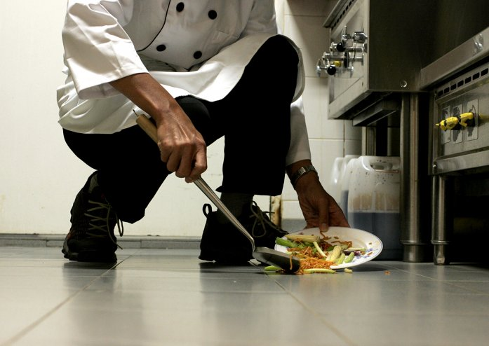
LITHUANIAN UNIVERSITY
OF HEALTH SCIENCES
01 | INTRODUCTION
Poor hygiene:
has been detected in 27.5 % of officially controlled food retail places in 2017 in Lithuania;
The main violations were:
  insufficient environmental hygiene (cleanness);
  insufficient conditions of waste products’ storage;
  cross-contamination of raw and processed foods;
  finished expiry date of food products;
  no food documents in place.
Photo: The Straits Times
Data of State Food and Veterinary Service official control
8th International Conference on Food Safety & Regulatory Measures – Healthier the Food, Merrier the World;
11-12 June 2018 Barcelona, Spain
Notes:
According the Data of State Food and Veterinary service‘s official control, poor hygiene was detected...

Slide 5
LITHUANIAN UNIVERSITY
OF HEALTH SCIENCES
01 | INTRODUCTION
The importance of consumers in food control
In 2016 active consumers helped to find out about 800 cases of untrustworthy producers, hygiene and other violations.
Almost 3000 complaints were registered and analysed by State Food and Veterinary Service.
Albout 90 % of retail markets are inspected annualy (422 inspections in 2016).
Data of State Food and Veterinary Service
8th International Conference on Food Safety & Regulatory Measures – Healthier the Food, Merrier the World;
11-12 June 2018 Barcelona, Spain

Slide 6
LITHUANIAN UNIVERSITY
OF HEALTH SCIENCES
01 | INTRODUCTION
Ready-to-eat products usualy represent the highest risk group;
The main saurces of Food borne infections in 2017 were caused by meat and meat products (15.6 %), fish and fish products (11.9 %), salads (8.9 %) and unknown products (38.5 %).
The main bacteria, caused foodborne infections, by consuming contaminated salads were Salmonella spp. (4.7 %).
Data of Department of Public Health and Care at the Ministry of Health of The Republic of Lithuania
8th International Conference on Food Safety & Regulatory Measures – Healthier the Food, Merrier the World;
11-12 June 2018 Barcelona, Spain
Notes:
Salmonella spp., Shigella spp., pathogenic Escherichia coli, Listeria monocytogenes and Campylobacter spp. are the most important vegetable-borne pathogens.

Slide 7
LITHUANIAN UNIVERSITY
OF HEALTH SCIENCES
02 | THE AIM
The aim of the work was to evaluate in-store hygiene conditions (up to 28 points) in three different retail market places (supermarkets, medium size shops and farmers‘ markets; n=15) and the relationship with microbiological quality (Aerobic colony count (ACC), Coliforms and E. coli) and safety (Salmonella spp., L. monocytogenes) indices of the products: minced meat (chicken, pork, beef and turkey meat; n=96), cold and hot smoked fish (Salmo salar, Clupea harengus membras, Abramis brama, Scomber scombrus; n=96) and fresh coleslaw (n=40).
8th International Conference on Food Safety & Regulatory Measures – Healthier the Food, Merrier the World;
11-12 June 2018 Barcelona, Spain
Notes:
Despite the numbers of official control of hygien status, there is a lack of detailed analysis of microbiological contamination of food products in retail.
The lack of data can be found also about the hygiene assurance in different types of retail markets. Therefore :
The aim of this study was to evaluate the hygiene quality in retail market places of three different size and the microbiological criteria of the foods provided by these shops.

Slide 8
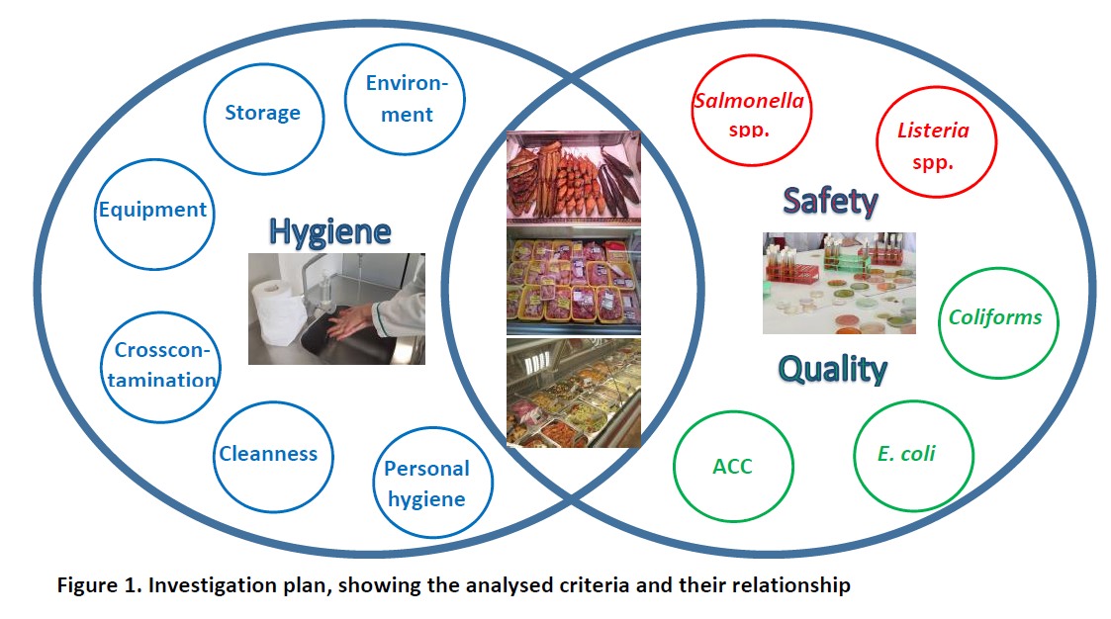
LITHUANIAN UNIVERSITY
OF HEALTH SCIENCES
03 | INVESTIGATION PLAN I
8th International Conference on Food Safety & Regulatory Measures – Healthier the Food, Merrier the World;
11-12 June 2018 Barcelona, Spain

Slide 9
LITHUANIAN UNIVERSITY
OF HEALTH SCIENCES
03 | INVESTIGATION PLAN II
Hygiene evaluation
Supermarket
x5
Medium size shop x5
Farmers‘ market x5
Minced meat
ACC – EN ISO 4833-1:2013
E. coli –
Coliforms – EN ISO 4832:2006
Chicken, pork, beef, turkey meat; n=96
Cold/hot smoked fish
Salmo salar, Clupea harengus membras, Abramis brama, Scomber scombrus; n=96
Salmonella spp.– EN ISO 6579-1:2017
Listeria spp.– ISO 11290-1:2017
Coleslaw
n=40
8th International Conference on Food Safety & Regulatory Measures – Healthier the Food, Merrier the World;
11-12 June 2018 Barcelona, Spain

Slide 10

LITHUANIAN UNIVERSITY
OF HEALTH SCIENCES
04 | HYGIENE EVALUATION METHODOLOGY
Final hygiene evaluation:
25-28 points – sufficient; 16-24 points – partly sufficient; 0-15 points – insufficient
8th International Conference on Food Safety & Regulatory Measures – Healthier the Food, Merrier the World;
11-12 June 2018 Barcelona, Spain

Slide 11
LITHUANIAN UNIVERSITY
OF HEALTH SCIENCES
05 | HYGIENE EVALUATION RESULTS
Hygiene evaluation in different retail market places
Average hygiene | points
Supermarkets | 27.9±0.20
Medium size shops | 23.3±2.05
Farmers markets | 12.5±4.5
8th International Conference on Food Safety & Regulatory Measures – Healthier the Food, Merrier the World;
11-12 June 2018 Barcelona, Spain

Slide 12
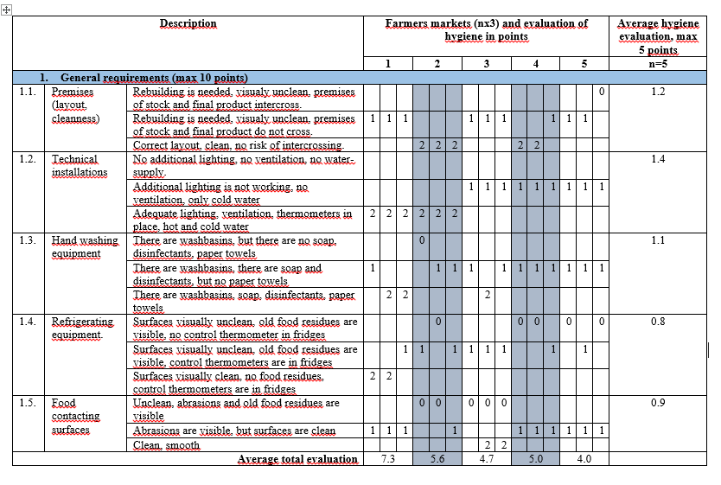
LITHUANIAN UNIVERSITY
OF HEALTH SCIENCES
05 | HYGIENE EVALUATION RESULTS
Detailed Hygiene evaluation in Farmers markets (1)
8th International Conference on Food Safety & Regulatory Measures – Healthier the Food, Merrier the World;
11-12 June 2018 Barcelona, Spain

Slide 13
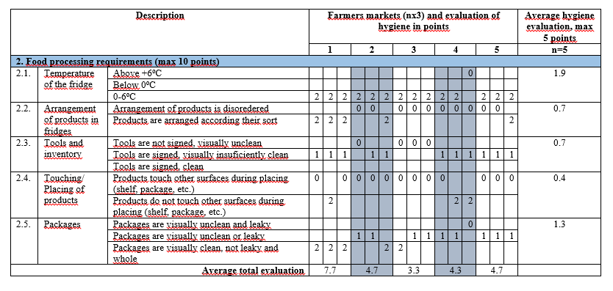
LITHUANIAN UNIVERSITY
OF HEALTH SCIENCES
05 | HYGIENE EVALUATION RESULTS
Detailed Hygiene evaluation in Farmers markets (2)
8th International Conference on Food Safety & Regulatory Measures – Healthier the Food, Merrier the World;
11-12 June 2018 Barcelona, Spain

Slide 14
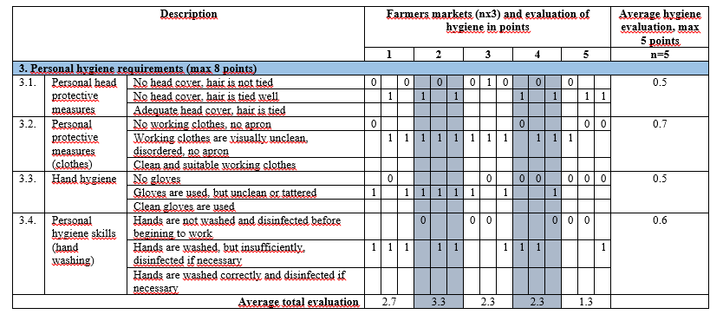
LITHUANIAN UNIVERSITY
OF HEALTH SCIENCES
05 | HYGIENE EVALUATION RESULTS
Detailed Hygiene evaluation in Farmers markets (3)
8th International Conference on Food Safety & Regulatory Measures – Healthier the Food, Merrier the World;
11-12 June 2018 Barcelona, Spain

Slide 15
LITHUANIAN UNIVERSITY
OF HEALTH SCIENCES
06 | RESULTS OF FOOD MICROBIOLOGICAL ANALYSIS
Aerobic colony count (ACC) in analyzed foods
The relationship between hygiene in farmers market and ACC in coleslaw: r=0.44, p<0.05
8th International Conference on Food Safety & Regulatory Measures – Healthier the Food, Merrier the World;
11-12 June 2018 Barcelona, Spain
Notes:
Aerobinių kolonijų skaičiui, koliforminių bakterijų skaičiui mėginiuose nustatytiems rezultatams interpretuoti buvo pasirinktas Airijos Maisto saugos tarnybos (FSAI) išleistas: „Rinkoje esančio paruošto vartojimui maisto mikrobiologinių tyrimų aiškinimas“ (38). Remiantis juo kopūstų salotų aerobinių kolonijų skaičius priimtinas <6log₁₀ KSV/g , iš dalies priimtinas 6 - < 7log₁₀ KSV/g ir nepriimtinas ≥ 7 log₁₀ KSV/g.
Žuviai: Remiantis „Food safety authority of Ireland“ pateikiama informacija, matoma, jog patenkinamos AKS ribos yra iki 10⁶ ksv/g, nuo 10⁶ iki 10⁷ ksv/g ribos dar yra priimtinos, tačiau viršijus jas jos tampa nebepriimtinos.
Mėsai : Kaip nurodoma reglamente (EB) Nr. 2073/2005 dėl maisto produktų mikrobiologinių kriterijų smulkintoje mėsoje yra vertinamas aerobinių kolonijų skaičius: aerobinių bakterijų –5x10⁵– 5x10⁶ KSV/g.

Slide 16
LITHUANIAN UNIVERSITY
OF HEALTH SCIENCES
06 | RESULTS OF FOOD MICROBIOLOGICAL ANALYSIS
Coliforms in analyzed foods
8th International Conference on Food Safety & Regulatory Measures – Healthier the Food, Merrier the World;
11-12 June 2018 Barcelona, Spain
Notes:
Koliforminių bakterijų skaičius, kurį nustatėme šviežių kopūstų salotų mėginiuose negali būti interpretuojamas pagal Airijos Maisto saugos tarnybos išleistą leidinį, kuriame nurodytos mikrobiologionių rodiklių ribinės vertės paruoštam vartojimui maistui. Jame aiškiai apibrėžta, jog koliforminės bakterijos priklausančios Enterobabacteriaceae šeimai taikomi apribojimai mikrobiologiškai vertinant vaisius ir daržoves bei iš jų pagamintiems gaminiams (sumuštiniams, kopūstų salotomos ir tt.). Kadangi ant šių produktų ir taip aptinkami dideli kiekiai koliforminių bakterijų, kaip jų natūrali mikroflora. Tačiau jeigu nustatomas koliforminių bakterijų itin didelis kiekis, galima daryti prielaidą, kad yra ir patogeninių mikroorganizmų.
Smulkintoje mėsoje koliforminiai mikroorganizmai vertinami kaip indikatoriniai mikroorganizmai, kadangi jų nustatymas parodo užterštumą žmonių ar gyvūnų išmatomis.

Slide 17
LITHUANIAN UNIVERSITY
OF HEALTH SCIENCES
06 | RESULTS OF FOOD MICROBIOLOGICAL ANALYSIS
E. coli in analyzed foods
E. coli in coleslaw – not found
8th International Conference on Food Safety & Regulatory Measures – Healthier the Food, Merrier the World;
11-12 June 2018 Barcelona, Spain
Notes:
Pagal pateiktus reglamente Nr. 2073/2005 dėl maisto produktų mikrobiologinių kriterijų kriterijus smulkintoje mėsoje E.coli ribos neturi būti didesnės kaip 50 – 500 KSV/g,

Slide 18
LITHUANIAN UNIVERSITY
OF HEALTH SCIENCES
07 | CONCLUSIONS
The most often found hygiene violations were improper storage conditions of the food, cross contamination and poor personal hygiene.
Hygiene of the farmers‘ markets was evaluated as insufficient (12 points out of 28), whereas the highest hygiene level (28 points out of 28) was assured in supermarkets:
  the hygiene conditions of farmers had a positive correlation (r=0.44, p<0.05) on the ACC of the products.
The highest counts of aerobic bacterias, coliforms and E. coli were found in foods, sold in farmers markets: in turkey meat (ACC- 8.18 log CFU g⁻¹), in coleslaw (coliforms - 5.21 log CFU g⁻¹), beef (coliforms - 6.85 log CFU g⁻¹) and turkey meat (E. coli - 4.56 log CFU g⁻¹).
Salmonella spp. and Listeria spp. were absent in all samples.
8th International Conference on Food Safety & Regulatory Measures – Healthier the Food, Merrier the World;
11-12 June 2018 Barcelona, Spain

Slide 19
LITHUANIAN UNIVERSITY
OF HEALTH SCIENCES
THANK YOU
FOR ATTENTION

