Slide 1

About OMICS Group
OMICS Group International is an amalgamation of Open Access publications and worldwide international science conferences and events. Established in the year 2007 with the sole aim of making the information on Sciences and technology ‘Open Access’, OMICS Group publishes 400 online open access scholarly journals in all aspects of Science, Engineering, Management and Technology journals. OMICS Group has been instrumental in taking the knowledge on Science & technology to the doorsteps of ordinary men and women. Research Scholars, Students, Libraries, Educational Institutions, Research centers and the industry are main stakeholders that benefitted greatly from this knowledge dissemination. OMICS Group also organizes 300 International conferences annually across the globe, where knowledge transfer takes place through debates, round table discussions, poster presentations, workshops, symposia and exhibitions.

Slide 2
About OMICS Group Conferences
OMICS Group International is a pioneer and leading science event organizer, which publishes around 400 open access journals and conducts over 300 Medical, Clinical, Engineering, Life Sciences, Pharma scientific conferences all over the globe annually with the support of more than 1000 scientific associations and 30,000 editorial board members and 3.5 million followers to its credit.
OMICS Group has organized 500 conferences, workshops and national symposiums across the major cities including San Francisco, Las Vegas, San Antonio, Omaha, Orlando, Raleigh, Santa Clara, Chicago, Philadelphia, Baltimore, United Kingdom, Valencia, Dubai, Beijing, Hyderabad, Bengaluru and Mumbai.

Slide 3


2015 September 01
Crash behavior of telescopic crash box with aluminum foam
Ahmet Serdar Önal
Beyçelik Gestamp Die and Automotive Parts Production Industry Company, Bursa, Türkiye
&
Necmettin Kaya
Mechanical Engineering Department / Uludağ University, Bursa, Türkiye

Slide 4
Presentation Headlines
1- Beyçelik Gestamp Introduction
2- Introduction
3- Finite Element Model
4- Results
5- References
6- Questions& Remarks

Slide 5
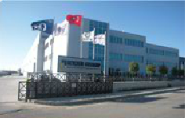
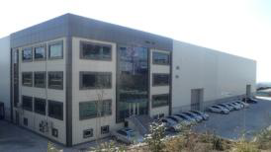
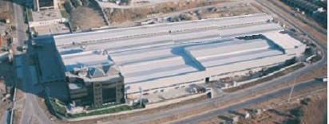
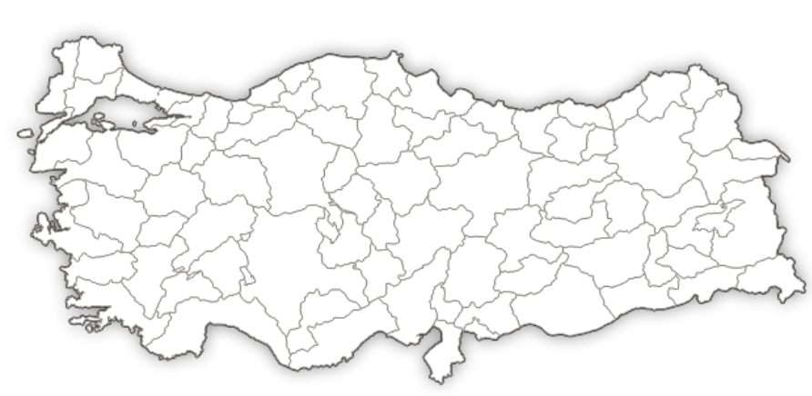
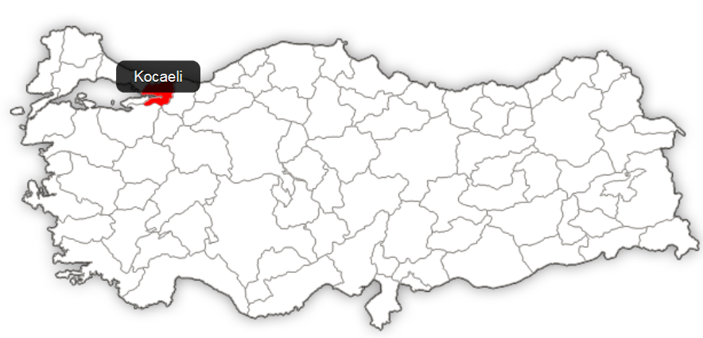
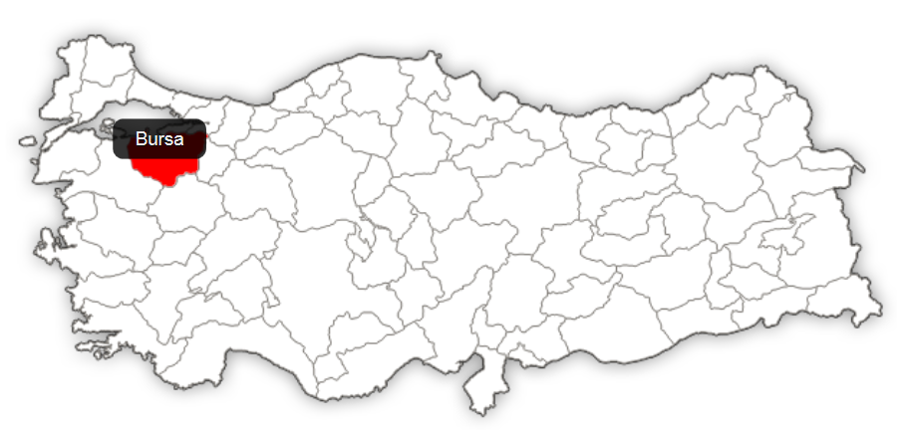

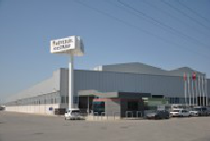
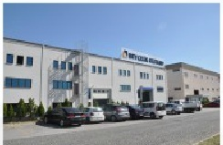
History
TOOLING PLANT &
R&D CENTER
GEBZE CHASSIS PLANT
AUTOMOTIVE PLANT
10.000 m²
16.000 m²
60.000 m²
ASSEMBLY PLANT
&
STEEL CENTER
HOT STAMPING & G1 PLANTS
10.000 m²
22.500 m²

Slide 6














Customers & References

Slide 7

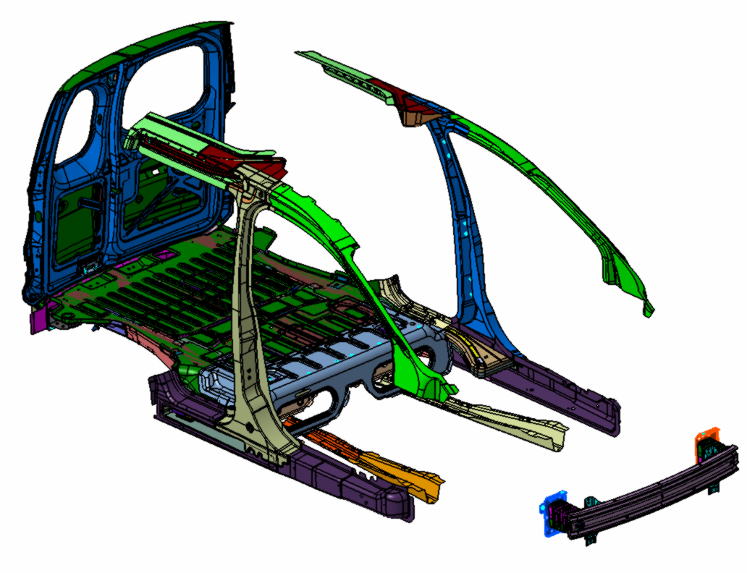

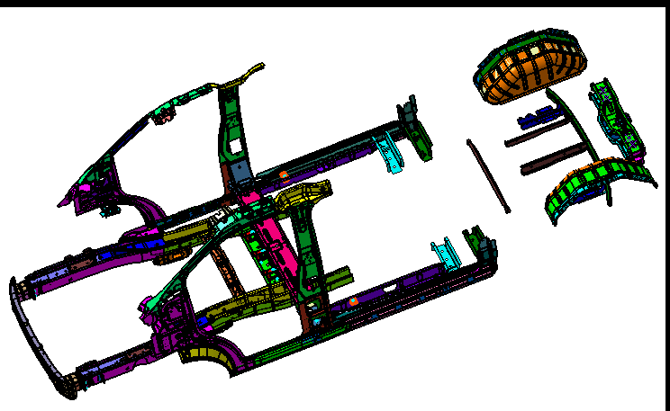

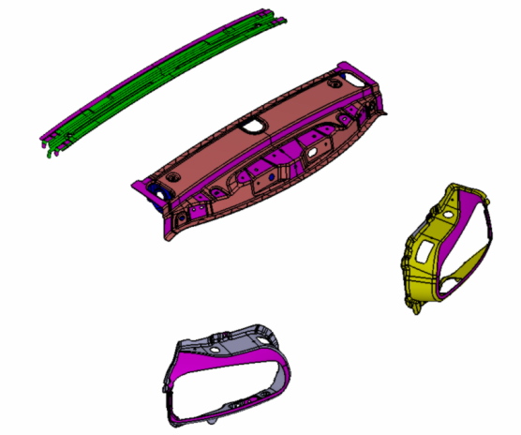

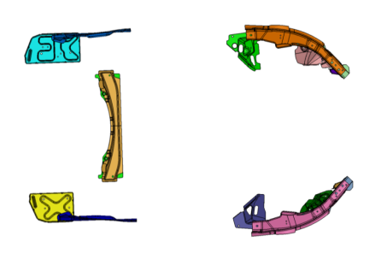
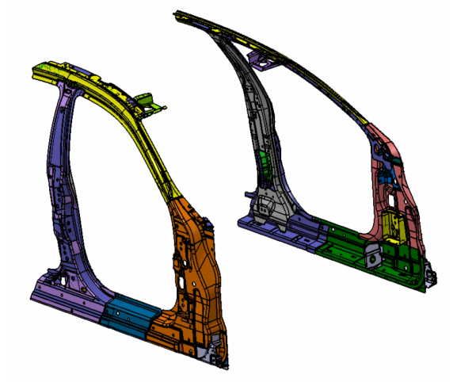

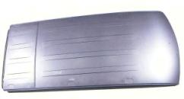
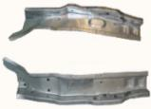

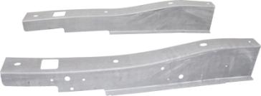
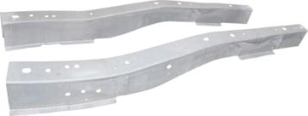
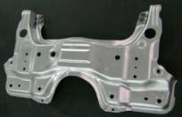


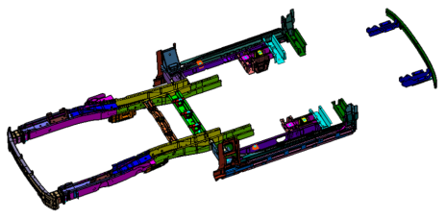

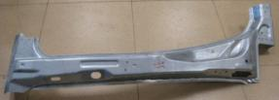

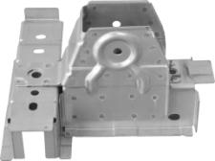
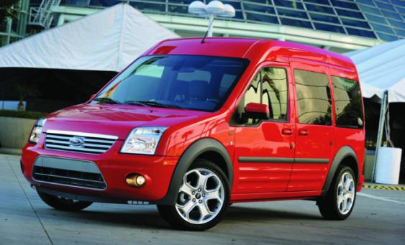
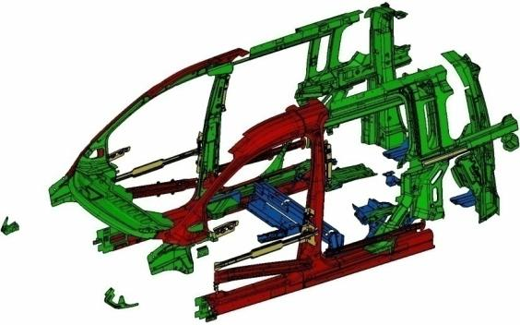
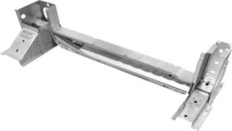
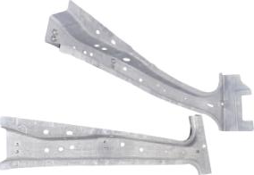
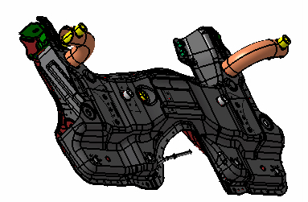

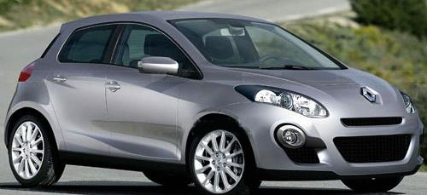
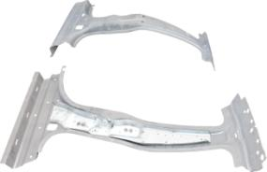


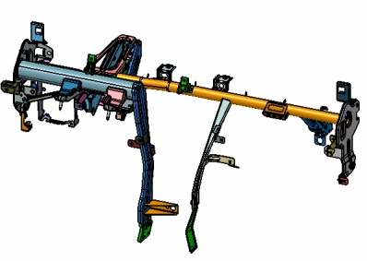
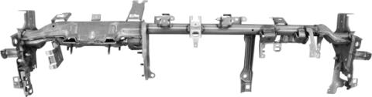


Products
SKIN PANELS
CHASSIS GROUP
CRASH GROUP
REAR AXLE
ENGINE CROSS
MEMBER
FRONT FLOOR CROSS MEMBER
SIDE RAIL CENTER
B460 – Ford Torneo Courier
V36X – New Ford Transit
BMW- F54
M156 – Maserati Quattroporte
VOLVO- V526
INNER PANELS
FRONT RAIL
SPRING HANGER
SLIDING DOOR STEP
PILLARS
RINFORZA MONTANTE CENTRALE
V 408 – Ford Connect
X98 - Renault Clio IV(Cross-Car Beam)
FRONT BUMPER
CROSS MEMBER
CROSS CAR BEAM
TOFAŞ- B-SEDAN 356

Slide 8
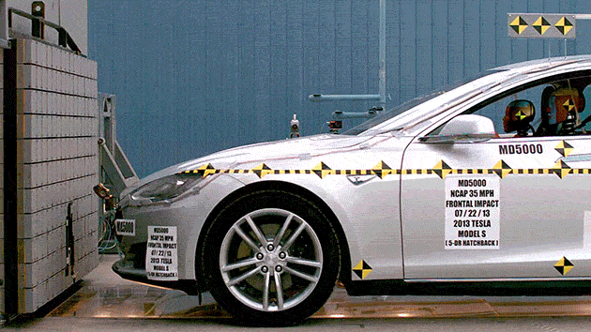
2. Introduction
Thin-walled tubular structures behind the bumpers of vehicles protect passengers and the structure during the impact.
Fig.1 . Frontal Impact

Slide 9
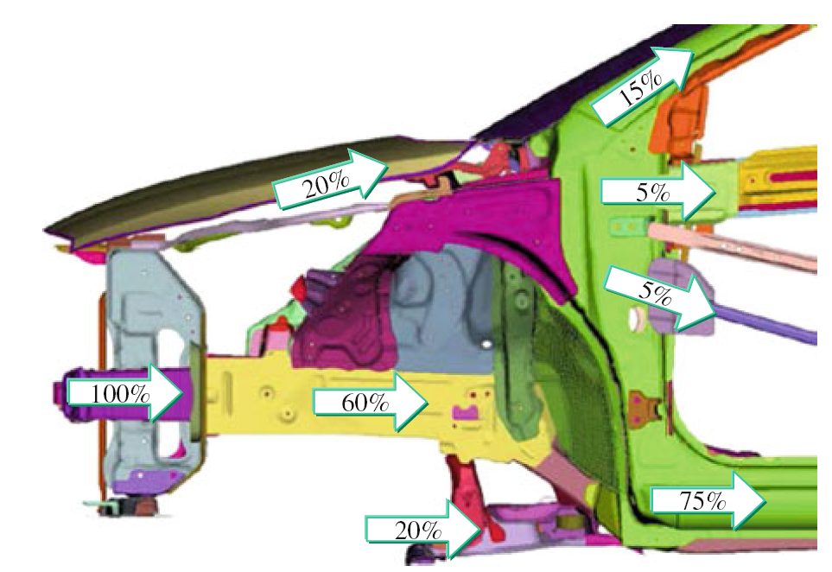
2. Introduction
The bumper deforms first, then the following component deforms until the all energy is absorbed.
Fig. 2 Division of crash force transmission

Slide 10
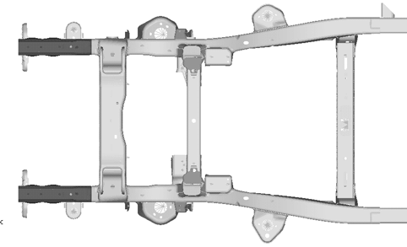
2. Introduction
Thin-walled structures absorb most of the crash energy with a progressive folding deformation.
Fig. 3 Under Body Crash Force Transmission

Slide 11
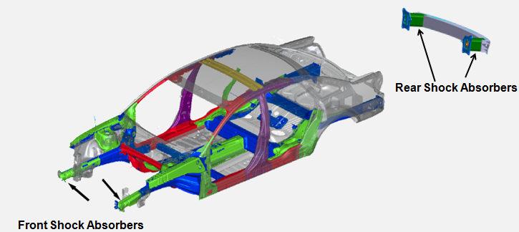
2. Introduction
Crash Box is a the part which is usually advanced of the rails that should collapse at relatively low force to absorb energy in a controlled way [1].
Fig.4 . Shock Absorbers ( Crash Boxes)

Slide 12
2. Introduction
In this study, aluminum foam effect of the crashworthiness behavior analyzed on the telescopic crash box geometry.
The geometric models were modeled with CATIA.
The post processing of the FEA models were prepared Hyper Mesh.
The crash simulations were performed with LS-DYNA.

Slide 13
3. Finite Element Model
The behavior of the crash box has been studied by simulating the impact of a rigid barrier.
Fig.5 . Impact model and true stress-strain diagram of material

Slide 14
3. Finite Element Model
Parameter | Abbreviation | Value | Unit
Rigid Barrier Velocity | v | 15600 | mm/s
Rigid Barrier Mass | m | 0,36 | t
Dynamic Friction Coefficient | F_{D} | 0,1
Static Friction Coefficient | F_{S} | 0,1
Table 1. Rigid Barrier Properties

Slide 15
3. Finite Element Model
Parameter | Abbreviation | Value | Unit
Density | ρ | 7.85x10⁻⁹ | g/m³
Yield Stress | σ_{ak} | 390 | MPa
Young’s Modulus | E | 210000 | MPa
Poisson’s Ratio | Nu | 0.3
Thickness | t | 1.5 | mm
Table 2. DP600 Properties

Slide 16
3. Finite Element Model
Parameter | Abbreviation | Value | Unit
Density | ρ | 1.11x10⁻⁹ | g/m³
Young’s Modulus | E | 1100 | MPa
Poisson’s Ratio | Nu | 0.0
Yield Stress | SIGP | 0.777
Table 3. Al-Foam Properties

Slide 17
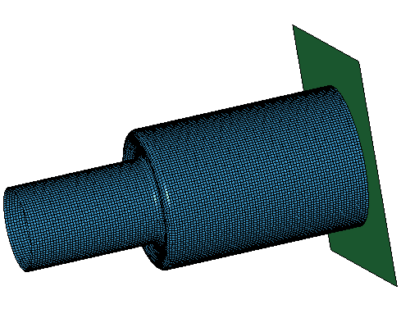
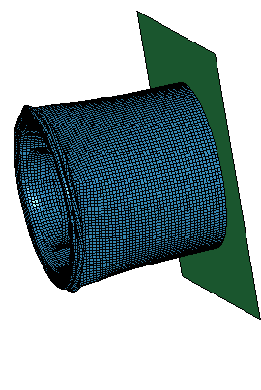
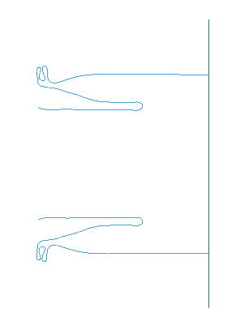
3. Finite Element Model
Fig.5. Undeformed, deformation characteristics and section view for empty telescopic crash box (deformed time=10 ms)

Slide 18
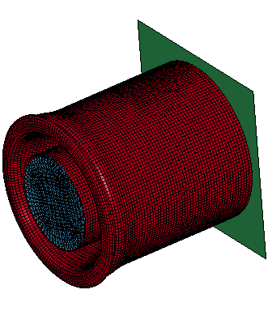
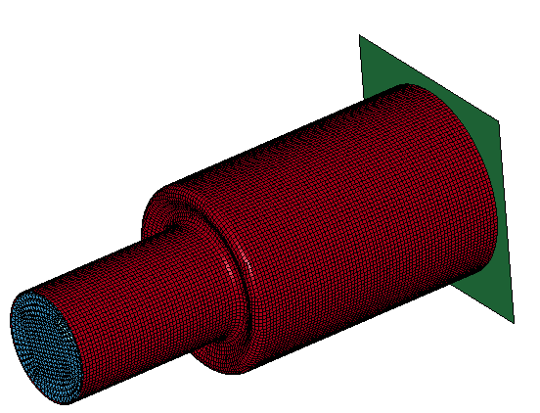
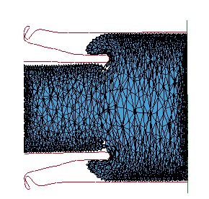
3. Finite Element Model
Fig.5. Undeformed, deformation characteristics and section view for aluminum foam filled crash box (deformed time=10 ms)

Slide 19
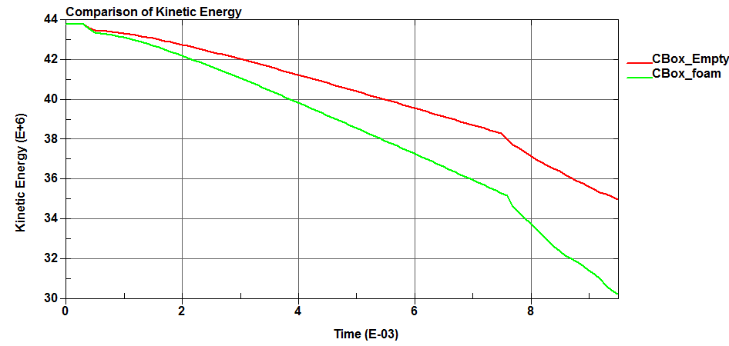
4. Results
Fig.11. Comparison of Kinetic Energy for with and without aluminum foam

Slide 20
4. Results
In order to maximize the absorbed energy, new telescopic box geometry with aluminum foam-filled is analyzed.
It is revealed that aluminum foam filled crash box energy absorption capability is % 47 higher than the empty one.
Profile | Total Absorbed Energy | Unit
Empty Crash Box | 8,81 | kJ
Aluminum Foam Filled Crash Box | 13,57 | kJ
Table 4. Total Absorbed Energies

Slide 21
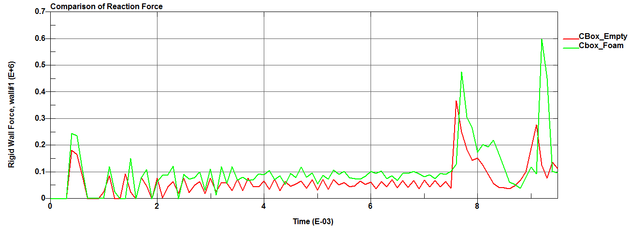
4. Results
Fig.10. Comparison of Reaction Force for with and without aluminum foam

Slide 22
4. Results
The initial reaction force of the aluminum foam filled telescopic crash box profile %34 higher than the empty telescopic crash box profile.
Profile | Initial Reaction Force | Unit
Empty Crash Box | 183 | kN
Aluminum Foam Filled Crash Box | 245 | kN
Table 4. Initial Reaction Forces

Slide 23
4. Results
Numerical simulation’s show that in terms of achieving maximum energy absorption, telescopic crash geometry and filling the box with aluminum foam can be preferable to thickening the box wall.

Slide 24
7. References
OptiBody,2007. Guidelines on optimal architectures for crashworthiness and compability improvement. WP3 report, Fp7 26622.
Optimisation of Collector Form and Response, http://www.engineering.lancs.ac.uk/lureg/group_research/wave_energy_research/Collector_Shape_Design.php, Access Date: 24.04.2015.
Kaya, N. and Öztürk F., Multi-objective crashworthiness design optimisation of thin-walled tubes, International Journal of Vehicle Design, Vol. 52, Nos. 1/2/3/4, 2010, pp.54-63.
Shen, Z., Qiao, X., Chen, H.,2012. BIW Safety Performance Research Based on Vehicle Frontal Crash, Proceedings of the FISITA 2012 World Automotive Congress, Beijing, China.

Slide 25
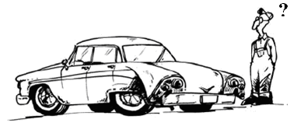
8. Questions & Remarks
Steel is not Cold for Us!!!
Thanks for your attention …

