Slide 1
About OMICS Group
OMICS Group International is an amalgamation of Open Access publications and worldwide international science conferences and events. Established in the year 2007 with the sole aim of making the information on Sciences and technology ‘Open Access’, OMICS Group publishes 400 online open access scholarly journals in all aspects of Science, Engineering, Management and Technology journals. OMICS Group has been instrumental in taking the knowledge on Science & technology to the doorsteps of ordinary men and women. Research Scholars, Students, Libraries, Educational Institutions, Research centers and the industry are main stakeholders that benefitted greatly from this knowledge dissemination. OMICS Group also organizes 300 International conferences annually across the globe, where knowledge transfer takes place through debates, round table discussions, poster presentations, workshops, symposia and exhibitions.

Slide 2
About OMICS Group Conferences
OMICS Group International is a pioneer and leading science event organizer, which publishes around 400 open access journals and conducts over 300 Medical, Clinical, Engineering, Life Sciences, Pharma scientific conferences all over the globe annually with the support of more than 1000 scientific associations and 30,000 editorial board members and 3.5 million followers to its credit.
OMICS Group has organized 500 conferences, workshops and national symposiums across the major cities including San Francisco, Las Vegas, San Antonio, Omaha, Orlando, Raleigh, Santa Clara, Chicago, Philadelphia, Baltimore, United Kingdom, Valencia, Dubai, Beijing, Hyderabad, Bengaluru and Mumbai.

Slide 3
Anadolu University Faculty of Aeronautics and Astronautics
Flight Control of a UAV Using Fuzzy
Gain–Scheduled PID
Ahmet Ermeydan
Ozan Durmaz
Emre Kiyak

Slide 4
Content
Introduction
Fuzzy Logic Overview
Pioneer UAV
Fuzzy Logic Structure
Table of Rules
Airspeed, Altitude and Heading Responses
Conclusion

Slide 5
Introduction
Since the first flight of human being took place in the history, unmanned aerial vehicles (UAV) have been the focal point of aviation.
Today UAVs have many applications fields such as remote inspection and monitoring, search operations, spy work, rescue and surveillance.
In this work, the design of airspeed, altitude and heading controllers for Pioneer Unmanned Aerial Vehicle (UAV) aircraft is studied.
A performance comparison between PID and Fuzzy-PID controllers designed for airspeed, altitude and heading are made.

Slide 6
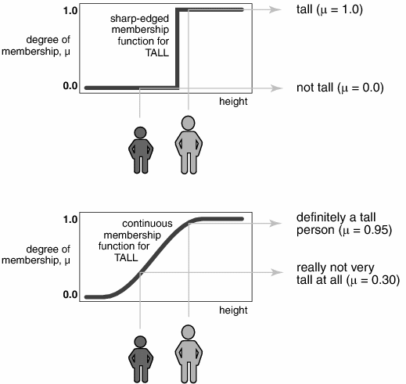
Fuzzy Logic Overview
Fuzzy Logic was developed in the seventies by Lotfi A. Zadeh, a professor at the University of California.
Recently, fuzzy logic control has emerged as one of the most active and promising fields in the application of fuzzy set theory.
There are now many technological products employing fuzzy logic, ranging from washing machines to high-speed trains.

Slide 7
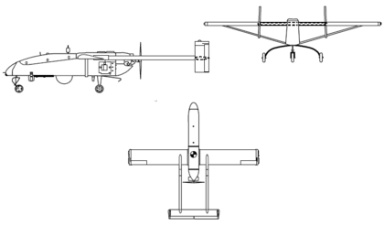
Pioneer UAV
Length: 14 feet (4 m)
Height: 3.3 feet (1.0 m)
Weight: 205 pounds (452 kilograms)
Wingspan: 16.9 feet (5.2 m)
Speed: 110 knots (200 km/h)
Range: five hours at 100 nautical miles (185 kilometers )

Slide 8
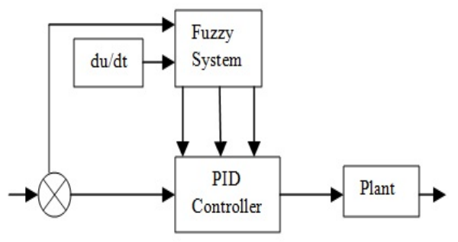
Fuzzy Logic Structure

Slide 9
Table of Rules
When |e| is bigger value, Kp should be bigger, Kd should be smaller for better tracking performance and the Ki should be set to zero for avoiding integral saturation and heavier overshoot.
When |e| and |ec| are middle value, neither Kp, Ki and Kd is too large for slight overshoot. Ki should be smaller while Kp and Kd should be moderate for rapid response.
When the |e| is smaller value, both Kp and Ki should be increased for better steady performance .Kd should be moderate for avoiding oscillation around the corresponding static value.

Slide 10
Airspeed Response

Slide 11
Altitude Response

Slide 12
Heading Response

Slide 13
Conclusion
In this study a fuzzy gain scheduled PID controller is designed and implemented to an UAV autopilot system in SIMULINK environment.
The control of airspeed, altitude and heading parameters of UAV is performed using both PID and Fuzzy-PID.
Results show that changing controller gains dynamically gives a better performance than fixed gain values.
It should be noted that these results can be improved with a better tuning of the fuzzy logic parameters.

Slide 14
Anadolu University Faculty of Aeronautics and Astronautics
THANK YOU FOR YOUR ATTENTION

