Slide 1
The correlations of activins and follistatin with viral load, liver damage, IL-6 and TNF-α in treatment naïve patients with chronic hepatitis C genotype 1 and 4: A case-control study
Ahmed Mohammed Ashshi¹, Bassem Refaat¹, Adel Galal El-Shemi¹ and Adnan AlZanbagi²

Slide 2
Chronic Hepatitis C (CHC)
WHO:
170 million infected World Wide
3-4 NEW infections/Year
It has been classified in to 6 genotypes
Genotypes1 and 4 in Saudi Arabia
Major cause of liver damage
Fibrosis/Cirrhosis
Hepatocellular Carcinoma

Slide 4
Immune Response to HCV
Infected hepatocyte
DCs
IL-2
IFN-α\β
NKT
NK
IFN-γ & TNF–α
IFN-γ TNF-α
Inhibit Viral Replication without destroying of hepatocytes

Slide 5
Acute Phase of HCV Infection
(Th2)
IL-4
IL-6
IL-10
(Th1)
INF-α
IFN-γ
IL-12

Slide 6
Chronic Phase of HCV Infection
(Th1)
INF-α
IFN-γ
IL-12
(Th2)
IL-4
IL-10
IL-13
Th2 Response also includes the stimulation of Transforming Growth Factor (TGF)-β

Slide 7
Activins
Members of TGF-β superfamily
Originally identified as gonadal proteins
Recently involved in many systems:
Growth & differentiation
Inflammation (Pro or Anti depending on cellular context)
Fibrotic diseases

Slide 8
Structure of Activins proteins
βA-subunit
βB-subunit
βA
βB
βA
βA
βB
βA
βB
βB
Activin-A
Activin-AB
Activin-B

Slide 9
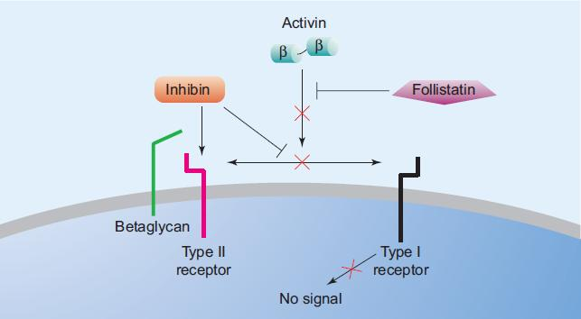
Follistatin (Activin binding protein)

Slide 10
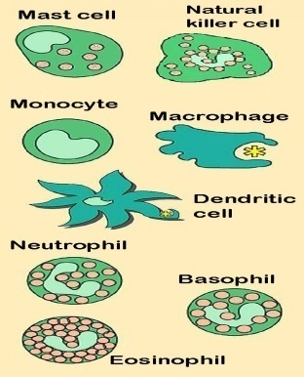
Activins & Follistatin
TGF-β
Activin
In normal liver (Hepatocyte regeneration)
In immune system (Th1 & Th2 responses)
follistatin
In Liver disease (Fibrosis, HCC)
Regulation

Slide 11
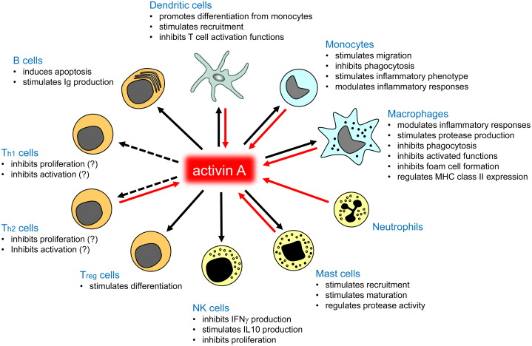
Activins and the Immune system

Slide 12
Research Questions
What are the effects of CHC genotype 1&4 on serum activin-A & B and follistatin
Is there a difference between:
Male and Female patients?
Genotype 1 & 4?
Do activins & follistatin correlate with:
Pro-inflammatory cytokines (TNF-α and IL-6)?
Liver enzymes?
Liver fibrosis?

Slide 14
Study Design (Case-Control)
80 Participants
Control Group
40 Healthy Participants
Case Group
40 CHC treatment Naïve Patients
20 Males
20 Females
20 Males
20 Males
10 G1
10 G4

Slide 15
Inclusion criteria
Control Group | Case Group
Patient age ≥ 18 ≤ 45 years. | Patient age ≥ 18 ≤ 45 years.
No concurrent acute/chronic disease | HCV RNA positive
Proven fertility | No concurrent infection with HBV or HIV
Not taking exogenous hormones/oral contraceptive pills for at least 3 months prior to enrolment | Proven fertility
No history of hospitalisation and no medication for significant clinical disease | Not taking exogenous hormones/oral contraceptive pills for at least 3 months prior to enrolment
laboratory results for their haematological, biochemical and metabolic parameters were within normal range | Treatment naïve patients
 | Compensated liver disease (e.g. no liver cirrhosis, failure or cancer) & APRI ≤ 1.2
 | Acceptable haematological and biochemical indices
 | No or controlled type 2 diabetes mellitus and hypertension

Slide 16
Methods
Liver function parameters & Viral load
AST/Platelet Ratio Index (APRI) to assess liver fibrosis
ELISA to measure serum:
Activin-A
Activin-B
Follistatin
IL-6
TNF-α

Slide 18
1- Demographic and laboratory characteristics of the patients according to viral genotype and gender of the participants (ND = not done; a = p < 0.05 compared to CM and b = p < 0.05 compared to CF groups).
 | Control Male (CM) (n = 20) | Control Female (CF) (n = 20) | Male G1 (MG1) (n= 10) | Male G 4 (MG4) (n= 10) | Female G1 (FG1) (n= 10) | Female G4 (FG4) (n= 10)
Age (years) | 39 ± 5.4 | 36 ± 8.3 | 40.3 ± 4 | 39.2 ± 5.7 | 37.9 ± 6.2 | 34.8 ± 8.8
Viral load at diagnosis (IU/mL) | ND | ND | 866784.8 ± 237056.2 | 945148.7 ± 381181.2 | 1007458.5 ± 318742.4 | 988447.8 ± 372327.8
ALP (IU/L) | 79.4 ± 21.6 | 69.2 ± 16.1 | 125 ± 45.8^{a,b} | 133.3 ± 35.4^{a,b} | 130.6 ± 63^{a,b} | 124 ± 32.3^{a,b}
ALT (IU/L) | 28 ± 11.2 | 22.2 ± 5.6 | 89.3 ± 18.1^{a,b} | 81.6 ± 19^{a,b} | 71.9 ± 22.7^{a,b} | 72.8 ± 20.1^{a,b}
AST (IU/L) | 21 ± 4.6 | 22.1 ± 3.1 | 50.5 ± 14.3^{a,b} | 54.6 ± 12.5^{a,b} | 57.8 ± 13.4^{a,b} | 51.9 ± 15.5^{a,b}
Albumin (g/dL) | 4.4 ± 0.24 | 4.5 ± 0.27 | 3.7 ± 0.5^{a,b} | 3.6 ± 04^{a,b} | 3.6 ± 0.4^{a,b} | 3.7 ± 0.5^{a,b}
APRI | 0.37 ± 0.07 | 0.36 ± 0.06 | 0.78 ± 0.3^{a,b} | 0.84 ± 0.25^{a,b} | 0.85 ± 0.29^{a,b} | 0.89 ± 0.32^{a,b}

Slide 19
2- Mean ± standard deviation of IL-6 and TNF-α in the different study groups (a = p < 0.05 compared to CM, b = p < 0.05 compared to CF; c = p < 0.05 compared to MG1; d = p < 0.05 compared to MG4 and e = p < 0.05 compared to FG4 groups).
 | Control Male (CM) (n = 20) | Control Female (CF) (n = 20) | Male G1 (MG1) (n= 10) | Male G 4 (MG4) (n= 10) | Female G1 (FG1) (n= 10) | Female G4 (FG4) (n= 10)
TNF-α (pg/mL) | 6.1 ± 1.5 | 5.8 ± 2.1 | 12..1 ± 2.4^{a,b} | 12.5 ± 1.8^{a,b} | 11.9 ± 1.6^{a,b} | 12.3.± 2.1^{a,b}
IL-6 (pg/mL) | 4.1 ± 1.1 | 3..6 ± 1.01 | 10.6 ± 1.6^{a,b} | 11 ± 1.9^{a,b} | 9.9 ± 1.4^{a,b} | 10.8.2 ± 1.7ª

Slide 20
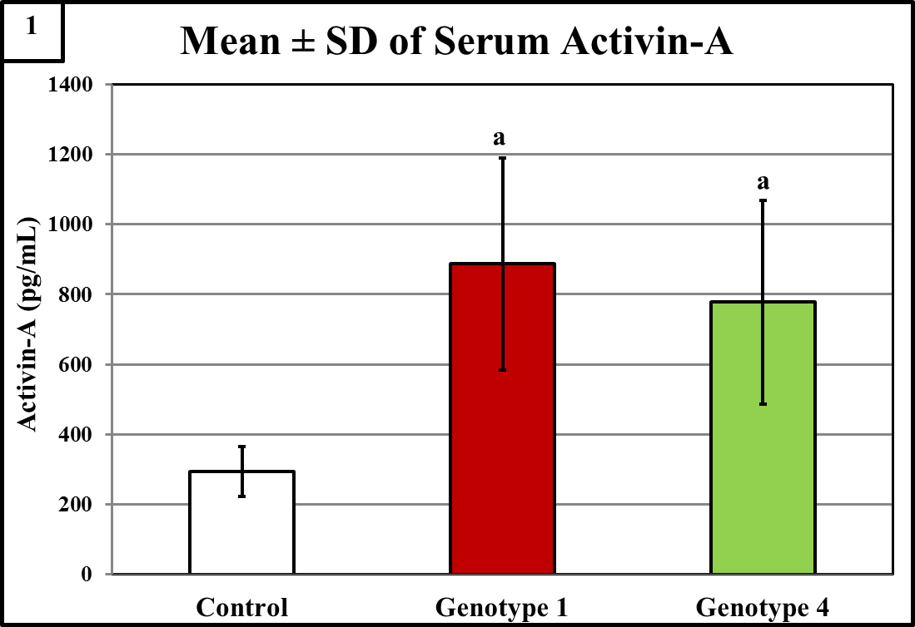
3- Serum Activin-A according to viral genotype (a = p < 0.05 compared to control)

Slide 21
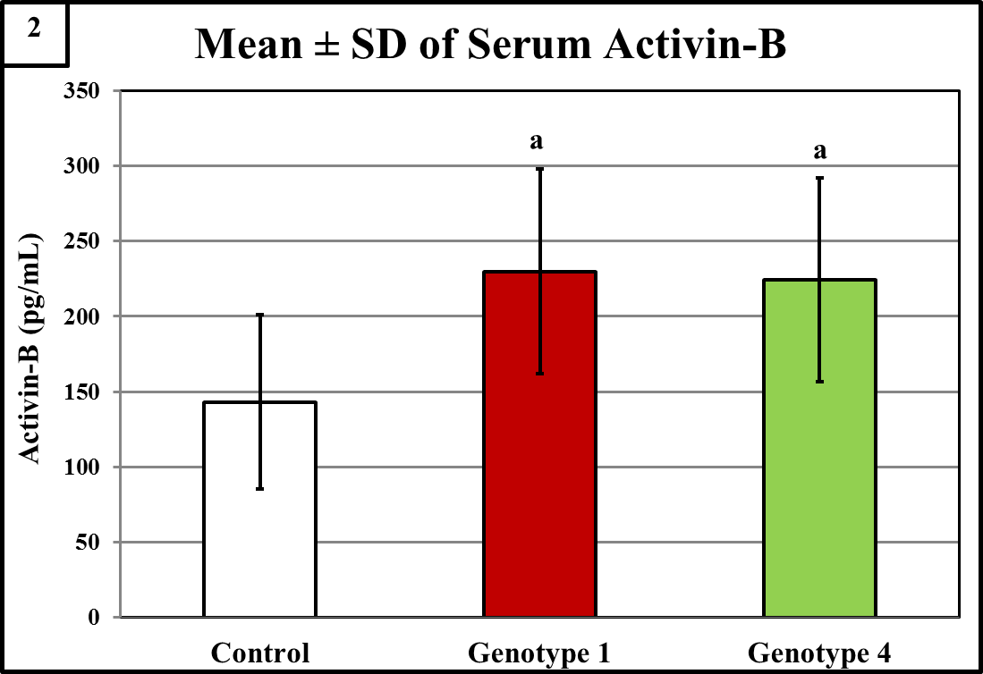
4- Serum Activin-B according to viral genotype (a = p < 0.05 compared to control)

Slide 22
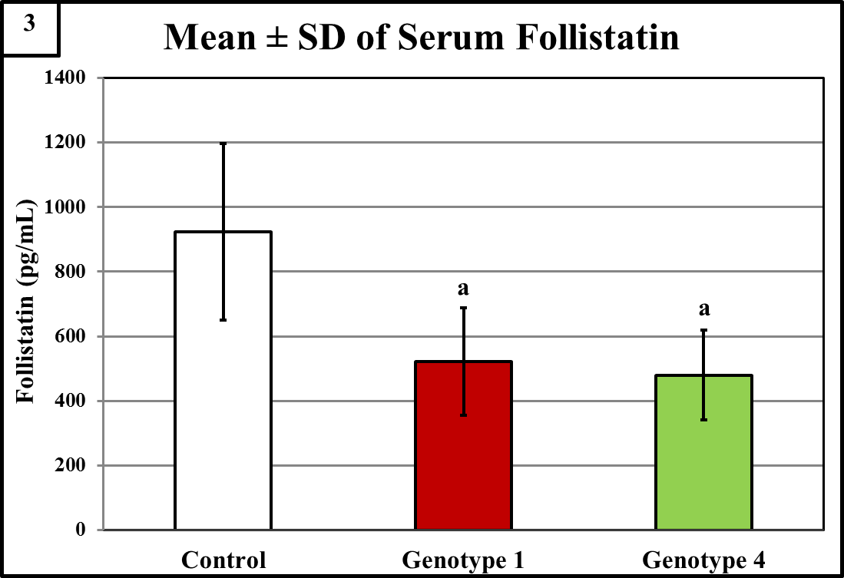
5- Serum follistatin according to viral genotype (a = p < 0.05 compared to control)

Slide 23
6- Correlation of serum activins and follistatin with pro-inflammatory cytokines, liver function parameters and viral load
Activin-A was strongly and positively correlated with:
viral load
APRI
IL-6 and TNF-α
negatively with albumin
Activin-B showed similar correlations to activin-A but only in CHC genotype 1 and it was weaker
No correlation was detected for follistatin

Slide 24
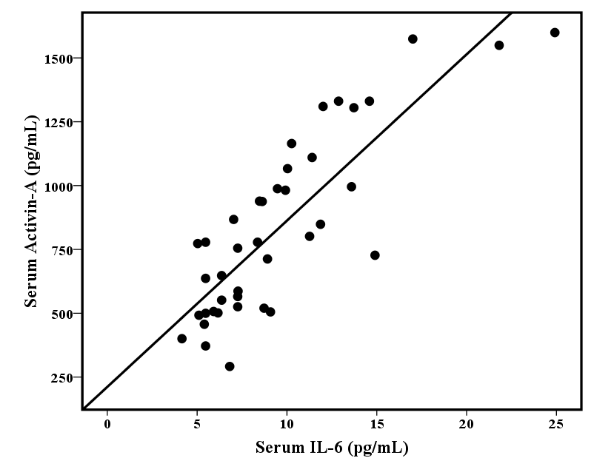
R = 0.836
P = 0.01 X 10⁻⁹

Slide 25
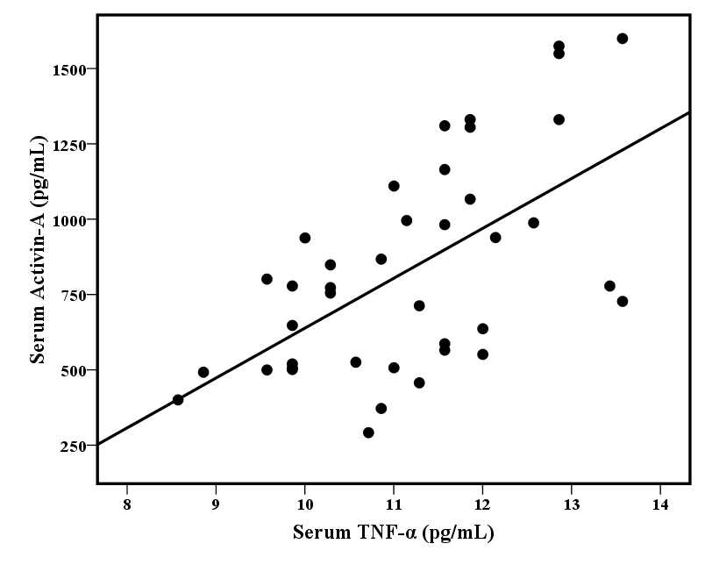
R = 0.593
P = 0.0005

Slide 26
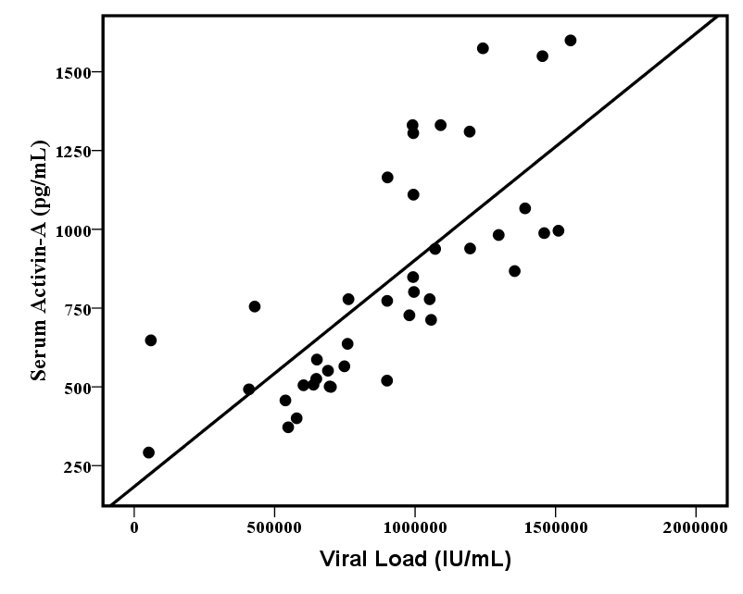
R = 0.745
P = 0.03 X 10⁻⁶

Slide 27
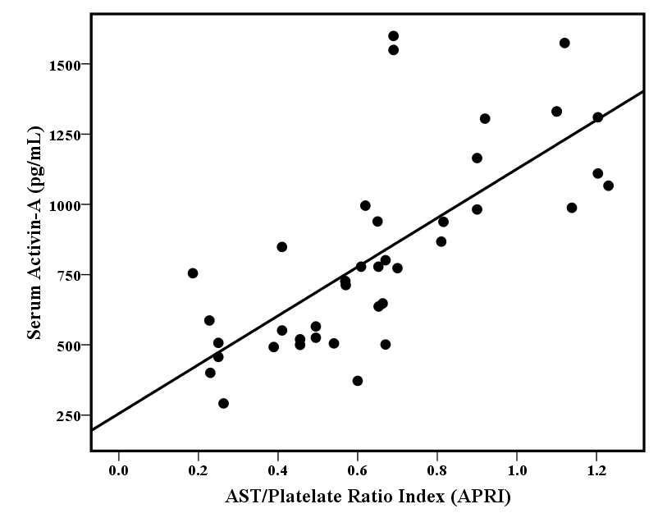
R = 0.734
P = 0.006 X 10⁻⁴

Slide 28
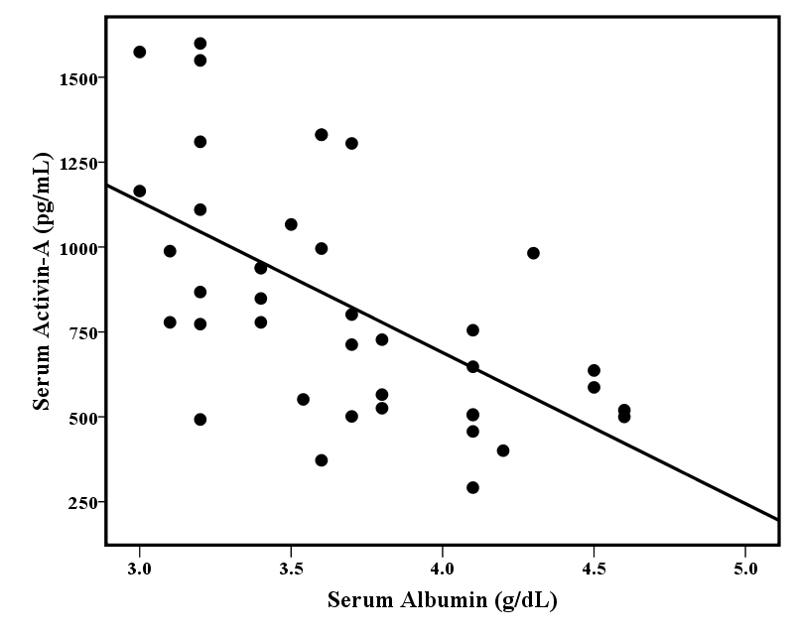
R = -0.586
P = 0.0007

Slide 29
Conclusions
CHC genotype 1 and 4 significantly altered serum activins and follistatin
The observed significant correlations with viral load, IL-6 & TNF-α suggests that activins are involved in the host immune response to HC
The correlation of activins with liver enzymes and APRI suggest that the dysregulation of activins is associated with liver injury

Slide 30
Future Work
Could serum activins and follistatin be used as non-invasive markers for the diagnosis/staging of liver fibrosis?
Could serum activins and follistatin be used as prognostic markers for the prediction of CHC treatment outcome?

Slide 31
Thank You

