Slide 1



Slide 2
chemical and biological remediation of lindane residue in aqueous media
Ahmed Massoud¹; Aly Derbalah¹; Ibrahim El-Mehasseb² and Moustafa Saad Allah¹
¹Pesticides Chemistry and Toxicology Department, Faculty of Agriculture, Kafr-El-Sheikh University, 33516 Egypt
²Chemistry Department, Faculty of Science, Kafr-El-Sheikh University, 33516 Egypt

Slide 3
For the first time in the history of the world, every human being is now subjected to contact with dangerous chemicals, from the moment of conception until death. The systemic pesticides have been so thoroughly distributed throughout the animate and inanimate world that they occur virtually every where. Residues of these chemicals have entered and lodged in the bodies of fish, birds and they have been found in water and in man himself (Carson 1962).
Water pre requisite for life and key reasons of humanity, is abundant on earth. However, 97% is salt water. The remaining 2.5% that is the fresh water, 70% is frozen in the polar ice caps. Only less than 1% of the world’s fresh water resources are readily available for human use (WHO 2002).

Slide 4
Egypt, today is facing and suffering from two huge problems. The first one is the Renaissance Dam in Ethiopia, it can cause a shortage in water supply and reduction Egypt’s share of the Nile water by 14.5 billion cubic meters, which can irrigate 3 million Fadden and the second problem is the environmental pollution in general, and particularly agrochemical pollutants in surface water through the intensive used of pesticides and fertilizers.
On the other hand, the pollution of surface water and wastewater has increased sharply and it constitutes a major problem due to an extensive use of these substances (Evgenidou et al., 2007). The monitoring of pesticides in surface water showed the presence of organochlorines, organophosphorus and carbamates insecticides in water resources in Kafr El-sheikh Governorate (Hamed 1997; Abd El-Razik, 2006; Massoud et al., 2007a; Massoud et al., 2011; Ismail et al., 2015).

Slide 5
Nanotechnology is an emerging technology, which can lead to a new revolution in every field of science (Rico et al., 2011). This technology is used with association to optics, electronics, and biomedical and materials sciences. Research in this field has gained momentum in the recent years by providing innovative solutions in different scientific disciplines.
Zinc oxide crystallizes in two main forms, hexagonal wurtzite (Fierro 2006) and cubic zincblende. ZnO semiconductor has several unique properties such as good transparency, high electron mobility, wide band gap, and strong room temperature luminescence. The wide band gap and large excitonic binding energy have made zinc oxide important both for scientific and industrial applications (Wang et al., 2004).
Titanium dioxide (TiO₂) is considered very close to an ideal semiconductor for photocatalysis because of its high stability, low cost and safety toward both humans and the environment. TiO₂ belongs to the family of transition metal oxides. There are four commonly known polymorphs of TiO₂ found in nature: anatase (tetragonal), brookite (orthorhombic), rutile (tetragonal), and TiO₂ (B) (monoclinic) (Crap et al. 2004).

Slide 6
In this study the efficiency of advanced oxidation processes with different nano materials and bioremediation with Xanthomonas campestris pv. Translucens and Aspergillus fumigatus were evaluated to achieve the total degradation of lindane. The enzymes activity and histological changes in liver and kidney of rats was measured to confirm the complete detoxification of lindane-contaminated water.

Slide 7
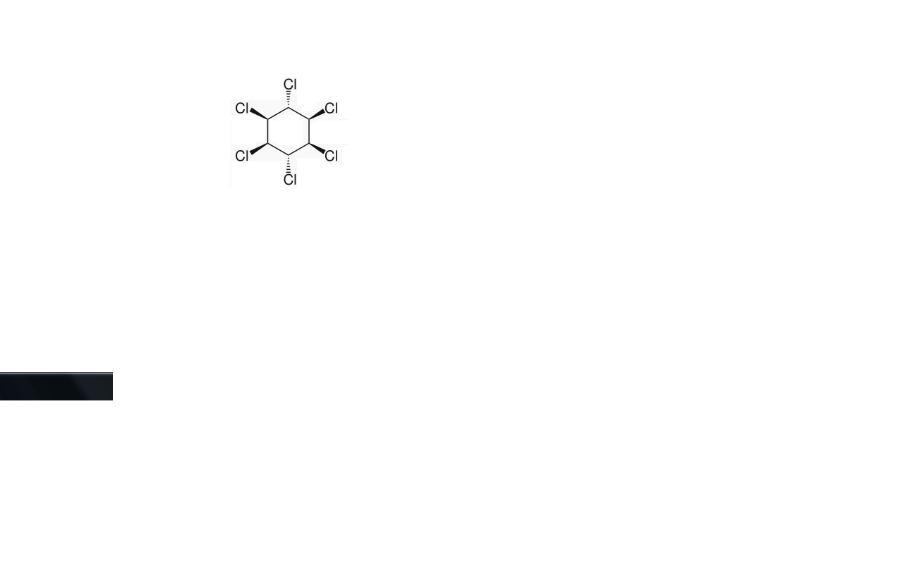
MATERIALS AND METHODS
Tested insecticides
Chemical class: Organochlorine (Lindane with purity of 99.5% )
Empirical formula: C₆H₆CL₆.

Slide 8
Photochemical remediation
The scope of the experiments included the following treatments: Nano titanium dioxide combined with hydrogen peroxide(TiO₂ (nano)/H₂O₂/UV), nano photo zinc oxide combined with hydrogen peroxide (ZnO (nano)/H₂O₂/UV), photo Fenton reagent (Fe²⁺/H₂O₂/UV), photo titanium dioxide combined with hydrogen peroxide (TiO₂ /H₂O₂/UV) and photo zinc oxide combined with hydrogen peroxide (ZnO/H₂O₂/UV).
For photo Fenon and Fenton like reaction UV Lamp as employed for the irradiation of lindane in aquatic solution. Ferric chloride and ferrous sulphate were used as source of iron catalyst. The solution was prepared by addition of desired amount of lindane (5 mg L⁻¹) distilled water and carefully agitated.

Slide 9
Synthesis of nonmaterials
1- Synthesis of ZnO nanoparticles (NPs)
Zinc acetate dihydrate (ZnAc₂.2H₂O) and capping agent (triethylamine, TEA) were mixed at a molar ratio of 5:3 in ethanol with typically 3.2926 gm of zinc acetate dihydrate and 1.255 ml of triethylamine. The mixed solution was stirred for 60 min at 50-60º C in a condensation system until it turned white cloudy. The resulting cloudy solution indicates the growth of ZnO nanoparticles (El-Kemary et al., 2010)..

Slide 10
2-Synthesis of TiO₂ nanoparticles (NPs)
Nanostructured TiO₂ catalysts have been prepared by hydrolysis of titanium isopropoxide or titanium tetrachloride (Addamo et al., 2004). The nanostructured TiO₂ sample was prepared by hydrolysis of titanium tetrachloride TiCl₄. In a typical synthesis: 4 ml TiCl₄ solution was dropped into 400 ml of a mixture of ethanol and distilled water (4:1). The mixture was refluxed at 80 ºC with stirring; a white suspension of TiO₂ nanoparticles was formed in about 120 min of reflux.

Slide 11
3- photo Fenon and Fenton like reaction
photo Fenon and Fenton like reaction UV Lamp as employed for the irradiation of lindane in aquatic solution. Ferric chloride and ferrous sulphate were used as source of iron catalyst. The solution was prepared by addition of desired amount of lindane (5 mg L⁻¹) distilled water and carefully agitated. Then, freshly prepared ferric chloride or ferrous sulphate at concentration level of 50 mg L⁻¹ as Fe³⁺ was added followed by the addition of H₂O₂ at concentration level of 20mg/L. After that the solution was completed with water up to 1000 mL. The initial pH of the solution was adjusted to be 2.8 by using hydrochloric acid 1 Molar for all experiments [Derbalah et al. 2004].

Slide 12
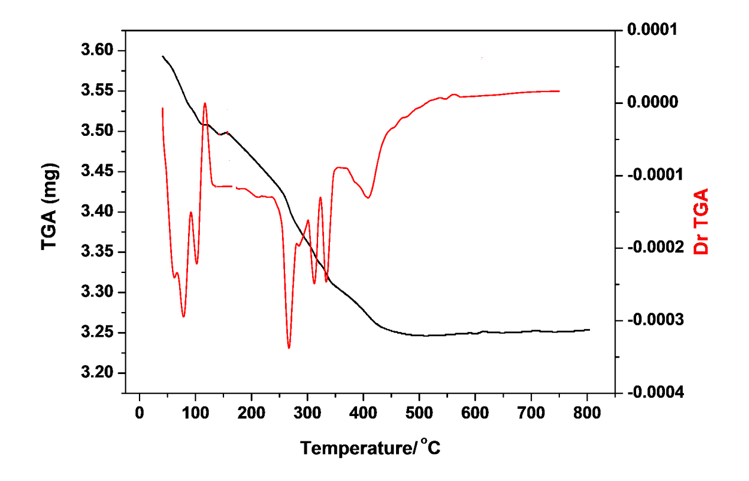
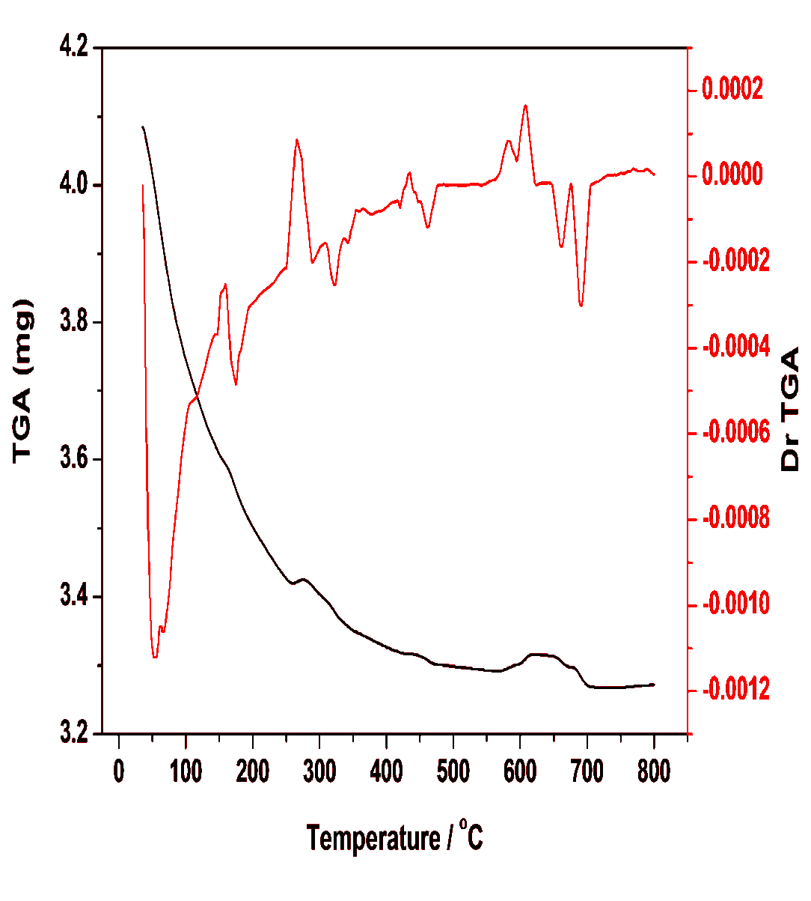
TGA-DrTGA of the synthesized ZnO isolated at a heating rate of 10 ºC/min under nitrogen atmosphere.
TGA-DrTGA of the synthesized TiO₂ powders measured at a heating rate of
10 ºC/min under nitrogen atmosphere.

Slide 13
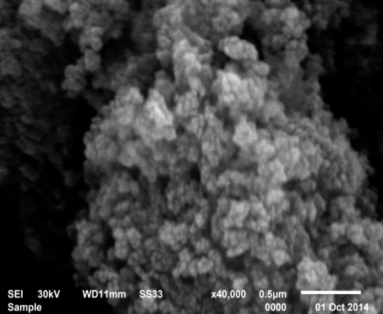
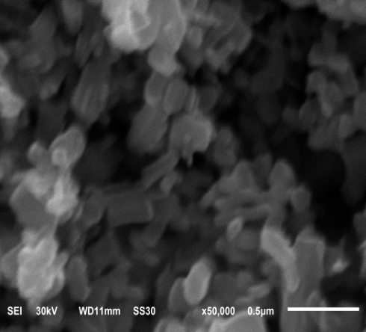
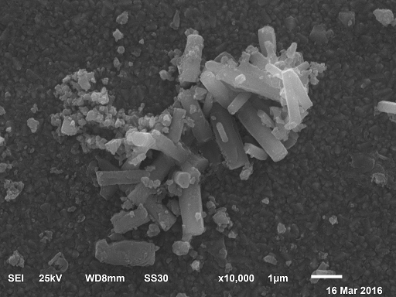
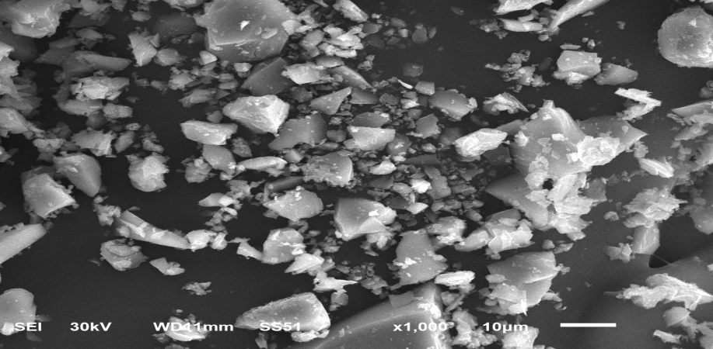
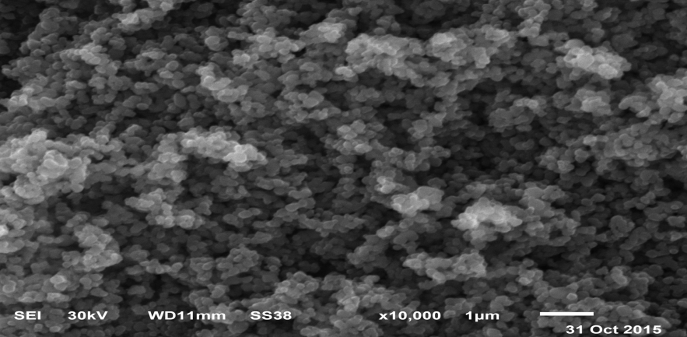
Scanning Electron Microscope (SEM)
Fig. (22):SEM image of the synthesized ZnO (s).
spherically shape
(size :30-49 nm)
Fig. (23): SEM image of commercial ZnO.(size d:34 to 119 nm L:169 to 399 nm hexagonal prisms
Fig. (24):SEM image of synthesized ZnO thin film on FTO substrate.(sized:100-450 nm , l: 0.4 3µm)hexagonal nanorods
Fig. (25): SEM images of the synthesized TiO₂ (s). (spherically shape )
(size d:30 to 40 nm )
Fig. (26): SEM images of the commercial TiO₂. (spherically shape ) (size: 126-206 nm)

Slide 14
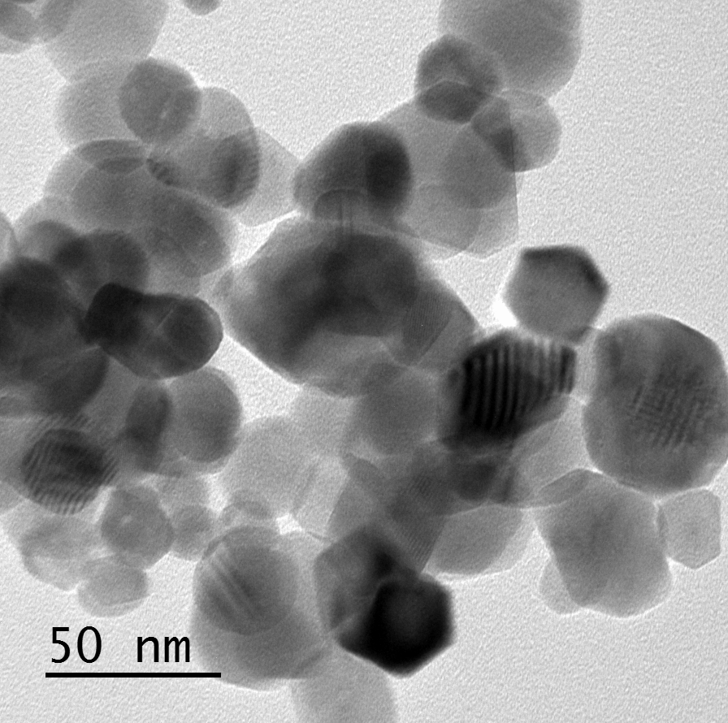
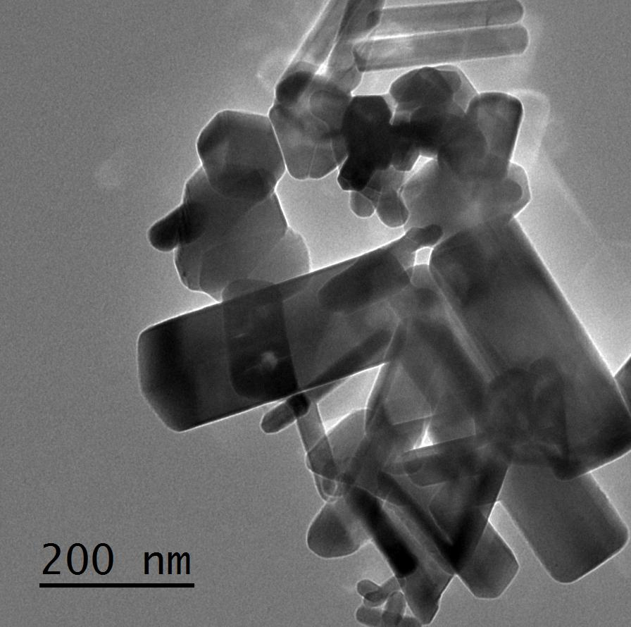
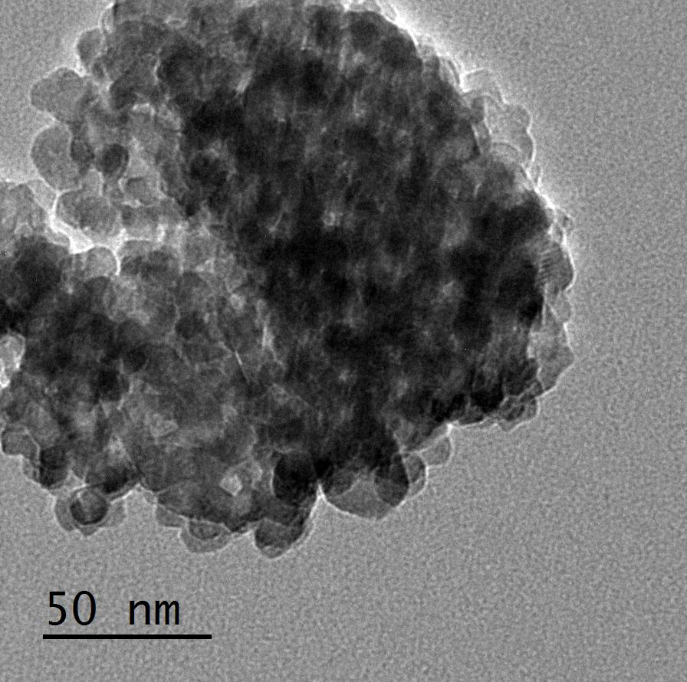
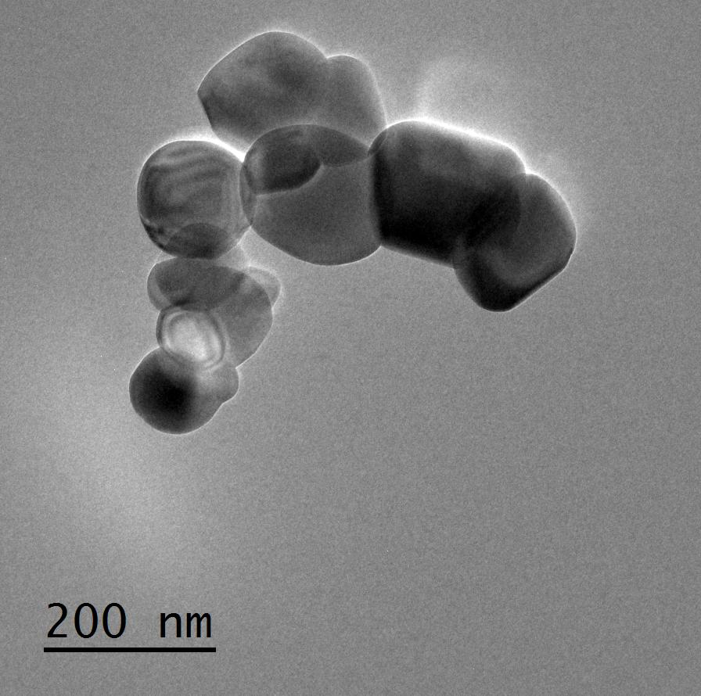
Transmission Electron Microscope (TEM)
Fig. (27): TEM images of ZnO (s).
(size:12.48-26.12 nm )
Fig. (28): TEM images of ZnO (c) nanowire. (size d:30-83.87, l: 70.9-406.5 nm)
Fig. (29):TEM images of synthesized TiO₂ .
(size: 8.52-34.5 nm)
Fig. (30): TEM images of commercial TiO₂ (antase).(size d: 33.3-100nm, l:100-273 nm)

Slide 15
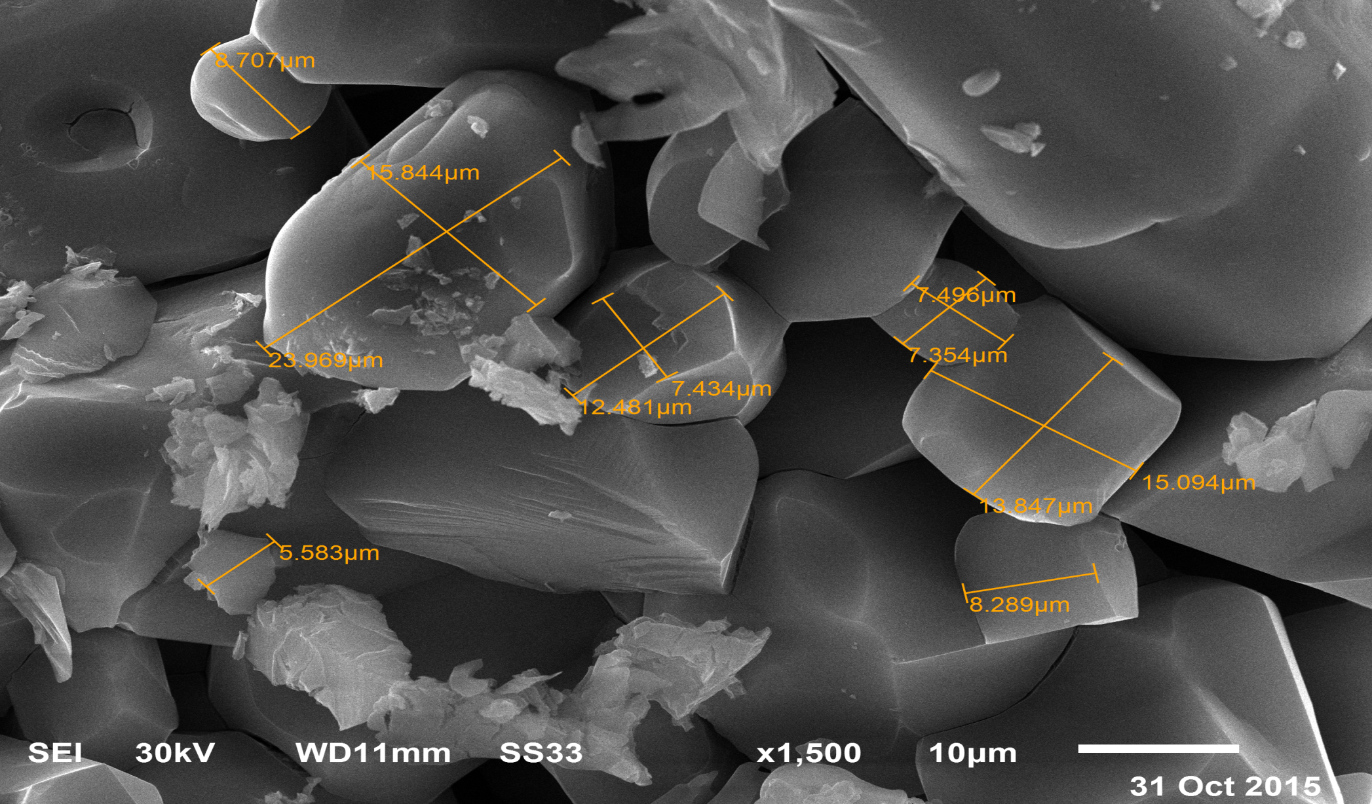
Scanning Electron Microscope (SEM) from Iron

Slide 16
Bioremediation Technique
The bioremediation test was carried out at pesticides laboratory, Dep. of Pesticides chemistry and Toxicity, Fac. of Agric. Kafrelsheikh Univ. The selected microbial isolates (A1) Aspergillius fumigatus and (A2) Xanthomonas campestris pv. Translucens were cultured onto MSL spiked with the tested insecticides (lindane), separately for 7 days and then the growing colonies were washed with three ml sterilized MSL liquid medium. The cell suspension of 10⁸cfu/ml (cfu:colony forming unit) was used to inoculate 100 ml MSL liquid medium containing 5ppm of the tested insecticide.

Slide 17
Toxicity test
To confirm the complete detoxification of lindane in treated water, toxicity test was conducted on rats. Lindane contaminated-waters after treatment with ZnO/H₂O₂/UV, and Xanthomonas campestris pv. Translucens were orally administrated to the tested rats. This test was carried out to measure the effect of the possible remaining lindane (parent or metabolites) in the water samples after remediation on rats with respect to histological changes in liver and kidney of treated rats relative to control.
Adult rats (Sprague Dawley) with 100-120 gm of weight, obtained from Faculty of Veterinary Medicine, Kafr-El-Shiekh University were used. Rats were housed in polypropylene cages under standard conditions with free access to drinking water and food. The animals were randomly divided into five groups each comprising of three animals and the treated samples that possibly contain lindane were given to rats as oral administration. Control group rats were fed with normal diet and given oral dose containing no lindane. After 28 days, the rats were scarified under anesthesia and the kidney and liver organs were removed and prepared for histopathological examination according to the method described by Bancroft and Stevens (1996).

Slide 18
Results and Discussion

Slide 19

Organic pollutant + AOPs (•OH , O₂ ^{.-})
hv ≥ Eg
Semiconductor
CO₂+H₂O+ Inorganic ions
Total mineralization

Slide 20
UV-Visible Spectra of ZnO
The band gap energy (E) was calculated as per the literature report using the following equation (Hoffmann et al., 1995):
Band gap energy (E) =hc / λ
Where h is the Plank’s constant (6.625×10⁻³⁴ Js), c is the speed of light (3.0×10⁸ m/s) and (λ) is the wavelength.
According to this equation, the band gap of the synthesized ZnO(s) is 3.36 eV while the band gap of the commercial ZnO is 3.29 eV. The wide band gap energy of semiconductor nanoparticles is the more reactive in a photocatlytic degradation of the organic pollutants (Dhal et al., 2015).

Slide 21
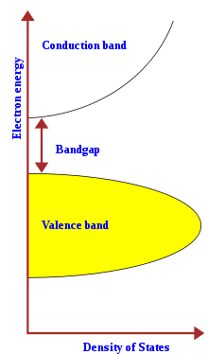

Slide 22
1- Degradation of lindane by advanced oxidation processes

Slide 23
Degradation of lindane at initial concentration of 5ppm under UV, H₂O₂/UV, Fe³⁺/H₂O₂/UV, Fe²⁺/H₂O₂/UV, ZnO(nano)/H₂O₂/UV, ZnO/H₂O₂/UV, TiO₂(nano)/H₂O₂/UV and TiO₂/H₂O₂/UV systems by HPLC analysis.

Slide 25
Degradation of lindane at initial concentration of 5ppm under insecticide only, H₂O₂, Fe³⁺/H₂O₂, Fe²⁺/H₂O₂, ZnO(nano)/H₂O₂, ZnO/H₂O_{2,}TiO₂/H₂O₂ and TiO₂(nano)/H₂O₂ systems in dark conditions by HPLC analysis.
Time (min) | Lindane | H₂O₂ | FeCl₃/ H₂O₂ | FeSO₄/ H₂O₂ | ZnO/ H₂O₂ | ZnO(nano) H₂O₂ | TiO₂/ H₂O₂ | TiO₂(nano)/ H₂O₂
0 | 5 | 5 | 5 | 5 | 5 | 5 | 5 | 5
10 | 4.996 | 4.998 | 4.998 | 4.999 | 4.995 | 4.99 | 4.999 | 4.998
20 | 4.992 | 4.996 | 4.989 | 4.998 | 4.989 | 4.988 | 4.998 | 4.992
40 | 4.988 | 4.992 | 4.972 | 4.985 | 4.985 | 4.987 | 4.985 | 4.986
60 | 4.985 | 4.989 | 4.968 | 4.979 | 4.977 | 4.986 | 4,979 | 4,98
80 | 4.981 | 4.985 | 4.961 | 4.975 | 4.969 | 4.982 | 4.975 | 4.974
160 | 4.977 | 4.97 | 4.957 | 4.968 | 4.967 | 4.961 | 4.968 | 4.961
320 | 4.973 | 4.965 | 4.95 | 4.959 | 4.966 | 4.94 | 4.967 | 4.945
360 | 4.970 | 4.96 | 4.948 | 4.95 | 4.96 | 4.923 | 4.961 | 4.928

Slide 26
Dark

Slide 27
Photochemical degradation of lindane at initial concentration 5 ppm under ZnO(c)/H₂O₂/sunlight, ZnO(s)/H₂O₂/sunlight and sunlight alone systems using HPLC analysis.
Time (min) | Lindane + sun | Lindane +ZnO (normal) + H₂O₂+ sun | Lindane +ZnO (nano) + H₂O₂+ sun
0 | 5 | 5 | 5
10 | 5 | 4.98 | 4.9
20 | 4.89 | 4.39 | 4.25
40 | 4.76 | 3,8 | 3.75
60 | 4.69 | 3.2 | 2.54
80 | 4.495 | 2.6 | 1.75
160 | 4.368 | 1.4 | 1.25
320 | 4.24 | 0.8 | 0.6
360 | 4 | 0.5 | 0.012

Slide 29
Biodegradation of Lindane using microbe isolates

Slide 30
Biodegradation of lindane at concentration level 5ppm by Xanthomonas campestris pv. Translucens and Aspergillus fumigatus in aqueous media.
Time (min) | Lindane + Xanthomonas campestris pv. | Lindane + Aspergillus fumigatus | Lindane +MSL (Control)
0 | 5 | 5 | 5
10 | 4.89 | 4.98 | 4.99
20 | 3.82 | 3.93 | 4.985
40 | 3.23 | 3.4 | 4.981
60 | 2.65 | 2.9 | 4.971
80 | 2.06 | 2.31 | 4.963
160 | 1.47 | 1.76 | 4.958
320 | 0.88 | 231 | 4.953
360 | 0.30 | 0.8 | 4.94

Slide 32
The histopathological changes in the kidney and Liver

Slide 33
Sections in kidney of rats treated with remediated water from lindane- with ZnO (nano)/H₂O₂/UV (B), and Xanthomonas campestris pv. Translucens(C), as well as ZnO (nano)/H₂O₂ (D) and Xanthomonas campestris pv. Translucens (E) without lindane relative to control (A).

Slide 34
Sections in liver of rats treated with remediated water polluted from lindane with ZnO (nano)/H₂O₂/UV (B), and Xanthomonas campestris pv. Translucens(C), as well as ZnO (nano)/H₂O₂/UV and Xanthomonas campestris pv. Translucens (E) without lindane relative to control (A).

Slide 35
CONCLUSIONS
From previous results, it can be concluded that, the better understanding for photochemical degradation mechanism through advanced oxidation processes (AOPs) with Zinc oxide (nano particles) and titanium dioxide (nano particles).,the minerals are generated from hetero atoms such as S,N,Cl, containing organic pollutants and Eg is the band gap of semiconductors and electron-hole pairs are generated in valence and conduction bands of a semiconductor due to presence of free radical, attack the molecules of pollutants such as (Lindane).
The photo titanium dioxide and photo zinc oxide combined with hydrogen peroxide showed much promise in the complete degradation and detoxification of lindane in contaminated water, especially by using titanium and zinc oxide nanoparticles.

Slide 36
Lindane as long life resistance in soil and in water have a good stability chemical structure and resist against degradation. Therefore the use of advanced oxidation processes in presence of ZnO or TiO₂ in nanoparticles play an important role for the mechanism of the chemical degradation. The nanoparticles exhibit photocatalytic activity and the mechanism might be due to cascade electron transfer in the ternary phase (Dhal et. al., 2015)
The degradation of the tested insecticide may be attributed to the secretion of enzymes from either tested bacterial or fungal strains which are capable of degrading pesticides. Xanthomonas campestris pv. Translucens and Aspergillus fumigatus are promising as effective and safe bioremediation for lindane removal in water.

Slide 37

شكرا لكم

Slide 38


Semiconductor band structure.
Thank you
Thank you

