Slide 1


Ahlke Heydemann
University of Illinois at Chicago
Physiology and Biophysics ahlkeh@uic.edu
The MRL mouse strain is naturally resistant to high fat diet-induced hyperglycemia

Slide 2
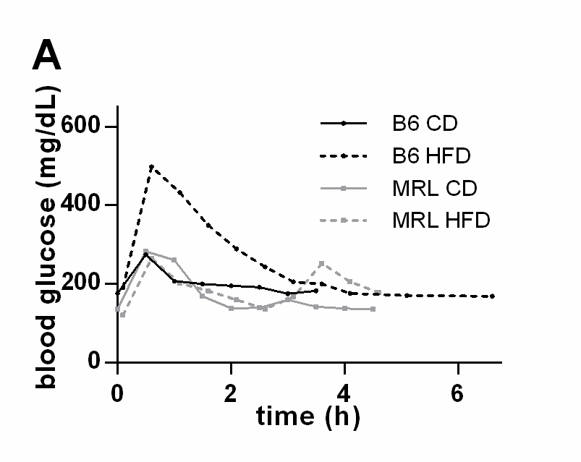
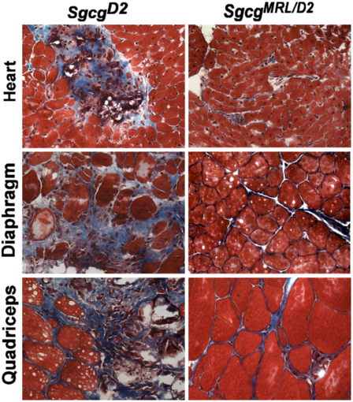
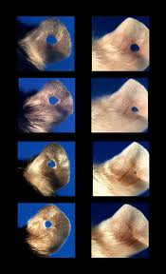

The super healing wild type MRL mouse
Mull 2014
B6 CD
spine
B6 HFD
spine
C57
MRL
1) Heal ear punches used for identification
Heal all tissues; cartilage, blood vessels, glands, hair follicles, nerves
femur
day 1
femur
2) No fibrosis when breed to have muscular dystrophy
Mouse tissues stained with Masson’s trichrome at 8 weeks old. Blue represents fibrotic scar tissue. Very rare in the MRL mice on the right.
MRL CD
spine
MRL HFD
spine
3) The MRL and B6 mice gain equal amounts of fat and weight.
When put on a 12 week high fat diet. Fat appears white in dual energy X-ray (top). Quantified in the bottom panel.
But they are…
day 9
femur
femur
4) Resistant to HFD mediated type 2 diabetes pathology
When challenged with a glucose bolus the HFD MRL mice cleared the glucose quickly, like the control diet mice.
p<0.0001
p<0.01
p<0.05
p<0.0001
day 20
The MRL mice
5) Are also susceptible to
autoimmune diseases.
6) Contain 2 mitochondrial
heteroplasmies (Sachadyne
2008)
day 33
Mull 2014
Clark 1998
Mull, 2014
Heydemann 2012

Slide 3
Serum analysis of 6 hour fasted animals at end of 12 week diets
A
P=0.001
C
p<0.05
B
p<0.0001
p<0.01
p<0.0005
Mull, 2014

Slide 4
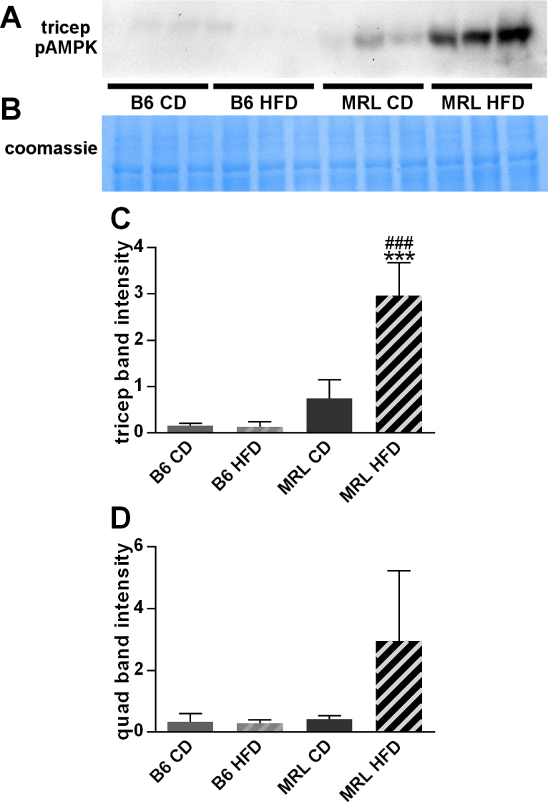
pAMPK quantitation
of 6 hour fasted animals
C
p<0.001
p<0.0001
D
Mull, 2014
Notes:
Figure 7.

Slide 5
Quadriceps Tissue
Mull, 2014
Notes:
Figure 9. EM

Slide 6

Liver tissue of 6 hour fasted animals at end of 12 week diets
B6
MRL
CD
HFD
CD
HFD
pAMPK
AMPK

Slide 7
Liver Glycogen Assay after 12 week diet, 6 hour fast
Notes:
B6, d2, mrl – change order!!!

Slide 8
Heart size
p=0.015
Notes:
Fig 1 No morphologic changes in HFD-MRL mice
A HW/tibia length
B Card size
C anything that could fit in here from the echo

Slide 9
Cardiac; pAMPK comparison (n=9)
*
*
*
*
* p<0.05
Notes:
Fig 3 Glycolytic changes
A pAMPK AMPK
B G4, HK2……
C activity assays

Slide 10
Cardiac; HKII comparison (n=6)
***
***
*
* p<0.05, *** p<0.0005

Slide 11
Cardiac; Glut 4 comparison (n=3)
*
*
* p<0.05

Slide 12
CD B6
HFD B6
Heart
*
*
+
+
CD MRL
HFD MRL
Notes:
Figure 7 -EM
* - Cytoplasmics lipid droplets
+ - Mitochondrial lipid droplets
Bar 0.5um

Slide 13
MRL mitochondrial heteroplasmies
One mitochondria and cell containing more than one mitochondrial genome.
MRL mice have 2; T3900C and an adenine tract length insert (Sachydyn 2008).
  MRL cytosine at 3900
  MRL more than 8 adenines in the tract
Inherited from the mother
Inherited independently
Polymorphisms in tRNA^{Met} and tRNA^{Arg}

Slide 14
Muscular dystrophy fibrosis
hydroxyproline nM/mg tissue

Slide 15
Mitochondrial DNA Correlations
Notes:
Add 2 female 12s to the ear hole graph
Explain why no 0% cytosines in weight graph?

Slide 16
Male Female
P1 D Sgcg-/- x MRL
F1 nuc^{M50D50}mito^{M}, Sgcg+/- x MRL
N1 (nuc^{M75D25}mito^{M}, Sgcg+/-)² x MRL
N2 nuc^{M88D12}mito^{M}, Sgcg+/- x MRL
N3 nuc^{M94D6}mito^{M}, Sgcg+/- x MRL
N4 (nuc^{M97D3}mito^{M}, Sgcg+/-)² x MRL
Current and
future plans
Early generation sib-crosses
wild type mice;
ear wound healing (2mm ear punch)
HFD, metabolic profile *
Sgcg-/- mice;
Muscular Dystrophy panel *
* genome wide association studies with mitochondrial content as a covariate
Four pure-breeding resultant mouse lines;
nuc^{M}mito^{M} Sgcg +/-
nuc^{M}mito^{D} Sgcg +/-
nuc^{D}mito^{M} Sgcg +/-
nuc^{D}mito^{D} Sgcg +/-
Late generation sib-crosses
wild type mice;
ear wound healing
HFD, metabolic profile
Sgcg-/- mice;
Muscular Dystrophy panel

Slide 17
Conclusions
Wild type MRL mice can heal ear wounds, heal cardiac
cryo-injuries, resist muscular dystrophy-mediated fibrosis,
resist high fat diet-mediated type 2 diabetes.
Multiple pieces of data indicate MRL-introduced
mitochondrial heteroplasmies
beneficially alter metabolism.
Tirsit K. Berhanu
Nathan W. Roberts
Aaron J. Mull
Jenan Holley-Cuthrell
Magdalis Vega-Gonsalez

Slide 18
B6 CD
spine
B6 HFD
spine
femur
femur
MRL CD
spine
MRL HFD
spine
femur
femur
p<0.05
p<0.01
Mull, Figure 2

Slide 20
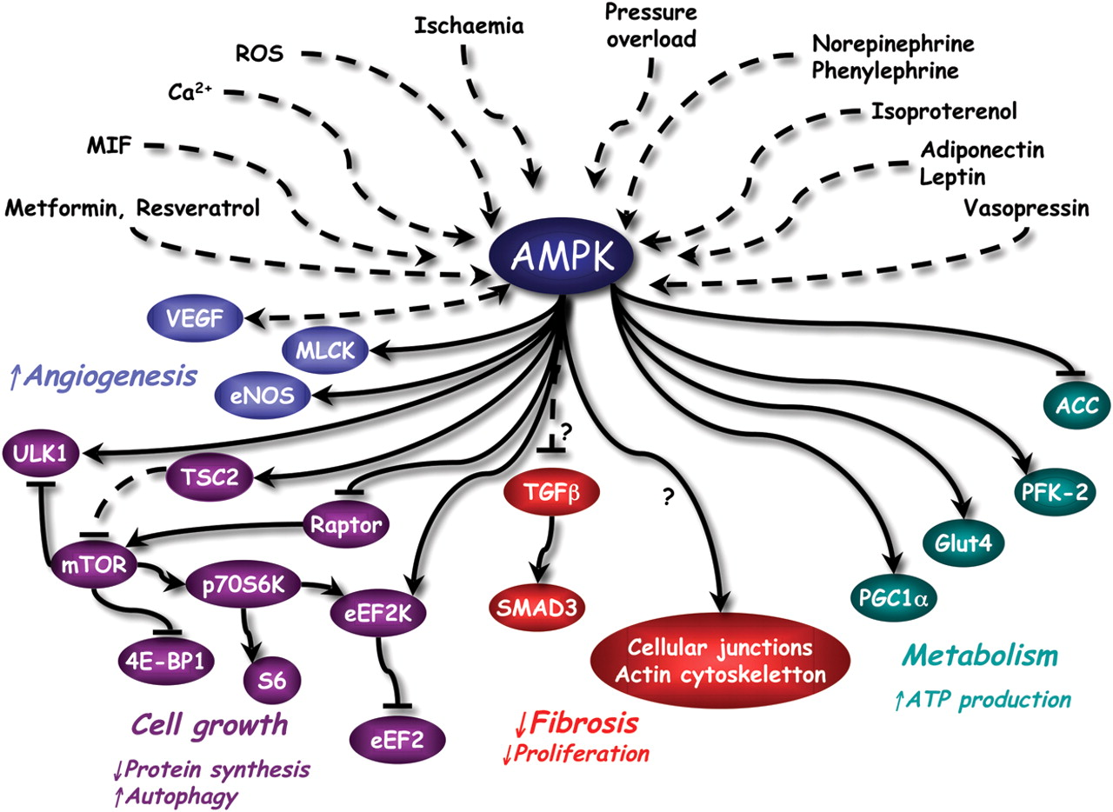
Upstream stimulatory factors and downstream targets of AMPK in the heart.
ROS
Beauloye C et al.
Cardiovasc Res 2011;90:224-233
Notes:
Upstream stimulatory factors and downstream targets of AMPK in the heart. Dashed lines correspond to indirect mechanisms. Question mark signifies that this pathway has not been studied in the heart. Abbreviations: 4E-BP1, 4E binding protein-1;140 ACC, acetyl-CoA carboxylase;141 eEF2K, eukaryotic elongation factor 2 kinase;87,142,143 eNOS, endothelial nitric oxide synthase;92–94 Glut4, glucose transporter 4;144 MIF, migration inhibitory factor;50 MLCK, myosin light chain kinase;44 mTOR, mammalian target of rapamycin;145 p70S6K, p70 ribosomal S6 protein kinase;146 PGC1alpha, peroxisome proliferator-activated receptor gamma co-activator alpha;77 PFK-2, 6-phosphofructo-2-kinase;39 ROS, reactive oxygen species;70-72 S6, ribosomal S6 protein;147 TGFbeta, transforming growth factor beta;122 TSC2, tuberous sclerosis factor 2;85 ULK1, uncoordinated51-like kinase 1;88-90 VEGF, Vascular endothelial growth factor.95

