Slide 1

Na,K-ATPase isoform-selective cardiac glycosides-
a potential anti-cancer drug ?
Adriana Katz,
Cherniavsky-Lev M., Ainbinder E., Tal D. and Karlish SJD
Weizmann Institute of Science, Israel

Slide 2
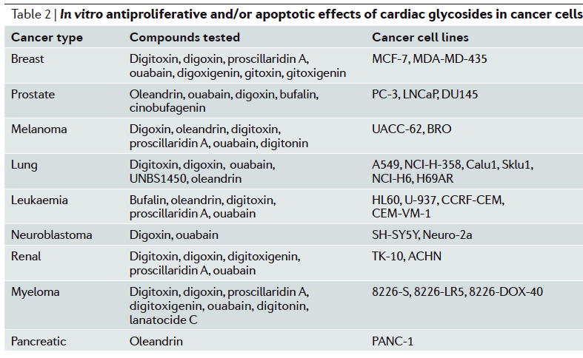
Ion channels and pumps as cancer targets!
Over the years, several reports have suggested that cardiac
glycosides may have an anticancer utilization. In vitro and ex vivo
experiments have revealed that some cardiac glycosides induce potent and
selective anticancer effects, which may occur at concentrations commonly
found in the plasma of patients treated with these drugs.
Na+ /K+ -ATPase could be targeted to combat chemoresistant cancers.

Slide 3
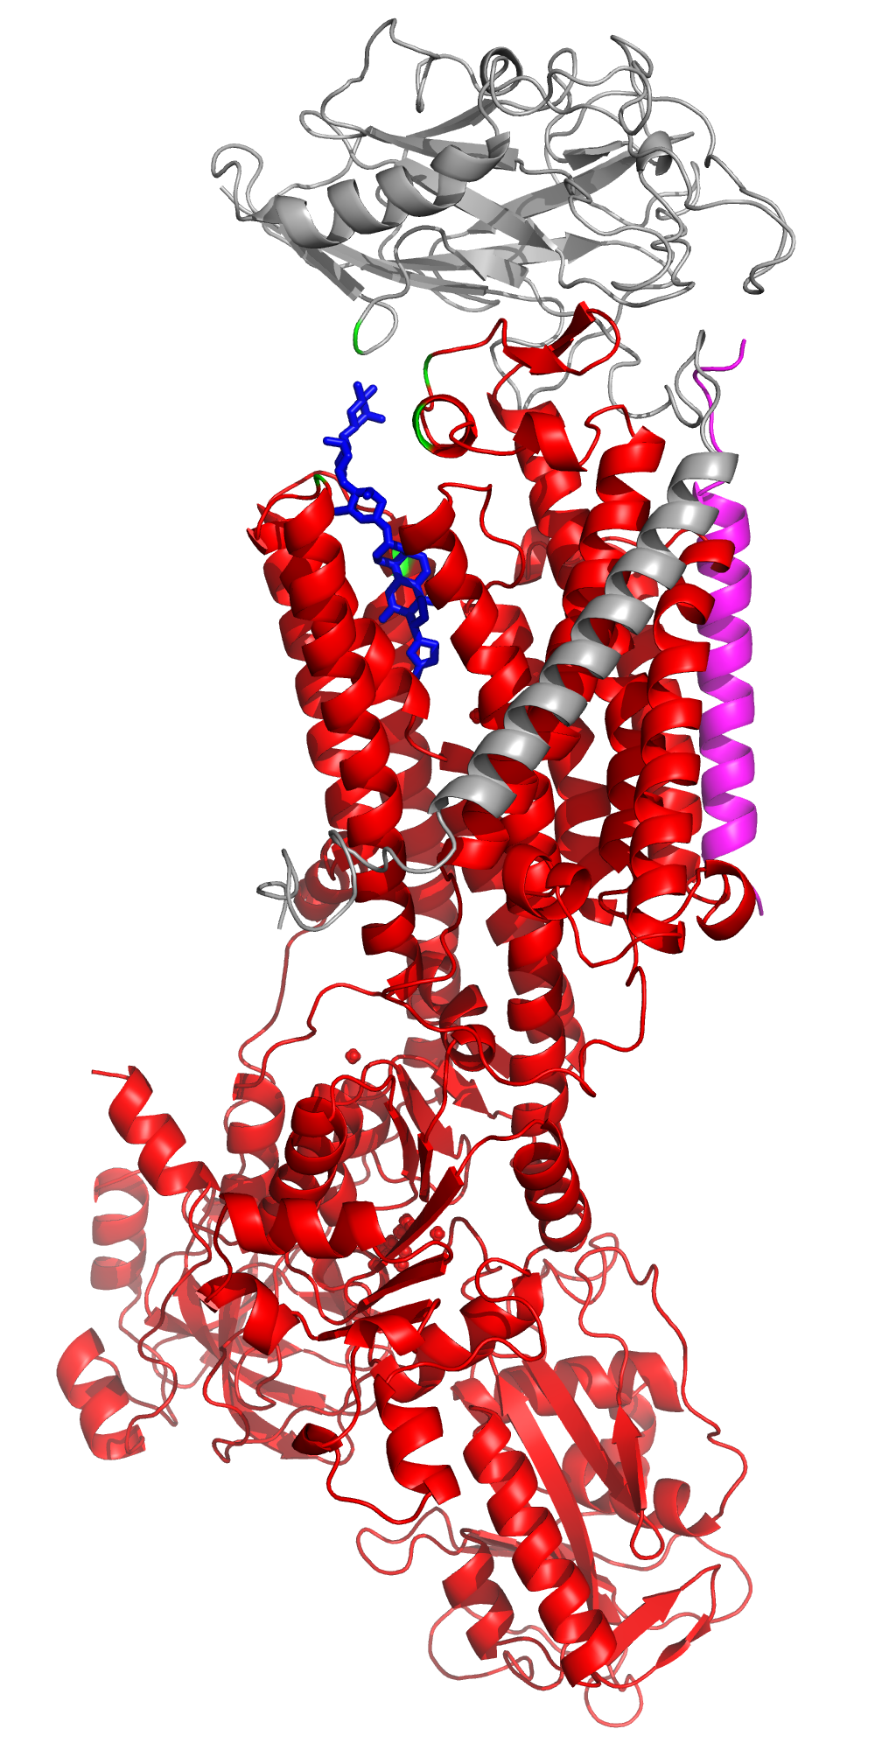
Na,K ATPase is a vital protein in all mammalian cells.
Na,K -ATPase is an oligomeric transmembrane protein, localized to the basolateral plasma membrane in most epithelial cells.
Na,/K-ATPase pumps Na+ and K+ against their physiological gradients.
.
.
Digoxin
Specific inhibitor
Subunit
targets into the membrane, 3 isoforms:
β1
β2
β3
Extracellular space
membrane
FXYD
accessory protein, regulator
Cytoplasm
α subunit
Catalytic moiety, 4 isoforms:
a1, ubiqutous , all tissues
a2, skeletal muscle, heart, eyes
a3, neurons brain
a4, sperms
Notes:
The Na,K-ATPase is an integral plasma membrane protein that consist of 2 subunits .
Alfa subunit contains the catalytic moiety with binding sites for ATP, Mg2+, Na+ and K+. and 10 transmembrane domains, 4isoforms
Beta subunit which has one trans membrane domain , which forms a tight active complex with a. and targets it into the membrane. 3isoforms
FXYD, conserved motif of the whole family, 7 proteins, not necessary for activity but modulates it .
CG site And a very specific site for binding of Cardiac glycosides, which are inhibitors of the pump, and actually this site and the inhibitors is subject of this lecture.

Slide 4
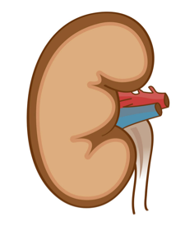
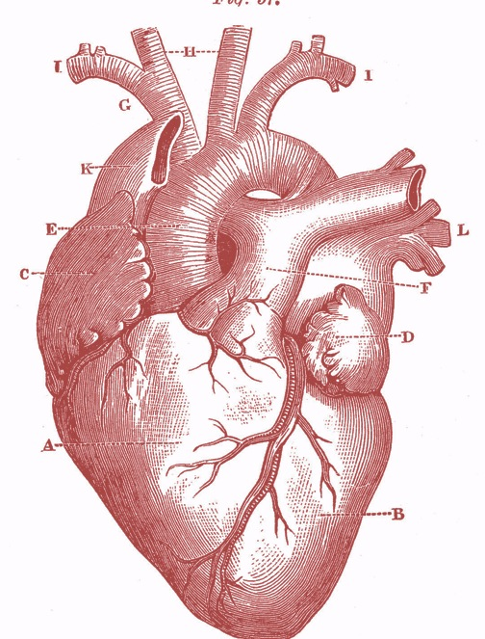
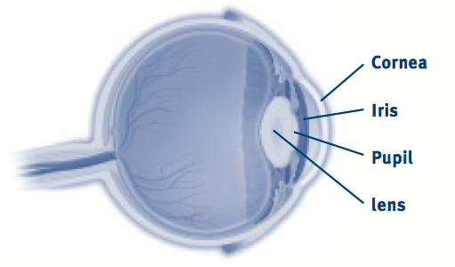
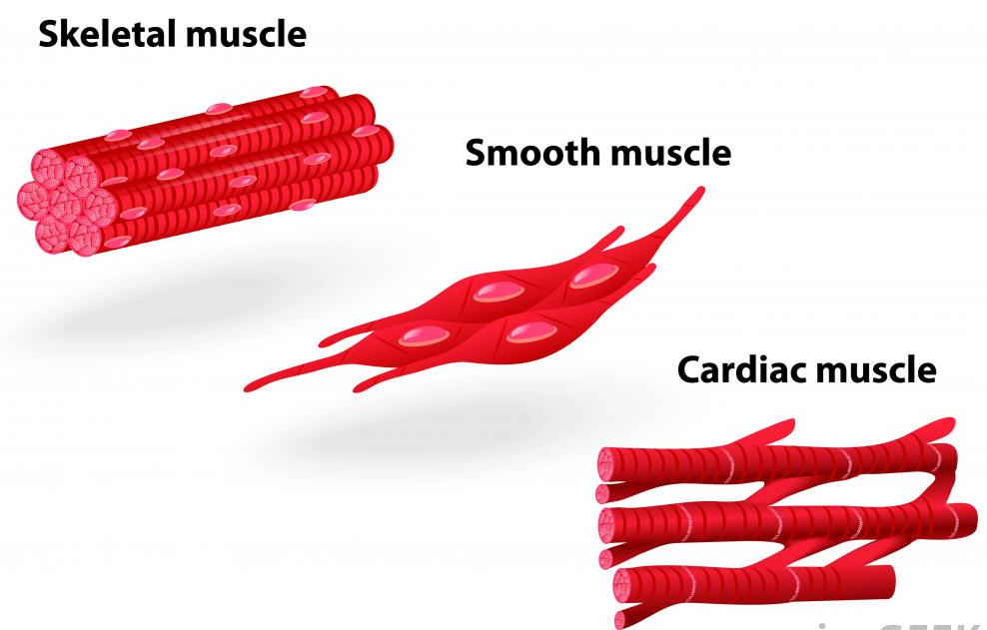
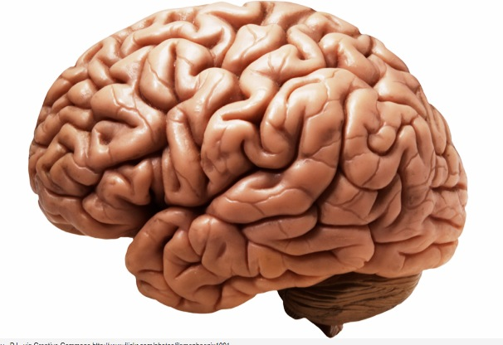
Na,K pump is essential for many physiological processes
Renal function, and regulation of hypertension .
Cardiac contraction
Regulation of intra ocular pressure, IOP.
And many more….
Expression of isoforms in different tissues.
All of the isoforms are expressed in a tissue and functional specific manner.
α1/β1
α1/β1
α3β1
α1β1
α2/β3
α3/β1
α2/β2
α1/β1
α2/β1
Notes:
Na,K-ATPase plays a crucial role in all mammalian cell physiology,
essential for regulation of hypertension , Cardiac contraction
Regulation of Iintraocular pressure,, production of aquoas humor
*All of the isoforms are expressed in a tissue and functional specific manner.
The most studied protein is the kidney a1b1 complex.It was isolated purified and most of the biochemical studied for many years were done on this protein.
The reason is that in most other tissues there is a mixture of isoforms and its very hard to study each of them separately.
Due to their distinct tissue-specific physiological roles, there is much interest in studying different isoform combinations,

Slide 5
Cardiac glycosides (CG)
The cardiac glycosides are an important class of naturally occurring
drugs whose actions include both beneficial and toxic effects on the heart.
Lactone ring
Steroid
Glycone

Slide 6
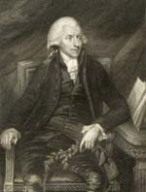
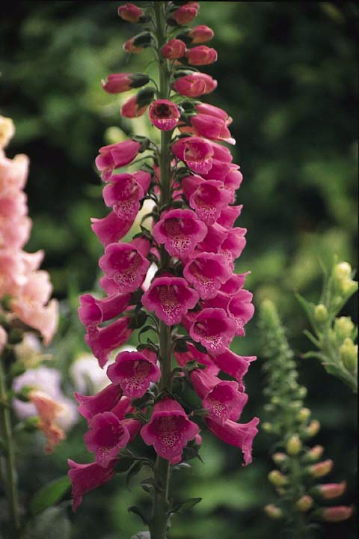
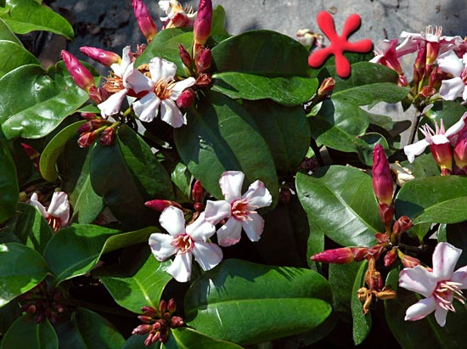
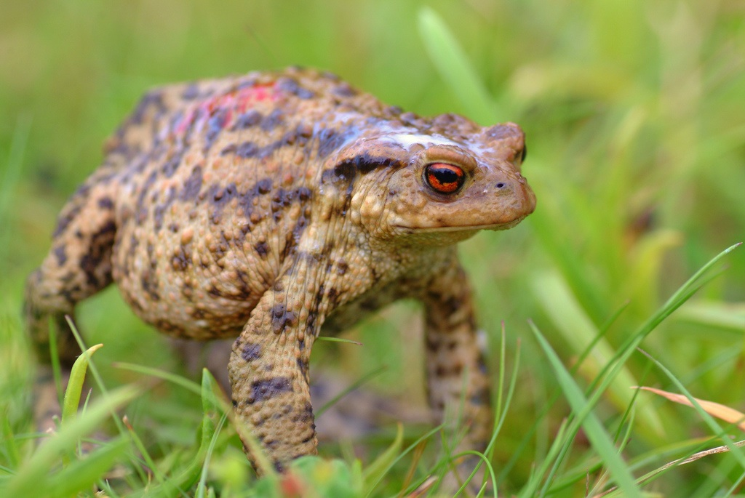
Cardiac glycosides, naturally occurring in plants and animals.
Digoxin
Withering W (1785).
“An account of the
foxglove and some
of its medical uses:
with practical remarks
on dropsy and other
diseases.”
Digitalis purpurea
Strophanthus gratus
Bufo bufo Bufalin
Ouabain
Notes:
A physician and botanist in, England, wrote a book describing how for ten years he had used an extract of foxglove to treat patients ,
Plants containing cardiac steroids have been used as poisons and heart drugs at least since 1500 B.C
Cardiac steroids are widely used in the modern treatment of congestive heart failure, yet their toxicity remains a serious problem.

Slide 7
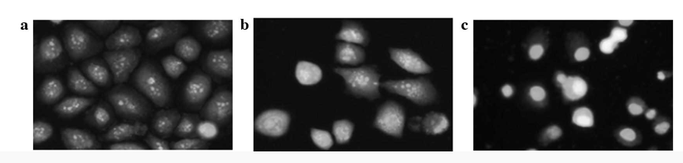
Cardiac glycosides have a long history of therapeutic application.
Plants containing cardiac steroids have been used as poisons and heart drugs
at least since 1500 B.C.
The early understanding of their positive inotropic effects facilitated their use as effective
drugs for the treatment of heart-related pathologies, yet their toxicity remains a serious problem.
More recently, considerable in vitro, in vivo and epidemiological data support novel roles
for CG’s such as inducing apoptosis and inhibit the growth of cancer cell lines.
Control
+10uM CG
+20uM CG
Liang‑Fei Ye,et al.2013 Oncology letters

Slide 8
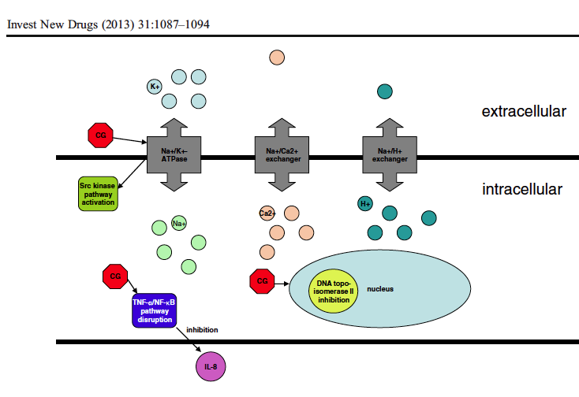
Proposed mode of action of cardiac glycosides, CG
Slingerland M. et al
Na⁺,K⁺
ATPase
Na⁺/Ca⁺²
exchang.
Na⁺/H⁺ exchang.
The decrease in intracellular K+ and increase in intracellular Na+ and Ca2+ following inhibition of the Na+/K+-ATPase may induce apoptosis
Notes:
CG induce apoptosis by :
decrease of K and increase in Na and Ca intracellulary
Intracellular acidification
Inhibition of IL-8 production and the TNF a/NF-kB pathway
Inhibition of DNA topoisomerase
Activation of src

Slide 9
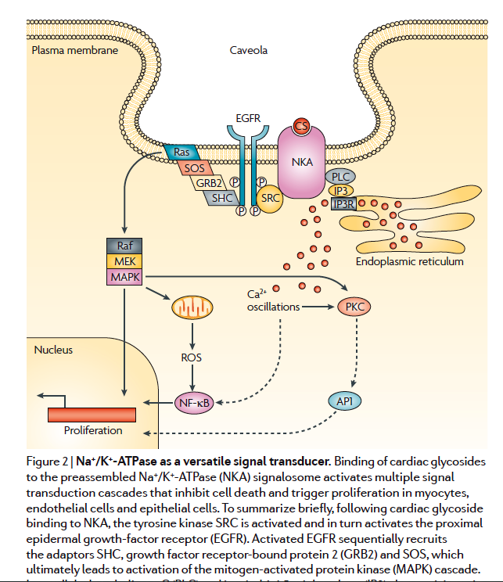
Na,K-ATPase as a versatile signal transducer ?
Na+/K+-ATPase may
also act as a signal transducer. When intact cells are exposed to digitalis drugs (e.g., ouabain and digoxin) specific inhibitors
of this enzyme various cell signaling pathways are activated leading to highly cell-specific down-stream consequences.
Notes:
Binding of CG to NaK activates mutlitple signal transduction cascades that inhibits cell death and triggers proliferation in different cells.

Slide 10
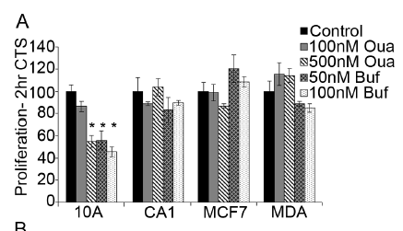
Proliferation of CG-treated cells.
Normal Cancer cells
Breast cancer cells are not more sensitive to CG’s cytotoxicity
than are normal cells.
Clifford RJ, and Kaplan JH 2013 PLOS ONE 8,

Slide 11
Purification and stabilization of isoforms of human
Na,K-ATPase expressed in Pichia pastoris

Slide 12
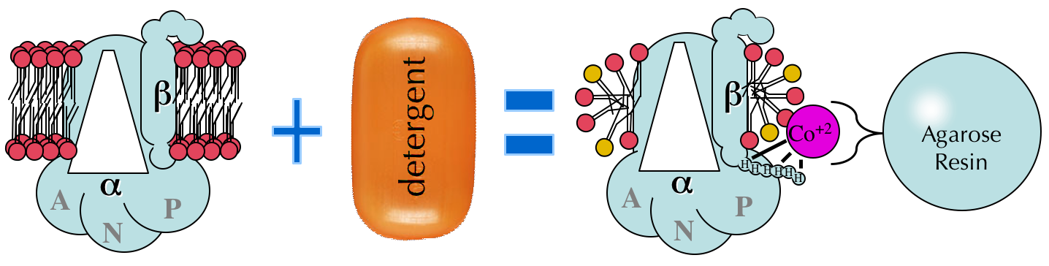
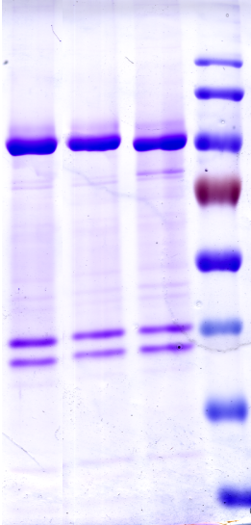
Isoforms of human Na,K-ATPase expressed in Pichia pastoris
Human α isomers/β1 purified enzymes
MW
α₃
α₂
α₁
FXYD1
α
Functional, stable, detergent-soluble αβFXYD complex
β
Detergent , C12E8
Phosphatidyl serine,SOPS
Phosphatidyl choline, PC
Cholesterol
Enables different combinations of isoforms
Notes:
We have a functional and stable protein in solution that contains of corse lipids detergent and cholesterol , this is to mimic the natural enviroment the membrane.
we have today about 10 different pure enzymes in solution with different combinations of isoforms that actually mimics the combinations in the native tissues.
*Here you can see the reconstituted isoforms about 80% purity alpha beta. Looks Very simple very neat and it tooks 17 years to develop , but this is along story.

Slide 13
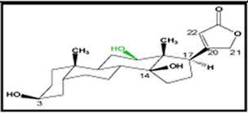
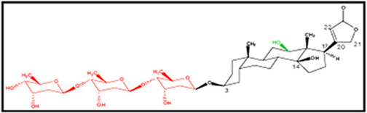
Cardiac glycoside affinity and selectivity for the α isoforms.
1.2
1
Digoxigenin
0.8
α1
α2
α3
0.6
0.4
0.2
0
0.001
0.01
0.1
1
10
Digoxigenin, μM
1.2
Bound ³H-Ouabain, fraction of control
Digoxin
1
0.8
0.6
0.4
0.2
0
0.001
0.01
0.1
1
Digoxin, μM
Isoform selectivity is determined by the sugar component!
Digoxin, is partially α2-selective CG, while Ouabain shows very low selectivity

Slide 14
Isoform selectivity of Cardiac glycosides
CG | Calculated Kd±SEM, nM |  |  | Ratio of Kd’s, ± SE
 | α1 | α2 | α3 | α1/α2 | α1/α3
Ouabain | 9.8±0.33 | 21.9±0.56 P=0.0001 | 11.1±1.3 | 0.44±0.01 | 0.88±0.1
Digoxin | 87±6.0 | 25.6±2.8 P=0.001 | 25±2.4 P=0.001 | 3.39±0.43 | 3.48±0.41
Digoxigenin | 270±21 | 332±11 | 307±27 | 0.81±0.06 | 0.88±0.1
β-Methyl digoxin | 129±20 | 43±7 P=0.018 | 31±4 P=0.009 | 3.0±0.67 | 4.16±0.84
Digitoxin | 38±3 | 18.3±4 P=0.02 | 14±3.9 P=0.008 | 2.07±0.48 | 2.70±0.78
Digitoxigenin | 101±13.4 | 125±13.6 | 134±15.6 | 0.8±0.13 | 0.75±0.13
Bufalin Marinobufagenin | 42.5±6.5 2240±137 | 45±8 2470±45 | 40±11 2430±205 | 0.94±0.22 0.91±0.06 | 1.06±0.33 0.92 ±0.1

Slide 15
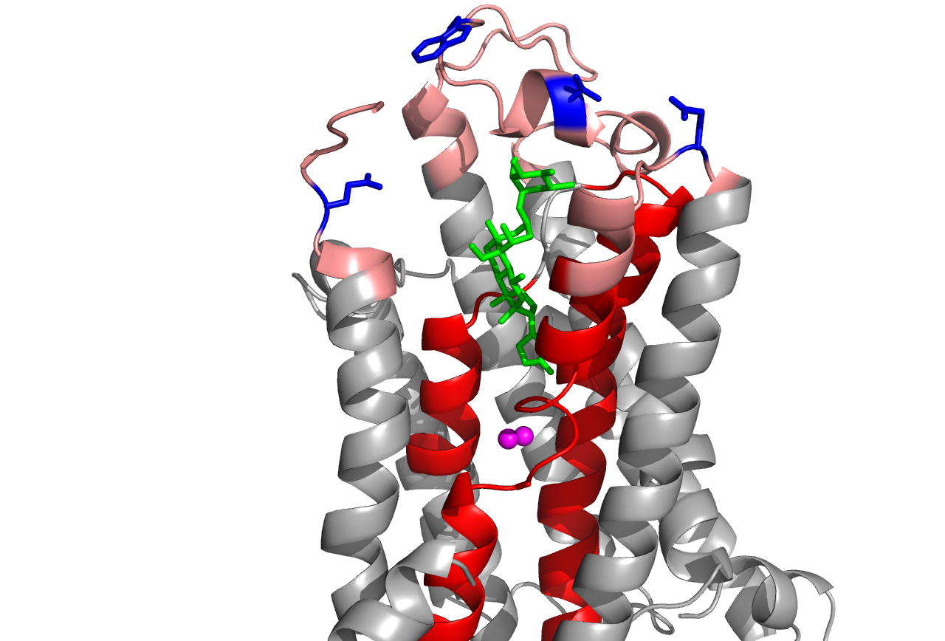
Na,K-ATPase structure with bound ouabain
Ouabain
The residues common to α2 and α3 and different in α1 are all located on the extracellular loops at the entrance to the Ouabain binding site, close to the sugar moiety.
Notes:
Moerover when modeling the structure with Digoxin which has 3 sugars it became clear that only 1 aa from a and 1 from b that are in close proximity to the third sugar

Slide 16
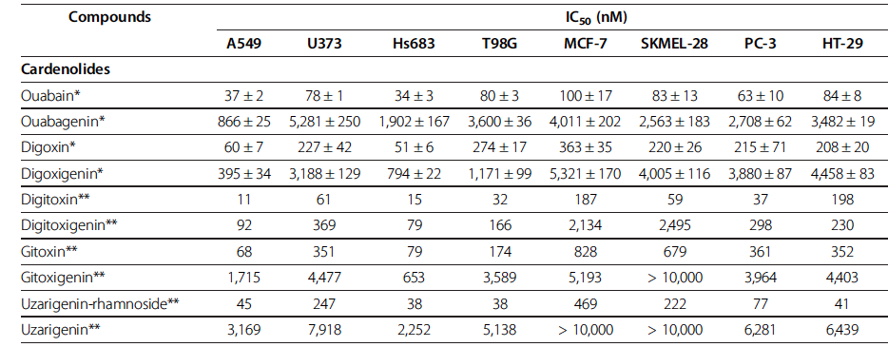
Inhibition of cancer cell proliferation at low concentrations is used to assess the therapeutic potential of drug candidates in preclinical studies.
In vitro growth inhibitory concentrations at 50% (IC50) in human cancer cells after
three days of culture in the presence of the drug of interest
Notes:
Effect of sugar – lowers the IC50

Slide 17
2.

Slide 18
3.

Slide 19
In vitro growth inhibitory concentrations at 50% (IC₅₀) in human cancer cells after two days of culture in presence of GBR, the most effective CG.
1.
TK-10
HCT-116
MCF-7
LLC-PK
Cell lines: LLC-PK pig kidney, MCF-7 breast cancer , HCT-116 colon cancer, TK-10 renal cancer.

Slide 20
Correlation of Ki for inhibition of human α1β1 by cardiac glycosides and the growth inhibition effects
GBR
Oleandrin
Hellebrin
Digoxin
Hellebrig.
Ouabain

Slide 21
Correlation of Ki for inhibition of human α1β1 by cardiac glycosides and the growth inhibition effects
1. Digoxin
2.Hellebrin
3.Ouabain
4.Oleandrin
5.Hellebrigenin
6. Gamabuf. Rhamnoside
1
2
3
5
4
6
4 repetitions with 14 different cancer cells.
Cell growth is linearly correleted to the affinity of individual CG
to the Na,K-ATPaes

Slide 22
Viability is linearly correlated with number of active pumps in partially silenced H1299 cells
α1-GFP
Si-α1-8
Viability at 30 nM Ouabain (% of NT)
Si-α1-5
Si-α1-3
Relative binding capacity (%of α1-GFP)

Slide 23
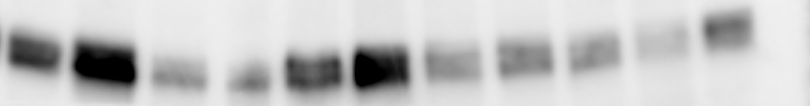

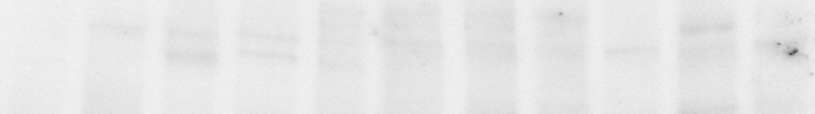

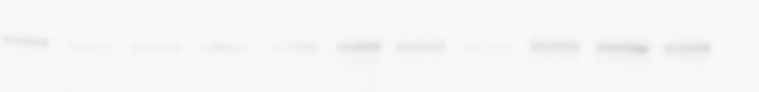

Viability is linearly correlated with number of active pumps in a
panel of cells
h1299
llcpk1
lncap
hff
mda-mb-231
a549
skmel5
hela
panc1
A
mcf7
hek
ovcar3
50 ng Pur. Pr.
α1 α2 α3
anti α1
anti α2
anti α3
B
C
mdamb231
lncap
mdamb231
llcpk1
lncap
a549
mcf7
mcf7
llcpk1
hela
hela
a549
skmel5
skmel5
panc1
panc1
hek
hek
Viability (%of NT)
ovcar3
Viability (%of NT)
ovcar3
h1299
hff
h1299
hff
Total α1 (a.u.)
Bmax (pmol oub*mg protein⁻¹)

Slide 24
Viability is linearly correlated with number of active pumps– CG affect cancer cell viability
only through binding and inhibition of NaK ATPase transport
Although cardiac glycosides can inhibit the proliferation of cancer cells at very low concentrations (nM), they inhibit the proliferation of human nonmalignant
cells at similar concentrations; this strongly suggests that their potential for cancer therapy is low.
More experimental data are needed to further decipher the structure-activity relationship between CG’s and cancer cell cytotosicity.

Slide 25
Acknowledgments
Steven Karlish
Marina Cherniavsky-Lev
Elena Ainbinder
Daniel Tal
Yotam Nadav
Michael Habeck
Thank you for your attention.

