Slide 1
Testosterone Replacement Therapy & Monitoring in HIV Infected Men
Adam B. Murphy, MD, MBA, MSCI
October 29, 2014

Slide 2
Acknowledgement
Ramona Bhatia MD (HIV Research Fellow, First Author)
Chad Achenbach MD (HIV Researcher, senior author)
James L. Raper, Gabriel Chamie, Mari M. Kitahata, Daniel R. Drozd, Kenneth Mayer, Sonia Napravnik, Richard Moore
the Centers for AIDS Research (CFAR) Network of Integrated Clinical Systems (CNICS)

Slide 3
Support
Creative and Novel Ideas in HIV Research (CNIHR) Award from the US National Institutes of Health (NIH) Office of AIDS Research
NIH-funded Centers for AIDS Research[grant number 60032569 ];
the National Institute of Allergy and Infectious Diseases at the NIH[grant numbers R24 AI067039 and P30 AI027757 and P30 AI50410], with a supplement from the National Cancer Institute; and the National Center for Advancing Translational Sciences at the NIH[grant number KL2 TR000421].

Slide 4
Background
Global testosterone sales have increased 12-fold over the last decade
US is the 2nd leading consumer worldwide[1].
Androgen use tripled from 2001-2011 in the US, with 2.9% of men over 40 years of age on testosterone replacement therapy (TRT)[2].
Establishing biochemical testosterone deficiency is recommended before TRT initiation[3], yet up to 83% of men on TRT lack pre-treatment testosterone measurements[4].

Slide 5
Background 2
TRT may increase the risk of cardiovascular events[7, 8], including myocardial infarction[9, 10], stroke[10], thrombosis[11], and death[10].
HIV is associated with testosterone deficiency[12] in 20-70% of men, despite successful antiretroviral therapy (ART)[3,13]
HIV associated hypogonadism is expected to increase as this population ages[14]

Slide 6
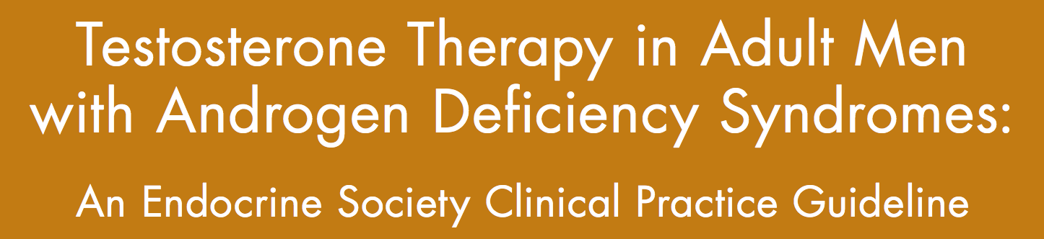
Diagnosis in men with signs & symptoms & unequivocally low serum Testosterone level
Notes:
Only go looking/case finding for Testosterone Deficiency in men with HIV associated weight loss or sellar mass or radiation, glucocorticoid or opioid use, ESRD and maintenance dialysis, COPD< Infertility, Osteoporosis or low trauma fracture, Type 2 Diabetes Mellitus. Benefits are not clear in that population due to the lack of studies.

Slide 7
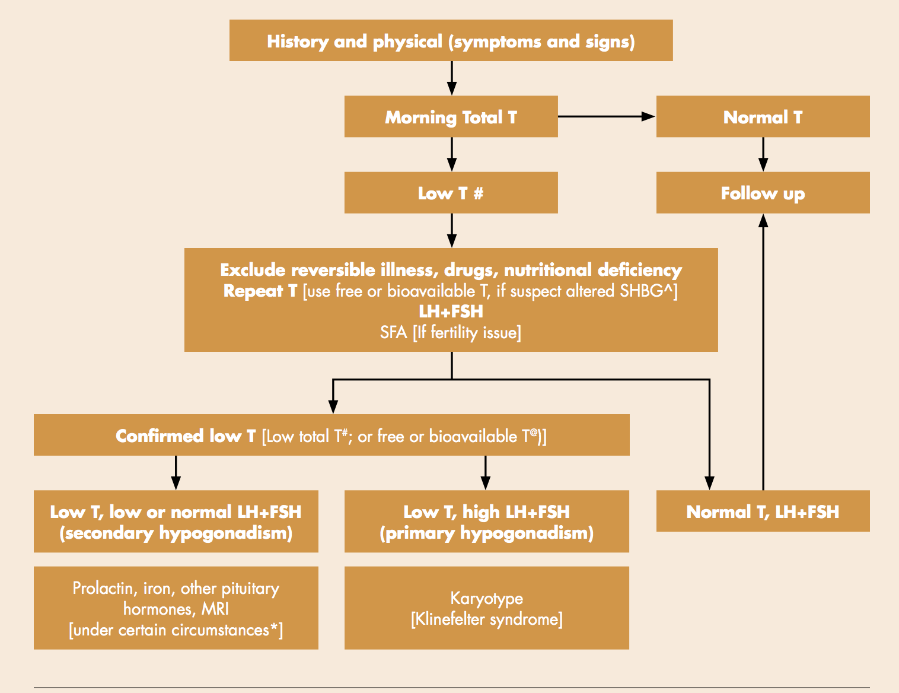
Diagnostic evaluation of TD
Notes:
In some labs, range lower limit is 280-300ng/dl but this range may vary in other labs. Use your reference lab levels.
Free testosterone lower levels range from < 5-9ng/dl using equilibrium dialysis or calculated from total testosterone and SHBG, however this may vary between labs based on the method uses, the reference population used. Use your labs reference levels.
Perform MRI to exclude pituitary and/or hypothalamic tumor or infiltrative disease: If T < 150ng/dl, pan hypopituitarism, persistent hyperprolactinemia or symptoms or signs of tumor mass effect such as headache, visual impairment, or visual field defect is present.

Slide 8
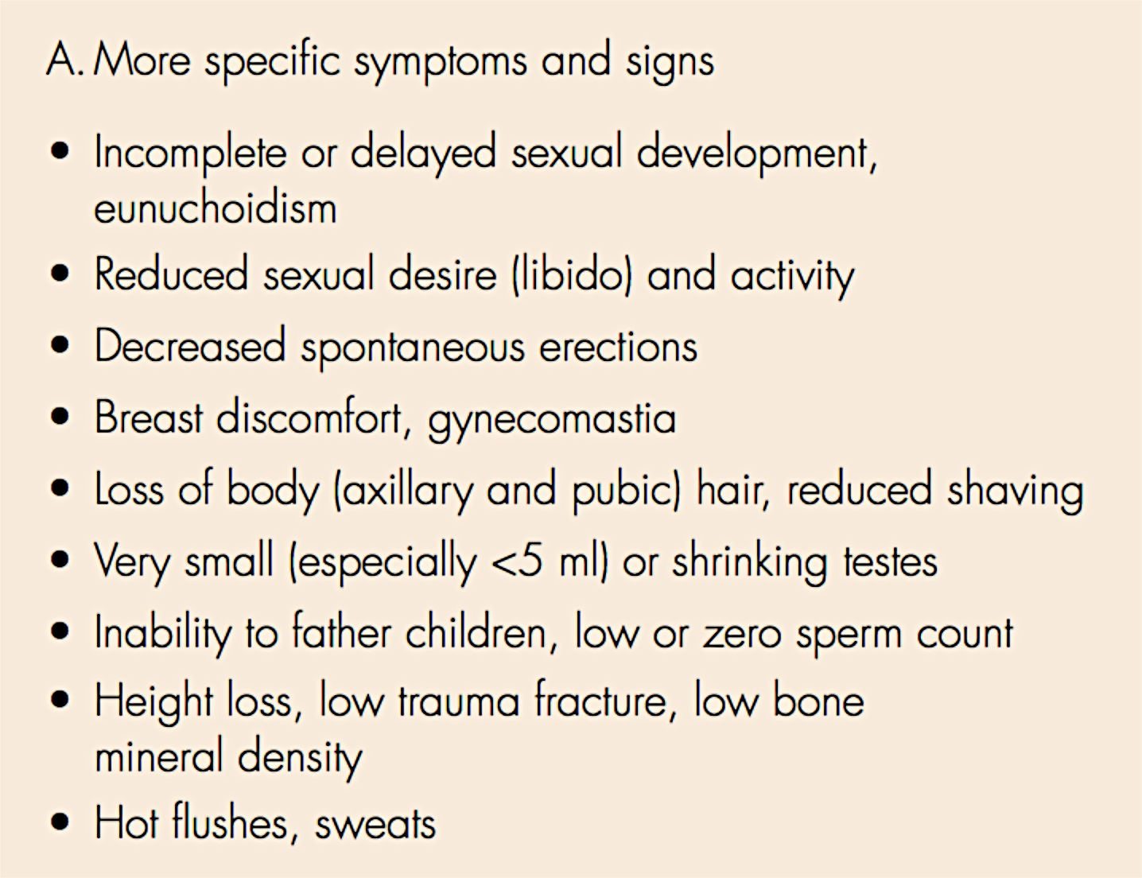
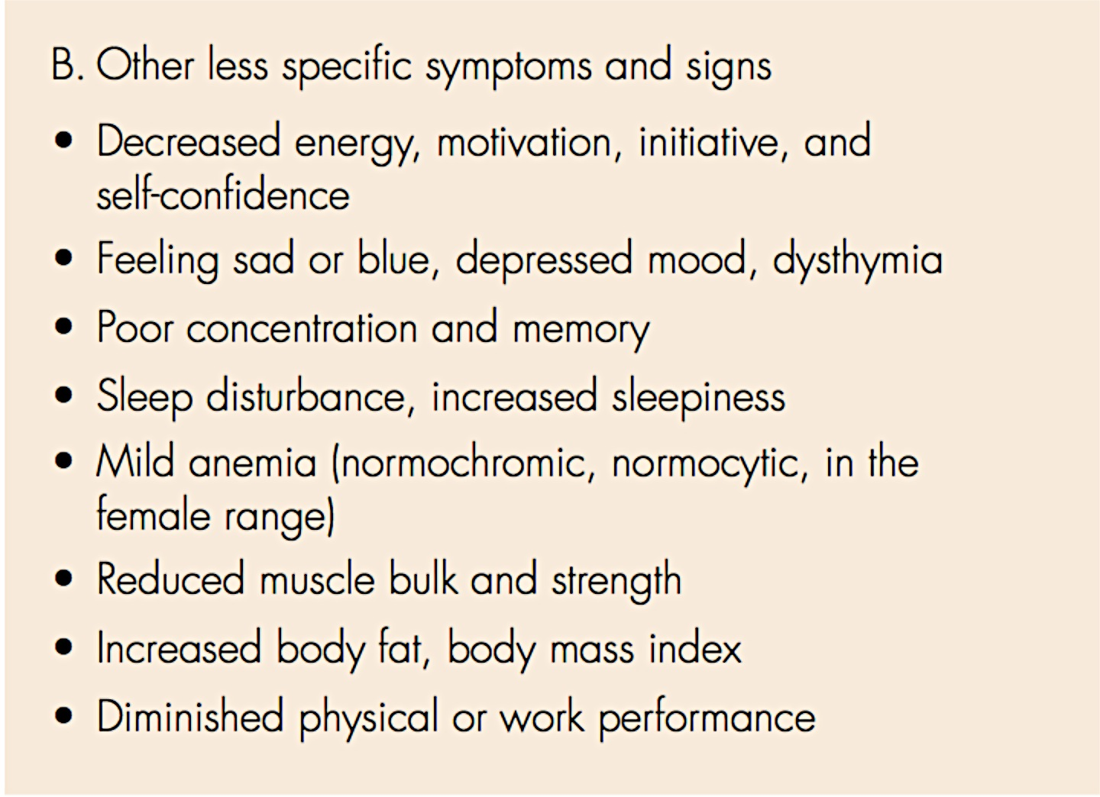
Signs & Symptoms

Slide 9
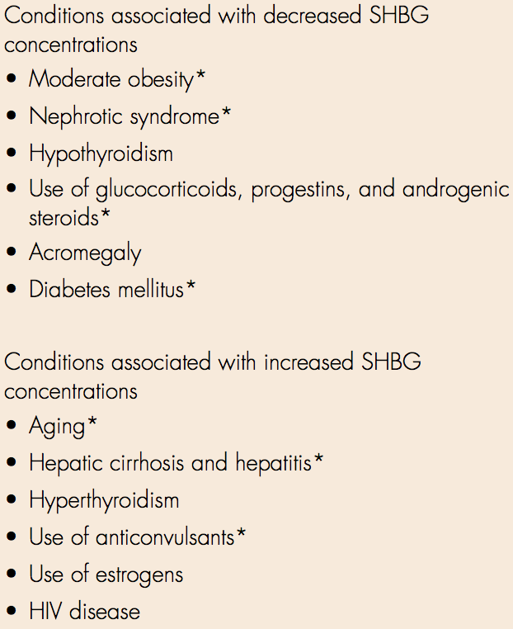
Confirmation
Confirm the diagnosis by repeating measurement of morning total testosterone.
Can add free or bioavailable testosterone in men with low normal levels or where SHBG abnormality is suspected.
Notes:
Free testosterone includes the unbound testosterone only.
Bioavailable testosterone includes free plus weakly bound to albumin

Slide 10
If testosterone deficient…
Primary vs. Secondary
If deficient check LH and FSH
If high→ Primary TD
  Check: Karyotype
If low to normal → Secondary TD
  Prolactin, Iron Saturation, pituitary function tests and MRI sella turcica to evaluate for secondary hypogonadism
Refer to Endocrinology if abnormal otherwise treat

Slide 11
Primary Testicular Failure
Testicular exam < 6ml
Karyotype for Klinefelter syndrome
DXA (BMD)

Slide 12
Do not start in men with…
Breast or Prostate cancer
Abnormal rectal exam or PSA
Hematocrit > 50%
Severe sleep apnea (untreated)
Severe LUTS (>19 IPSS)
Poorly controlled heart failure
AAs & men with Fam History and PSA >3ng/ml should be referred to urologists first

Slide 13
Treatment
Aim for mid-normal range 400-700ng/ml
high & low levels predispose to side effects, residual symptoms, likely PCa and cardiovascular disease
Need to be monitored (varies by treatment type)
PSA at baseline and at 3-6 months, then per guidelines

Slide 14
Prostate Cancer
Can give TRT if clinically localized prostate cancer post prostatectomy with stable PSA for 2 years.

Slide 15
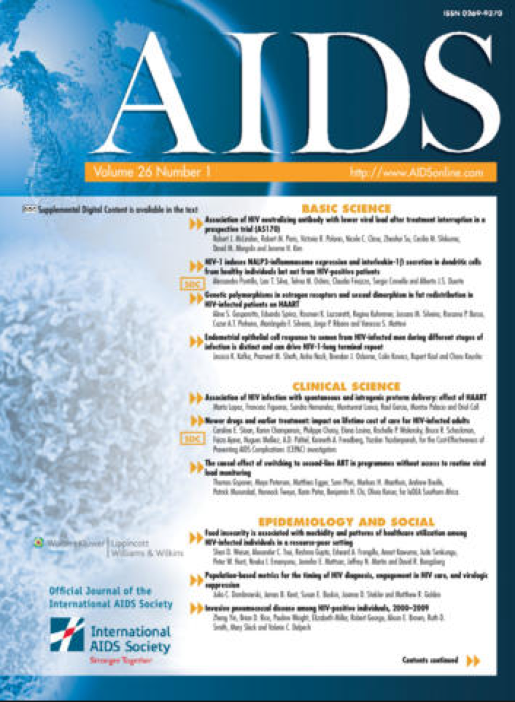
Testosterone replacement therapy among HIV-infected men in the CFAR Network of Integrated Clinical Systems (CNICS). AIDS. Accepted.
CONCISE COMMUNICATION
HIV
Testosterone
Hypogonadism
Men's Health
Patient Monitoring
Testosterone Replacement Therapy (TRT)
Authors declare no conflicts of interest

Slide 16
Objectives
The objectives of this study were to determine:
  the rate of testosterone replacement therapy (TRT) initiation
  TRT predictors
  patterns of monitoring in HIV-infected men.

Slide 17
Study Design
Multi-Site Cohort Study
HIV + Men age > 18 followed in 1 of 7 CNICS sites from 1996-2011.
Serum testosterone levels, sociodemographic, lab, clinical and medication data, BMI, smoking, alcohol use, and race/ethnicity.
Excluded men already taking TRT or within 30 days of cohort entry or unknown initiation date
Medication, chart abstraction, EMRs and pharmacy data for initiation dates.
Notes:
The 8th CNICS site did not have data on TRT available

Slide 18
Study Design 2
TD = total testosterone < 300ng/dl[3]
  free testosterone deficiency overlapped total testosterone
We calculated TRT initiation rate as number of TRT initiation events per person-years (py) of follow-up time from cohort entry to initial TRT date, loss to follow-up, or death.
TRT initiation predictors with univariable and multivariable Cox regression.

Slide 19
Results: Testosterone Supplementation
14,454 men without evidence of TRT prior to CNICS entry with 75,173 py of follow-up time.
TRT was initiated in 1,482 (10%) men at a median age of 44 (IQR 38-51) years.
The median time between cohort enrollment and TRT initiation was 868 days (IQR 280-1,907).
Of the 1584 incident medications, 624 (39%) were intramuscular, 503 (32%) were transdermal, 1 (0.1%) was oral, and 456 (29%) were unspecified.

Slide 20
Results: TRT initiation
We calculated a TRT initiation rate of 19.7/1,000 py (95% CI 18.7-20.7).
Higher rates of TRT initiation were associated with:
  age≥35y, White race, MSM (HIV risk factor), diagnosis of AIDS wasting, protease inhibitor (PI)-based ART, nadir CD4+ T-lymphocyte cell count (CD4)≤200 cells/mm³, non-smoking, and absence of alcohol abuse.

Slide 21
Multivariate Predictors
Age < 34 (HR 1.00)
  Age 35- 50 (HR 1.58, CI 1.37-1.83)
  Age > 50 (HR 1.82, CI 1.48-2.24)
White Race (HR 1.72, CI 1.51-1.96)
AIDS Wasting (HR 2.07, CI 1.64-2.60)
Nadir CD4 < 200 cells/mm³ (HR 1.23, CI 1.02-1.49)
PI based ART (HR 1.44, CI 1.23-1.68)
Hep C (HR 1.2, CI 1.04-1.38)
Not associated: MSM, Hep B, HIV viral load, BMI*, smoking or alcohol use
Notes:
BMI* = Moderate Obesity is associated but we may have coded improperly.

Slide 22
Assessment of Serum Testosterone
992 (67%) of the 1,482 men initiating TRT had pre-TRT serum total testosterone level measured
  Median pre-treatment level was 358 (IQR 248-499) ng/dl.
  Pre-TRT testosterone deficiency was found in 360 (24%).
Serum total Testosterone was measured at least once after TRT initiation in 898 (61%)
  Median maximum post-TRT level of 569 (IQR 370, 841) ng/dl.
  Median time to first post-TRT serum total testosterone measurement was 303 (IQR 104, 885) days.
  The first post-TRT serum total testosterone measurement occurred within six months of TRT initiation in 377 (25%) men.
Notes:
To change to nmol/l multiple the testosterone level by 0.035.

Slide 23
PSA monitoring
Over half (55%, 812/1,482) of those initiating TRT were above age 40. In this group, 273 (34%) and 97 (12%) had pre- and six month post-TRT prostate specific antigen (PSA) measurements, respectively.

Slide 24
We did not track
Hematocrit levels
Side Effect monitoring
Erectile Dysfunction
Bone Mineral Density

Slide 25
Conclusions
The rate of testosterone supplementation is higher than reported in the general population
Treatment Is often not accompanied by appropriate laboratory testing
Monitoring & follow up seem poor.
Limitations: under-reporting of testosterone use,
under-reporting of testosterone from outside labs, PSA controversies may effect clinical decisions

Slide 26
Next Steps
Explore rates of prostate cancer, advanced prostate cancer and treatment initiation rates for BPH/LUTS after TRT in HIV+ men.
Explore rates of non-fatal and fatal MI in CNICS cohort

Slide 27
References
Handelsman DJ. Global trends in testosterone prescribing, 2000-2011: expanding the spectrum of prescription drug misuse. Med J Aust 2013;199:548-551.
Baillargeon J, Urban RJ, Ottenbacher KJ, Pierson KS, Goodwin JS. Trends in androgen prescribing in the United States, 2001 to 2011. JAMA Intern Med 2013;173:1465-1466.
Bhasin S, Cunningham GR, Hayes FJ, Matsumoto AM, Snyder PJ, Swerdloff RS, et al. Testosterone therapy in men with androgen deficiency syndromes: an Endocrine Society clinical practice guideline. J Clin Endocrinol Metab 2010;95:2536-2559.
Katz A, Katz A, Burchill C. Androgen therapy: testing before prescribing and monitoring during therapy. Can Fam Physician 2007;53:1936-1942.
Layton JB, Li D, Meier CR, Sharpless J, Sturmer T, Jick SS, et al. Testosterone Lab Testing and Initiation in the United Kingdom and the United States, 2000-2011. J Cliin Endocrinol Metab 2014:jc20133570.
Wolfe SM. Increased heart attacks in men using testosterone: the UK importantly lags far behind the US in prescribing testosterone. BMJ 2014;348:g1789.
Xu L, Freeman G, Cowling BJ, Schooling CM. Testosterone therapy and cardiovascular events among men: a systematic review and meta-analysis of placebo-controlled randomized trials. BMC Med 2013;11:108.
Basaria S, Coviello AD, Travison TG, Storer TW, Farwell WR, Jette AM, et al. Adverse events associated with testosterone administration. N Engl J Med 2010;363:109-122.
Finkle WD, Greenland S, Ridgeway GK, Adams JL, Frasco MA, Cook MB, et al. Increased risk of non-fatal myocardial infarction following testosterone therapy prescription in men. PLoS One 2014;9:e85805.
Vigen R, O'Donnell CI, Baron AE, Grunwald GK, Maddox TM, Bradley SM, et al. Association of testosterone therapy with mortality, myocardial infarction, and stroke in men with low testosterone levels. JAMA 2013;310:1829-1836.
Glueck CJ, Wang P. Testosterone therapy, thrombosis, thrombophilia, cardiovascular events. Metabolism 2014;63:989-994.
Crum NF, Furtek KJ, Olson PE, Amling CL, Wallace MR. A review of hypogonadism and erectile dysfunction among HIV-infected men during the pre- and post-HAART eras: diagnosis, pathogenesis, and management. AIDS Patient Care STDS 2005;19:655-671.
Wunder DM, Bersinger NA, Fux CA, Mueller NJ, Hirschel B, Cavassini M, et al. Hypogonadism in HIV-1-infected men is common and does not resolve during antiretroviral therapy. Antivir Ther 2007;12:261-265.
Ashby J, Goldmeier D, Sadeghi-Nejad H. Hypogonadism in human immunodeficiency virus-positive men. Korean J Urol 2014;55:9-16.
Dobs AS, Few WL, 3rd, Blackman MR, Harman SM, Hoover DR, Graham NM. 1996. Serum hormones in men with human immunodeficiency virus-associated wasting. J Clin endocrinol Metab 81:4108-4112.
Arver S, Sinba-Hikim I, Beall G, Guerrero M, Shen R, Bhasin S 1999, Serum dihydrotestosterone and testosterone concentrations in human immunodeficiency virus-infected men with and without weight loss. J Androl 20:611-618.
https://www.endocrine.org/~/media/endosociety/Files/Publications/Clinical%20Practice%20Guidelines/FINAL-Androgens-in-Men-Standalone.pdf

