Slide 1
CAREFULL DIAGNOSIS & MANAGEMENT OF MONOCHORIONIC MONOAMNIOTIC TWINS
DR.ABINAYA VIJAYAN
Sree Balaji Medical College & Hospital
Chennai, INDIA

Slide 2
MOMO TWINS
Monochorionic monoamniotic twins are a subtype in monozygotic twin pregnancy

Slide 3
DEFINITION
Monoamniotic twins are identical twins that share the single chorionic sac, a single yolk sac and a single amniotic sac .
always identical
always monochorionic and are usually termed Monoamniotic-Monochorionic ("MoMo") twins.
They also share the placenta, but have two separate umbilical cords.

Slide 4
PATHOLOGY
-It results from a separation of a single ovum at 8-13 days following fertilisation (i.e. later than with an MCDA pregnancy).
By this time a trophoblast
has already formed,
yielding a single placenta.

Slide 5
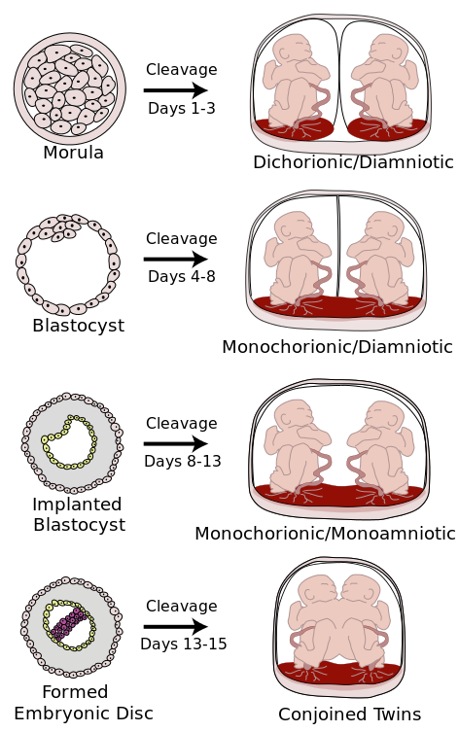

Slide 6
INCIDENCE
RARE
1 in 35,000 to 1 in 60,000 pregnancies

Slide 7
WHY INTENSIFIED MONITORING ???
associated with
Morbidity
and
Mortality.

Slide 8
CASE REPORT
Mrs.X, 30 yrs old, G2P1L1
-with previous Full term normal vaginal delivery,
-LCB- 9 years back
-Booked with our hospital from 2 months of amenorrhoea

Slide 9
Menstrual H/O:
RMP, 3/30 days cycle
Not associated with pain or clots
Marital H/O:
Married since 10 years
Non consanguinous marriage
Obstertric H/O:
1st pregnancy :
Conceived spontaneously
Boy/ FTNVD/ 9yrs/ Institutional/ Alive & Healthy
No H/O contraceptives

Slide 10
2nd pregnancy :
1ST TRIMESTER :
confirmed by UPT at 2 months of amenorhoea
Dating scan done
USG at 11 wks revealed – “MONOCHORIONIC MONOAMNIOTIC TWIN PREGNANCIES”
Tablet Folic acid taken
No H/O fever with rash/ irradiation exposure/ spotting or bleeding p/v.

Slide 11
2nd TRIMESTER :
Quickening at 18 weeks of gestation.
Anomaly scan at 20weeks – one fetus had SINGLE UMBILICAL ARTERY
- After 22 weeks SERIAL ULTRASOUND every 2 weeks was performed with regular Antenatal visits.
Every USG – Full assessment of fetal growth
- Amniotic fluid volume
- fetal doppler
-2 doses of Inj. TT were given.
No H/O abdominal pain/ discharge p/v/ pedal edema

Slide 12
3rd TRIMESTER:
Perceived fetal movements well
At 34 weeks – INJ.BETAMETHASONE 12mg IM 2 DOSES, 24 HOURS APART were given
Admitted at 34 weeks of gestation – “CLOSE MONITORING”
- DAILY NONSTRESS TEST WITH WEEKLY ULTRASOUND WITH DOPPLER
At 37 weeks she was taken up for EMERGENCY LSCS
- in view of PROM for >12 hours and non-progress of labour

Slide 13
Caesarean section was performed - I twin was delivered by vertex presentation and II twin by breech extraction.
She delivered two live female babies weighing 2.5kgs and 2.9kgs respectively with good APGAR score.
The first twin had single umbilical artery .
Placental examination showed a SINGLE PLACENTA WITH MONOCHORIONIC MONOAMNIOTIC MEMBRANE AND UMBILICAL CORD ENTANGLEMENT
Both infants showed good growth and development with nil complications at 6 months of age.

Slide 14
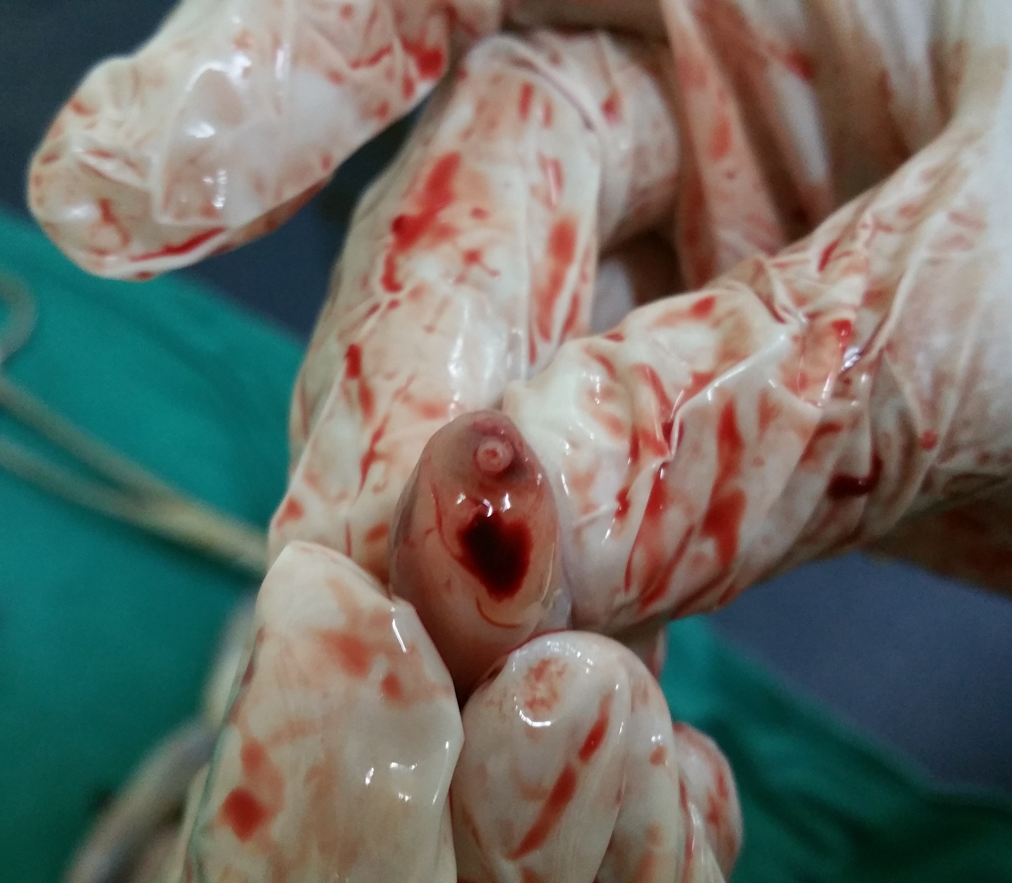
SINGLE UMBILICAL ARTERY

Slide 15
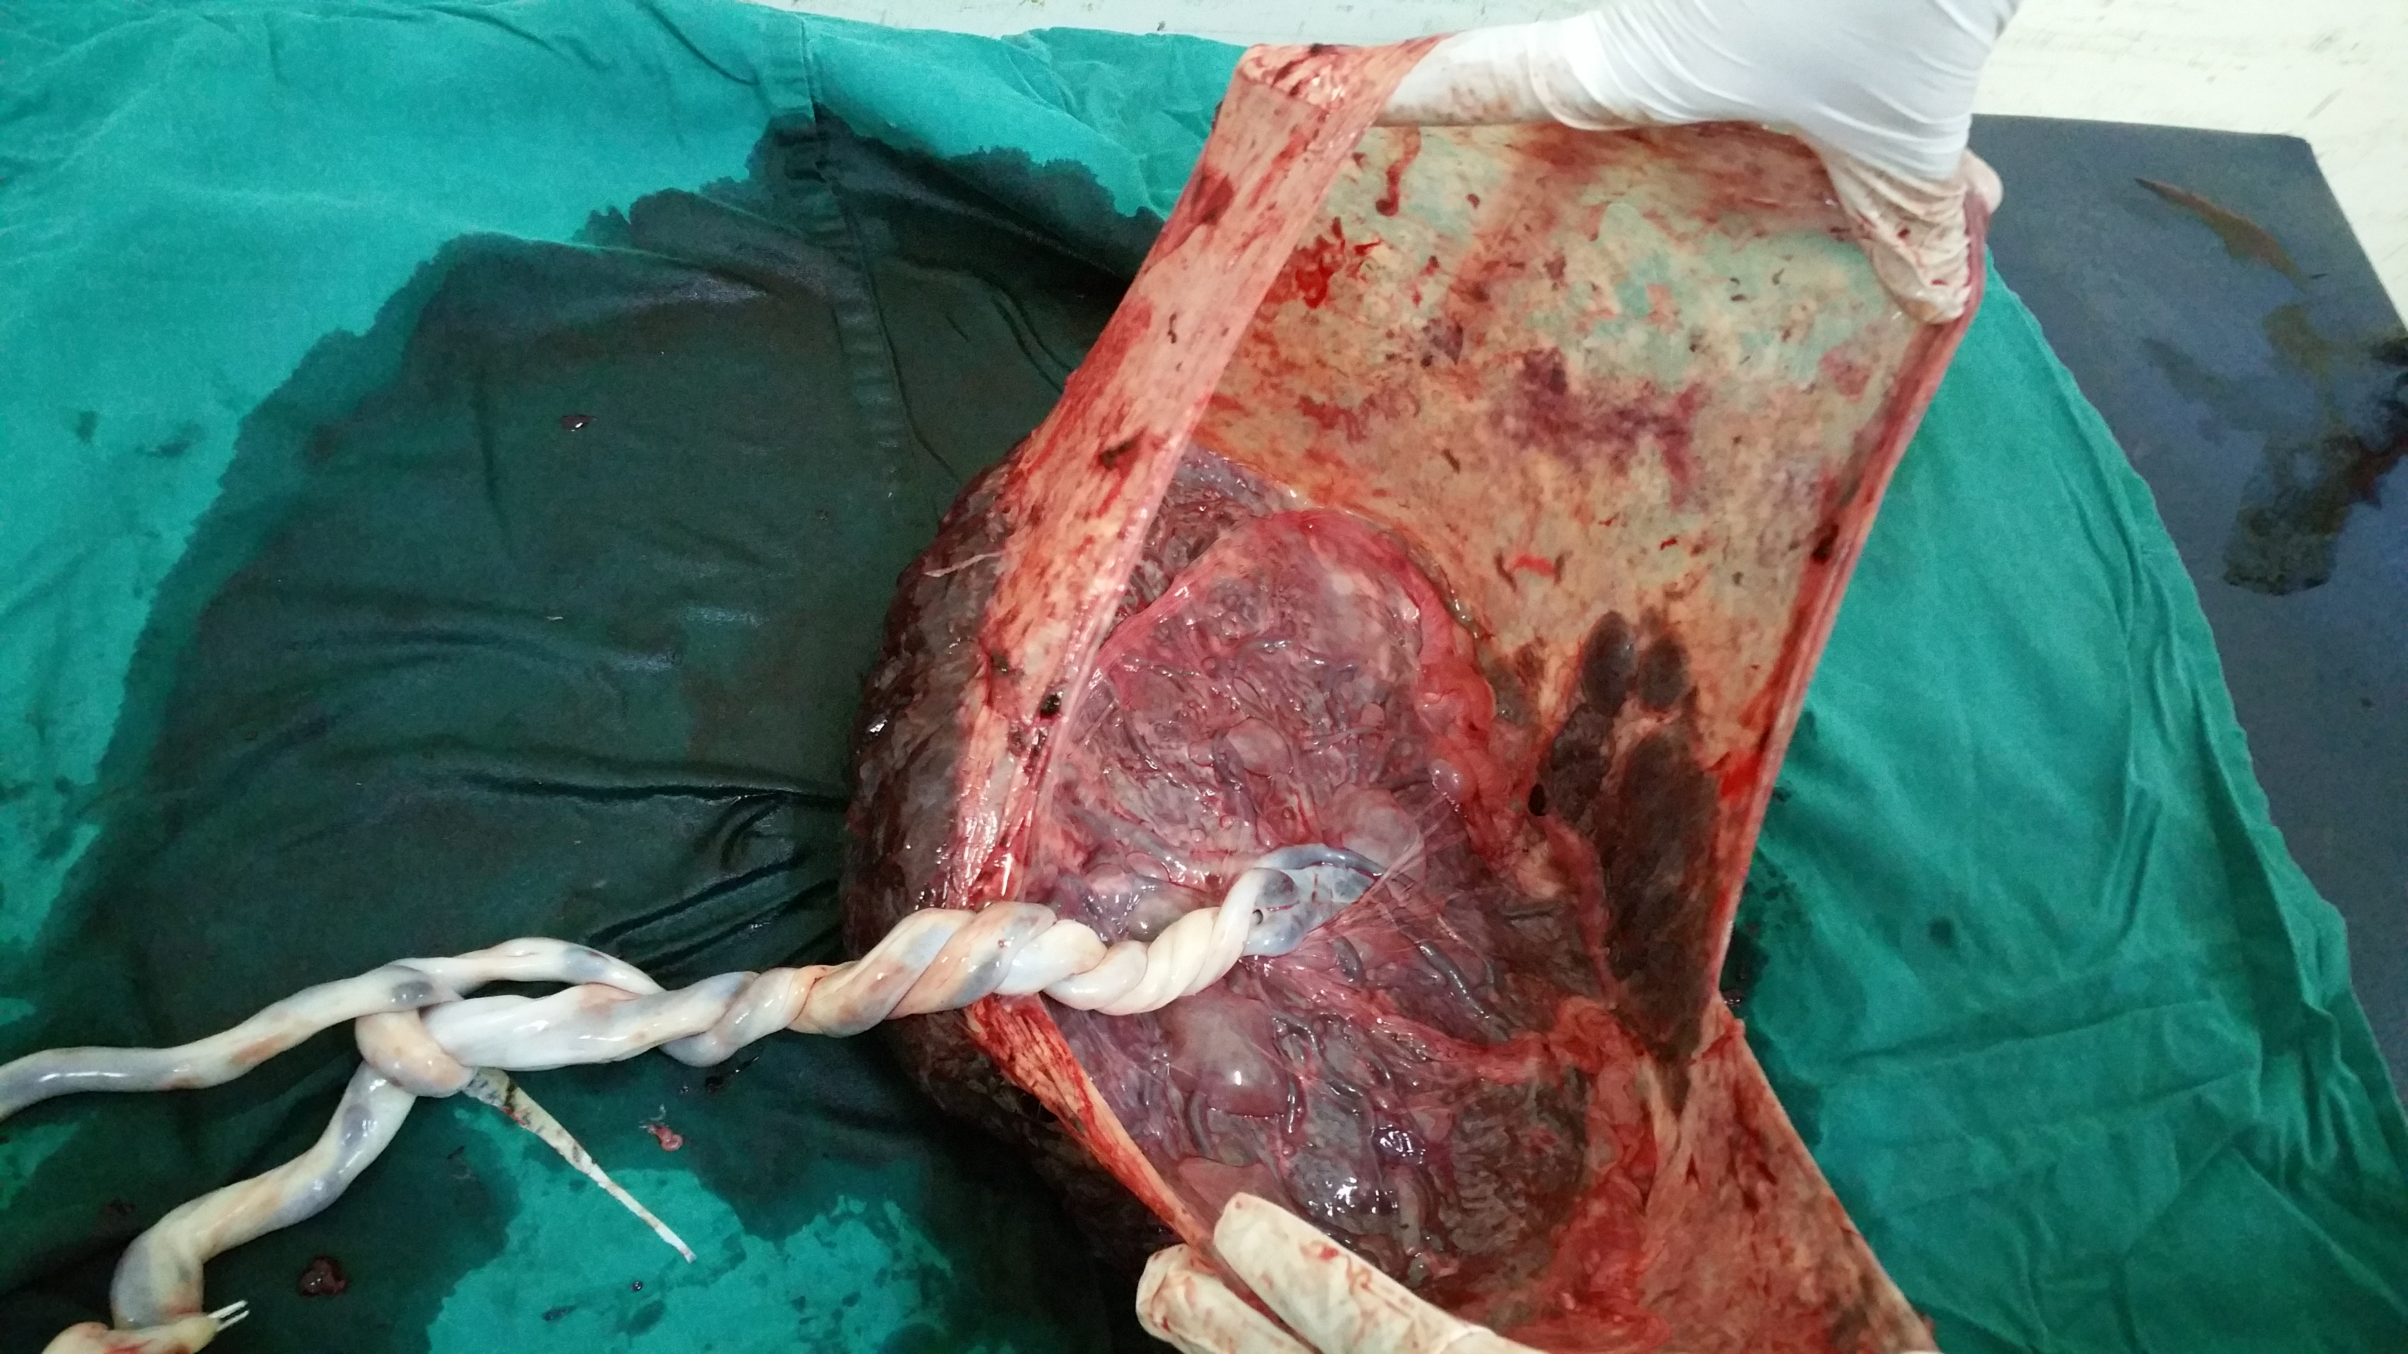
SINGLE PLACENTA WITH MOMO MEMBRANE & ENTANGLED CORD

Slide 16
COMPLICATIONS
CORD ENTANGLEMENT
ANOMALIES
TWIN TO TWIN TRANSFUSION SYNDROME
PREMATURITY

Slide 17
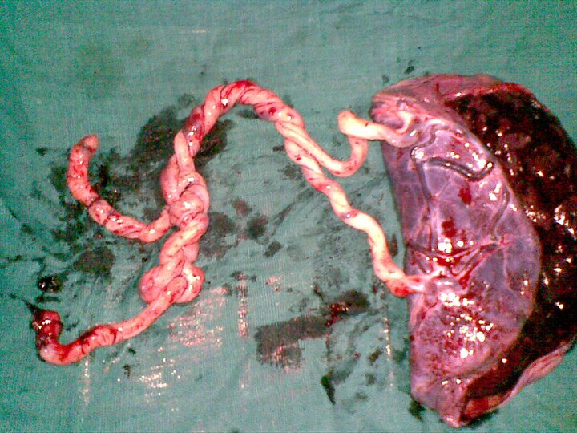

Slide 18
CORD ENTANGLEMENT
42% - 80% of cases
traditionally related to high perinatal mortality
CORD COMPRESSION is another life threatening condition preventing oxygenation and vital nutrients resulting in fetal demise

Slide 19
Cord entanglement is one of the main complications associated with monoamniotic twins.
Because the twins have NO AMNIOTIC MEMBRANE separating them, their umbilical cords can easily become entangled.

Slide 20
CORD COMPRESSION
Cord compression is another life threatening condition common in monoamniotic twins.
As the twins move around in the amniotic sac, it is possible that one will compress the other"s umbilical cord.
This can prevent vital nutrients and blood from traveling to the other baby. resulting in fetal death.

Slide 21
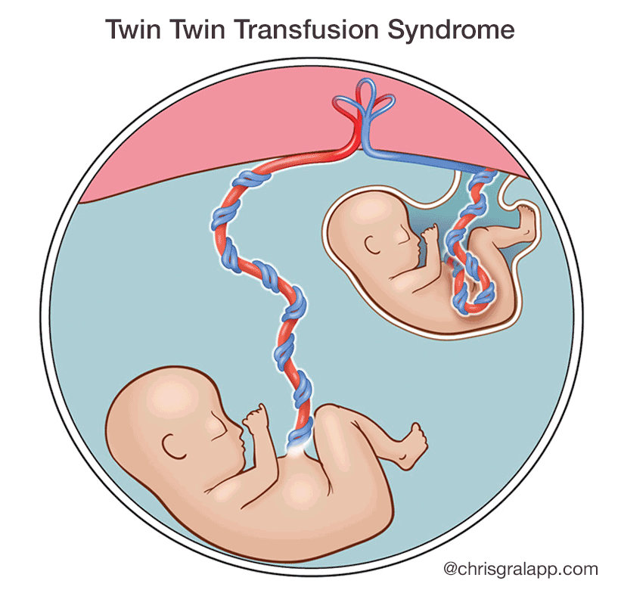

Slide 22
TWIN TO TWIN TRANSFUSION SYNDROME
-Because there is no barrier separating the two fetuses from each other, there are almost always blood vessel connections in the placenta shared by two fetuses in monochorionic twin (MC) pregnancies.
-10-15% of monochorionic twins
-In these instances, there may be significant transfer of blood from one twin (the so-called “donor”) to the other twin (the so-called “recipient”), resulting in twin-to-twin transfusion syndrome (TTTS).

Slide 23
TWIN TO TWIN TRANSFUSION SYNDROME
one twin becomes undernourished whereas the other develops hyperdynamic circulation and heart failure.
In severe TTTS presenting with acute polyhydramnios during the second trimester, endoscopic laser coagulation of the intercommunicating placental vessels is associated with survival of at least one baby in about 70% of the pregnancies
TTTS is not as common among MoMo as in MoDi pregnacies
The presence of polyhydramnios, discordant fetal growth, hydrops, congestive heart failure, tricuspid regurgitation and discordant bladder fillings make the prenatal diagnosis of TTTS possible.

Slide 24
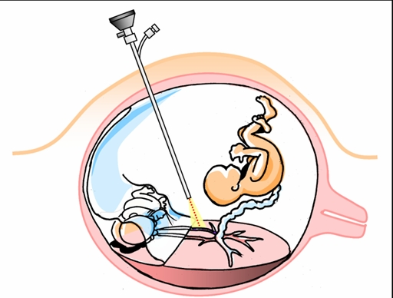
TREATMENT
-FETOSCPOIC LASER INTERVENTION
-AMNIOREDUCTION IN DI AMNIOTICS

Slide 25
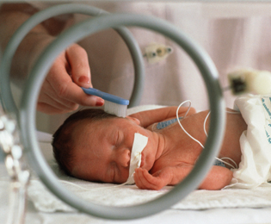
PREMATURITY
It is known that uncomplicated twin pregnancies have a higher incidence of premature birth than singletons and that MoMo twins are at an even greater risk of being born before 32 weeks of gestation.

Slide 26
Those born before 32 weeks of gestation
have a high incidence of
perinatal depression,
respiratory distress,
early and late onset sepsis,
patent ductus arteriosus,
necrotizing enterocolitis,
Intracranial hemorrhage,
prolonged hospitalization and
poor neurological outcomes.

Slide 27
DIAGNOSIS
MOMO twins has the highest perinatal mortality, about 50%.
Detection of monochorionic pregnancies at 10 to 14 weeks of gestation and monitoring by serial ultrasounds should lead to early diagnosis of TTTS

Slide 28
ULTRASOUND
Ist TRIMESTER
* shows a twin pregnancy with a single gestational sac and a single yolk sac (differentiating from a DCDA and MCDA pregnancy)
* there is no inter twin membrane: theoretically this differentiates from a DCDA and MCDA pregnancy
o however, even in a MCDA pregnancy the intertwin membrane may be difficult to see
o therefore non-visualisation of the intertwin membrane is not in itself diagnostic

Slide 29
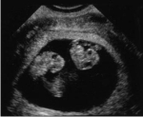
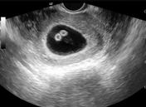
MOMO TWINS
MCDA TWINS

Slide 30
Second trimester
* specific to a MCMA pregnancy:
- there can be presence of cord entanglement
- there can be presence of cord fusion
- absent inter twin membrane: although may be difficult to see sometimes even with a MCDA pregnancy
* common to both MCMA and MCDA pregnancies
- a single placenta is seen
- absent twin peak sign

Slide 31
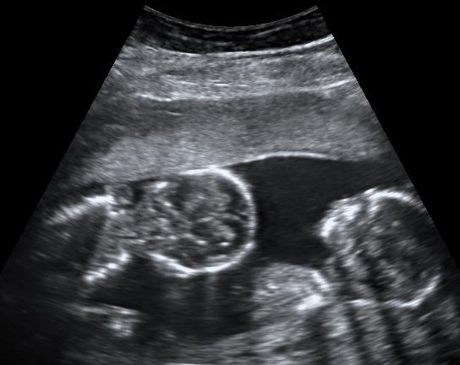
MOMO TWINS AT 16 WEEKS

Slide 32
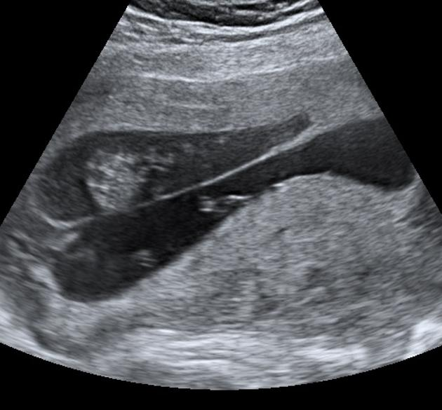
TWIN PEAK SIGN IN DCDA TWINS

Slide 33
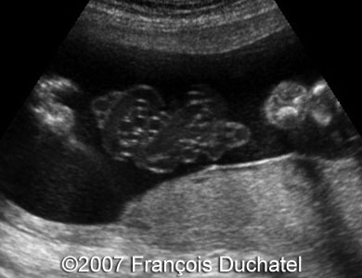
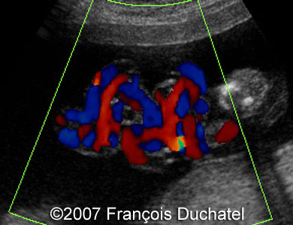
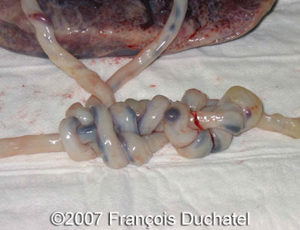

Slide 34
TREATMENT
-Unfortunately. there is no treatment that can reverse this pregnancy condition.
An experimental drug. SULINDAC - has been used to in some monoamniotic twins.
This drug lowers the amount of fluid in the amniotic sac thereby reducing the amount of fetal movement.
This is thought to lower the chances of cord entanglement or compression. However. this drug has not been studied in a large number of pregnancies and its potential side effects are unknown.

Slide 35
The best treatment for monoamniotic twins is to have regular and aggressive fetal monitoring.
twice-weekly monitoring of fetal heart rate and movement. particularly after the 26th week.
Aggressive monitoring can help to lower the risk of fetal death considerably.

Slide 37
CONCLUSION
Women with monochorionic monoamniotic twins should be counseled immediately after the diagnosis of MoMo twins regarding the complications and perinatal mortality.

Slide 38
With a multidisciplinary approach a good outcome can be achieved.
These antenatal women should be subjected to intensified monitoring as well early admission in the hospital for close monitoring; taking care and caution to prevent perinatal mortality, thus, progressing to deliver at term.

Slide 39
REVIEW OF LITERATURE

Slide 40
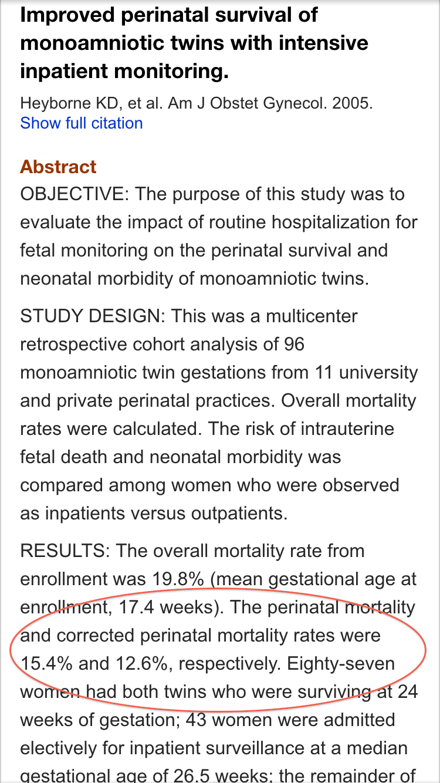
IMPROVED PERINATAL SURVIVAL WITH INPATIENT MONITORING

Slide 41
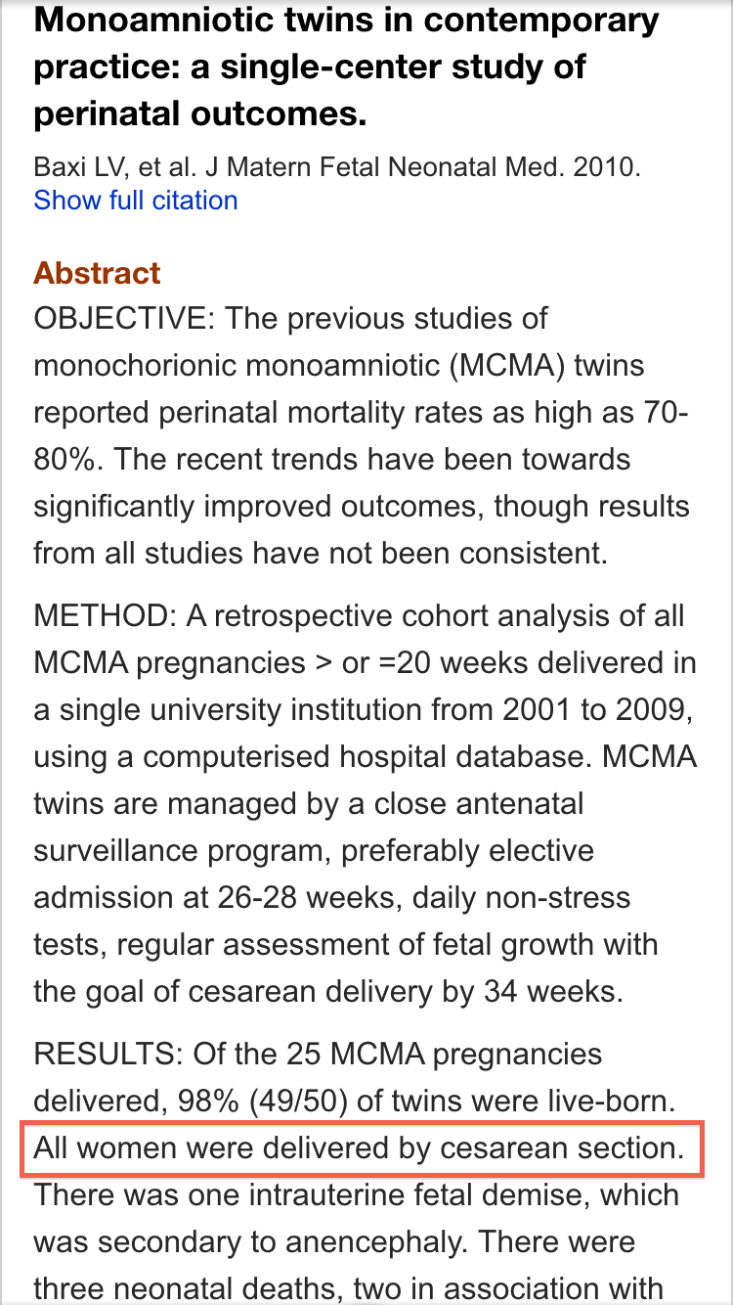
ALL WOMEN WERE DELIVERED BY CAESAREAN SECTION

Slide 42
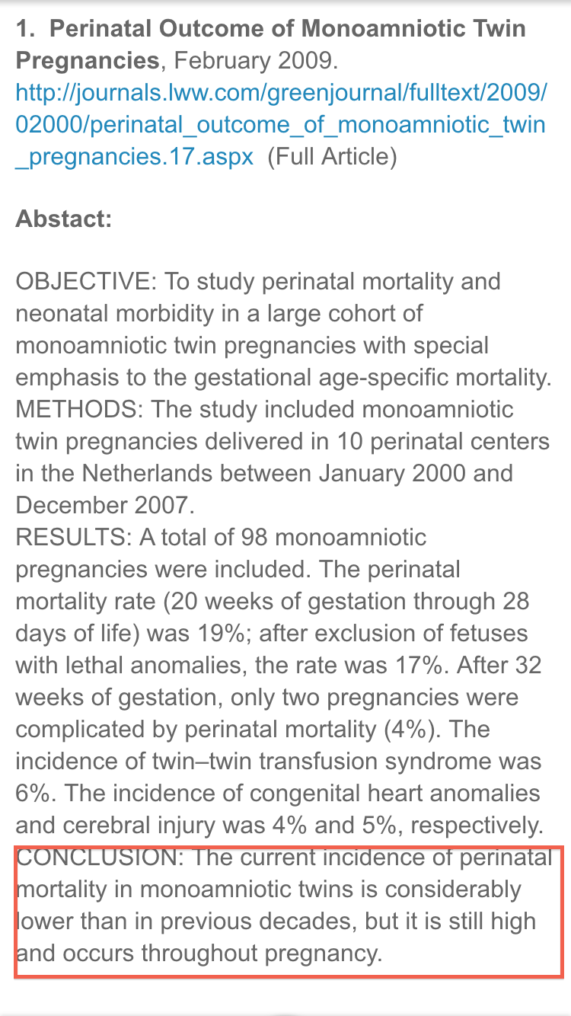
INCIDENCE OF PERINATAL MORTALITY HAS DECREASED

Slide 43
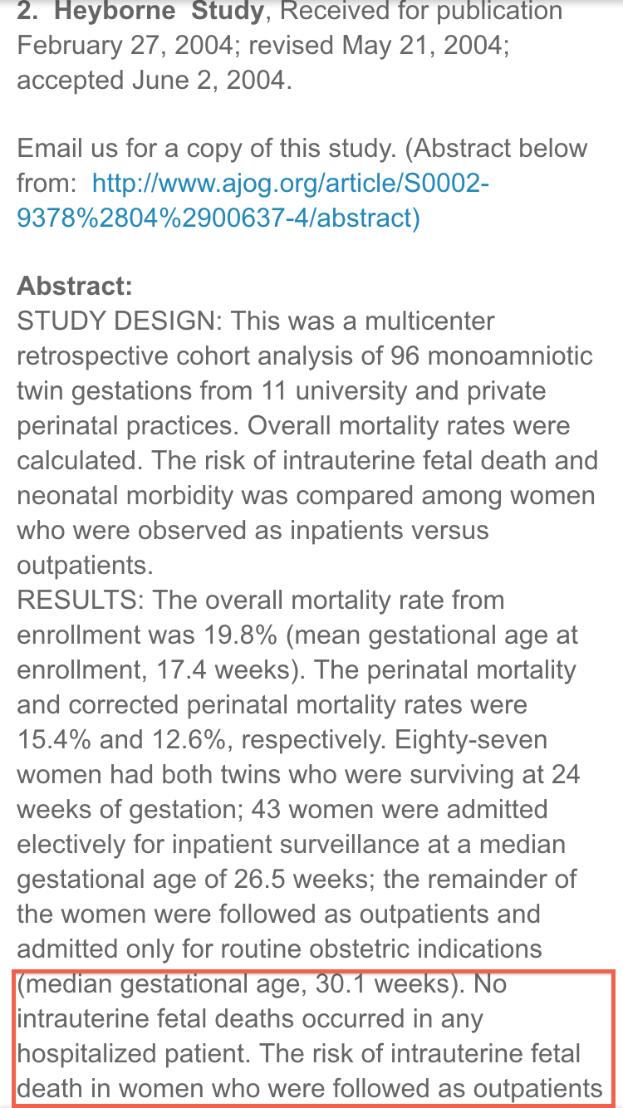
NO IUD IN ANY HOSPITALISED PATIENT

Slide 44
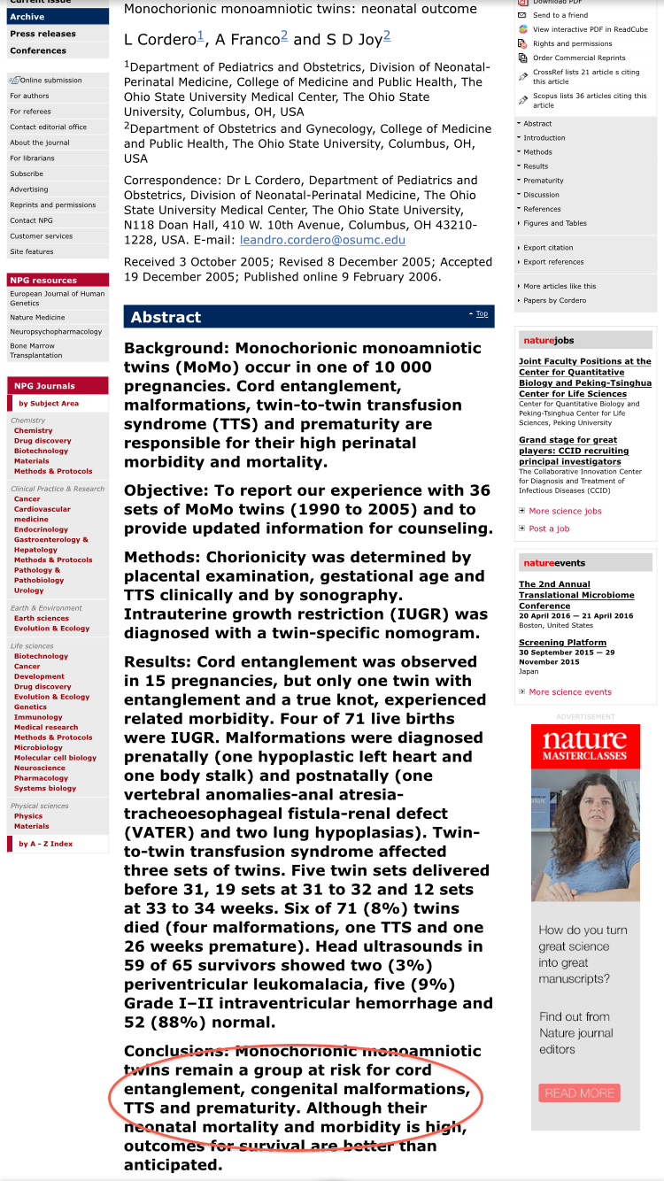
RISK FOR CORD ENTANGLEMENT, CONGENITAL MALFORMATION, TTS & PREMATURITY

Slide 45
REFERENCES
1.Benirschke K. The biology of the twinning process: how placentation influences outcome. Semin Perinatol 1995; 19: 342–350.
2.Carr SR, Aronson MP, Coustan DR. Survival rates of monoamniotic twins do not decrease after 30 weeks’ gestation. Am J Obstet Gynecol 1990; 163: 719 – 722.
3.Bilardo CM, Arabin B. Monoamniotic twins. In: Blickstein I, Keith LG (eds) Multiple Pregnancy. Taylor & Francis: London and New York, 2005, pp 574 – 582.
4. Rodis JF, McIlveen PF, Eagen JF, Borgida AF, Turner GW, Campbell WA. Monoamniotic twins: improved perinatal survival with accurate prenatal diagnosis and antenatal fetal surveillance. Am J Obstet Gynecol 1997; 177: 1046 – 1049.

Slide 46
5. Allen VM, Windrim R, Barrett J, Ohlsson A. Management of monoamniotic twin pregnancies: a case series and systematic review of the literature. Br J Obstet Gynecol 2001; 108: 931–936
6.Yosef Ezra, David Shveiky, Ella OphirMicael Nadjari etal. Intensive management and early delivery reduce antenatal mortality in monoamniotic twin pregnancies. Acta Obstet Gynecol Scand 2005:84; 432-435.
7.Obstetrics & Gynaecology: February 2009 – Volume 113 – issue 2, Part1 – pp 353-360 Perinatal Outcome of Monoamniotic twin pregnancies.
8.Roque H, Gillen-Goldstein J, Funai E, Young BK, Lockwood CJ. Perinatal outcomes in monoamniotic gestations. J Matern-Fetal Neonat Med 2003; 13: 414–421.

