Slide 1
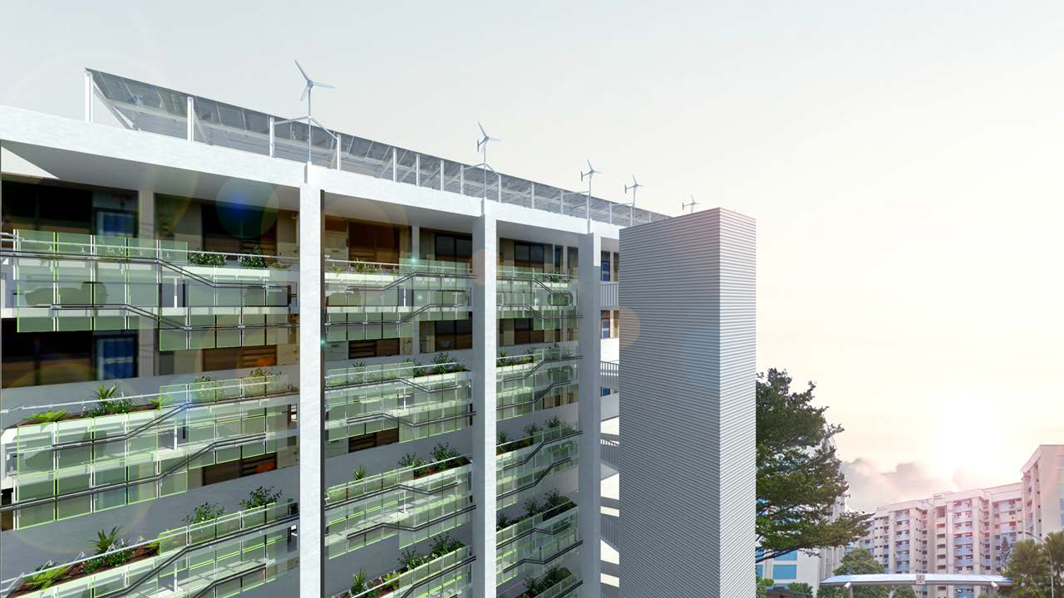

PRODUCTIVE FACADES:
POTENTIAL ENERGY AND FOOD HARVESTING IN SINGAPORE’S RESIDENTIAL BUILDINGS
Abel Tablada
Assist Prof.
National
University
Singapore
Renewable Resources and Architecture: M. ‘Ammar Bin Mohamad Malek, Ng Zhi Li Sean, Wang Yigeng, Tay Lee Kuan Roy, 2015

Slide 2

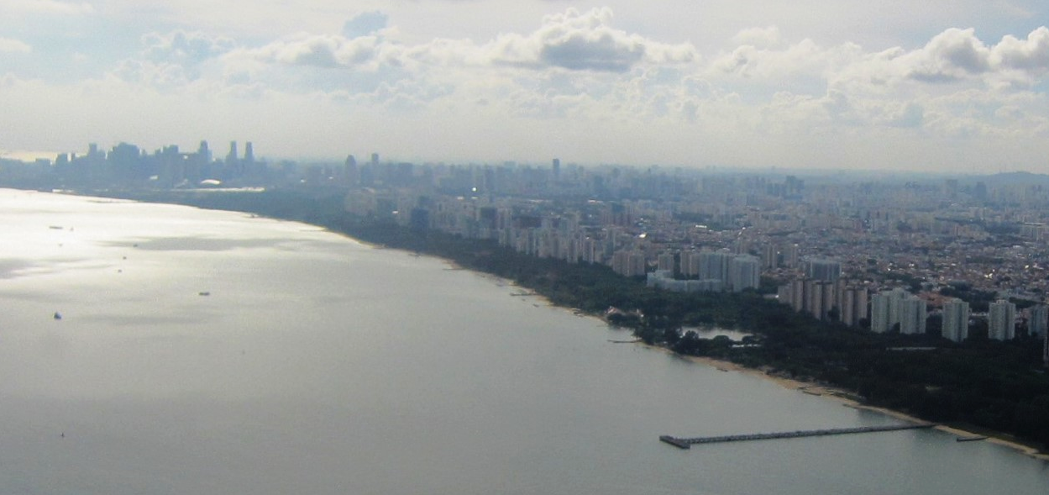
2/50 I. Background
1st Int Conf on Smart Grid Technologies, Singapore Sept 2017. PRODUCTIVE FACADES: POTENTIAL ENERGY AND FOOD HARVESTING IN SINGAPORE’S RESIDENTIAL BUILDINGS. Dr Abel TABLADA. Dept of Arch., SDE, NUS

Slide 3
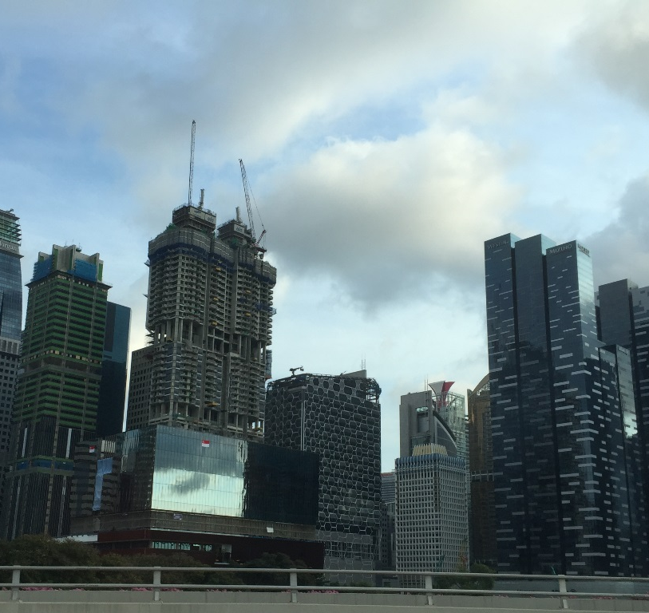
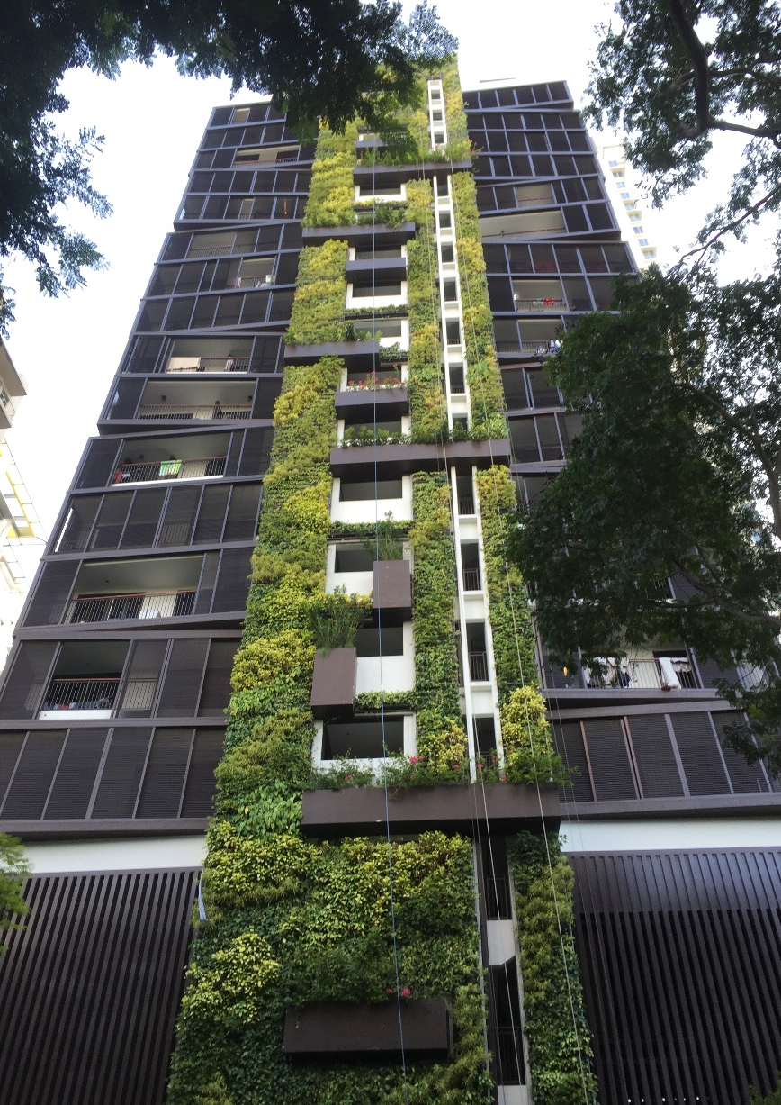
3/50 I. Background
1st Int Conf on Smart Grid Technologies, Singapore Sept 2017. PRODUCTIVE FACADES: POTENTIAL ENERGY AND FOOD HARVESTING IN SINGAPORE’S RESIDENTIAL BUILDINGS. Dr Abel TABLADA. Dept of Arch., SDE, NUS

Slide 4
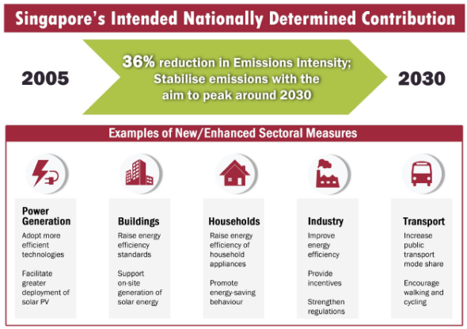
4/50 I. Background
http://www.greenfuture.sg/2015/12/16/the-paris-agreement-what-it-means-for-singapore-and-what-more-can-we-do/
Dec 2015 by Eugene Tay
1st Int Conf on Smart Grid Technologies, Singapore Sept 2017. PRODUCTIVE FACADES: POTENTIAL ENERGY AND FOOD HARVESTING IN SINGAPORE’S RESIDENTIAL BUILDINGS. Dr Abel TABLADA. Dept of Arch., SDE, NUS

Slide 5
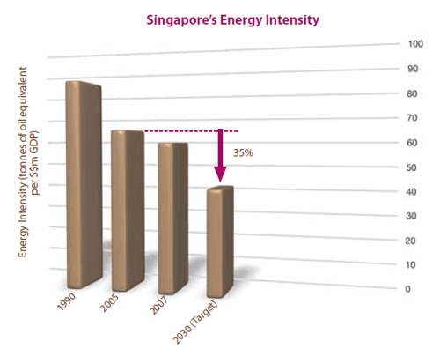
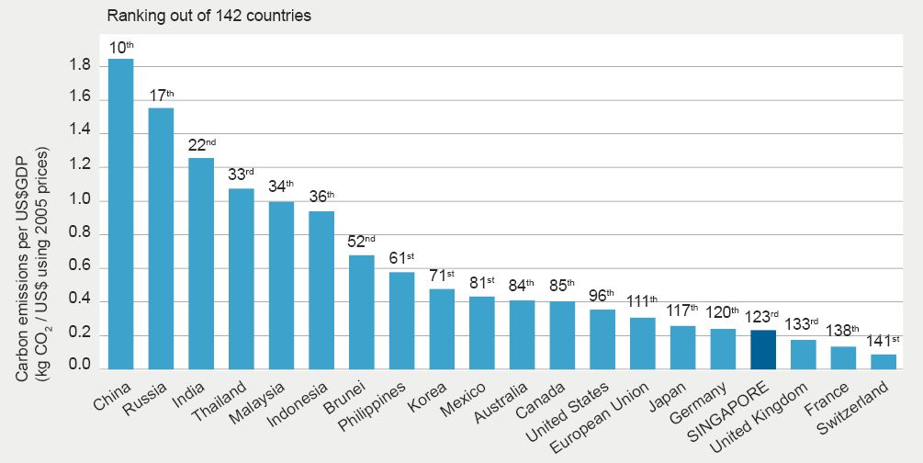
5/50 I. Background
Source: CO₂ Emissions from Fuel Combustion - 2015 Highlights © OECD/International Energy Agency, 2015
1st Int Conf on Smart Grid Technologies, Singapore Sept 2017. PRODUCTIVE FACADES: POTENTIAL ENERGY AND FOOD HARVESTING IN SINGAPORE’S RESIDENTIAL BUILDINGS. Dr Abel TABLADA. Dept of Arch., SDE, NUS

Slide 6


https://www.mti.gov.sg/ResearchRoom/Documents/app.mti.gov.sg/data/pages/885/doc/NEPR%202007.pdf
Notes:
The only thing should be grown is happiness and satisfaction with owns lives
The actual smartness would be to achieve happiness without growing economy and ecological footprint
Energy intensity is just a step towards it, but it may become a hypocrisy is while increasing energy intensity, the total C)2 emissios and ecological footprint also grow

Slide 7
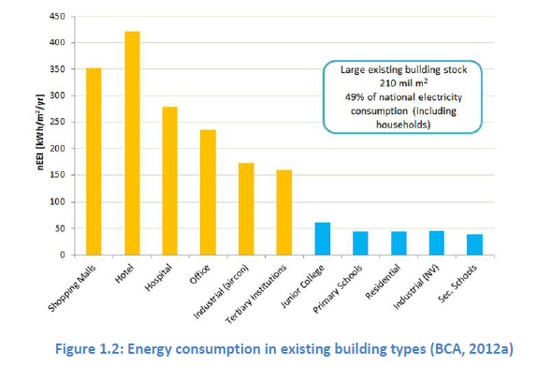
7/50 I. Background
http://www.greenfuture.sg/2015/12/16/the-paris-agreement-what-it-means-for-singapore-and-what-more-can-we-do/
Dec 2015 by Eugene Tay
1st Int Conf on Smart Grid Technologies, Singapore Sept 2017. PRODUCTIVE FACADES: POTENTIAL ENERGY AND FOOD HARVESTING IN SINGAPORE’S RESIDENTIAL BUILDINGS. Dr Abel TABLADA. Dept of Arch., SDE, NUS

Slide 8
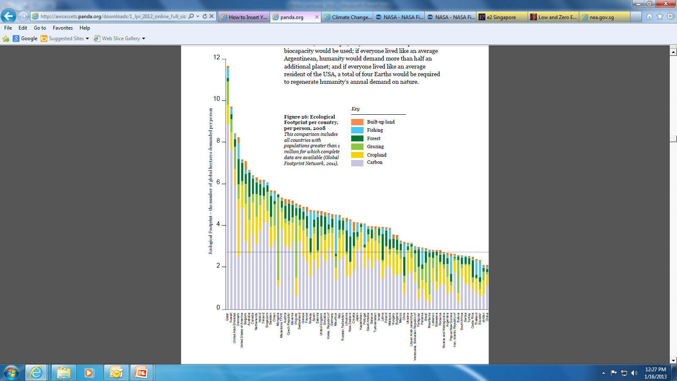
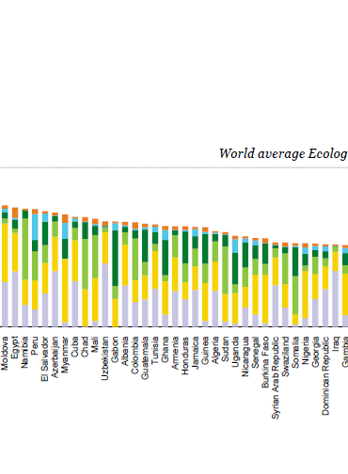
Living Planet Report 2014 WWF
Singapore 12th (21st 2007)
China
73th
 | Population | Gha/capita | Equivalent land (km2) | Actual country area (km2) | Times country area
Singapore | 5,400,000 | 6.1 | 329,400 | 716 | 460.0
China | 1,366,000,000 | 2.1 | 28,686,000 | 9,706,961 | 3.0
http://awsassets.panda.org/

Slide 9
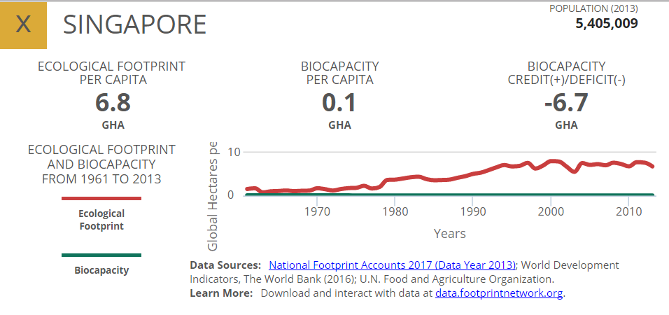
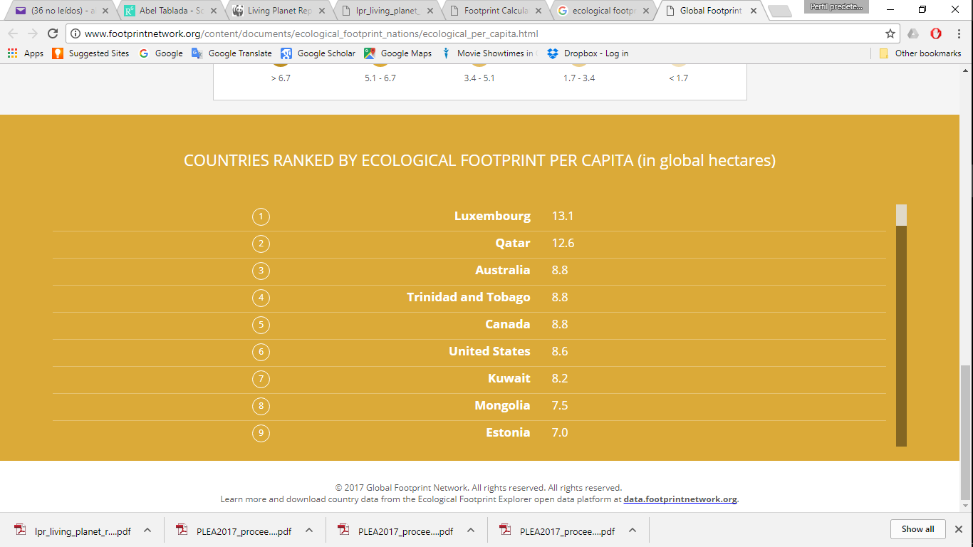
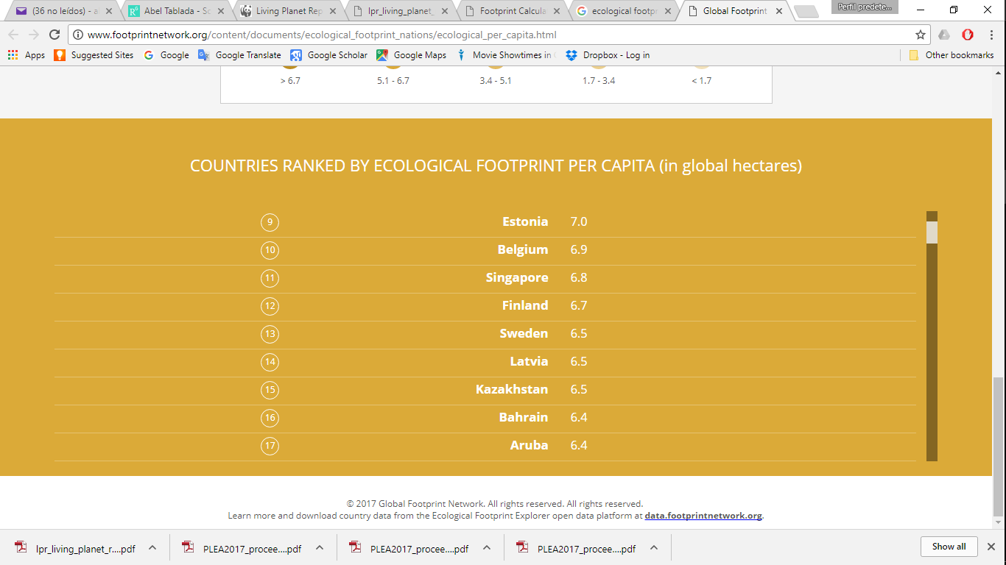

Slide 10
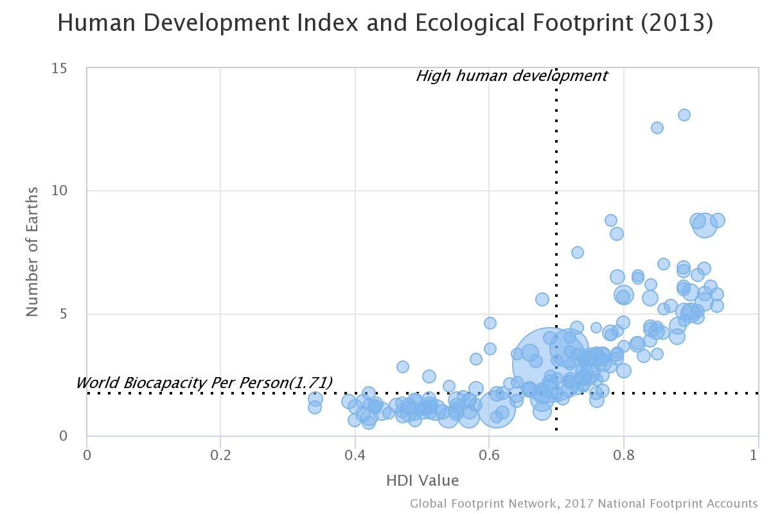
Singapore
http://data.footprintnetwork.org/countryMetrics.html?cn=49&yr=

Slide 11
Singapore
Sri Lanka
Georgia
Cuba
http://data.footprintnetwork.org/countryMetrics.html?cn=49&yr=

Slide 12
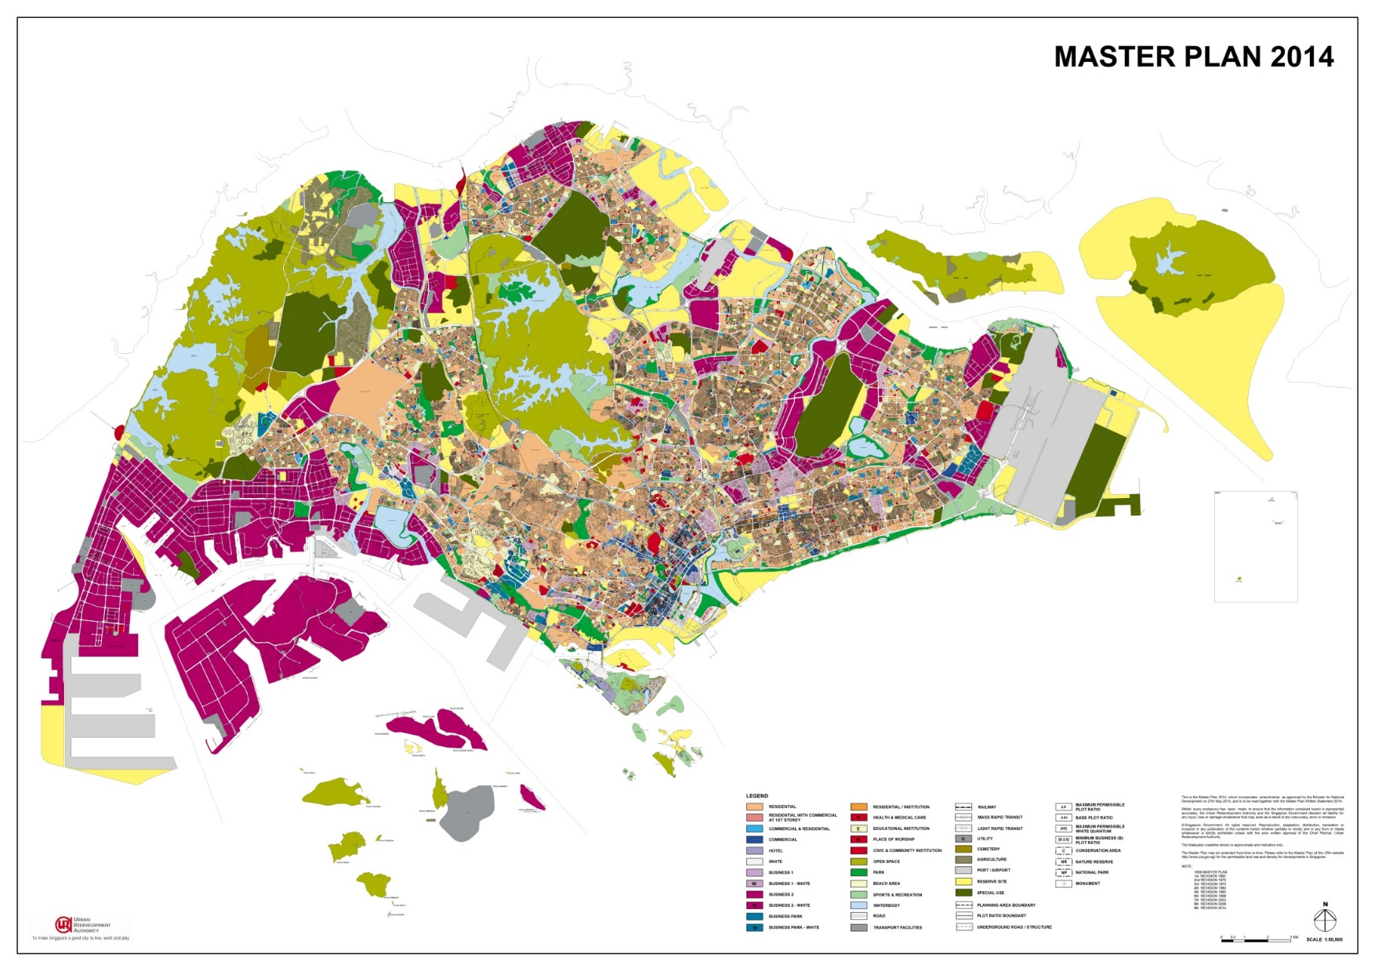
11/50 I. Background
719.1 km²
7,697 inh/km²
1st Int Conf on Smart Grid Technologies, Singapore Sept 2017. PRODUCTIVE FACADES: POTENTIAL ENERGY AND FOOD HARVESTING IN SINGAPORE’S RESIDENTIAL BUILDINGS. Dr Abel TABLADA. Dept of Arch., SDE, NUS

Slide 13
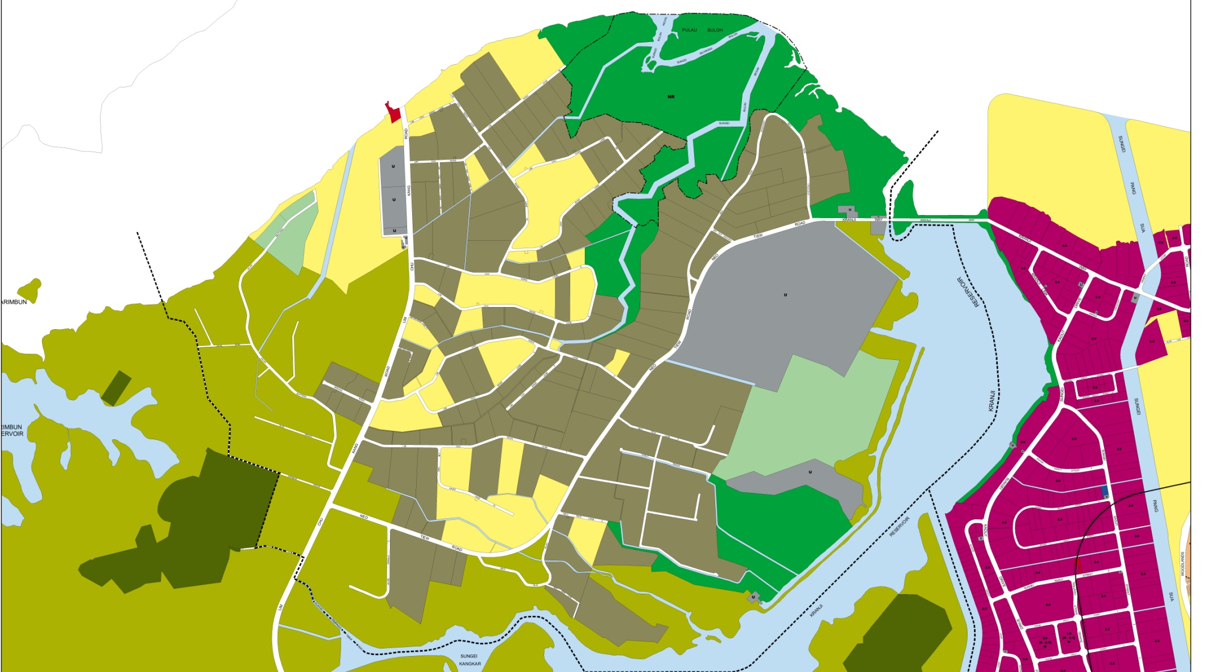
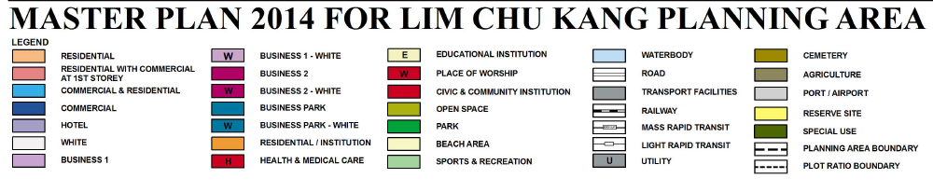
12/50 I. Background
Food import: 90%
Local farms:
8% of vegetables,
8% of fish and
26% of eggs.
Farming area: 675 ha
1st Int Conf on Smart Grid Technologies, Singapore Sept 2017. PRODUCTIVE FACADES: POTENTIAL ENERGY AND FOOD HARVESTING IN SINGAPORE’S RESIDENTIAL BUILDINGS. Dr Abel TABLADA. Dept of Arch., SDE, NUS

Slide 14
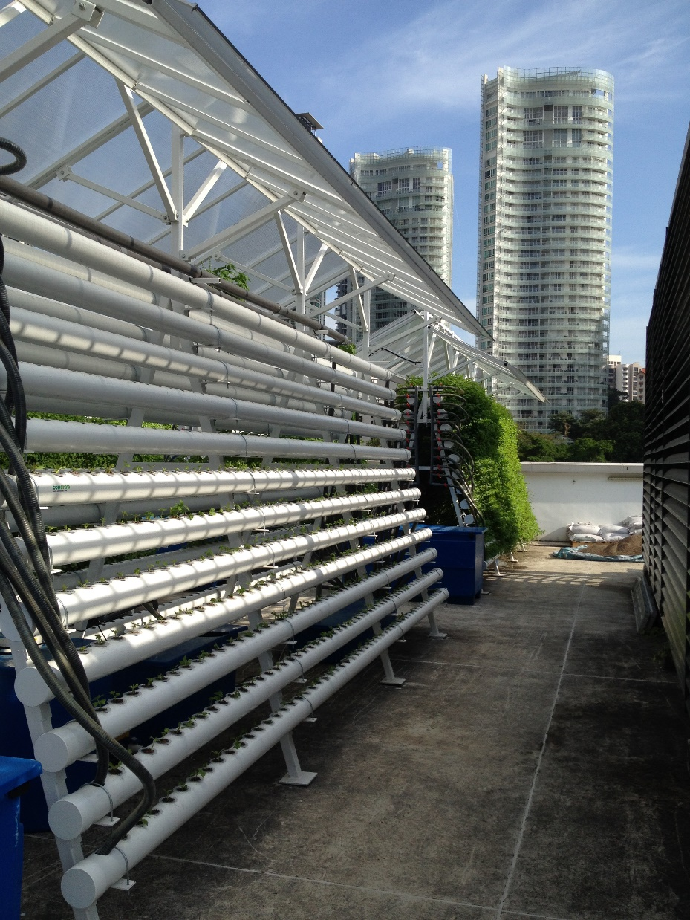
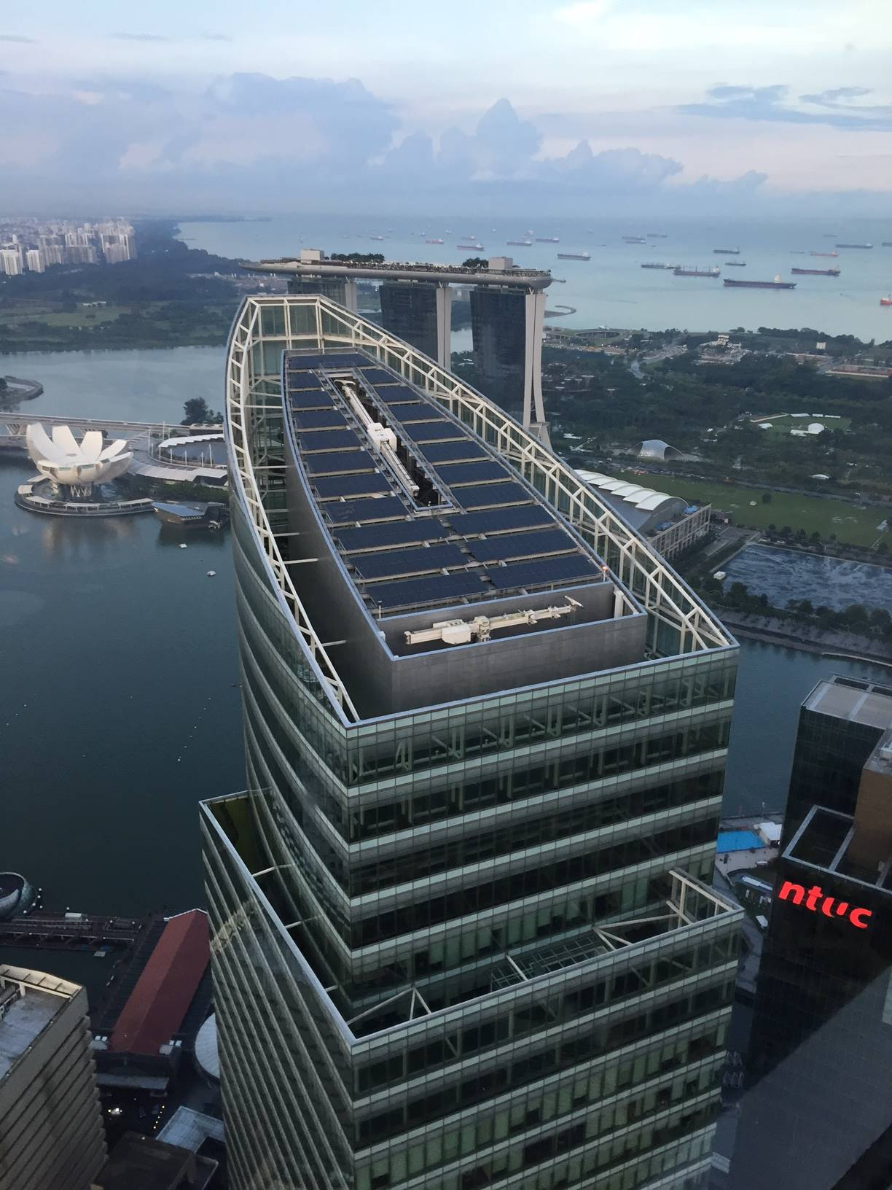
13/50 I. Background
1st Int Conf on Smart Grid Technologies, Singapore Sept 2017. PRODUCTIVE FACADES: POTENTIAL ENERGY AND FOOD HARVESTING IN SINGAPORE’S RESIDENTIAL BUILDINGS. Dr Abel TABLADA. Dept of Arch., SDE, NUS

Slide 15
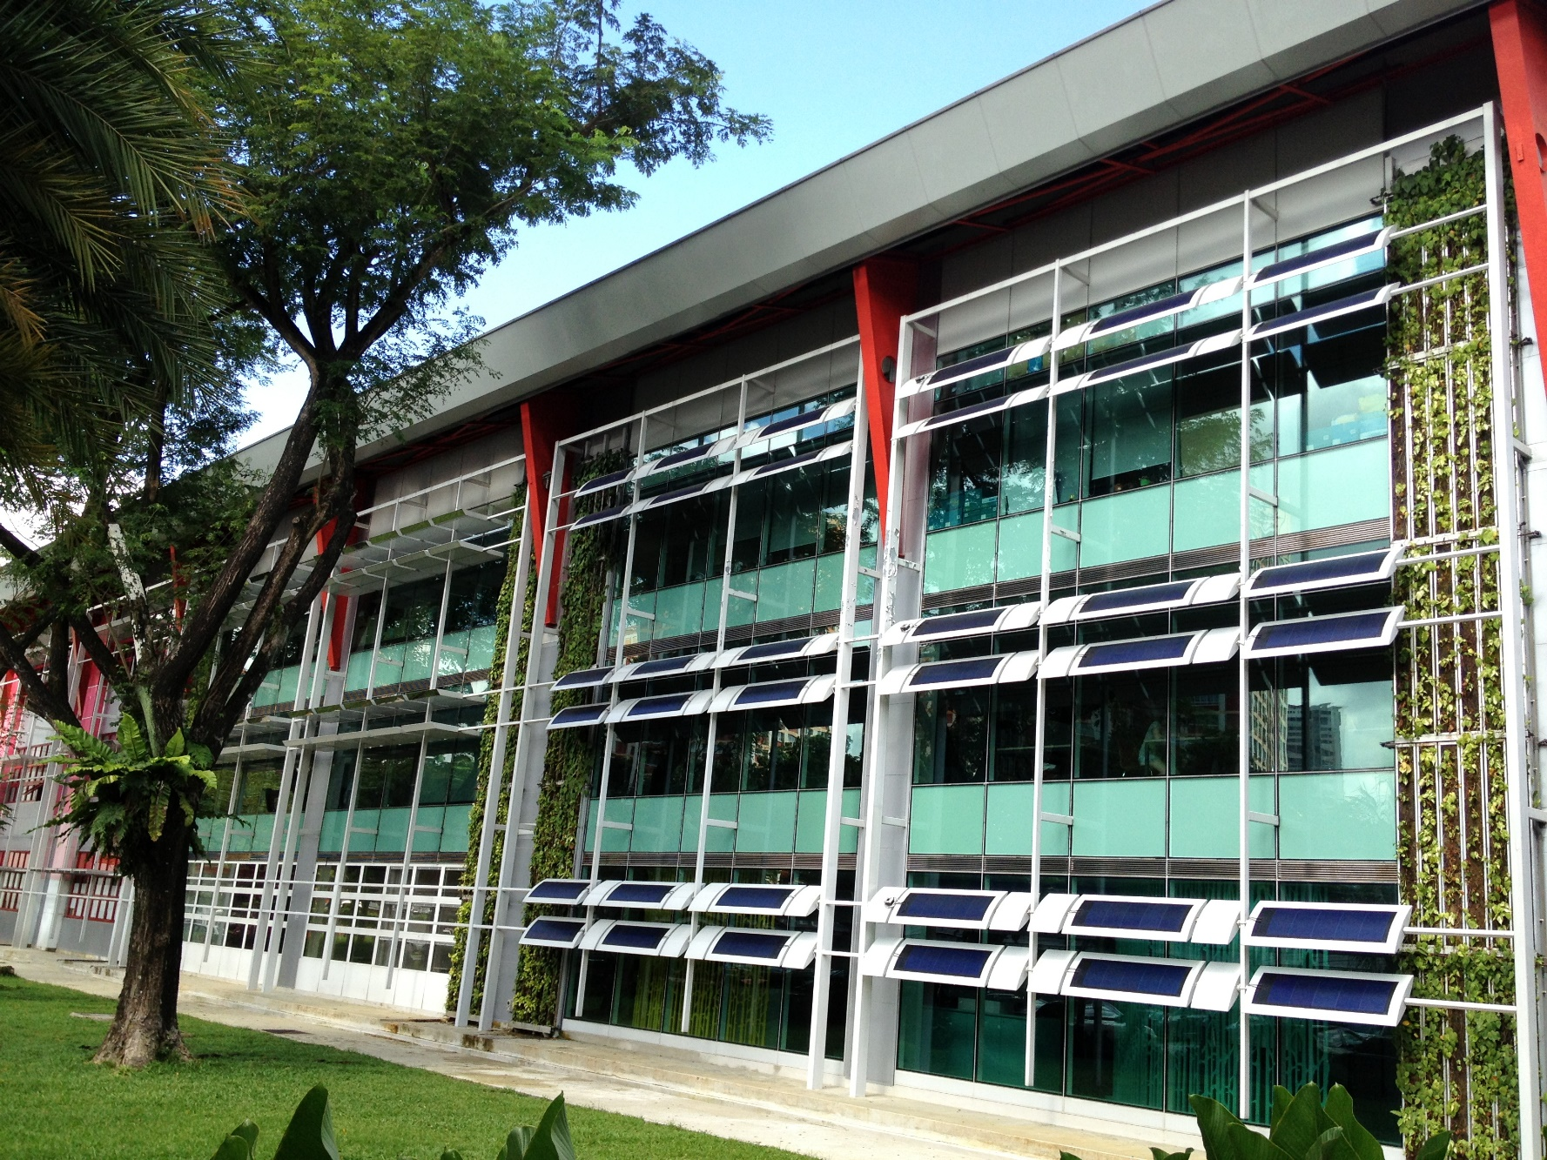
14/50 I. Background
1st Int Conf on Smart Grid Technologies, Singapore Sept 2017. PRODUCTIVE FACADES: POTENTIAL ENERGY AND FOOD HARVESTING IN SINGAPORE’S RESIDENTIAL BUILDINGS. Dr Abel TABLADA. Dept of Arch., SDE, NUS

Slide 16
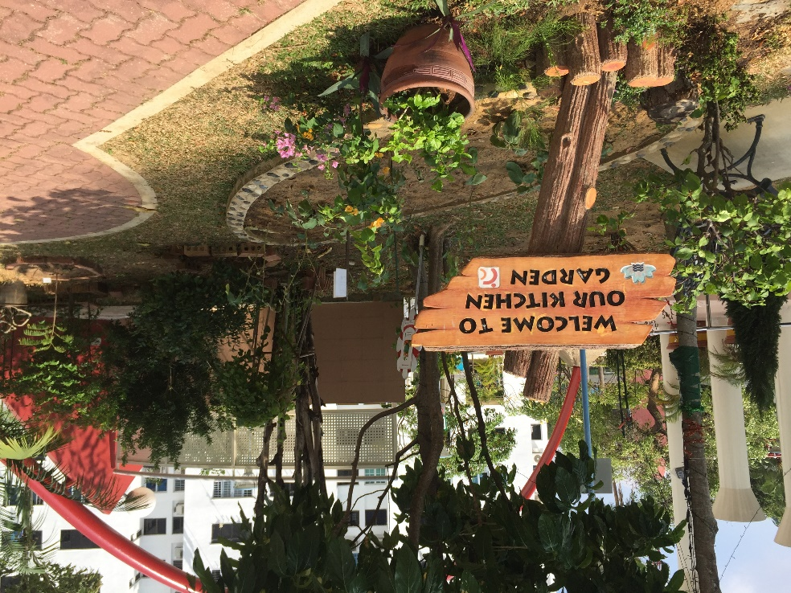
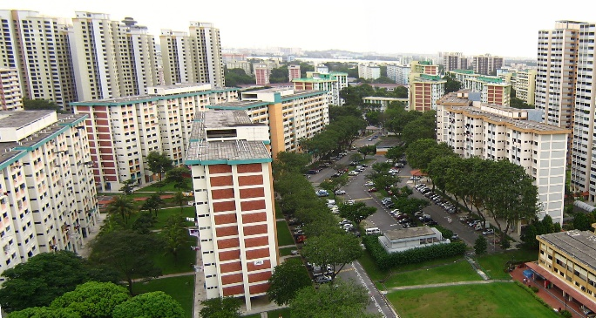
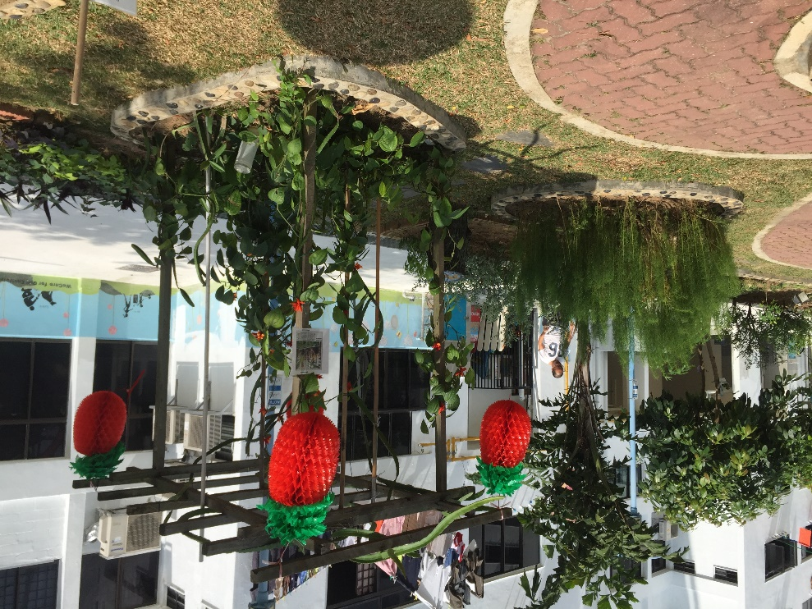
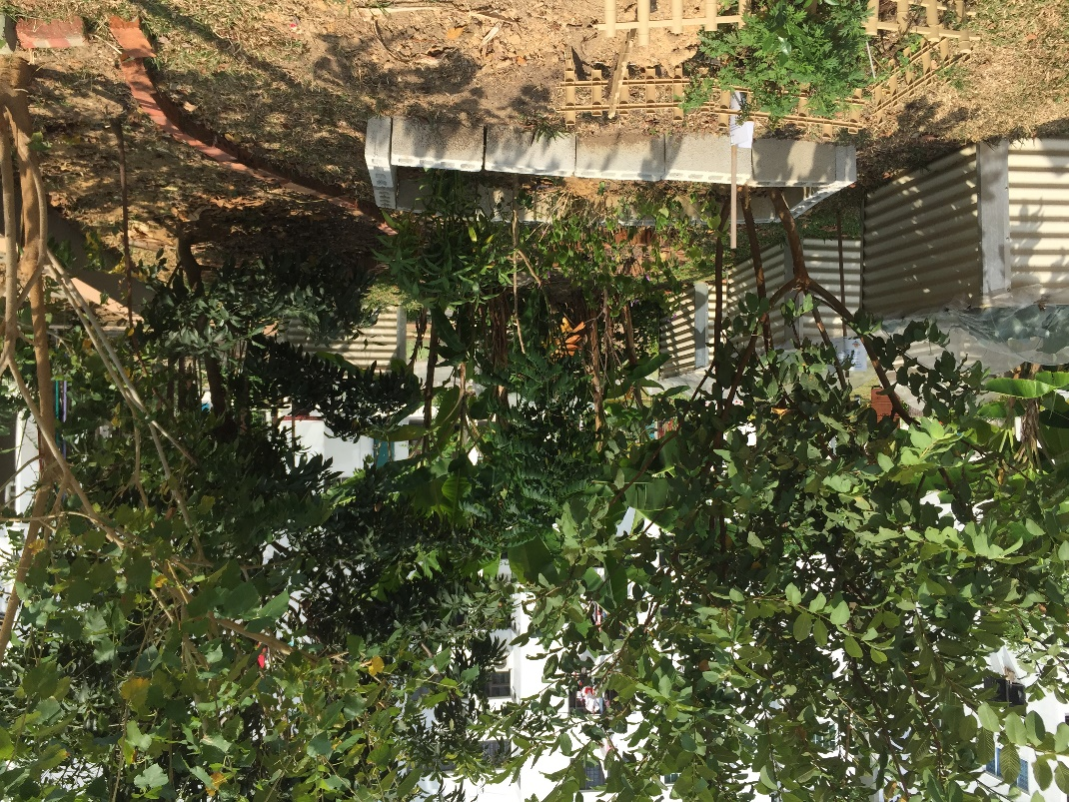
15/50 I. Background
Ecocity World Summit, Melbourne July 2017. FROM PRODUCTIVE FACADES TO PRODUCTIVE CITIES. Dr Abel TABLADA. Dept. of Archit., School of Design and Envir., NUS

Slide 17
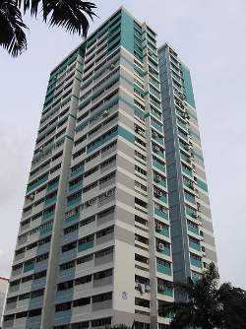
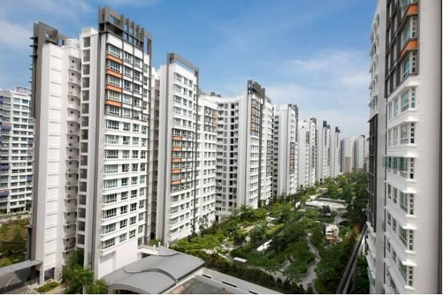
16/50 I. Background
1st Int Conf on Smart Grid Technologies, Singapore Sept 2017. PRODUCTIVE FACADES: POTENTIAL ENERGY AND FOOD HARVESTING IN SINGAPORE’S RESIDENTIAL BUILDINGS. Dr Abel TABLADA. Dept of Arch., SDE, NUS

Slide 18
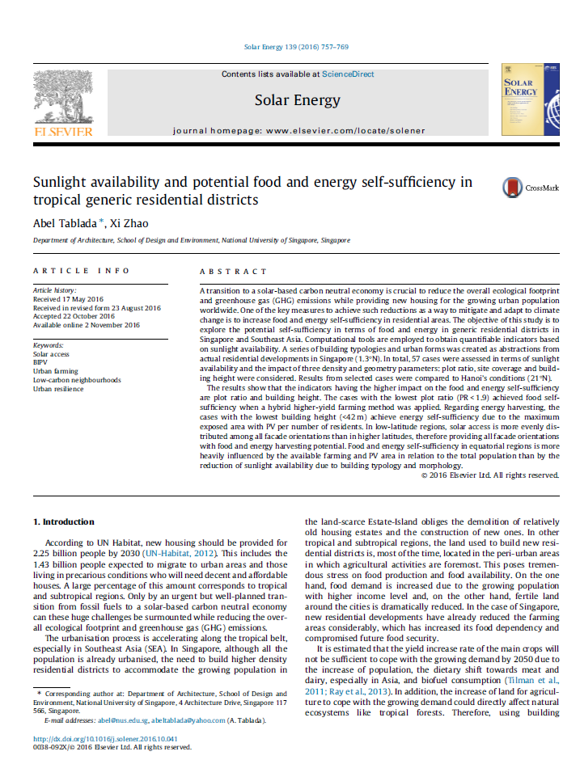

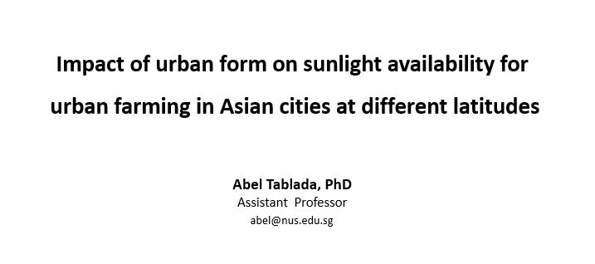
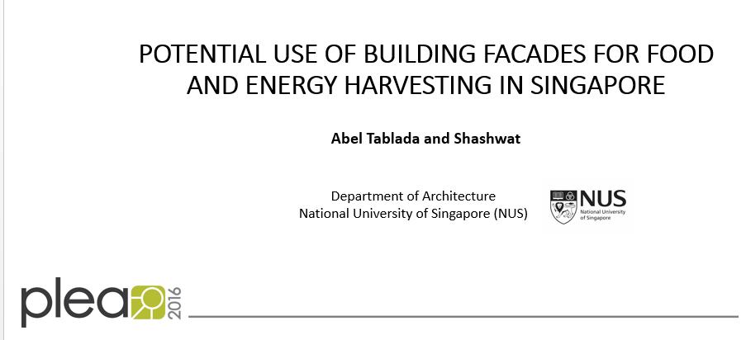
Justification
17/50 I. Background
1st Int Conf on Smart Grid Technologies, Singapore Sept 2017. PRODUCTIVE FACADES: POTENTIAL ENERGY AND FOOD HARVESTING IN SINGAPORE’S RESIDENTIAL BUILDINGS. Dr Abel TABLADA. Dept of Arch., SDE, NUS

Slide 19
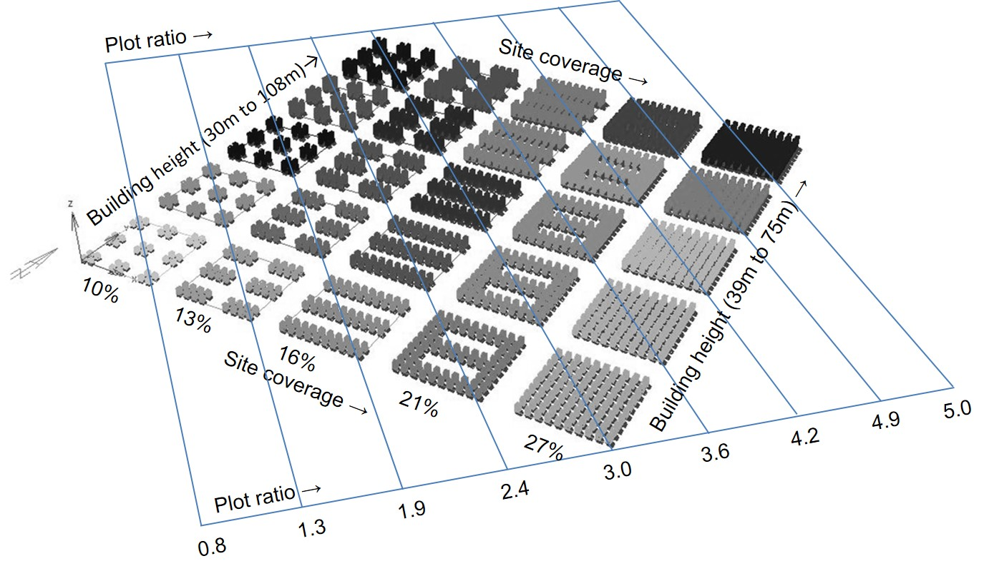

18/50 II. Productivity potential at urban level
1st Int Conf on Smart Grid Technologies, Singapore Sept 2017. PRODUCTIVE FACADES: POTENTIAL ENERGY AND FOOD HARVESTING IN SINGAPORE’S RESIDENTIAL BUILDINGS. Dr Abel TABLADA. Dept of Arch., SDE, NUS

Slide 20
19/50 II. Productivity potential at urban level
Point block
Slab block
Contemporary block
1st Int Conf on Smart Grid Technologies, Singapore Sept 2017. PRODUCTIVE FACADES: POTENTIAL ENERGY AND FOOD HARVESTING IN SINGAPORE’S RESIDENTIAL BUILDINGS. Dr Abel TABLADA. Dept of Arch., SDE, NUS

Slide 21
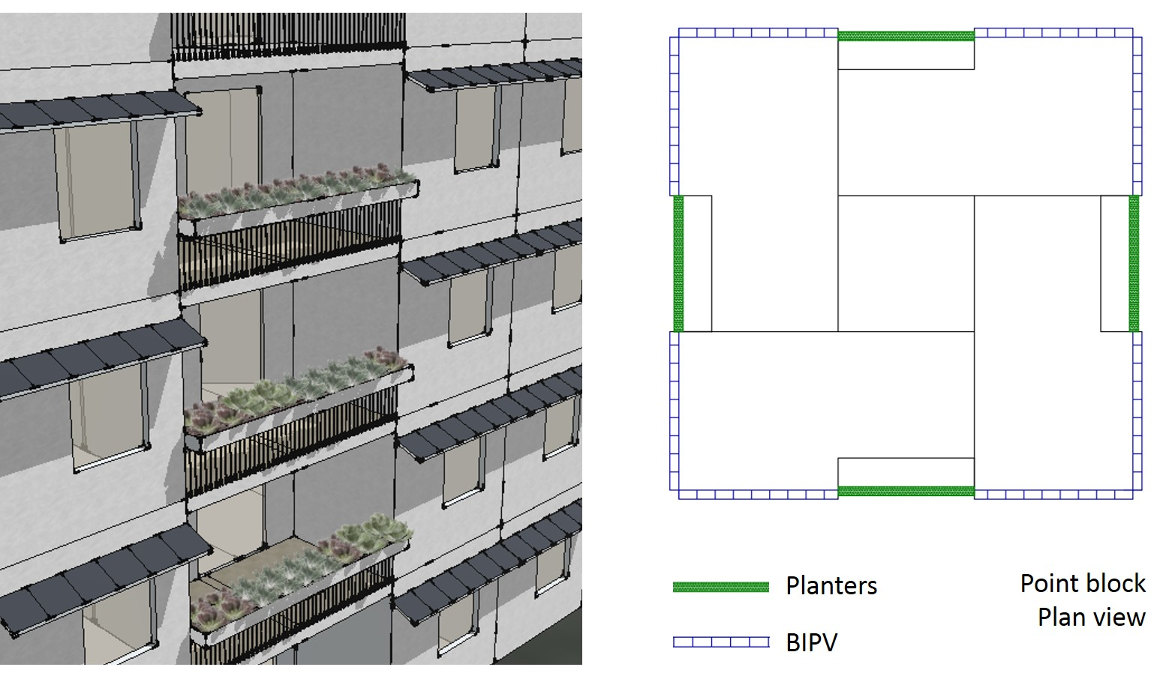
20/50 II. Productivity potential at urban level
1st Int Conf on Smart Grid Technologies, Singapore Sept 2017. PRODUCTIVE FACADES: POTENTIAL ENERGY AND FOOD HARVESTING IN SINGAPORE’S RESIDENTIAL BUILDINGS. Dr Abel TABLADA. Dept of Arch., SDE, NUS

Slide 22
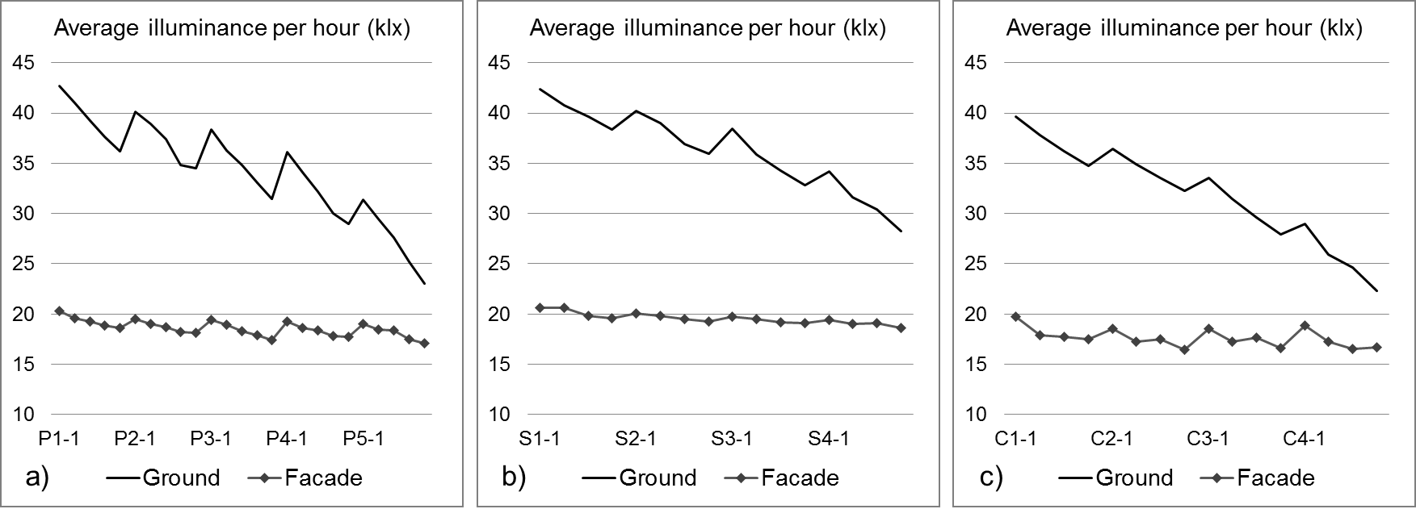
21/50 II. Productivity potential at urban level
1st Int Conf on Smart Grid Technologies, Singapore Sept 2017. PRODUCTIVE FACADES: POTENTIAL ENERGY AND FOOD HARVESTING IN SINGAPORE’S RESIDENTIAL BUILDINGS. Dr Abel TABLADA. Dept of Arch., SDE, NUS

Slide 23
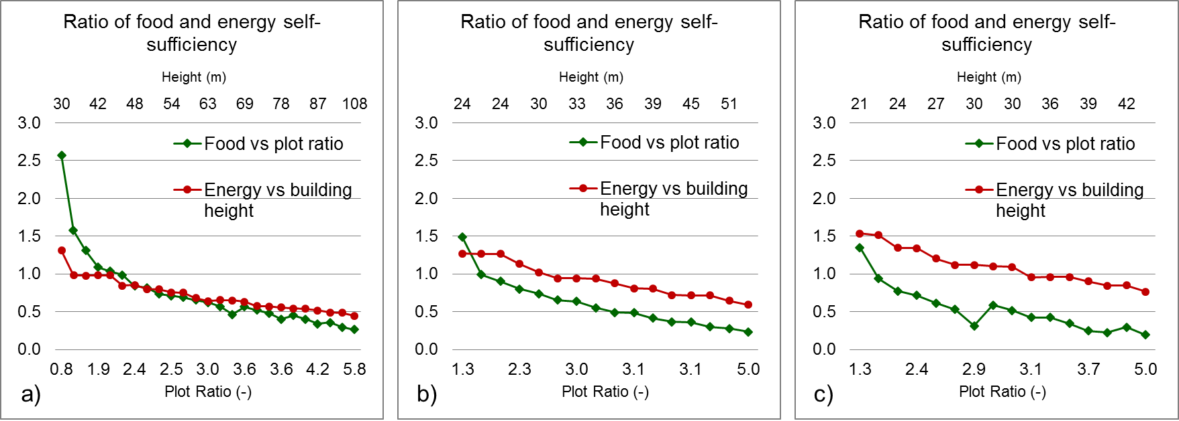
22/50 II. Productivity potential at urban level
1st Int Conf on Smart Grid Technologies, Singapore Sept 2017. PRODUCTIVE FACADES: POTENTIAL ENERGY AND FOOD HARVESTING IN SINGAPORE’S RESIDENTIAL BUILDINGS. Dr Abel TABLADA. Dept of Arch., SDE, NUS

Slide 24
23/50 II. Productivity potential at urban level
Food self-sufficiency is achieved with PR ≤ 1.9 if a hybrid farming method is applied (conventional + vertical).
Energy self-sufficiency is achieved for building height (< 42 m, < 14 storeys, PR < 3) due to the maximum exposed area with PV per amount of residents.
1st Int Conf on Smart Grid Technologies, Singapore Sept 2017. PRODUCTIVE FACADES: POTENTIAL ENERGY AND FOOD HARVESTING IN SINGAPORE’S RESIDENTIAL BUILDINGS. Dr Abel TABLADA. Dept of Arch., SDE, NUS

Slide 25
24/50 II. Productivity potential at urban level
Food self-sufficiency is achieved with PR ≤ 1.9 if a hybrid farming method is applied (conventional + vertical).
Energy self-sufficiency is achieved for building height (< 42 m, < 14 storeys, PR < 3) due to the maximum exposed area with PV per amount of residents.
Sunlight availability is sufficient for food and energy harvesting on all façade orientations.
For current typical New Towns in Singapore, food and energy self-sufficiency could reach about 60% and 80% respectively.
1st Int Conf on Smart Grid Technologies, Singapore Sept 2017. PRODUCTIVE FACADES: POTENTIAL ENERGY AND FOOD HARVESTING IN SINGAPORE’S RESIDENTIAL BUILDINGS. Dr Abel TABLADA. Dept of Arch., SDE, NUS

Slide 26
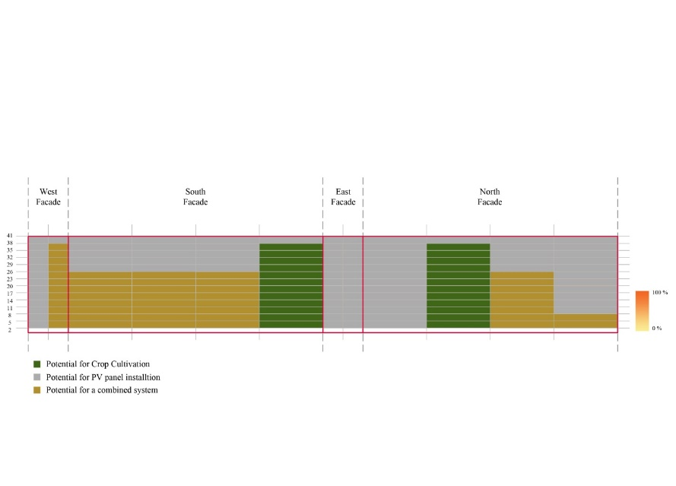
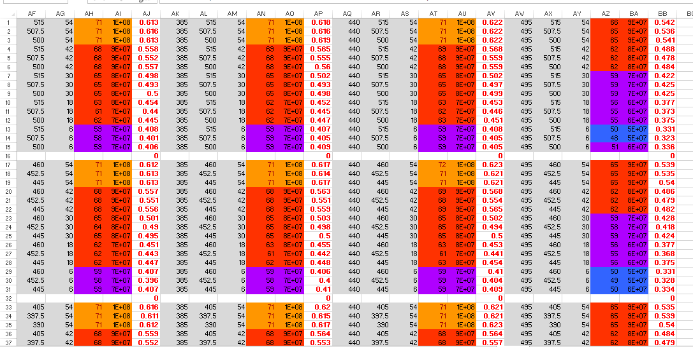
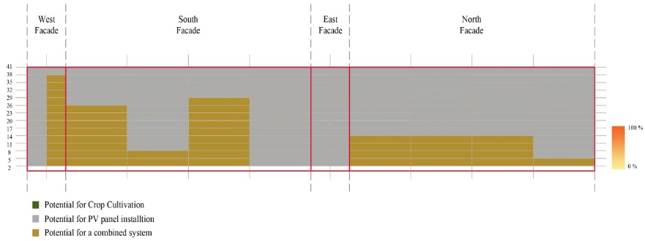
25/50 II. Productivity potential at urban level
To make recommendations for three categories of envelope use based on facade sunlight distribution:
  1) only BIPV,
  (2) combination of BIPV and farming
  (3) only farming or solar collectors.
1st Int Conf on Smart Grid Technologies, Singapore Sept 2017. PRODUCTIVE FACADES: POTENTIAL ENERGY AND FOOD HARVESTING IN SINGAPORE’S RESIDENTIAL BUILDINGS. Dr Abel TABLADA. Dept of Arch., SDE, NUS

Slide 27
26/50 II. Productivity potential at urban level
Food thresholds
Daylight Autonomy (DA)
required sunlight (RS)
Optimal RS = 80% > 10klx
Minimum RS = 40% > 10klx
Energy thresholds
Incident irradiance
PV > 800 kWh/m²
Solar collector > 400 kWh/m²
1st Int Conf on Smart Grid Technologies, Singapore Sept 2017. PRODUCTIVE FACADES: POTENTIAL ENERGY AND FOOD HARVESTING IN SINGAPORE’S RESIDENTIAL BUILDINGS. Dr Abel TABLADA. Dept of Arch., SDE, NUS

Slide 28
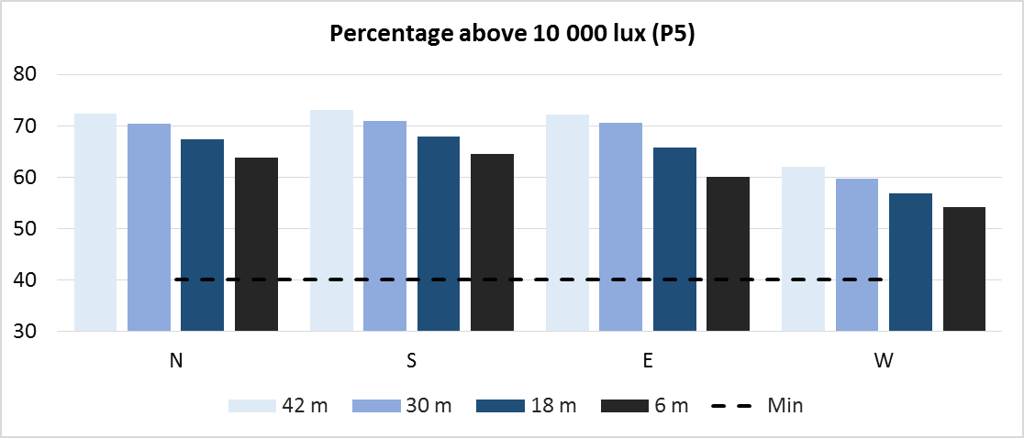
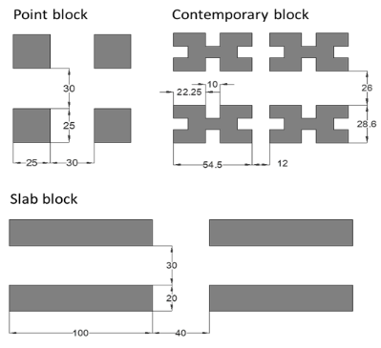
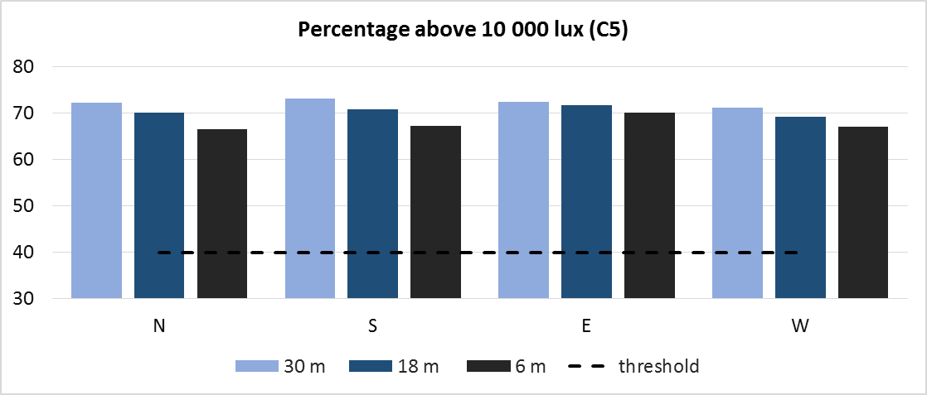
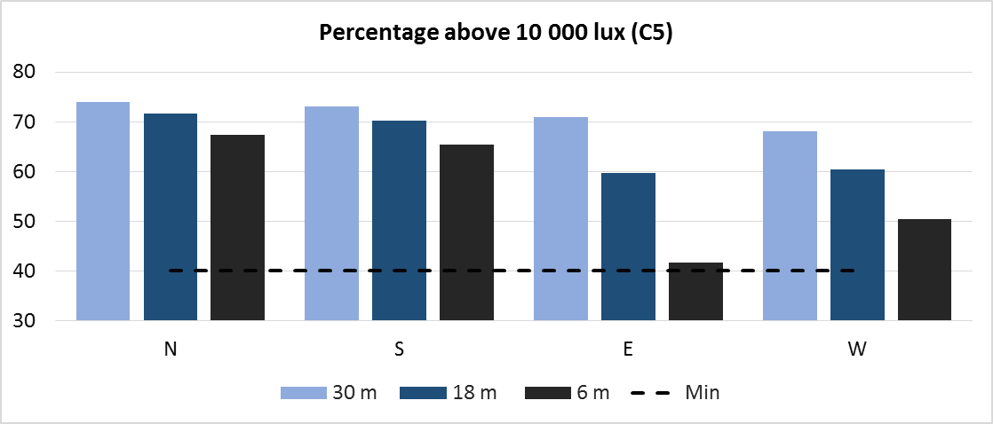
Results (Food)
27/50 II. Productivity potential at urban level
No facade and typology achieve the threshold requirement (RS=80%). All facades and sensor positions achieve RS > 40%.
North and south facades show minor differences (N 1-4% higher than S).
Higher differences were obtained between E & W facades which are more sensitive to sensor height position
1st Int Conf on Smart Grid Technologies, Singapore Sept 2017. PRODUCTIVE FACADES: POTENTIAL ENERGY AND FOOD HARVESTING IN SINGAPORE’S RESIDENTIAL BUILDINGS. Dr Abel TABLADA. Dept of Arch., SDE, NUS

Slide 29
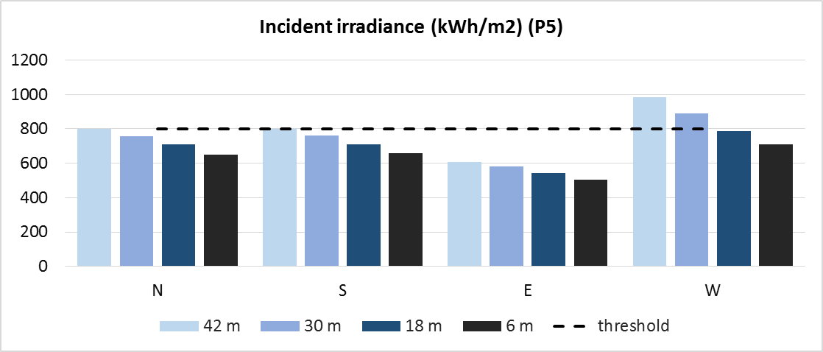
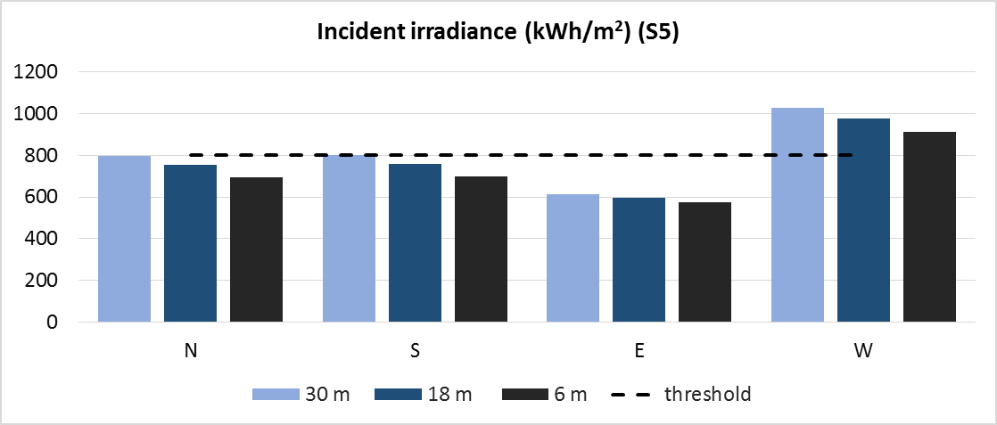
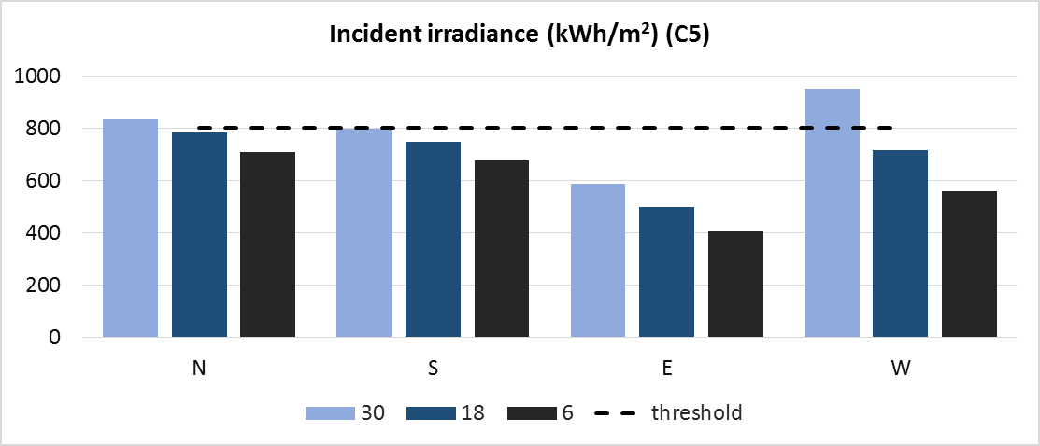
Results (Energy)
28/50 II. Productivity potential at urban level
N & S facades are only suitable on the top positions for the denser cases. It may allow the whole facade for the least dense morphologies (PR = 1.3).
All cases achieve higher values than 400 kWh/m², hence suitable for the installation of solar collectors on those facade locations not suitable for PV panels.
1st Int Conf on Smart Grid Technologies, Singapore Sept 2017. PRODUCTIVE FACADES: POTENTIAL ENERGY AND FOOD HARVESTING IN SINGAPORE’S RESIDENTIAL BUILDINGS. Dr Abel TABLADA. Dept of Arch., SDE, NUS

Slide 30
Recommendations and partial conclusions
29/50 II. Productivity potential at urban level
Cases | Farming 2nd category | PV (>800kWh/m²) |  |  |  | Solar collector
 |  | N | S | E | W
P1 | 100% | 100% | 33% | 0% | 100% | 100%
P3 | 100% | 50% | 33% | 0% | 75% | 100%
P5 | 100% | 25% | 25% | 0% | 50% | 100%
S1 | 100% | 100% | 50% | 0% | 100% | 100%
S3 | 100% | 33% | 33% | 0% | 100% | 100%
S5 | 100% | 33% | 33% | 0% | 100% | 100%
C1 | 100% | 100% | 100% | 0% | 100% | 100%
C3 | 100% | 50% | 0% | 0% | 100% | 100%
C5 | 100% | 33% | 0% | 0% | 33% | 100%
There is high potential of food and energy harvesting on building facades in low latitudes.
However, only densities lower than PR=3 allow the incidence of irradiance values above the threshold for energy harvesting
Farming and solar collectors can be installed on all facades at any height.
  However, it is recommended to be installed only on those facade areas where PV panels are not feasible based on irradiance threshold.
PV panels on the top section of all facades and farming and solar collectors on the remaining sections.
1st Int Conf on Smart Grid Technologies, Singapore Sept 2017. PRODUCTIVE FACADES: POTENTIAL ENERGY AND FOOD HARVESTING IN SINGAPORE’S RESIDENTIAL BUILDINGS. Dr Abel TABLADA. Dept of Arch., SDE, NUS

Slide 31
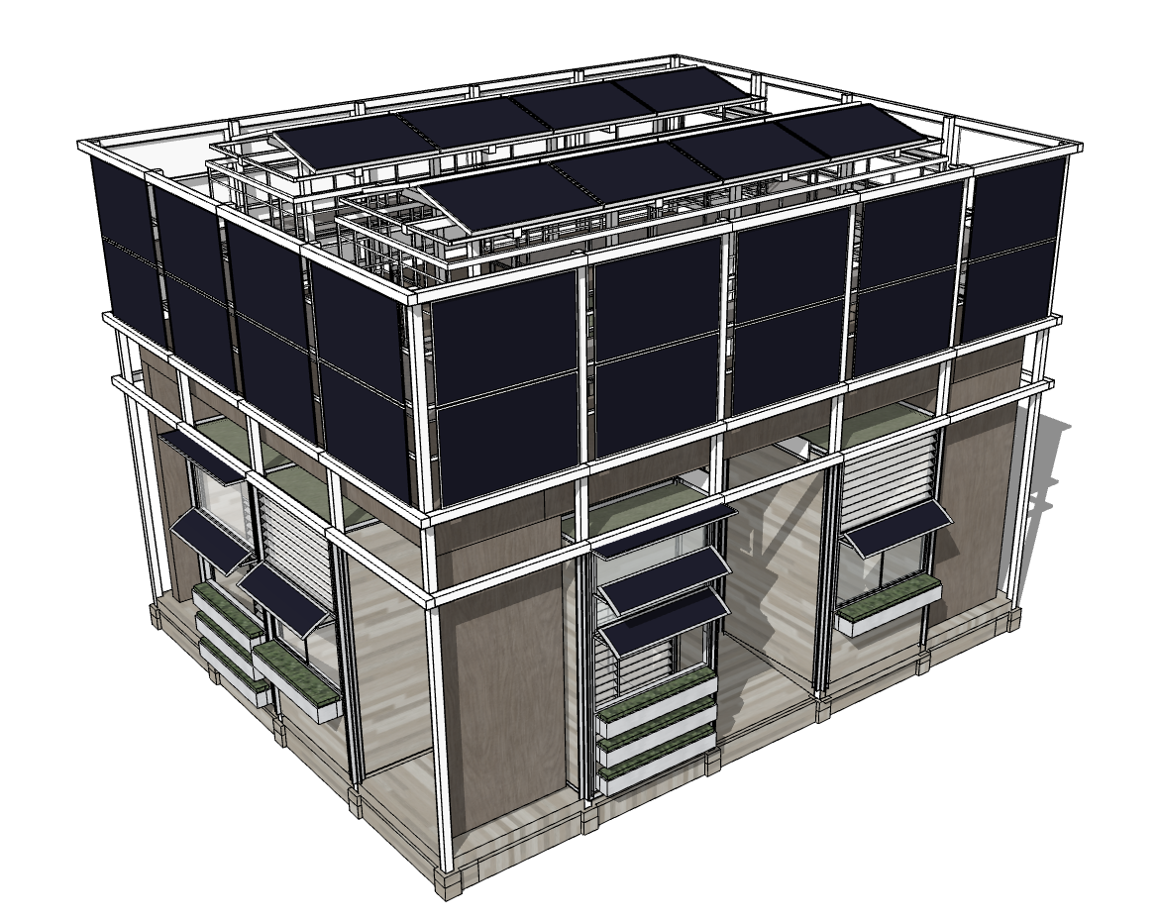
30/50 IV. Productive facades / Design development
Research team
Director:
Prof. Stephen Lau
Abel Tablada,
Siu Kit Lau,
Chao Yuan and
Shinya Okuda
Collaborators/ sponsors
Hugh Tan, Dept of Biological Sciences, NUS.
Thomas Reindl and Veronika Shabunko, Solar Energy Research Institute of Singapore (SERIS)
Vesna Kosoric, Huang Huajing and Ian Chaplin from Dept of Architecture, NUS.
City Development Limited
NUS-CDL Tropical Technologies (T²) Lab
1st Int Conf on Smart Grid Technologies, Singapore Sept 2017. PRODUCTIVE FACADES: POTENTIAL ENERGY AND FOOD HARVESTING IN SINGAPORE’S RESIDENTIAL BUILDINGS. Dr Abel TABLADA. Dept of Arch., SDE, NUS

Slide 32
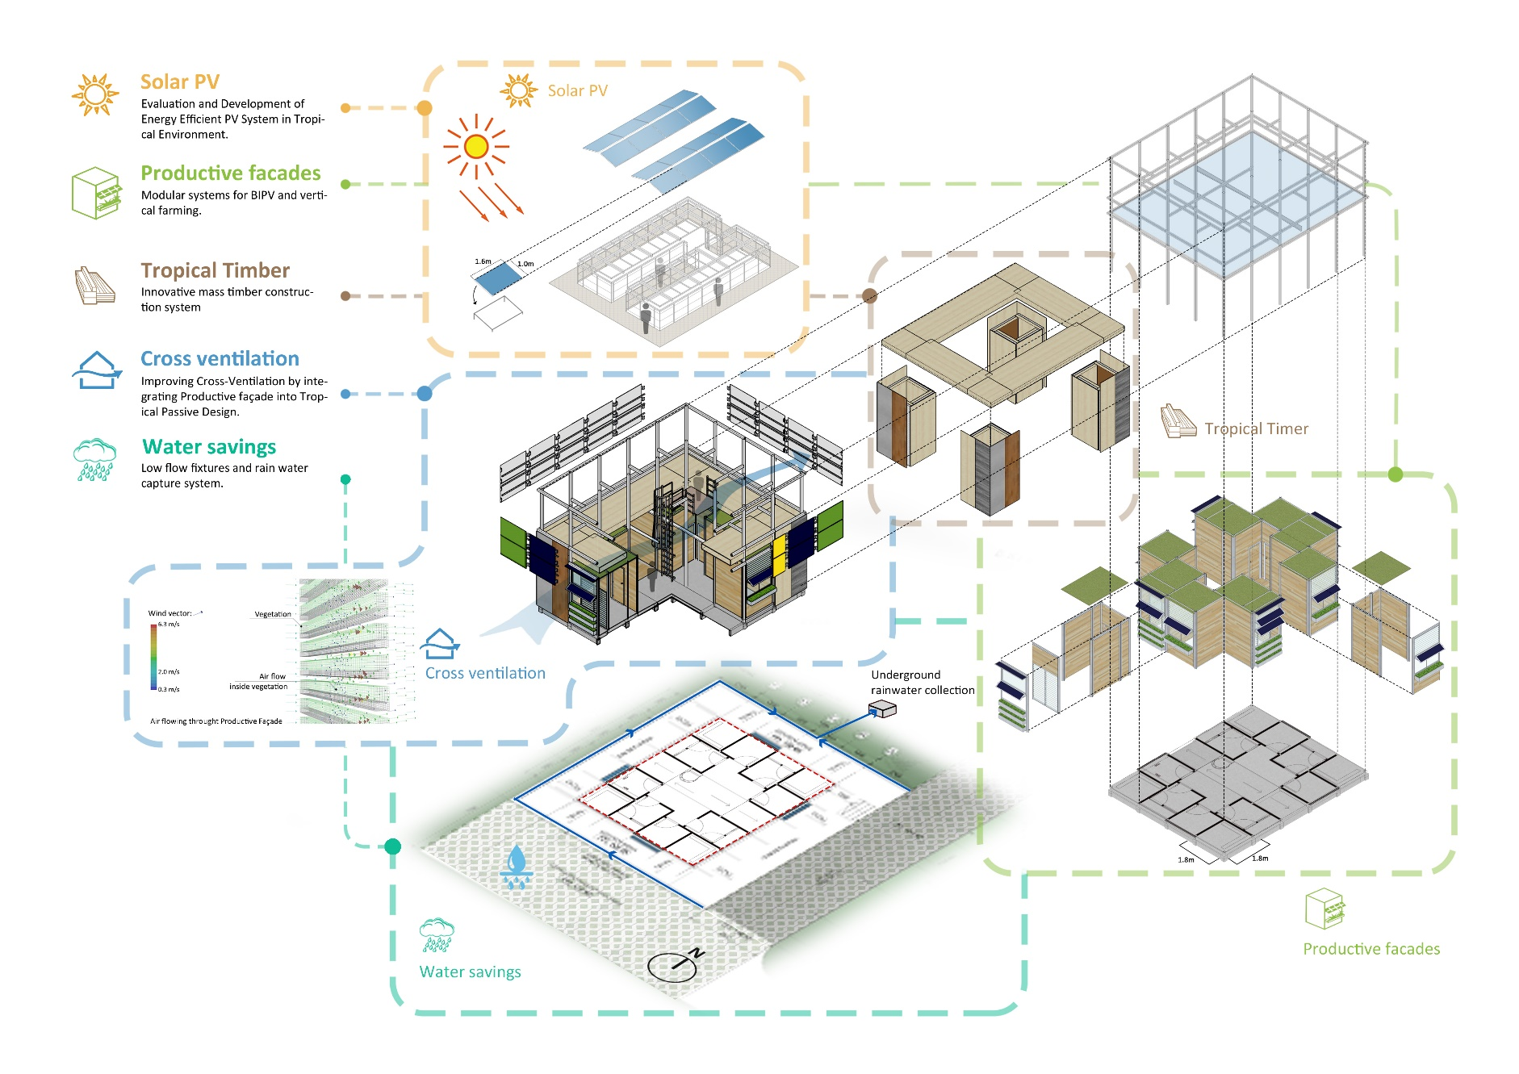
31/50 IV. Productive facades / Design development
1st Int Conf on Smart Grid Technologies, Singapore Sept 2017. PRODUCTIVE FACADES: POTENTIAL ENERGY AND FOOD HARVESTING IN SINGAPORE’S RESIDENTIAL BUILDINGS. Dr Abel TABLADA. Dept of Arch., SDE, NUS

Slide 33
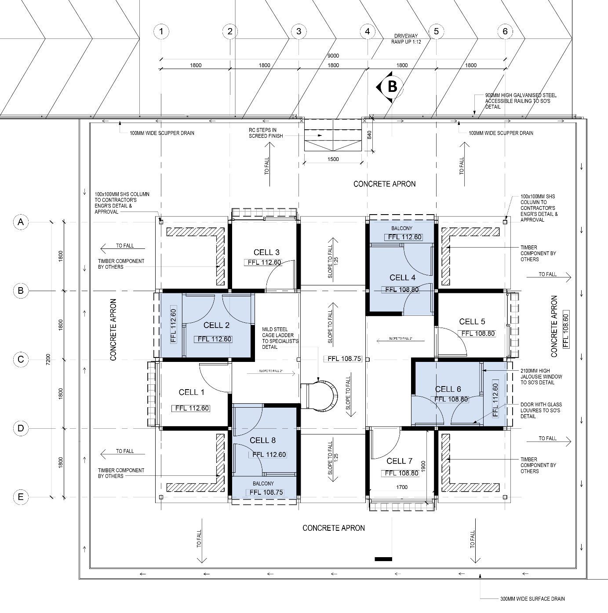
32/50 IV. Productive facades / Design development
1st Int Conf on Smart Grid Technologies, Singapore Sept 2017. PRODUCTIVE FACADES: POTENTIAL ENERGY AND FOOD HARVESTING IN SINGAPORE’S RESIDENTIAL BUILDINGS. Dr Abel TABLADA. Dept of Arch., SDE, NUS

Slide 34
33/50 IV. Productive facades / Design development
1. Initial definition of PSF components
Definition of PV system
Definition of Food Planters
2. Formulation of decision goal
3. Formulation of relevant design alternatives
Facade wall (N,S,E,W)
Facade with balcony (N,S,E,W)
Selected Design Alternative should balance: production output, costs, user comfort and aesthetics
4. Determination of relevant assessment criteria functions and weight coefficients
5. Assigning the criteria scores to design alternatives
Survey with experts and residents
Computer simulations
Calculations
Quantitative
Qualitative
6. Evaluation of SPF design alternatives and selection of the optimal SPF design alternative
Accepting one Design: proceed to step 7
7. Optimal PSF Design Alternative
Not accepting design: return to any previous step
Façade installation and monitoring
Definition of openings
MCDA method/VIKOR
1st Int Conf on Smart Grid Technologies, Singapore Sept 2017. PRODUCTIVE FACADES: POTENTIAL ENERGY AND FOOD HARVESTING IN SINGAPORE’S RESIDENTIAL BUILDINGS. Dr Abel TABLADA. Dept of Arch., SDE, NUS

Slide 35
34/50 IV. Productive facades / Design development
1. Initial definition of PSF components
Definition of PV system
Definition of Food Planters
2. Formulation of decision goal
3. Formulation of relevant design alternatives
Facade wall (N,S,E,W)
Facade with balcony (N,S,E,W)
Selected Design Alternative should balance: production output, costs, user comfort and aesthetics
4. Determination of relevant assessment criteria functions and weight coefficients
5. Assigning the criteria scores to design alternatives
Survey with experts and residents
Computer simulations
Calculations
Quantitative
Qualitative
6. Evaluation of SPF design alternatives and selection of the optimal SPF design alternative
Accepting one Design: proceed to step 7
7. Optimal PSF Design Alternative
Not accepting design: return to any previous step
Façade installation and monitoring
Definition of openings
MCDA method/VIKOR
1st Int Conf on Smart Grid Technologies, Singapore Sept 2017. PRODUCTIVE FACADES: POTENTIAL ENERGY AND FOOD HARVESTING IN SINGAPORE’S RESIDENTIAL BUILDINGS. Dr Abel TABLADA. Dept of Arch., SDE, NUS

Slide 36
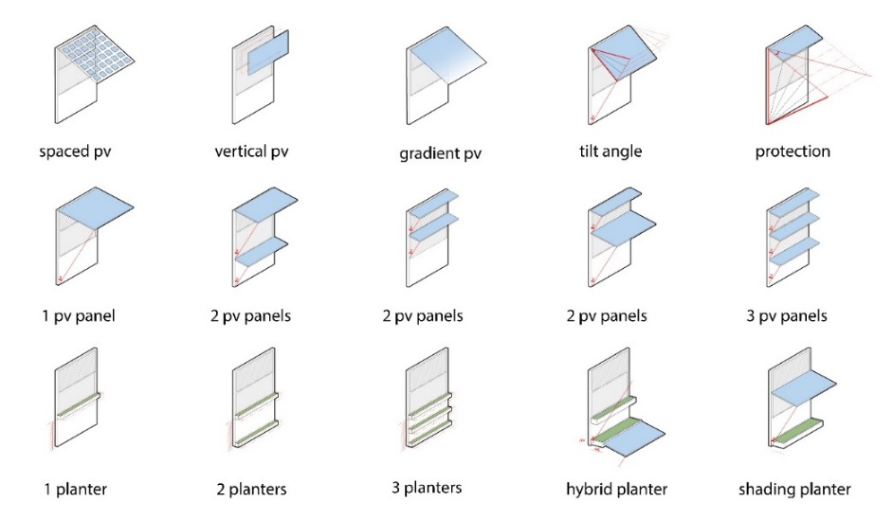
35/50 IV. Productive facades / Design development
Design alternatives
1st Int Conf on Smart Grid Technologies, Singapore Sept 2017. PRODUCTIVE FACADES: POTENTIAL ENERGY AND FOOD HARVESTING IN SINGAPORE’S RESIDENTIAL BUILDINGS. Dr Abel TABLADA. Dept of Arch., SDE, NUS

Slide 37
36/50 IV. Productive facades / Design development
1. Initial definition of PSF components
Definition of PV system
Definition of Food Planters
2. Formulation of decision goal
3. Formulation of relevant design alternatives
Facade wall (N,S,E,W)
Facade with balcony (N,S,E,W)
Selected Design Alternative should balance: production output, costs, user comfort and aesthetics
4. Determination of relevant assessment criteria functions and weight coefficients
5. Assigning the criteria scores to design alternatives
Survey with experts and residents
Computer simulations
Calculations
Quantitative
Qualitative
6. Evaluation of SPF design alternatives and selection of the optimal SPF design alternative
Accepting one Design: proceed to step 7
7. Optimal PSF Design Alternative
Not accepting design: return to any previous step
Façade installation and monitoring
Definition of openings
MCDA method/VIKOR
1st Int Conf on Smart Grid Technologies, Singapore Sept 2017. PRODUCTIVE FACADES: POTENTIAL ENERGY AND FOOD HARVESTING IN SINGAPORE’S RESIDENTIAL BUILDINGS. Dr Abel TABLADA. Dept of Arch., SDE, NUS

Slide 38
37/50 IV. Productive facades / Design development
Defining assessment criteria for façade optimization through the multiple criteria decision analysis (MCDA)
The MCDA VIKOR method is applied in order to provide a comprehensive evaluation and selection of the optimal design alternatives.
The VIKOR method relies on the weight coefficients of the criteria functions to model the preferred structure of a design strategy.
1st Int Conf on Smart Grid Technologies, Singapore Sept 2017. PRODUCTIVE FACADES: POTENTIAL ENERGY AND FOOD HARVESTING IN SINGAPORE’S RESIDENTIAL BUILDINGS. Dr Abel TABLADA. Dept of Arch., SDE, NUS

Slide 39
38/50 IV. Productive facades / Design development
1. Initial definition of PSF components
Definition of PV system
Definition of Food Planters
2. Formulation of decision goal
3. Formulation of relevant design alternatives
Facade wall (N,S,E,W)
Facade with balcony (N,S,E,W)
Selected Design Alternative should balance: production output, costs, user comfort and aesthetics
4. Determination of relevant assessment criteria functions and weight coefficients
5. Assigning the criteria scores to design alternatives
Survey with experts and residents
Computer simulations
Calculations
Quantitative
Qualitative
6. Evaluation of SPF design alternatives and selection of the optimal SPF design alternative
Accepting one Design: proceed to step 7
7. Optimal PSF Design Alternative
Not accepting design: return to any previous step
Façade installation and monitoring
Definition of openings
MCDA method/VIKOR
1st Int Conf on Smart Grid Technologies, Singapore Sept 2017. PRODUCTIVE FACADES: POTENTIAL ENERGY AND FOOD HARVESTING IN SINGAPORE’S RESIDENTIAL BUILDINGS. Dr Abel TABLADA. Dept of Arch., SDE, NUS

Slide 40
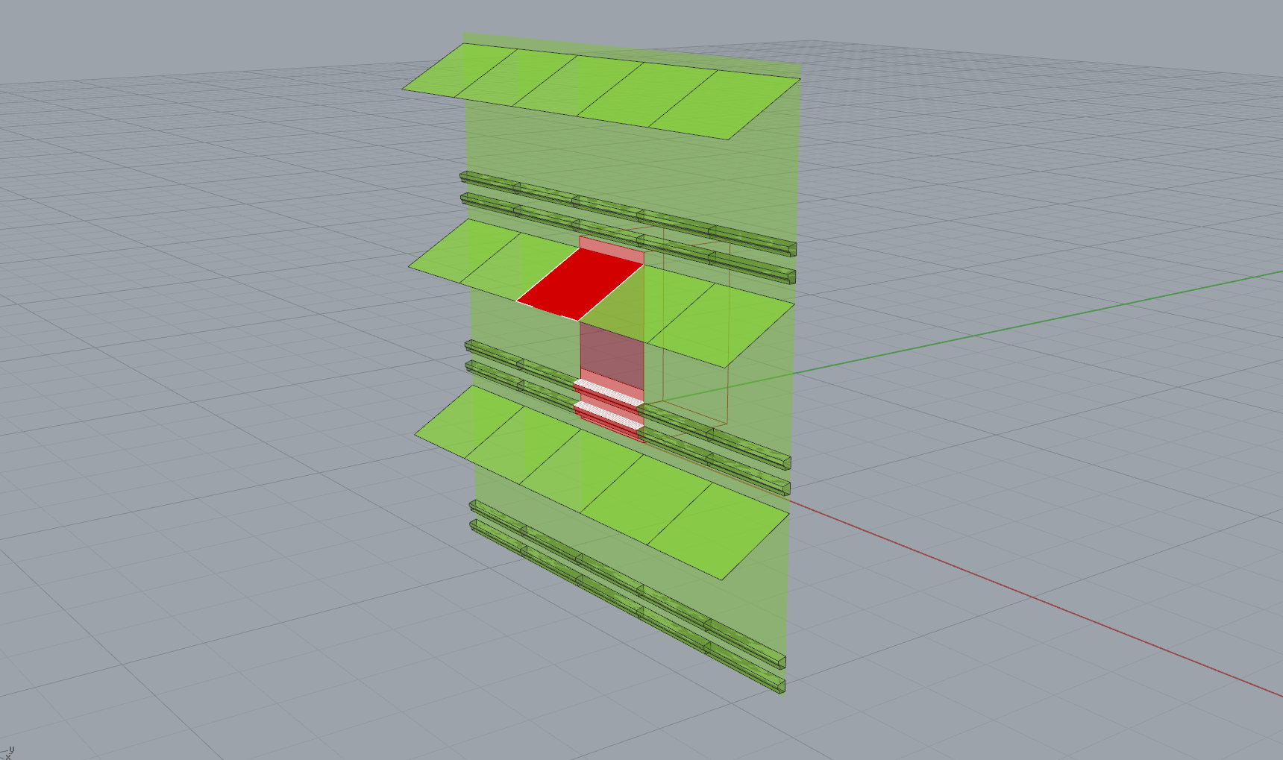
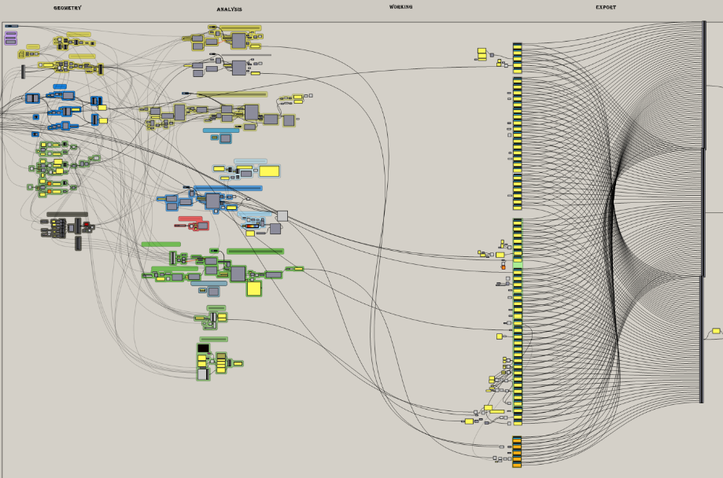
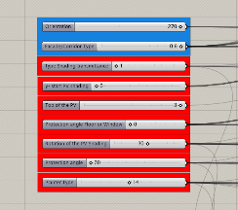
39/50 IV. Productive facades / Design development
Parametric simulation
Image of the Rhino model and the Grasshopper / Ladybug algorithm for the parametric calculation of building performance indicators and sunlight access.
1st Int Conf on Smart Grid Technologies, Singapore Sept 2017. PRODUCTIVE FACADES: POTENTIAL ENERGY AND FOOD HARVESTING IN SINGAPORE’S RESIDENTIAL BUILDINGS. Dr Abel TABLADA. Dept of Arch., SDE, NUS

Slide 41
40/50 IV. Productive facades / Design development
Design variants
1st Int Conf on Smart Grid Technologies, Singapore Sept 2017. PRODUCTIVE FACADES: POTENTIAL ENERGY AND FOOD HARVESTING IN SINGAPORE’S RESIDENTIAL BUILDINGS. Dr Abel TABLADA. Dept of Arch., SDE, NUS

Slide 42

41/50 IV. Productive facades / Design development
Design variants (total 12,180)
1st Int Conf on Smart Grid Technologies, Singapore Sept 2017. PRODUCTIVE FACADES: POTENTIAL ENERGY AND FOOD HARVESTING IN SINGAPORE’S RESIDENTIAL BUILDINGS. Dr Abel TABLADA. Dept of Arch., SDE, NUS

Slide 43




42/50 IV. Productive facades / Design development
Example: Test-run of the simulation
Tilt angle
15/30/45
Protection angle
10/20/30
Start PV shading
Top facade/planter
Planter
configuration
3
x
3
x
2
x
13
234 Cases
1st Int Conf on Smart Grid Technologies, Singapore Sept 2017. PRODUCTIVE FACADES: POTENTIAL ENERGY AND FOOD HARVESTING IN SINGAPORE’S RESIDENTIAL BUILDINGS. Dr Abel TABLADA. Dept of Arch., SDE, NUS

Slide 44



43/50 IV. Productive facades / Design development
Simulation results
Best case
Second best case
Prot. angle (20°) Tilt angle (30°)
Start shading (planter) Planter type (a10)
Prot. angle (10°) Tilt angle (45°)
Start shading (top fac.) Planter type (a6)
1st Int Conf on Smart Grid Technologies, Singapore Sept 2017. PRODUCTIVE FACADES: POTENTIAL ENERGY AND FOOD HARVESTING IN SINGAPORE’S RESIDENTIAL BUILDINGS. Dr Abel TABLADA. Dept of Arch., SDE, NUS

Slide 45




44/50 IV. Productive facades / Design development
Simulation results
1st Int Conf on Smart Grid Technologies, Singapore Sept 2017. PRODUCTIVE FACADES: POTENTIAL ENERGY AND FOOD HARVESTING IN SINGAPORE’S RESIDENTIAL BUILDINGS. Dr Abel TABLADA. Dept of Arch., SDE, NUS

Slide 46

45/50 IV. Productive facades / Design development
Survey to residents and experts
Extract of the survey to be conducted to residents of HDB buildings in order to obtain some of the criteria functions related to acceptance, accessibility and aesthetics.
1st Int Conf on Smart Grid Technologies, Singapore Sept 2017. PRODUCTIVE FACADES: POTENTIAL ENERGY AND FOOD HARVESTING IN SINGAPORE’S RESIDENTIAL BUILDINGS. Dr Abel TABLADA. Dept of Arch., SDE, NUS

Slide 47
43/50 IV. Productive facades / Design development
1. Initial definition of PSF components
Definition of PV system
Definition of Food Planters
2. Formulation of decision goal
3. Formulation of relevant design alternatives
Facade wall (N,S,E,W)
Facade with balcony (N,S,E,W)
Selected Design Alternative should balance: production output, costs, user comfort and aesthetics
4. Determination of relevant assessment criteria functions and weight coefficients
5. Assigning the criteria scores to design alternatives
Survey with experts and residents
Computer simulations
Calculations
Quantitative
Qualitative
6. Evaluation of SPF design alternatives and selection of the optimal SPF design alternative
Accepting one Design: proceed to step 7
7. Optimal PSF Design Alternative
Not accepting design: return to any previous step
Façade installation and monitoring
Definition of openings
MCDA method/VIKOR
1st Int Conf on Smart Grid Technologies, Singapore Sept 2017. PRODUCTIVE FACADES: POTENTIAL ENERGY AND FOOD HARVESTING IN SINGAPORE’S RESIDENTIAL BUILDINGS. Dr Abel TABLADA. Dept of Arch., SDE, NUS
Notes:
The objective of the study we are presenting today is to develop…. For each façade orientation two types of facades are going to be tested, façade wall and with balcony or corridor.

Slide 48


47/50 IV. Productive facades / Design development
VIKOR: multiple criteria decision analysis (MCDA)
1st Int Conf on Smart Grid Technologies, Singapore Sept 2017. PRODUCTIVE FACADES: POTENTIAL ENERGY AND FOOD HARVESTING IN SINGAPORE’S RESIDENTIAL BUILDINGS. Dr Abel TABLADA. Dept of Arch., SDE, NUS

Slide 49

48/50 IV. Productive facades / Design development
1st Int Conf on Smart Grid Technologies, Singapore Sept 2017. PRODUCTIVE FACADES: POTENTIAL ENERGY AND FOOD HARVESTING IN SINGAPORE’S RESIDENTIAL BUILDINGS. Dr Abel TABLADA. Dept of Arch., SDE, NUS

Slide 50
49/50 IV. Productive facades / Design development
1. Initial definition of PSF components
Definition of PV system
Definition of Food Planters
2. Formulation of decision goal
3. Formulation of relevant design alternatives
Facade wall (N,S,E,W)
Facade with balcony (N,S,E,W)
Selected Design Alternative should balance: production output, costs, user comfort and aesthetics
4. Determination of relevant assessment criteria functions and weight coefficients
5. Assigning the criteria scores to design alternatives
Survey with experts and residents
Computer simulations
Calculations
Quantitative
Qualitative
6. Evaluation of SPF design alternatives and selection of the optimal SPF design alternative
Accepting one Design: proceed to step 7
7. Optimal PSF Design Alternative
Not accepting design: return to any previous step
Façade installation and monitoring
Definition of openings
MCDA method/VIKOR
1st Int Conf on Smart Grid Technologies, Singapore Sept 2017. PRODUCTIVE FACADES: POTENTIAL ENERGY AND FOOD HARVESTING IN SINGAPORE’S RESIDENTIAL BUILDINGS. Dr Abel TABLADA. Dept of Arch., SDE, NUS

Slide 51

50/50 Experiment results: to be reported next time!
Thank you very much
Questions and suggestions
E-mail: abel@nus.edu.sg

