Slide 1
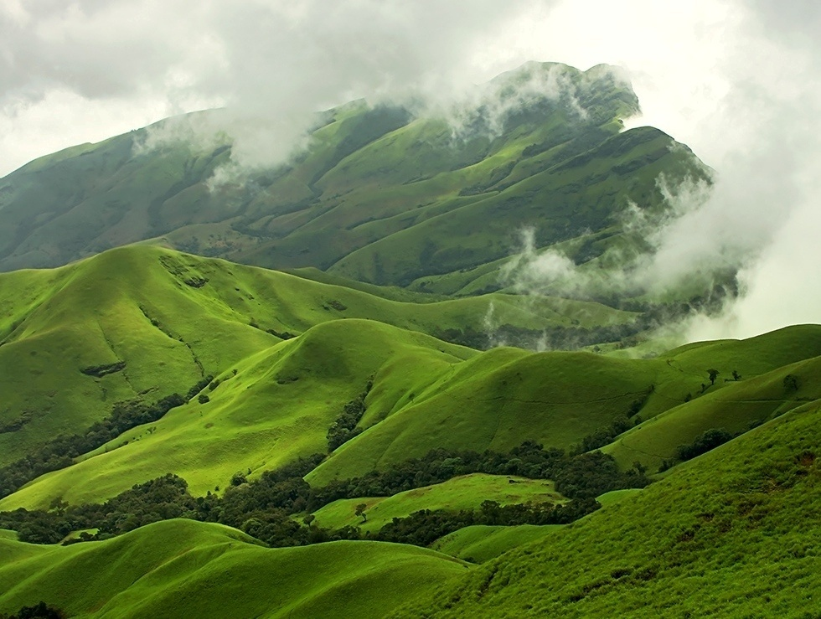
Floral structure in relation to pollination and breeding system of selected endemic Impatiens of Western Ghats.
A.K. SREEKALA
SCIENTIST
DIVISION OF CONSERVATION BIOLOGY
Jawaharlal Nehru Tropical Botanic Garden and Research Institute
Thiruvananthapuram - 695 562,
Kerala , India

Slide 2
Species highlighted
Beautiful plants: With variously coloured flowers and peculiar floral structure.
Family Balsaminaceae : Two genera- Hydrocera Blume & Impatiens L.
Succulent annuals or perennials, rarely becoming shrubs or epiphytes.
Great horticultural potential.
India : Genus represented by 209 species.
Distributed in three major centers of diversity i.e. Western Himalayas, Hills of North Eastern States and Western Ghats.
95 species in Peninsular India, more than 82 are endemic and confined to Western Ghats. 30 species have already in threatened category including 19 critically endangered ones.

Slide 3
Motivations for undertaking the study
Delicate structure
Explosive fruits
Anthropogenic pressures
Habitat degradation
Fluctuations in climate
Low insect visitation rate
Inbreeding depression
Low percentage of seed germination

Slide 4
The survival of the selected candidate species in the Western Ghats is questionable due to various biotic and abiotic factors including reproductive constraints.
Majority of the Impatiens species are mainly reproduced by means of cross pollination. So their survivability mainly depends on pollination by the visitors.
The visitation rate of the pollinators depends upon its colour, size, shape, fragrance and nectar availability.
In this background, a study had been framed to analyze the relation ship between floral structure, pollination and breeding system of selected Impatiens in the Western Ghats.

Slide 5
Species selected for the study
Impatiens coelotropis C.E.C.Fisch.

Slide 6
Impatiens grandis B.Heyne

Slide 7
Impatiens henslowiana Arn.

Slide 8
Impatiens phoenicea Bedd.

Slide 9
Impatiens platyadena C.E.C.Fisch.

Slide 10
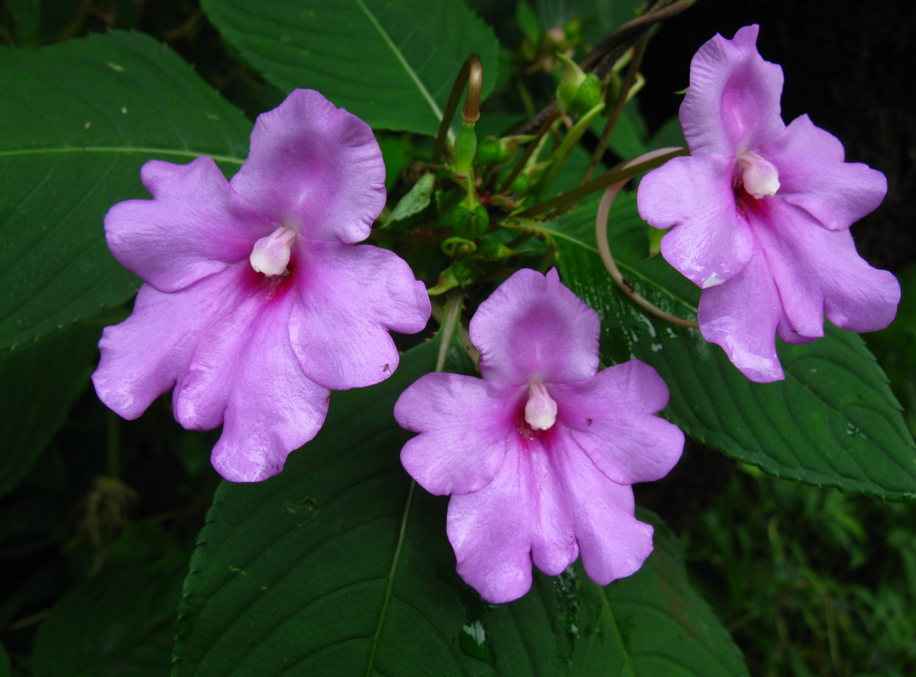
Impatiens pulcherrima Hook.f.
Impatiens pulcherrima Dalzell

Slide 11
Impatiens trichocarpa Hook. F.

Slide 12
Impatiens verticillata Wight.

Slide 13
Study area
Western Ghats, covering an area of 1,60,000 sq.km. The northern parts and extreme southern tips are less moist, while the central and Southern Western Ghats receive heavy annual precipitation of up to 6000mm, which supports dense diverse tropical forests rich in species diversity and endemism. The mountainous configuration, high altitude, heavy rainfall and humid climate makes this tract one of the botanically richest areas of India and therefore designated as one among 34 globally recognised biodiversity hotspots in the world.

Slide 14
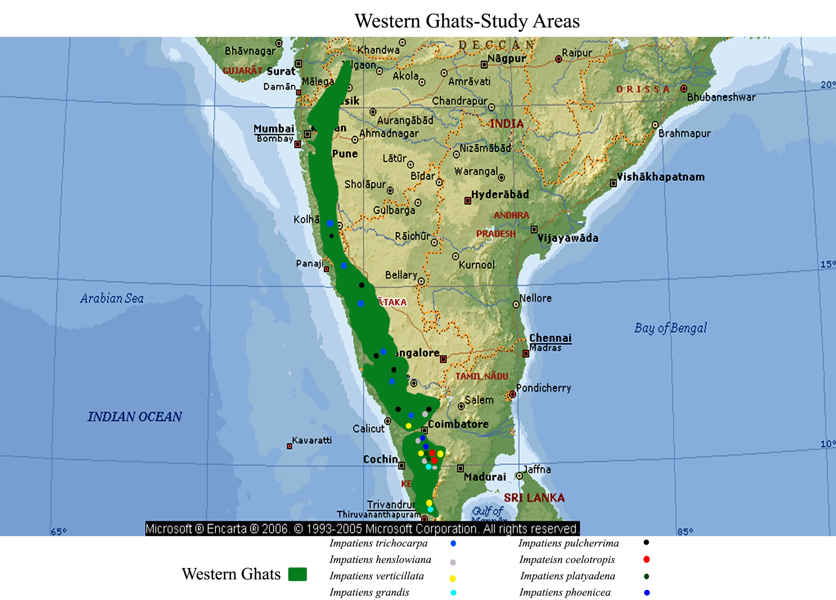

Slide 15
Methodology
Exploration trips
Phenology
Floral morphology
Pollination
Breeding experiments

Slide 16
Results
Morphology
Balsams are beautifully coloured flowers with peculiar floral structure. Every species of Impatiens have its special type, colour and shape of floral organs.
The floral parts (lip with spur and wing petals) are specially adapted for entomophilous pollination especially by bees and butterflies.
Calyx : Sepals 5, lateral 2 sepals are green or coloured , lower 3 sepals are modified into lip with spur. In I. coelotropis, the lip is large, deeply succate and deep green in colour. Usually the lip is boat shaped and the spur is long and coloured.
Corolla : 5 Petals. One standard petal. The lateral petals are usually bright coloured , the arrangement of wing petals act as a landing platform for bees and butterflies. Beautifully coloured/brightly coloured petals attract the floral visitors for pollination.

Slide 17
Cont…
Androecium : The androecium has 5 stamens with short filaments and are partially fused. The dithecal tetrasporangiate anther are connivent and open either apically or laterally by means of pores or slits
Gynoecium : The anthers lie as a cap above the gynoecium which has a 5 locular, syncarpous ovary with star shaped stigmas. The style is reduced. After the shedding of androecium the coherent stigma commonly spread and star shaped receptive stigmatic surface is exposed. The flowers are protandrous favouring cross pollination.

Slide 18
Floral characters of selected species of Impatiens
Floral Characters | I. coelotropis | I. grandis | I. henslowiana | I. phoenicea
Flowering period | Aug- Jan | Aug-Dec | July-Dec | July-Dec
Flower opening time | 2130-2330 h | 0300-0500 h | 2130-0530 h | 0330-0740 h
Flower type | Zygomorphic | Zygomorphic | Zygomorphic | Zygomorphic
Nectar (ul) | 5.7±1.87 | 5.2±1.67 | 6.4±1.43 | 4.1±1.08
Flower color | Red | White | White | Brick red
No. of anthers per flower | 5 | 5 | 5 | 5
Anther dehiscence time | Protandrous | Protandrous | Protandrous | Protandrous
Mean no. of pollens per flower | 42,520 | 48,620 | 38,250 | 28,860
Mean no. of ovules per flower | 24 | 26 | 22 | 14
Pollen size (µm) | 38.03±2.67 | 36±8.6 | 41.31±3.08 | 31.06±3.37
Stigma type | Wet and non pappillate | Wet and non- papillate | Wet and non pappillate | Wet and non pappillate
Percentage of fruit set in natural condition | 8% | 30% | 36% | 10%

Slide 19
Cont…
Floral Characters | I. platyadena | I. pulcherrima | I. trichocarpa | I. verticillata
Flowering period | Sep-Dec | July-Dec | July-Nov | Aug-Dec
Flower opening time | 0600-0930 h | 0500-0700 h | 0200-0330 h | 0300-0700 h
Flower type | Zygomorphic | Zygomorphic | Zygomorphic | Zygomorphic
Nectar (ul) | 8.3±2.81 | 5.3±1.42 | 3.5±1.82 | 2.8±0.81
Flower color | Red | Pink | Pink | Scarlet red
No. of anthers per flower | 5 | 5 | 5 | 5
Anther dehiscence time | Protandrous | Protandrous | Protandrous | Protandrous
Mean no. of pollens per flower | 37,530 | 24800 | 38,280 | 19,400
Mean no. of ovules per flower | 16 | 18 | 20 | 19
Pollen size (µm) | 32±2.8 | 38.16 | 34±7.2 | 28±3.5
Stigma type | Wet and non pappillate | Wet and non- papillate | Wet and non- papillate | Wet and non- papillate
Percentage of fruit set in natural condition | 34% | 38% | 29% | Nil

Slide 20
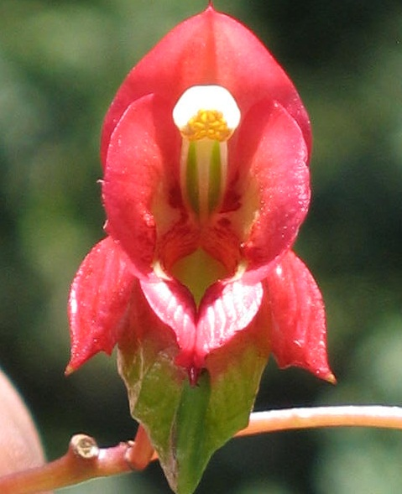
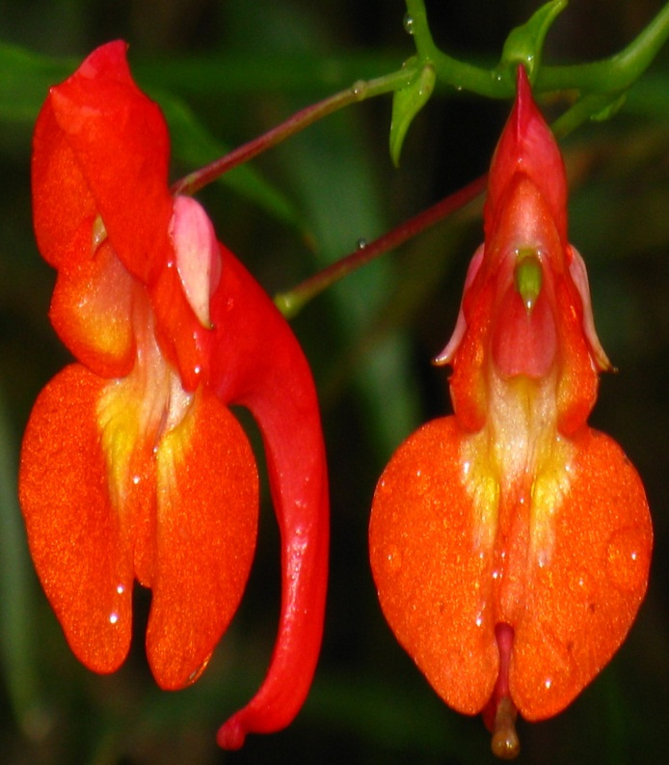
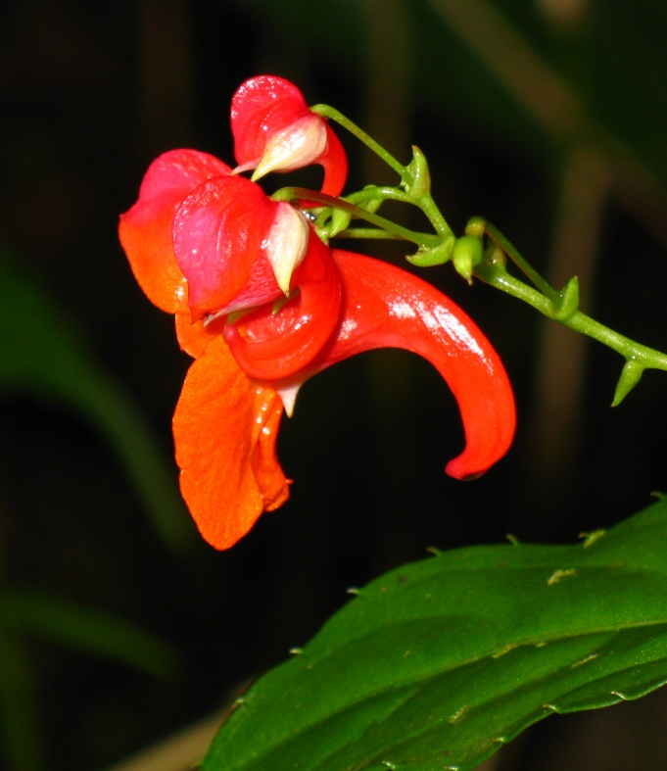
SP
AN
O
LS
LS
WP
WP
Lateral View
SP
LS
LS
O
L
L
S
WP
WP
S
WP
WP

Slide 21
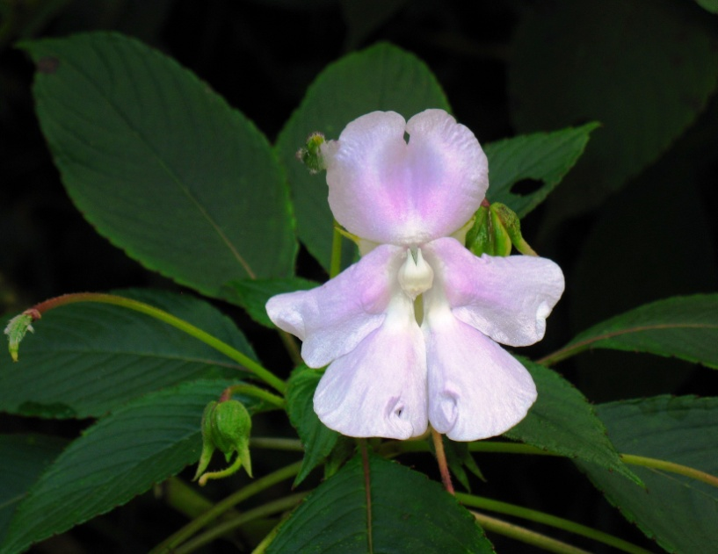
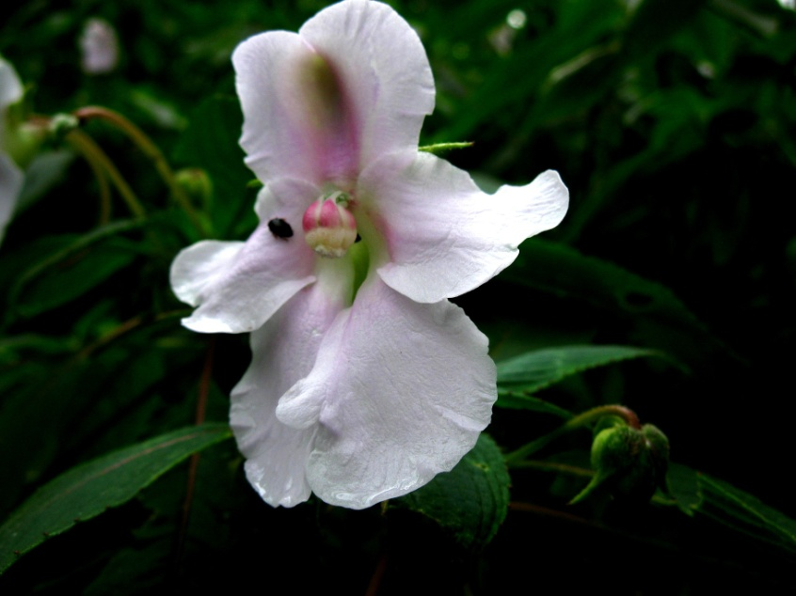
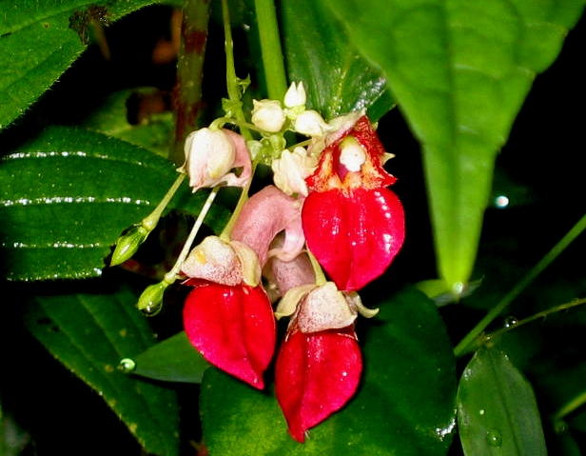
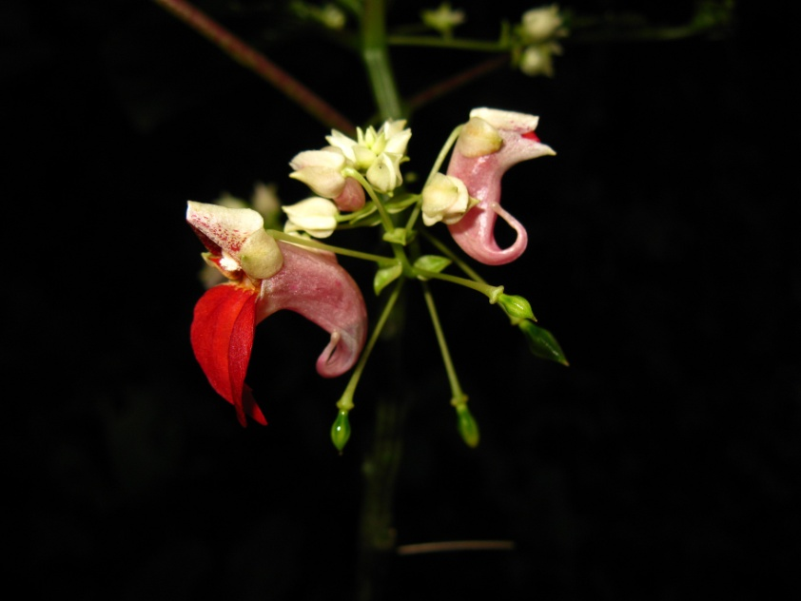
SP
SP
O
AN
WP
WP
AN
LS
S
WP
WP
L

Slide 22
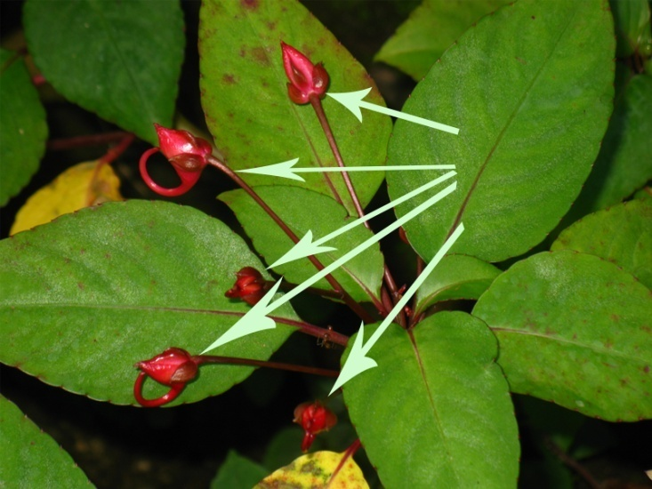
Resupination
In the majority of Impatiens, buds are positioned with the standard uppermost and the lip below them. Some flowers are born with lip above and the standard petals which are lowermost. The reversal position of flower buds occur as a result of a process called resupination. This process takes place 2-3 days before anthesis. Darwin suggested that, resupination supports pollination because the labellum assumes the position of a lower petal, so that insects can easily visit the flower.

Slide 23
Flowering phenology
Under the climatic conditions of Western Ghats about 90% of Impatiens blooms during July – December. This observation is similar to that of our candidate species also. Young seedlings of selected Impatiens begin to appear after the commencement of monsoon (June). Some of the high altitude balsams opens in the night (I. coelotropis, I. henslowiana, I. grandis, I. phoenicea, I. trichocarpa) and the rest of them bloom in the early morning. The plants were in flower for a total of 180 days in a year. The average life span of each flower is 2-4 days. Fruit development was completed between 18-20 days after pollination.

Slide 25
Pollination
Honey bees, Trigona sp, Butterflies and Hawk moths are the major pollinators.
In different climatic regions, species of pollinators are varying.
The insects land at the front of the flower and passes through the corolla to the spur behind the sepal to collect nectar. The insects collecting nectar from the spur, its back comes in contact with the androecium. The insect comes in contact with the second time, the androecium falls off and the stigma becomes exposed. Another insect visits the flower for nectar, its back comes into contact with the receptive stigma and thus pollination takes place. Finally, the perianth falls off and the insects visit have come to cease.

Slide 26
Pollinators and their foraging behaviour
Sl. no | Name of the pollinator | Foraging time | Foraging nature | Foraging period (hr) | Stigma Touch
1 | Apis cerana indica (c, pl, ph, g, v, pu, t, h) | Day | Nectar and pollen | 07 30-16 00 | +++
2 | Apis dorsata (c, h, g) | Day | Nectar and pollen | 09 00-13 00 | ++
3 | Trigona iridipennis (g, v, t, h) | Day | Nectar and pollen | 06 30-10 00 | ++
4 | Danaus chrysippus (pl, ph, pu, g, h) | Day | Nectar | 06 00-13 00 | ++
5 | Danaus genutia (g, h, t) | Day | Nectar | 07 00-09 00 | ++
6 | Tirumala limniace (v, g, h, pl) | Day | Nectar | 06 00-11 00 | ++
7 | Parantica aglea (pu, ph, h) | Day | Nectar | 07 00-16 00 | ++

Slide 27
Cont…
8 | Caprona ransonnetti (c, h, v) | Day | Nectar | 08 00-12 00 | ++
9 | Rpthima baldus (pl, ph, v) | Day | Nectar | 06 00-14 00 | ++
10 | Badamia exclamationis (c, ph, pu) | Day | Nectar | 09 00-16 00 | ++
11 | Macroglossum corythus (c, h, ph, t) | Night | Nectar | 22 00-24 00 | ++
12 | Papilio demoleus (ph, pu, t) | Day | Nectar | 06 00-16 00 | ++
13 | Pachliopta aristolochiae (pl, pu, t, v) | Day | Nectar | 07 00-16 00 | ++
13 | Pachliopta hector (ph, pl, g, h) | Day | Nectar | 06 00-17 00 | ++
14 | Pareronia valeria (h, t, pu) | Day | Nectar | 09 00-16 00 | ++
15 | Xylocopa sp. (c) | Day | Nectar | 08 00-11 00 | +
+ : 10 – 15 pollens, ++ : 30-50 pollens, +++ : more than 50 pollens
C: I. coelotropis, g: I. grandis, h: I. henslowiana, ph: I. phoenicea, pl: I. platyadena, pu: I. pulcherrima, t: I. trichocarpa, v: I. verticillata

Slide 28
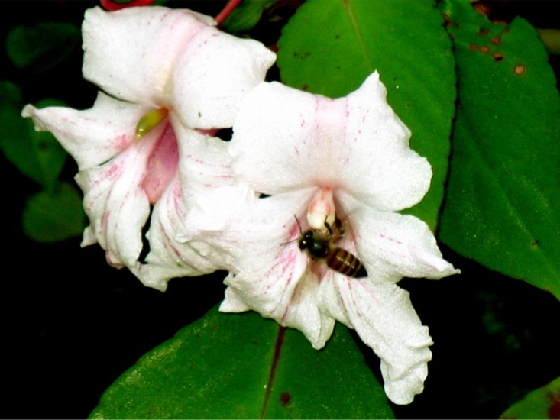
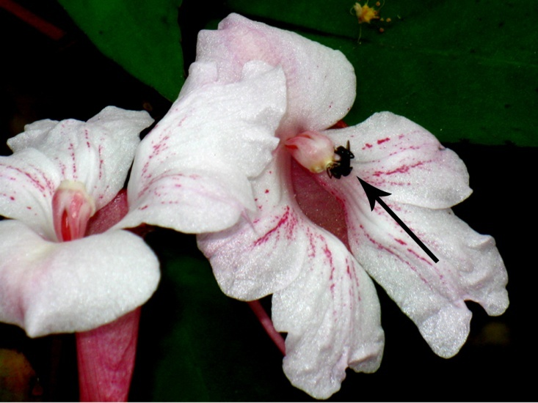
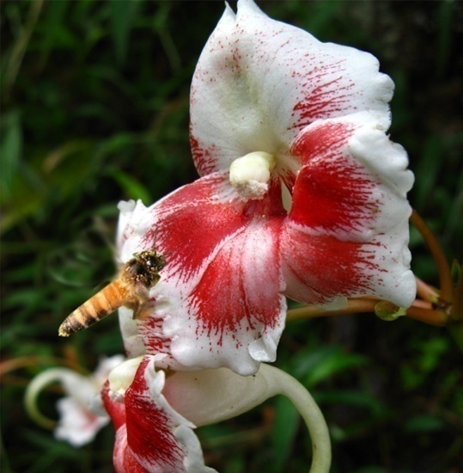
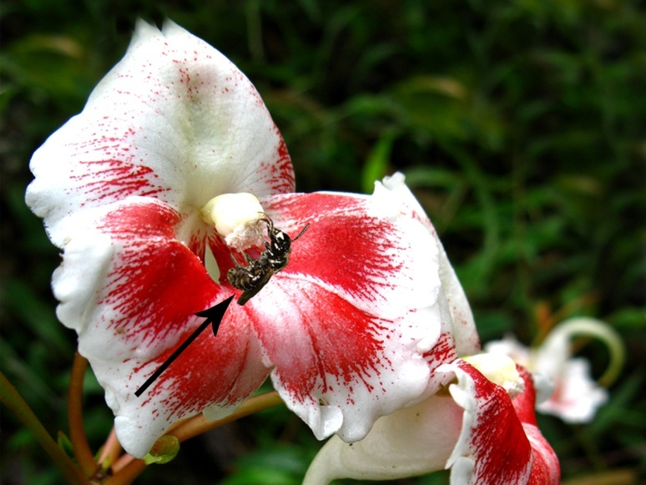
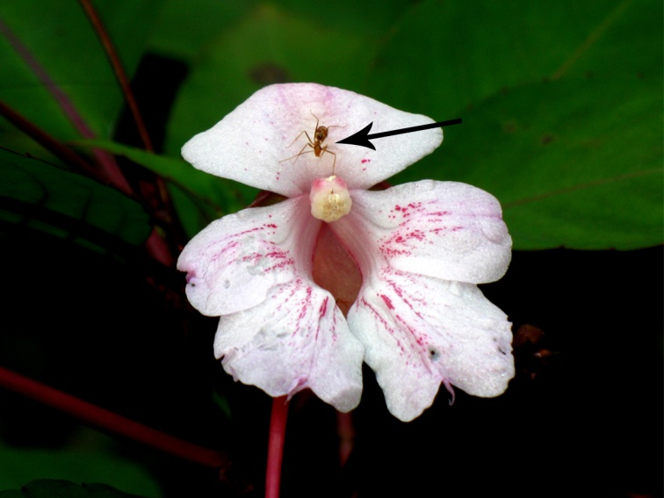
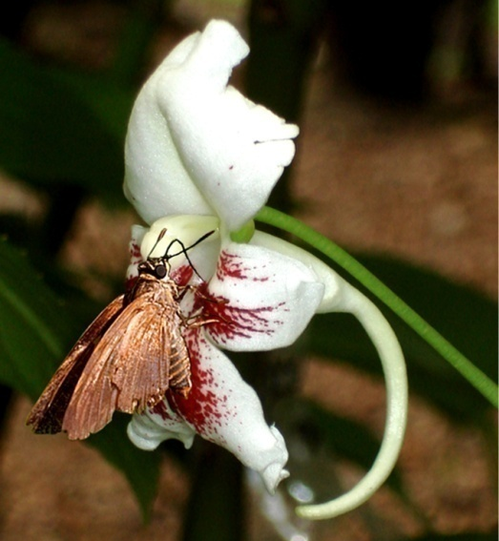
Pollinators of Impatiens grandis
Apis cerana
Trigona iridipennis
Apis dorsata
Ceratina cucurbitina
Oecophylla smaragdina
Badamia exclamationis

Slide 29
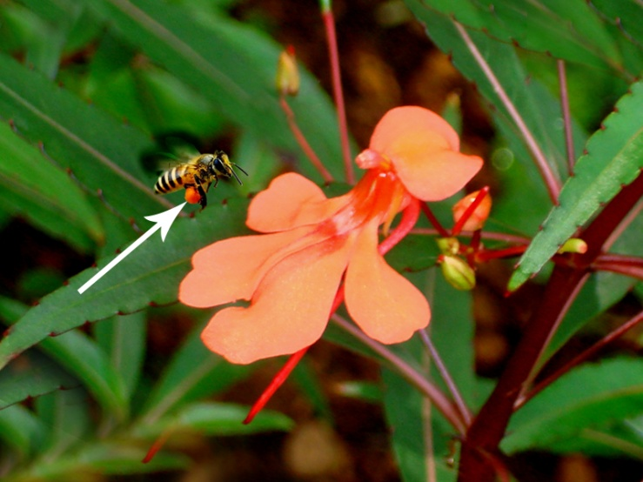
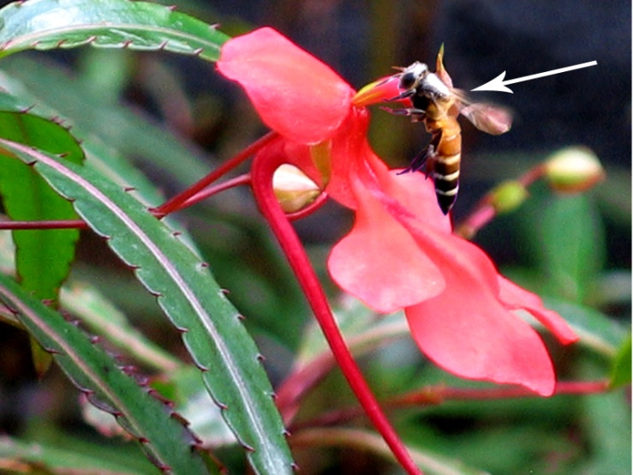
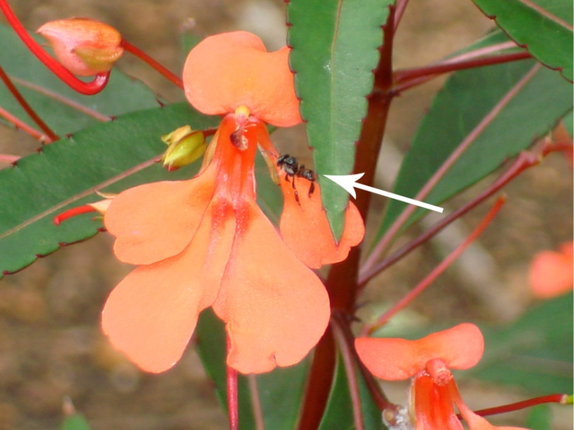
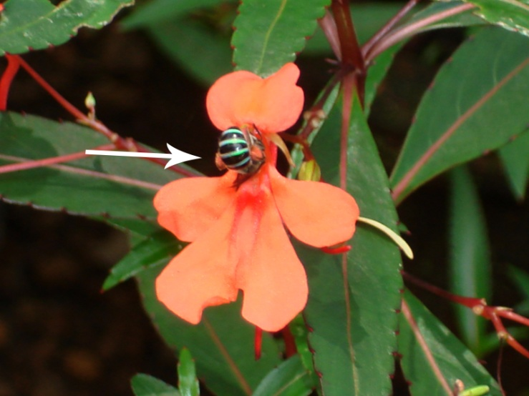
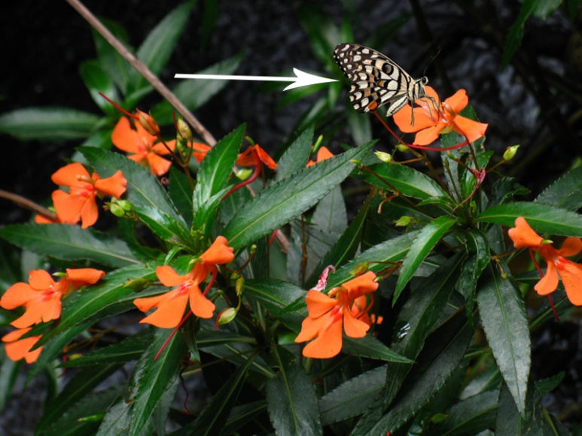
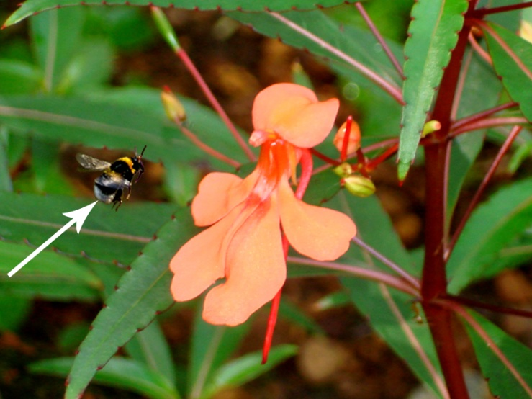
Pollinators of Impatiens verticillata
Apis cerana
Apis dorsata
Trigona iridipennis
Amegilla (Zonamegilla) sp.
Papilio demoleus
Unidentified bee sp

Slide 30
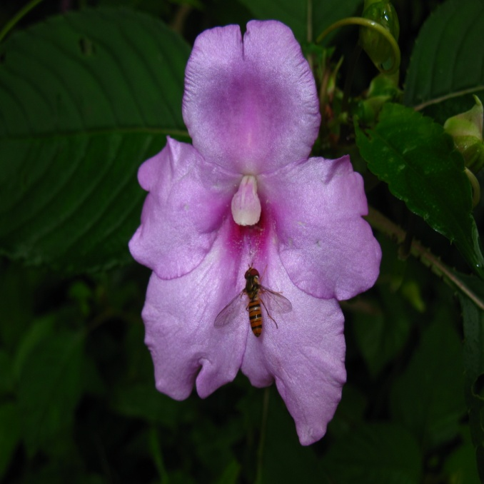
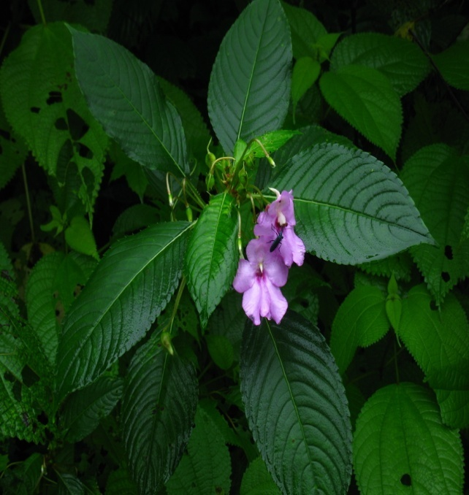
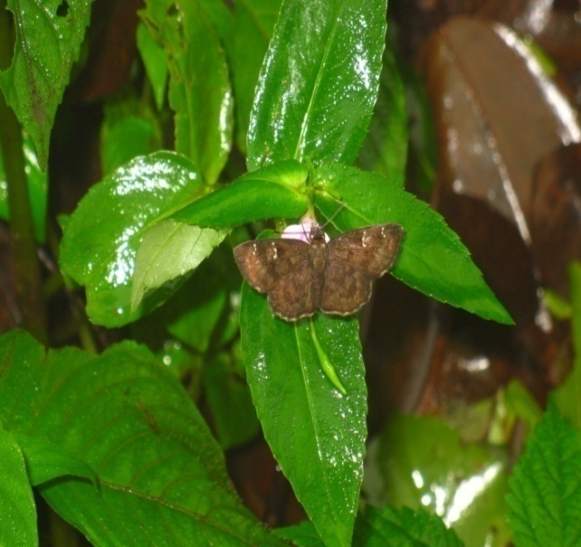
Floral visitors of Impatiens pulcherrima

Slide 31
Pollinators of I. trichocarpa, I. platyadena and I. coelotropis

Slide 32
Breeding experiments
In all the selected species, fruit set was not observed in autogamous self pollination.
In open pollination, 8-38 % fruit set was observed.
Impatiens coelotropis, I. henslowiana, I. phoenicea, I. platyadena, I. trichocarpa and I. verticillata are exclusively xenogamous pollinated. The other species such as I. grandis and I. pulcherrima permits both geitonogamous and xenogamous pollination.
Percentage of fruit set in manual pollination is higher than that resulting from natural pollination, which strongly indicates that some external agents are required for successful pollination.

Slide 33
Conclusion
The flowers of selected species of Impatiens are insect pollinated, the modification and adaptations of floral parts attract pollinators towards successful pollination. Out crossing is very significant in the pollination biology of Impatiens, which ensures better seed output.
In Impatiens, the morphology, size and shape of the flowers may vary between the species, but the breeding system of the species is almost same. Breeding experiments demonstrated that the percentage of fruit set in manual pollination was higher than that resulting from natural pollination, which strongly indicates that some external agents are required for successful pollination.
The visitation rate of the pollinators was affected by heavy rainfall, poor sunlight and humidity. In general, the number of visitors per population and visitation rate was low in the natural habitat, which leads to poor fruit set. The percentage of seed germination was also low. Their dependence on specialised habitat, a narrow environmental niche, scarcity of pollinators, poor fruit set, low percentage of seed germination could be the reasons for its limited distribution and endemism.

Slide 34
Acknowledgement
I thank the Director, Tropical Botanic Garden and Research Institute, Thiruvananthapuram, for providing facilities. Financial support received through a research project from DST, New Delhi is acknowledged. I express my sincere thanks to my colleagues and research scholars, viz. Dr. R. Ramasubbu, Dr. S.K. Kulloli, Mrs. Jayalakshmi. M and Ms. Maria Theresa for help during field collection.

Slide 37
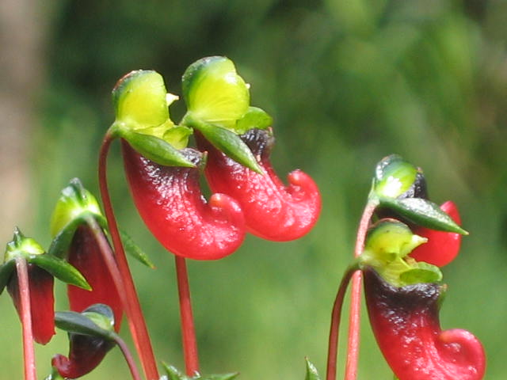
One need not be either play a role in recording or protecting biodiversity. With a spirit of care and love towards nature and a strong conservation ethic that focus protection on wilds can aim the conservation strategy to a long extant..!!!
Thank you

