Slide 1

Identification of Internal Waves in the Western Bay of Bengal: Observations and Modelling
A. D. Rao
Centre for Atmospheric Sciences
Indian Institute of Technology Delhi

Slide 2
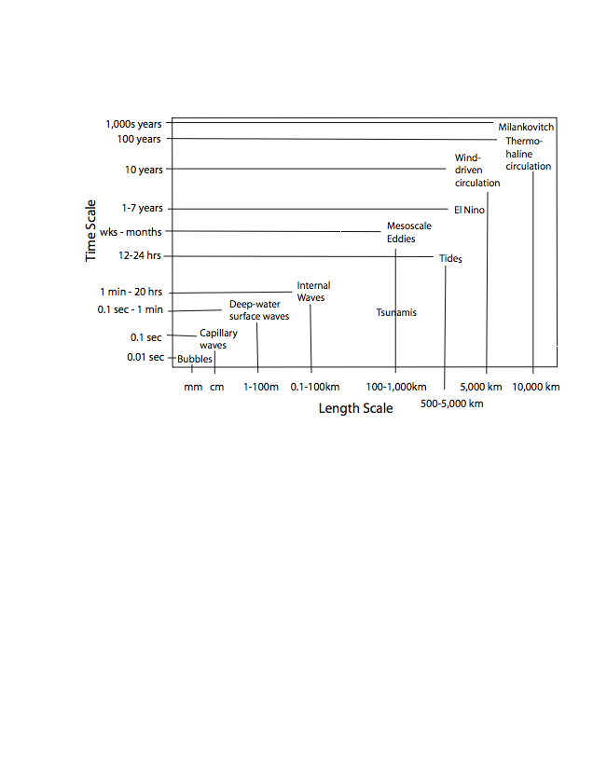
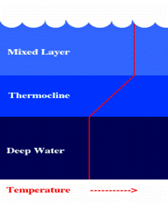
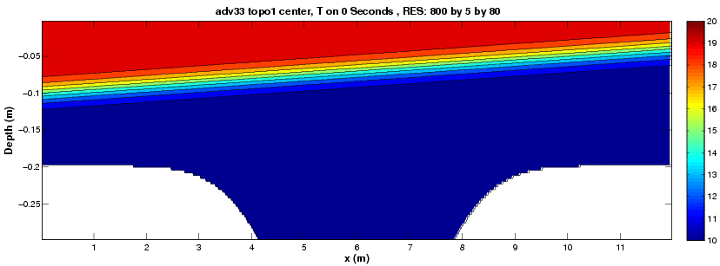
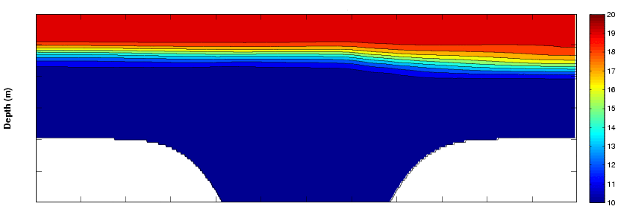
Internal Waves : Spatial and temporal scale
few min – few days
(25-150m)
( Slight/No Change of
density/temperature )
°C
(50-1000m)
( Rapid Change of
density/temperature )
Depth
( Slight/No Change of
density/temperature )
Horizontal extent

Slide 3
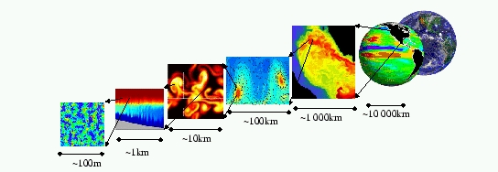
Model Domain for the Western shelf of the Bay of Bengal :
Hor. resolution: 2-3 km
Model matrix: 220x 280x 23.
MITgcm (Massachusetts Institute of Technology General Circulation Model ;Marshall et al, 1997)
Designed ⇒ for oceanic and atmospheric phenomena.
It resolves ⇒ large scale circulation, process studies (e.g. convection, eddies, internal waves) and laboratory studies.
hydrostatic
Non-hydrostatic
Model domain and bottom topography

Slide 4
In-situ data collection location and period
Station locations:
Stn. A: 84.80⁰E 18.61⁰N ( 100 m)
Stn. B: 84.44⁰E 18.33⁰N (100 m)
Stn. C: 84.67⁰E 18.38⁰N (500 m)
Data collection periods:
17-21 Feb 2012 (3d)
24 Aug – 5 Sept 2013 (11d)
20 Nov 2013 – 6 Jan 2014 (46d)
26 Feb – 23 Apr 2014 (56d)

Slide 5
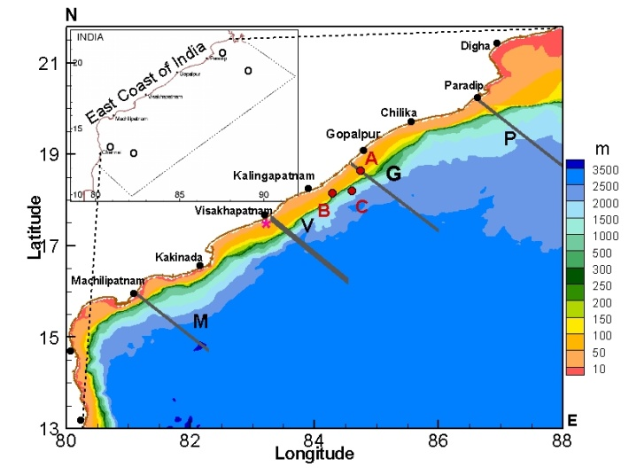
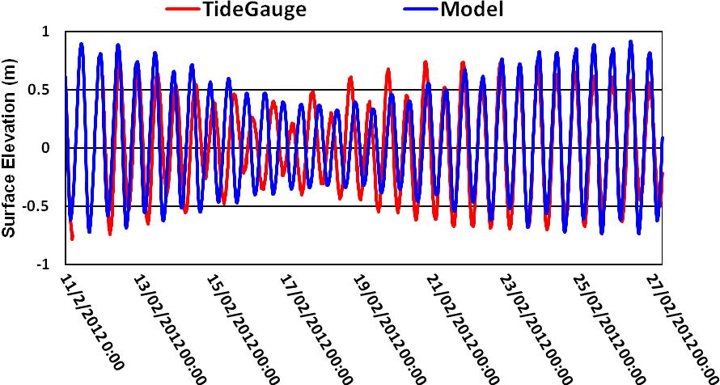
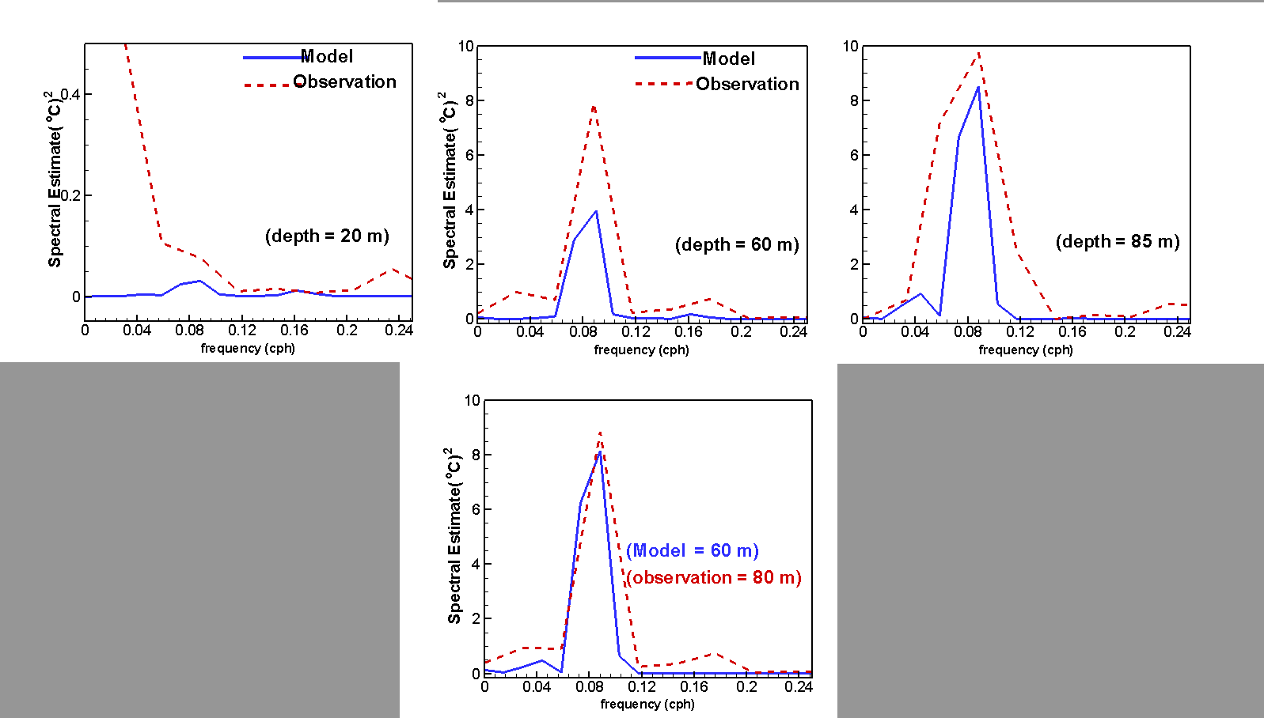
Model Validation: for Feb 2012
Tide gauge and MODEL simulation
Figure: Model analysis area shown in the inset map; Red dots depict the locations of in-situ observations during 19-21 February 2012 at Stn A, B and C. Tide gauge location is marked by star. The locations of TPXO are marked in circles in the inset.
In-situ temperature data and MODEL simulation
Figure: Comparison of model surface elevation (m) with tide gauge data February 2012.
TPXO data and MODEL simulation
Figure: Comparison of model surface elevation (m) during observational period with TPXO data at local depths of (a) 50m ,(b) 300m, (c) 2000m and (d) 3000m.
Figure : Estimates of spectral energies during 19-21 Feb 2012 at Stn A; (a, b) comparison at depths 60m 85m; (c) IW spectral energy at different depths; (d) vertical temperature & associated energy due to semidiurnal tide

Slide 6
Satellite imageries showing IWs over the shelf-slope region in western Bay of Bengal
a
A
B
C
Figure : Surface signatures of internal waves on 19 Feb 2012 (b) Closer look of three groups of rank ordered internal wave packets.

Slide 7
Model Validation:
For 20-23 Dec 2013
Station A (18˚36.54' N, 84˚47.24' E, Station depth 113m )
Fig: Bathymetry of the model domain
For 27-30 August 2013
Station A
Station C (18˚15.58' N, 84˚30.51' E, Station depth 265m )

Slide 8
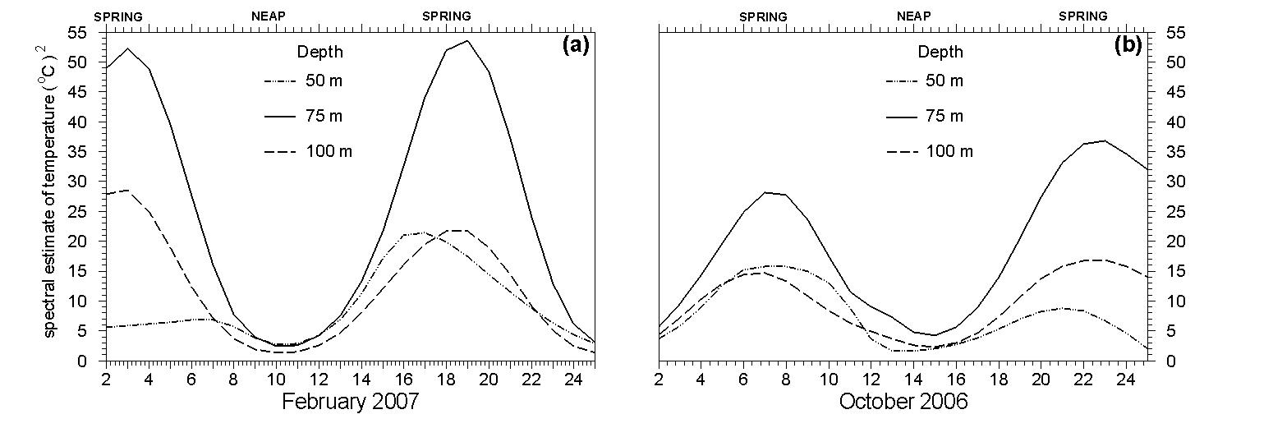
Intra-tidal variability of IWs off Gopalpur
Spring-tide
Neap-tide
Spring-tide
Neap-tide
sunny

Slide 9
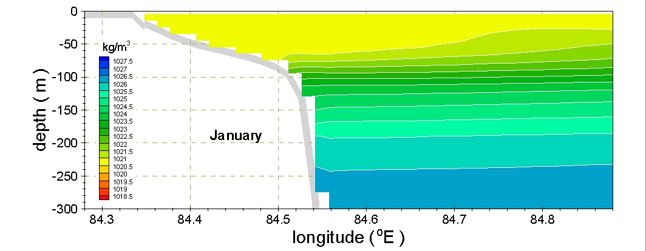
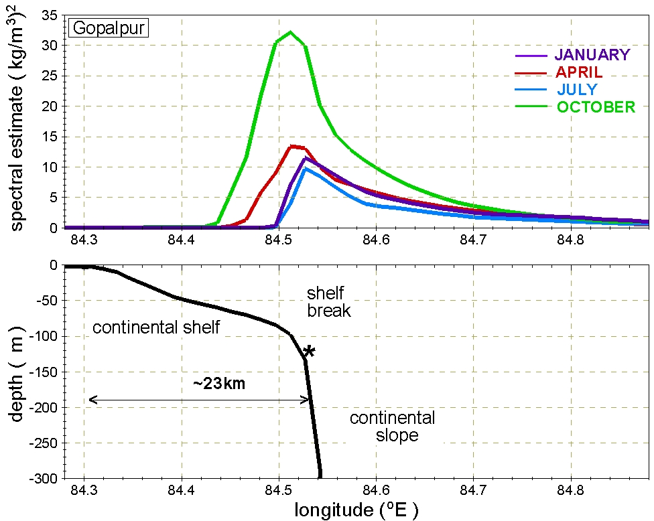
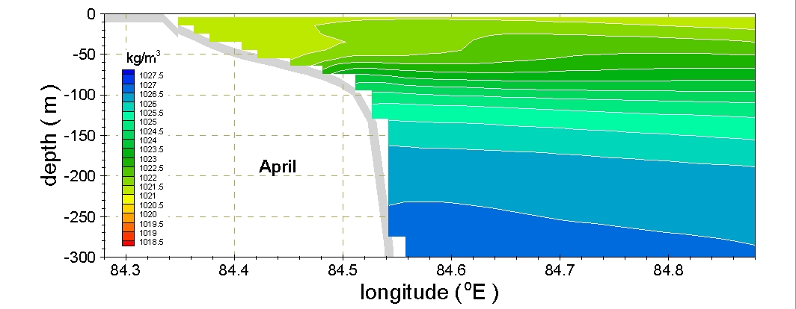
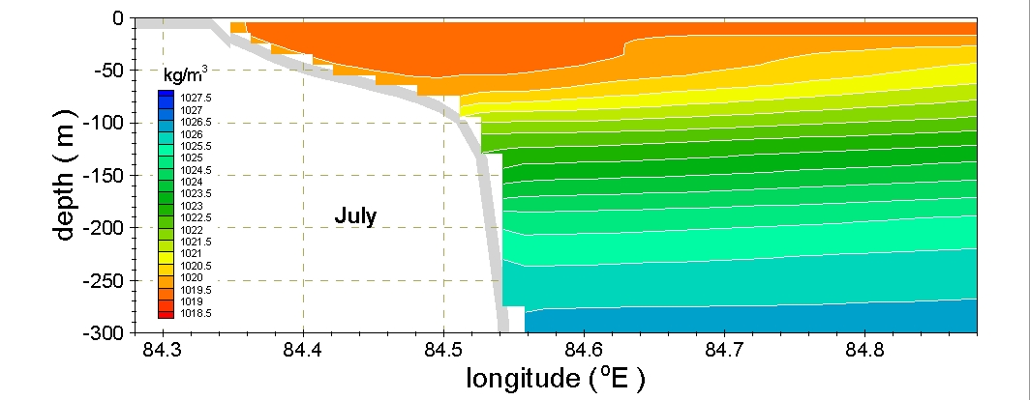
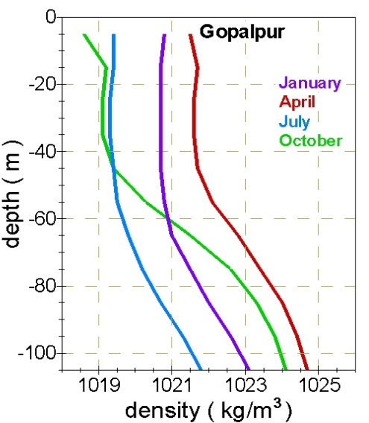
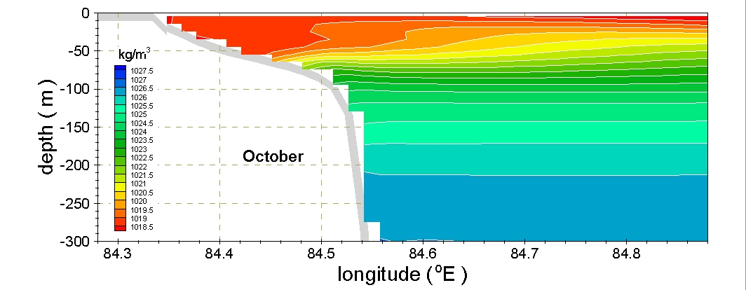
Inter-seasonal variability of Internal tides off Gopalpur

Slide 10
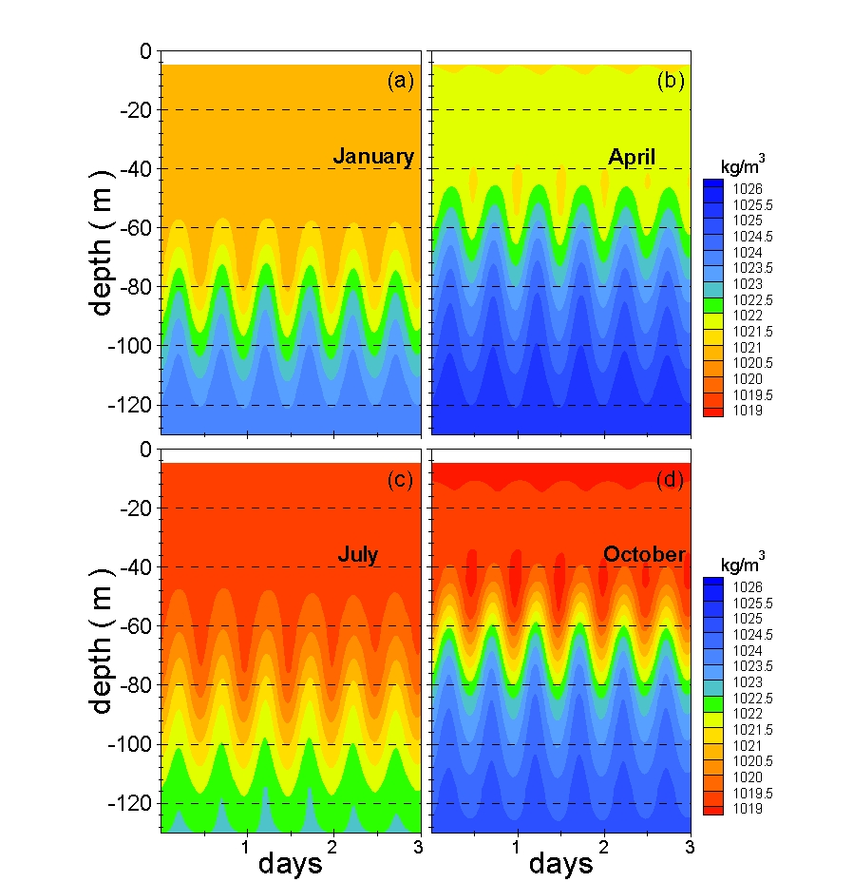
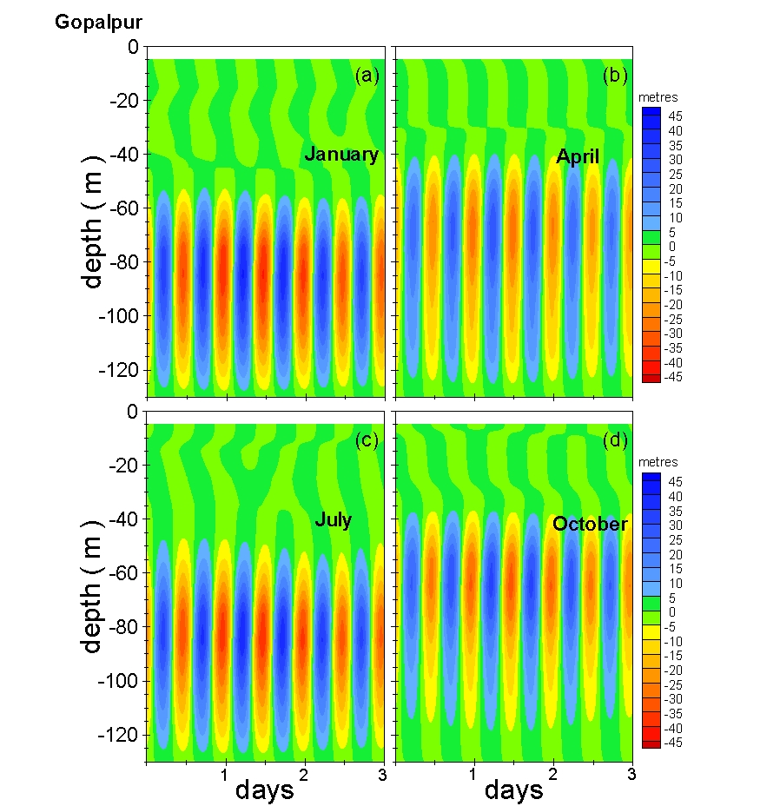
Density oscillations and isopycnal displacement at shelf break off Gopalpur
Density
Isopycnal displacement

Slide 11
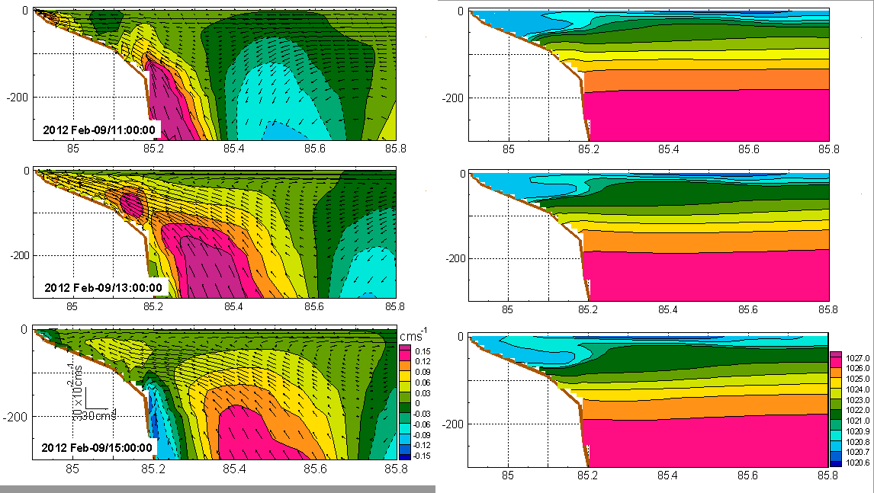
Snapshots of vertical velocity off Gopalpur
Vertical velocity
Figure: Snapshots of vertical velocity (shaded) and currents (vectors) at 2-hour interval off Gopalpur.

Slide 12
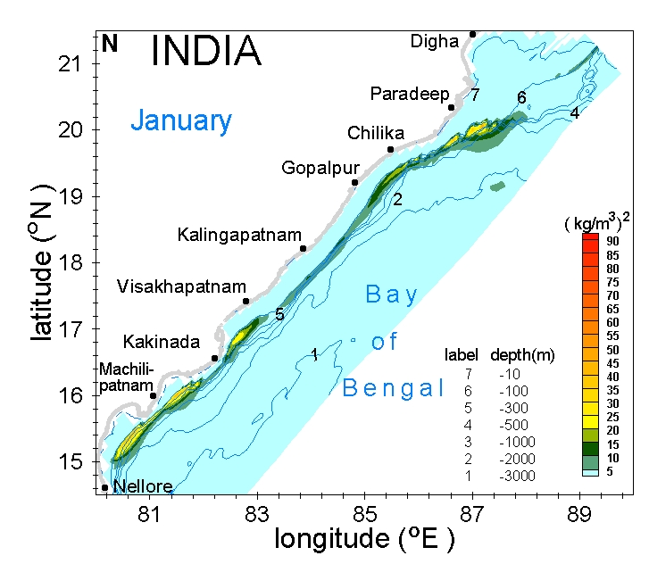
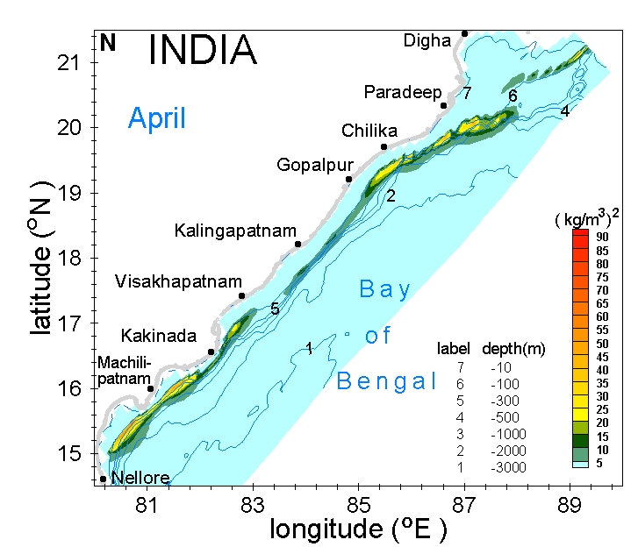

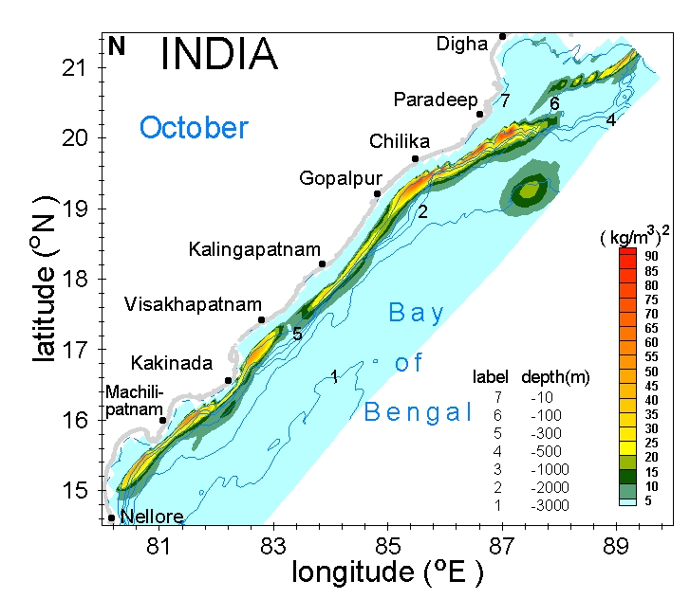
Inter-seasonal variability of Internal tides in the domain

Slide 13
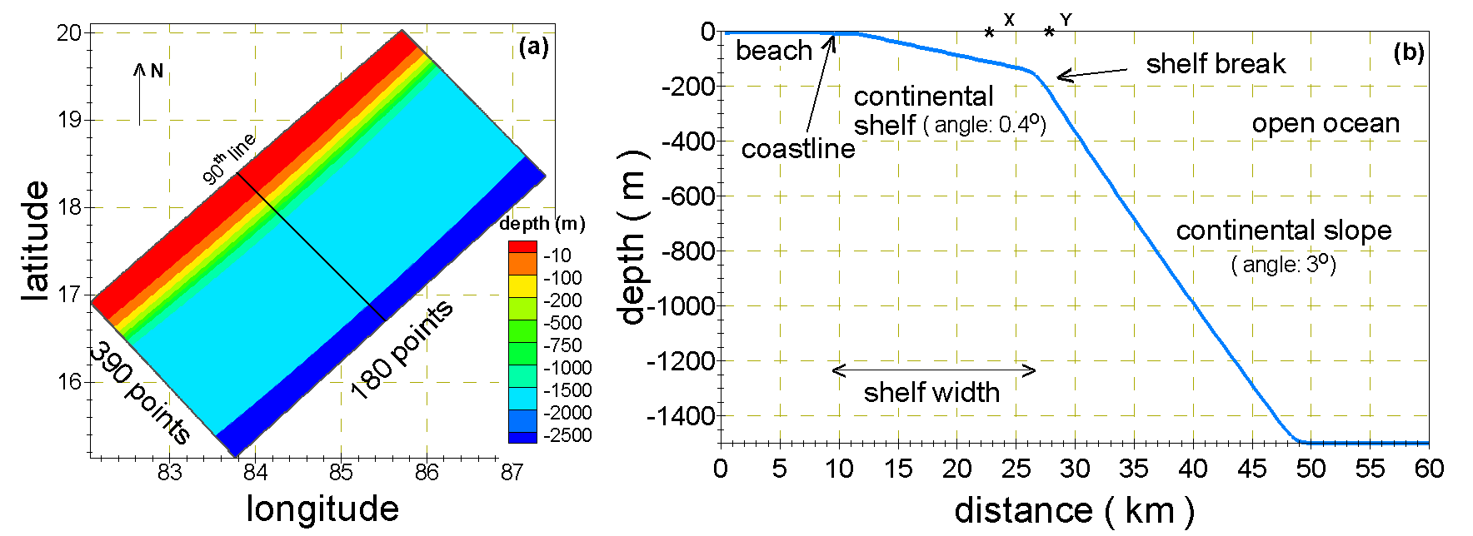
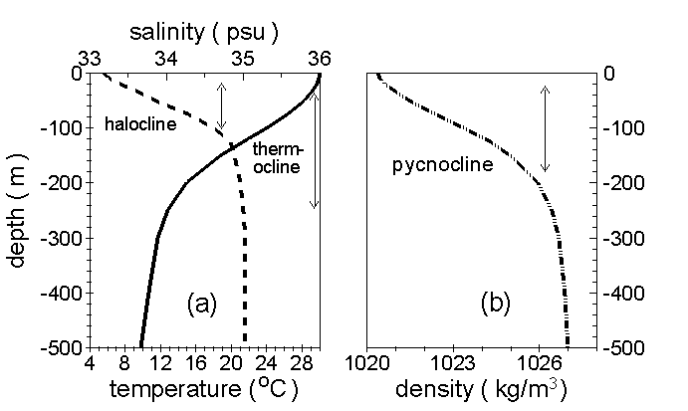
Experiments with shelf width & shelf break depth
Figure: (a) Schematic representation of model domain along with bathymetry, (b) representative bottom topography showing continental shelf, shelf break and continental slope.
Figure: Vertical profile representative of May (a) Temperature and Salinity, (b) Density.

Slide 14
Idealized experiments :
Experiments with continental shelf angle
and stratification
Figure: Spectral estimate of density across all cross-sections. (b) Bottom topography normal to the shelf for all angles (left) and vertical density profile (right).
Figure: (a) Spectral estimate of density across all cross-sections. (b) Bottom topography normal to the shelf (left) for all angles and vertical density profile (right).

Slide 15
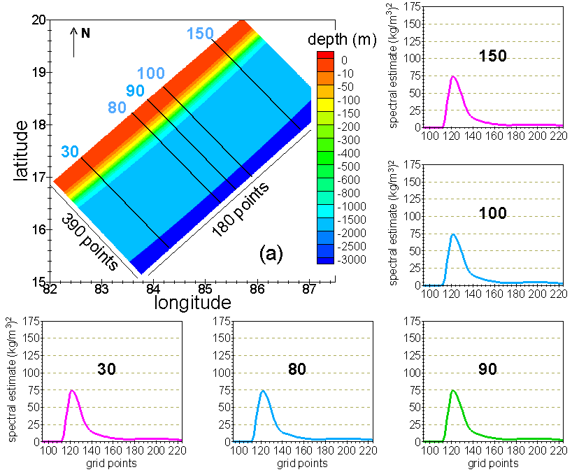

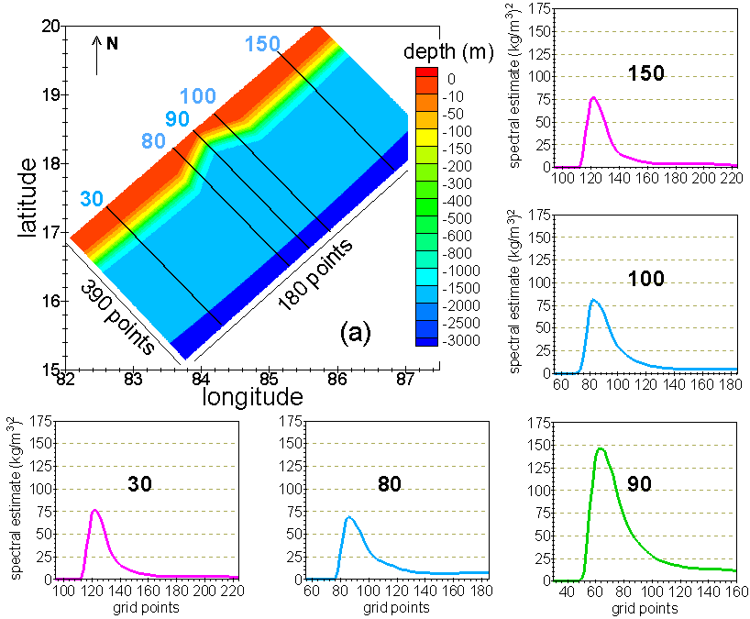



Effect of Coastal geometry with and without rotation :
f = 0
f ≠ 0
S
T
R
A
I
G
H
T
The estimate remains the same for f = 0.
The estimate increases towards the right for f ≠ 0.
The estimate is symmetric with maximum in the concave region for f = 0.
The estimate increases towards the right but have maxima in the concave part for f ≠ 0.
CONCAVE
The estimate is symmetric with a minima in the convex portion for f = 0.
The estimate is minimum in the convex portion and the values are less for f ≠ 0.
CONVEX

Slide 16

Internal tides in both the hemisphere
Northern hemisphere
Southern hemisphere
(a)
Summary:
The estimate increases from south to north in the northern hemisphere while it increases from north to south in the southern hemisphere.

Slide 17
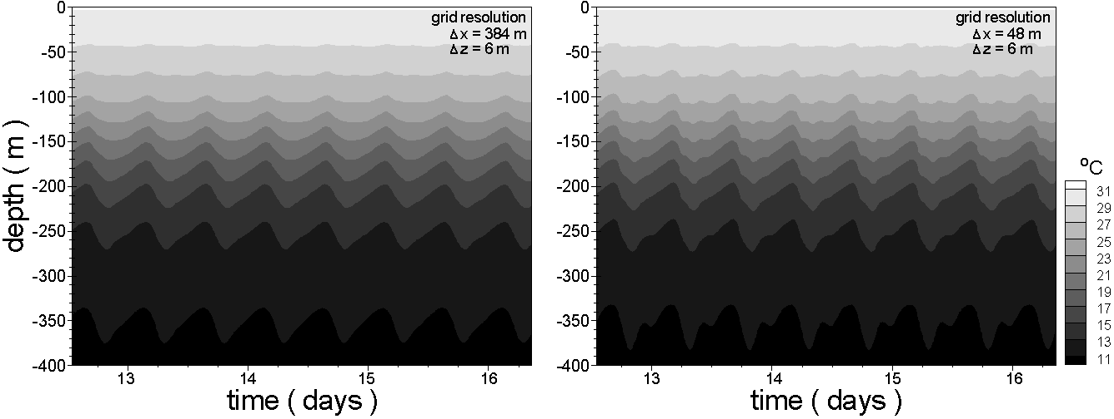
Higher frequency and High resolution modelling : simulations for different model resolutions (semi-diurnal tidal forcing)
Initial state of the 2D-model: bathymetry and density
Time-series of temperature for two different model resolutions
Computational time (for 30 days simulation ) and matrix size:
Δ x = 384m is 12 hours
Matrix size: 192 x 128
Δ x = 48m is 1.5 days
Matrix size: 1536 x 128

Slide 18
Spectral analysis for density with different model resolutions
Stn. X
X
Y
Stn. Y
Summary:
High-frequency (HF) IWs are captured well with high -resolution model, i.e. when Δ x : 48 m
Semi-diurnal estimate remains almost same while the estimate of HF IWs are large with high-resolution model.
The estimate are higher near the shelf-slope topography. i.e. Stn. X as compared to Stn. Y.
12, 6, 4.12, 3.12, 2.5 hrs : : 0.08, 0.16, 0.24, 0.32, 0.4 cph

Slide 19
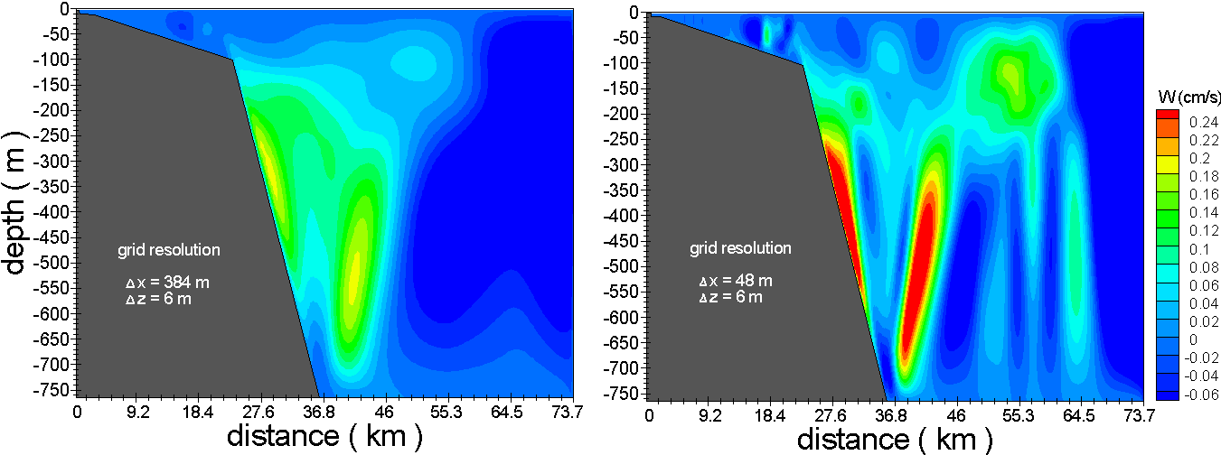
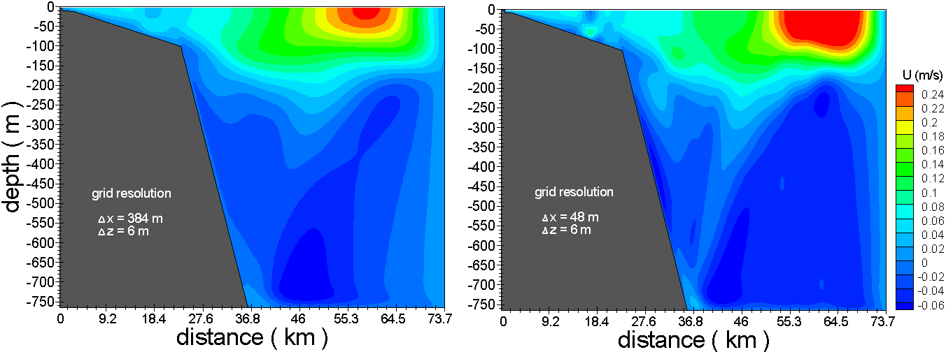
Vertical velocity for different model resolutions (snap-shot )
Horizontal velocity for different model resolutions (snap-shot )

Slide 20
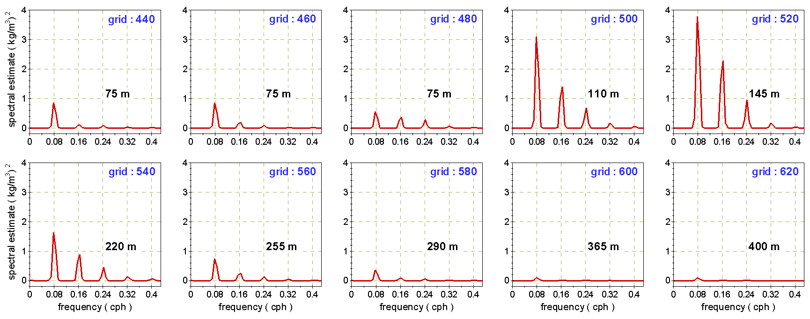
High-frequency zone in the shelf-slope region
Summary:
Low-frequency (LF) IWs of 12 hr period and High-frequency (HF) IWs of 6 hrs, 4.12 hrs, 3.12 hrs, 2.5 hrs are detected in the density spectra.
HF IWs are more evident from 75m to 220m depth. i.e. in the pycnocline and very near to the shelf-slope topography.
Δ x : 48 m
Δ z : 6 m

Slide 21
Thank You

Slide 22
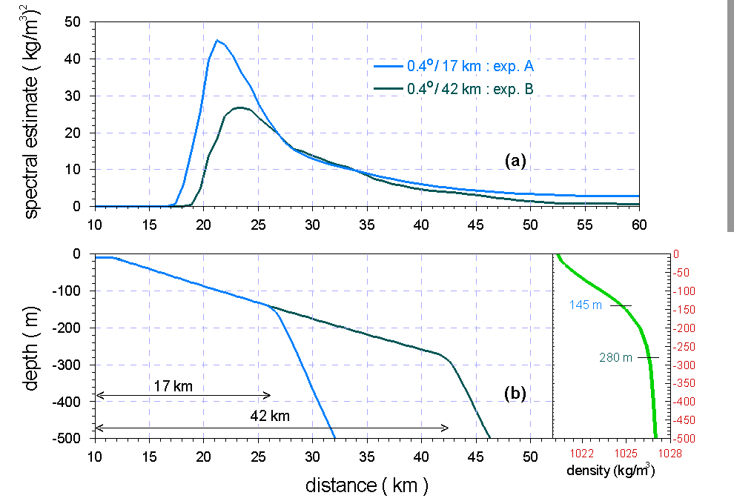
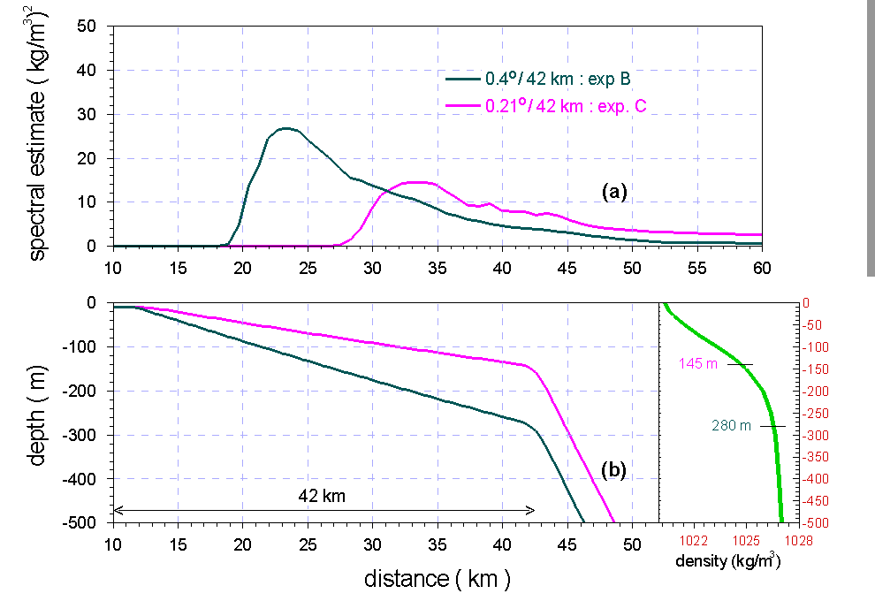
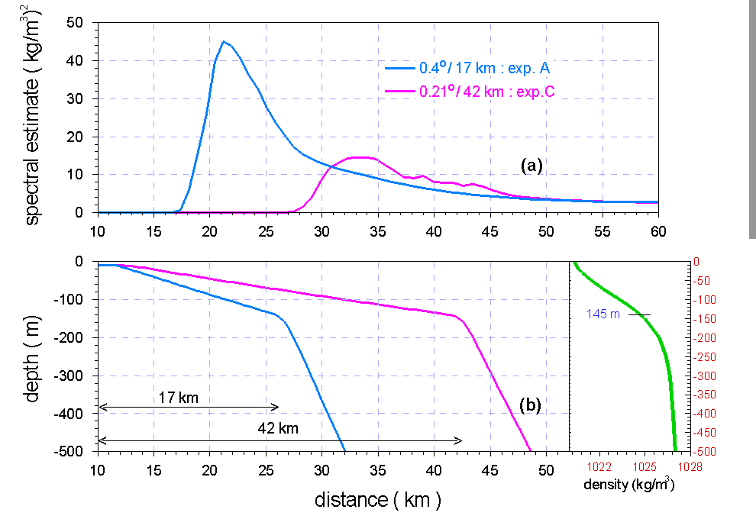
Experiments with shelf width & shelf break depth (conti….)
Inferences:
Both the shelf break depths falls in the pycnocline.
The smaller width induces larger estimates.
Propagation over smaller width is 7km and larger width is 15km.

Slide 23
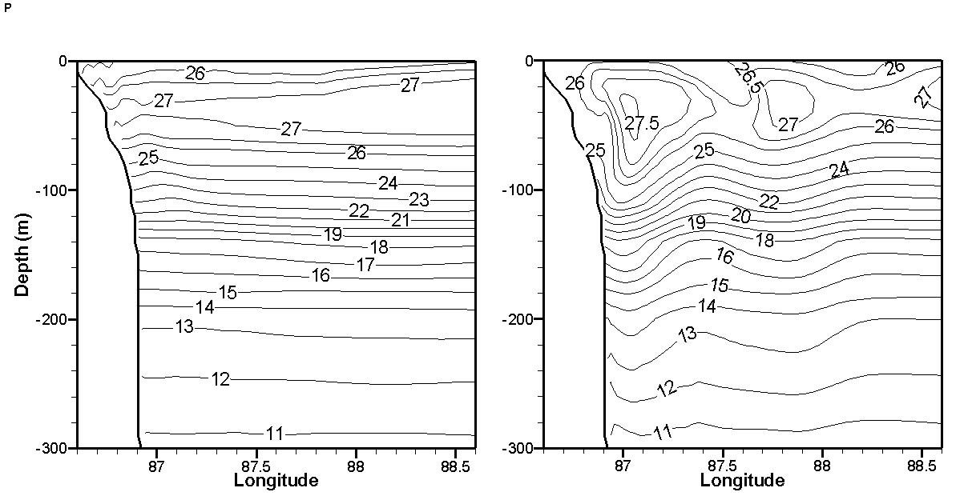
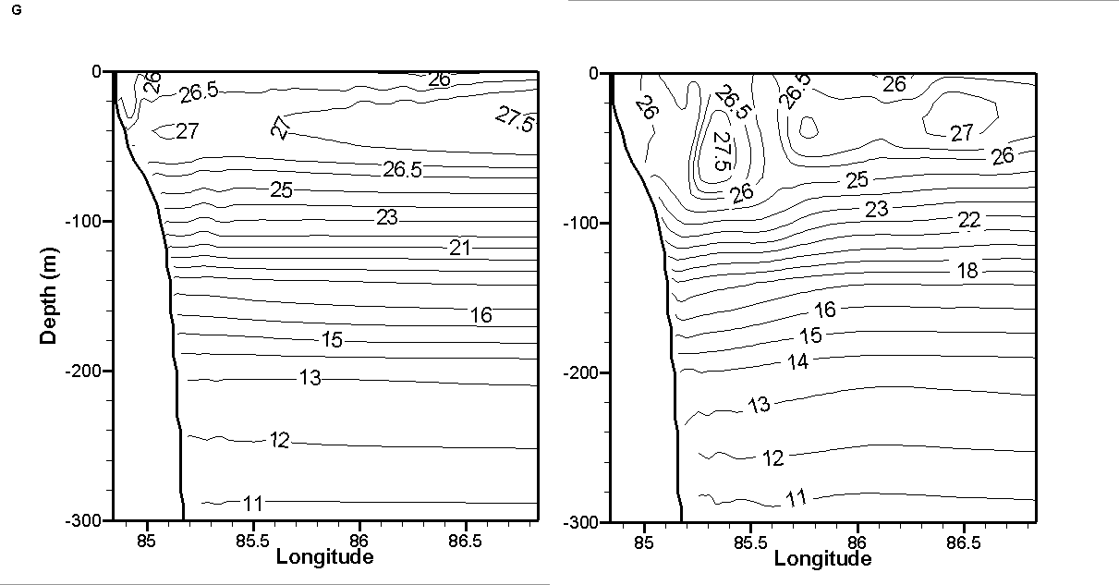
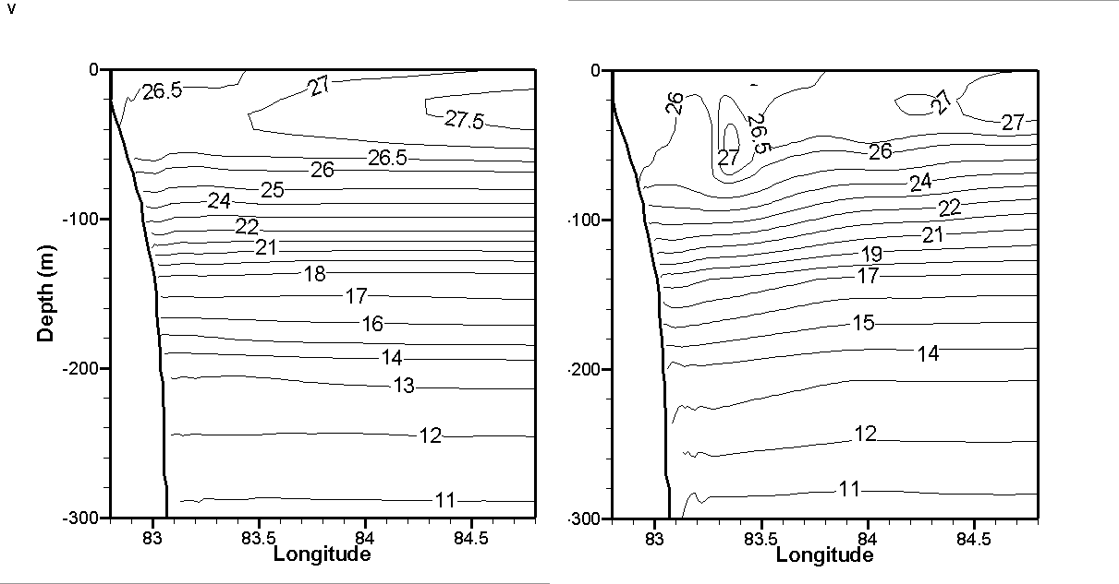

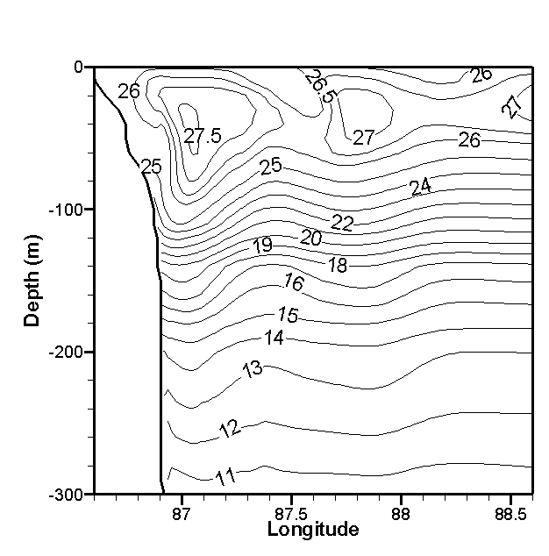
Vertical temperature with and without tide at different cross-sections
Paradeep
Gopalpur
Machilipatnam
Forcing
Wind
Wind
+
Tides
Figure: Model analysis area shown in the inset map; Bathymetry (m) of the area of interest along the coast with the cross-shelf sections Paradeep:P, Gopalpur:G, Visakhapatnam:V and Machilipatnam:M; Red dots depict the locations of in-situ observations during 19-21 February 2012 at Stn A, B and C.

Slide 24
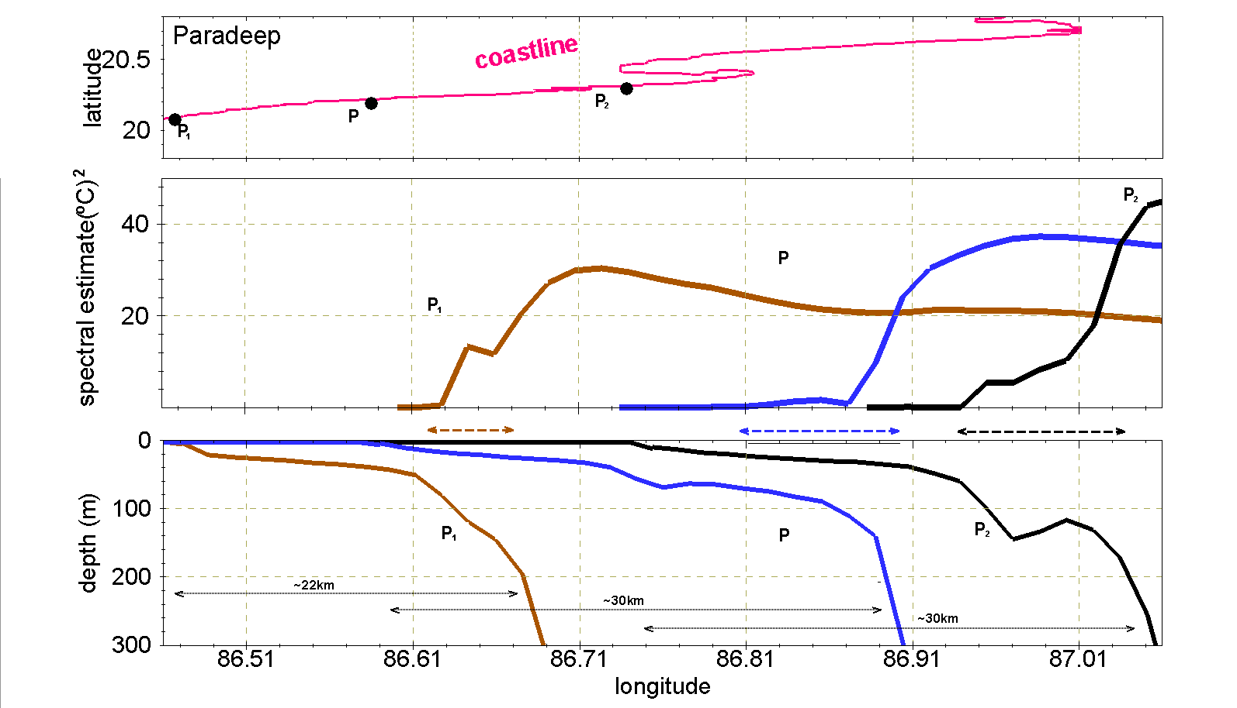
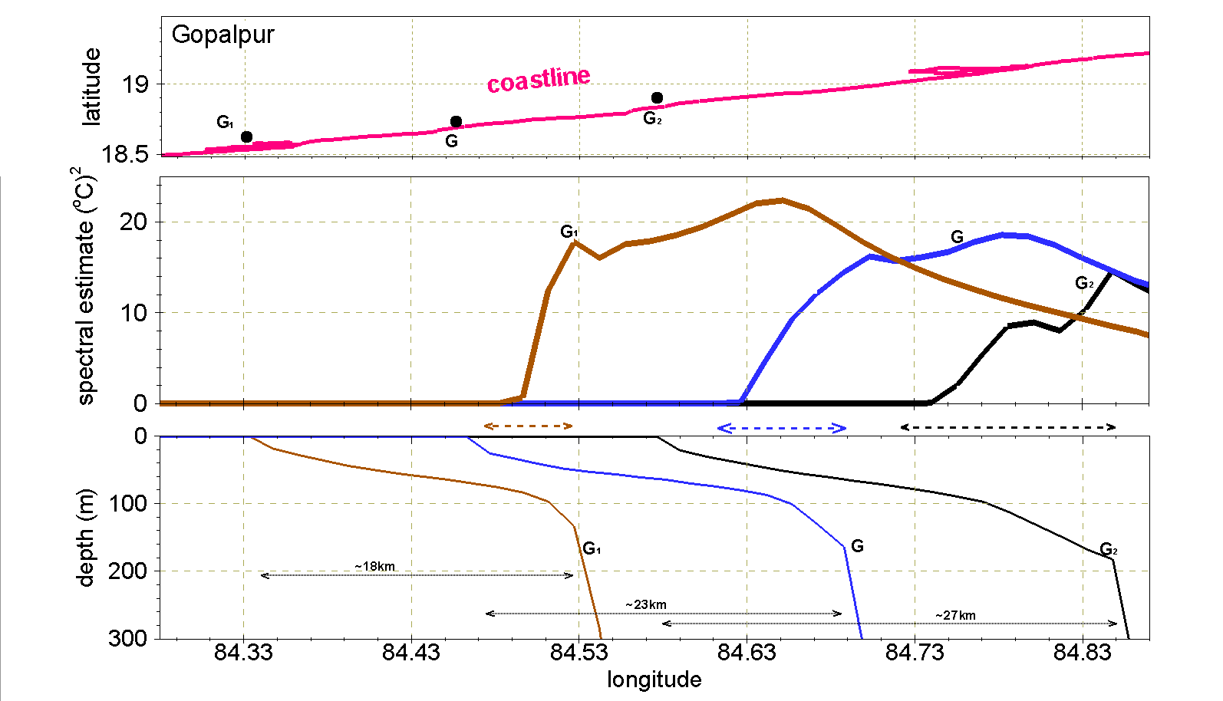
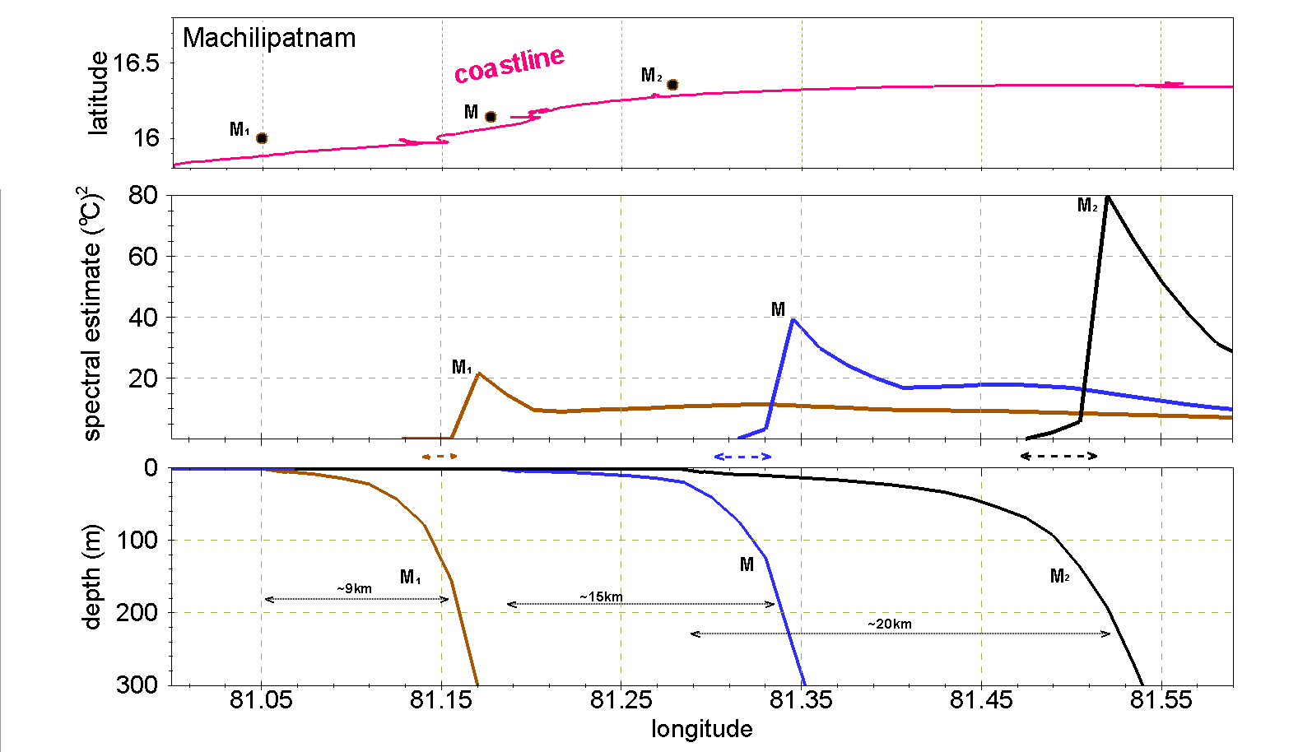
Influence of local coastal geometry and continental shelf on IWs
Paradeep
Gopalpur
Machilipatnam
Figure: Upper panel - Local coastline off Paradeep(P₁,P,P₂ ), Gopalpur(G₁,G,G₂) and Machilipatnam(M₁,M,M₂).
Middle panel - Spectral estimate of temperature (º C)² at these cross-sections.
Lower panel - Bathymetry of these cross-sections.

Slide 25
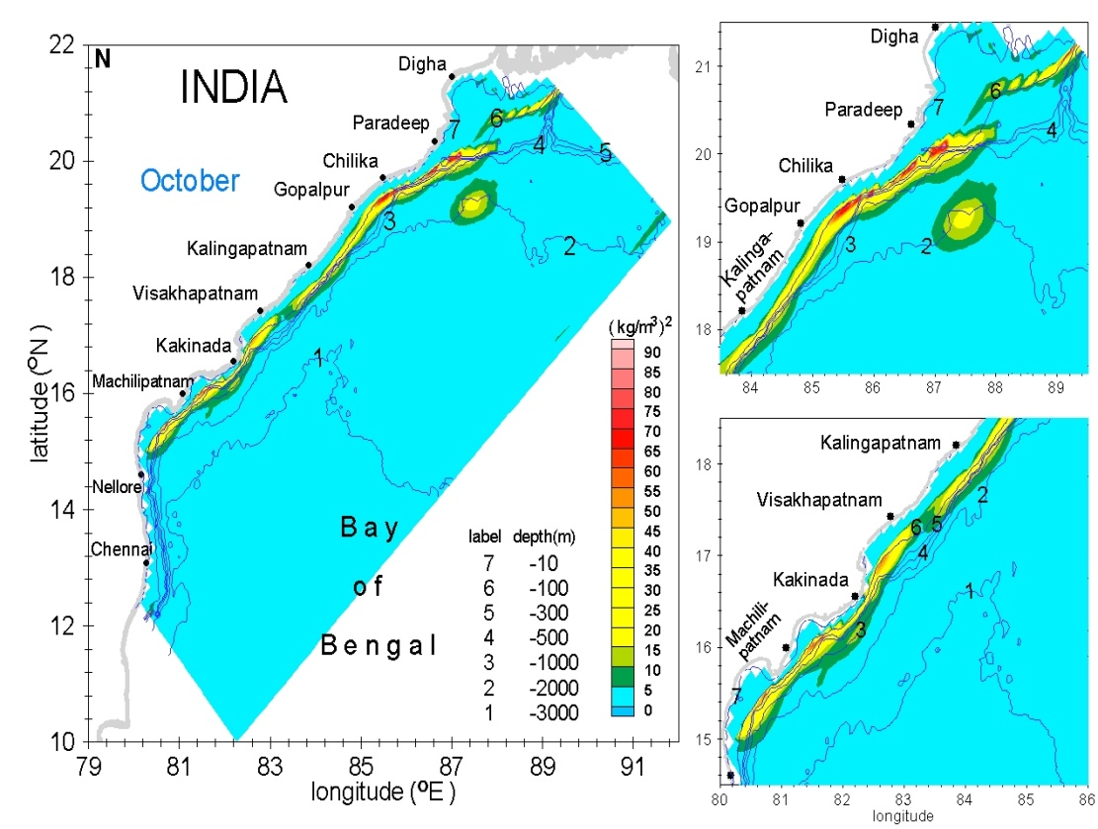
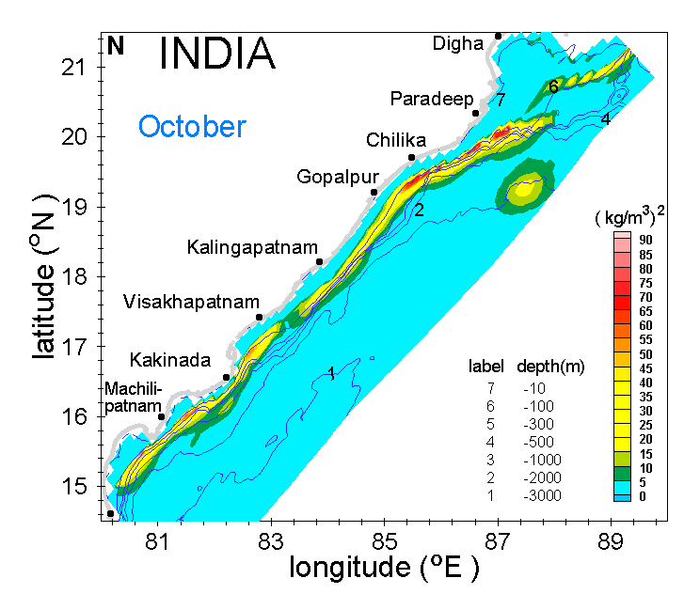

Slide 26
Spatial distribution of spectral estimates during February 2012
North of
Visakhapatnam
South of
Visakhapatnam
The estimates south of Machilipatnam, Kakinada and Visakhapatnam has larger estimates due to their concave coastline and steep slopes.
In the northern Bay off Paradeep the higher estimates are seen over a broader region due to a combined effect of higher tidal amplitudes and a steeper slope.
The maximum estimate of ~90 ºC² is found in the Machilipatnam region.

Slide 27
Snapshots of vertical velocity and temperature off Gopalpur
Vertical velocity
Density
kg/m³
Figure: Snapshots of vertical velocity (shaded) and currents (vectors) at 2-hour interval off Gopalpur.
Figure: Snapshots of temperature at 2-hour interval off Gopalpur.

Slide 28
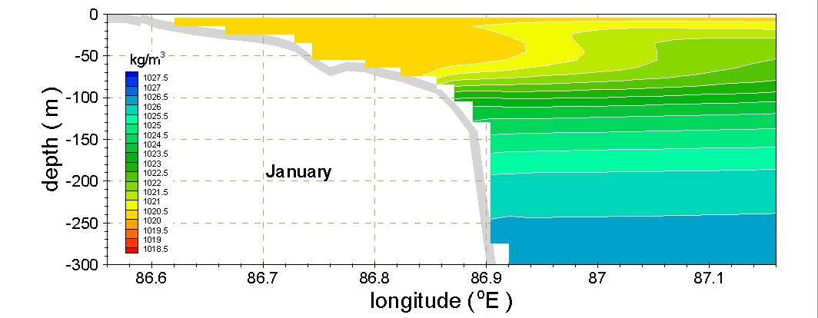
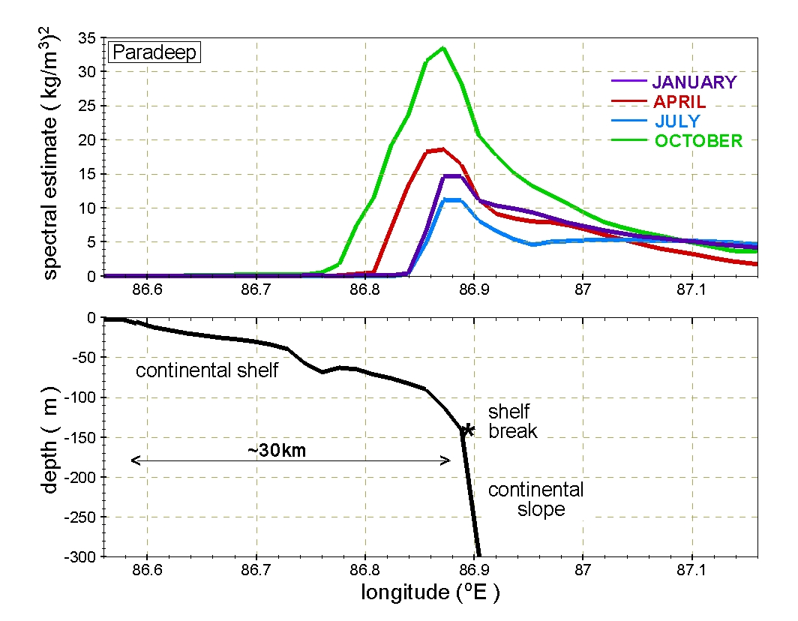
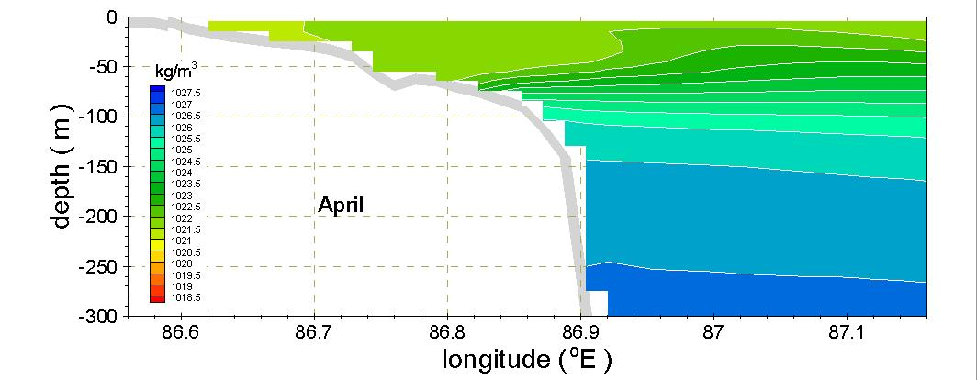
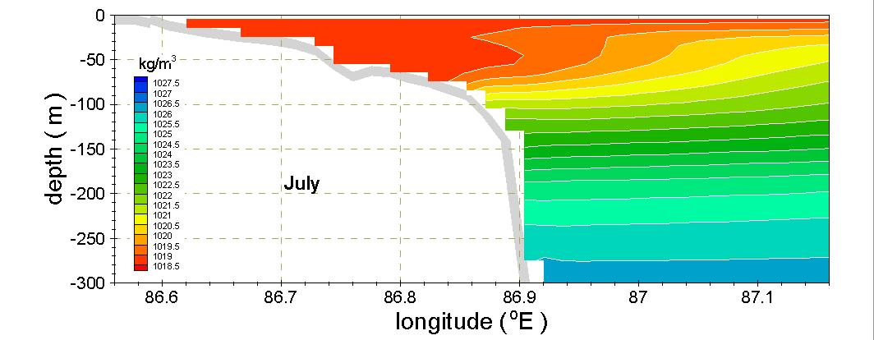
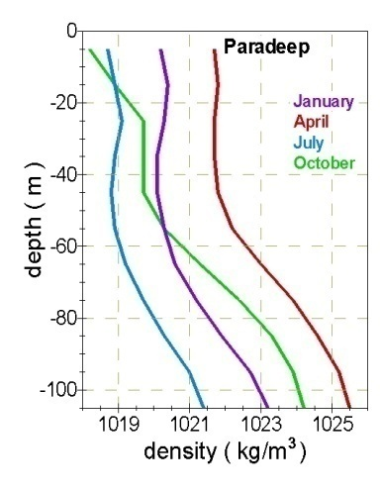
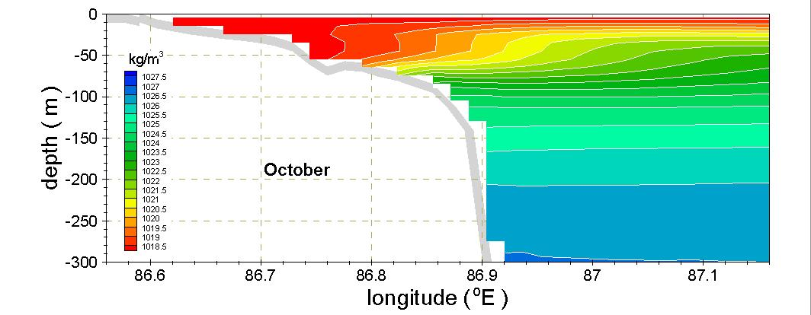
Inter-seasonal variability of Internal tides off Paradeep

Slide 29
