Slide 1
A COMBINATION OF TETRANDRINE (tt) AND Chloroquine (CQ) effectively treats cQ resistant falciparum malaria in aotus monkeys
Knox Van Dyke, Zuguang Ye, and Richard Rossan

Slide 2
In 2010-219 million malaria cases/year
1. This created 1.3 million deaths with 65% of deaths in children under 15 years of age.
About 125 million pregnant women are at risk each year and in Sub-Saharan Africa maternal malaria is associated with 200,000 estimated infant deaths /year.
There are 219 million cases/year worldwide .

Slide 3
Malaria Endemic in Equator
Malaria is endemic in a broad band around the equator- in areas of Central and South America, many parts of Asia, and much in Africa; in Sub-Saharan Africa 85-90% of malaria fatalities occur.
Every year , 125 million international travelers visit these countries and more than 30,000 get the disease.
It is usually found in rural areas rather than cities.

Slide 4
Drugs for Malaria
1. Originally quinine extracted from the bark of the chinchona tree was the best antimalarial drug.
2. World war II- chloroquine, primaquine and quinacrine were used extensvely
3. Vietnam-resistance to chloroquine
US Army had a major development program to develop new antimalarial. I developed the antimalarial drug screening system used worldwide today –mefloquine and halofantrine were found in our screening system.

Slide 5
Prophylaxsis of Malaria
1.The most important antimalarial drug from the points of cost and effectiveness is chloroquine = GOLD STANDARD
2.Over the last 60 years of use, chloroquine resistance has spread over almost the entire tropical belt.
3. Chloroquine is still used a great deal.
4.Where CQ use has stopped for some time-CQ is useful again as an antimalarial

Slide 6
Mechanism of Chloroquine’s Action
1. CQ is absorbed by the parasitized red cell
2. It goes through the membrane surrounding the parasite-the parasitopherous membrane
3.It goes through the membrane of the parasite.
4. It enters the food vacuole
5. It inhibits the parasites’s heme polymerase causing heme toxicity-killing the parasite

Slide 7
CQ Resistance Mechanisms
1. multiple drug resistance (MDR) is a 170 Kd glycoprotein membrane exit pump utilizing ATP/ATPase. The glycoprotein for falciparum malaria is PfMDR. CQ is pumped from food vacuole.
2. PfCRT is the chloroquine resistance transporter . It is a chloride channel linked to proton translocation. CQ does not enter if resistance transporter is mutated or damaged.
Some parasites have only 1. Some may have only 2 and some parasites have both 1 and 2.

Slide 8
Using Tetrandrine(TT) and CQ
1. We found that using both tetrandrine and chloroquine together- the power of CQ was increased 43 fold.
We know that tetrandrine inhibits the MDR mechanism
We know that tetrandrine is antimalarial without CQ resistance
If tetrandrine binds the PfCRT, which it almost certainly does, synergism probably occurs from inhibition of multiple mechanisms.

Slide 9
Use of tetrandrine and chloroquine in CQ resistance
1. It is likely that tetrandrine reverses chloroquine resistant falciparum malaria involving PfCRT because verapamil(V) ,a calcium channel blocker accomplishes this feat. We know tetrandrine stimulates MDR-ATPase like ( V).
2. Tetrandrine is a calcium channel blocker which reverses PfMDR exit pump like (V).
3. Tetrandrine inhibits PfMDR blocking CQ exit

Slide 10
Mechanisms of Tetrandrine(T)
1. T inhibits the MDR exit pump by stimulating MDR- ATPase and depleting ATP causing energy loss and shutting off pump.
2. T inhibits the nf-kappa b transcription factor responsible for MDR pump production. This action inhibit s CQ’s exit from food vacuole.
3. T overcomes the effect of the mutations of the PfCRT and therefore allows CQ to enter parasite food vacuole thus killing it.

Slide 11
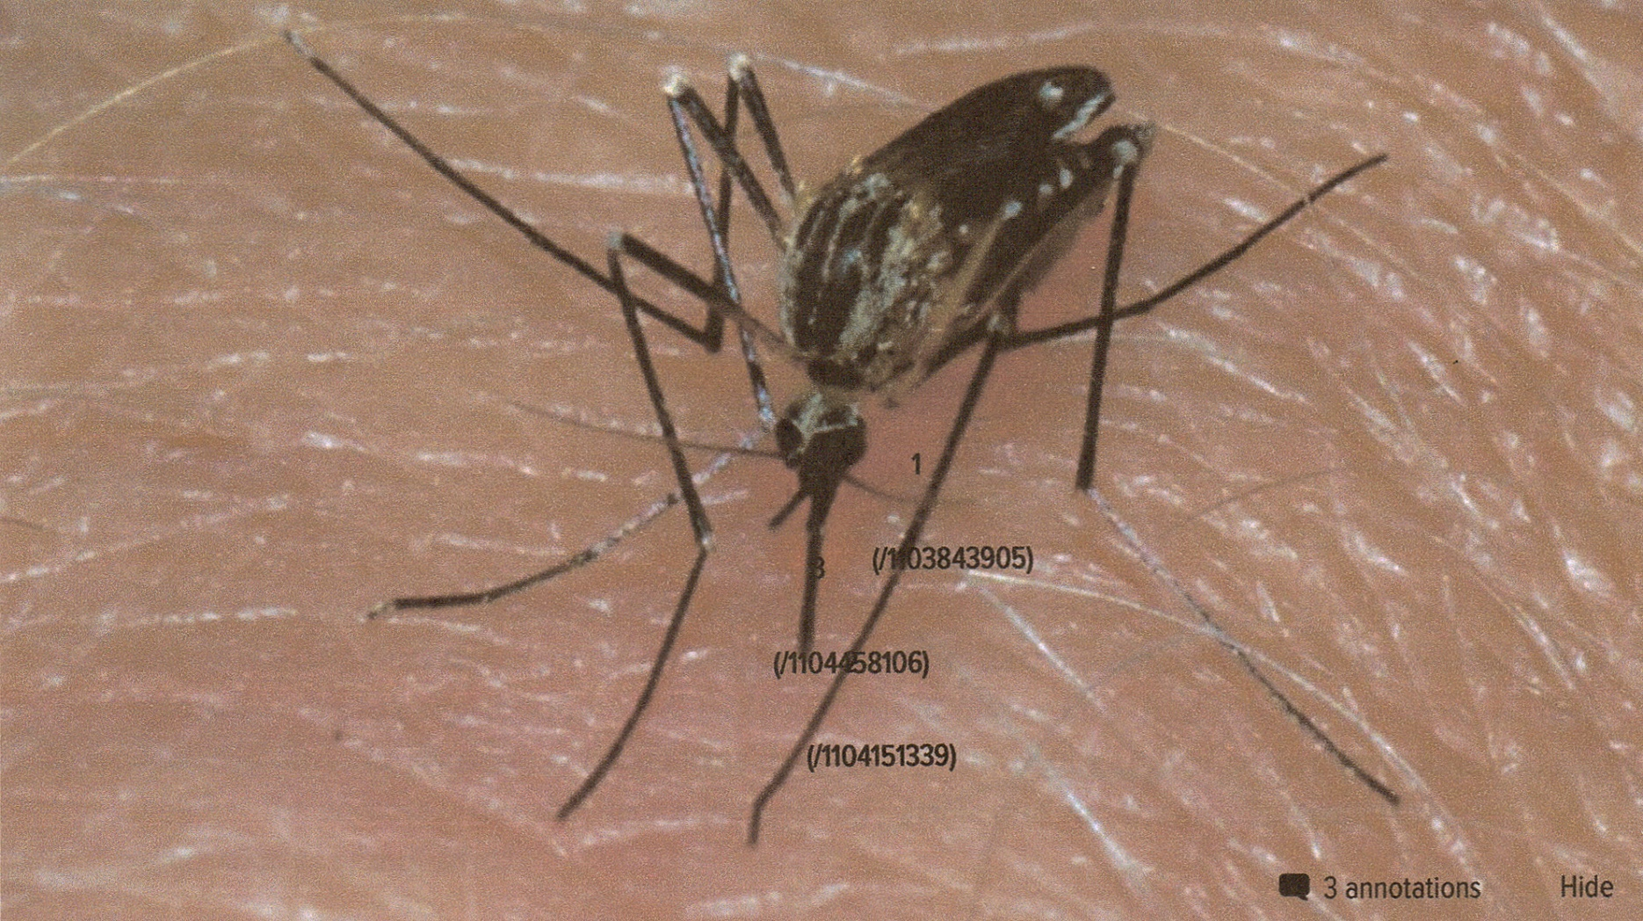
Anopheles Mosquito

Slide 12
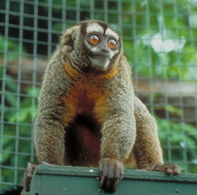
Aotus Monkey

Slide 13
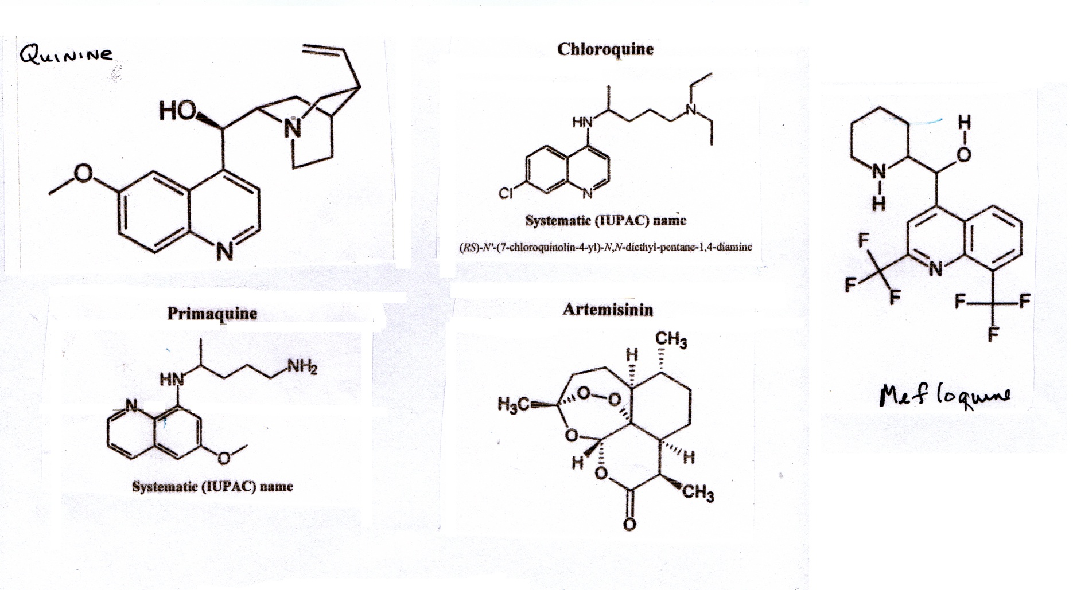
Anti-Malarial Drugs

Slide 14
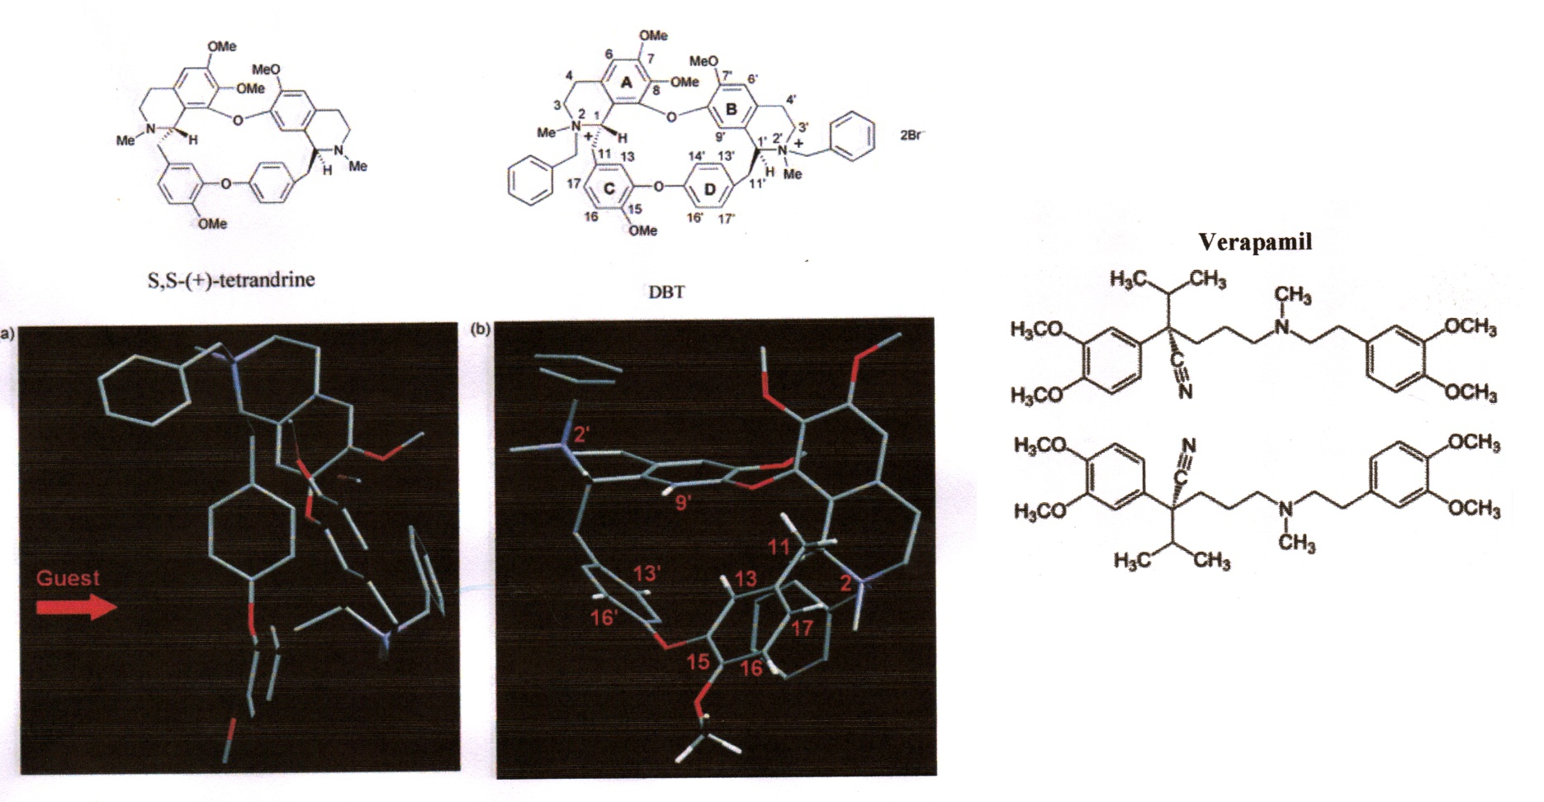
Tetrandrine & Verapamil

Slide 15
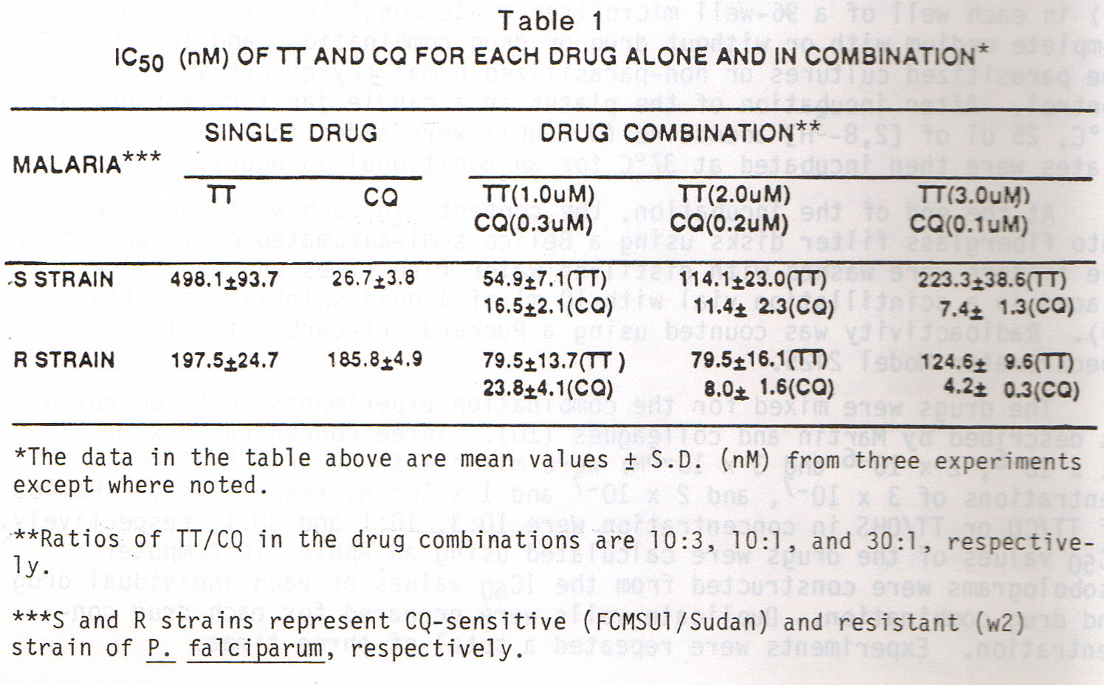
Combination of CQ & TT

Slide 16
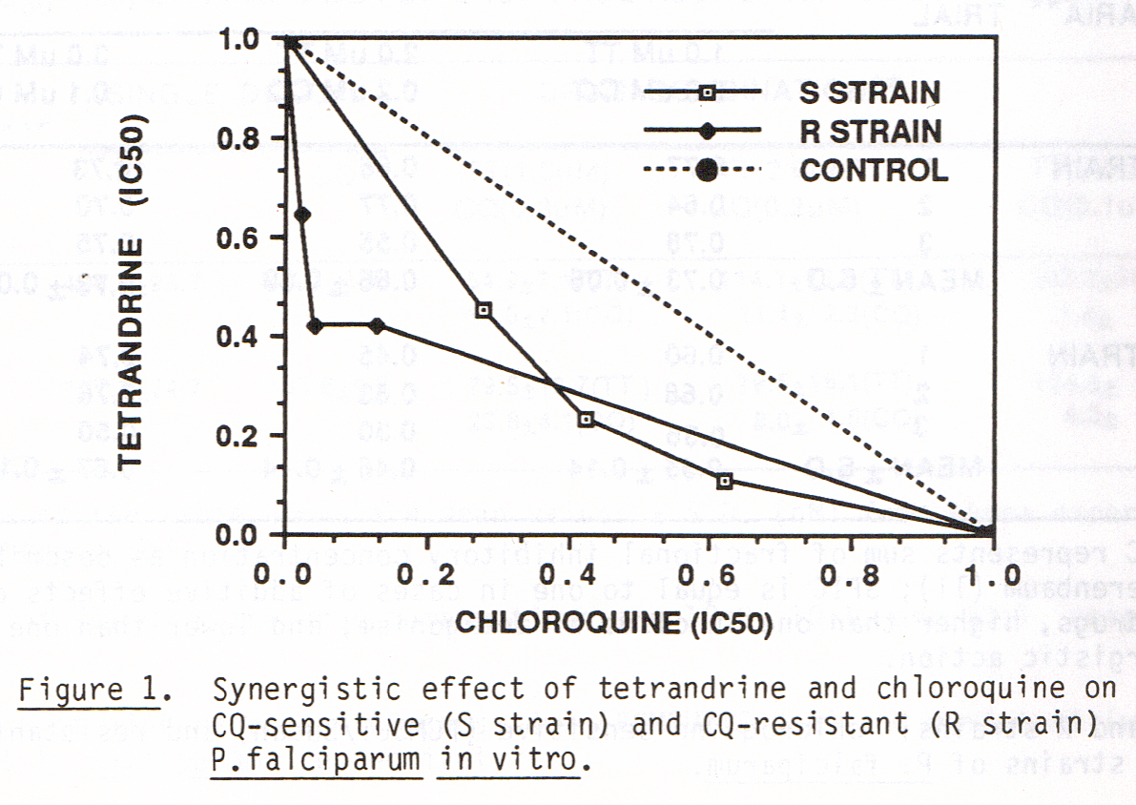
Berenbaum Plot of CQ & TT

Slide 17
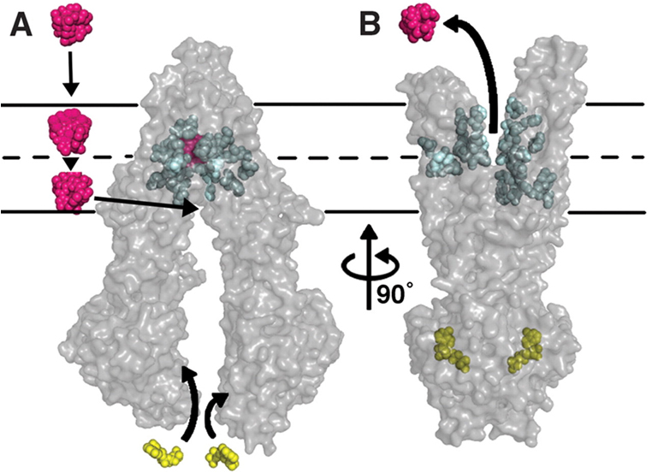
MDR Drug Pump

Slide 18
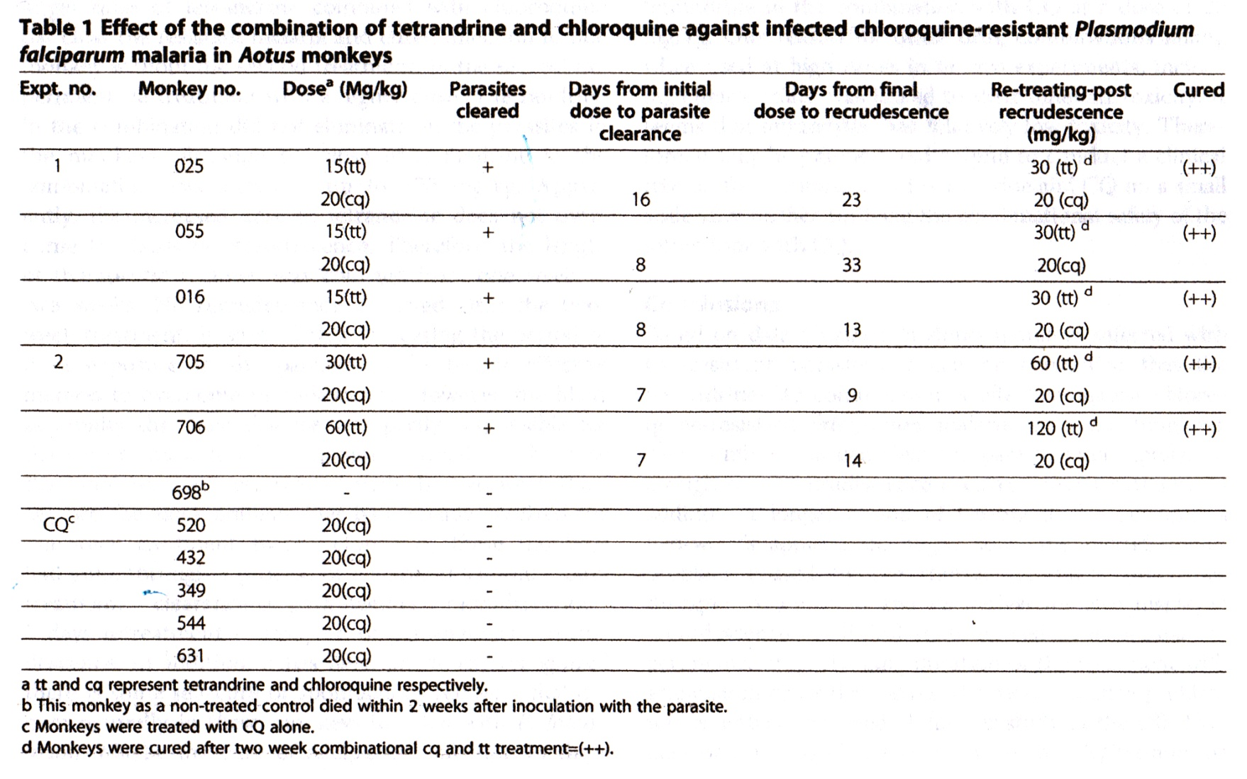
Effect of CQ & TT Against CQ Resistant Malaria in Aotus Monkey

Slide 19
Conclusions-CQ+TT
The combination of CQ and TT produces a synergistic effect on CQ resistant falciparum malaria.
It occurs because the combination inhibits both multiple drug resistance and affects the chloroquine resistance transporter.
Toxic verapamil inhibits both mechanisms as well. It is likely that both mechanisms are inhibited by hydrophobic binding –Tetrandrine does the same and both drugs inhibit calcium channels but TT exerts little toxicity.

Slide 20
Acccomplishments since 1966
1.Developed the first antimalarial drug screen
2.Development of malarial purine salvage and pyrimidine “de novo” synthesis
3.After screening 10,000 drugs –mefloquine and halofantrine were recognized
4.First recognition of 43 fold synergism between chloroquine(CQ) and tetrandrine (TT) against P. falciparum chloroquine resistance
5. CQ andTT effective in CQ res. Aotus monkeys

