Slide 1
About Omics Group
OMICS Group International through its Open Access Initiative is committed to make genuine and reliable contributions to the scientific community. OMICS Group hosts over 400 leading-edge peer reviewed Open Access Journals and organize over 300 International Conferences annually all over the world. OMICS Publishing Group journals have over 3 million readers and the fame and success of the same can be attributed to the strong editorial board which contains over 30000 eminent personalities that ensure a rapid, quality and quick review process.

Slide 2
About Omics Group conferences
OMICS Group signed an agreement with more than 1000 International Societies to make healthcare information Open Access. OMICS Group Conferences make the perfect platform for global networking as it brings together renowned speakers and scientists across the globe to a most exciting and memorable scientific event filled with much enlightening interactive sessions, world class exhibitions and poster presentations
Omics group has organised 500 conferences, workshops and national symposium across the major cities including SanFrancisco,Omaha,Orlado,Rayleigh,SantaClara,Chicago,Philadelphia,Unitedkingdom,Baltimore,SanAntanio,Dubai,Hyderabad,Bangaluru and Mumbai.

Slide 3
Mid-IR laser imaging for molecular recognition
in
security and medical applications
Anadi Mukherjee
InfraSign
Fremont, CA
Lasers, Optics & Photonics, Oct 7-9, 2013
InfraSign

Slide 4
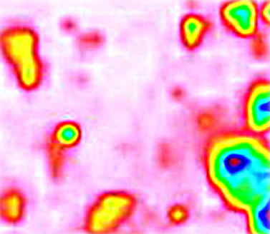
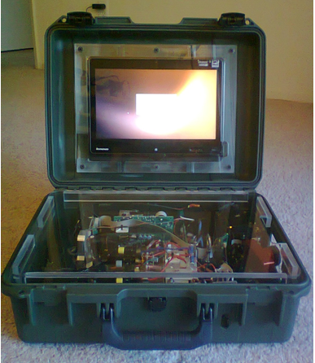
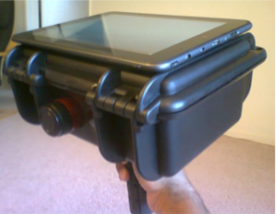
InfraSign
Revealing the Invisible for a Safer World
Mid-IR laser imaging for
Molecular Recognition
Security
  HAZMATs
  Food Safety
Medical
  Tagless Pathology
  Pharma QC/QA
Hand-held,
battery operated system
www.infrasign.com
2
Lasers, Optics & Photonics, Oct 7-9, 2013
InfraSign

Slide 5

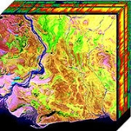
MIRIS – Mid-IR Imaging Spectroscopy
Diffuse Reflection
Trace Molecules
Or
Molecular Modifications
Laser
Camera
Strong fundamental Vibrations (MIR) vs. Weak Overtone (NIR) or Raman
λ₂
λ₁
λ₃
λ₄
Hyperspectral Imaging
3
Lasers, Optics & Photonics, Oct 7-9, 2013

Slide 6
      Security
        Trace HAZMATS & Narcotics
  Medical
    Food Safety - Biocontamination Sensor
    Pharma - Real-time in-line Quantitative QC/QA
    Laser Pathology - Antibody-free Diagnosis
      Body Fluids
      Tissues – Cancer Biomarkers
      In-vivo diagnosis/surgery, New Microarrays
4
Lasers, Optics & Photonics, Oct 7-9, 2013
InfraSign

Slide 7
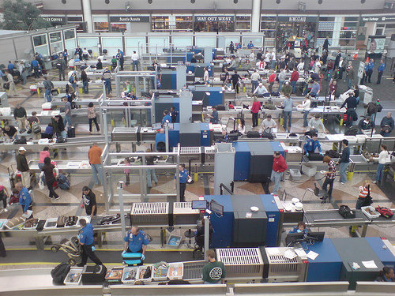
Security
5
Lasers, Optics & Photonics, Oct 7-9, 2013
Notes:
Size of Homeland Security Market - $51B in 2012, rising to $81B in 2020 http://www.homelandsecurityresearch.com/2012/09/u-s-homeland-security-public-safety-market-2013-2020/

Slide 8
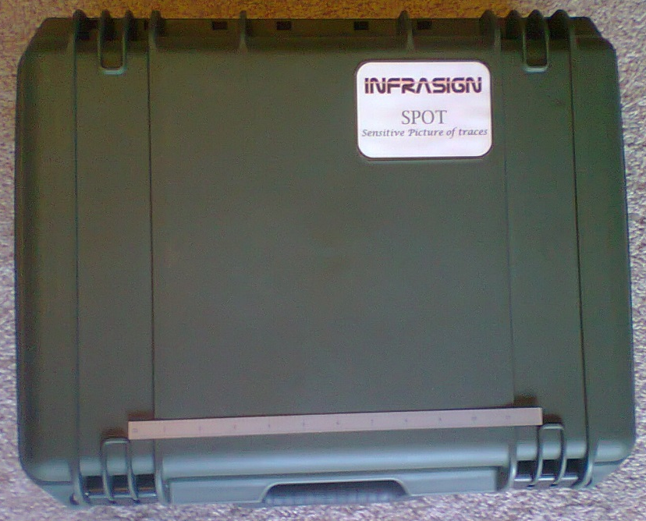
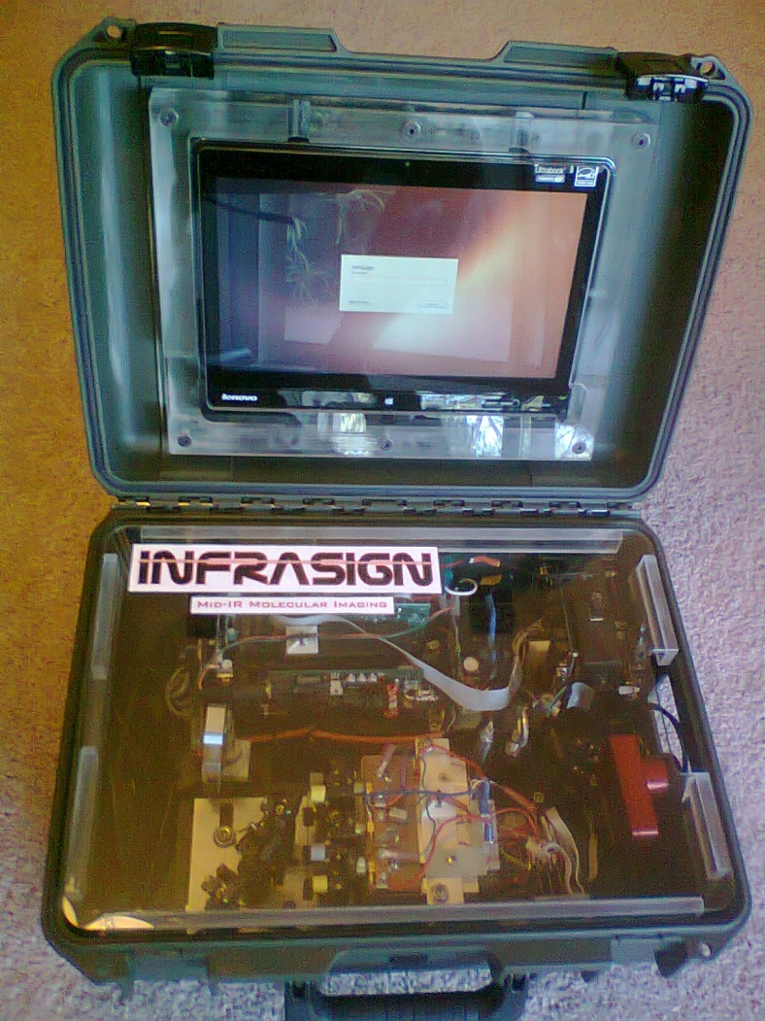
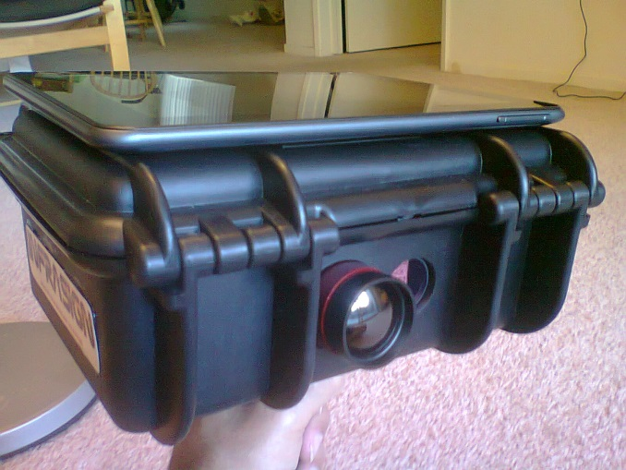
SPoT - Sensitive Picture of Traces
12”
6
Hand-held, battery operated, 9”x7”x4”, < 4 lbs
Lasers, Optics & Photonics, Oct 7-9, 2013

Slide 9
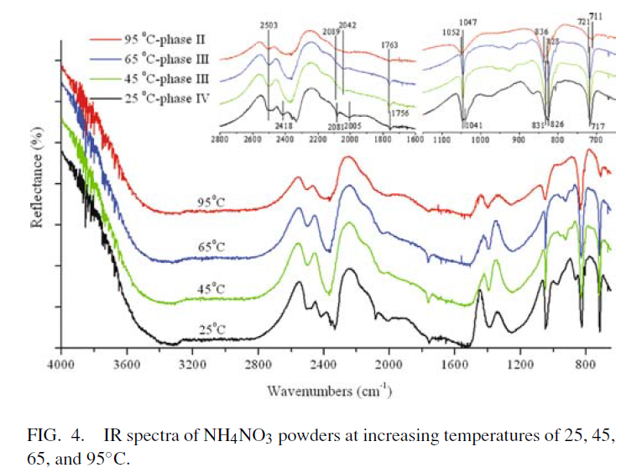
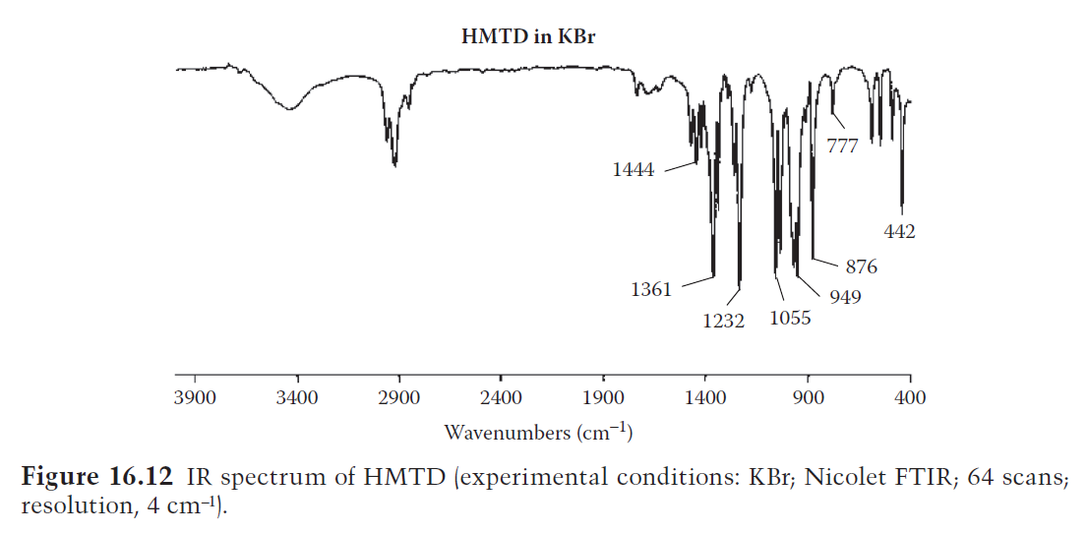
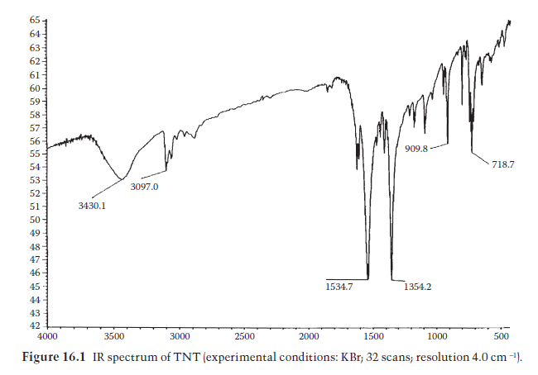
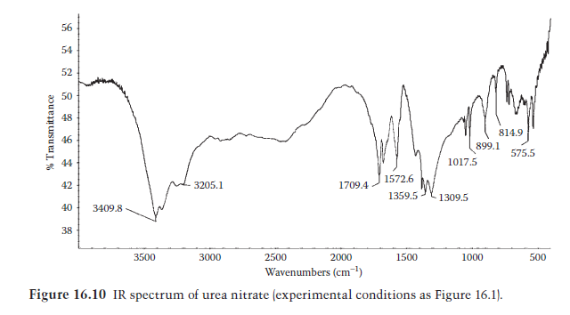
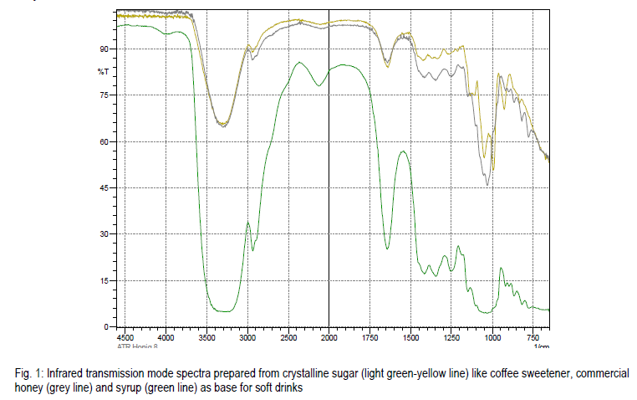
R →
AN
9.25um
Explosive/Binder
AN
HMTD
TNT
Urea Nitrate
Sugar
7.38um
9.5um
TNT
Urea Nitrate
Sugar
8
Lasers, Optics & Photonics, Oct 7-9, 2013

Slide 10
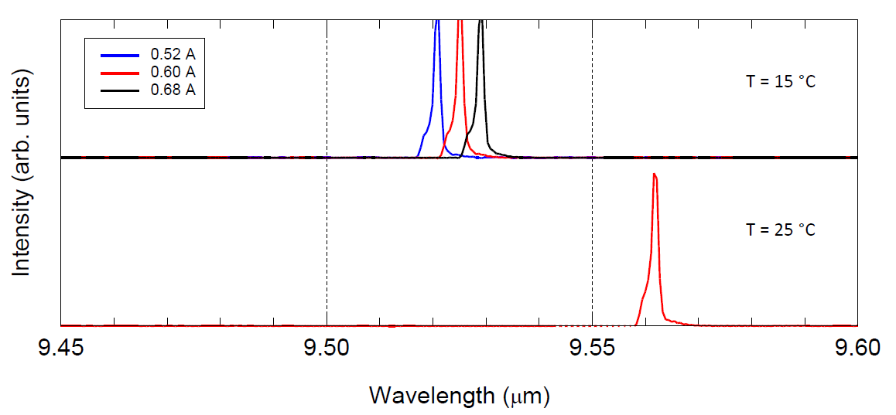
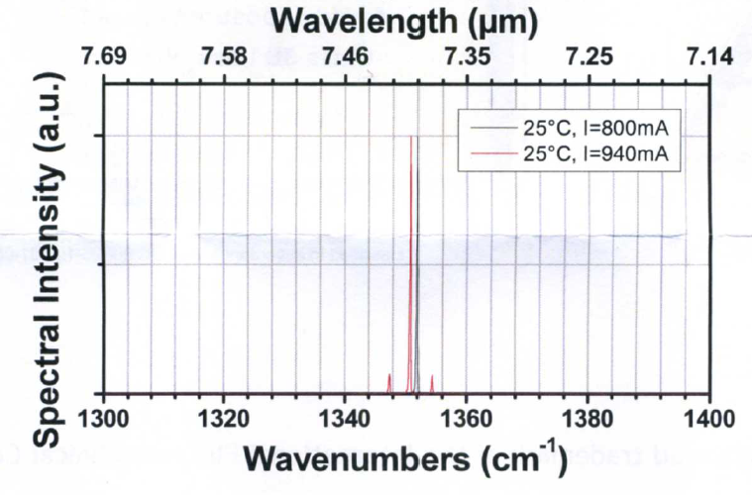
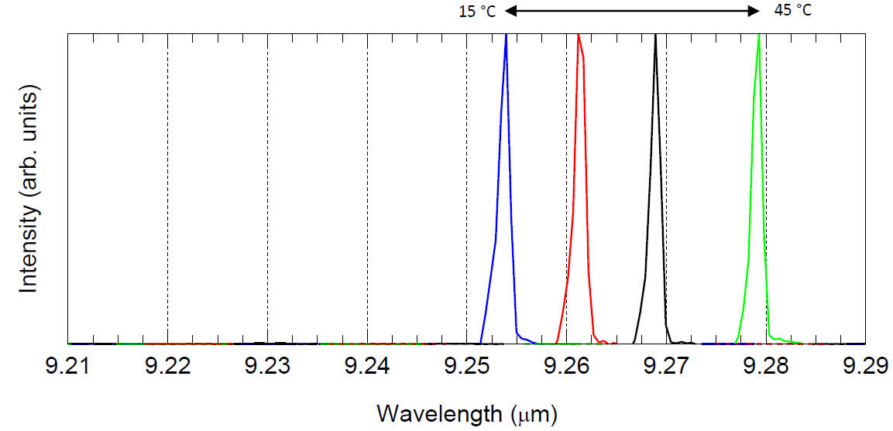
3 QCLs
9.5 μm
7.38 μm
DFB
FP
DFB
9.25 μm
7

Slide 11






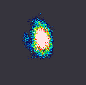
SPoT raw image results of AN trace on polyethylene
Very thin (cloudy) film of
AN on polyethylene film
R →
Absorption
9.25um
9.5um
Incident beams
6”
7.38um
7.38um
9.25um
9.5um
9
Lasers, Optics & Photonics, Oct 7-9, 2013

Slide 12

Validation
First explosive trace imaging system sold for use by US Navy
Customer quote: “(SPoT) continues to function well despite the traveling it has done. The hardware has proven to be remarkably robust.”
10
Lasers, Optics & Photonics, Oct 7-9, 2013

Slide 13


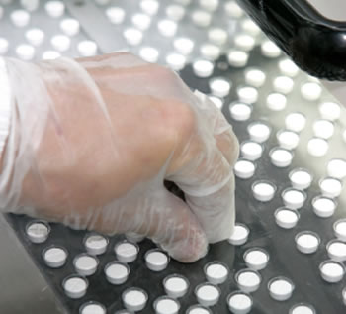
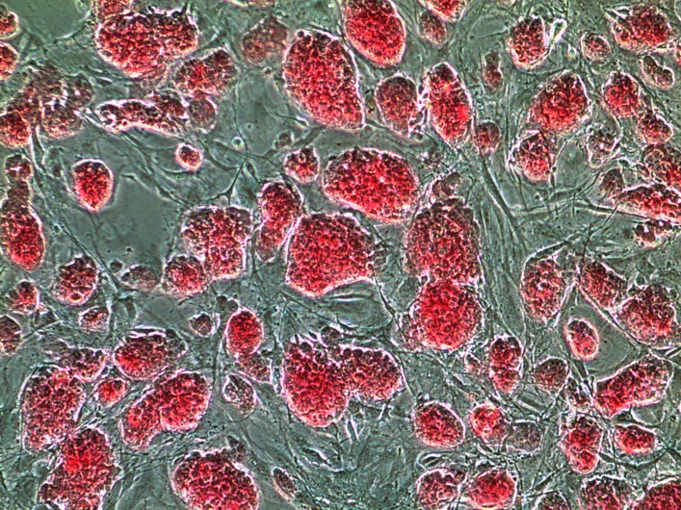
Safety & Medical
Industrial Plant Safety/TICs
Food Safety
Pharmaceutical QC/QA
Medical Imaging
11
Lasers, Optics & Photonics, Oct 7-9, 2013
Notes:
http://www.shutterstock.com/pic-72687217/stock-photo-the-security-section-testing-there-anti-fire-and-safety-systems-in-the-petrochemical-plant.html
http://www.elpasocountyhealth.org/service/food-safety

Slide 14
Fundamental Biomolecular Vibrations
Proteins
Overlap
Sugars
Fatty Acids
12
Lasers, Optics & Photonics, Oct 7-9, 2013
InfraSign

Slide 15
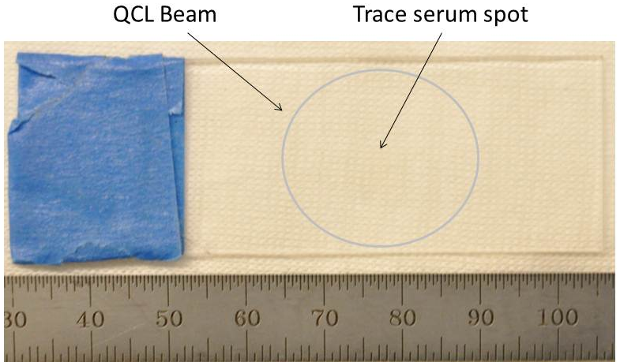
Hyperspectral Imaging
of Serum Protein
ROC Curve
Sensitivity
PD of 99%
Specificity
PFA of 10⁻² (PD of 99%)
77ug/cm²
Anadi Mukherjee et al “Spectroscopic imaging of serum proteins using quantum cascade lasers”,
Journal of Biomedical Optics 18(3), 036011 (March 2013).

Slide 16
Acknowledgements
Pathology Department UCSF
Professor Tarik Tihan, UCSF
Manu Prasanna
Steve Barnett
Quentin Bylund
Biswaroop Mukherjee
Block Engineering – Petros Kotidis
Adtech Optics – Mariano Troccoli
ThorLabs – John Bruno
Thanks
14
Lasers, Optics & Photonics, Oct 7-9, 2013

Slide 17
Let Us Meet Again
We welcome all to our future group conferences of Omics group international
Please visit:
www.omicsgroup.com
www.Conferenceseries.com
http://optics.conferenceseries.com/

