Slide 1
Microneedles: An Approach to vaccine drug delivery system
Dr. Vasudha Bakshi
M.Pharm., Ph.D
Principal
Lalitha College of Pharmacy,
Anurag Group of Institutions
Hyderabad.

Slide 2
What is Vaccination
Vaccination: Effective method of preventing infectious diseases.
Vaccination is the administration of antigenic material (a vaccine) to stimulate an individual's immune system to develop adaptive immunity to a pathogen.

Slide 3
Routes of administration of vaccines
Skin attractive area for drug and vaccine delivery

Slide 4
Transdermal Delivery system
ADVANTAGES
Avoidance of presystemic metabolism
Absence of gastric irritation and enzymatic degradation
Convenience
Inconvenient injections and Painlessness
Non-invasiveness and improved patient compliance

Slide 5
Skin contains large no of Antigen presenting cells (Langerhans cells and dermal dendritic cells)----------Suitable site for vaccination

Slide 6
Transdermal drug delivery
20 active drug molecules marketed in market
Low mol wt drugs or molecules poses no problem
Higher drug molecules difficult to overcome stratum corneum barrier.

Slide 7
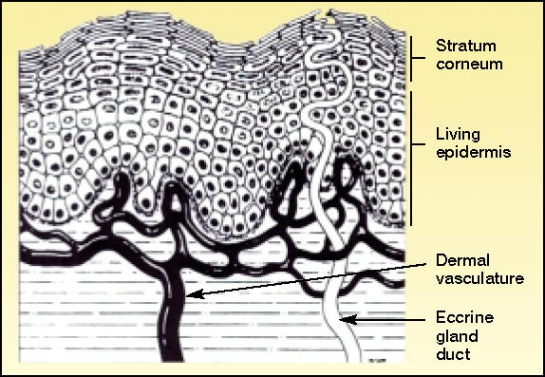
Disadvantages
Inability of large majority of drugs to cross the skin at desired therapeutic rate

Slide 8
NEED FOR TRANSDERMAL DRUG DELIVERY SYSTEMS
Oral administration not feasible
Overcome painful hypodermic needle a common alternative
Approach more appealing to patients
Drug delivery across skin using patch
Transdermal delivery limited by majority of drugs to cross skin at therapeutic rates
Stratum corneum if the main barrier

Slide 9
Number of approaches
Physical and chemical enhancers
Enhancers create holes big enough for drug molecules to pass.
Alternative approach create----large transport pathways of microns dimensions by using arrays of microscopic needles
Proposed micron scale holes in skin is safe
Holes are smaller than made by hypodermic needles

Slide 10
First Generation transdermal delivery system
Delivery of small lipophilic low dose drugs
Esteraderm®
Androderm ®
Use the liquid Reservoir design
Most currently available patches are
Adhesive matrix Design

Slide 11
Second Generation transdermal delivery systems
Small lipophilic and larger hydrophilic molecules
Enhancement techniques include
Chemical Penetration enhancers eg DMSO, Menthol, Glyceryl monoleate
Gentle Heating
Iontophoresis: Tiny current promote flow of drug through skin
Disrupt stratum corneum and providing driving force for movement limited to smaller molecule

Slide 12
Third Generation transdermal delivery systems
Aims to severely disrupt stratum corneum to allow large molecules to pass into the circulation.
Form microchannel and large drug molecule permeated by any of below methods
Various methods
Iontophoresis
Thermal ablation
Ultrasound
Microneedle arrays consiting of chips

Slide 13
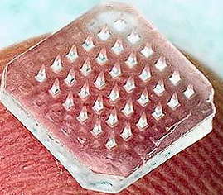
What are Microneedles
Microneedles are the needles having length of about 150 to 200 micro meter, with well designed geometry.
Microneedles are of a few hundred microns in size, capable of creating transient pores across the skin by penetrating the stratum corneum layer to deliver molecules.
These needles are not big enough to reach the nerve-rich regions of the skin; as a result, the drug delivery is perceived as completely painless and devoid of bleeding.
Drugs, vaccines, proteins, peptides and other biomolecules are suitable for delivery using the microneedle technology.

Slide 14
Microneedles have been fabricated with various materials such as: metals, silicon, silicon dioxide, polymers, glass .
Smaller than the hypodermic needle,
Various types of needles have been fabricated ex: solid (straight, bent filtered, hollow)
The hollow needle designs include tapered and beveled tips, and could be used to deliver micro liter quantities of drugs to very specific locations.

Slide 15
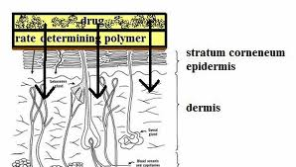
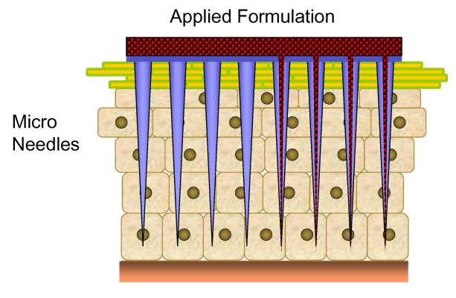
MAJOR DIFFERENCE
TRANSDERMAL PATCH
TRANSDERMAL MICRONEEDLES

Slide 16
Why microneedles are Painless
Skin is having outer layer of stratum corneum which is 10 – 15 um in thickness and is primary barrier in drug transport through skin.
Nerves are located below 150– 200 um into the skin.
When we insert the microneedle into the skin they only pass out the stratum corneum layer and does not reach upto the nerve endings and become painless.

Slide 17
Types of microneedles

Slide 18
Solid Microneedles
Solid microneedles are fabricated in 750-1000um in length and 15-20 angle tip tapered
Increase the permeability by poking the holes in skin, rub drug over area or coat needle with drug.
Wear time is short from 30 sec-10 min
Hollow microneedles
Are fabricated with lumen dia 30 microns and height 250 microns
Used continously to carry drug into the body by diffusion
Large amount of drug are deliverd for therapeutic effect

Slide 19
METHODOLOGY OF DRUG DELIVERY
These include
• Poke with patch approach
• Coat and poke approach
• Biodegradable microneedles
• Hollow microneedles
• Dip and scrape
Poke with patch approach
It involves piercing an array of solid microneedles into the skin followed by application of the drug patch at the treated site.
Transport of drug across skin can occur by diffusion or possibly by iontophoresis if an electric field is applied.
Coat and poke approach
In this approach needles are first coated with the drug and then inserted into the skin for drug release by dissolution.
The entire drug to be delivered is coated on the needle itself.

Slide 20
Biodegradable microneedles
It involves encapsulating the drug within the biodegradable, polymeric microneedles, followed by the insertion into the skin for a controlled drug release.
Hollow microneedles
It involves injecting the drug through the needle with a hollow bore. This approach is more reminiscent of an injection than a patch.
Dip and scrape
Dip and scrape approach, where microneedles are first dipped into a drug solution and then scraped across the skin surface to leave behind the drug within the microabrasions created by the needles.
The arrays were dipped into a solution of drug and scraped multiple times across the skin of mice in vivo to create microabrasions.
This study used blunt tipped microneedle measuring 50-200 micron in length over 1cm2 in area.

Slide 21
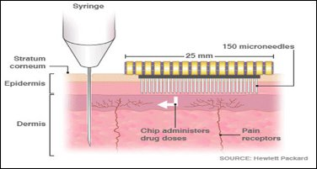
Mechanism of action
Mechanism is not only diffusion.
Instead, it is based on the temporary mechanical disruption of the skin and the placement of the drug or vaccine within the epidermis, where it can more readily reach its site of action.

Slide 22
In microneedle devices, a small area is covered by hundreds of microneedles that pierce only the stratum corneum (the uppermost 50 μm of the skin), thus allowing the drug to bypass this important barrier.
The tiny needles are constructed in arrays to deliver sufficient amount of drug to the patient for the desired therapeutic response.
Solid MN deliver drugs via passive diffusion by creating microchannels to increase skin permeability followed by the application of a drug-loaded patch on the channels.
Needles dissolve within minutes, releasing trapped drug at intended delivery site.
It is desirable for the microchannels to close soon after needle removal to prevent permeation of undesired toxic substances or infection by pathogenic microorganisms .

Slide 23
FABRICATION OF MICRONEEDLE:
Microneedles can be fabricated employing microelectro mechanical systems (MEMS). The basic process can be divided in to three parts: deposition, patterning and etching.
Microneedles have become a new type of the bio-medicine injector, it can throw the cuticle and not excite the nerve, and the patient will feel nothing.
Deposition:
Refers to the formation of thin films with a thickness anywhere between a few nanometers to about 100 micrometers.
Patterning:
Is the transfer of a pattern onto the film.

Slide 24
Lithography:
Is used to transfer a pattern into a photosensitive material by selective exposure to a radiation source such as light.
This process can involve photolithography, electron beam lithography, ion beam lithography or X-ray lithography. Diamond patterning is also an option for lithography.
Etching:
Is a process of using strong acid or mordant to cut into the unprotected parts of a material’s surface
To create a design in it and can be divided into two categories: wet etching or dry etching. The selection of any of the above mentioned methods largely depends on the material of construction and the type of microneedle.

Slide 25
Dissolving Microneedles
Dissolving MN are fabricated on the basis of the “poke and release” principle.
They are made from polysaccharides or other polymers.
These MN release encapsulated drug into the skin following application and dissolution.
Micromoulding is the preferred fabrication method for making dissolving MN.
Certain drugs and vaccines are thermolabile so moulds are often filled with solutions of drugs and excipients and then dried under mild conditions.
The fabrication process involves pouring the polymer solution into female molds, filling the microcavities of the mould under vacuum or pressure, drying under ambient conditions, centrifugation or pressure .
These include the one-step application process which is convenient for patients.

Slide 26
Coated Microneedles
Coated microneedles refer to microneedles which are coated with the drug-containing dispersion.
An approach using electrohydrodynamic atomisation (EHDA) principles in the preparation of smart microneedle coatings.
Essential characters of coating process
Uniform coating
Limit deposition onto microneedle
Avoid high temperature
High drug loading
Good adhesion of coating solution
Aqueous coating solution
Rapid or controlled – dissolution kinetics

Slide 27
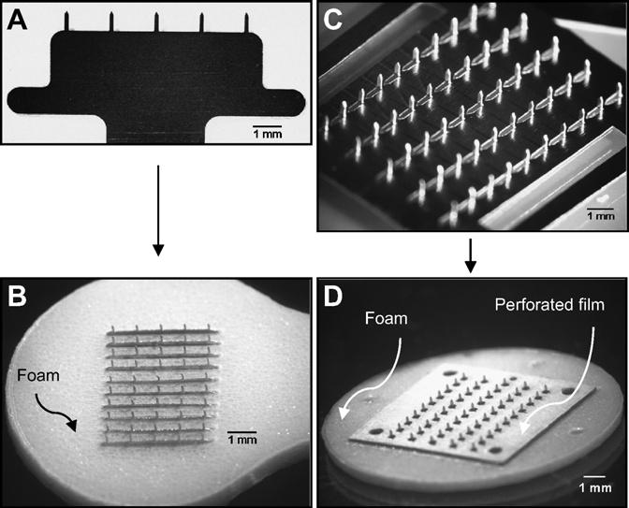
MICRONEEDLE ARRAY PATCHES
The adhesive layer was periodically disrupted via small holes or slits to allow the microneedles to stick out for penetration.
The adhesive served to hold microneedles firmly against the skin by compensating for the mechanical mismatch between the flexible skin tissue and the rigid microneedle substrate, especially in the case of out-of-plane microneedle arrays.
Microneedle arrays prepared on the basis of this design are shown for patches of in-plane microneedles (Fig. 4B)
out-of-plane microneedles (Fig. 4D).

Slide 28
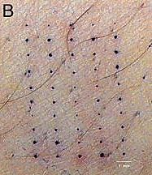
Delivery from coated microneedles
No residue on skin surface
Increased bioavailability
Vaccine delivery – potent immune response
Storage - antigen stability
Eliminate cold-chain storage.

Slide 29
There is immense potential for the use of these micron-sized needles for transdermal drug delivery enhancement.
A number of challenges also have to be addressed including irritation, microbial contamination and the delivery of therapeutically relevant concentrations of drugs.
There is also a limited choice of appropriate biomaterials, lack of mechanical strength, poor control of drug delivery, and limitation of drug loading dose.
Potent drugs requiring low doses and vaccines seem to be the drugs most likely to be delivered in therapeutically useful concentrations.

Slide 30
Another challenge is the delivery of macromolecules- products of biotechnology. These molecules have high molecular weights and also high hydrophilicity making them particularly challenging to deliver across the skin.
Some MN such as those fabricated from silicon and some polymers may not have adequate mechanical strength to pierce the skin.
The ideal scenario is to fabricate MN with a low insertion force and a high fracture force.
It is also cumbersome for MN to be applied in a two-step manner, that is to porate the skin first and then apply a patch. There is also the need to balance penetration enhancement with painlessness.

Slide 31
Clinical trials
A case study involving intradermal injection of a clinically licensed rabies vaccine,
Delivered by a 1 to 3 mm BD Soluvia microneedle syringe, in a group of 66 healthy adult volunteers formally proved the safety and reliability of microneedle injection.
In this study, as little as a 1/4 dosage of the rabies vaccine was sufficient to produce higher seroconversion rates than intramuscular injection,
Displayed clear support of the dose-sparing advantage linked to the targeting of the immune-cell rich network of skin layers

Slide 32
Subunit vaccines contain only fragmented portions of disease-causing viruses that serve as the effective antigens.
One Using a probability-based theoretical analysis for targeting skin APCs, a densely packed array of microneedle projections,
Nanopatch, was devised to generate greater immune responses by directly contacting thousands of APCs.
A study that investigated the effects of Nanopatch coated with a commercially approved inactivated split virion influenza vaccine,
Fluvax, has demonstrated improved efficacy and a notable level of dose-sparing advantage that produced similar functional antibody levels with only a single vaccination and 1/100th of antigen delivered by intramuscular route .
A variation of this technology, utilizing a dissolving type Nanopatch, encapsulating Fluvax vaccine also produced higher systemic immune response in mice than intramuscular immunization.

Slide 33
The delivery of inactivated H1N1 A/PR/8/34 virus coated on metal microneedles in mice manifested significant serological antibody titers, protective immunity against virus infection, and a strong Th1 bias in comparison to intramuscular injection
Moreover, studies of inactivated seasonal influenza virus vaccines coated on solid metal microneedles proved that microneedle delivery induced better cellular immune responses,
Also successful induction of virus-specific memory B cells, and improved lung viral clearance in mice than intramuscular delivery, providing empirical support that microneedles hold a promising potential as an alternative to conventional vaccine administration methods.

Slide 34
The market is still in its infancy.
One microneedle based delivery device, Soluvia prefilled microinjection system, has reached the market. The vaccine-device combination product was FDA approved in May 2011 for intradermal delivery of Fluzone influenza vaccine.
More than 25 companies, with proprietary microneedle technology, actively working towards the development of microneedle-based drug or vaccine products.
Clearside Biomedical, NanoPass Technologies, Corium International, Circassia, Radius Health and Zosano Pharma are examples of companies which are evaluating microneedle based drug/vaccine – device combination productsin clinical trials.
There are 22 products currently in different stages of development.

Slide 35
Expect around ten products to be launched by the end of this decade, providing the much needed push to this market.
Technological advancements will ensure the development of microneedle systems with improved safety and efficacy profile.
As more products move from pipeline to the market, we expect to see an increase in the investment in this area from various quarters.

Slide 36
CONCLUSION
Microneedles can deliver a plethora of drugs and vaccines; the technology is not limited to any specific class of drugs.
More than 70% of the products in development are patches incorporating solid or dissolvable needles, rest are hollow microneedle arrays which employ the use of a syringe.
About 12 products based on microneedle technology are currently in clinical development, more than half of which are in phase II or a higher stage of development. In addition, there are a number of other products currently in preclinical trials.
Many academic institutions are also exploring the use of microneedles for diagnostics, gene delivery and continuous drug monitoring purposes.
Majority of these research projects are focused in developing microneedle products as easy-to-use wearable patches.
With several new microneedle based therapeutic product launches by the end of this decade, we expect the overall market for microneedle based delivery devices to reach annual sales of 485 million units by 2030.

Slide 37
THANK YOU

