Slide 1
About OMICS Group
OMICS Group International is an amalgamation of Open Access publications and worldwide international science conferences and events. Established in the year 2007 with the sole aim of making the information on Sciences and technology ‘Open Access’, OMICS Group publishes 400 online open access scholarly journals in all aspects of Science, Engineering, Management and Technology journals. OMICS Group has been instrumental in taking the knowledge on Science & technology to the doorsteps of ordinary men and women. Research Scholars, Students, Libraries, Educational Institutions, Research centers and the industry are main stakeholders that benefitted greatly from this knowledge dissemination. OMICS Group also organizes 300 International conferences annually across the globe, where knowledge transfer takes place through debates, round table discussions, poster presentations, workshops, symposia and exhibitions.

Slide 2
About OMICS Group Conferences
OMICS Group International is a pioneer and leading science event organizer, which publishes around 400 open access journals and conducts over 300 Medical, Clinical, Engineering, Life Sciences, Pharma scientific conferences all over the globe annually with the support of more than 1000 scientific associations and 30,000 editorial board members and 3.5 million followers to its credit.
OMICS Group has organized 500 conferences, workshops and national symposiums across the major cities including San Francisco, Las Vegas, San Antonio, Omaha, Orlando, Raleigh, Santa Clara, Chicago, Philadelphia, Baltimore, United Kingdom, Valencia, Dubai, Beijing, Hyderabad, Bengaluru and Mumbai.

Slide 3
Dynamic Simulation of a Cranktrain
R.A. Ihsan Uluocak
Dr. Hakan YAVUZ

Slide 4
Objective
To provide
Lower vibration magnitudes
Reduced maintenance cost and weight
More comfort to passengers
Increasing the safety

Slide 5
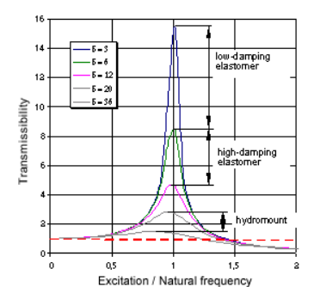
Damping of Torsional Vibration
Damping refers to keeping the vibration deflection within acceptable limits once the resonance point has been passed as the extraction of kinetic energy by means of thermal conversion
Elastomer materials exhibit
greater damping than metal
due to internal material
friction.

Slide 6
How do we calculate damping?

Slide 7
What is TV Damper?
Torsional Vibration
Designed to;
prevent from fatigue failures of crankshaft
Protect other driveline parts from wear
İncreasing the NVH performance of the car
AVL Excite Designer software is used to simulate the system

Slide 8
AVL Excite Designer
Leads crank train and driveline design analysis with less set of data
Performs modal analysis of the system and determines its torsional frequencies and torsional modes, as well as critical speeds
Results of dynamic forced response calculation include dynamic torques, angular displacements, and dissipation power of torsional vibration damper

Slide 9
- Engine Illustration
Simulation Interface

Slide 10
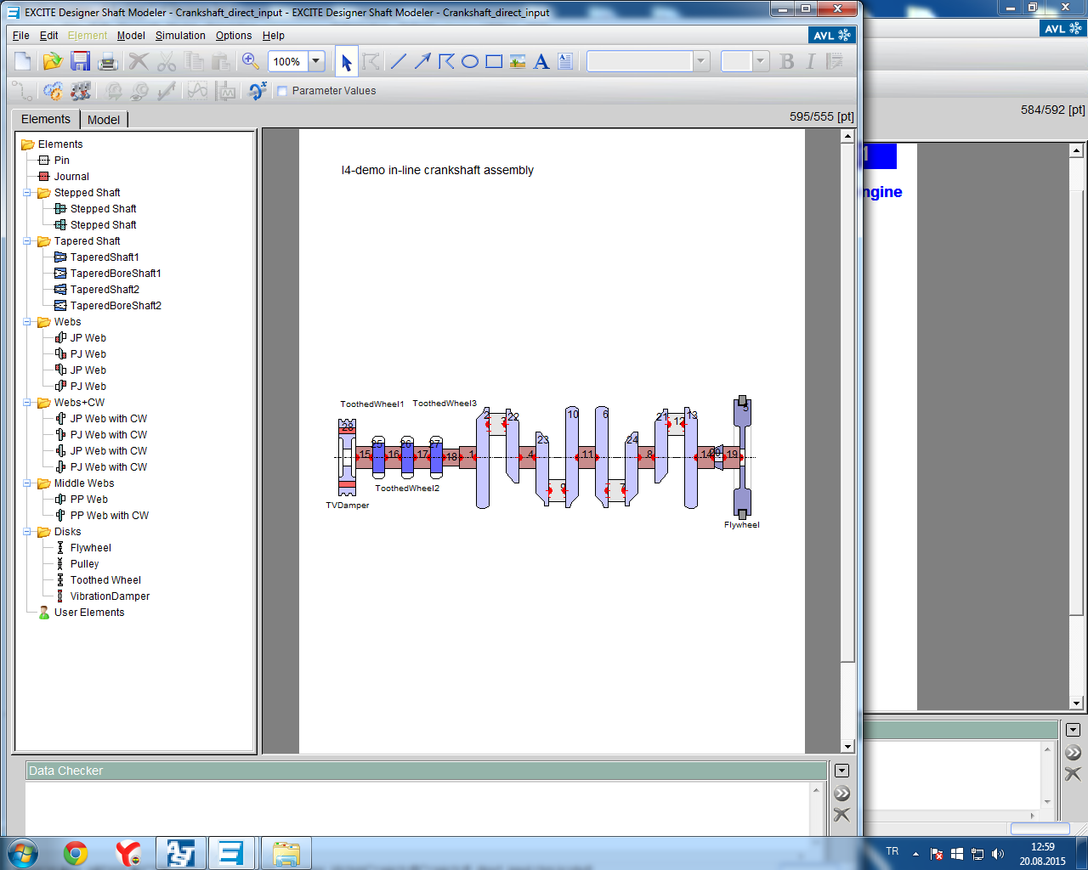
- The Crankshaft Model

Slide 11
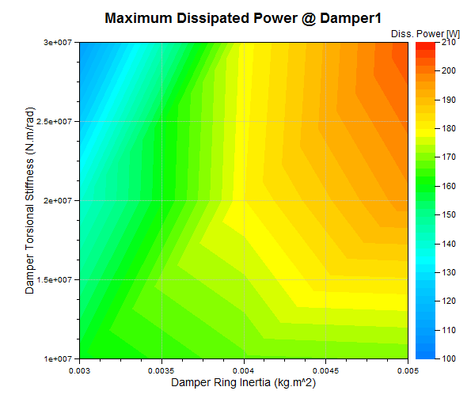
The biggest power dissipation (210 W) occur at right and upper side. Too much dissipated power can wear elastomer material of TV damper.

Slide 12
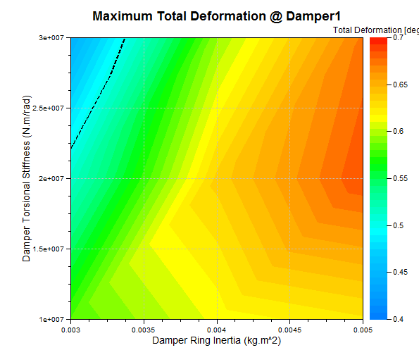
The most deformation on TV damper occurs at 2*107 stifness and 0.005 inertia value as smilar with dissipated power graph

Slide 13
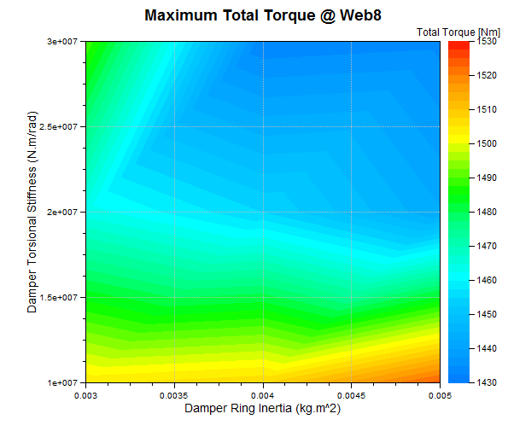
The highest magnitude of torsional torque occurs at fillet of web8 . it can reach more than 1500 N.m

Slide 14
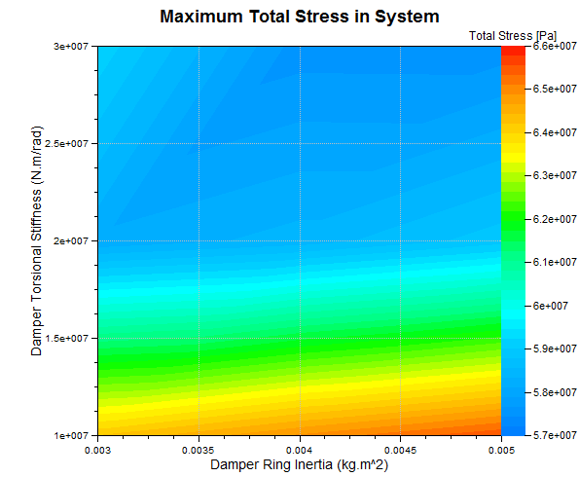
The total stress values graph of the sytem is in parallel with the graph of web8.

Slide 15
Conclusions
Damper inertia and stiffness have a big impact on maximum torsion torque on the system.
Lower stiffness values increase the torsional torque on the system.
Decreasing the inertia of the damper can eliminate deformation and dissipated power on the TV damper

Slide 16
Acknowledgement
The authors acknowledge AVL-AST, Graz, Austria for providing us AVL-Excite Designer under the AVL-Çukurova University Partnership Program.

Slide 17
Thanks for Listening
Any questions?

