Slide 1


Welcome Singapore

Slide 2

Effects of home-based rehabilitation for patients with acute myocardial infarction: A randomized controlled trial
Wenru Wang, PhD, Assistant Professor
Alice Lee Centre for Nursing Studies,
National University of Singapore
Euro Nursing – 2015, Valencia, Spain

Slide 3
Study Background
China has undergone
rapid economic growth,
urbanization and industrialization,
an ageing population
has seen a dramatic increase in the incidence and prevalence of coronary heart disease, especially acute myocardial infarction (MI)
The evidence suggests that rehabilitation plays a significant role in enhancing recovery from an acute cardiac event .
Notes:
Coronary heart disease (CHD) is one of the leading causes of death and disability among adults. It accounts for an estimated five million deaths a year worldwide. Not only is it the leading cause of death in Western industrialised countries; it is an increasingly important problem in developing countries (World Development Report, 1993).

Slide 4
Phases of CRP (AHA)
Phase I
In-patient rehabilitation, may occur when the patient is admitted to hospital for a CHD condition such as angina and AMI, and continues until the patient is discharged from hospital
Phase II
Out-patient rehabilitation, occurs after the patient has been discharged, and usually lasts for 4 to 6 weeks but may last up to 6 months.
Phase III
Maintenance rehabilitation, focuses on maintaining cardiovascular stability and long-term conditioning with an emphasis on secondary prevention

Slide 5


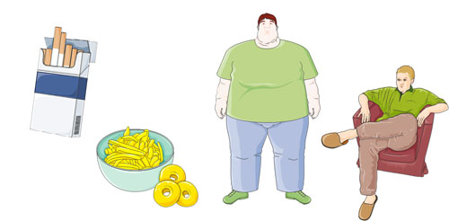

Components of out-patients CRP (AHA)
Patient education
CRP
Risk factor modification
Physical exercise training
Psycho-social management

Slide 6
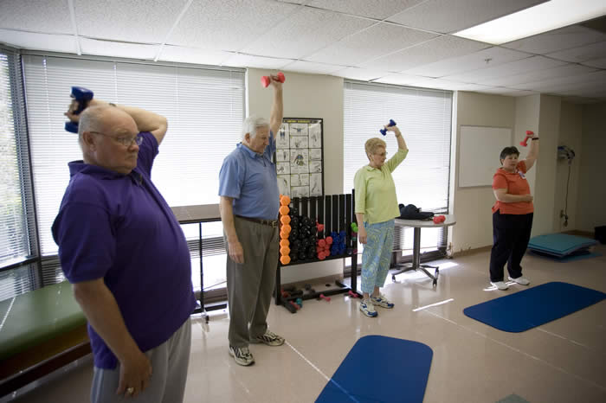
Over the past decade, the centre/hospital-based cardiac rehabilitation (CR) programmes have been well developed, and the benefits of attending those programmes have been widely documented .
Unfortunately, the programme uptake rates are disappointingly low with only 10-40% participation reported consistently in the literature.
Home-based CR progaramme may be more practical and feasible for Chinese patients with MI
Different approaches:
 Home-based Exercise Training CRPs
 Heart Manual Approach
http://www.theheartmanual.com/Programmes/Pages/default.aspx
Notes:
This means that patients have to return to the hospital or rehabilitation centre for their exercise training and education sessions according to a scheduled timetable. Until now, most rehabilitation programmes have been developed and delivered in this form. Such programmes have been demonstrated to have a favourable and positive impact on AMI patients, and should be accessible and available to all patients who may benefit from them.

Slide 7
Study Aim
We hypothesized that a home-based programme would provide an effective and viable alternative to usual care in improving HRQL and psychological status.
.

Slide 8
Methods
Study design
A randomised controlled study
Study setting
the cardiovascular units of two university-based teaching hospitals in the city of Xi’an in Shaanxi Province in China.
Sampling
convenience sample of 160 MI patients
Xi’an

Slide 9
Methods (Con’t)
-- Inclusion criteria include patients:
(1) a documented diagnosis of acute MI;
(2) able to speak and read Chinese;
(3) living at home after hospital discharge;
(4) available for telephone follow-up;
-- Exclusion criteria were:
(1) a known history of major psychiatric illness;
(2) pre-existing mobility problems;
(3) unstable angina;
(4) severe complications

Slide 10


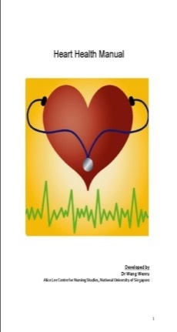

Methods (Con’t)
6-week home-based self-management CR programme
HM
Education session
Nurse facilitator
Telephone follow-up

Slide 11

Methods (Con’t)
Intervention (Heart Manual Approach) –
6-week home-based rehab. programme
Heart Manual: contains three sections:
❶ six weekly topics on health education
❷ answers commonly asked questions about
medication, PCI, and anxiety and depression
❸ information on the normal values of cardiac
physiological risk parameters
Education session for participants in Ex group
Telephone follows at 3 weeks after discharge for participants in Ex group
Notes:
A 6-week home-based rehabilitation programme was introduced using a self-help heart manual developed by the researchers. The content was informed by the experiences and needs of adapting to and living with MI as perceived by patients and their partners,¹⁴ and the views and beliefs concerning cardiac rehabilitation as perceived by Chinese health professionals.

Slide 12
Methods (Con’t)
Outcome measures
-- Chinese Mandarin version of SF-36 (CM:SF-36):
-- Chinese Mandarin version of the Myocardial
Infarction Dimensional Assessment Scale (CM-MIDAS)
-- Chinese Mandarin version of the Hospital Anxiety and
Depression Scale (CM-HADS)
-- Demographic and clinical data
-- Unplanned service use : cardiac related readmission, emergency visit and unplanned medical consultation

Slide 13

Instruments used in the study
MIDAS: disease-specific instrument, 35 items, 7 subscales (Physical Activity, Emotional Reaction, Insecurity, Dependency, Diet, Concerns over Medications, Side Effects) Score, HQoL
HADS: 14 items, two subscales (Anxiety, Depression)
Score, Anxiety and Depression
SF-36: generic instrument, 36 items, 8 subscales (Physical Function, Role Physical, Bodily Pain, General Health, Vitality, Role Emotional, Social Function, Mental Health) Score, HQoL

Slide 14
Data Collection Procedure
Participants recruitment (n=160)
Baseline data collection (T1)
Randomization
Ex.Group( n=80)
6-week HM CRP + usual care
Co. Group (n=80)
Usual care
Data collection at programme end (T2)
Data collection at three months (T3)
Data collection at six months (T4)

Slide 15
Data Analysis
-- Descriptive statistics: used for sample descriptio
and summarization of the data from the outcome
variables.
-- independent t-t and Chi-square: Homogeneity of
the study groups
-- Multivariate repeated measures ANOVA: was used
to compare changes in study outcomes (i.e., time,
group, and time×group effects) between the two
groups across the four study end points

Slide 16
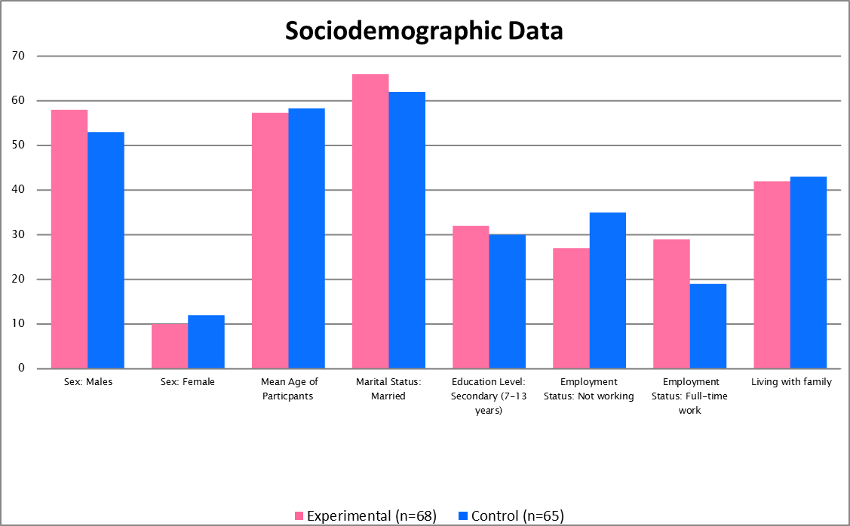
Results: Sociodemographics
97%
85%
57.3
58.3
95%
81%
62%
66%
53%
47%
42%
46%
40%
29%
15%
18%

Slide 17
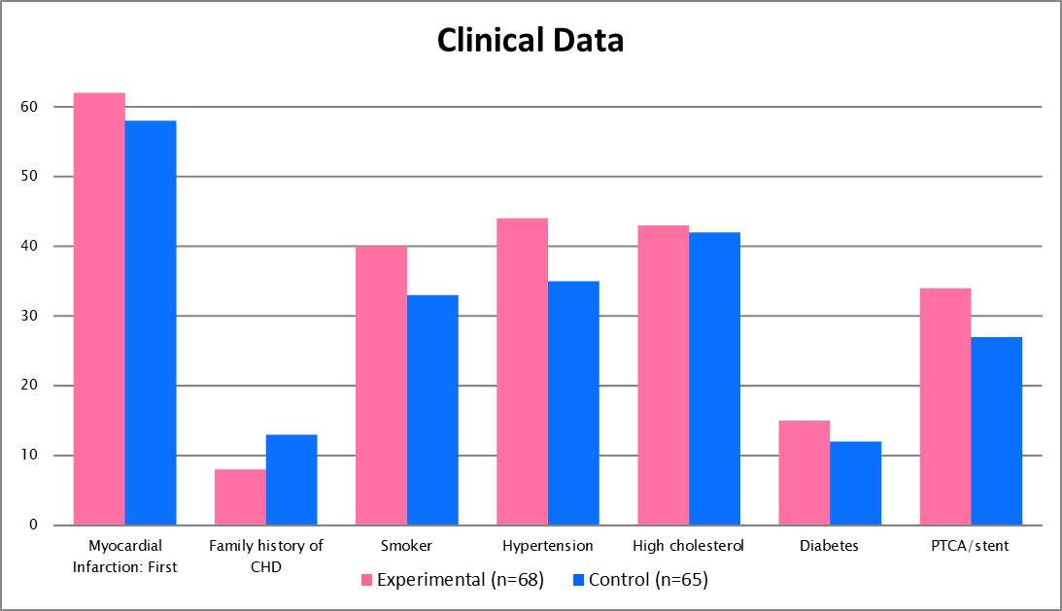
Results: Clinical Data
91%
89%
64%
63%
58%
62%
54%
50%
50%
42%
22%
20%
18%
12%

Slide 18
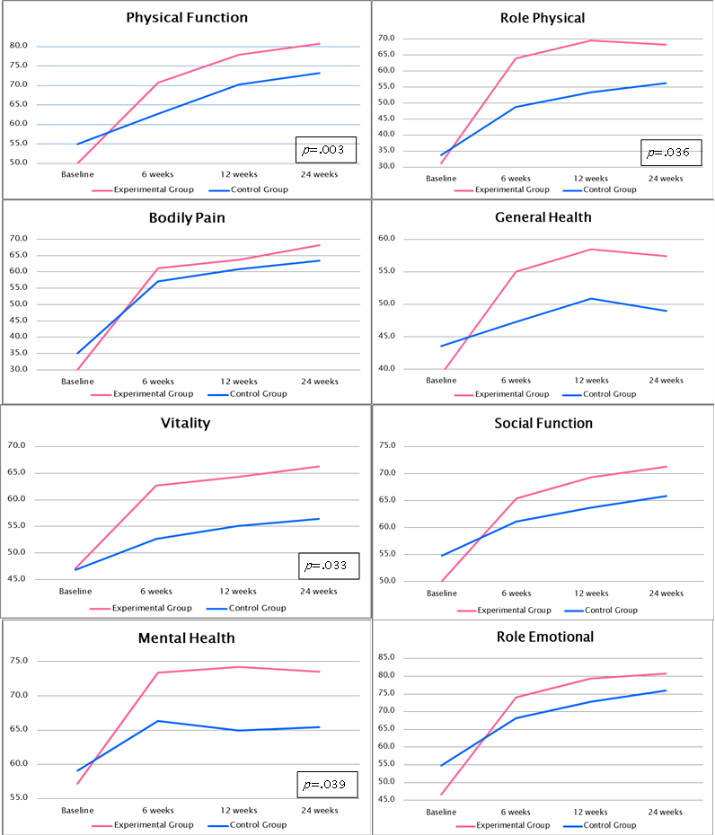
Results – SF-36 (Group Effect)

Slide 19
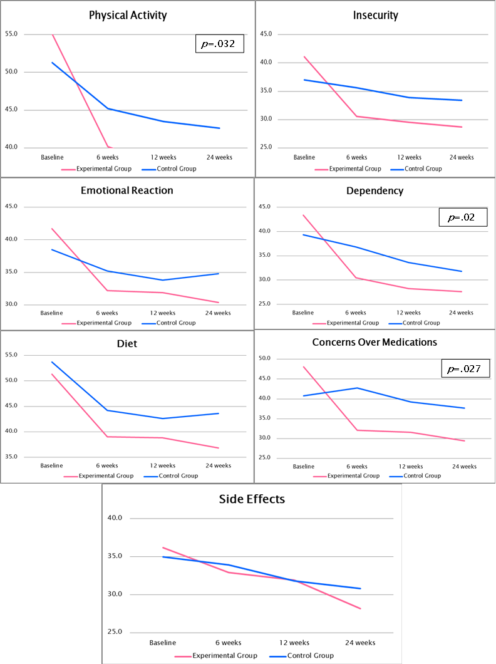
Results – MIDAS (Group Effect)

Slide 20
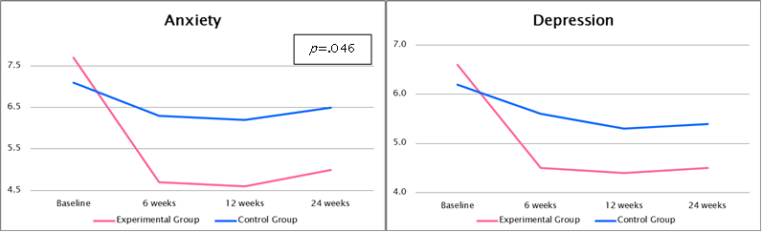
Results – HADS (Group Effect)

Slide 21
Results: Cardiac risk factors
Quit smoking

Slide 22
Comparison of unplanned health service use (Mean, SD) at the 6-month post-test study endpoint between the study groups
Results: Unplanned Health
Service Use

Slide 23
Discussion
There were significant differences in the main outcomes when the home-based group was compared with the usual care group at 6 weeks, 3 and 6 months.
The home-based group had significantly higher scores on 4 of the 8 domains of the Chinese SF-36 and 3 of the 7 dimensions of the Chinese MIDAS, and significantly lower scores on the anxiety, but not the depression, subscale of the Chinese HADS.

Slide 24
Discussion (Con’t)
The study may provide a useful tool to help health-care professionals to meet the cardiac rehabilitative care needs of patients with MI.
It empowers patients to take responsibility and accountability for their own disease management and helps confronting the challenge of limited health care resources.
Such a model appears appropriate for Chinese MI patients

Slide 25
Limitations
Convenience sampling
The absence of a blind condition may threaten the internal validity of the study
the researcher played the role of both intervener and outcome assessor and this might have influenced participants to provide desired answers, and so interviewer bias cannot be excluded.
In the absence of an evaluation of the level of adherence, the integrity of the intervention cannot be assured.

Slide 26


