Slide 1
EVALUATION OF RICE TRANSPLANTER AT DIFFERENT AGE OF SEEDLINGS AND SPACINGS
Dr. U. Vineetha
Scientist (Agro)
ARS, Nellore, ANGRAU
A.P, INDIA

Slide 2
PADDY TRANSPLANTER
Rice transplanters were first developed in japan in the 1960s, whereas the earliest attempt to mechanize rice transplanting dates back to late 19th century. [1]In Japan, development and spread of rice transplanters progressed rapidly during the 1970s and 1980s.
1. The paddy planter can transplant more than 0.2-0.4
hectare field per hour. 2. Time saving and labor saving. The rice transplanter
machine can transplant the seedling quickly and
with less than two people. 3. The machine is with compact structure and small
volume can operate in the field easily.
4. Machine transplanting involves planting young rice seedlings
into puddled soil by machine

Slide 3
The use of mechanized transplanter increased rice yields by 3.5 to 4.0 q/acre and decrease of cost by 50 %( (Harish Damodaran, 2000)
Mechanical transplanter saves about 78% labour and 48% of cost of operation compared to manual transplanting with higher grain yield (Giri Rao, 2008 and Katyal, 2008)

Slide 4
Basis for prioritization
Transplantation in paddy is becoming more and more expensive due to increased labour wages and unavailability of labour during peak agricultural season. So mechanization is the only substitute to the human labour which reduces the drudgery and allows timely transplanting. Hence, to find out the technology needed for the efficient performance of transplanter under field conditions, this experiment is proposed.

Slide 5
How to Transplant Rice by Machine?
Raise seedlings in special mat nurseries or in seedling trays. Use 12-15 kg of good seed per acre
Seedlings will be ready for transplanting in 12-18 days after seeding (DAS).
Ensure that fields are well puddled and leveled.
Drain fields and allow mud to settle for 1-2 days after the final puddling.
The subsurface soil layers need to be hard enough to support the transplanting machine.
The soil is ready when a small “V” mark made in the puddled soil with a stick holds its shape. At this moisture level, the soil can hold the seedlings upright.
Soil should not be so dry that it sticks to and interferes with planting parts or wheels of the transplanter.
Load the seedling mats on the machine and transplant the seedlings at the selected machine setting

Slide 6
Advantages: Machine transplanting
Fast and efficient (1-2 ha/d), uses less labor and ensures timely planting.
Reduces stress, drudgery and health risks.
Ensures uniform spacing and plant density.
Seedlings recover fast, tiller vigorously, and mature uniformly.

Slide 7
Limitations
Seedlings must be planted while still young, and so mechanical transplanting is best suited for irrigated areas only.
Special nursery management is needed (mat nursery or seedling trays).
Good land preparation, levelling and water management are required.
Fields need good access for machine transport and field entry.
Transplanting machines are expensive; so poor farmers cannot afford them (contract hiring of transplanters is available in some countries).
Problems in poorly prepared and leveled land, or with poorly designed machines.
Good training is needed to operate the machine properly.

Slide 8
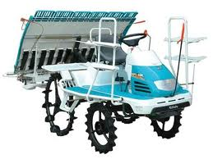
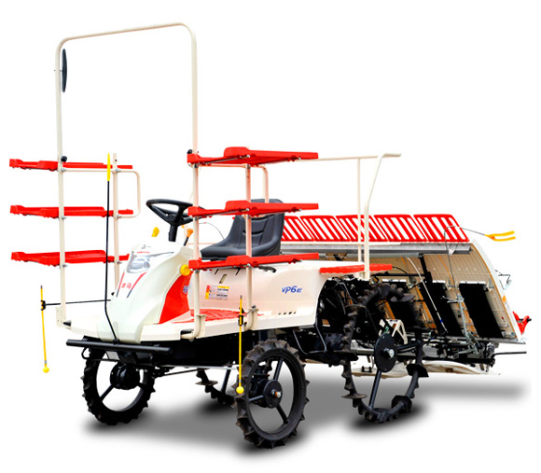
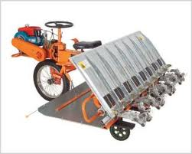
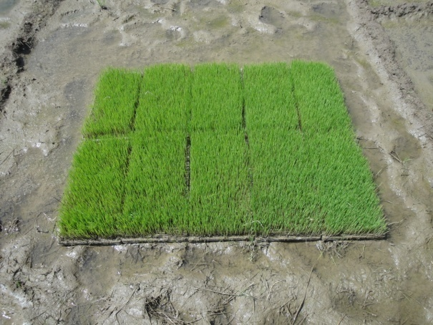
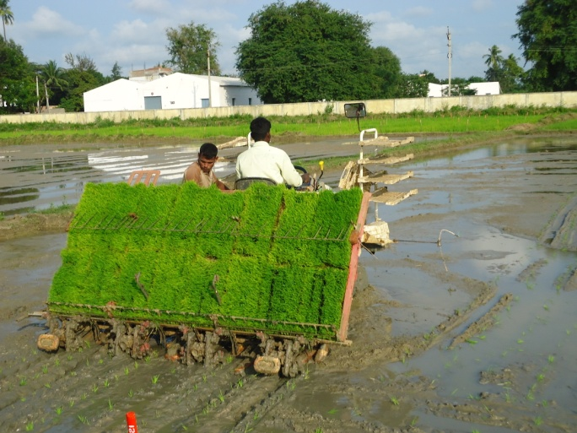
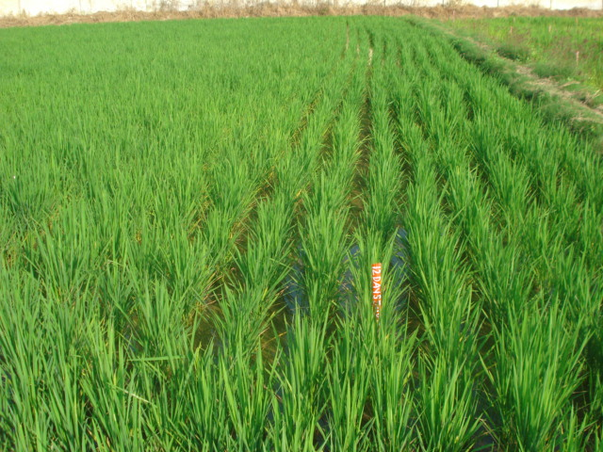
MACHINE TRANSPLANTATION
KUBOTA (6 row)
YANMAR ( 8 row)
YANJHI SHAKTI (8 row)

Slide 9
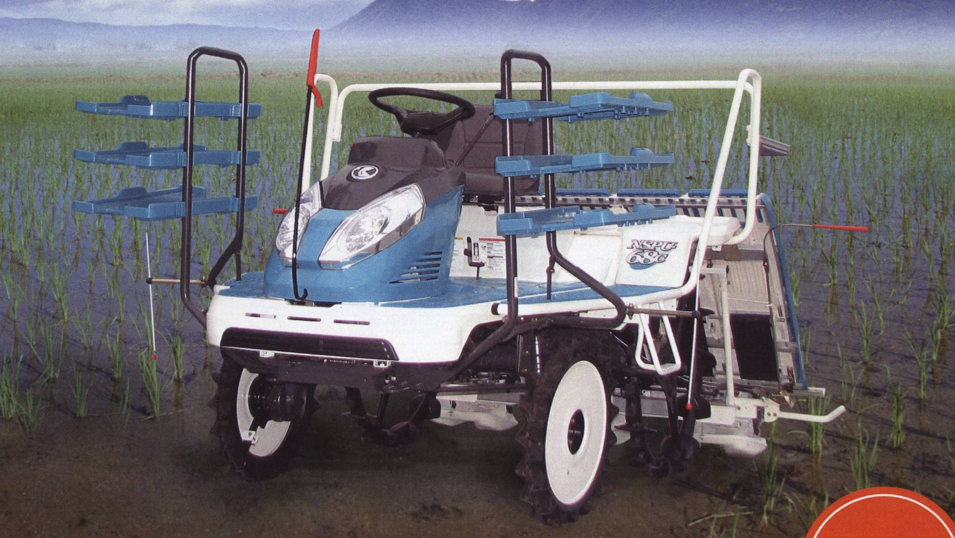
Kubota Paddy Transplanter

Slide 10
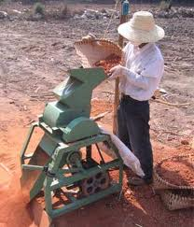
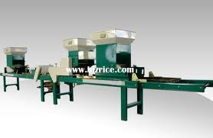
Mechanized System of Rice Intensification
Soil pulverizer
Paddy seeding unit

Slide 11
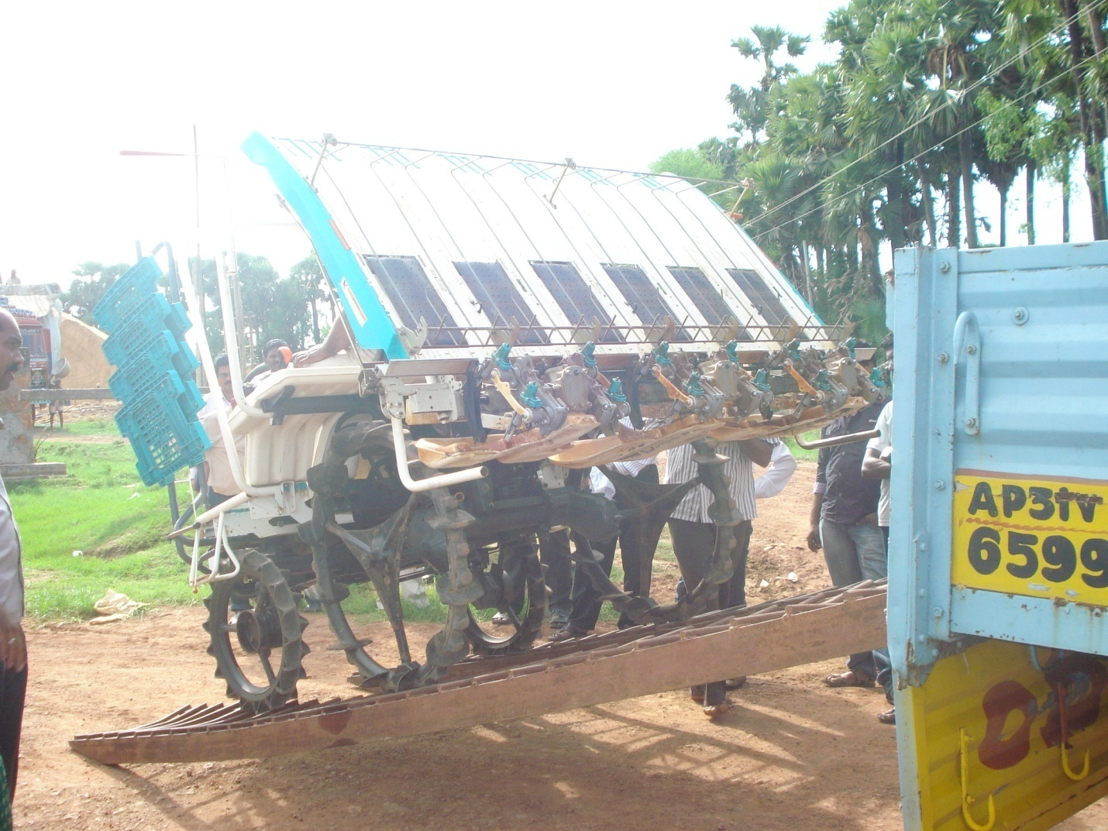

Slide 12
Evaluation of rice transplanter (kubota) at different age of seedlings and spacings
Design: Split plot Replications: 3
Main plots: Sub plots:
Age og seedlings spacings
A₁: 12 days S₁: 30x12
A₂: 15 days S₂: 30x14
A₃: 18 days S₃: 30x16
S₄: 30x18 S₅: 30x21
Variety: NLR 3042

Slide 13
Objectives
1. To find out optimum age of
seedlings for planting with rice
transplanter
2. To findout the optimum spacing
for mechine transplanting in rice

Slide 14
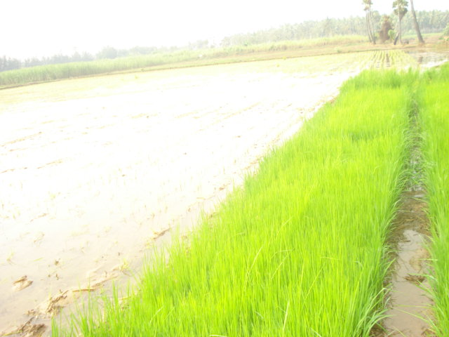

Slide 15
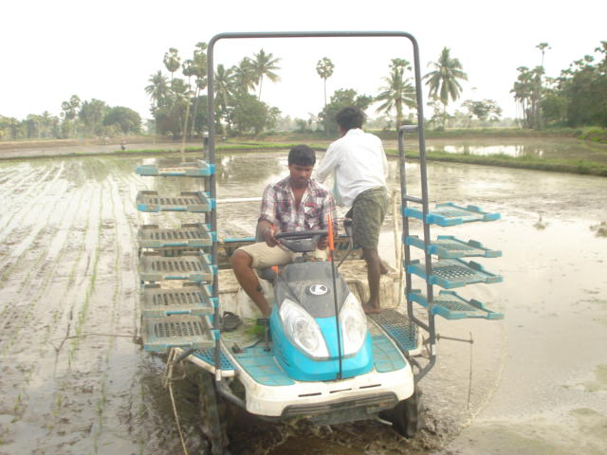

Slide 16
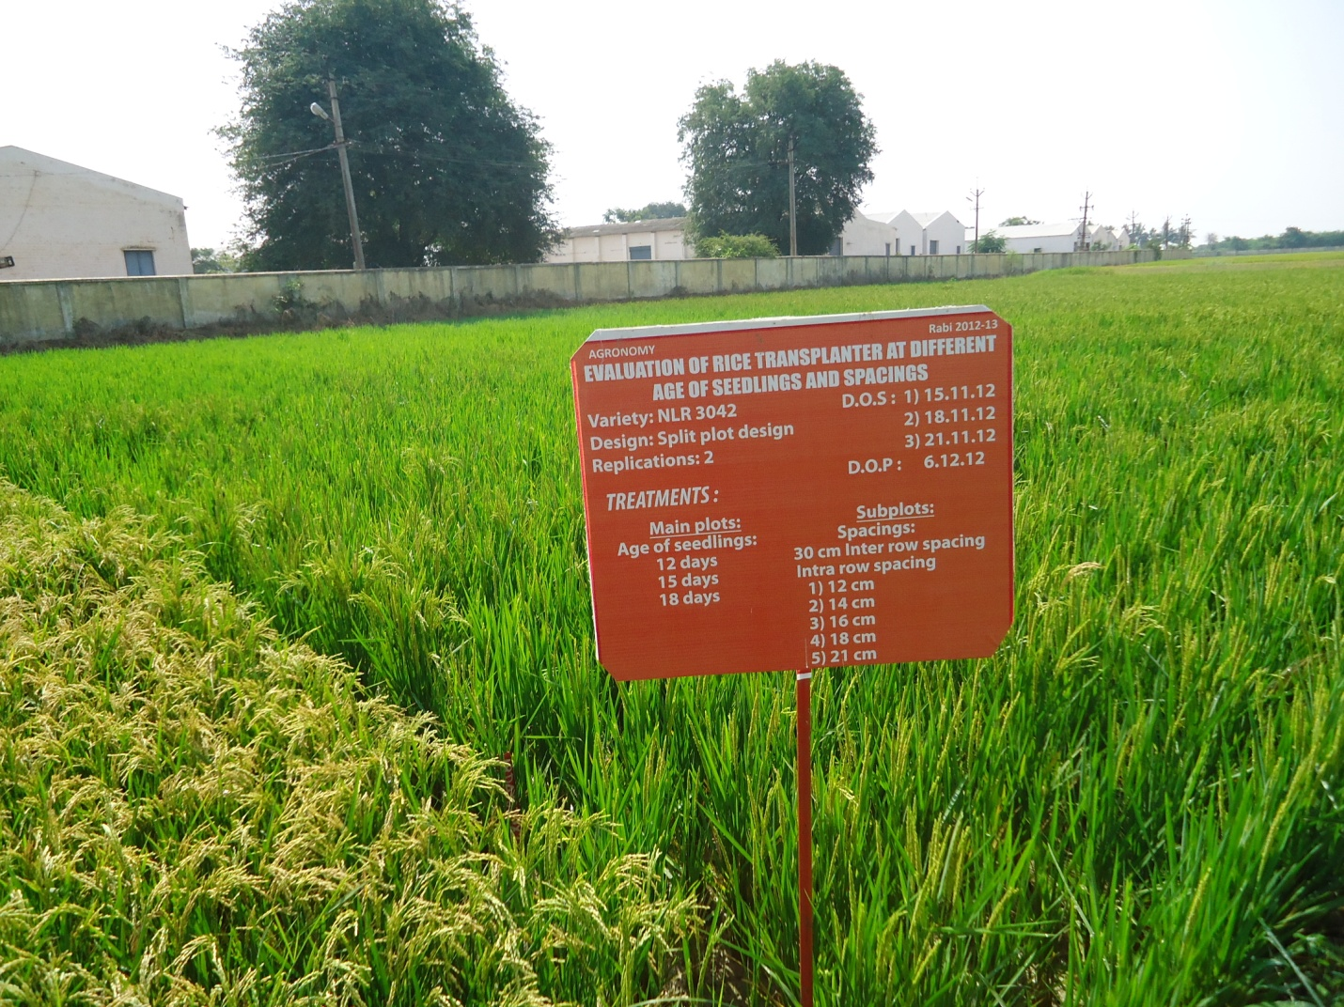

Slide 18
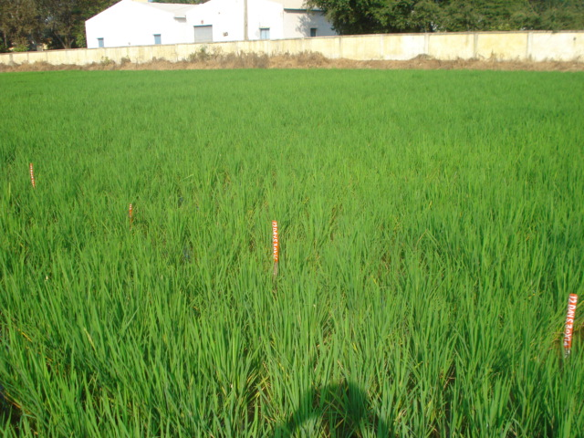

Slide 20
Evaluation of rice transplanter at different age of seedlings and spacings(Kubota)( Rabi, 2012)
Treatments | No. of Seedlings hill⁻¹ |  | Plant popnm⁻² | Plant Height (cm) | No of panicleshill⁻¹ |  | Panicle Length (cm) | No. of filled grains panicle⁻¹ | No. of un filled grains panicle⁻¹ |  | Test Weight (g) | Grain yield kg ha⁻¹
Age of seedlings
12 Days | 4.1 |  | 26 | 81.3 |  | 17.0 | 18.2 | 169 | 13.9 |  | 18.0 | 6168
15 Days | 3.9 |  | 27 | 80.8 |  | 16.5 | 18.9 | 181 | 15.0 |  | 18.5 | 6073
18 Days | 4.1 |  | 27 | 74.2 |  | 17.1 | 19.7 | 189 | 15.9 |  | 17.8 | 5871
CD@5% | NS |  | NS | 3.1 |  | NS | NS | 7.2 | NS |  | NS | NS
Spacings
30x12 | 4.0 |  | 30 | 80.2 |  | 15.6 | 18.3 | 172 | 15.7 | 18.2 |  | 5896
30x14 | 3.7 |  | 28 | 78.3 |  | 15.9 | 18.5 | 174 | 16.0 | 18.6 |  | 6017
30x16 | 4.1 |  | 25 | 78.2 |  | 16.7 | 18.6 | 181 | 14.3 | 18.1 |  | 6118
30x18 | 4.2 |  | 25 | 77.8 |  | 18.1 | 19.4 | 184 | 14.2 | 18.2 |  | 6106
30x21 | 4.3 |  | 24 | 77.3 |  | 18.1 | 19.7 | 187 | 14.4 | 17.4 |  | 6018
M at S
CD@5% | NS |  | 2.5 | 1.7 |  | 2.7 | NS | NS | NS | NS |  | NS
S at M
CD@5% | NS | 3.1 |  | 1.7 |  | 2.7 | NS | 21.3 | NS | NS |  | NS
Interaction
CD@5% | NS | 3.1 |  | 2.1 |  | 3.3 | NS | NS | NS | NS |  | NS
Farmers practice | 3.6 | 66 |  | 79.2 |  | 9.2 | 19.0 | 176 | 11.3 | 17.8 |  | 6023

Slide 21
Evaluation of rice transplanter at different age of seedlings and spacings(Kubota)( Rabi, 2013)
Treatments | Plant popn m⁻² | Plant Height (cm) | No. of tillers hill⁻¹ | No. of panicleshill⁻¹ | Panicle Length (cm) | No. of filled grains panicle⁻¹ | No. of un filled grains panicle⁻¹ | Test Weight (g) | Grain yield kg ha⁻¹
Age of seedlings
12 Days | 28 | 78.1 | 36 | 31 | 17.6 | 162 | 54 | 17.0 | 6280
15 Days | 27 | 76.6 | 31 | 30 | 18.1 | 173 | 36 | 17.6 | 6108
18 Days | 27 | 74.4 | 30 | 30 | 17.7 | 148 | 37 | 17.3 | 5782
SEm± | 0.4 | 0.9 | 2.5 | 1.6 | 0.2 | 4.2 | 6.6 | 0.3 | 173
CD@5% | NS | 3.6 | NS | NS | NS | 16.3 | NS | NS | NS
Spacings
30x12 | 32 | 76.8 | 27 | 25 | 18.1 | 147 | 42 | 17.6 | 6091
30x14 | 31 | 76.8 | 32 | 28 | 17.7 | 158 | 49 | 17.6 | 5980
30x16 | 28 | 76.1 | 32 | 31 | 17.9 | 169 | 42 | 17.0 | 6237
30x18 | 26 | 76.6 | 34 | 30 | 17.7 | 163 | 38 | 17.4 | 6073
30x21 | 21 | 75.9 | 37 | 33 | 17.7 | 161 | 39 | 17.0 | 5905
SEm± | 0.7 | 0.8 | 2.5 | 1.3 | 0.3 | 5.3 | 5.9 | 0.5 | 150
CD@5% | 2.0 | NS | 7.2 | 3.9 | NS | 15.5 | NS | NS | NS
Interaction
CD@5%
MatS | 2.0 | NS | 7.2 | 3.9 | NS | 15.5 | NS | NS | NS
SatM | 2.0 | 2.5 | 7.2 | 3.9 | 0.8 | 15.5 | 17.0 | 1.3 | 439
MxS | 2.4 | 3.1 | NS | NS | NS | 19.0 | NS | NS | NS
CV% | 5.3 | 2.4 | 16.3 | 9.5 | 3.2 | 7.1 | 19.5 | 5.6 | 5.3
F.P | 86 | 79.7 | 12.0 | 11.0 | 20.3 | 147 | 9 | 19.4 | 6768

Slide 22
Age of seedlings on grain yield
Year 2012
Year 2013

Slide 23
Effect of spacings on grain yield
Year 2012
Year 2013

Slide 24
Influence of age of seedlings and spacing on yield of rice transplanter
Treartments | Grain yield kg/ha
 | 2012 | 2013 | Mean
Age of seedlings
12 Days | 6168 | 6280 | 6224
15 Days | 6073 | 6108 | 6091
18 Days | 5871 | 5782 | 5827
SEm± | 205 | 173
CD@5% | NS | NS
Spacings
30x12 | 5896 | 6091 | 5994
30x14 | 6017 | 5980 | 5999
30x16 | 6118 | 6237 | 6178
30x18 | 6106 | 6073 | 6090
30x21 | 6018 | 5905 | 5962
SEm± | 150 | 150
CD@5% | NS | NS
Interaction
CD@5%
MatS | NS | NS
SatM | NS | 439
MxS | NS | NS
CV% | 5.4 | 5.3
Farmers practice | 6023 | 6768 | 6396

Slide 25
There is no significant yield difference with different age of seedlings from 12-18 days and also with different intra row spacings i.e from 12-21 cm (Inter row spacing of 30 cm is constant) when transplanting was done with 6 row Kubota transplanter.

Slide 26
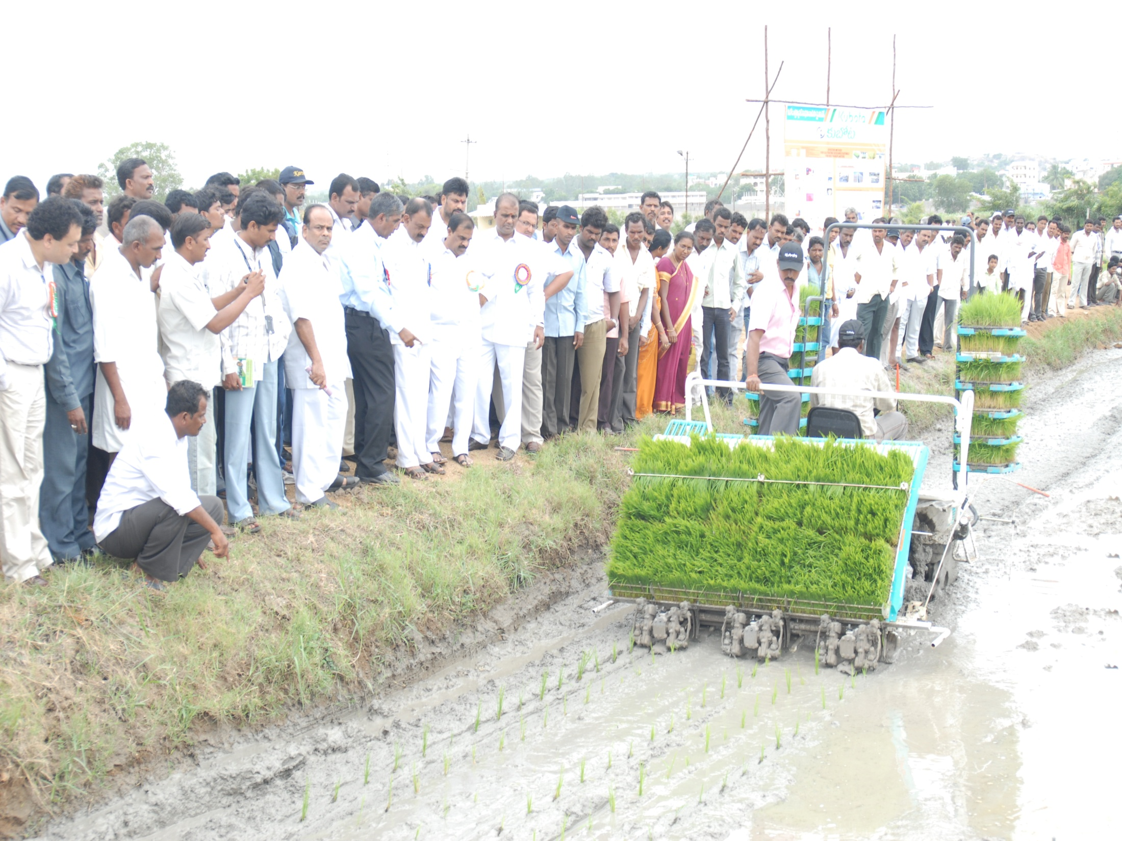
Thank you

