Slide 1
Pay 4 Performance in Korean Hospital Nursing
Sukyong Seo, PhD
Department of Nursing
Eul-Ji Univ., South Korea

Slide 2
Healthcare Quality
Quality assessment : Avedis Donabedian, 1980
“In my discussion of the context of quality assessment I pointed out that as attention shifts from the interaction of one patient-practitioner pair to the provision of care by groups of practitioners to entire populations, a number of attributes of care become much more prominent determinants of the quality of care”.
Approach: Structure, Process, and Outcome

Slide 3
Pay 4 Performance & Quality Health care
The rationale behind Paying for Performance(P4P) in health care is that if compensation is directly linked to quality of care, providers will shift more effort towards quality improvement.
Adopted in health care as a means to alter financial incentives of providers.
Well aligned providers’ main financial incentives with meeting quality targets → successful

Slide 4
Contents
Introduction & purpose of Study
Health system in Korea
Methods & Results
Conclusions
Policy implications

Slide 5
Introduction
The number of active nurses per 100 acute beds was about 4.8 in Korean(1990s), which was quite low compared with Western standards
Compelling evidences that nurse staffing directly influences quality of care
Rewarding hospitals according to their staffing levels may be an effective way to increase hospital investment in nursing resources
However, raising staffing levels requires substantial capital investment. The bonuses linked to P4P metrics are often too small to cover the labor costs required.

Slide 6
In 1999, the social insurance in South Korea(National Health Insurance Services, NHIS) reformed the hospital payment method to provide acute hospitals with incentives based on level of nurse staffing
In 2007, added a disincentive, whereby hospitals failing to reach a threshold level had to pay penalties
A decade of experience in South Korea provides a testable case to examine the effectiveness of financial incentives to increase nursing resources.

Slide 7
Brief overview of the health care system in South Korea
Korea’s social health insurance since 1977
- Expanded; limited population → businesses with fewer
employs & self employed population
- Subsidized by government; 35-50% → 20%
- Subsidies as a share of total general government
expenditures; 0.7% → 4.1%
Household premiums subsidized by employers & government
Consumer out-of-pocket payment (20-55%) not covered by social insurance

Slide 8
Brief overview of the health care system in South Korea
Medical providers compensated on a fee-for-services (FFS) basis
Committee for Financial Management
- Sets the medical fee schedules and defines the scope of
national health insurance coverage and benefits
- Kept fee schedules very low, often not covering actual costs
for some services, and excluding coverage for many
expensive services
An independent agency, the Health Insurance Review and Assessment Service (HIRA)
authoritative to make strategic purchasing
reviewing provider payment scheme and fee schedules, auditing insurance claims, and assessing quality of health care providers
established pay-for-performance (P4P) and public reporting programs

Slide 9
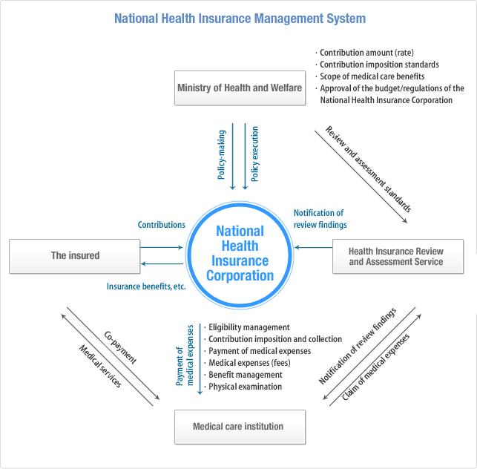
Source: Ministry of Health and Welfare

Slide 10
Building blocks of the P4P
A monitoring system, price setting, and an adjustment system
1) Monitoring
collects data on each hospital’s nurse staffing on a quarterly basis
following the assessment, pays for that quarterly nursing fee (the Nursing Administration Fee)
Separates the revenue category of nursing care from the daily room-and-board charge
the nursing fee - based on a per-bed ratio, not accounting for nursing intensity provided for each patient

Slide 11
Building blocks of the Korean Nursing P4P
2) Price setting
Sets up six grades:
hospitals are paid 100% of the base nursing fee (per diem per patient rate) by NHIS when complying with the minimum requirement (Grade 6)
The value of base rate is annually determined through the National Health Insurance Policy Review Committee chaired by the vice minister of health and welfare
As it advances into the upper grades, the capital benefits that a hospital would gain increase by 40% of the base rate
At the highest level, a hospital is paid 300% of the fee (Grade 1)
3) Actual payment adjusting factors
By grouping hospitals according to cost related to hiring nurses

Slide 12
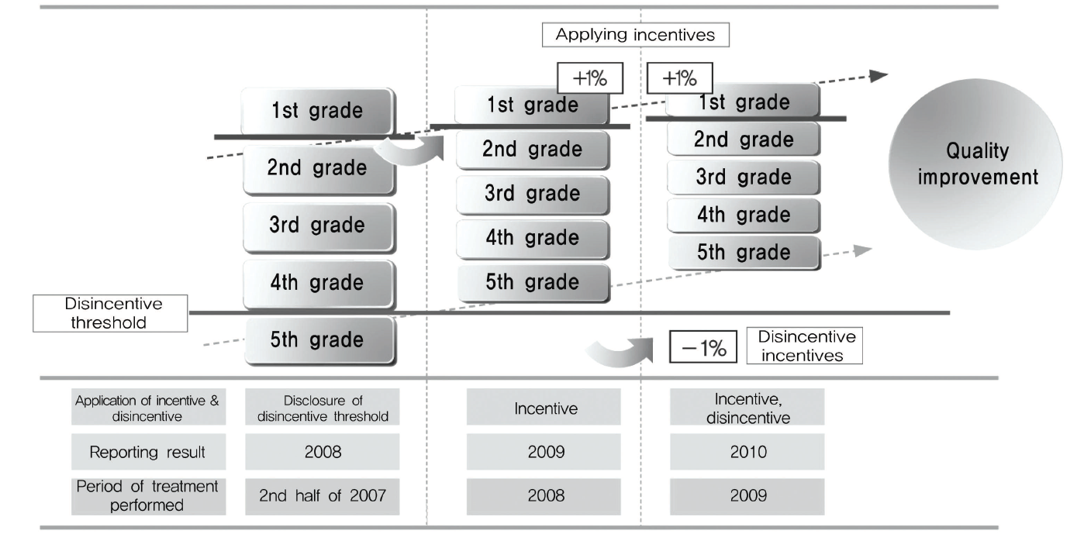

Slide 13
Purpose of study
To examine whether the payment incentive leads hospitals to increase nurse staffing
To examine whether the response to the nursing incentive has been consistent across hospitals with various financial statuses
To examine whether the resulting staffing changes improved nurses’ working conditions

Slide 14
Data Sources
Annual financial reports (1996-2005) on 756 - 1,525 hospitals
including short-term acute hospitals, excluding psychiatric, specialty, and long-term care hospitals
inpatient units only
2010 nationwide survey of hospital RNs performed by the Korean Health and Medical Workers Union to learn whether work conditions were improved following payment reform
2,387 RNs from 29 nationwide hospitals
including medical-surgical units and obstetrics and gynecological units, excluding the ICUs, OR, and EDs

Slide 15
Measures
Nursing payment reform
pre-policy years (1996 and 1999)
intervention year (1999)
post-policy years (2002, 2005, 2008)
‘post intervention 1’
‘post intervention 2’
‘post intervention 3’
Nurse staffing level
grade 1 – grade 6 (currently)
whether the level had improved since 2005 (by 1 grade, by 2 grade, no improvement).

Slide 16
Nurses’ work conditions
job satisfaction, burnout, and intention to leave
job satisfaction: 4-point Likert-type scale (1 = very dissatisfied, 2 = dissatisfied, 3 = satisfied, and 4 = very satisfied)
degree of burnout: the Maslach Burnout Inventory–Human Services Survey, (Maslach, Jackson & Leiter 1986)
intention to leave current employer was measured by a single item asking, “Are you intending to leave your current employer(s) within a year?”
Characteristics of nurses
age, marital status, years of nurse experience, position (charge or staff nurse), and education
current employer: number of beds, location
Hospital characteristics
Hospital type, size, location, ownership, teaching status, etc
Hospital type was categorized as
General hospital : 100 licensed beds and met particular criteria
Hospital: 30 to 100 licensed bed

Slide 17
Statistical analysis
First, analyzed the trend of nursing staffing by comparing data from before the policy with that from after the policy
Next, estimated what factors affected the changes in nurse staffing by using multivariate regressions
Controlled for the factors pertinent hospitals’ staffing decisions (location, hospital type, size, case mix)
Last, multilevel logistic regression analysis
to examine whether hospital nurses had perceived improvements in their working conditions after the nursing payment reform
Applied multilevel specifications
to control for the hospital effect since respondents coming from the same hospitals shared the same work conditions as well as other organizational characteristics

Slide 18
Table 1. Descriptive statistics of Korea’s acute hospitals, 1996-2008
 |  | 1996 |  | 1999 |  | 2002 |  | 2005 |  | 2008
 |  | n | % | n | % | n | % | n | % | n | %
Hospital Type | General Hospital | 275 | 36.38 | 275 | 32.66 | 275 | 28.86 | 286 | 22.27 | 303 | 19.87
 | Hospital | 481 | 63.62 | 567 | 67.34 | 678 | 71.14 | 998 | 77.73 | 1,222 | 80.13
Ownership* | Public | 122 | 16.14 | 100 | 11.88 | 103 | 10.81 | 139 | 10.83 | 119 | 7.8
 | Private | 619 | 81.88 | 742 | 88.12 | 850 | 89.19 | 1145 | 89.17 | 1,406 | 92.2
Location | Capital city and neighbor | 280 | 37.04 | 294 | 34.92 | 322 | 33.79 | 399 | 31.07 | 460 | 30.16
 | Metropolitan | 176 | 23.28 | 232 | 27.55 | 274 | 28.75 | 379 | 29.52 | 438 | 28.72
 | Rural | 300 | 39.68 | 316 | 37.53 | 357 | 37.46 | 506 | 39.41 | 627 | 41.11
Training Hospitals | Yes | 246 | 32.54 | 226 | 26.84 | 210 | 22.04 | 217 | 16.9 | 199 | 13.05
 | no | 510 | 67.46 | 616 | 73.16 | 743 | 77.96 | 1067 | 83.1 | 1,326 | 86.95
Total |  | 756 | 100 | 842 | 100 | 953 | 100 | 1284 | 100 | 1,525 | 100
* 1996: missing 154

Slide 19
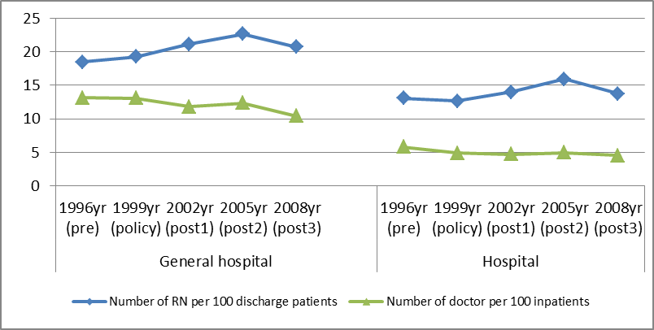
Figure 1. Average number of nursing workforce in Korean hospitals,1996 -2008
Notes:
Figure 1 illustrates the yearly staffing trend, holding patient discharges constant. The average number of RNs per 100 bed increased by about 12%, rising from 18.51 in 1996 to 20.70 in 2008. Meanwhile the number of physicians did not show any increasing trend. The increase in RN staffing was more significant in General hospitals than in Hospitals. General hospitals’ demand for RNs peaked in 2005 and disappeared afterward.

Slide 20
Table 2. Estimates of the effect of P4P in the nursing payment on nurse staffing in Korean hospitals
Dependent variable: Number of RNs(log)
Variables | Estimate | SE | p-Value
General Hospital (referent to Hospital) | 0.442 | 0.06 | <.0001
Number of beds | 0.629 | 0.015 | <.0001
Number of patient discharges | 0.423 | 0.009 | <.0001
Public ownership (referent to private) | 0.257 | 0.03 | <.0001
Location (referent to rural area)
Capital city & neighbor | 0.244 | 0.022 | <.0001
Metropolitan | 0.165 | 0.022 | <.0001
Teaching status (referent to non-teaching hospitals) | 0.212 | 0.032 | <.0001
Policy period (referent to 1996)
Policy intervention (1999) | 0.236 | 0.06 | <.0001
Post intervention 1 (2002) | 0.386 | 0.06 | <.0001
Post intervention 2 (2005) | 0.472 | 0.06 | <.0001
Post intervention 3 (2008) | 0.436 | 0.059 | <.0001
Hospital type & Policy interactions
Hospital*policy | 0.034 | 0.072 | 0.64
Hospital*post intervention 1 | -0.045 | 0.071 | 0.524
Hospital*post intervention 2 | -0.081 | 0.07 | 0.247
Hospital*post intervention 3 | -0.166 | 0.069 | 0.016
N | 4,902
Adj R-Sq | 0.792
Notes:
Table 2 presents estimates of the changes in RN staffing from our multiple regression. The first two columns present regression coefficients and standard errors for the number of RNs. RN staffing appeared to be higher in General Hospitals than in Hospitals. The volume of patients cared for at a hospital, ownership, urban location, and teaching status were significantly associated with nurse staffing.
The coefficients of policy indicators showed significant changes in hospital RN staffing, after controlling for the effects of covariates, after nursing payment reform was implemented. The coefficients of 2002, 2005, and 2008 were 0.39, 0.47, and 0.44, respectively. The interaction terms indicating the effect of policy among Hospital-level institutions compared to General Hospitals showed that Hospitals were not significantly likely to increase their staffing of RNs responding to the payment reform.

Slide 21
Table 3. Descriptive statistics on hospital nurse survey in 2010
 |  | n | %
Number of beds | Less than 500 | 407 | 17.05
 | 500-799 | 791 | 33.14
 | More than 800 | 1189 | 49.81
Location | Capital area | 1123 | 47.05
 | Metropolitan | 862 | 36.11
 | Rural | 402 | 16.84
Level of Nurse Staffing | Grade 1 | 570 | 24.28
 | Grade 2 | 1096 | 46.68
 | Grade 3 | 485 | 20.66
 | Grade 4 | 99 | 4.22
 | Grade 5 | 98 | 4.17
 | Grade 6 | 0 | 0
Changes in staffing grade, past 5 years | No change | 568 | 24.84
 | Advanced by 1 grade | 1094 | 47.84
 | Advanced by 2 + grade | 625 | 27.33
Demographics of RNs
Age | <25 | 621 | 26.02
 | 25-29 | 989 | 41.43
 | >=30 | 777 | 32.55
Marital status | married | 662 | 27.93
 | no married | 1708 | 72.07
Experiences (years) | <5 | 1302 | 54.55
 | 5-9 | 617 | 25.85
 | >=10 | 468 | 19.61
Positions | staff nurse | 2,164 | 91.62
 | charge nurse | 158 | 6.69
 | head nurse | 40 | 1.69
Education | 3 year nursing program | 1,234 | 52.2
 | College graduate | 996 | 42.13
 | Master’s or higher | 134 | 5.67
Total |  | 2,387 | 100

Slide 22
Table 4. Changes in staffing levels and nurse’s work conditions in Korean hospitals
 | Job satisfaction (%) |  |  |  | High burn out(%) |  |  |  | Intention to leave (%)
 | unsatisfied | satisfied | N | chi sq (p) | no | yes | N | chi sq (p) | no | yes | N | chi sq (p)
No change | 70.72 | 29.28 | 567 | 5.463 | 25.09 | 74.91 | 562 | 4.53 | 63.09 | 36.91 | 550 | 6.993
Advanced by 1 grade | 68.41 | 31.59 | 1089 | (0.065) | 26.46 | 73.54 | 1077 | (0.104) | 68.97 | 31.03 | 1070 | (0.032)
Advanced by 2+ grades | 64.52 | 35.48 | 620 |  | 30.29 | 69.71 | 614 |  | 69.36 | 30.64 | 607
N | 67.93 | 32.07 | 2276 |  | 27.16 | 72.84 | 2253 |  | 67.62 | 32.38 | 2227

Slide 23
Table 5. Estimates of the effect of the nursing payment reform on nurse’s work conditions in Korean hospitals
Dependent variables | Job Satisfaction |  |  | High burn out |  |  | Intention to leave
Variables | OR | 95% CI |  | OR | 95% CI |  | OR | 95% CI
Changes in nurse staffing grade, past 5 years (referent to no change)
Advanced by 1 grade | 0.994 | (0.574 | 1.723) | 1.217 | (0.627 | 2.363) | 1.153 | (0.717 | 1.854)
Advanced by 2+ grades | 0.887 | (0.429 | 1.835) | 1.314 | (0.549 | 3.141) | 1.579 | (0.834 | 2.991)
Note: All regression models include nurse demographics (age, marital status, years of nurse experience, position, education) and hospital characteristics (number of beds, location, levels of nurse staffing).

Slide 24
Conclusions
Examining a decade of experience in P4P in Korean hospital nurse staffing, this study shows that the approach is somewhat effective for “the general hospitals” with adequate resources to invest in nurse staffing, but less so with “the hospitals” that lack such resources.
Our findings inform policymakers in other countries that a policy to incentivize nurse staffing using P4P can be more effective by considering those hospitals in poor financial shape.

Slide 25
Policy implications
Linking institution-level nurse staffing to payment is effective in improving nurse staffing in the hospital sector.
This approach could be added to already existed staffing regulations such as minimum nurse-to-patient ratios or patient classification systems.
To be more effective, careful considerations for hospitals in poor financial shape are required when designing and implementing this approach.
Surprisingly, nurse outcomes including job dissatisfaction, burnout, & intention to leave were not significantly improved, while overall staffing increased.
Investment to improve nurse work conditions is required to increase staffing levels.

