Slide 1
Flipping the Classroom to Improve Self-Directed Learning for RN to BSN Students in Taiwan: A Pilot Test
Su-Fen Cheng, RN, PhD
Jean Lee-Hsieh, Professor
Chu-Yu Huang, RN, PhD
National Taipei University of Nursing and Health Sciences

Slide 2
Introduction-1
Lifelong learning is one of the core competences for nurses. The self-directed learning is one way to reach the goal of lifelong learning.
Cheng et al. (2010) proposed the four domains of SDL should include learning motivation, planning and implementation, self-monitoring and interpersonal communication.
Current literature showed that nursing students reported low ratings on their own lifelong learning, critical thinking (Wu, Hsieh & Hsu, 2014), self-directed learning (SDL) and learning motivations (Cheng, Lee-Hsieh, Turton, 2014)
Notes:
Lifelong learning is one of the core competences for nurses, which enables nurses to function effectively in the constantly changing and complex healthcare system.
However, current literature has shown that nursing students reported low ratings on their own lifelong learning, critical thinking (Wu, Hsieh & Hsu, 2014), self-directed learning and learning motivations (Cheng, Lee-Hsieh, Turton & Lin, 2014).
self-directed learning and learning motivations

Slide 3
Introduction-2
Anema and McCoy (2010) discovered that nursing students not only were deficient in their ability to completing clinical tasks but also weak in the areas of reading, writing, oral communication, problem solving, critical thinking, self-discipline and working with groups.
Thus, the previous findings reflect weaknesses on SDL.
Developing innovative teaching strategies and advocated for integration of the four SDL elements into nursing curriculum/or individual courses can remediate these weaknesses (Cheng et al., 2014).

Slide 4
Introduction-3
Flipped classroom learning may effectively stimulate learning motivations and provide trainings for communication skills, discernment capability, problem-solving skills and collaborative team work (Bishop & Verleger, 2013; Johnsonet et al., 2014).
Pearson and colleagues (2013) indicate that FLIP (in flipped classroom learning) stands for
Flexible environment
Learning culture
Intentional content
Professional educator.
Notes:
Flipped classroom learning is a teaching strategy that has gained increasing recognition in the past decade.

Slide 5
Purpose
The purposes of this study were to demonstrate the process for developing a BFCTS (blended flipped classroom teaching strategy) and pilot test its effectiveness in promoting SDL and students’ satisfaction.

Slide 6
Methods
Course planning and development
Implementation
Evaluation

Slide 7
Course planning and development
Course: 2-credit hour pediatric nursing course
Program: RN to BSN program
Original Course design:
a 5-week classroom/online instruction and 90-hour practicum
Innovation of three stage Course design

Slide 8
Innovation of Course Design
Stage 1: Understanding students’ learning needs and preferences
Stage 2: Constructing learning platform
Stage 3: Developing the 4D-CBL (four phases dynamic case based learning).

Slide 9
Stage 1: Understanding students’ learning needs and preferences
Characteristics of RN to BSN students
Licensed RN
Prior exposures to pediatric clinical
15 RN-BSN students (aged 21-22) were interviewed to understand their learning needs, learning difficulties and preferred learning styles, as well as strategies to improve their SDL.

Slide 10
Results from interview
Difficulties in transferring knowledge into practice
Limited clinical experiences in pediatric nursing
This pediatric course focused on knowledge transformation to practice and communication with pediatric patients of various developmental stages and their families

Slide 11
Course Design of the BFCTS
Traditional classroom teaching with technology assisted (LINE ® – a communication Application) and role play
Online lectures
The 4-phase dynamic case-based learning (4D-CBL).
Notes:
After receiving the feedbacks from students, the course instructor designed a BFCTS, consisting of the following two components: (1) in-class technology assisted (LINE ® – a communication Application) lectures and role plays, and (2) 4-phase dynamic case-based learning (4D-CBL).

Slide 12
Stage 2: Constructing learning platform
The course materials (e.g. course handouts, audiovisual recordings, course instructions, syllabus etc.) were uploaded to the university’s iLMS system and a discussion forum was created in the system.
The Power Cam software was used to record three learning modules, namely, cardiovascular, gastrointestinal, and respiratory systems.
Notes:
The Power Cam software was used to record three learning modules, namely, cardiovascular, gastrointestinal, and respiratory systems. Each recording was kept between 12 to 15 minutes to maximize the effectiveness. According to Selingo (2014), the lengths of the best concentration time among college students ranged between 10 and 18 minutes. Students were required to review these modules online prior to scenario discussions in class.

Slide 13
Each recording was kept between 12 to 15 minutes to maximize the effectiveness.
Students were required to review these modules online prior to scenario discussions in class.

Slide 14
Stage 3: Developing the 4D-CBL
Four phases
Construct a brief case for discussion
Revise case based on synthesis of faculty and student questions
Case discussion in group
Presentation of discussion results.

Slide 15
Brief Case for Discussion
John Wang is a one-year-old child who has been diagnosed with Tetralogy of Fallot. Wang was admitted for a cardiac catheter procedure in preparation for his coming cardiac surgery.

Slide 16
Construct a Brief Case for Discussion
Each group of students was asked to raise at least two questions related to the scenario and submitted these questions to the online learning platform.
This step served dual purposes: to clarify students’ questions/concerns related to the scenario, and to incorporate student-generated questions into reconstruction of the scenario.

Slide 17
Synthesis student questions and
revise the case for discussion

Slide 18
Case Discussion in Group
John Wang, 1 year old, male. Birth weight: 2200 grams. Aged 37 weeks +1 day. Digoxin qd. Weight 7 kilograms. Height 80 cm. Normal findings based on DDST. Has been diagnosed with Tetralogy of Fallot at birth. Was admitted for a cardiac catheter procedure in preparation for his coming cardiac surgery.

Slide 19
Prior to admission (examples of questions)
What are the clinical manifestations that you expect from the report by outpatient nurse during hand-off? Why does the patient show these clinical manifestations? What is the pathophysiological mechanism?
What else do you need to assess based on the patient’s current condition?

Slide 20
Implementation
The course was implemented in the Spring of 2015.
In class, students were required to search relevant information in preparation for the discussions, electronic devices (such as mobile phone, iPad, laptop etc.) were encouraged to use in class for the research purpose.
After the classroom discussions, the course faculty randomly selected students to present the group discussion results.
Notes:
The course was implemented in the Spring of 2015.
The BFCTS was implemented in three (cardiovascular, gastrointestinal and respiratory systems) out of the ten pediatric course content areas .
In class, students were required to search relevant information in preparation for the discussions, electronic devices (such as mobile phone, iPad, laptop etc.) were encouraged to use in class for the research purpose.
After the classroom discussions, the course faculty randomly selected students to present the group discussion results.

Slide 21
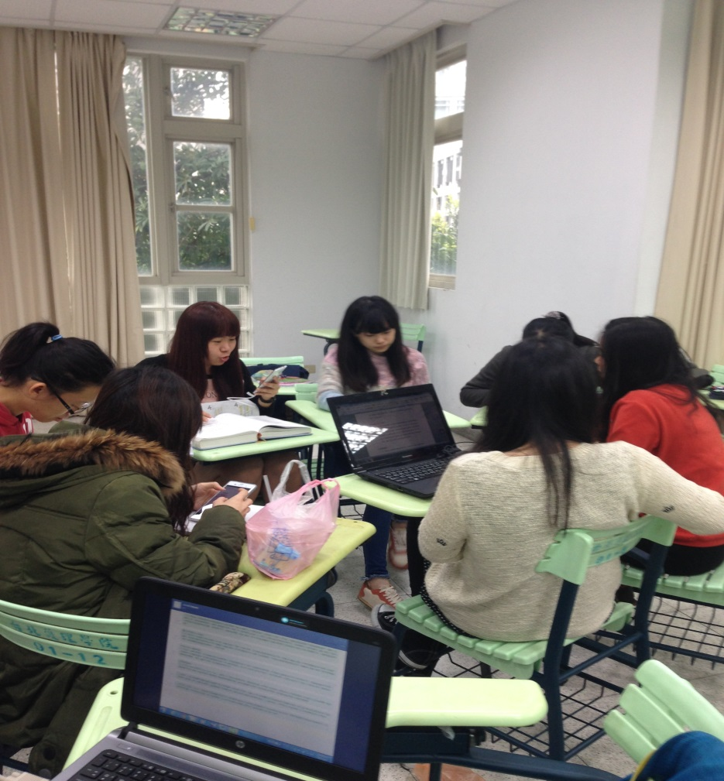

Slide 22
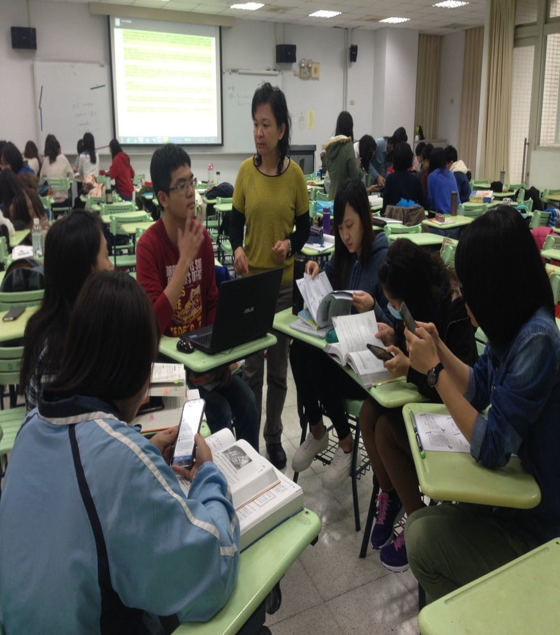
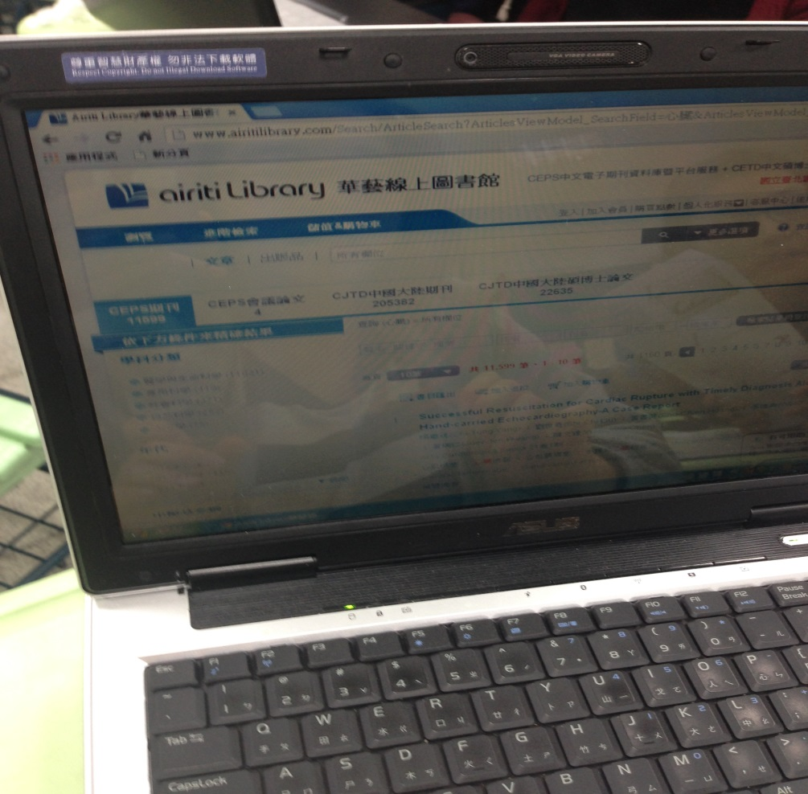

Slide 23
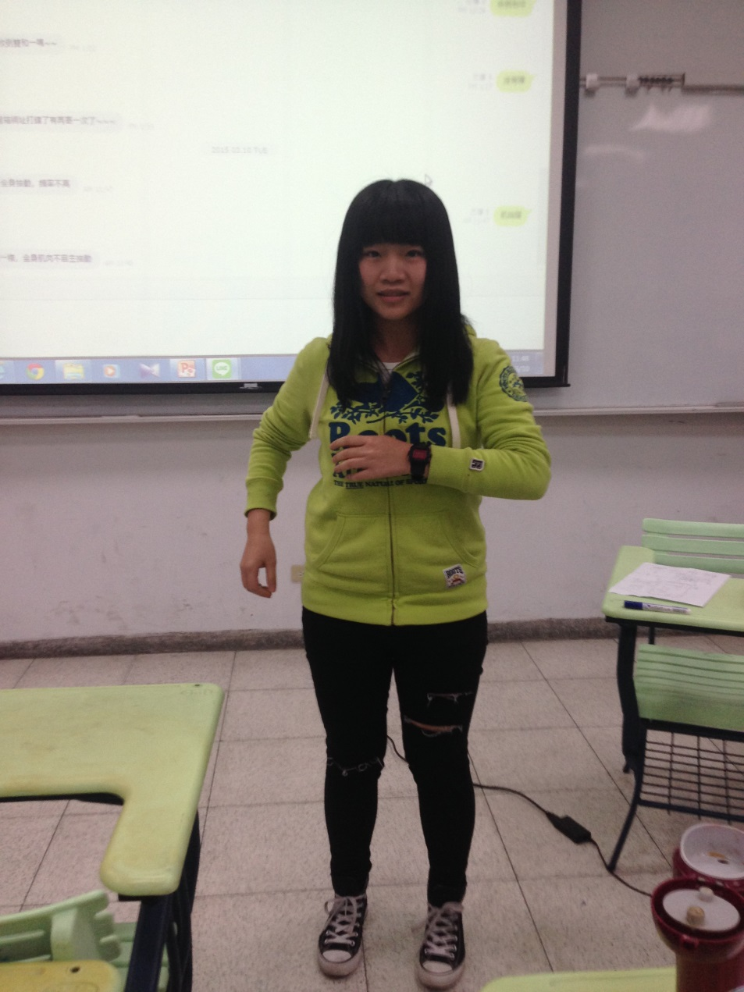

Slide 24
Evaluation
A course survey (developed by the researchers) and in-depth interviews were used to evaluate student satisfaction and effectiveness of the BFCTS.

Slide 25
Results
A total of 46 students took the pediatric nursing course , and 43 students (93.5%) completed the survey . All students were females (range of ages: 21-23) and had no prior clinical working experiences.
After completion of the course, 88% of students (n=37) stated the FCTCB teaching strategy stimulated their interest in pediatric nursing.

Slide 26
All students reported that the FCTCB improved their clinical reasoning and problem solving ability as well as SDL.
84% of the students stated that the FCTCB teaching strategy had increased their learning motivation.
More than 90% of the students believed it had increased their “planning and implementing ”, “self-monitoring ” and “interpersonal communication” ability.

Slide 27
The average score of teaching satisfaction in the pediatric nursing course was 4.60, with scores ranged from 4.53 to 4.64 (using 5-point Likert scale).
Students indicated high satisfaction (X= 4.53) on the design of teaching and curriculum, and reported that the professor and the teaching modality stimulated motivation for learning (X =4.61).

Slide 28
Qualitative Findings
A total of 11 students were interviewed.
The interview results revealed four themes:
Decreased discrepancies between theory and practice,
Promoted development ability of SDL
Effectiveness of 4D-CBL in increasing the depth and breadth of learning
Group discussions facilitated growth in collaborative ability.

Slide 29
Decreased Discrepancies Between Theory and Practice
“I think this teaching strategy is more clinical. We learned theories and knowledge from reading the textbooks. We did OK on exams. But, it is hard to image what questions (patient’s) moms will ask, how does each individual child differ, or what questions children will ask in clinical? This is the part that I am lacking. Also, textbooks give us the major principles to communicate with children. We don’t have problems understanding these principles. However, we have no idea how to answer questions from clinical scenarios. In my past experience in clinical, when I did not know how to answer parent’s questions, I always said that I would check on it and let them know later. Although it did not seem appropriate, I did not know what else to do. Through the clinical scenario, I am able to see things from various perspectives. I am better aware of parent’s viewpoints, and provide appropriate answers.”

Slide 30
Promoted Development Ability of SDL
“I think this class also taught us how to learn. I can use these learning skills when I work in the hospital in the future. In this class, I discovered lots of things that are not in the textbooks. We had to solve the problems on our own, and search for information. When we found the information on our own, we learned it. In the past, my instructors lectured. We were not sure how much we understood and retained. Now I know to find problems on my own, search for supporting evidences and information, then to find the information that I need.”

Slide 31
Effectiveness of 4D-CBL in Increasing the Depth and Breadth of Learning
“I think learning finally became interesting. I could go beyond the boring classroom contents. The clinical situations are too “alive”. The instructor’s case scenarios were very short at the beginning. We had to dig deeper into this disease in order to ask questions. I think this strategy allowed us to take initiative in reading a variety of books. We were able to have a deeper understanding about the disease and nursing care. Questions that the professor asked stimulated our thinking and forced us to consider issues arise in various situations. I think we got to think deeper and further, which is lacking in the traditional classrooms.”

Slide 32
Group Discussions Facilitated Growth in Collaborative Ability
“I have been to many small group discussions in the past. Usually, we came from different cohorts and had different schedules. Whenever we could find the time to get together, we typically divided up works and took charge of the tasks that we were responsible for……. However, in this class, there was time limitation for discussions of the case scenarios. We all had to stay focused on discussions. When questions arose, we may ask the instructor immediately. The questions were resolved and we gained a deeper understanding on the contents. This is unlike learning at home….. Having discussions in class clarified all questions at once, and allowed us to hear what other groups had to say. I think the class was great.”

Slide 33
Conclusion and Discussion
This paper demonstrated the process of developing the BFCTS in pediatric nursing course, 4D CBL was the key element in success learning, students are satisfied this innovation teaching strategy, they believe the BFCTS can improve their self-directed learning and problem solving ability.
Although some students preferred just listen to what teacher taught in class and reported overloading in learning, they also think it is worth to learning knowledge from BFCTS.

Slide 34
Acknowledgements
National Science Council for providing founding for my study
RN to BSN students from National Taipei University

Slide 35
Thank you very much
sufen@ntunhs.edu.tw

